Slide 1
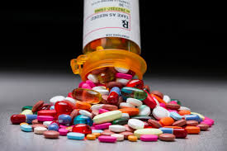
Massage Therapy & Medications Part II

Slide 2
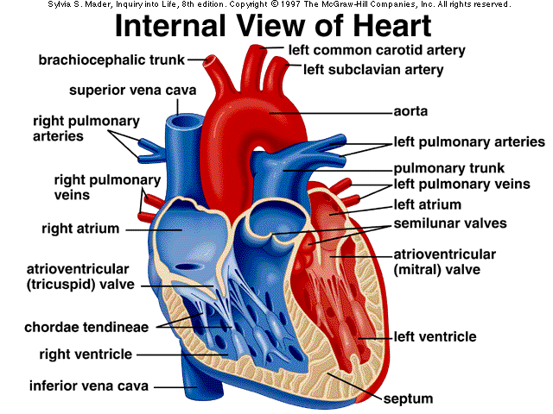
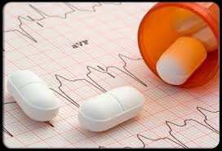
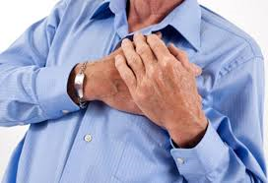
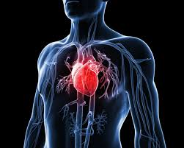
Chapter 7: Drugs for Managing Cardiovascular Disease
The Learning Company | Massage Therapy & Medications |

Slide 3

Drugs for Managing
Cardiovascular Disease – Introduction
The Learning Company | Massage Therapy & Medications |

Slide 4
Drugs for Managing Cardiovascular Disease – Introduction
Major risk factors for cardiovascular disease (CVD) include:
  Hypertension, dyslipidemia, diabetes mellitus, current cigarette smoking, obesity, sedentary lifestyle
  Age, male gender, family history of CVD
General treatment for cardiovascular disease includes the following:
  Diet and exercise
  Stress reduction and weight loss
  Medications
  Surgery
You will see clients with cardiovascular disease!
The Learning Company | Massage Therapy & Medications |

Slide 5

Drugs for Managing Cardiovascular Disease – Common Cardiovascular Conditions
Atherosclerosis (cholesterol buildup in artery walls occluding blood flow)
Angina (typically secondary to atherosclerosis – intermittent chest pain produced by the lack of oxygen to the heart tissue due to restriction in blood supply, specifically, though the coronary arteries)
Myocardial infarction (Also known as a heart attack; acute myocardial ischemia resulting in cardiac tissue death)
Hypertension, arrhythmias
Transient ischemic attack (similar to angina, but occurs in the brain)
Congestive heart failure (the heart is unable to efficiently pump blood to meet the body’s metabolic demands – generally secondary to MI)
The Learning Company | Massage Therapy & Medications |

Slide 6
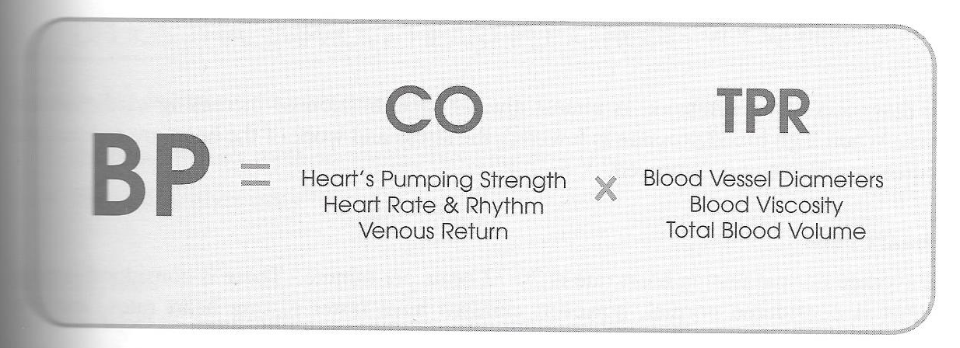
Drugs for Managing Cardiovascular Disease – BP, HR and CVD
The cardiovascular system is responsible for the transport of nutrients to the cells as well as the removal of wastes from the cells via the bloodstream
  Supply and demand! When the body’s demands are greater due to a stressor like exercise, the cardiovascular system enhances the blood supply by increasing BP/HR and redirecting blood flow to higher priority tissues/organs
Blood pressure:
  Measured in mmHG; systolic blood pressure over diastolic blood pressure
  Normal blood pressure is <120/80 mmHg
  Chronic hypertension (≥140/90 mmHg) places unnecessary stress on the body, increasing the risk for heart attack, stroke, kidney disease and death!
    Primary/idiopathic HTN (most common)
    Secondary HTN and white coat HTN

Slide 7
Drugs for Managing Cardiovascular Disease – BP, HR and CVD
Heart rate:
  Measured in beats per minute (bpm)
  Normal resting heart rate ranges between 60-100 bpm depending on age, fitness, emotions and medications (Mayo Clinic)
  Heart rate is increased in times of stress (recall supply and demand), but chronic heart rate elevation has negative effects on heart health
Medications routinely indicated in the treatment of cardiovascular disease produce the following effects:
  Improvement of heart function
  Vasodilation, reduction in blood volume
  Affect coagulation, decrease cholesterol

Slide 8
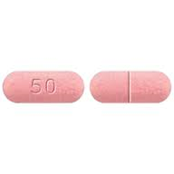
Drugs for Managing Cardiovascular Disease – Medications that Improve Heart Function
Beta-blockers
  These drugs bind to and inhibit beta-adrenergic receptors and reduces the work of the heart through decreased heart rate and force of contraction
  Indicated for the treatment of hypertension, arrhythmia, angina, migraines (prevention) and tremors
    Includes metoprolol, propranolol, nadolol, carvedilol, etc.
  Mechanism of action
    Beta-blockers inhibit the action of sympathetic neurotransmitters like epinephrine, which would normally result in increased BP/HR and force of contraction, simply by occupying the beta-adrenergic receptors
  Common side effects include²:
    Hypotension, bradycardia, dizziness, fatigue, nausea, diarrhea

Slide 9
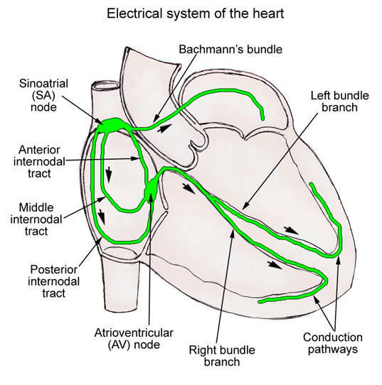
Drugs for Managing Cardiovascular Disease – Medications that Improve Heart Function
Cardiac glycosides
  Sometimes referred to as digitalis; found in foxglove
  Indicated for the treatment of congestive heart failure and arrhythmias
    Includes digoxin (Toloxin)
  Mechanism of action²
    Increases contractility of the heart by inhibiting the Na⁺/K⁺ pump, which increases intracellular sodium in myocardial cells and leads to calcium influx through the Na⁺/Ca²⁺ pump (calcium is important heart muscle contraction)
    Decreases heart rate by suppressing the atrioventricular node in the heart (responsible for impulse conduction)
  Common side effects include²:
    Nausea/vomiting, diarrhea, dizziness, headache, visual disturbances

Slide 10
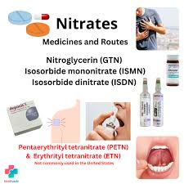
Drugs for Managing Cardiovascular Disease – Medications that Cause Vasodilation
Nitrates
  Common group of vasodilator medications indicated for the treatment of angina and heart failure
    Includes nitroglycerin (oral/sublingual tablets, sublingual spray, IV, patches), isosorbide dinitrate, etc.
  Mechanism of action
    Metabolized to nitric oxide, which causes smooth muscle relaxation in the blood vessels leading to vasodilation in the coronary arteries and peripheral arteries/veins
    Decreased peripheral resistance, increased blood flow, decreased stress on the heart
  Common side effects include²:
    Dizziness, lightheadedness, headache, nausea, dry mouth, bradycardia, orthostatic hypotension, peripheral edema, tachycardia, syncope

Slide 11
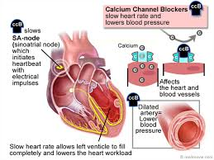
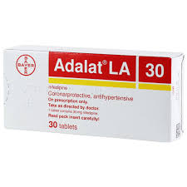
Drugs for Managing Cardiovascular Disease – Medications that Cause Vasodilation
Calcium channel blockers
  Family of medications indicated for the treatment of angina,
hypertension, migraine prevention
    Includes nifedipine, amlodipine, diltiazem, verapamil, felodipine, etc.
  Mechanism of action²
    Prevents calcium from entering smooth muscle cells in blood vessels and the myocardium resulting in coronary/peripheral vasodilation, which reduces blood pressure
  Common side effects include:
    Dizziness, headache, nausea, flushing, fatigue, hypotension, peripheral edema

Slide 12

Drugs for Managing Cardiovascular Disease – Medications that Cause Vasodilation
ACE inhibitors
  The renin-angiotensin system, which plays an important role in the regulation of blood pressure, is affected by ACE inhibitors
  ACE inhibitors are a common family of medications indicated in the treatment of hypertension and heart failure
    Includes ramipril, fosinopril, lisinopril, enalapril, captopril
  Mechanism of action
    ACE inhibitors inhibit the angiotensin converting enzyme, which is responsible for converting angiotensin I to angiotensin II. Angiotensin II causes vasoconstriction and aldosterone secretion (salt and water retention) 🡪 increased blood pressure
    Blocking the production of angiotensin II reduces blood pressure
  Common side effects include²
    Dizziness, headache, fatigue, orthostatic hypotension, nausea, cough
ARBs are similar to and are sometimes prescribed to replace ACE inhibitors!

Slide 13
Drugs for Managing Cardiovascular Disease – Medications that Cause Vasodilation
Alpha-1 receptor blockers
  Common group of drugs indicated in the treatment of hypertension and benign prostatic hyperplasia (more commonly prescribed for BPH)
    Includes alfuzosin, doxazosin, prazosin
  Mechanism of action²
    To reduce blood pressure, these drugs cause vasodilation and decreased total peripheral resistance by inhibiting alpha-1 adrenergic receptors in blood vessels
  Common side effects include²
    Dizziness, fatigue, headache, orthostatic hypotension, flushing, nausea, dry mouth, sexual dysfunction
Alpha-2 agonists, such as clonidine, stimulate alpha-2 receptors in the brain leading to decreased peripheral resistance and decreased blood pressure

Slide 14
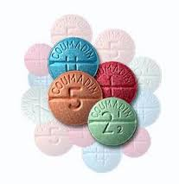
Drugs for Managing Cardiovascular Disease – Medications Affecting Coagulation
Blood coagulation is imperative when bleeding occurs secondary to tissue injury. Medications
affecting blood coagulation fall under three categories – anticoagulants, platelet inhibitors and thrombolytics
Anticoagulants
  Warfarin (Coumadin®)
    Vitamin K antagonist – inhibits formation of certain clotting factors, slow onset
    Popular oral anticoagulant indicated for the treatment of DVT and the prevention of thrombosis/embolism associated with heart attack and stroke
    Side effects: risk of bleeding, headache, fatigue, nausea, diarrhea
  Heparin
    IV/SC injection indicated for the treatment of acute coronary syndrome as well as deep vein thrombosis and pulmonary embolism, fast onset
    Enhances the activity of antithrombin III, which complexes with thrombin leading to the
inhibition of enzymes that are essential to the clotting process¹
    Side effects²: hemorrhagic shock, headache, fever, nausea, vomiting, bruising

Slide 15

Drugs for Managing Cardiovascular Disease – Medications Affecting Coagulation
2) Platelet inhibitors
  These medications that are responsible for platelet aggregation (clumping together) inhibition are indicated in the prevention of thrombosis/embolism associated with heart attack and stroke
    Includes aspirin, clopidogrel, Aggrenox (dipyridamole and aspirin), ticagrelor
  Side effects: increased risk of bleeding, nausea, fatigue, headache
3) Thrombolytics
  Medications that dissolve clots/thrombi formed in blood vessels by converting plasminogen to plasmin, which is essential to fibrinolysis
  Indicated in the treatment of heart attack (reteplase, tenecteplase and alteplase), stroke (alteplase), pulmonary embolism (alteplase)
  Side effects²: GI/GU BLEEDING, injection site bleeding

Slide 16
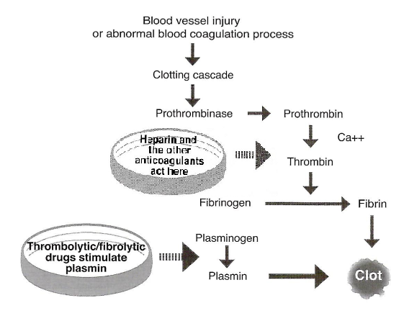
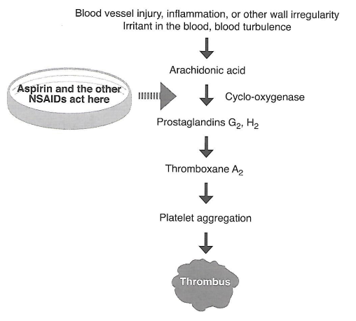
Drugs for Managing Cardiovascular Disease – Medications Affecting Coagulation (MOA)

Slide 17
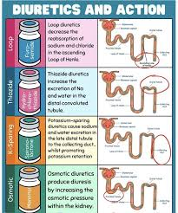

Drugs for Managing Cardiovascular Disease – Medications that Reduce Blood Volume
Also known as “diuretics” or “water pills”
Well tolerated group of medications that exert their effect on the kidneys, resulting in increased urine production
Three pharmacologic categories: Thiazide diuretics, Loop diuretics, Potassium sparing diuretics
Diuretic medications are indicated in the treatment of high blood pressure, heart failure, cirrhosis (liver disease), pulmonary and other edema

Slide 18
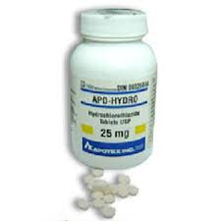
Drugs for Managing Cardiovascular Disease – Medications that Reduce Blood Volume
Thiazide diuretics
  Includes hydrochlorothiazide, chlorthalidone
  Mechanism: Thiazides work by inhibiting the reabsorption of sodium in the distal and convoluted tubules of the nephron leading to increased sodium and water excretion
  Side effects²: dizziness, headache, orthostatic hypotension, nausea
Loop diuretics
  Includes furosemide (Lasix)
  Mechanism²: Loop diuretics work by inhibiting the reabsorption of sodium and chloride in the ascending loop of Henle leading to increased sodium, chloride and water excretion
  Side effects²: dizziness, headache, orthostatic hypotension, nausea

Slide 19
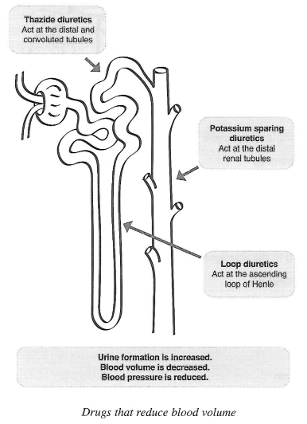
Drugs for Managing Cardiovascular Disease – Medications that Reduce Blood Volume (MOA)
Potassium sparing diuretics
  Includes spironolactone, triamterene
  Mechanism²: Works by increasing NaCl/water excretion and conserving potassium ions in the distal renal tubules
  Side effects²: headache, drowsiness, nausea, diarrhea

Slide 20
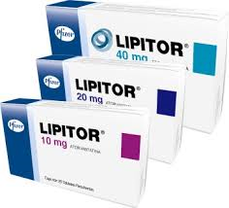
Drugs for Managing Cardiovascular Disease – Medications that Lower Blood Lipid Levels
Lipids are important in normal body functions! Triglycerides can provide energy for the body while cholesterol is necessary for hormone production and is a component of cell membranes!
Lipid-lowering medications are used to treat dyslipidemia, which can be defined high LDL (“bad” cholesterol), high triglycerides, high total cholesterol and low HDL (“good” cholesterol)
  Primary dyslipidemia (genetic) and secondary dyslipidemia (lifestyle)
  Dyslipidemia causes atherosclerosis and increases the risk of heart attack and stroke
Treatments for dyslipidemia include:
  Lifestyle modification (healthy diet and exercise)
  Medications (“statins”, niacin, fibrates and bile acid sequestrants)

Slide 21
Drugs for Managing Cardiovascular Disease – Medications that Lower Blood Lipid Levels²
HMG CoA Reductase inhibitors (the “statins”)
  Includes atorvastatin (Lipitor), rosuvastatin (Crestor), lovastatin (Mevacor), pravastatin (Pravachol)
  Side effects: nausea, diarrhea, muscle/joint pain, rhabdomyolysis
Nicotinic acid/Niacin (side effects: nausea, diarrhea, facial flushing, headache, dry skin)
The Fibrates
  Includes fenofibrate, bezafibrate (Bezalip), gemfibrozil
  Side effects: headache, fatigue, nausea, diarrhea, rhabdomyolysis
Bile Acid Sequestrants
  Includes cholestyramine, colestipol
  Side effects: nausea, abdominal pain, diarrhea/constipation, flatulence, fatigue

Slide 22
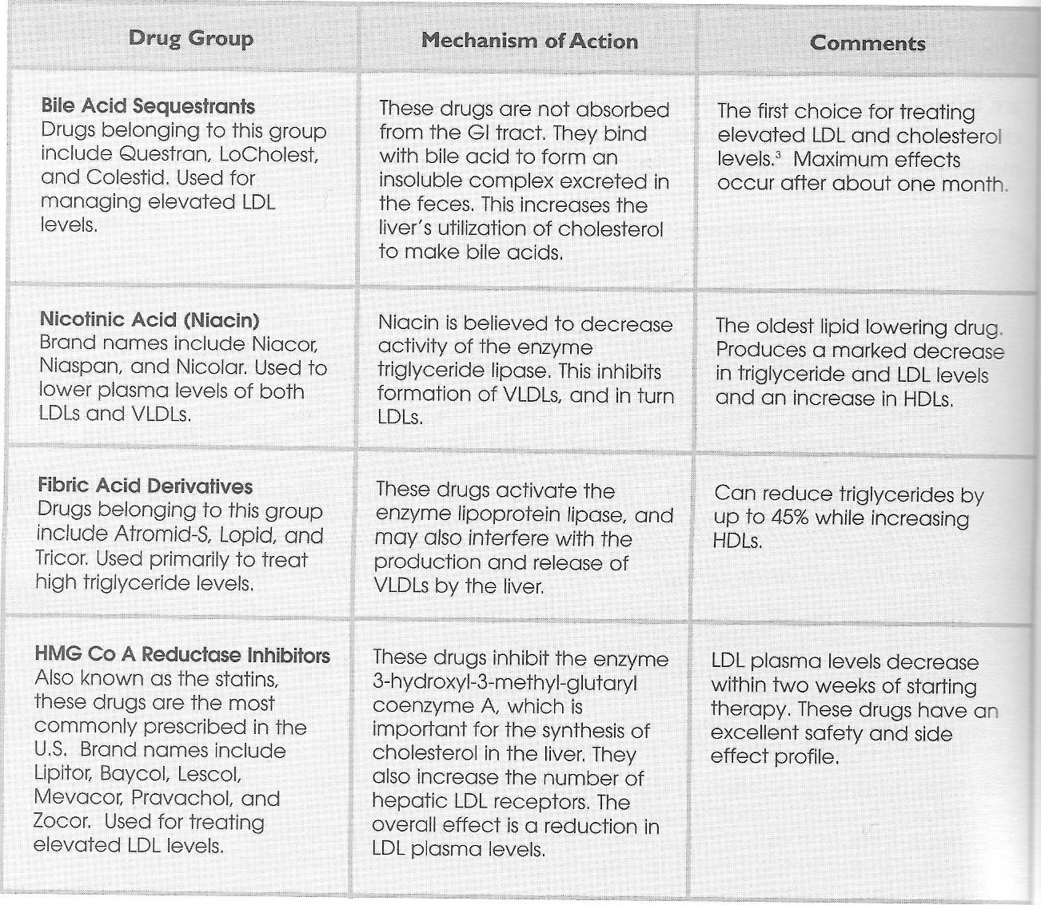
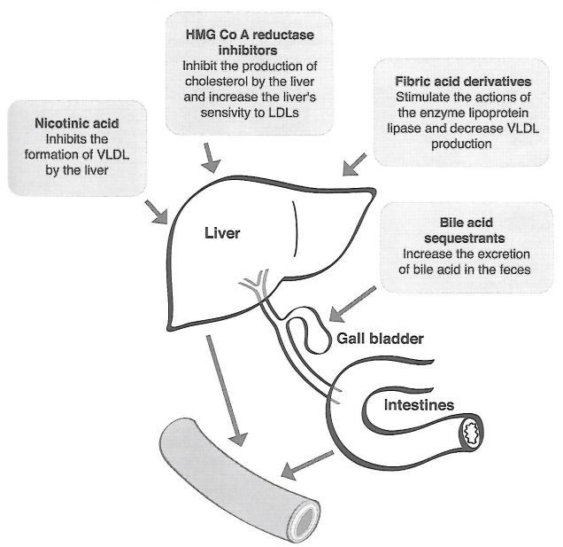
Drugs for Managing Cardiovascular Disease – Medications that Lower Blood Lipid Levels (MOA)

Slide 23
Drugs for Managing Cardiovascular Disease – Quick Guide to Case History Taking
Questions:
  What cardiovascular disease is present? How is it being treated (lifestyle modifications, medications, alternative therapy)? Is the condition stable?
  Regular follow-up with physician? Any exercise/hydrotherapy restrictions?
  Poor circulation? Any numbness or sensation abnormalities?
  Procedures for angina attack if experienced during treatment?
Observations:
  Presence of bruising or peripheral edema? Varicose veins?
  Problems with shortness of breath?

Slide 24
Drugs for Managing Cardiovascular Disease – Quick Guide to Working with Clients with CVD
Client positioning
  Prone positioning may not be appropriate in clients with cardiovascular disease, especially clients with moderate/severe hypertension or recent heart surgery
  Support and elevate areas of the body where edema is present. Do not elevate the feet above heart-level in clients with moderate/severe CHF!
Choice of techniques
  Relaxing/soothing techniques should be the focus of treatment! (Reduce TPR, BP and workload of the heart)
  AVOID/MODIFY techniques including heavy tapotement, deep tissue work or trigger point release (may cause sympathetic nervous system response – fight or flight)
  AVOID techniques that increase venous return to the heart including effleurage, petrissage, excessive elevation and large scale ROM work.
    Wringing and muscle squeezing benefit these clients by increasing local circulation without markedly increasing venous return to he heart.
  MODIFY depth of technique in clients with atherosclerosis and other medical conditions that predispose clients toward clotting.
    Massage is contraindicated for known thrombus sites!

Slide 25
Drugs for Managing Cardiovascular Disease – General Massage Guidelines
Be aware of ALL medications the clients is taking as well as indications and adverse reactions! Use the Medication Case History Forms to get the complete picture – Rx/OTC/herbal!
Recall the medical stability of the patient! Schedule treatment AFTER the client’s dose of medication in clients with more severe conditions, such as angina or arrhythmias.
After lying down on the massage table for an extended period of time, sit up slowly and wait for a few minutes before standing. This is especially important in patients on medications that can cause orthostatic hypotension!
Be aware of implanted devices, medication patches and other topical products!

Slide 26
Drugs for Managing Cardiovascular Disease – Specific Guidelines
Beta-blockers can cause shortness of breath, bradycardia, hypotension, cold extremities and fatigue. Measure client BP, monitor for symptom changes and obtain client feedback more often!
Watch for digoxin toxicity (GI irritation, confusion, visual disturbances, abnormal heart rate)!
ACE inhibitors can cause dry cough (supine position can aggravate this), calcium channel blockers can cause ankle edema (possible referral) and nitroglycerin patches can cause irritation/rash at the application site (never remove patches and consider a referral)!
Deep kneading, muscle stripping and cross fiber frictions are NOT RECOMMENDED in patients taking anticoagulants/platelet inhibitors/ thrombolytics!
Diuretics may cause muscle cramping/spasm/pain/weakness! MODIFY stretching and strengthening techniques and refer to family physician!
Lipid lowering medications can cause muscle/joint pain and rhabdomyolysis in clients! Be aware of unexplained muscle pain/weakness!

Slide 27
Drugs for Managing Cardiovascular Disease – Specific Guidelines
Hydrotherapy
  Be aware of any physician restrictions on the use of hydrotherapy as well as client’s tolerance of hydrotherapy.
  Client’s with cardiovascular disease are at increased risk of hydrotherapy adverse reactions!
    “Start low and go slow”. Monitor client closely!
    Use local treatment rather than systemic treatment!
Exercise
  “Start low and go slow”. Monitor client closely!
  “exercise prescription for the most compromised types of cardiovascular patients is…beyond the scope of most massage therapists…it is best to work with a healthcare team that provides the services of a qualified exercise therapist.”¹

Slide 28
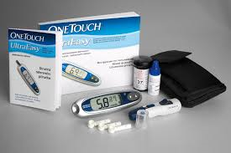
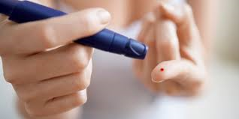
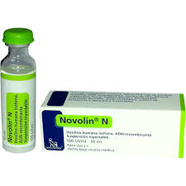
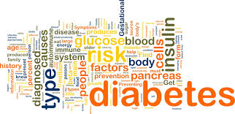
Chapter 8: Medications for Managing Diabetes Mellitus

Slide 29
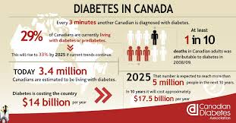
Medications for Managing Diabetes Mellitus – Introduction
“Diabetes mellitus is a chronic metabolic disturbance characterized by fasting and/or postprandial hyperglycemia.” (Therapeutic Choices 6th Ed.)
What organ is involved in diabetes mellitus?

Slide 30
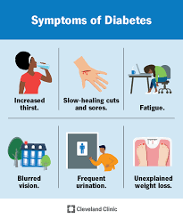
Medications for Managing Diabetes Mellitus – Introduction
Type 1 diabetes (insulin-dependent)
  Early onset, usually in childhood; 5-10% of diabetic patients
  Pancreatic insulin production ends and patients require exogenous insulin
  Risk factors for type 1 diabetes include autoimmune dysfunction, genetic inheritance, etc.
Type 2 diabetes (non-insulin dependent)
  Later onset in adulthood; 90-95% of diabetic patients (MOST COMMON)
  Characterized by “insulin resistance” (insulin is produced but not properly utilized) or a reduction in pancreatic insulin output
  Risk factors for type 2 diabetes include obesity, sedentary lifestyle, family history, race/ethnicity, impaired glucose tolerance, etc.
Gestational diabetes - occurs during some pregnancies. The diabetes generally resolves after delivery, but mom remains at higher risk of developing diabetes in the future

Slide 31
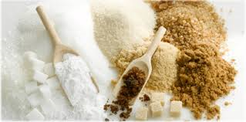
Medications for Managing Diabetes Mellitus – Introduction
Complications of diabetes mellitus include
  Neuropathy (nerve problems), retinopathy/blindness
  Cardiovascular disease and kidney disease
  Infections/amputation and erectile dysfunction
Typical treatment for diabetes mellitus Type 2 includes the following:
  Lifestyle modifications (healthy diet and exercise)
  Stress and anxiety management
  Oral Hypoglycemic medications, may progess to insulin therapy
  Regular follow-up with family physician/specialist(s)
Treatment for Type 1 Diabetes: Insulin therapy must be given

Slide 32
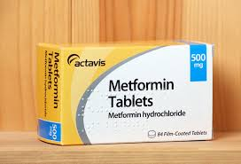
Medications for Managing Diabetes Mellitus – Oral Hypoglycemics
Oral medications used to control blood glucose levels in diabetic patients are referred to as oral hypoglycemic drugs
  Only indicated in the treatment of TYPE 2 DIABETES MELLITUS (NOT Type 1)
  Includes² sulfonylureas, biguanides, alpha-glucosidase inhibitors, thiazolidinediones, dipeptidyl peptidase IV inhibitors, glucagon-like peptide-1 (GLP-1)receptor agonists
Biguanides
  Enhances insulin sensitivity (ie. cellular uptake/utilization) and decreases the production of glucose in the liver²
    Includes metformin (Glucophage)
  1st line agent in the pharmacologic treatment of type 2 diabetes; other medications are added to existing therapy if treatment targets are not met
    Monitoring parameters include fasting/postprandial glucose levels and A1C
  Side effects: nausea, vomiting, diarrhea, headache, dizziness, weight-neutral

Slide 33
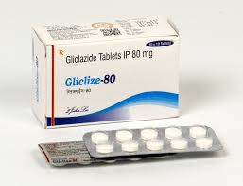
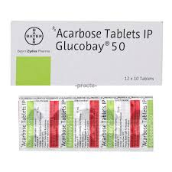
Medications for Managing Diabetes Mellitus – Oral Hypoglycemics
Sulfonylureas
    Insulin secretagogue (stimulate pancreatic release of insulin from functioning beta cells 🡪 secretion is enhanced, NOT production)
      Includes gliclazide (Diamicron MR), glimepiride, glyburide
    Side effects²: hypoglycemia, dizziness, headache, nausea, diarrhea/constipation
Alpha-glucosidase inhibitors
  Delays the absorption of glucose by inhibiting the alpha-glucosidase enzyme (responsible for metabolizing complex carbohydrates to glucose), which decreases postprandial glucose levels
  Includes acarbose (Glucobay)
  Side effects³: nausea, abdominal pain, diarrhea, headache, flatulence
Thiazolidinediones (enhances insulin sensitivity)
    Includes pioglitazone (Actos) and rosiglitazone (Avandia)
      Avandia U.S. Boxed Warning (congestive heart failure and myocardial infarction)
    Side effects: hypoglycemia, edema, headache, muscle pain

Slide 34
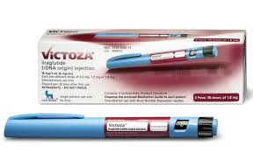
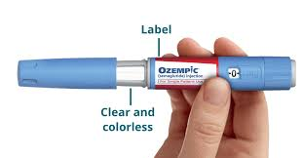
Medications for Managing Diabetes Mellitus –
Injectable Hypoglycemics
Glucagon-like peptide-1 receptor agonists² (SC injection)
  Includes: semaglutide (Ozempic, Wegovy, Ryselsus)
  Terzepatide (Mounjari, Zepbound) liraglutide (Victoza)
  MOA: increase GLP 1 hormone effects in the gut - slows gastric emptying, promotes feelings of satiety, stimulating insulin release & sensitivity
  Side effects: headache, nausea, diarrhea, injection site reactions, possible pancreatitis or gallbladder issues

Slide 35
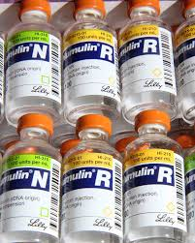
Medications for Managing Diabetes Mellitus – Insulin
Under normal circumstances, the pancreas secretes insulin in response to elevated serum concentration of glucose secondary to meal consumption.
  Insulin promotes cellular uptake of glucose 🡪 essential to cellular functions
Insulin produces the following effects¹:
  Increased glycogen production in the liver
  Increased uptake/utilization of glucose into cells
  Increased synthesis/storage of fats
  Decreased blood glucose levels
Synthetic insulin preparations are indicated in the treatment of:
  Type 1 diabetes, type 2 diabetes (usually following failed lifestyle modification/oral hypoglycemic therapy trials) and gestational diabetes

Slide 36
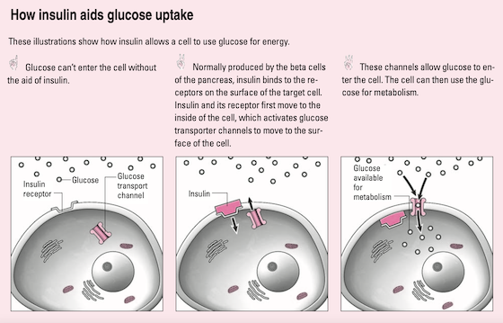
Medications for Managing Diabetes Mellitus – Insulin MOA

Slide 37
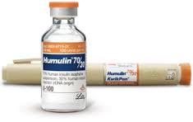
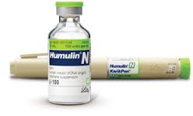
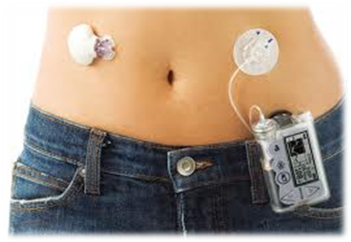
Medications for Managing Diabetes Mellitus – Insulin Administration
Insulin is self-administered in patients via subcutaneous injection
  Multiple daily injections (type 1/type 2 insulin schedules)
  Insulin pump
    External device comprised of an insulin reservoir, battery-operated insulin pump and computer hardware/software responsible for regulating insulin delivery (programmed by the patient)
    Better control of glucose levels, fewer injections for the patient
Insulin injection sites include the abdominal wall, lateral arm, around the waist and hips, and the thigh¹
  Injection site rotation
Two procedures for self-administration of insulin
  Insulin VIALS and SYRINGES
  Insulin PENS and CARTRIDGES

Slide 38
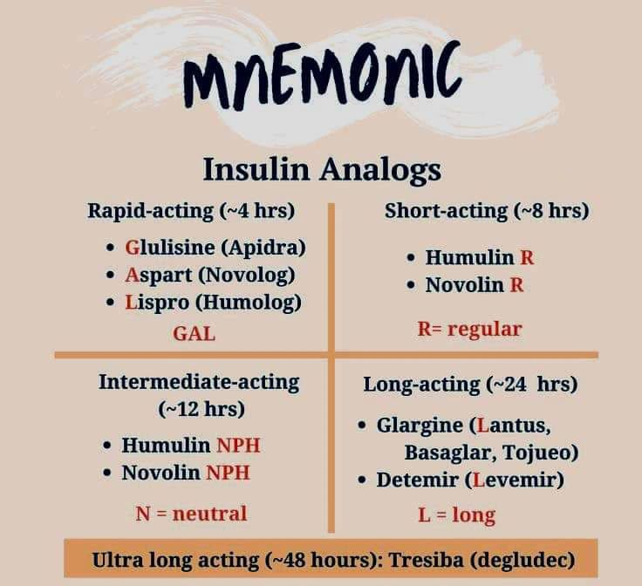
Medications for Managing
Diabetes Mellitus – Insulin

Slide 39
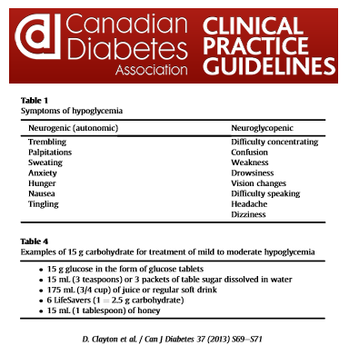
Medications for Managing Diabetes Mellitus – Diabetic Instability Reactions
Hypoglycemia
  Development of symptoms secondary to low blood glucose levels
  Risk factors:
    One or more oral hypoglycemic medications
    Insulin overdose
    Drug interactions
    Alcohol consumption
    Skipped meals
  Severe hypoglycemia may result in loss of consciousness!
  “Always give sugar; never give insulin.”¹
    Seek medical attention if no improvement within 5-10 minutes!
Hyperglycemia (high blood glucose levels)

Slide 40
Medications for Managing Diabetes Mellitus – Quick Guide to Case History Taking
Questions
  General health and medical conditions (presence of cardiovascular or renal disease)? Type of diabetes? Is the client stable?
  Medications including insulin and oral hypoglycemics? Insulin self-injection or pump and associated sites? Other medications (Rx/OTC/herbal)?
  History of hypoglycemic episodes? Carbohydrate treatment for hypoglycemia?
  Presence of diabetic neuropathy? Abnormal sensation? Open sores/infection?
  Physician restrictions on massage or hydrotherapy? Experience with massage therapy/hydrotherapy?
  Self-monitoring of blood glucose? Regular follow-up with physician?
  Last dose of medication? Last meal?
Observations
  Watch for open sores/infection, edema and bruising and abnormal sensation

Slide 41

Medications for Managing Diabetes Mellitus – Quick Guide to Working with Clients with Diabetes
“Start low and go slow.” Shorter treatment duration and targeted therapy is recommended in new diabetic clients (monitor closely)!
Excellent hygiene is essential in diabetic clients due to their increased risk of infection. If you are sick, reschedule the appointment!
Each session should commence with a proper assessment of the client. Are there signs of hypoglycemia? Should treatment be modified or re-scheduled?

Slide 42
Medications for Managing Diabetes Mellitus – General Massage Guidelines
The client’s medical stability should be the top priority when developing a treatment plan for massage/hydrotherapy as well as an exercise regimen!
Massage is contraindicated in clients experiencing hypoglycemia! Know how to help your client if they have a hypoglycemic episode!
AVOID massage therapy for 1-2 weeks following any changes to medications!
Schedule massage therapy/hydrotherapy appointments when medications are the most effective (peak bioavailability) to ensure the client’s medical stability. Be aware that massage/hydrotherapy may cause a hypoglycemic effect – use caution and monitor the patient until you know the magnitude of effect!!
Ensure your client has eaten sufficiently prior to each session!
Questions or concerns? Contact the family physician!

Slide 43
Medications for Managing Diabetes Mellitus – Specific Guidelines
Insulin sites
  Recall Chapter 5: Do not treat injection sites that are red/irritated or infected! Do not work within a 4-6 inch radius of implanted/medical devices!
  AVOID direct manual techniques/local hydrotherapy over recent injection sites!
Oral hypoglycemic medications
  Sulfonylureas, specifically glyburide, are notorious for causing hypoglycemia. Watch closely for symptoms of hypoglycemia!
  Sulfonylurea/NSAID drug interaction (“NSAIDs may enhance the hypoglycemic effect of sulfonylureas”): Lexi-Comp Risk Rating B (no action needed)²
  Shorter/specific treatment may be beneficial in clients on metformin due to adverse effects such as weakness.
  Clients taking acarbose may want to use the washroom prior to treatment because the combination of this medication and massage can result in flatulence.

Slide 44
Medications for Managing Diabetes Mellitus – Specific Guidelines
Hydrotherapy guidelines
  “Start low and go slow.” Be aware of injection sites/sensory abnormalities and ensure there is appropriate therapy modification!
  Systemic hydrotherapy (ie. full bath, whirlpools, saunas) is NOT RECOMMENDED for diabetic patients because it may potentiate hypoglycemic episodes!
Exercise recommendation
  Develop a progressive exercise regimen that accounts for the client’s lifestyle, current activity levels and current medications!
    Questions or concerns? Contact the family physician!
  Without appropriate patient education, exercise can increase the risk of hypoglycemia (especially in type 1 diabetic patients)! Careful exercise scheduling is essential!!

Slide 45
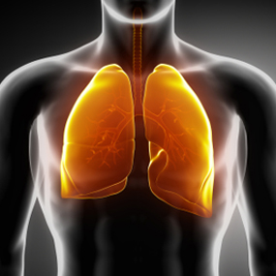
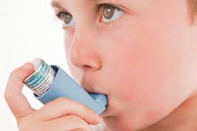
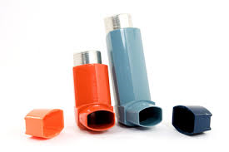
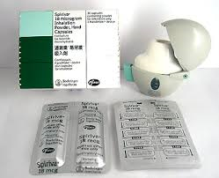
Chapter 9: Drugs for Managing Respiratory Inflammation and Congestion

Slide 46

In-Class Assignment #3 – Common Respiratory Conditions (10 minutes)
Go to the “Asthma Society of Canada” website and answer the following questions:
  What are “reliever” medications used in asthma treatment? Give two examples of reliever medications.
  Find and list 3 educational resources on the Asthma Society of Canada website.
Go to “The Lung Association” (Canadian) website and answer the following questions:
  In COPD, what percentage of cases are caused by smoking?
  Give two examples of common COPD medications.

Slide 47
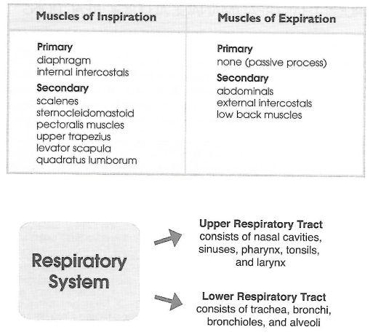
Drugs for Managing Respiratory Inflammation and Congestion – Introduction
The respiratory system, which consists of the upper and lower respiratory tracts, is responsible for the addition of inhaled oxygen to the bloodstream and removal of wastes, such as carbon dioxide, that are subsequently exhaled.
  Chronic irritation, infection and disease can all impact the respiratory system!
Common respiratory conditions include ASTHMA, COPD (emphysema and chronic bronchitis) and ALLERGIES/ALLERGIC RHINITIS

Slide 48
Drugs for Managing Respiratory Inflammation and Congestion – Introduction
Asthma
  Chronic respiratory condition characterized by episodes of shortness of breath, wheezing, chest tightness, cough and mucus production
    Airways are inflamed, constricted and hyper-responsive to stimuli
  Asthma is a hereditary condition
  Triggers include cold air/water, pollen, air pollutants, moulds, animals, exercise, etc.
Chronic obstructive pulmonary disease (COPD)
  Progressive respiratory condition characterized by shortness of breath, chronic cough and mucus production
    Includes chronic bronchitis (airway inflammation/mucus production) and emphysema (damage to alveoli in the lungs)
  COPD is most commonly caused by SMOKING
  Triggers include respiratory infections, air pollutants, cold air, etc.
Allergies/allergic rhinitis (sneezing, itchy/watery eyes, runny nose, nasal congestion)

Slide 49
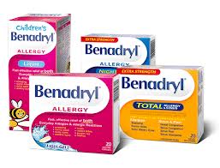
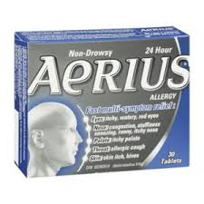
Drugs for Managing Respiratory Inflammation and Congestion – Medications that Treat/Manage Allergic Reactions
Antihistamines
  Antihistamines are indicated in the treatment of allergic rhinitis, hypersensitivity reactions, insomnia and cough
  Antihistamines reduce allergic symptoms, such as sneezing or runny nose, by preventing histamine (released from mast cells) from binding to the various H1 receptor sites in the body
    Includes chlorpheniramine (Chlor-Tripolon), diphenhydramine (Benadryl), loratadine (Claritin, cetirizine (Reactine), etc.
  “Effects of Histamine” Table (page 148)
  Side effects of antihistamines
    1st generation (ie. Benadryl/Chlor-Tripolon): drowsiness
    2nd generation (ie. Claritin/Reactine): well tolerated

Slide 50

Drugs for Managing Respiratory Inflammation and Congestion – Medications that Treat/Manage Allergic Reactions
Cromolyn sodium
  Indicated in the treatment of allergic rhinitis/conjunctivitis
  Prevents histamine release by stabilizing mast cell membranes which prevents allergic symptoms
    Includes NasalCrom and Opticrom
  Side effects: well tolerated

Slide 51
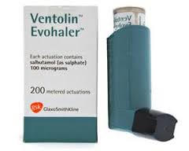
Drugs for Managing Respiratory Inflammation and Congestion – Medications that Increase Airway Diameter
Also known as “bronchodilators”
  Indicated in the treatment of asthma, COPD and respiratory infections
  Includes beta-2 adrenergic agonists, anticholinergic agents and theophylline (not commonly used)
Beta-2 adrenergic agonists
  Includes salbutamol (Ventolin), formoterol (with budesonide in Symbicort Turbuhaler), salmeterol (Serevent Diskus)
  Mechanism of action: stimulates beta-2 receptors, which causes bronchial smooth muscle relaxation, leading to bronchodilation
    Salbutamol is a “RELIEVER” medication that treats acute bronchospasm within a few minutes
  Side effects: shakiness, headache, dizziness, nausea

Slide 52
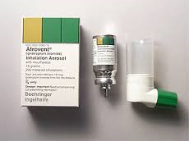
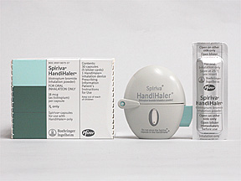
Drugs for Managing Respiratory Inflammation and Congestion – Medications that Increase Airway Diameter
Anticholinergic agents
  Includes ipratropium (Atrovent) and tiotropium (Spiriva Handihaler)
  Mechanism of action²: causes bronchodilation by occupying parasympathetic receptor sites in bronchial smooth muscle, which blocks the effects of acetylcholine (normally causes bronchoconstriction!)
  Side effects: headache, dizziness, nausea, dry mouth

Slide 53
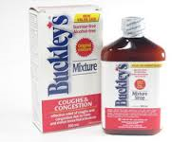




Drugs for Managing Respiratory Inflammation and Congestion – Medications that Manage Respiratory Congestion
Nasal congestion and chest congestion are typically caused by infection, inflammation and irritation, resulting in symptoms such as stuffy/runny nose or productive cough
  Medications used to treat respiratory congestion include decongestants, expectorants and corticosteroids
Decongestants
  Includes pseudoephedrine/phenylephrine (common in cough and cold preparations)
  Mechanism of action: stimulates alpha receptors causing vasoconstriction, which leads to a decrease in mucus production and edema (ie. nasal congestion)
  Side effects: generally well tolerated, but can cause increased blood pressure and heart rate, dizziness, excitability, nausea
Expectorants (ie. guaifenesin)

Slide 54



Drugs for Managing Respiratory Inflammation and Congestion – Medications that Manage Respiratory Congestion
Corticosteroids
  Corticosteroids are used to managed inflammation associated with asthma/COPD and allergic rhinitis (usually ongoing therapy)
    Referred to as “controller” medications in asthma treatment
    Sometimes prescribed for respiratory infections (discuss)
  Includes fluticasone inhalation (Flovent), fluticasone nasal spray (Flonase and Avamys), budesonide inhalation (Pulmicort), mometasone nasal spray (Nasonex), beclomethasone inhalation (QVAR), etc.
    Also asthma/COPD combination products such as Advair/Symbicort
  Side effects: hoarseness, cough, throat irritation, oral thrush

Slide 55


Drugs for Managing Respiratory Inflammation and Congestion – Medications that Suppress Coughing
Also known as “antitussives” (typically found in cough and cold preparations)
Common antitussive medications include:
  Dextromethorphan (DM)
  Diphenhydramine
  Codeine
Side effects: drowsiness!!

Slide 56
Drugs for Managing Respiratory Inflammation and Congestion – Quick Guide to Case History Taking
Questions
  General health and medical conditions? Respiratory conditions? What medications are used to treat the condition? Is the condition stable? History of hospitalization?
  For asthma and allergies, what are the client’s triggers?
  Does the client use a metered-dose inhaler? Is it a “reliever” inhaler?
  Regular follow-up with physician/specialist? Last appointment? Physician restrictions on massage or hydrotherapy?
  Exercise tolerance? History of shortness of breath?
Observations
  Watch for thoracic posture (Hyperkyphosis? Barrel chest?), status of the muscles of respiration, breathing patterns (Shortness of breath? Wheezing?) and allergic symptoms (runny noses, watery eyes, sneezing)

Slide 57

Drugs for Managing Respiratory Inflammation and Congestion – Quick Guide to Working with Clients with Respiratory Conditions
Massage is contraindicated during an asthma attack or respiratory infection!
  Begin with shorter treatments and closely monitor the client’s response to therapy before progressing to longer and/or more intense treatment.
    Unsure about treatment? Contact the client’s physician!
Client positioning
  Semi-supine/seated positions are advisable in client’s with nasal congestion or sinusitis. Supine/prone position may be problematic for clients with asthma.
  “Towel rolls/small bolsters can be used to stretch thoracic structures during massage treatment.”¹ (full description in the textbook)
Choice of techniques
  Typically, specific work to muscles of respiration and joints of the thoracic spine will result in benefit to the client. It may be necessary to modify direct manual techniques in the presence of tissue fragility.
  Tapotement on the back is not recommended in clients with asthma (may cause bronchospasm) but can be beneficial in clients with chest congestion to promote expectoration of mucus and phlegm.

Slide 58
Drugs for Managing Respiratory Inflammation and Congestion – General Massage Guidelines
NSAID medications (ie. aspirin and ibuprofen) and beta-blockers (ie. metoprolol, atenolol, propranolol and nadolol) can cause asthma attacks! These medications can lead to increased use of asthma medications.
  These clients should be referred to their family physician!
Ensure your client is comfortable and have drinking water available in the event of throat irritation or coughing episodes!
Set aside additional treatment time to provide specific work on the muscles of respiration!

Slide 59
Drugs for Managing Respiratory Inflammation and Congestion – Specific Guidelines
SHORTER TREATMENT may be necessary in clients experiencing increased drowsiness or fatigue secondary to antihistamine use!
In clients using bronchodilators, tapotement, especially on the back, is NOT RECOMMENDED because it may promote exaggerated cardiovascular and respiratory reactions!¹
Decongestants can be of concern when they cause increased blood pressure and heart rate in the client. Monitor your client and measure blood pressure regularly!
  Not usually an issue – decongestants are typically short-term treatment!
Dextromethorphan and altered sensory perception? (discuss)

Slide 60
Drugs for Managing Respiratory Inflammation and Congestion – Specific Guidelines
Hydrotherapy guidelines
  Be aware of physician restrictions on hydrotherapy!!
  Ask your client if they have sensitivities to essential oils or bath additives. If the client is unsure, begin therapy with water modalities only, then gradually introduce additives!
  In clients taking decongestant medications, monitor blood pressure during hydrotherapy because the client’s heat dissipation responses to temperature may be altered (can lead to irregular heart beat and increased blood pressure).
  AVOID facial steams in patients taking decongestants (both oral or nasal) because even in the presence of heat, nasal passage blood vessels won’t vasodilate as expected and could result in client burns!!
    Why?
Exercise recommendation
  Adequate hydration during exercise is important in clients taking decongestants and antihistamines (can cause increased sweating)!
  Develop a progressive exercise regimen that accounts for the client’s current activity levels and exercise tolerance (ie. presence of exercise or environmental triggers)!
    When in doubt, contact the client’s physician!

Slide 61




Chapter 10: Drugs for Managing Mood and Emotional Disorders

Slide 62
In-Class Assignment #4 – Mood and Emotional Disorders (10 minutes)
Go to the “Canadian Mental Health Association” website and answer the following questions:
  When is the 64th Annual Mental Health Week?
  List two different types of anxiety disorders.
  Explain how depression is different from the “blues”.
  Where is the Winnipeg branch of the Canadian Mental Health Association?
  What is the main benefit of these in-class assignments to massage therapy students?

Slide 63

Drugs for Managing Mood and Emotional Disorders – Introduction

Slide 64
Drugs for Managing Mood and Emotional Disorders – Introduction
Mood and emotional disorders are also known as “AFFECTIVE DISORDERS”.
This section of the textbook will review the following affective disorders:
  Anxiety, depression and psychosis
Episodes of anxiety and/or low mood are generally not a significant cause for concern as long as these episodes are short-lived.
  Ie. anxiety prior to an upcoming examination or course lecture
  Ie. low mood following a break-up or after losing a job
However, when these episodes of anxiety and/or depression are persisting long-term and impacting daily life and normal functioning, a diagnosis will be made and medication is usually necessary!
  Affective disorders are caused by imbalances of neurotransmitters in the brain
  Implicated neurotransmitters in affective disorders include SEROTONIN, NOREPINEPHRINE and DOPAMINE (too little)
Medications employed in the treatment of affective disorders include anxiolytics, antidepressants and antipsychotics

Slide 65

Drugs for Managing Mood and Emotional Disorders – Introduction

Slide 66

Drugs for Managing Mood and Emotional Disorders – Anti-Anxiety Medications

Slide 67


Drugs for Managing Mood and Emotional Disorders – Anti-Anxiety Medications
Benzodiazepines
  VERY COMMON family of medications indicated in the treatment of anxiety, insomnia and epilepsy
  Includes diazepam (Valium), lorazepam (Ativan), temazepam (Restoril), alprazolam (Xanax), clonazepam (Rivotril), etc.
  Mechanism of action²: Enhances the inhibitory actions of GABA (neurotransmitter) by binding to benzodiazepine receptors on postsynaptic GABA neurons in the central nervous system. This causes calcium influx into the neurons leading to a less excitable state.
  Side effects: dizziness, drowsiness, fatigue, headache, nausea, diarrhea

Slide 68
Drugs for Managing Mood and Emotional Disorders – Anti-Anxiety Medications
Buspirone
  Less commonly used medication indicated in the treatment of generalized anxiety disorder (GAD). Buspirone is also used off-label as augmentation therapy with antidepressant medications.
  Mechanism of action: unknown (high affinity for serotonin receptors)
  Side effects: dizziness, drowsiness, headache, nausea
NOTE: This textbook is outdated! Keeping up-to-date on new information and advances in medicine is essential!!
  Several of the following medications are not mentioned in the textbook!

Slide 69


Drugs for Managing Mood and Emotional Disorders – Antidepressant Medications

Slide 70
Drugs for Managing Mood and Emotional Disorders – Antidepressant Medications
“Approximately 8% of adults will experience major depression at some point in their lives.” (CMHA)
Major depression
  Presence of depressive symptoms, nearly every day, for at least two weeks
  Symptoms include depressed mood, loss of interest, sleep disturbances, eating disturbances, difficulty concentrating, decreased productivity, fatigue, feelings of worthlessness or guilt, etc.
  Medications indicated in the treatment of depression include:
    Anxiolytics
    Antidepressants (selective serotonin reuptake inhibitors (SSRIs) and serotonin/norepinephrine reuptake inhibitors (SNRIs), tricyclic antidepressants, bupropion, mirtazapine, trazodone
    Not common (augmentation therapy): lithium carbonate, antipsychotic medications

Slide 71


Drugs for Managing Mood and Emotional Disorders – Antidepressant Medications
Selective serotonin reuptake inhibitors (SSRIs)
  Common medications typically used in the treatment of depression, anxiety, obsessive-compulsive disorder and panic disorder
    Includes citalopram (Celexa), fluoxetine (Prozac), sertraline (Zoloft), paroxetine (Paxil), etc.
  Mechanism of action²: increases serotonin activity in the brain by inhibiting the presynaptic reuptake of serotonin from the synapse
    Usually takes 4-6 weeks for noticeable symptom improvement
  Side effects: headache, drowsiness, fatigue, nausea, dry mouth, yawning, sweating
Serotonin/norepinephrine reuptake inhibitors (SNRIs)
  Similar to SSRIs
  Includes venlafaxine (Effexor) and duloxetine (Cymbalta)

Slide 72

Drugs for Managing Mood and Emotional Disorders – Antidepressant Medications
Tricyclic antidepressants
  Medications indicated in the treatment of depression, chronic pain, post-traumatic stress disorder, insomnia, etc.
    Includes amitriptyline (Elavil), imipramine (Tofranil), doxepin (Silenor)
  Mechanism of action²: inhibition of serotonin/norepinephrine reuptake by presynaptic neurons in the central nervous system
  Side effects: dizziness, drowsiness, orthostatic hypotension, tachycardia, nausea, dry mouth, constipation, blurred vision, sweating
Bupropion
  Dopamine-reuptake inhibitor indicated in the management of depression (mono/combo therapy) and smoking cessation
    Includes Wellbutrin XL/SR and Zyban
  Side effects: headache, dizziness, dry mouth, increased sweating, tachycardia

Slide 73

Drugs for Managing Mood and Emotional Disorders – Antidepressant Medications
Mirtazapine
  Indicated in the treatment of depression (sometimes prescribed for insomnia)
    Includes Remeron
  Mechanism of action²: alpha-2 adrenergic antagonist that enhances serotonin/norephephrine release into the synapse in the central nervous system
  Side effects: dizziness, drowsiness, dry mouth, abdominal pain
Trazodone
  Serotonin reuptake inhibitor/antagonist² that is indicated in the treatment of depression and insomnia
    Includes Oleptro
  Side effects: dizziness, drowsiness, fatigue, nausea

Slide 74
Drugs for Managing Mood and Emotional Disorders – Antipsychotic Medications
“Psychosis is a major emotional disorder characterized by personality disintegration and loss of contact with reality.”¹
One common chronic mental disorder that encompasses psychotic behaviour is schizophrenia
  Affects 1% of the Canadian population (CMHA)
  Caused by an imbalance of the neurotransmitter, dopamine (too much)
  Symptoms include disorganized thought, delusions, hallucinations, anxiety, agitation, hostility, paranoia, etc.
  Managed with first generation antipsychotics (“typical” antipsychotics) and second generation antipsychotics (“atypical” antipsychotics)
Antipsychotics are also indicated in the treatment of bipolar disorder and major depression with psychotic features

Slide 75


Drugs for Managing Mood and Emotional Disorders – Antipsychotic Medications
First generation (“typical”) antipsychotics
  Includes haloperidol (Haldol), perphenazine, chlorpromazine, methotrimeprazine
  Mechanism of action²: reduces psychotic symptoms by occupying and blocking postsynaptic dopamine receptors in the brain
  Side effects: headache, drowsiness, constipation, dry mouth, nausea, tachycardia, tardive dyskinesia
  Recall medications affecting body temperature control mechanisms (ie. methotrimeprazine, perphenazine, prochlorperazine² can affect body temperature regulation) and the resulting hydrotherapy implications
Second generation (“atypical”) antipsychotics
  Includes risperidone (Risperdal), clozapine (Clozaril), olanzapine (Zyprexa), quetiapine (Seroquel), aripiprazole (Abilify), etc.
  Mechanism of action: dopamine AND serotonin receptor antagonists
  Side effects: drowsiness, fatigue, weight gain, nausea, constipation, orthostatic hypotension

Slide 76
Drugs for Managing Mood and Emotional Disorders – Quick Guide to Case History Taking
Questions
  Medical conditions including mood disorders? Current medications?
  Client’s goals for massage therapy? Tried massage therapy in the past?
  Support system available (ie. friends and family)?
  Presence of life stressors/destabilizing factors (ie. poor diet, lack of sleep, work stress, relationships, alcohol)?
Observations
  Is the client focused and attentive?
  Is the client cooperative during case history taking?
  Watch for postural holding patterns (may help identify areas of tension) and breathing patterns (rapid/shallow breathing indicates stress)

Slide 77
Drugs for Managing Mood and Emotional Disorders – Quick Guide to Working with Clients with Affective Disorders
Prior to therapy, review your treatment plan with the client including techniques used and body areas involved to ensure your client is comfortable with the proposed therapy!
Be sensitive, show acceptance and listen to your client!
“Start low and go slow!” First time clients may benefit from SHORTER treatments (monitor client response and slowly introduce new techniques)!
Choice of techniques
  AVOID deep/aggressive techniques that can cause anxiety in your client
  The goal of therapy is to create a nurturing and relaxing environment for the client! Very gentle/standard techniques are appropriate in this situation!
  Communicate with your client! Tell your client what you are going to do to ensure your client is comfortable and there are no surprises!

Slide 78
Drugs for Managing Mood and Emotional Disorders – General Massage Guidelines
Be aware of common side effects of medications used in affective disorders and monitor clients for adverse reactions or unexpected symptoms!
Headache is a common side effect of affective disorder medications! Consider that headache may be a side effect rather than a symptom!
  May warrant a referral to the physician
Massage treatment may amplify side effects of dizziness/drowsiness and lightheadedness, which are very common to these medications! SHORTER treatment may be necessary and ensure your client gets up SLOWLY after therapy!
Identify medication injection sites (ie. Risperdal Consta) your client may have and take appropriate action!

Slide 79
Drugs for Managing Mood and Emotional Disorders – Specific Guidelines
SHORTER/LIGHTER treatment may be advisable in clients taking benzodiazepines (ie. fatigue/drowsiness)! If the physician is not aware of these side effects or they are severe in nature, re-schedule the appointment and refer your client to their physician!
USE CAUTION or AVOID stretching techniques in clients on benzodiazepines (or muscle relaxants)! Why?
AVOID deep work/stretching techniques in clients experiencing muscle spasms or movement disorders secondary to first generation (“typical”) antipsychotics! Soothing relaxation work is appropriate in this situation!
Watch for orthostatic hypotension in clients taking second generation (“atypical”) antipsychotic medications!

Slide 80
Drugs for Managing Mood and Emotional Disorders – Specific Guidelines
Hydrotherapy guidelines
  Be aware of physician restrictions on the use of hydrotherapy!! Measure client blood pressure before/after treatment and monitor closely during treatment!
  LOCAL hydrotherapy with MODIFIED temperatures is recommend in clients taking benzodiazepines (CNS depressants)!
  MODIFY temperature and treatment duration in clients taking TCAs/SSRIs (these medications cause increased sweating and, when combined with hydrotherapy, can lead to dehydration!)
  Systemic hot/cold hydrotherapy is CONTRAINDICATED in clients taking phenothiazines (ie. first generation antipsychotics) because they can affect temperature regulation in the body!
Exercise recommendation
  Develop a progressive exercise regimen that is approved by the client’s physician!
  Encourage adequate hydration in clients taking TCAs and SSRIs!
  Clients taking phenothiazines should AVOID vigorous exercise, especially in hot/sunny environments!

Slide 81




Chapter 11: Drugs for Managing Cancer

Slide 82

Drugs for Managing Cancer – Introduction

Slide 83

Drugs for Managing Cancer – Introduction

Slide 84
Drugs for Managing Cancer – Introduction
According to the Mayo Clinic, “Cancer refers to any one of a large number of diseases characterized by the development of abnormal cells that divide uncontrollably and have the ability to infiltrate and destroy normal body tissue. Cancer also has the ability to spread throughout your body.”
The following medical approaches can be used in the treatment of cancer:
  Surgery
  Radiation therapy
  Chemotherapy (oral/IV treatment)
  Monoclonal antibodies
The goals of chemotherapy include the following:
  Slowing tumour growth/cancer spread, controlling pain, improving quality of life and attaining remission/cure
Chemotherapy medications include antineoplastic drugs and antiemetics

Slide 85

Drugs for Managing Cancer – Antineoplastic Medications – Mechanism of Action Overview

Slide 86
Drugs for Managing Cancer – Antineoplastic Medications
Medications affecting cancer cell replication:
Alkylating agents (cyclophosphamide, cisplatin, carboplatin)
Antimetabolites (fluorouracil, capecitabine)
Antitumor antibiotics (doxorubicin, daunorubicin, bleomycin, epirubicin)
Medications that affect mitotic spindle (paclitaxel, irinotecan, vinblastine)

Slide 87
Drugs for Managing Cancer – Antineoplastic Medications
Medications affecting tumor growth:
Hormonal agents (tamoxifen, anastrozole, bicalutamide, nilutamide)
Interferons (interferon alfa-2b/Intron-A, peginterferon alfa-2b/Peg-Intron)
Angiogenesis inhibitors (bevacizumab/Avastin, sunitinib/Sutent)

Slide 88

Drugs for Managing Cancer – Antiemetic Medications
Antiemetic medications are prescribed
for nausea and vomiting associated with chemotherapy

Slide 89

Drugs for Managing Cancer –
Side Effects
Please refer to the textbook for common side effects of antineoplastic medications and antiemetics! General guidelines for antineoplastic/antiemetic medications:
  Antineoplastic medications cause NAUSEA and VOMITING
  Antiemetic medications cause DIZZINESS and DROWSINESS (except dexamethasone)
  Clients will be monitored closely by their ONCOLOGIST and have routine medical appointments/bloodwork to assess for adverse effects!
When dealing with clients taking cancer medications, look up the side effect profile for EACH DRUG!! If you have questions or concerns regarding adverse effects of medications or effects of massage therapy, contact the client’s physician/oncologist!
Refer to other drug resources such as Lexi-Comp and the CPS!!

Slide 90
Drugs for Managing Cancer – Unique
Side Effects of Select Anticancer Drugs

Slide 91
Drugs for Managing Cancer – Quick Guide to Case History Taking
Questions
  Type of cancer? Current cancer treatment (surgery, radiation, chemotherapy)?
  Prescription medications, over-the-counter products, alternative therapy, etc.?
  If surgery has been done: What was removed? What is the condition of the area? Presence of abnormal sensation, edema, decreased range of motion?
  If radiation has/is being done: What area is involved? What is the condition of the area? Current skin integrity? Abnormal sensation? Radiation protocol? Massage therapy restrictions?
  What is the chemotherapy protocol? Adverse effects? Is the client fatigued or in a weakened state? Previous experience with massage therapy? Goals for massage therapy?
  Oncologist/physician restrictions on massage therapy/hydrotherapy?
Observations
  Watch for general posture, protective holding patterns, skin integrity, presence of skin irritation/infection and abnormal sensation!

Slide 92
Drugs for Managing Cancer – Quick Guide to Working with Cancer Patients
Get frequent feedback from your client and adjust treatment accordingly!
Schedule massage appointments AFTER chemotherapy days to allow the client to recover (can be 1-2 days or longer)!
“Start low and go slow.” Monitor client response with shorter/lighter therapy before progressing to longer/more intense therapy! Involve the medical team!
Be ready to postpone appointments in the event that your client is not feeling well! Encourage your patients to reschedule in these situations!
Ensure that your treatment approach is focused on relaxation and that your client is comfortable (use pillows, towels, etc.)!

Slide 93
Drugs for Managing Cancer – General Massage Guidelines
Be aware of all your client’s medications! Ask your client about medication changes and the presence of side effects! Use drug references when needed (ie. Lexi-Comp, CPS, Merck Manual, etc.)
If the client is experiencing severe adverse effects or showing signs of toxicity (ie. refer to drug monographs), reschedule treatment and refer your client to their oncologist!
Excellent hygiene practices are essential when working with cancer patients because antineoplastic medications can cause immunosuppression! If you (or your client) are sick, reschedule the appointment!
Monitor your clients blood pressure routinely and watch for dizziness, lightheadedness and orthostatic hypotension!
Be ready to end treatment early in the event of a fatigued client! Be aware of injection sites and implant devices!

Slide 94
Drugs for Managing Cancer – Specific Guidelines
In clients taking alkylating agents, avoid local massage in areas of severe peripheral neuropathy!
In clients taking tamoxifen (hormonal agent that increases the risk of DVT), local massage is contraindicated if a clot is suspected (unilateral presentation; WARM, SWOLLEN and PAINFUL leg)! Seek immediate medical attention!
In clients taking medications affecting the mitotic spindle (ie. paclitaxel), watch for signs of bowel obstruction (constipation, increasing distension and pain)! If present, seek immediate medical attention!
Shorter treatments may be necessary in clients using interferon preparations because these medications can affect mood and sleep!

Slide 95
Drugs for Managing Cancer – Specific Guidelines
Hydrotherapy guidelines
  Before treatment, ensure that there are no physician/oncologist restrictions on the use of hydrotherapy! Be aware of all medications and adverse effects that could have an impact on hydrotherapy!
  Refer to the textbook for more detail (pages 206-207). If unsure about treatment, contact the client’s physician/oncologist!
Exercise recommendation
  Develop a progressive exercise regimen based on your client’s lifestyle, current activity levels, energy level and OTHER MEDICAL CONDITIONS (ie. cardiovascular disease, respiratory disorders, etc.)! Reinforce that adequate hydration is essential during exercise!

Slide 96




Chapter 12: Drugs for Managing HIV/AIDS

Slide 97

Drugs for Managing HIV/AIDS – Introduction

Slide 98
Drugs for Managing HIV/AIDS – Introduction
Human Immunodeficiency Virus (HIV)
  HIV infection/AIDS is a chronic infection caused by the HIV retrovirus that targets CD4+ lymphocytes (WBC) of the immune system leading to a reduced ability to fight infections
  Transmitted via contact with infected bodily fluids (through sharing needles, sexual intercourse, mother to baby)
  Progression from HIV infection to AIDS takes years
Acquired immunodeficiency Syndrome
  CD4+ lymphocyte counts are drastically decreased; patients are severely immunocompromised!
  AIDS patients die as a result of opportunistic infections rather than the HIV retrovirus
HIV/AIDS is always treated with distinct drug protocols (combination therapy)!

Slide 99

Drugs for Managing HIV/AIDS – Pathogenesis

Slide 100

Drugs for Managing HIV/AIDS – Antiviral Medications – Mechanism of Action Overview

Slide 101
Drugs for Managing HIV/AIDS – Antiviral Medications
Antiretroviral medications employed in the treatment of HIV/AIDS:
Nucleoside reverse transcriptase inhibitors (NRTIs): tenofovir (Viread), abacavir (Ziagen), emtricitabine (Emtriva), lamivudine (Epivir)
Non-Nucleoside reverse transcriptase inhibitors (NNRTIs): efavirenz (Sustiva), etravirine (Intelence), nevirapine (Viramune)
Protease Inhibitors: ritonavir (Norvir), darunavir (Prezista), lopinavir

Slide 102
Drugs for Managing HIV/AIDS – Antiviral Medications
Antiretroviral medications employed in the treatment of HIV/AIDS:
Fusion inhibitors: enfuvirtide (Fuzeon)
Integrase inhibitors: raltegravir (Isentress)
Combination products: Atripla, Truvada, Kivexa

Slide 103

Drugs for Managing HIV/AIDS – Antiviral Medications – Side Effects
Clients will be monitored closely by their PHYSICIAN/SPECIALIST and have routine medical appointments/bloodwork to assess for adverse effects!
When dealing with clients taking HIV/AIDS medications, look up the side effect profile for EACH DRUG!! If you have questions or concerns regarding adverse effects of medications or effects of massage therapy, contact the client’s physician/specialist!
Refer to other drug resources such as Lexi-Comp and the CPS!!

Slide 104
Drugs for Managing HIV/AIDS – Unique Side Effects of Select HIV/AIDS Drugs

Slide 105
Drugs for Managing HIV/AIDS – Quick Guide to Case History Questions
Questions
  Medical conditions (including HIV/AIDS)? All medications (prescription, over-the-counter products, alternative therapy)? Is HIV infection/AIDS stable? History of adverse effects or drug toxicity?
  Nutritional status? Is the client taking nutritional supplements? Any issues with lack of appetite, nausea or vomiting?
  Presence of skin rashes/irritations? Areas of abnormal sensation?
  Has the client tried massage therapy before? What are the treatment goals?
Observations
  Watch for client posture, gait, presence of edema and breathing patterns. Evaluate the skin for rashes/irritation and infections, tissue integrity, fragility and bruising.

Slide 106
Drugs for Managing HIV/AIDS – Quick Guide to Working with HIV/AIDS Patients
Be aware of HIV/AIDS prevention guidelines (ie. Health Canada) and always ensure excellent hygiene practices!
If you are feeling sick, for your client’s safety, reschedule the appointment for a later date (AIDS patients are immunocompromised)!
“Start low and go slow.” Constantly monitor clients and modify treatment based on client feedback, tissue fragility and areas of altered sensation!
Monitor your client’s blood pressure before and after treatment! Ensure your client is comfortable during massage therapy (ie. use pillows, towels, blankets, etc.)!
Choice of techniques
  Develop a treatment plan that focuses on relaxation for the client! Appropriate techniques include modified effleurage/petrissage, passive ROM, gentle joint play and slow rhythmic techniques.
  In clients with tissue fragility and/or altered sensation, AVOID deep/aggressive techniques!

Slide 107
Drugs for Managing HIV/AIDS – General Massage Guidelines
HIV/AIDS patients will be taking numerous different medications, which increases the risk of adverse effects and drug interactions! Monitor your client closely for development of adverse effects or symptoms of toxicity!
Massage therapy is generally contraindicated in the follow situations: pancreatitis, blood dyscrasias, skin rashes/irritations/infections and liver dysfunction!
Your client’s health status may change from day to day. Communicate with your client to ensure they are feeling well enough for treatment. If not, encourage them to reschedule!
Watch for adverse effects, including fatigue, dizziness, and orthostatic hypotension, that can be amplified by massage treatment! Instruct clients sit up slowly and wait for a few minutes before getting up from the massage table!

Slide 108
Drugs for Managing HIV/AIDS – Specific Guidelines
SHORTER/LESS INTENSE treatment may be necessary in clients experiencing dizziness, headache, fatigue or sleep disturbances secondary to antiretroviral medications!
  For additional massage recommendations on adverse effects of HIV/AIDS medications, refer to the textbook (pages 221-223)

Slide 109
Drugs for Managing HIV/AIDS – Specific Guidelines
Hydrotherapy guidelines
  Before treatment, ensure that there are no physician restrictions on the use of hydrotherapy! Be aware of all medications and adverse effects that could have an impact on hydrotherapy! Ask your client about normal shower/bath temperatures!
    Refer to the textbook for examples (page 223)
  “Start low and go slow.” Monitor your client closely starting with mild, better tolerated hydrotherapy applications!
Exercise recommendation
  Develop a progressive exercise regimen based on your client’s lifestyle, energy levels and current activity levels! Watch for adverse effects that can impact exercise such as increased sweating, photosensitivity and fatigue/weakness!
  When in doubt of your exercise recommendation, contact the medical team!

Slide 110
References
¹Persad, Randal S. Massage Therapy & Medications: General Treatment Principles. Toronto: Thistle Printing Limited, 2011. Print.
²Lexi-Comp Mobile App for iPhone. Version: 2.3.1 (2015)
³RxVigilance Mobile App for iPhone. Version: 1.2.55 (2015)

Slide 111
Thank you and good luck!!

