Slide 1
HYDROTHERAPY
INTERNAL OR EXTERNAL USE OF WATER AS A SOLID, LIQUID OR AS A GAS FOR THERAPEUTIC EFFECTS. CAN AID IN PREVENTING AND TREATING DISEASE OR PHYSICAL TRAUMA, OR TO BE USED AS PART OF SELF-CARE.
RATTRAY, CHAPTER 6, PG 67-73
SNIDAL, “HYDROTHERAPY – A TEACHING MANUAL”
Laurel Fowlie - An Introduction to Heat & Cold as Therapy

Slide 2
WHAT ARE SOME EXAMPLES OF HYDROTHERAPY?
HOT SPRINGS
THERMEA
TEN SPA
FLOAT.CALM
ELKHORN
ICE
HOT TUB
ICE BATH
POLAR PLUNGE
BODY SCRUBS
BODY WRAPS
STEAMS
HYDROCOLLATOR
PARAFFIN WAX
FOOT BATHS
COMPRESSES
FACIAL STEAM
SWIMMING

Slide 3
HOMEOSTASIS
A LEVEL OF BALANCE IN THE BODY. PHYSIOLOGICAL ADJUSTMENTS ARE MADE BY THE BODY TO INTERNAL AND EXTERNAL INFLUENCES TO MAINTAIN THIS BALANCE.
THE BODY TRIES TO MAINTAIN AN INTERNAL TEMPERATURE OF 37°C/98.6 F.
HOT VS COLD, WHAT ARE THE BODY’S REACTIONS?

Slide 4
WHY USE HYDROTHERAPY?
ACCESSIBLE – COMMON HOUSEHOLD ITEMS
INEXPENSIVE
EFFECTIVE
ADAPTABLE. EASY TO STORE, TRANSPORT, AND CHANGE THE STATE OF IT.
IDEAL FOR SELF-CARE. PROMOTING THE CLIENT TO BECOME INVOLVED IN THEIR HEALTH CARE.
SIMPLE

Slide 5
WHEN TO USE HYDROTHERAPY
IN CLINICAL SETTINGS: LOCAL OR FULL BODY TREATMENTS.
DAILY HEALTH CARE
TO AID IN THE INFLAMMATORY PROCESS
  MOST COMMON

Slide 6
HYDROTHERAPY IS A USEFUL ADJUNCT TO ANY TREATMENT. IT CAN PREPARE THE TISSUE BEFORE A TREATMENT.
HEAT IS USED BEFORE APPLYING FASCIAL TECHNIQUES TO INCREASE THE FLEXIBILITY OF THE FASCIA.
COLD IS USED AFTER FRICTIONS TO REDUCE THE INFLAMMATORY RESPONSE.
IT CAN ALSO BE USED TO STIMULATE THE “REACTION” OF THE BODY.
HEALTHY RESPONSE TO STRESS BY INITIATING A STRENGTHENING REACTION THAT WILL INCREASE THE SPEED AND EFFICIENCY OF ITS FEEDBACK RESPONSES.
ALLOWS THE BODY TO SUCCESSFULLY WITHSTAND STRONGER AND MORE FREQUENT STRESSORS
  FEEDBACK CYCLE IS PRIMARY MEANS OF ADJUSTING TO DISCOMFORTS, REFLECTS CHANGES IN BODY FUNCTION TO ADAPT TO A STIMULUS

Slide 7
GENERAL USES FOR HYDROTHERAPY
HYDROTHERAPY CAN BE A TREATMENT UNTO ITSELF OR USED IN CONJUNCTION WITH MASSAGE THERAPY, NATUROPATHIC TREATMENTS AND EXERCISE.
ACUTE TRAUMA OR SIDE EFFECTS RELATED TO AN ACUTE TRAUMA
FEVER ASSOCIATED WITH AN ILLNESS
CHRONIC ILLNESS – CAN IMPROVE A CLIENT’S OVERALL RESPONSE, I.E. SWEATING, ELIMINATION, AND HELP RELIEVE CONGESTION AND HYPERTONICITY DUE TO CHRONIC TENSION
REHABILITATION – AFTER MAJOR TRAUMA OR POST SURGERY, CAN BE USED IN CONJUNCTION WITH PHYSIOTHERAPY AND OTHER REHABILITATION MEASURES.
DAILY HEALTH CARE – REGULAR USE CAN STIMULATE AND HELP REGULATE THE A(UTONOMIC)NS, WHICH IS AFFECTED TO A GREAT DEGREE BY DAILY STRESSES AND IS INVOLVED IN HEALING THE BODY.
HYDROTHERAPY CAN HELP STRENGTHEN THE IMMUNE SYSTEM AND THE RESPIRATORY SYSTEM AND NORMALIZE MUSCLE TONE.
SLUGGISH DIGESTION/CONSTIPATION.

Slide 8
WHEN IS HYDRO CONTRAINDICATED? SNIDAL
SEVERE CONGESTIVE HEART FAILURE
HEMORRHAGE/BLEEDING
HIGH OR UNSTABLE BLOOD PRESSURE: ANGINA PECTORIS, ATHEROSCLEROSIS
ADVANCED KIDNEY FAILURE
LIVER DISEASE
RECENT MISCARRIAGE: CAUSE FOR INFECTION IF SUBMERGED IN WATER
POST MYOCARDIAL INFARCTION, CEREBRAL VASCULAR ACCIDENT, OR CARDIAC SURGERY
ALLERGIES: ADDITIVES IE. CLEANING PRODUCTS, ESSENTIAL OILS
FUNGAL INFECTIONS: IE. ATHLETES FOOT

Slide 9
BURNS/BLISTERS/FROSTBITE
BUERGER'S DISEASE: INFLAMMATION OF SML/MED VEINS/ARTERIES USUALLY IN FEET/LEGS LEADING TO POSSIBLE GANGRENE
CHEMOTHERAPY/RADIATION THERAPY(24-48 HRS POST TX)
COLD SENSITIVITIES
SKIN CONDITIONS: ECZEMA
FEVER
MS
RAYNAUD’S/RAYNAUD’S PHENOMENON
SENSORY IMPAIRMENT
SUPERFICIAL PINS/PLATES/WIRES

Slide 10
HYDROTHERAPY PRINCIPLES
THERMAL EFFECTS OCCUR WITH APPLICATIONS OF WATER AT TEMPERATURES ABOVE OR BELOW THAT OF THE BODY. GENERALLY, THE GREATER THE TEMPERATURE DIFFERENCE, THE MORE PRONOUNCED THE EFFECTS.
THE EFFECTS OF AN APPLICATION VARY DEPENDING IN THE TEMPERATURE AND LENGTH OF TIME APPLIED.
- A BRIEF APPLICATION OF COLD (LESS THAN 1 MINUTE) PROVOKES THE BODY TO MAINTAIN THERMAL AND CIRCULATORY EQUILIBRIUM. VASOCONSTRICTION IN THE SKIN IS FOLLOWED BY VASODILATION, CREATING A PERCEPTION OF WARMTH, HYPEREMIA, REFLEXIVITY INCREASED MUSCLE TONE AND A FEELING OF WELL BEING.
A SHORT APPLICATION OF HEAT (LESS THAN 5 MINUTES) STIMULATES CIRCULATION, WITH LOCAL CUTANEOUS VASODILATION (DILATION OF THE VESSELS OF THE SKIN) FOLLOWED BY VASOSTASIS ( ABNORMALLY SLOW MOTION OF BLOOD IN THE VEINS)
A PROLONGED APPLICATION OF HEAT LONGER THAN 5 MINUTES CAUSES THE METABOLIC RATE TO INCREASE. THIS INCREASES THE CIRCULATORY RATE, WHICH PLACES AN EXTRA STRESS ON THE CIRCULATORY SYSTEM.

Slide 11
PRINCIPLES CONTINUED
HYDROTHERAPY MAY BE USED OVER THE ENTIRE BODY OR LOCALLY. A FULL BODY APPLICATION HAS A MORE PROFOUND EFFECT THAN A SMALL, LOCAL APPLICATION.
A HOT FULL IMMERSION BATH HAS AN EFFECT ON THE WHOLE BODY, WHILE A HOT TOWEL APPLIED TO ONE MUSCLE AFFECTS THE LOCAL CIRCULATION.
GENERALLY THE CLIENT SHOULD REST FOLLOWING ANY FULL BODY HYDRO FOR AT LEAST THE SAME LENGTH OF TIME THE HYDRO WAS APPLIED FOR.
THE WEIGHT OF AN INDIVIDUAL HYDRO IS CONSIDERED BEFORE USE. THE WEIGHT OF A LARGE, HEAVY ICE PACK MAY PAINFULLY COMPRESS AN INFLAMED BURSA WHEREAS A THINNER LIGHTER ONE MAY BE MORE TOLERABLE.

Slide 12
HEAT
EFFECTS OF HEAT
LOCALLY THERE IS AN INCREASE IN TISSUE TEMPERATURE.
THERE IS AN INCREASE IN LOCAL VASODILATION AND BLOOD FLOW TO THE SKIN AND MUSCLES BELOW THE HEAT SOURCE. THIS RESULTS IN AN INCREASE IN METABOLISM, OXYGEN AND NUTRIENT SUPPLY, CAPILLARY PERMEABILITY AND AN INCREASE IN SWEAT PRODUCTION. EX. A TWOFOLD INCREASE IN BLOOD FLOW WAS NOTED AFTER A 30 MINUTE APPLICATION TO THE FOREARM, THIS PERSISTED FOR APPROXIMATELY 1 HOUR.
PAIN PERCEPTION IS DECREASED AS A RESULT OF A DECREASE IN NERVE CONDUCTION VELOCITY
MUSCLE TONE AND SPASM ARE ALSO DECREASED, BECAUSE HEATING MUSCLE SPINDLES CAUSES THEM TO DECREASE THEIR SENSITIVITY AND RATE OF FIRING.
HEAT BETWEEN 42 AND 45 DEGREES CELSIUS INCREASES THE EXTENSIBILITY OF COLLAGEN TISSUE, MAKING JOINTS AND MUSCLES MORE FLEXIBLE WITH STRETCHING
THERE IS A REFLEX INCREASE IN BLOOD FLOW IN THE CONTRALATERAL LIMB
ANOTHER REFLEX EFFECT WITH HEAT APPLIED TO THE ABDOMEN IS DECREASED GASTROINTESTINAL MOTILITY AND GASTRIC ACID PRODUCTION.
A GREATER SENSE OF SEDATION AND RELAXATION OCCURS WITH HEAT APPLICATIONS

Slide 13
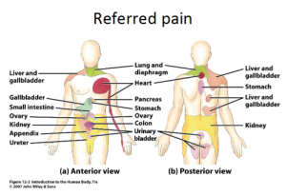
REFLEX EFFECT
THE PRIMARY MEANS WHICH COLD/HOT TREATMENTS AFFECT INTERNAL ORGANS THROUGH THE REFLEX EFFECT, SINCE TEMPS ARE NOT CHANGED BY THE APPLICATION.
A REFLEX IS A REACTION IN RESPONSE TO A STIMULUS THAT IS APPLIED TO A PERIPHERY OF THE BODY, BUT ENACTED IN A DEEPER STRUCTURE THROUGH MEDIATION OF THE CNS.
THESE ARE PROGRAMMED REFLEX RESPONSES TO ADAPT TO THE CNS’S PERCEPTION OF THE INTENT OF STIMULUS.
THE PATTERN CAN BE USED THERAPEUTICALLY TO STIMULATE THE BODY SURFACE AND PRODUCE DESIRED EFFECTS IN DEEPER STRUCTURES. TREATING SKIN IN A REFLEX AREA CAN ADDRESS TEH RELATED ORGAN.

Slide 14
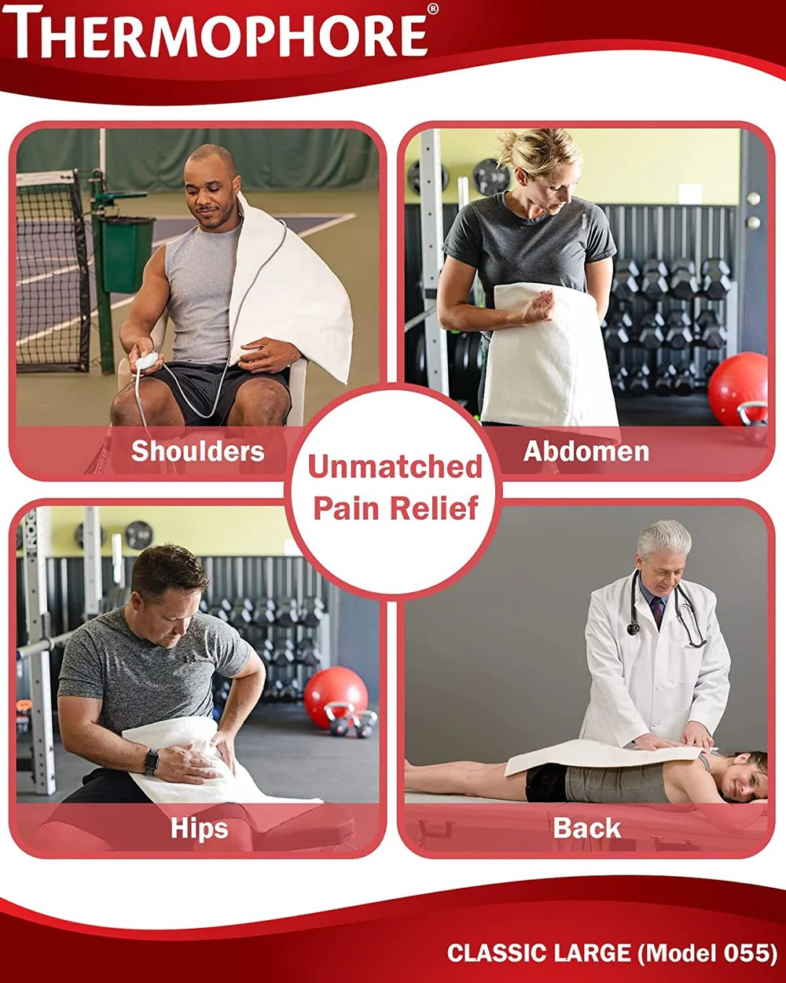
SPECIFIC HEAT APPLICATIONS
THE THERAPIST SHOULD MAKE SURE THAT THE SKIN IS NOT HYPER- OR HYPOSENSITIVE TO HEAT, THAT THE APPLICATION IS NOT SO HOT AS TO BURN THE CLIENT, AND ALSO THAT THE HYDROTHERAPY IS NOT APPLIED FOR PROLONGED PERIODS.
THERMOPHORE – AN ELECTRIC MOIST HEAT PAD. A TOWEL IS PLACED BETWEEN THE THERMOPHORE AND THE CLIENTS SKIN. DURATION – UP TO 10 MINUTES.

Slide 15
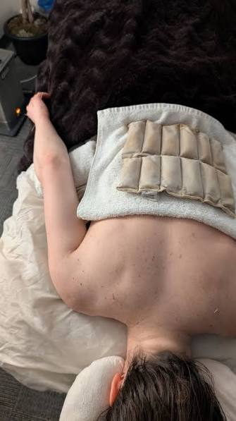
HYDROCOLLATOR – GEL FILLED CLOTH PACKS. THEY ARE KEPT IN TEMPERATURE CONTROLLED HOT WATER BETWEEN USES. WRAP IN A TOWEL BEFORE APPLICATION. DURATION OF APPLICATION IS UP TO 10 MINUTES. THE WEIGHT OF THE APPLICATION IS CONSIDERED.

Slide 16
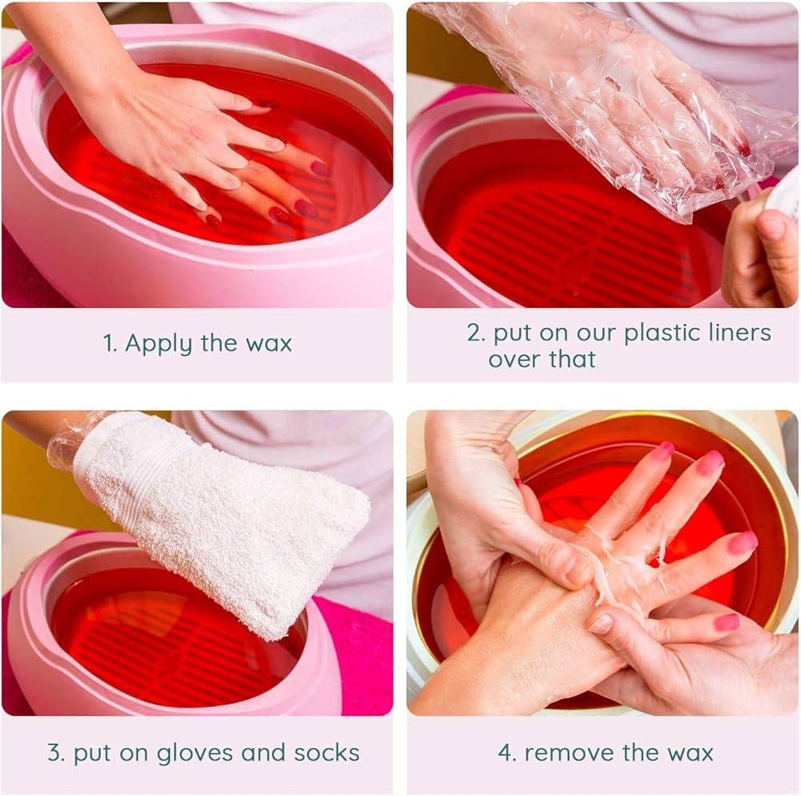
WAX (PARAFFIN) BATHS – A TEMPERATURE CONTROLLED CONTAINER CONTAINING MELTED PARAFFIN WAX. THE CLIENTS CLEAN HAND OR FOOT CAN BE DIPPED IN THE WAX 6 – 12 TIMES. ALLOWING THE WAX TO COOL BETWEEN DRIPPINGS. STRIPS OF CHEESECLOTH CAN BE DIPPED INTO THE WAX THEN APPLIED IN SEVERAL LAYERS OVER THE SKIN. ANOTHER METHOD IS TO USE A PAINT BRUSH TO APPLY THE WAX TO THE CLIENTS SKIN. ONCE THE WAX IS APPLIED IT IS COVERED IN PLASTIC WRAP THEN IN A TOWEL TO CONSERVE HEAT. THE WAX IS LEFT ON FOR UP TO 20 MINUTES.

Slide 17
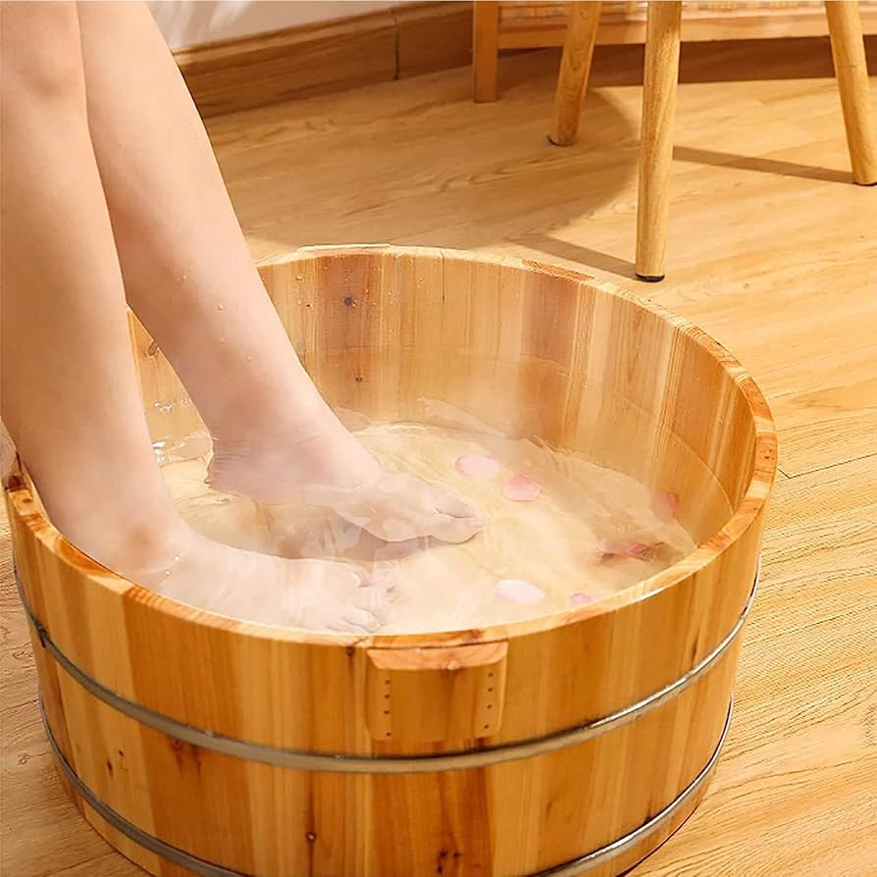
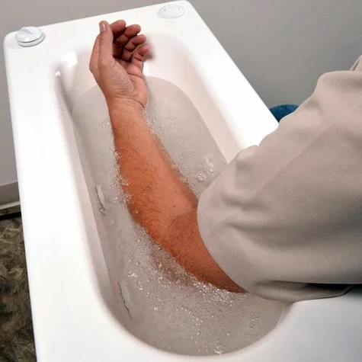
ARM AND FOOT BATHS – THIS IS A LOCAL IMMERSION IN WATER. IMMERSION TIMES OF UP TO 30 MINUTES ARE INDICATED.

Slide 18
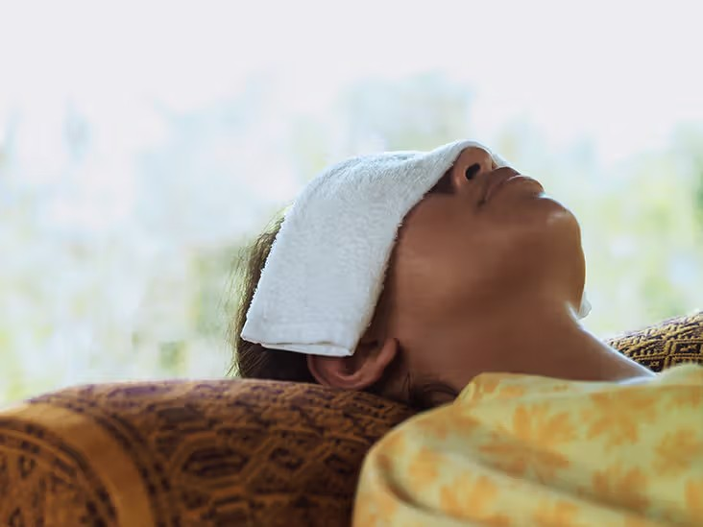
COMPRESS – TOWELS OR CLOTHS ARE IMMERSED IN HOT WATER, WRUNG OUT AND APPLIED TO THE CLIENTS SKIN. THE COMPRESS IS COVERED WITH AN INSULATING TOWEL.

Slide 19
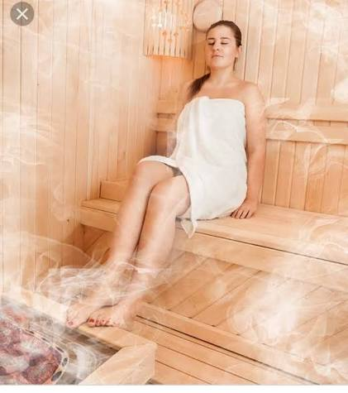
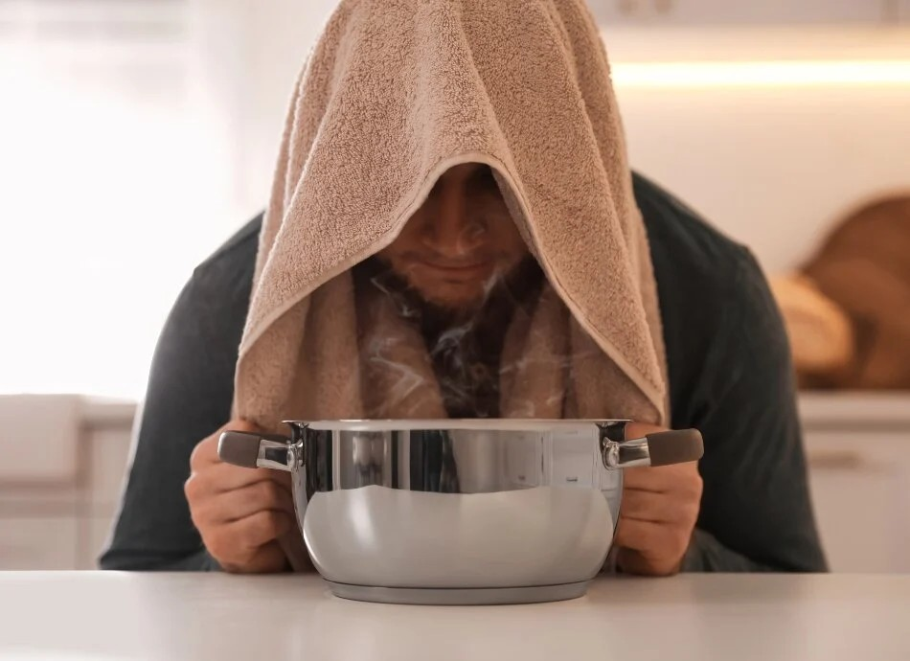
STEAM INHALATION – A BOWL IS FILLED WITH WATER THAT HAS BEEN BOILED. THE CLIENT SITS IN FRONT OF THE BOWL WITH A LARGE TOWEL COVERING THE HEAD AND SHOULDERS. THE CLIENT IS INSTRUCTED TO CLOSE THEIR EYES AND INHALE THE STEAM.

Slide 20
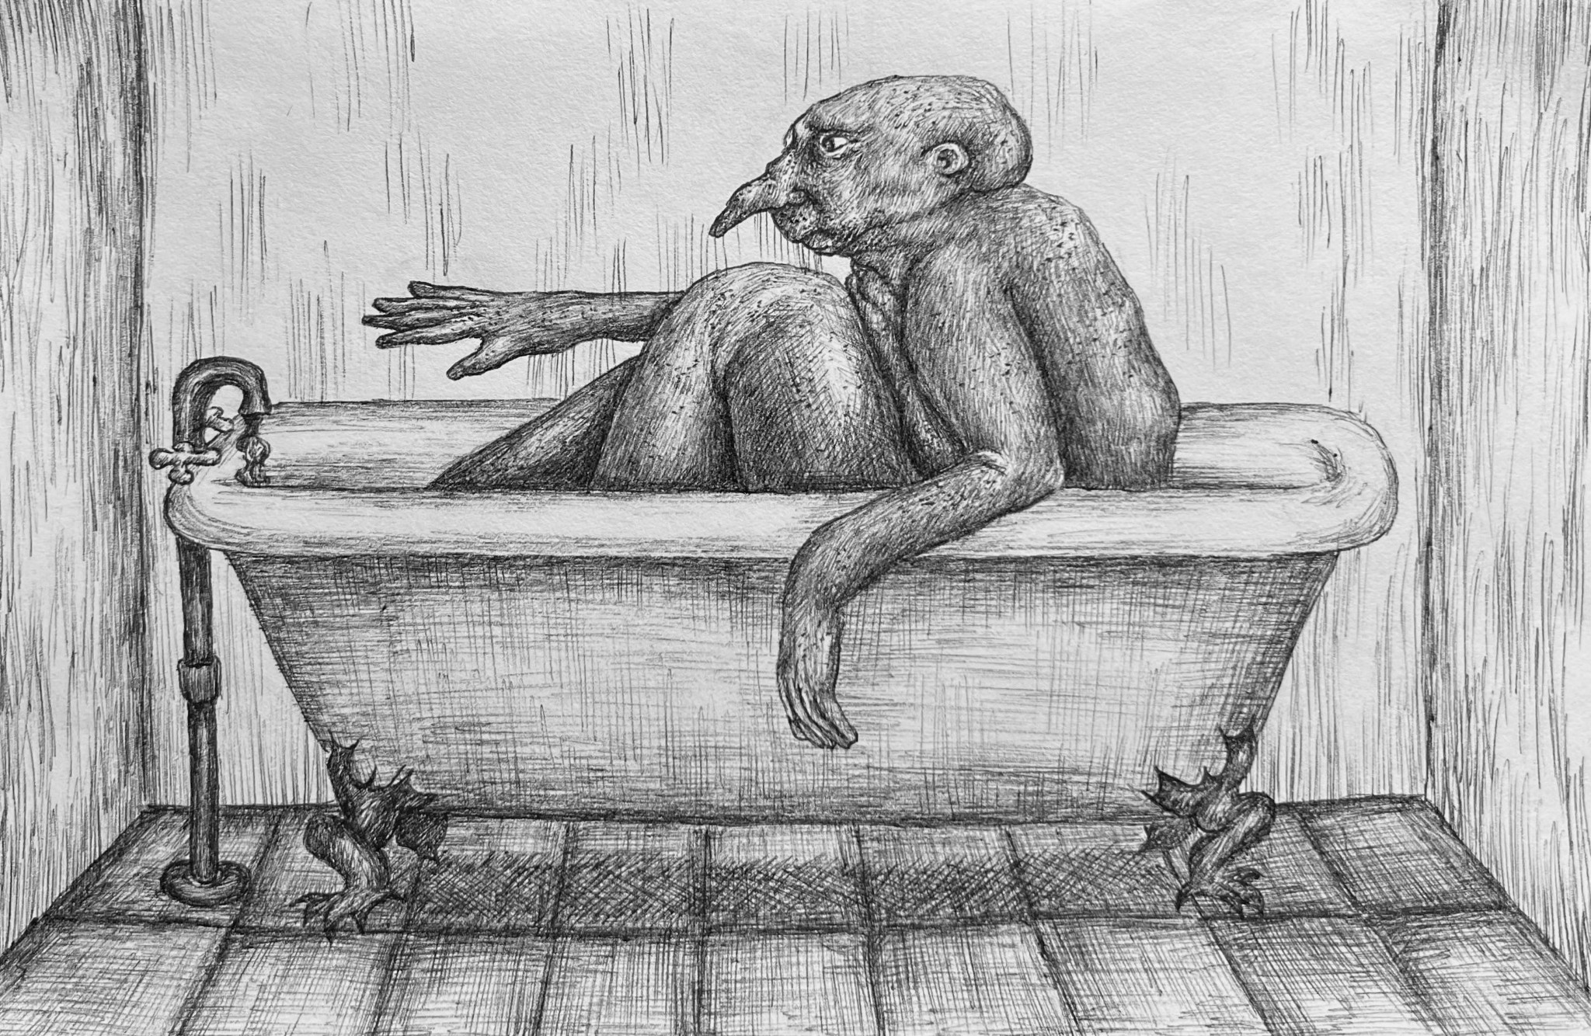
FULL BODY BATHS – OFTEN GIVEN AS SELF CARE THESE MAY BE UP TO 15 MINUTES IN DURATION. TEMPERATURES ABOVE 38 DEGREES MAY BE TOO STIMULATING ESPECIALLY AT NIGHT BEFORE BED. A COOL CLOTH FOR THE FOREHEAD AND A DRINK OF WATER SHOULD BE AVAILABLE FOR THE CLIENT. AN EPSOM SALT BATH HAS UP TO 500 MILLILITERS OF EPSOM SALTS ADDED TO THE WATER.

Slide 21
EFFECTS – HEAT IS USED WITH CHRONIC CONDITIONS, TO SOFTEN CONNECTIVE TISSUE AND AFTER TREATING TRIGGER POINTS. IT INCREASES VASODILATION, LOCAL CIRCULATION, CONTRALATERAL CIRCULATION, HEART RATE, METABOLISM, COLLAGEN EXTENSIBILITY AND OVERALL RELAXATION. IT DECREASES PAIN, SPASM, HYPERTONICITY AND INTESTINAL ACTIVITY.
CONTRAINDICATIONS –
ACUTE INJURY – HEAT WILL INCREASE BLEEDING AND SWELLING IF USED IN THE FIRST 48 HOURS AFTER INJURY
CIRCULATORY PATHOLOGIES – ESPECIALLY WITH PROLONGED OR FULL BODY HEAT APPLICATIONS
SENSORY CHANGES
ACUTELY INFLAMED JOINTS
ACUTE INFECTIONS
EXISTING BURNS
HYPERSENSITIVITY TO HEAT
DEPENDANT LIMBS ( A DANGLING POSITION MAY CAUSE EDEMA IN THE LIMB)
HEAT APPLICATIONS CAN ALSO CAUSE BURNS IF HEAT IS LEFT ON THE TISSUE FOR TOO LONG, OR IS TOO HOT..
WITH MS LARGE APPLICATIONS OF HEAT ARE NOT TOLERATED WELL.

Slide 22
COLD
EFFECTS OF COLD
COLD APPLIED LOCALLY REDUCES THE TEMPERATURE OF THE SKIN. MUSCLE AND JOINT IT IS SUPPLIED TO. SKIN TEMPERATURE DECREASES TO A GREATER DEGREE THAN MUSCLE, HOWEVER, DEPENDING IN THE LENGTH OF TIME THE APPLICATION, MUSCLE TISSUE MAY STAY COLD FOR UP TO 45 MINUTES AFTER THE SOURCE IS REMOVED.
COLD CAUSES LOCAL VASOCONSTRICTION, DECREASING BLOOD FLOW, THIS ALLOWS COLD TO PENETRATE DEEPER IN TO THE TISSUES. A LOWER TEMPERATURE INCREASES BLOOD VISCOSITY, REDUCING BLEEDING. WITH INJURED TISSUE THIS MEANS DECREASED INFLAMMATION, SWELLING, EDEMA AND BLEEDING. DECREASED CELL METABOLISM AND LEUKOCYTE MIGRATION AND ALSO NOTED WITH A PROLONGED APPLICATION OF COLD, FURTHER DECREASING INFLAMMATION.
PAIN IS DECREASED BY COLD WITHER BLOCKING PAIN TRANSMISSION OR ACTING AS A COUNTERIRRITANT.
MOST OF THE TIME THE REACTION OF COLD IS DEPRESSIVE (SLOWS METABOLIC FUNCTIONS), BUT EFFECTS OF CRYOTHERAPY CAN BE STIMULATION IF APPLICATION IS BRIEF, OR USED TO ACHIEVE REFLEX EFFECTS

Slide 23
MUSCLE SPASM IS DECREASED DUE TO REDUCED MUSCLE SPINDLE FIRING
COLLAGEN EXTENSIBILITY IS DECREASED WITH COLD APPLICATION
IF APPLIED IN LESS THAN 2 MINUTES AFTER A DEEP BURN, COLD GIVES IMMEDIATE PAIN RELIEF, DECREASED TISSUE DAMAGE AND HASTENED HEALING.
THE GREATER THE TEMP DIFFERENCE, THE LARGER THE DROP IN TISSUE TEMP.
COOLING OF THE BODY SURFACE INITIATES RESPONSES THAT UNDERPIN THE EFFECTS OF COLD.
  RETROSTASIS: THE BLOOD VESSEL CONSTRICTION IN THE SKIN/SUBCUTANEOUS TISSUES, IS THE ACTION OF FLUID BEING MOBILIZED FROM THE BODY SURFACE INTO DEEPER TISSUES AND INTERNAL ORGANS
  HEAT CONSERVATION: IF THE HEAT OF WARM BLOOD IS NEEDED IN ANOTHER PART OF THE BODY, IT WILL BE SHUNTED IN FROM OTHER BODY PARTS THAT HAVE EXCESS BLOOD
  HUNTING RESPONSE: WHEN THE TEMP IN A TISSUE IS REDUCED FOR 12-15 MIN OR MORE, OR WHEN IT IS BROUGHT BELOW 10 DEGREES CELSIUS (50F). THIS CAN INDUCED A COLD-INDUCED VASODILATION FOLLOWS THE INITIAL VASOCONSTRICTION. THIS IS AN ATTEMPT OF THE BODY TO ENSURE THAT PERIPHERAL BODY PARTS RECEIVE SUFFICIENT BLOOD WHEN EXPOSED TO COLD SO THEY CAN RESIST TISSUE DAMAGE (FROSTBITE)

Slide 24
SPECIFIC COLD APPLICATIONS
AT FIRST COLD IS OFTEN NOT WELL TOLERATED BY THE CLIENT, HOWEVER ONCE ACCUSTOMED TO IT, CLIENTS OFTEN GET SIGNIFICANT RELIEF FROM PAIN AND SPASM.
AN AVERAGE APPLICATION OF ICE OR A GEL PACK TO REDUCE INFLAMMATION AND PAIN IS 25 – 30 MINUTES.
MAKE SURE THE APPLICATION IS NOT PLACED DIRECTLY ON THE SKIN OR LEFT ON SO LONG AS TO CAUSE FROSTBITE.
COLD CAN BE USED FOLLOWING FRICTIONS AND AS SELF CARE BEFORE OR AFTER EXERCISE TO DECREASE INFLAMMATION.
WITH A COLD APPLICATION THE CLIENT WILL EXPERIENCE THE FOLLOWING STAGES OVER SEVERAL MINUTES
A SENSATION OF COLD
TINGLING OR ITCHING
ACHING OR BURNING
NUMBNESS OR ANALGESIA

Slide 25
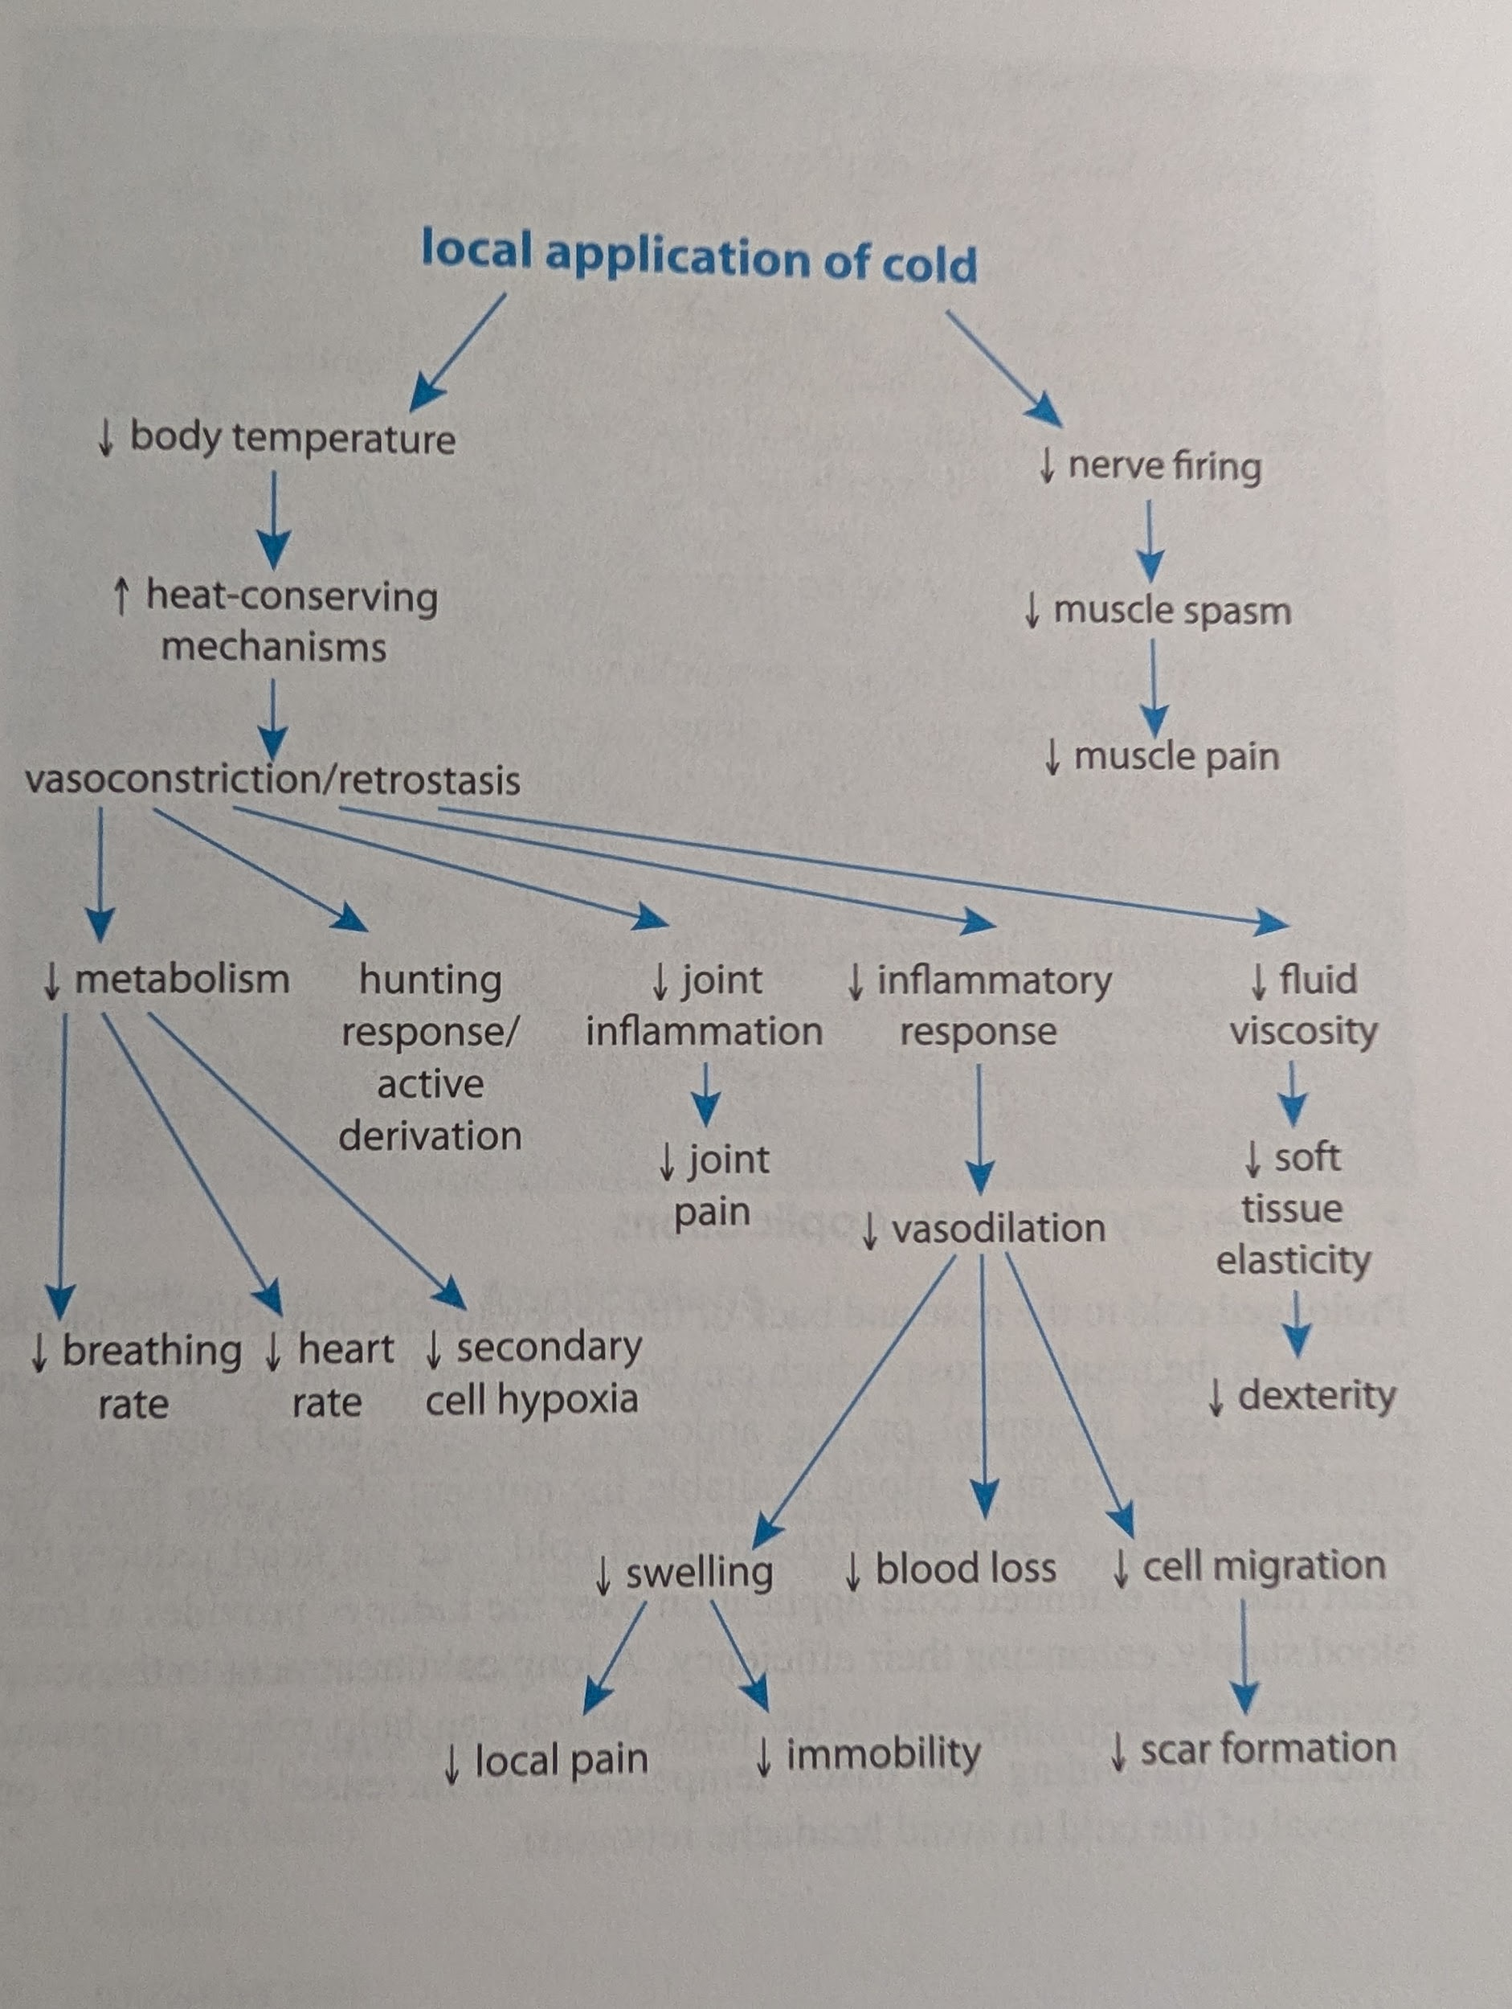

Slide 26
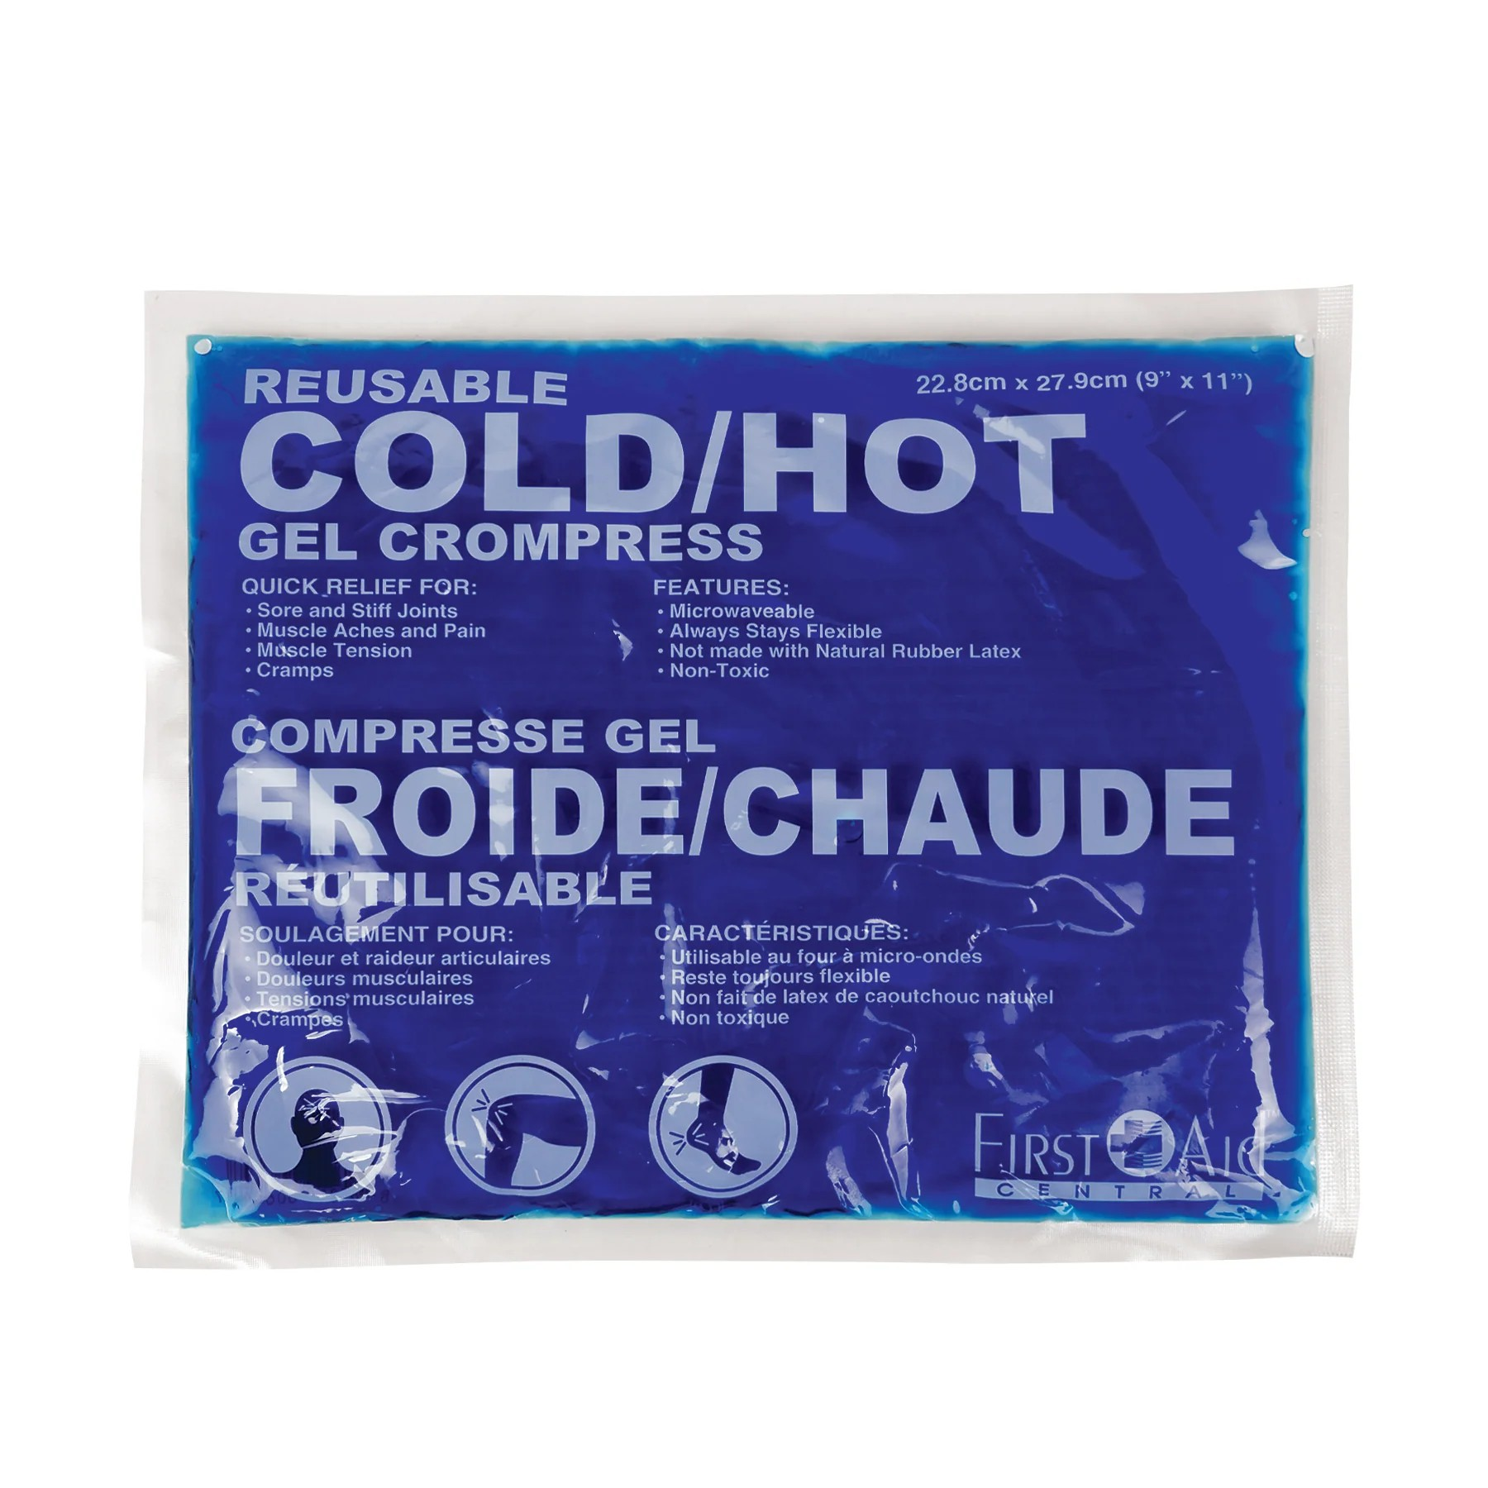
ICE PACKS – GEL FILLED PACKS THAT ARE KEPT IN A FREEZER. THE PACK IS WRAPPED IN A TOWEL BEFORE APPLICATION TO THE AFFECTED AREA. ANOTHER TOWEL IS USED TO INSULATE THE ICE PACK FOR 25-30 MINUTES.
ICE MASSAGE – WATER IS FROZEN IN A PAPER OR STYROFOAM CUP. THE ICE IS RUBBED OVER THE SKIN SURFACE IN A CIRCULAR MANNER. IT IS USED FOR EITHER 5 – 10 MINUTES OR 15 – 30.
ARM AND FOOT BATHS – LOCAL IMMERSION IN COOL OR COLD WATER. IMMERSION TIMES ARE UP TO 1 MINUTE.
COMPRESS – TOWELS OR CLOTHS ARE IMMERSED IN COLD WATER, WRUNG OUT AND APPLIED TO THE CLIENTS SKIN. COVER THE COMPRESS WITH AN INSULATING TOWEL.
COOL WASH – USES A CLOTH THAT HAS BEEN FOLDED IN 4 AND RUN UNDER COLD WATER. USE ONE SQUARE THEN CHANGE TO ANOTHER AS THE SQUARE HEATS UP.
HEATING COMPRESS – WILL DRAW CIRCULATION TO THE AREA USING THE BODY’S REFLEXES TO WARM UP A COLD AREA. A COLS CLOTH IS PLACED ON AN AREA AND COVERED BY A DRY CLOTH. THIS REMAINS IN PLACE UNTIL THE BODY HAS HEATED THE COLD CLOTH TO BODY TEMPERATURE.

Slide 27
EFFECTS
COLD IS USED WITH ACUTE CONDITIONS
AFTER A CROSS FIBER FRICTION TECHNIQUE
AS A BRIEF DISTRACTION WHEN TREATING TRIGGER POINTS.
INCREASES VASOCONSTRICTION
DECREASES LOCAL CIRCULATION, PAIN, INFLAMMATION, EDEMA, SPASM, METABOLISM AND COLLAGEN EXTENSIBILITY
BRIEF APPLICATIONS ARE STIMULATING.
STIMULATE ACTIVITY IN TARGET ORGANS
PROLONGED COLD TO NOSE, BACK OF NECK FOR NOSEBLEEDS
OVER HEART TO REDUCE HEART RATE
CONTRAINDICATIONS
RAYNAUD’S DISEASE
OTHER CIRCULATORY INSUFFICIENCIES
SENSORY CHANGES (DECREASED SENSITIVITY TO TEMPERATURE)
COLD SENSITIVITY (COLD ALLERGY)
DEBILITY AND THE CLIENT FEELING CHILLED

Slide 28
INDICATIONS FOR COLD APPLICATIONS
ACUTE SPRAINS/STRAINS
ACUTE SOFT TISSUE TRAUMA IN GENERAL, INCLUDING CONTUSIONS
INFLAMMATION
EDEMA
MM PAIN
MM GUARDING/SPASM (EXCEPT WHEN ISCHEMIA IS PRIME CAUSE)
ACUTE TENDONITIS/BURSITIS
FRACTURES
POST SURGICAL CONDITIONS
HA’S/MIGRAINES
HEMORRHOIDS
RA/OTHER INFLAMMATORY ARTHRITIDES
INFLAMMATORY JT DISORDERS
MS
DEPRESSION

Slide 29
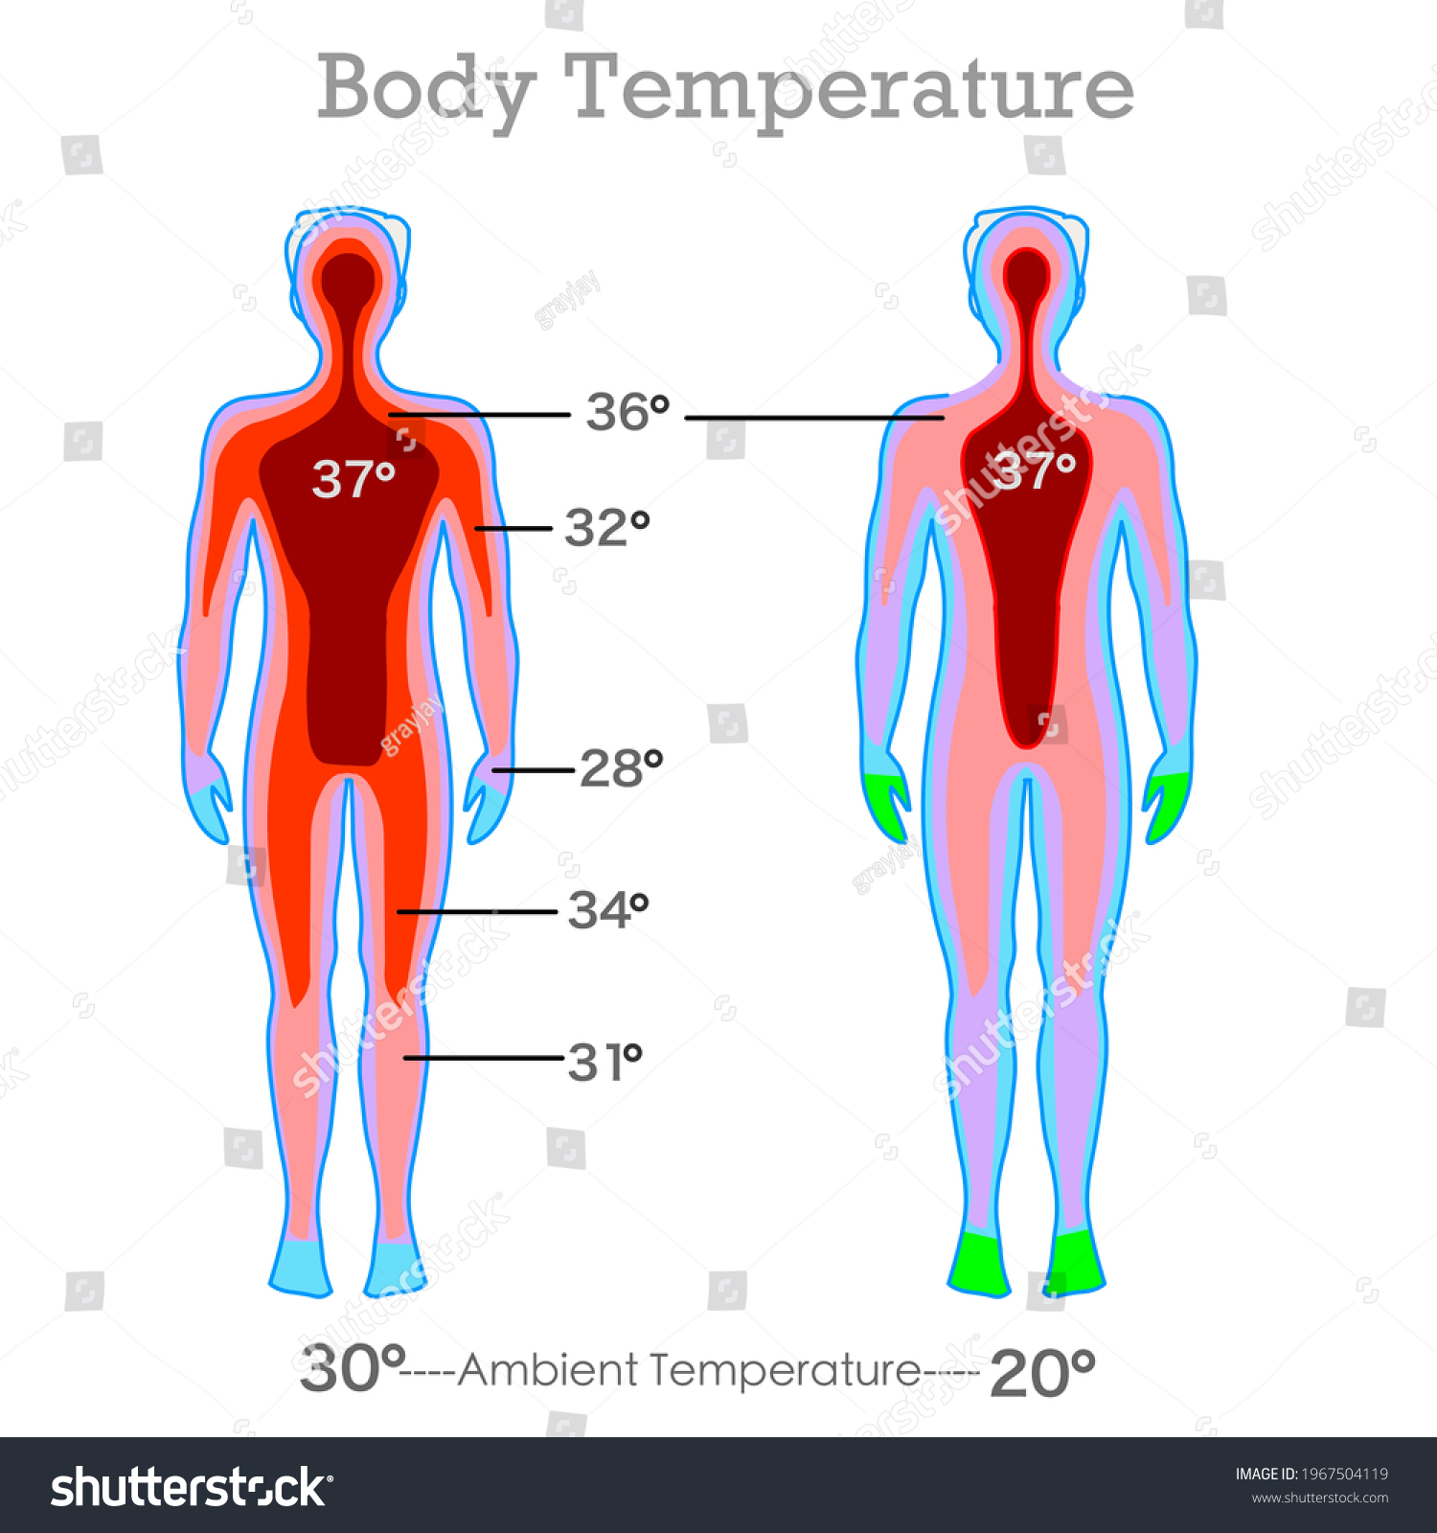
CONTRAST
CONTRAST HYDROTHERAPY IS A WARM OR HOT APPLICATION FOLLOWED BY A COOL OR COLD APPLICATION. THIS CAUSES ALTERNATING VASODILATION AND VASOCONSTRICTION OF THE ARTERIOLES AND CAPILLARIES. CAUSES A MARKED INCREASE IN LOCAL CIRCULATION AND VENOUS RETURN. THIS HELPS MOVE METABOLITES, DECREASE EDEMA, INCREASE TISSUE HEALING., AND INCREASE LOCAL BLOOD FLOW BAY 100%.
A COMMON RATIO FOR EACH APPLICATION OF HEAT AND COLD IS 3:1 THREE MINUTES OF HOT, ONE MINUTE OF COLD. VASOCONSTRICTION HAPPENS IN 20 SECONDS SO THE COLD APPLICATION MAY BE AS BRIEF AS 30 SECONDS.
THE SEQUENCE IS REPEATED 6-8 TIMES, TX CAN BE UP 30-45 MINUTES LONG IF DONE ON IT’S OWN, OR IF COUPLED WITH MASSAGE IT IS REPEATED 3-4 TIMES.
THE GREATER THE DIFFERENCE IN TEMPERATURE BETWEEN HOT AND COLD, THE GREATER THE EFFECT ON LOCAL CIRCULATION. HEAT BRINGS OXYGENATED BLOOD CARRYING DEFENSIVE/HEALING CELLS AND COLD LIMITS LOCAL PAIN/REDUCES BUILD-UP OF EDEMA/WASTE PRODUCTS.
CONTRAST APPLICATIONS SHOULD ALWAYS END IN COLD.
THE MINIMAL TEMP DIFFERENCE SHOULD BE 10 DEGREES C(18F)

Slide 30
SPECIFIC CONTRAST APPLICATIONS
ARM AND FOOT BATHS AND COMPRESSES
EFFECTS
CONTRAST HYDROTHERAPY IS USUALLY USED FOR TREATING SUBACUTE CONDITION, IT INCREASES LOCAL CIRCULATION.
CONTRAINDICATIONS
ACUTE CONDITIONS
DECREASED SKIN SENSITIVITY TO TEMP
VASCULAR PATHOLOGIES
CLIENT FEELING CHILLED.

Slide 31
INDICATIONS FOR CONTRAST THERAPY
EDEMA
NON-ACUTE SOFT TISSUE CONDITIONS
SUB ACUTE INJURY
CHRONIC CONDITIONS WITH UNRESOLVED EDEMA/CIRCULATORY CONGESTION

Slide 32
GENERAL EFFECTS
PHYSIOLOGICAL OR REFLEXIVE
PHYSIOLOGICAL
  RETURNS BODY TO HOMEOSTASIS
  HEAT APPLICATION – VASODILATION – INCREASE OF BLOOD FLOW TO PROMOTE MUSCLES TO RELAX
  COLD APPLICATION – VASOCONSTRICTION – DECREASE BLOOD FLOW TO DECREASE PAIN
REFLEXIVE
  HOW DOES AN APPLICATION EFFECT ANOTHER PART OF THE BODY?

Slide 33
TEMPERATURE CHART (SNIDAL)
TEMP OF EXTREMITIES CAN BE AS LOW AS 26°-27°C
TEMP OF THE SKIN OF THE TORSO
OPTIMAL THERAPEUTIC RESULTS
FOR SWEATING TX’S
BLITZ GUSS, JAPANESE BATHS 44°C
** SKIN TOLERANCE TO DIRECT HEAT APPLICATION IS 44°C
VERY COLD
COLD
COOL
TEPID
NEUTRAL
WARM
HOT
VERY HOT**
SCALDING
BURNING
CELL DESTRUCTION
0°-9° C
10°-18° C
19°-22°C
23°-31°C
32°-35°C
36°-38°C
39°-42°C
43°-48°C
49°-56°C
60°C
72°C

Slide 34
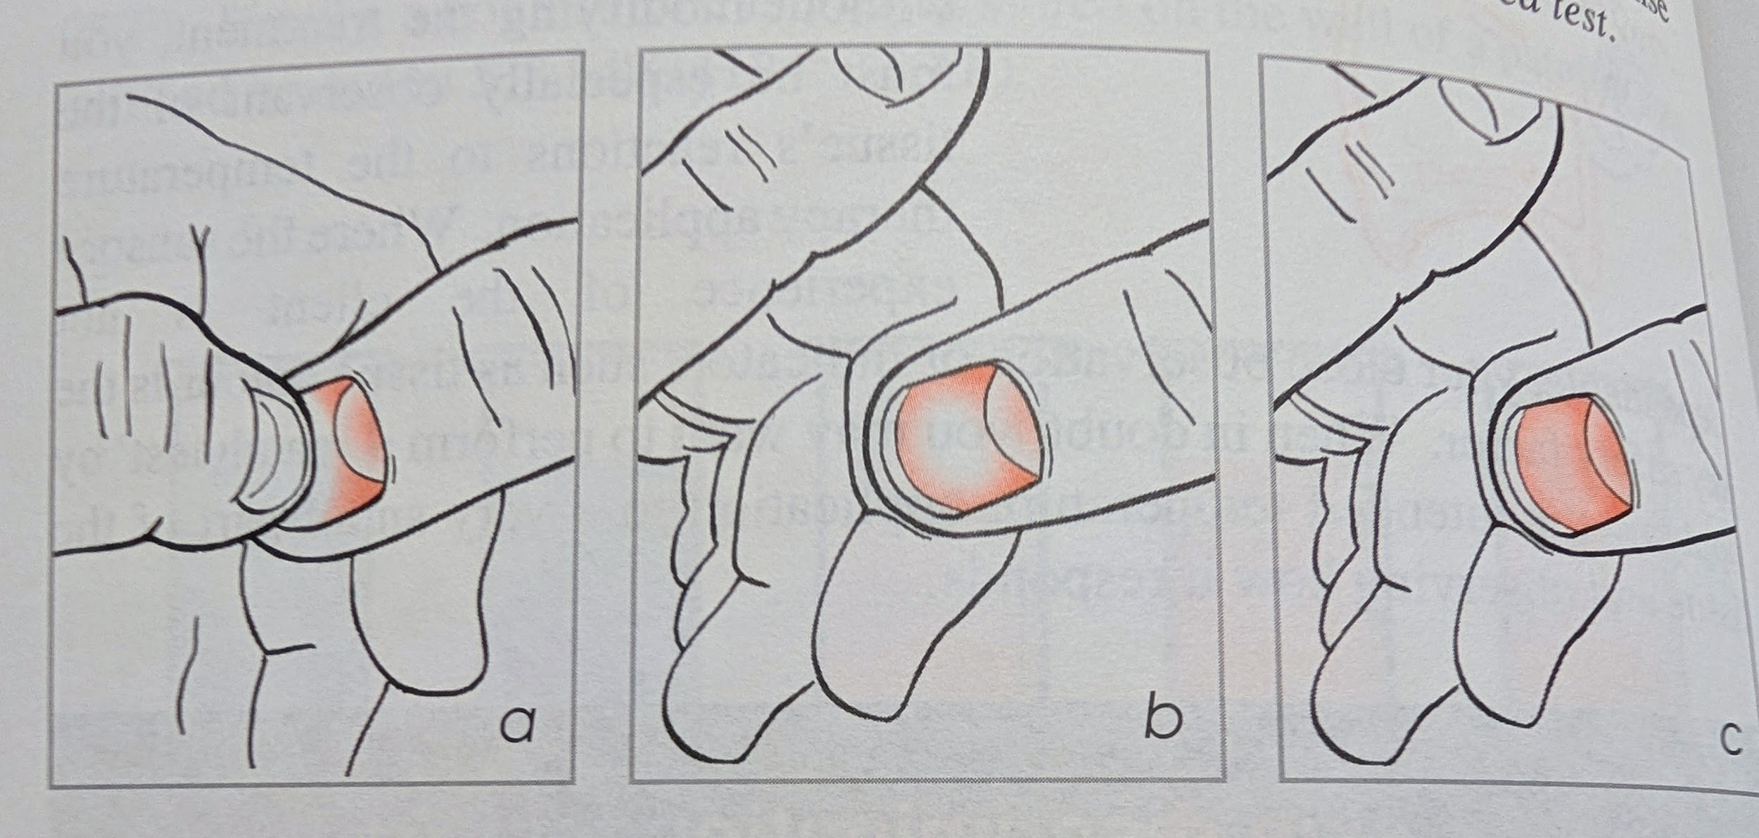
NAIL BED TEST
COMPRESSING THE FINGERNAIL/TOENAIL BED, DECREASING LOCAL BLOOD FLOW, TURNING AREA WHITE. ONCE PRESSURE IS OFF, TISSUE SHOULD TURN BACK TO NORMAL COLOR, IF NOT THE PERSON MAY HAVE AN ABNORMAL PERIPHERAL VASCULAR RESPONSE.

Slide 35
STAGE OF HEALING AND SUGGESTED TREATMENT METHODS
(SNIDAL)

Slide 36
ACUTE CONDITIONS PG.19 SNIDAL
Timeline?
Time of trauma – 3-4 days
Cold or hot application?
Why?
Analgesic effect on pain receptors
Slows metabolism
Signs and Symptoms | Treatment | Length of Tx
Elevated temp Pain or tenderness Loss of movement Loss of function, sensation Swelling Redness | Short cold treatments: Cold compress Cryotherapy: Ice-cube massage, gel packs, ice bags | Up to 60 seconds; replace when warm Cover and leave on for 20 mins, repeat every 2-4 hours

Slide 37
SUBACUTE CONDITIONS
TIMELINE?
2-3 DAYS – 3 WEEKS
TYPE OF TX?
WHY?
PUMP EFFECT, FLUSHING
VASODILATION FOLLOWED BY VASOCONSTRICTION
Signs and Symptoms | Treatment | Length of Treatment
Decreased swelling Decreased pain Decreased redness Increased function Increased mobility Noticeable bruising due to healing process | Contrast Treatments Contrast foot baths Contrast towels Contrast showers | Begin with warm application, 3-5 mins End with cold, 10-60 seconds 2-4 cycles Warm app can be shorter if affected area has palpable heat Increasing cold cycle will not produce a better reaction Ice or gel packs are not recommednded in place of cold towel WHY?

Slide 38
CHRONIC CONDITIONS
TIMELINE?
2-3 WEEKS- 1-2 YEARS
Signs and Symptoms | Treatment | Length of Treatment
Paleness Peripheral coldness on the limbs and affected site Decreased circulation due to muscle spasms Possible swelling, congestion in the muscles Tenderness, achey, “deep pain” Decreased mobility No inflammation, no obvious redness and/or swelling | Warm Tx’s -fomentations -paraffin wax -full or partial steams, saunas -whirlpools Contrast Tx’s -contrast bath/shower Prolonged Cold -heating compresses Cryotherapy -ice-cube massage | Short warm -20 minutes -always finish with cold rinse Contrast times -3-5 min warm -10-30 sec cold Prolonged Cold -1-2 hours Cryotherapy - Use of brief stimulus

Slide 39
TREATMENT VARIABLES
BODY TYPE, AGE, GENERAL HEALTH, MEDS
  SMALL OR THIN – PREFER WARM TXS, CORE HEAT SOURCE IS SMALL, SO STAYS AROUND ABDOMEN MORE, EXTREMITIES ARE OFTEN COLD, BENEFIT MORE FROM GENTLE, SHORT, COLD TXS AFTER ANY PROLONGED HEAT TX. TXS TO FEET, HANDS, SKIN WILL GENTLY IMPROVE PERIPHERAL CIRC.
  LARGE, STOCKY – DRAWN TO AND CAN HANDLE COLD TXS, REG USE OF COLD CAN STIMULATE THEIR METABOLISM AND ELIMINATION. SWEAT AND CONTRAST TXS ARE IMPORTANT TO KEEP THE SKIN FUNCTIONING PROPERLY SO THE BODY CAN ELIMINATE INTERNAL HEAT BUILD UP QUICKLY.
  ACTIVE/ATHLETIC (RECREATIONAL VS HIGH PERFORMANCE) – HAVE ACTIVE CIRC SYSTEM THAT RESPOND QUICKLY TO STIMULI. EXTREME TEMP TXS ARE NOT REQ’D TO CREATE A POSITIVE EFFECT. TXS AFTER EXERCISE OR WORKOUT WOULD AID THE BODY IN ELIMINATING TOXINS.
  CHILDREN, ELDERLY – TXS SHORTER IN DURATION, NO EXTREME TEMP

Slide 40
MOST EFFECTIVE TIME OF DAY FOR TX
MAJORITY OF PEOPLE, BODY TEMP STARTS TO DECREASE FROM 3 PM – 2 AM
3AM-3PM THE BODY GOES THROUGH A REHEATING PHASE, METABOLISM INCREASES, AND PEAKS FROM 9AM-2PM
COLD TXS – BODY BEGINS TO REHEAT IN THE EARLY AM, COLD TX CAN INCREASE THE BODY’S INTERNAL TEMP. 5-8AM
WARM TXS- ENCOURAGE RELAXATION AND SLOW DOWN METABOLISM, MID-EVENING
STRONG TXS- SAUNAS, SWEATING BATHS, LATE AM, EARLY AFTERNOON, TO ALLOW BODY TO RETURN TO BALANCE BEFORE SLEEP
MILD TXS- WASHINGS, FOOTBATHS EARLY AM, OR LATE PM.

Slide 41
EPSOM SALTS
USED TO RELIEVE STRESS, HA’S, IMPROVE SLEEP. DECREASE MM TENSION/SORENESS, AND DETOXIFY THE BODY
MAGNESIUM HELPS REGULATE ELECTROLYTE LEVELS, NECESSARY FOR GOOD CARDIO AND NN SYSTEM FUNCTIONS
HAS A ROLE IN CALCIUM REGULATION, VITAL SKELETAL AND HEART MM CONTRACTION AND HEALTHY BLOOD CLOTTING. STRESS MANAGEMENT/MENTAL HEALTH, AS WELL AS THE PRODUCTION/MAINTENANCE OF SEROTONIN (BALANCING MOOD)
DIFFUSION OF THE SKIN IS THE EFFICIENT METHOD FOR ABSORPTION, BECAUSE FOOD/MEDS INHIBIT OPTIMAL ASSIMILATION THROUGH THE DIGESTIVE TRACT.

Slide 42
MEASUREMENTS
COMPRESS: 250ML (1CUP) EPSOM WITH 2L (½ GALLON) WARM WATER, PLACE ON SORE AREA
FOOT BATH: 250 ML OF EPSOM, SOAK FOR 15-20 MIN
FULL BATH: 500 ML, SOAK FOR 15-20 MIN (SHOWER AFTER TX)

