Slide 1
LYMPHATIC DRAINAGE TECHNIQUES
Pg. 35-37 Rattray

Slide 2
Edema
Local or general accumulation of fluid in the interstitial tissue spaces.
Localized edema is often due to lymphatic obstruction or increased capillary permeability (the quality of a material or membrane that causes it to allow liquids or gases to pass through it).
Generalized edema is frequently due to a systemic pathology or condition such as heart failure, liver or kidney disease.
Resultant of an acute, or subacute trauma

Slide 3
What is lymph?
Lymph is a clear, colourless, watery interstitial fluid. It contains plasma proteins, white blood cells, fats and debris such as cell fragments, bacteria and viruses. This fluid is only called lymph once in the lymphatic system.
Lymphatic system vessels are responsible for the absorption, collection and transport of lymph fluid
70% of lymphatic vessels are located in the skin

Slide 4
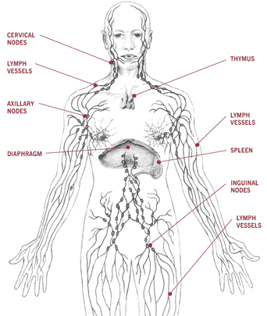

Slide 5
Massage and the Lymphatic System
Specialized massage techniques are proven to increase lymphatic flow in the superficial lymphatic capillaries.
Light Swedish techniques (stroking and kneading) as well as elevation of the affected limb are shown to increase the flow of lymph.
Massage techniques move lymph by mechanically pumping the lymphatic fluid through the lymphatic capillaries. Thus reducing the edema and pain in the area being treated.
Compression empties the capillaries, while decompression allows them to refill.
Pressure within the capillaries is reduced allowing the lymph to flow.
In those with lymphedema, lymphatic drainage results in an increase of urine output.

Slide 6
Lymphatic Drainage Massage
Refers to systems of soft tissue manipulation designed to assist the function of the lymphatic system
Techniques include gentle slow repetitive strokes performed in a specific direction and sequence to improve lymph circulation
It is precise rhythmical massage used for general wellness, to enhance healing and treat lymphedema

Slide 7
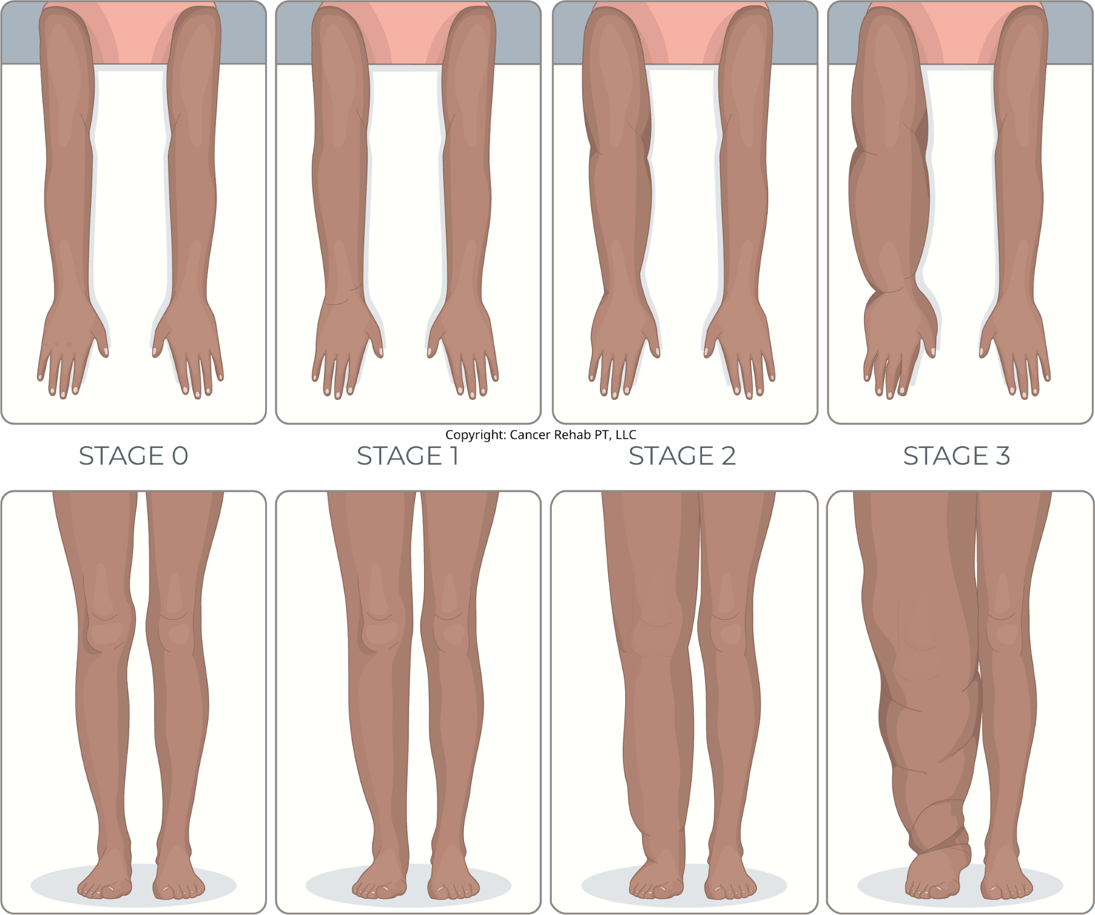
Indications
Used to treat a number of common conditions that involve lymphatic blockages
Allergy symptoms, arthritis, colds, colitis, edema, sinus congestion, and psoriasis
Treating of musculoskeletal injuries may also be enhanced with lymphatic treatment
Also used to treat chronic disorders such as lymphedema which is most often due to a mechanical insufficiency of the lymphatic system

Slide 8
Contraindications
If infections or parasites are present avoid lymphatic drainage all together since the increase in circulation may cause a flare up of the infection.
Untreated or metastasizing tumors are contraindicated for treatment due to the increase in circulation
Edema present as a result of medical treatment from either radiation or lymph node removal though is okay to treat.
Local or distal work with edema present if present due to thrombophlebitis or DVT (deep vein thrombosis).
Kidney pathologies
Asthma and other respiratory conditions ie: TB, bronchitis…
Thyroid conditions
Congestive heart failure: avoid full body drainage techniques and no elevation of limbs above the level of the heart.
Menstruating women
NOTE: Any condition that may worsen by increased fluid circulation warrants caution with applying lymph techniques.

Slide 9

WHEN IN DOUBT, REFER OUT!!
Find an RMT certified in Manual Lymphatic Drainage, or Lymphatic Drainage Therapy

Slide 10
Treatment

Slide 11
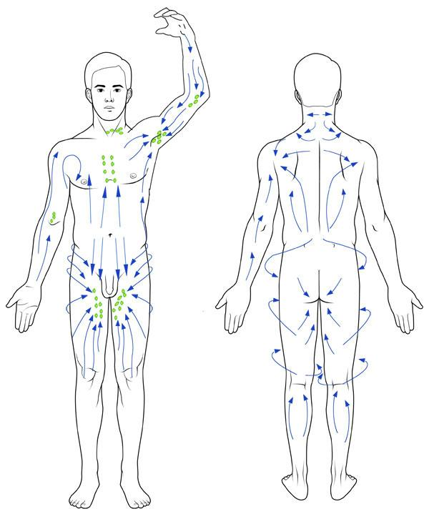
Basic Principles to follow for Lymph Drainage
Lymph is pushed toward the nodes.
The area proximal to a node is treated before the distal area so that the proximal area is emptied to make room for the fluid flowing from the distal end.
Pressure is limited to just enough to move the skin.
With each movement the skin is stretched with enough intensity that it ‘snaps back” when released.
There is a rest phase with no pressure applied between each stroke.
The techniques are applied in a rhythmical manner, 5-7 times.
The pressure phase of a circle lasts longer than the rest phase.
There should not be hyperemia created.
There should be NO pain.

Slide 12
4 things an RMT should remember when applying techs
Pressure
  LIGHT! Only superficial layer of the skin is engaged
  1-4 ounces of pressure, 20-40 mmHG, or weight of a nickle
Direction
  Towards target lymph nodes
  Rest phase between strokes
Rhythm
  SLOW
  Repeated 5-7 times
Sequence

Slide 13
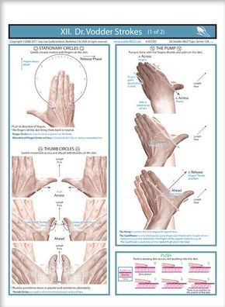
Techniques
Nodal pump ** consent and communication**
Stationary circles
Local techniques
  Web
  Thumbs
NO MEDIUM NECESSARY

Slide 14
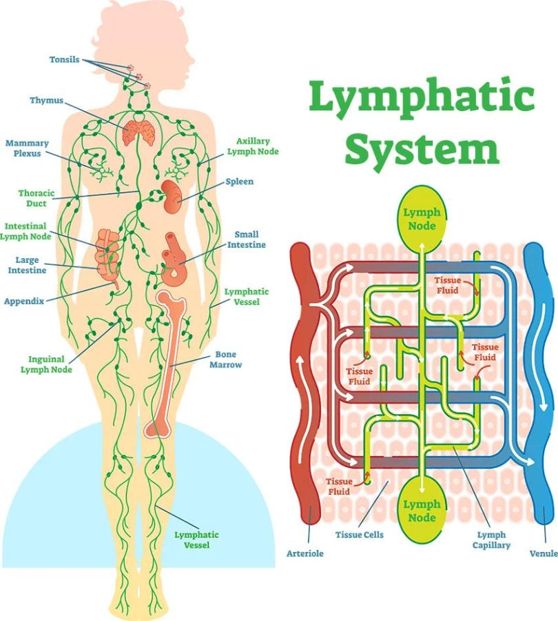
Manual Lymph Drainage
Encourages lymph flow and reduces certain types of edema.
Slow, repetitive, rhythmic nature of these techniques also decreases pn perception and the effects of the SNS.

Slide 15
The MLD Technique:
Light, repetitive techs are used to pump the lymphatic fluid through the superficial lymphatic capillaries.
Each manipulation must be repeated a minimum of 5-7 times in order to pump the lymphatic fluid through the tissue.
Strokes are unidirectional (one direction only) and overlapping
The pressure is applied towards the heart in a rhythmic manner starting at the proximal lymph node and working distally towards the edematous site.
Thorough treatment of a single limb may take up to 20 minutes.
Pressure of 20-40 mmHG is used to avoid collapsing the superficial lymphatic capillaries. (more than 60 will collapse the vessels)

Slide 16
Lymphatic techniques
Therapist works from proximal to distal towards the localized edema
Nodal Pumping:
Is applied to the lymphatic nodes of the most proximal part of the limb that has edematous tissue.
The palmar surface of the hand is used and pressure is applied in a wave-like motion, from just distal to the mode in a proximal direction
  in the arm, axillary nodes
  in the leg, inguinal nodes

Slide 17
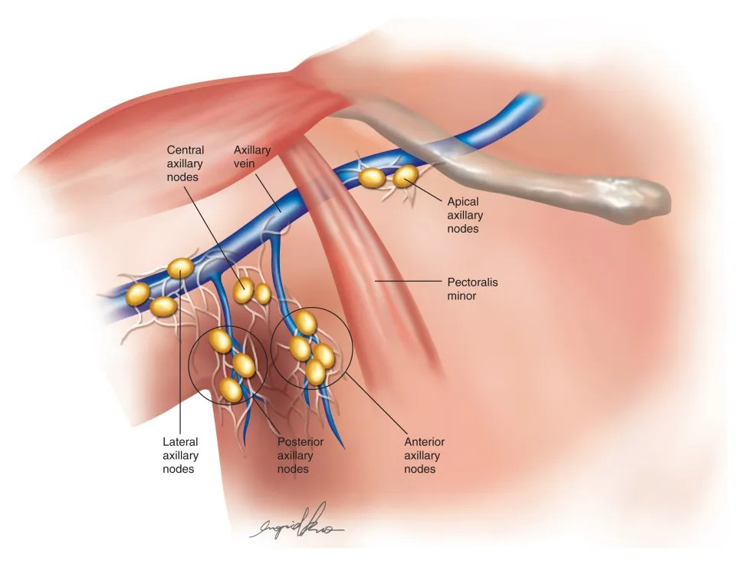
Local Technique:
used to treat the tissue immediately proximal to the edema
the ulnar border of the hands, web between the thumb and the index finger or the broad surface of the entire thumbs are used to stroke the tissues in a proximal direction.

Slide 18
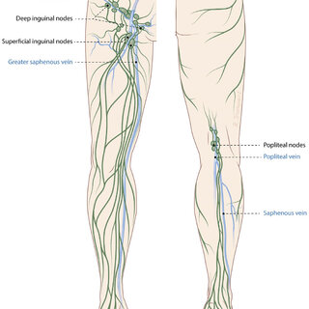
Stationary Circles:
used to treat larger areas of the limb between the edema and the proximal nodes

Slide 19
Tissue distal to the lesion site is not treated with lymphatic drainage until the edema that is congesting the site itself is decreased!

Slide 20
Treatment
Nodal pumping 3 times on the most distal node
work in sections
Stationary circles - start proximal and work distal
each circle is repeated 5-7 times
Pressure is in a proximal direction, towards the heart

