Slide 1
Nonswedish Techniques
RATTRAY pg 31

Slide 2
Diaphragmatic Breathing –
Diaphragmatic breathing should be a key part of every massage treatment. It is the easiest
way for the client to achieve relaxation and to break the pain cycle.
- allows the most efficient intake of oxygen and output of carbon dioxide.
- decreases the effects of the sympathetic nervous system.

Slide 3
Apical breathing is an inefficient breathing pattern, where the client mainly uses the upper chest, or apex of the lungs, to breathe. Can be seen with respiratory dysfunctions such as asthma, postural dysfunctions or when a client is in pain or under stress.
Paradoxical breathing occurs when the clients abdomen does not appear to rise as the client inhales. Dancers, figure skaters and gymnasts are trained to breathe like this. It can be indicative of a pathology – pneumothorax or paralysis of the diaphragm.

Slide 4
Diaphragmatic Breathing Technique
- the client is instructed to inhale through the nose, which warms and filters the air before it enters the lungs and exhale through the mouth.
- While the client is supine the therapist puts their hands on the clients abdomen and asks the client to “lift up my hands with your breathe”. You could also get them to inflate a balloon in their abdomen with as little movement in the chest as possible.
- Next the therapist places their hands on the lateral parts of the rib cage. The client is instructed to “move my hands out with your breathing”. The therapist can apply some resistance to increase the clients awareness of this aspect of correct breathing.
- For proper exhalation the therapist can get the client to relax the diaphragm first followed by the intercostal muscles and then the neck muscles. The therapist can gently touch the areas in the above order as the client exhales.

Slide 5
Effects: Diaphragmatic breathing increases relaxation, lymphatic flow and efficiency of gas exchange and facilitates stretching techniques. It also decreases pain and stress.

Slide 6
Static Pressure Techniques

Slide 7
Golgi Tendon Organ (GTO) Release
The Golgi tendon organs are proprioceptive nerve receptors or minute sensory organs located in the tendons near the junction with the muscle. They detect the “load” placed on the tendons and are part of a muscle tension – monitoring system.
GTO release can be used to reduce muscle spasm and tone, especially when on-site massage is too painful.
direct compression placed in the tendon near the junction with the muscle will yield the best results.
The therapist uses reinforced thumbs or fingers, holding for a minimum of 30 seconds or until the muscle relaxes. The tendon may also be bowed into and “s” or “c” shape.
The rate is slow and the pressure is moderate to deep.
Effects: GTO Release reduces muscle tone and spasm.

Slide 8
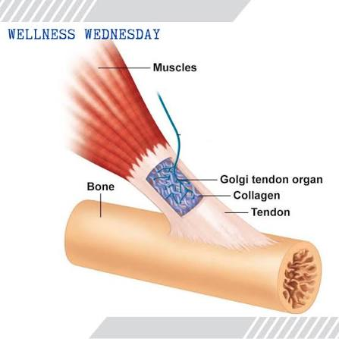

Slide 9
Origin and Insertion Technique (O and I)
Is a variation of the Golgi Tendon Organ release used when the tendon to be treated is short or it is used to reduce spasm and tone in a muscle when direct work on the muscle belly is uncomfortable.
the therapist thoroughly treats the origin of the muscle using either reinforced finger or thumb kneading.
Cross fiber and then with fiber strokes, like little plus signs, are made on the same location.
The therapist then moves several centimeters along the origin to repeat the technique, continuing to make plus signs along the entire origin.
The insertion is then treated in the same manner.
The rate is slow and the pressure is moderate to deep
Effects: O and I technique reduces muscle tone and spasm

Slide 10
Muscle Approximation
The muscle spindles are proprioceptive nerve receptors or minute sensory organs located in the muscle belly. Muscle spindles protect the muscle from being overstretched. This technique uses the reflex effect of muscle spindles to reduce tone or spasm in a muscle. Bringing the ends of the muscle closer together lessens the stretch on the muscle spindles. This decreases gamma firing and reduces muscle tone and spasm.
the therapist can either compress the origin and insertion onto the bony structures below, then use a pincer grasp on the muscle and bring the ends closed together. An average of 2 pounds of pressure is applied from each end towards the muscle belly.
It is held until the muscle relaxes
The rate is slow. The therapist does not slide over the surface of the skin.
The technique is primarily used on short muscles such as sections of the erector spinae group.
Effects: Muscle Approximation reduces muscle tone and spasm

Slide 11
Pressure Point Technique
Compression then release of painful tissue helps create a temporary local ischemia followed by reactive hyperemia. Once the pain cycle is broken, hypertonicity and spasm also diminish.
this technique is the gradual application of tolerable, static pressure to painful tissue. The pressure is maintained until the symptoms decrease or the muscle relaxes.
The rate is slow and pressure variable.
Effects: the pressure point technique helps to relax muscles and treat sinus congestion.

Slide 12
Cross Fiber Frictions
This technique is specifically intended to disrupt and break down existing and forming adhesions in muscles, tendons and ligaments using compression and motion. The therapists fingers or thumb do not slide over the skin, instead ,the superficial tissues are moved over the deeper ones.

Slide 13
The Cross Fiber Friction Technique
This technique is applied once the adhesion is located. This is often the most tender spot reported by the client. It is sometimes palpated as a different texture to the surrounding tissue
the pressure used is sufficient to penetrate the depth of the adhesion, while remaining within the clients pain tolerance.
Less pressure is required for more superficial or for a relatively fragile sub acute adhesion than a deep or tough chronic one.
When the appropriate depth of tolerable pressure is achieved, the therapist moves their finger back and forth at right angles to the fibers of the tissue.
The rate of movement is about 2 to 3 cycles per second.
Minute circular movements may also be used, although these are not as effective.

Slide 14
Initially the pressure is to the clients pain tolerance. After one or two minutes of treatment the analgesic effect occurs and the client will report that the area is less tender. If the tender ness has not subsided, or if the pain has increased, the technique is discontinued.
A subacute injury may respond in one or two minutes, while a chronic one may take over 2 minutes or longer. Longer applications cause bruising of the skin over the site and may be poorly tolerated by both the therapist and the client.
After frictions repetitive effleurage may be used to increase local circulation through the injury site and to decrease remaining pain perception.
Ice is used after frictions.
Effects: Cross fiber friction breaks down adhesions found in late subacute and chronic injuries.

Slide 15
Fascial or Connective Tissue Techniques
Connective tissue or fascia surrounds all muscles, muscle groups, bones and organs, holding them in place. Fascia is a continuous sheet of supportive tissue that envelops the entire body. It is strong yet mobile. It is oriented in a longitudinal direction, except for the layers covering the lower opening of the pelvis, the thoracic diaphragm and the junction of the thorax and cervical regions

Slide 16
Three categories of fascia
Superficial – lies just below the skin and is composed of loosely knit connective tissue combines with fat, vascular structures and nerve receptors. Is quite mobile and has the potential for the accumulation of tissue fluids and metabolites.
Deeper – denser, tougher and tighter. It compartmentalizes the body and surrounds the muscles and viscera, contributing to the body’s contours and function.
Subcutaneous – is a loose areolar tissue that covers the viscera. It supports the organs and provides lubrication so they may slide against each other.

Slide 17
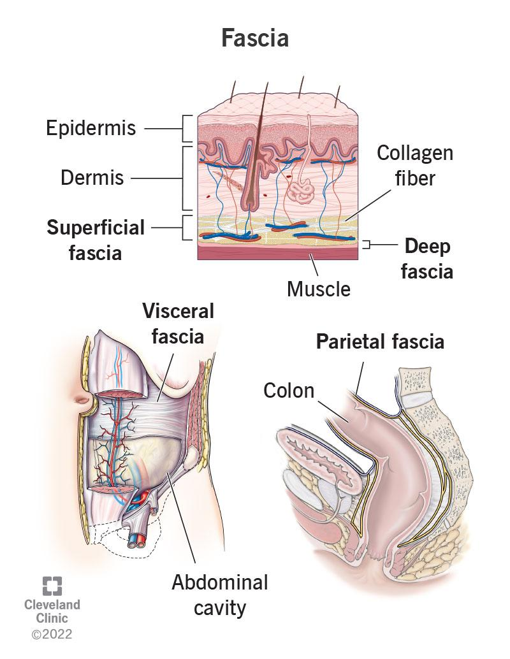

Slide 18
Fascial shortening, adhesions or restrictions due to inflammation, trauma, surgery, pathology or postural imbalances create abnormal tension patterns. Symptoms that appear unrelated may actually be transmitted from one body part to another through fascial imbalances.
with slow skin rolling , any resistance in the superficial fascia is noted.
With fascial glide, the therapists hands contact the skin and move or glide it over the deeper structures. The skin is moved on the cardinal planes, anteriorly, posteriorly, superiorly, inferiorly, laterally or medially. The pressure and direction of the glide vary depending on the fascia to be assessed.
With positional testing, the limb or body part is passively moved through its range until a barrier to motion is encountered. A fascial barrier occurs before a ligamentous or joint capsule barrier, which is called a capsular end feel.

Slide 19
Direct Fascial Techniques
Takes the fascia towards the restriction or adhesion. This engages the soft tissue barrier. The tissue is then carefully taken beyond the barrier, which breaks down the bonds between the connective tissue fibers. An example of intense, direct fascial techniques is a “rope burn” skin wringing.

Slide 20
Generally, direct techniques are based on the following concepts
the appropriate level of fascia is reached by applying pressure to the tissue. The amount of pressure varies with the depth of the fascia.
A stretch is placed on the fascia to be treated, which takes the elastic slack out of the tissue
The tissue is engaged by holding the stretch
The stretch is held for a period of time sufficient to break some of the bonds. Between the individual fibers of the connective tissue. A burning sensation is perceived by the client.
Several minutes may be required to achieve successful tissue release
Successful release is indicated by hyperemia, a palpable release of heat, decrease of pain or other symptoms and a softening or lengthening of the tissue.
Little or no lubricant is used as these techniques rely on tissue drag for their effects. The pressure is moderate to deep and the speed is slow.

Slide 21
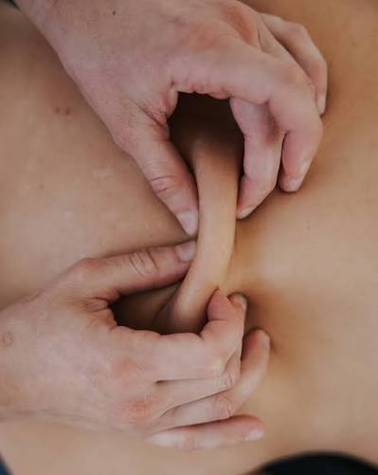
Skin Rolling
The thumbs are placed on the skin next to each other while the fingers grasp the skin forming a line. The fingers are pulled toward the thumbs, raising the skin between them from the underlying layer. The thumbs are slowly pushed away as the fingertips are “walking”over the skin. The rate is slow and the technique is performed in long sweeps.

Slide 22
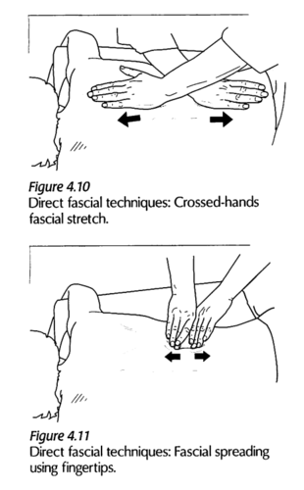
Fascial Spreading
The fingertips are placed on the skin at the required depth, them moved apart to take up the slack. The fingers continue to move apart, stretching the fascia between them.

Slide 23
Cutting Technique
The therapist fingers are held together then placed at the required depth. The tissue is engaged by pulling towards the therapist. The fingertips are pulled through the tissue towards the therapist in a cutting motion.

Slide 24
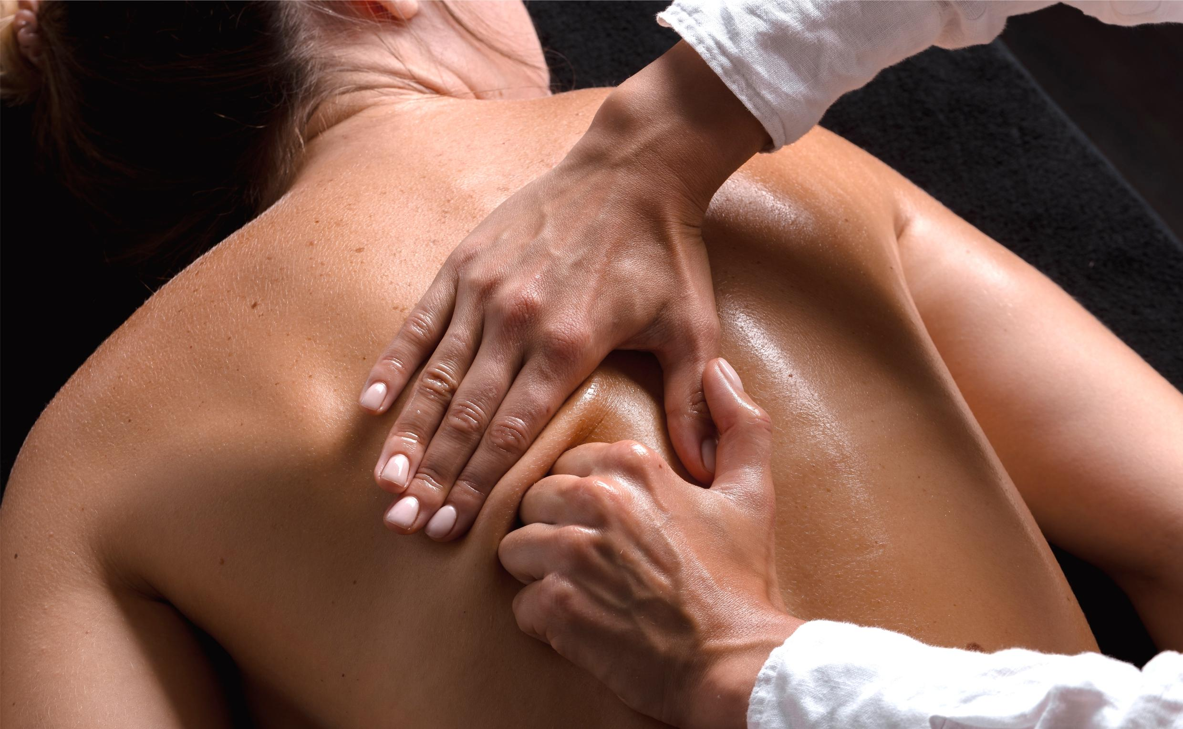
Fascial Torquing
The tissue is raised between the fingertips and thumbs of both hands to take up the slack, then pulled further off the underlying surface and twisted to engage it.

Slide 25
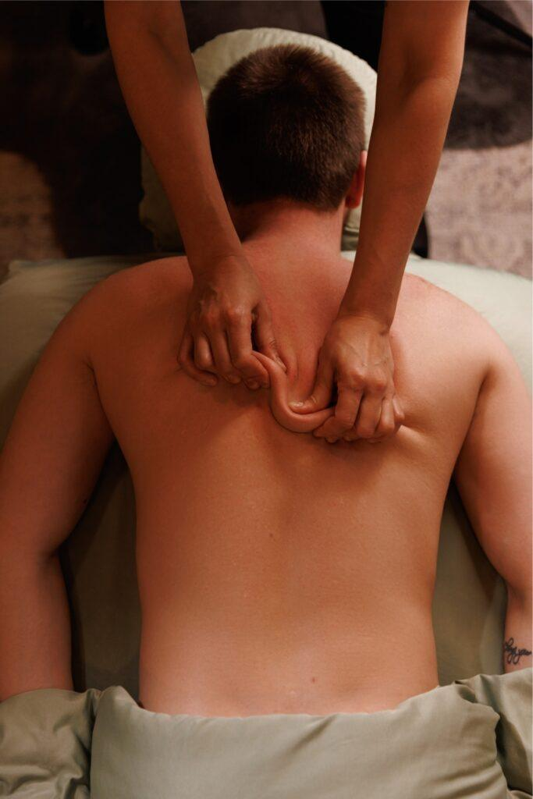
S-Bowing Fascial Technique
The thumbs are placed on the skin parallel to and pointing towards each other so when the thumbs are moved towards each other the fascia distorts in an s shape. If the same thumb position is used on a tendon it is called s bowing Golgi tendon organ release.

Slide 26
C-Bowing Fascial Technique
The thumbs are placed on the skin next to each other while the fingers grasp the skin forming a line. The fingers are pulled towards the therapist, with the little and ring fingers moving more than the index and middle fingers. At the same time the thumbs are pushed away from the therapist. Can also do a c-bowing golgi tendon release.
Another way to do this technique is to have one hand placed on the skin in a c shape. The fingertips of the other hand engage the skin so they point into the web between thumb and index finger on the first hand. The skin is distorted into a c shape.

Slide 27
J – Stroke
This is the deepest and most destructive direct fascial technique.
The therapist makes a fist and places it on the tissue with the proximal phalanges contacting the tissue. The knuckles are pulled towards the therapist and a j shape is pulled through the tissue
Effects: Direct fascial techniques increase the excursion and flexibility of fascia by moving it towards, then beyond, the restriction.

Slide 28
Connective Tissue Massage
This type of direct fascial massage includes techniques such as skin rolling and connective tissue cutting. Restrictions in the fascia are assessed with one application of skin rolling, then treated with repeated skin rolling until the restriction is gone. Repeated tissue cutting is also done until a release is felt.
Effects: connective tissue techniques reduce pain ad hypertonicity and increase local circulation, the autonomic nervous system is also affected.

Slide 29
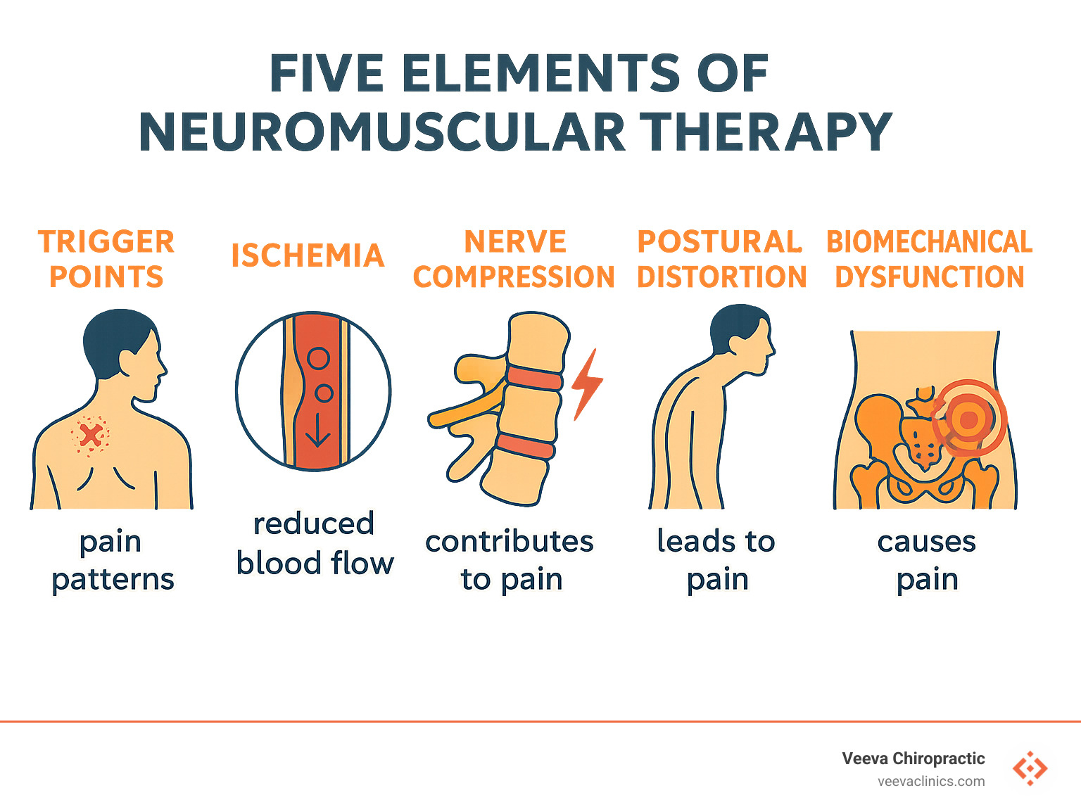
Neuromuscular Therapy
It is a system that treats regions of the body for structural imbalances that cause pain. The system incorporates fascial techniques with passive ROM, overpressure and stretching to lengthen tight or shortened tissues.
Effects: Neuromuscular therapy reduces pain, hypertonicity and postural dysfunctions, and lengthens and strengthens tissues.

Slide 30
Indirect Fascial Techniques
Are thought to unhook the connective tissue. The therapist moves the tissue in the direction it will move most easily, the slack of the fascia is taken up, the fascia is then held in this position as the tissue attempts to return to its original position. As the tissue stops resisting the therapists pressure further slack will develop. This slack is taken up again holding until more slack develops. This process is repeated through several cycles. Until a tissue release is felt.
Effects: Indirect fascial techniques increase the excursion and flexibility of fascia by moving it in the direction of ease, usually opposite the restriction.

Slide 31
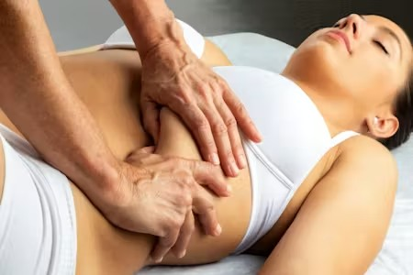
Visceral Manipulation
Healthy viscera should be able to slide over each other as the person breathes and moves.
Visceral manipulation consists of assessment for visceral motion and direct or indirect fascial techniques to treat any dysfunctions found and restore normal visceral motion.
Effects: Visceral manipulation restores the motion and function of affected viscera.

Slide 32
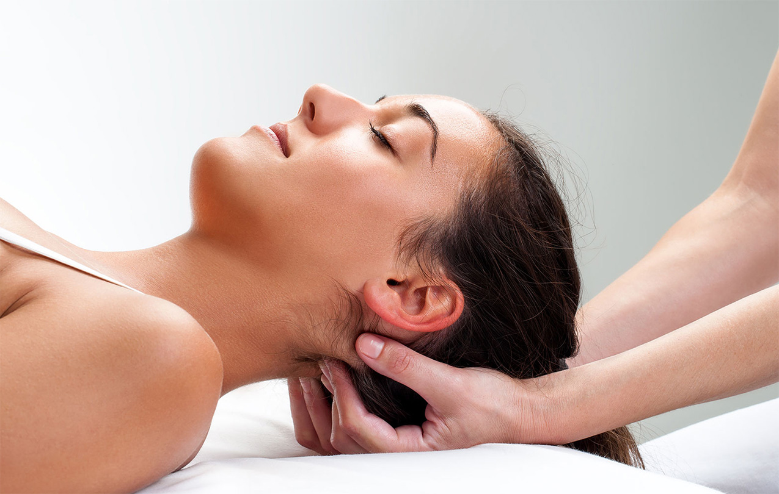
Craniosacral Therapy
The cranial bones have subtle, identifiable and patterned motions that are allowed by the cranial sutures. This motion is a result of fluctuations in the production and flow of cerebrospinal fluid (CSF) which is contained within the meninges- cranial membranes- and bathes the brain and spinal cord. These membranes containing the brain, spinal cord and cerebrospinal fluid form a semiclosed hydraulic system. These CSF fluctuations have an effect on the meningis and the cranial bones. As fascia throughout the body is interconnected, the craniosacral rhythm is palpable in connective tissue throughout the body as well as through the cranial bones and sacrum.

Slide 33
The rhythm consists of 2 movements, called cranial flexion and extension. In flexion(expansion) which is active, there is a subtle, palpable increase in the width of the skull and body. The limbs move into a subtle external rotation. In extension (relaxation), which is passive, the opposite occurs. There is a subtle narrowing of the head and body and the limbs move into internal rotation.
This rhythm occurs at a rate of 6 – 12 cycles per minute.
both indirect and direct fascial techniques are used.
The pressure for many of the techniques is light - 5 grams and the rate is slow.
Tissue drag is required so no lubricant is used.
Effects: craniosacral therapy is used to treat chronic pain, visceral dysfunctions, headache and temporomandibular joint dysfunction.

Slide 34
Myofascial Release
Combines soft tissue, craniosacral and muscle energy techniques.
These slow and subtle techniques can be used to release fascia and muscle throughout the body. The tight –loose concept is an integral part of myofascial release. Tightness creates shortness, compression and therefore asymmetry in the tissue. Looseness in another area permits this asymmetry
techniques include light to moderate traction, range of motion, appropriate tension and twisting action to achieve biomechanical and reflex changes.
Effects: myofascial release techniques reduce painful soft tissue dysfunctions.

