Slide 1
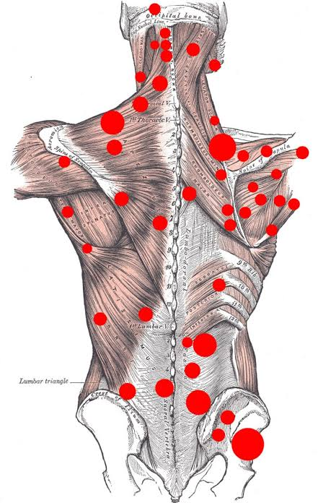
Trigger Points

Slide 2
Definition:
A hyperirritable spot, usually within a taut band of skeletal mm
Sensitive to touch and pressure
Often exhibits a predictable pain referral pattern
Causes shortening of the affected mm
Note: Healthy mm DOES NOT contain TPs
Can also occur in ligaments, JT capsules, periosteum and
fascia
Referral patterns are not extensively documented for
the above
Company Name
Date

Slide 3
Types of Trigger Points
Symptom
  Active Trigger Point
  Latent Trigger Point
Location
  Primary
  Secondary
  Satellite
Company Name
Date

Slide 4
A1. Active Trigger Point
Pnful at rest
Pnful with active/passive mov’ts/stretches of the mm containing it
Refers pn in a pattern that is usually specific and predictable for that mm
TPs prevent the mm from lengthening and decreases its strength
  Protective spasm will occur to prevent further damage by preventing lengthening
Palpation can elicit a local twitch response
Palpation can also cause mm to contract
Palpation may produce referred Autonomic Phenomenon
  Vasomotor changes(constriction followed by dilation)
  Increased sudomotor activity (sweating)
  Pilomotor response (goosebumps)
  Lacrimation (tears)
  Nasal discharge/irritation
Company Name
Date

Slide 5
A2. Latent Trigger Point
- Produces pn only when pressure applied
- May have all the other characteristics of an active TP
- More common
- May persist for yrs after original trauma
- Can become ACTIVE IF:
- Activated by referred pn
- Overuse of mm
- Over stretch of mm
- Chiling of mm
- Leaving mm in a shortened position for several hrs
ie. sleep/road trip/plane

Slide 6
B1. Primary Trigger Point
Directly activated by acute or chronic mechanical strain or overload of affected mm
B2. Secondary Trigger Point
Activated in the overworked synergist or antagonist mm
B3. Satellite Trigger Point
Found in mm that lies within the referral pattern of another TP

Slide 7
Effects of Trigger Points
Shortens affected mm
Can mimic the pain of other conditions, OA, tendonitis, cardiac pain
A healthy mm
  Does not contain TP’s
  No taut bands
  Not tender
  Reffered pain cannot be evoked and local twitch response is absent

Slide 8
Origin of a Trigger Point
TP’s are idiopathic in nature
  Mechanisms that cause TP’s are not fully understood
Janet Travell’s theory is that an initial trauma to the mm overloads some of the mm fibers which leads to the development of TP’s
Travell theorized that:
  Active TP’s develop in the most physically active years of life
  Latent TP’s develop in the more sedentary or later years of life

Slide 9
Activating a Trigger Point
Travell believed that an initial trauma gave rise to the development of a TP and that direct and indirect stimuli can activate a trigger point
Direct Stimuli:
- Trauma
- acute mm overload
- overwork
- fatigue
- chilling of the mm
Indirect Stimuli:
Referred pain from other TP
Emotional stress
Visceral pain

Slide 10
Perpetuating Factors
Mechanical Stresses
  Bony asymmetries that indirectly or directly shorten mm’s
    Leg length discrepancy
    Small hemipelvis
Postural Stresses
  Poor posture
  Mm immobilities
  Poor body mechanics *
Muscle Constriction
  Back packs
  Sports bras
  Sport equipment

Slide 11
4. Nutritional inadequacies
  Vitamin b
  Vitamin c
  Folic acid
5. Metabolic Inadequacies
  Hyperthyroidism
  Hypothyroidism
6. Psychological Factors
  Depression
  Anxiety
7. Chronic Infections
  Viral Infections
  Bacterial Infections
8. Impaired Sleep
  Can lead to anxiety and increased mm tension, fatigue

Slide 12
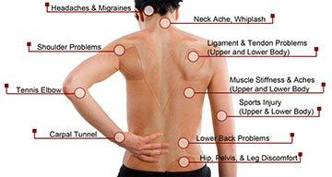
The more perpetuating factors a person has, or the more severe the perpetuating factors, the increased probability of a latent trigger point becoming active

Slide 13
How to Recognize a Trigger Point
Sensitivity of a TP can change over several hours/days
Passively stretching the mm causes pain
Contraction of the affected mm can be painful
Shortening and hypertonicity of the affected mm occurs, therefore; decreasing ROM
Mm weakness is present without mm atrophy or neurological deficit
Perpetuating factors may be present
Possible autonomic factors
Feels like a nodule
Pain can be described as achey, deep, and constant

Slide 14
Health History Questions
Clients general health?
Previous acute or overuse injury to the affected mm?
Pain?
Describe, onset, location, aggravate/alleviate
Are any autonomic Sx present?
Was the mm in a shortened state for a long time?
Is mm stiffness, weakness, decreased ROM present?
Are there any perpetuating factors present?

Slide 15
CI’s
DO NOT apply ischemic compression too quickly or too deep
Do not release too quickly
Do not forget to apply either a passive stretch and heat OR slow full active free ROM and heat after treating TP
When treating TP’s that are proximal to an area of acute inflammation, DO NOT use heat
  For acute inflammation, use EFF to increase flushing
DO NOT treat TP’s in areas of Acute or early Subacute overstretch injuries (strain or sprain)
Avoid prolonged chilling of a mm containing a TP
DO NOT ice a TP
Avoid combining aggressive techniques on the same mm in the same Tx
  Friction + TP work = too much stress on mm
DO NOT fully stretch mm’s that cross hypermobile joints
  Use mm stripping and heat

Slide 16
Other Considerations
Reassess mm length after tx of TP’s
Treat any secondary TP’s in synergists or antagonist that may refer pain into the same region
If there are multiple trigger points, do not over treat
  Treat TP in area of Primary complaint
  Treat others next Tx

Slide 17
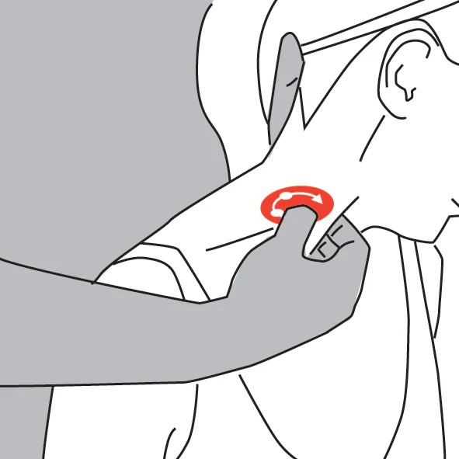
Tx of Trigger Points
Put mm into a slight stretch (pain free)
Locate TP using skin rolling or palpation or pincer grasp (mm belly between thumb and fingers)
Use one or more of the following techniques;

Slide 18
Prolonged Ischemic Compressions
  Most specific technique
Reinforced finger or thumb pressure is slowly applied to the TP, keep pain tolerance at client’s level
  For deeper muscles, elbow can be used
  Do not apply pressure to fast as client will experience pain and guard the muscle
Appropriate pressure is maintained until the TP reduces
  20 seconds – 1 minute
  as it reduces, TP will feel like it is melting
  client will feel the pain diminish
  communicate with client – client is to let therapist know when pain diminishes
Compression will slowly be released
Repetitive petrissage is used to flush the area
Follow with heat and stretch
If the pain does not diminish, MT may slowly increase pressure until client’s tolerance is reached again, holding for appropriate amount of time, or until the pain diminished (Repeat 1-4)
Deep breathing should be encouraged
If TP moves, follow it
If TP does not release after 1 minute, flush area appropriately and treat TP next Tx

Slide 19
Slow, Repetitive muscle stripping
  Pressure begins superficial, and slowly deepens
  Performed along the entire length of the taut band of muscle
Alternating Ischemic Compressions
  Used for TPs that are too painful for prolonged ischemic compressions
  Use reinforced fingers or thumbs
Apply pressure for 7-10 seconds
Release
Cycle through 1-2, pain should diminish with every application
Apply repetitive eff, and pet between compressions
May take several Tx’s to decrease TP’s

Slide 20
Expected Outcome
Outcome depends largely on eliminating any perpetuating factors
Time of onset affects outcome
  A TP is more likely to be decreased if Tx’d shortly after development
  A TP that is months or years old may take several tx’s to eliminate
Client compliance with self-care greatly affects outcome
  Along with eliminating perpetuating factors

Slide 21
Tx Frequency
Fiona Rattray says…
  1 or 2 TP’s
    TP may be eliminated in a general Tx
  Multiple or hyperirritable TPs
    30 min sessions 2-3x per week

