Slide 1
General Principles and Techniques 1

Slide 2
More in depth look at…
Contraindications
Chapter 13, pg 147 - Rattray
Def’n -
Sign, symptom or circumstance that makes a particular treatment (massage) inadvisable
Why? What is the Importance? How is it going to be relayed to you by the client?
Understand Changing Landscape – ie. Concussions, medical breakthroughs etc.
Keep yourself educated, newspaper, journals, etc. “I don’t know” is not a good excuse!

Slide 3
Review of Terms and Categories…
Absolute = NO
Modified = CAUTION
General = whole body
Local = Specific Area

Slide 4
Medications
Pharmacology
Why important?
- alter stretch response of muscles - mental state
- alter pain sensations - affects on cardiovascular system
- affect skin
- temperatures

Slide 5
Acute Conditions requiring medical attention
Anaphylaxis – severe allergic reaction
Appendicitis – possibility of becoming septic if bursts
CVA – Stroke
  “FAST” - Facial drooping - arm weakness - speech difficulties - time to call ems
Diabetic Coma or Insulin Shock
MI – Heart Attack
Pneumothorax – air in pleural space, unilateral, sharp shooting P, shortness of breath
Atelectasis – collapsed lung
Severe Asthma Attack – severe shortness of breath,
Status asthmaticus – acute exacerbation of asthma, unresponsive to bronchodilators
Acute seizure
Syncope – (fainting)
Massage cannot, and will not help in this instance!

Slide 6
Absolute treatments for General Conditions
Absolute – No!
- exceptions
General – Whole body, affects your overall treatment plan

Slide 7
Acute Pneumonia
Infection of the lung tissue that can affect the exchange of gases
Reason:
  Don’t want to overload the immune system

Slide 8
Eclampsia
Sudden convulsive seizure without loss of consciousness, especially during pregnancy
Associated with high blood pressure
Often under medical supervision

Slide 9
Post – CerebroVascularAccident , unstable
Sudden decrease of blood supply to areas of the brain
Reason
  Possible reoccurrence

Slide 10
Severe Atherosclerosis
Fatty substances in the inner lining of the medium and large arteries
Decreases the size of the arterial lumen
Reason
  Massage will increase circulation
  Circulatory system will be overloaded

Slide 11
Headaches – severe, undiagnosed
If described as “pain like I’ve never felt”
May have a serious underlying cause requiring immediate attention
Ex
  Stroke
  Meningitis
  Aneurysm

Slide 12
Hypertension – severe, unstable
High BP
May have serious underlying cause that requires medical attention
Massage will increase circulation

Slide 13
Hemophilia
Hereditary bleeding disorder cause my a deficiency of the specific clotting factor in the blood
Pressure can cause vessels to rupture

Slide 14
Hemorrhage
Escape of blood from ruptured blood vessels
Loss of blood

Slide 15
Shock
Failure to deliver adequate oxygen and nutrients to the body
Medical emergency that can be fatal

Slide 16
Fever 38.5C/101.5 F
Abnormally high body temperature
A serious underlying cause may be present
  Infection
  Tumors
  MI

Slide 17
Cancer – increased metastatic
Uncontrolled growth of cells that spread from one part of the body to another
Increased circulation, will spread
*palliative care*

Slide 18
Modified treatments for General Conditions
Modified - Massage is ok, with CAUTION
General – Whole body, affects your overall treatment plan

Slide 19
Fibromyalgia
Description:
chronic condition, musculoskeletal pain
All individuals experience different degrees of pain
Reason:
Symptoms change on a day to day basis
communication is key

Slide 20
Diagnosed Atherosclerosis
Description:
Systemic disease affecting the ARTERIES, characterized by NARROWING of the large and medium sized arteries due to accumulation of LIPIDS
Reason:
Refrain from extreme temps
Refrain from hydrotherapy that will increase circulation

Slide 21
Hypertension
Description:
Increased/high blood pressure
Reason:
Refrain from extreme temps
Refrain from hydrotherapy that will increase circulation

Slide 22
Hypotension
Description:
decreased/low blood pressure
Reason:
Refrain from extreme temps
Caution with Body positioning
  Speed of rolling over, getting off table

Slide 23
Drug withdrawal
Reason:
Doctors referral would be beneficial
Understanding of the drug would be beneficial, to understand how it affected their body
  Alcohol
  Marijuana
  Stimulants
  Opiates
  etc
Symptoms can change, and are different for every individual

Slide 24
Inflammatory Arthritides
Description:
Blanket term for conditions of inflammation in the joints
  Rheumatoid Arthritis (RA)
  Systemic Lupus Erythmatosus
  Gout
  Pseudo-Gout
  Ankylosing Spondilitis
  Psoriatic Arthritis
  Osteomyalitis
Reason:
Symptoms are different for individuals
Location of the body
Flare-up?

Slide 25
Major Surgery or Abdominal Surgery
Major by medical terms? Or to Client? There’s a difference
What kind of surgery?
Where?
Why?
What were the doctor recommendations?
Reason:
Positioning on table
Depth of pressure
Meds?

Slide 26
Diabetes
Chronic disease, body does not/has difficulty producing insulin (Type 1), or is not using the insulin it does produce properly (Type2)
Reason:
Understand symptoms or diabetes (can lead to absolute generals/locals)
Caution with extreme temperatures

Slide 27
Osteoporosis
Disorder where bone reabsorption is higher that bone formation, resulting in decreasing bone mass
Reason:
Symptoms for individual
Caution with pressure, especially directly on bone

Slide 28
Osteomalacia
Description:
Softening of the bones
Reason:
Individual symptoms

Slide 29
Post-CVA or MI
Description:
Period of time after some has experienced either cerebrovascular accident or myocardial infarction
Reason:
Rx’s
How much time between? Doctor ok’d
Temperature extremes
Circulatory effects

Slide 30
Seizure Disorders
Reason:
Know triggers, to avoid them

Slide 31
Absolute treatments for LOCAL Conditions
*some of these conditions are the same for other CI categories… consider the stage… Acute… and consider location

Slide 32
Inflammatory Arthritides – acute flare up
Refer to slide 25 for def’n
Reason:
In an acute stage, may exacerbate symptoms

Slide 33
Neuritis – Acute
Inflammation of the nerve
Reason:
Exacerbate pain

Slide 34
Trigeminal Neuralgia - ACUTE
Chronic pain disorder that affects the trigeminal nerve.
Reason:
Exacerbate Symptoms

Slide 35
Aneurysm - acute
Reason:
Result in rupture, extensive bleeding, and death

Slide 36
Deep Vein Thrombosis (DVT)
Formation of a clot in a deep vein of the body, most often in the femoral and iliac veins
Reason:
Requires medical evaluation
Massage treatment can dislodge thrombus ---> embolus

Slide 37
Arteritis
Inflammation of an artery, most likely due to autoimmune response
Reason:
Aggravate condition

Slide 38
Thrombophlebitis
Inflammation of a superficial or deep vein that leads to the formation of a thrombus
Reason:
Requires medical attention

Slide 39
Ectopic Pregnancy
Implantation of the fetus, outside the uterine cavity
Reason:
Requires medical attention and monitoring
NO ab massage

Slide 40
Esophageal Varicosities
Presence of dilated and tortuous veins in the esophagus
Reason:
Possible rupture of veins, can cause severe bleeding that can be fatal

Slide 41
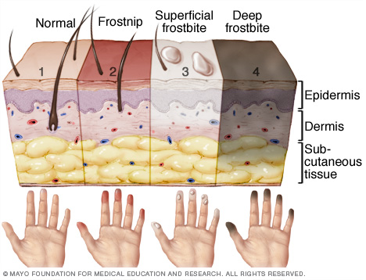
Frostbite
Know what it looks like!
Reason:
Tissue is fragile
Mx can cause further damage

Slide 42
Local contagious conditions – warts, athlete’s foot
Reason:
Massage can spread condition to an unaffected area, much like scratching

Slide 43
Local Irritable skin conditions
psoriasis or eczema with open lesions
Reason:
May exacerbate Symptoms

Slide 44
Malignancy
Abnormal formation of tissue that grows at the expense of the healthy organism
Reason:
Possibility of spreading with Massage manipulations

Slide 45
Open Wound
Reason:
Infection
Fragile tissue

Slide 46
Radiation Therapy Site
Reason:
Tissue is fragile

Slide 47
Recent Burn
Includes sunburn
Reason:
Can cause blistering even with light pressure

Slide 48
Sepsis/Septicemia
Reason:
Numerous accompanied Symptoms with sepsis
Risk of spreading

Slide 49
Undiagnosed Lump
Reason:
Requires medical evaluation

Slide 50
Varicosities
Abnormally dilated and tortuous veins that can result in stagnation of the blood which tends to promote thrombi formation
*first time C’s, refer to MD for ok*
Reason:
If a thrombus is present, Massage can dislodge

Slide 51
Open Wound
Reason:
Infection
Fragile tissue

Slide 52
MODIFIED treatments for LOCAL Conditions

Slide 53
Abdominal Disease (chronic)
Ex. Inflammatory bowel disease, Irritable Bowel Syndrome
Reason:
Symptoms?
Triggers?
Current flare up?

Slide 54
Abortion (recent)
The spontaneous or induced expulsion of the products of conception for the uterus before 20 weeks of pregnancy
Reason:
Cause?
Symptoms
NO AB work, or Low Back work for ~6 months, not unless otherwise stated by MD

Slide 55
Aneurysm
brain (cerebral) aneurysm is a bulging, weak area in the wall of an artery that supplies blood to the brain
No symptoms, can go unnoticed for quite some time.
Location, how long has it been present?
MD Prescribed meds?
No aggressive work.

Slide 56
Chronic Arthritic Conditions
What are the C’s Symptoms?
Cause? Trauma? Overuse?
Condition?
Caution with extreme temperatures for Hydrotherapy

Slide 57
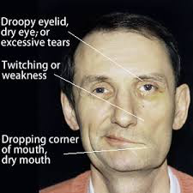
Bell’s Palsy
Disease of the 7th cranial nerve (facial nerve), results in paralysis of one side of the face.
Symptoms can very
Due to paralysis, sensation loss

Slide 58
Buerger’s Disease
An inflammatory disorder of the medium sized arteries of the legs and arms, can result in thrombus formation.
Caution with extreme temperatures

Slide 59
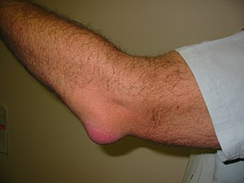
Bursitis
Inflammation of a bursa
What is a bursa?
A small fluid filled sac lined by synovial
membrane that provides a cushion
between bones and tendons and/or muscles around a joint.
Use light pressure
Principle! Peripheral – Central – Peripheral

Slide 60
Constipation - prolonged
Difficulty passing stool
Cause?
Symptoms?
Rebound test, if positive, DO NOT MASSAGE!

Slide 61
Diarrhea
Frequent, sometimes uncontrolled passing of loose modified stool
Cause?
Symptoms?

Slide 62
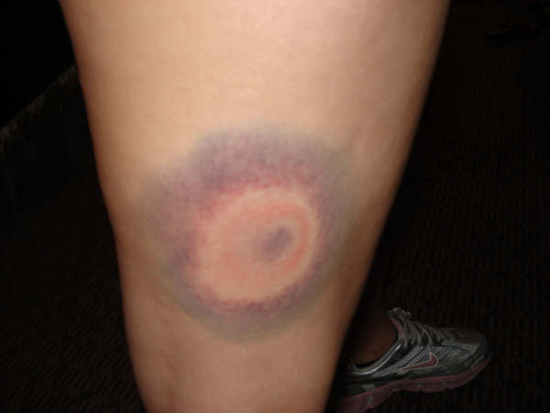
Contusion
Bruise
Size?
Stage of healing?
Work within C’s pain tolerance

Slide 63
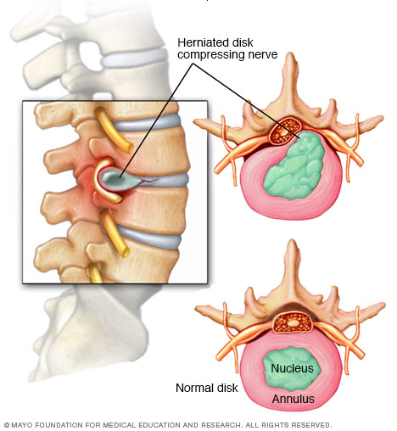
Acute Disc Herniation
Intervertebral disc injury that results in the rupture of the annular fibers
Severity?
Symptoms?
Cause?

Slide 64
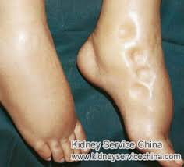
Edema - pitted
Abnormal local or general accumulation of fluid in the tissues of the body
Split finger depression test
Cause?
No deep work, focus on
drainage

Slide 65
Endometriosis
Condition in which the endometrial tissue is found in areas outside of the uterus
Symptoms?
Severity?

Slide 66
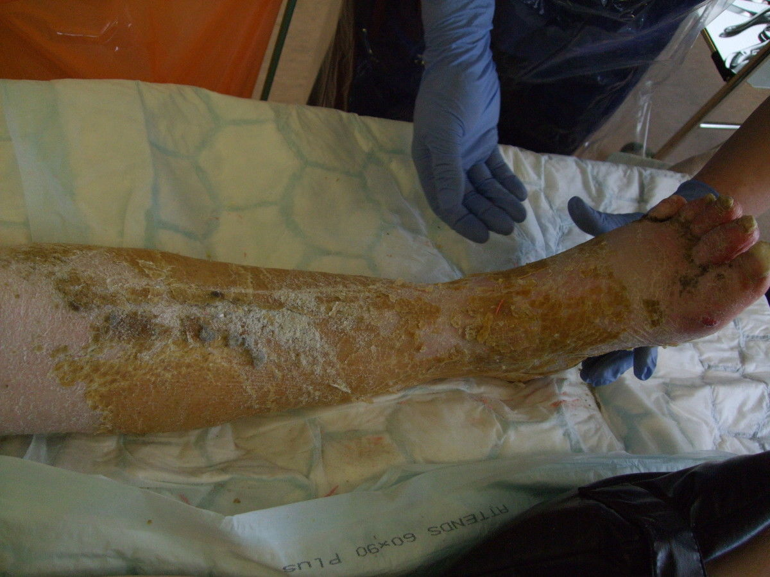
Fracture
Casted, removed, decreased mm tone
Tissue is fragile

Slide 67
Adhesive Capsulitis
Aka. Frozen shoulder
Initially painful, significant restriction of active and passive ROM in the shoulder
Stage?
Pain tolerance?

Slide 68
Hematoma
Coagulated blood located outside of a blood vessel
Size?
Symptoms?
Cause?
Stage of healing?

Slide 69
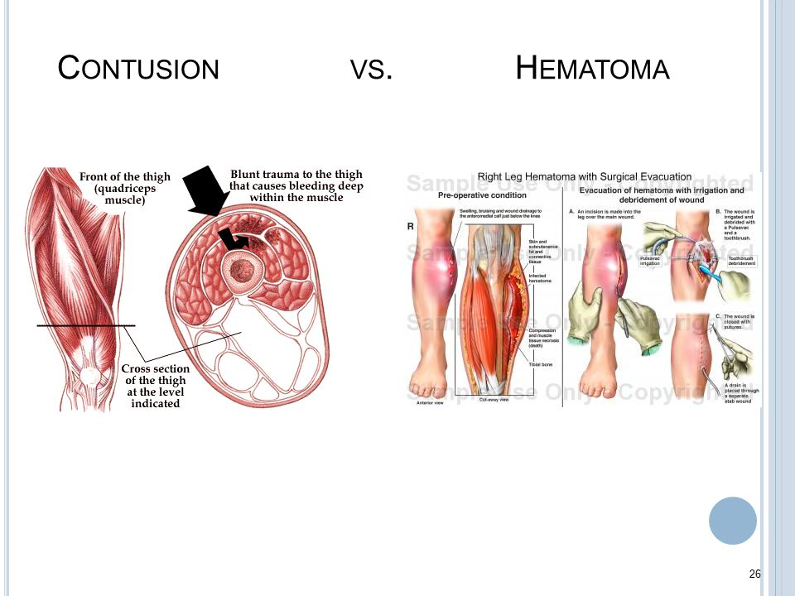

Slide 70
Hernia
Protrusion of a part of an organ or the entire organ through an abdominal opening in the structure that normally contains it, such as the abdominal wall
Symptoms?
Cause?
MD recommendations?
Positions? Can C lay prone?
Comfort?

Slide 71
Inflammatory Bowel Disease
Used to refer to both Crohn’s Disease (inflammation of parts of the GI tract, resulting in scarring) and Ulcerative Colitis (inflammation of the large intestine resulting in lesions of broad areas)
Symptoms?
Severity?
Flare up?

Slide 72
Irritable Bowel Syndrome (IBS)
*flare up*
Characterized by altered bowel function and steady, or intermittent pain
Symptoms?
Cause?
Severity of Pain?

Slide 73
Injection Site
Reason:
Know what area of the body injection is
Why?
For what condition?

Slide 74
Joint Instability/Hypermobility/hypomobility
Joint/s affected?
Which muscles cross joint/s?
Cause?
Pain tolerance?

Slide 75
Lymph Edema
Chronic accumulation of interstitial fluid in the tissues
Cause?
Degree of edema?

Slide 76
Kidney Infection/Stones
Cause?
Degree?
Any Rx?
Ass’d symptoms? Back pain? UTI?

Slide 77
Mastitis
Inflammation of the breast, most common when breast feeding
Severity?
Pain?
Position?

Slide 78
Migraine
Throbbing pain in the head, more severe than a headache
Pain? Type? Where on head?
Triggers?
Sensitivities? Music, photosensitive, scents….

Slide 79
Flaccid Paralysis
Defective, or absent muscle control cause by a nerve lesion
Severity

Slide 80
Pelvic Inflammatory Disease
Inflammation of the organs in the pelvic cavity, usually caused by bacteria
Symptoms?
Rx’s?

Slide 81
Raynaud’s Disease & Phenomenon
Intense spasms of the arteries and arterioles that supply the hands (and sometimes feet). Phenomenon is progressive, and tissue damage is likely to occur.
Symptoms?
Severity?
Rx?

Slide 82
Stress Fracture Site
Small crack in a bone
No deep pressure techniques

Slide 83
Surgery (minor)
Reason:
Type? Location? Why?
Be mindful of client positioning
Remember principles of massage

Slide 84
Temporo-Mandibular Joint Dysfunction
A collection of signs and symptoms produced by TMJ Dysfunction
Reason:
Cause?
Symptoms?

Slide 85
Thrombosis (chronic)
Presence of a stationary clot
Reason:
No heavy, deep work
Inc circ techniques
May dislodge clot

Slide 86
Torticollis (spasmodic)
Abnormal positioning of the head and neck relative to the body characterized by involuntary twitching of the affected muscles and shoulder
Reason:
Stage of healing?
No deep work

Slide 87
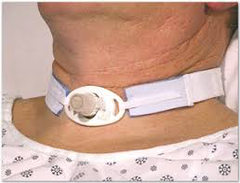
Tracheotomy Site
Reason:
Positioning of client

Slide 88
Trigeminal Neuralgia (between attacks)
Chronic pain disorders of the trigeminal nerve.
Reason:
symptoms

Slide 89
Vaginal Birth (recent)
Reason:
Hormones involved with pregnancy
Make changes in pressure with low back work,

Slide 90
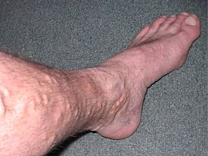
Varicosities (Mild)
Reason:
Light pressure
Severity
Pain

