Slide 1
Urinary System Pathologies

Slide 2
Introduction
The urinary system consists of the kidneys, ureters, urinary bladder, and urethra. The kidneys filter the blood to remove wastes and produce urine. The ureters, urinary bladder, and urethra together form the urinary tract, which acts as a plumbing system to drain urine from the kidneys, store it, and then release it during urination. Besides filtering and eliminating wastes from the body, the urinary system also maintains the homeostasis of water, ions, pH, blood pressure, calcium and red blood cells.

Slide 3
Urinary System Anatomy
The kidneys are a pair of bean-shaped organs found along the posterior wall of the abdominal cavity. The left kidney is located slightly higher than the right kidney because of the presence of the liver in the upper right side of the abdominal cavity.
The kidneys, unlike the other organs of the abdominal cavity, are located posterior to the peritoneum and touch the muscles of the back - this is described as retroperitoneal.
The kidneys are surrounded by a layer of adipose that holds them in place and protects them from physical damage.
The kidneys filter metabolic wastes, excess ions, and chemicals from the blood to form urine.

Slide 4
Ureters
The ureters are a pair of tubes that carry urine from the kidneys to the urinary bladder. The ureters are about 10 to 12 inches long and run on the left and right sides of the body parallel to the vertebral column.
Gravity and peristalsis of smooth muscle tissue in the walls of the ureters move urine toward the urinary bladder. The ends of the ureters extend slightly into the urinary bladder and are sealed at the point of entry to the bladder by the ureterovesical valves. These valves prevent urine from flowing back towards the kidneys.

Slide 5
Urinary Bladder
The urinary bladder is a sac-like hollow organ used for the storage of urine. The urinary bladder is located along the body’s midline at the inferior end of the pelvis.
Urine entering the urinary bladder from the ureters slowly fills the hollow space of the bladder and stretches its elastic walls. The walls of the bladder allow it to stretch to hold anywhere from 600 to 800 milliliters of urine.

Slide 6
Urethra
The urethra is the tube through which urine passes from the bladder to the exterior of the body. The female urethra is around 2 inches long and ends inferior to the clitoris and superior to the vaginal opening. In males, the urethra is around 8 to 10 inches long and ends at the tip of the penis.
The flow of urine through the urethra is controlled by the internal and external urethral sphincter muscles. The internal urethral sphincter is made of smooth muscle and opens involuntarily when the bladder reaches a certain set level of distention. The opening of the internal sphincter results in the sensation of needing to urinate. The external urethral sphincter is made of skeletal muscle and may be opened to allow urine to pass through the urethra or may be held closed to delay urination.

Slide 7
Blood & Nerve Supply of the kidney
The renal arteries branch off of the abdominal aorta and supply the kidneys with blood. Due to the position of the aorta, the inferior vena cava, and the kidneys in the body, the right renal artery is normally longer than the left renal artery. The renal arteries carry a large portion of the total blood flow to the kidneys; up to a third of the total cardiac output can pass through the renal arteries to be filtered by the kidneys.
Renal blood supply starts with the branching of the aorta into the renal arteries and ends with the exiting of the renal veins to join the inferior vena cava. The renal arteries split into several segmental arteries upon entering the kidneys.

Slide 8
Continued
Each segmental artery splits further into several interlobar arteries and enters the renal columns, which supply the renal lobes. The interlobar arteries split at the junction of the renal cortex and medulla to form the arcuate arteries. The arcuate arteries form arcs along the base of the medullary pyramids. Cortical radiate arteries, as the name suggests, radiate out from the arcuate arteries. The cortical radiate arteries branch into numerous afferent arterioles, and then enter the capillaries supplying the nephrons.
The renal veins are the veins that drain the kidneys and connect them to the inferior vena cava. The inferior vena cava is on the right half of the body, and as such, the left renal vein is generally the longer of the two. Unlike the right renal vein, the left renal vein often receives the left gonadal vein (left testicular vein in males, left ovarian vein in females). It frequently receives the left suprarenal vein as well.

Slide 9
Continued
The kidney and nervous system communicate via the renal plexus, whose fibers course along the renal arteries to reach each kidney. Input from the sympathetic nervous system triggers vasoconstriction in the kidney, thereby reducing renal blood flow. The kidney also receives input from the parasympathetic nervous system, by way of the renal branches of Vagus nerve (Cranial nerve X).
Sensory input from the kidney travels to the T10-11 levels of the spinal cord and is sensed in the corresponding dermatome. Thus, pain in the flank region may actually be referred pain from the corresponding kidney.

Slide 10
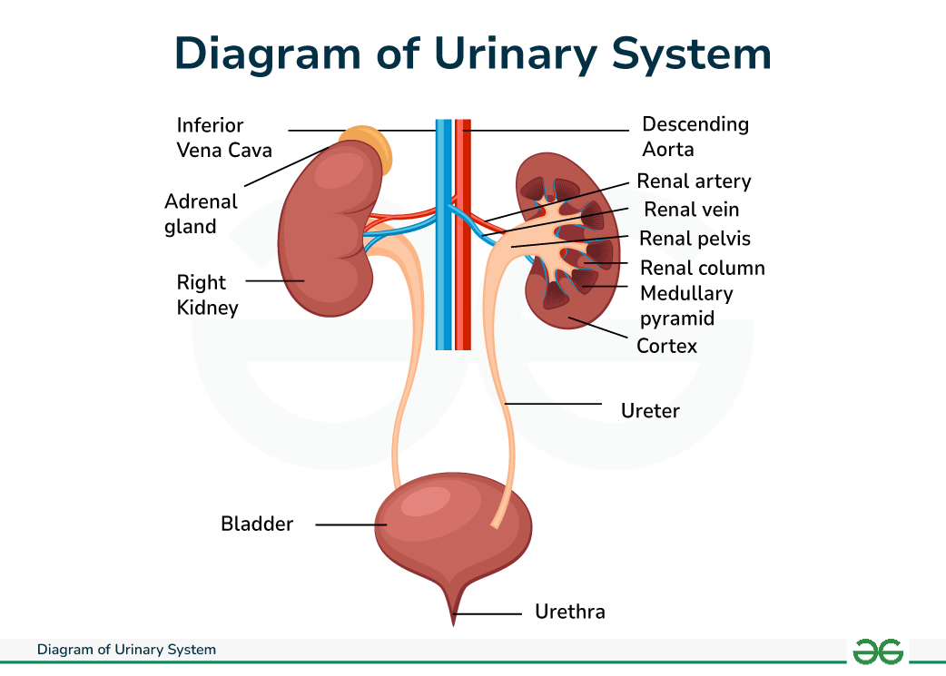

Slide 11
Urine Formation
urine
  A liquid excrement consisting of water, salts, and urea, which is made in the kidneys then released through the urethra.
glomerulus
  A small, intertwined group of capillaries within nephrons of the kidney that filter the blood to make urine.

Slide 12
Continued
The process of urination is essential for the removal of certain waste products from the body to keep it healthy. Most of us have probably never thought of urine as something of value; but we could not survive if we did not (a) produce it and (b) eliminate it.
Urine is composed of water, certain electrolytes, and various waste products that are filtered out of the blood system. As the blood flows through the body, wastes resulting from the metabolism of food and nutrients in the body cells are deposited back into the bloodstream, and this waste must be disposed of in some way. A major part of this "cleaning" of the blood takes place in the kidneys and, in particular, in the nephrons, where the blood is filtered to produce urine.

Slide 13
Continued
Both kidneys carry out this essential blood-cleansing function. Normally, about 20% of the total blood pumped by the heart each minute will enter the kidneys to undergo filtration; this is called the filtration fraction. The remaining 80% of the blood flows through the rest of the body to service the various nutritional, respiratory, and other needs that are ever present.
In order to produce urine, the two million or more nephrons (about a million in each kidney) form urine by three precisely-regulated processes: filtration, reabsorption, and secretion.
During filtration, blood enters the afferent arteriole and flows into the glomerulus where filterable blood components such as water and nitrogenous waste will move towards the inside of the glomerulus, and non filterable components such as cells will exit via the efferent arteriole. These filterable components accumulate in the glomerulus to form the glomerular filtrate.

Slide 14
Continued
The next step is reabsorption, during which molecules and ions will be reabsorbed back into the circulatory system. What remains in the glomerulus after this process has taken place is known as the tubular fluid and this is what will pass through to the collecting duct to form urine.
During secretion, some substances such as hydrogen ions, creatinine, and drugs will be removed from blood through the peritubular capillary network into the distal convoluted tubule, or collecting duct. The end product of all these processes is urine; a collection of substances that has not been reabsorbed during glomerular filtration or tubular reabsorption.

Slide 15
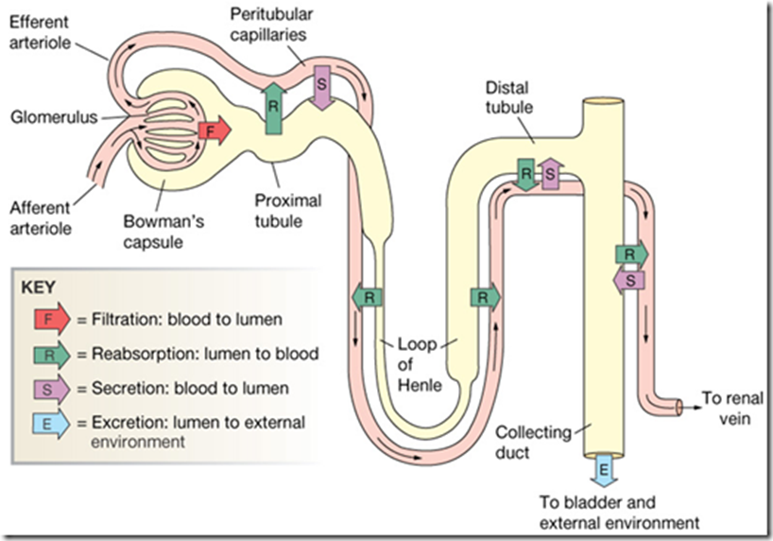

Slide 16
Evaluation of kidney function- FYI
Kidney function tests are common lab tests used to evaluate how well the kidneys are working. Such tests include:
  BUN
  Creatinine - blood
  Creatinine clearance
  Creatinine - urine
BUN - blood test
  BUN stands for blood urea nitrogen. Urea nitrogen is what forms when protein breaks down. A test can be done to measure the amount of urea nitrogen in the blood.
Creatinine blood test
  The creatinine blood test measures the level of creatinine in the blood. This test is done to see how well the kidneys work. Creatinine can also be measured with a urine test

Slide 17
Continued
Creatinine clearance test
  The creatinine clearance test helps provide information about how well the kidneys are working. The test compares the creatinine level in urine with the creatinine level in blood. Creatinine is a breakdown product of creatine, which is an important part of muscle. This test requires both a urine sample and blood sample.
Creatinine - urine
  The urine creatinine test measures the amount of creatinine in urine. Creatinine is removed from the body entirely by the kidneys. Creatinine can also be measured by a blood test.

Slide 18
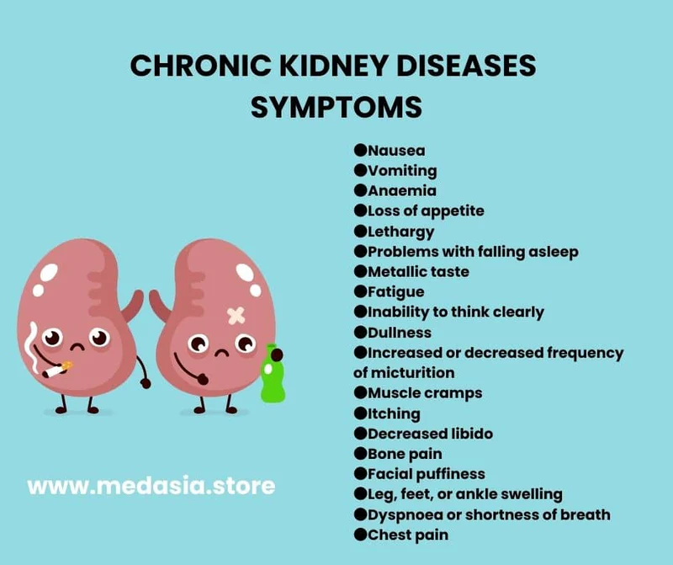
Kidney Pathologies

Slide 19
Pathologies of the Urinary Tract & Bladder

Slide 20
Urinary tract infections: Including pyelonephritis
Acute pyelonephritis:
is a sudden and severe kidney infection. This condition causes the kidneys to swell, can permanently damage the kidneys, and can even be life threatening.
When there are repeated or persistent attacks, the condition is called chronic pyelonephritis. The chronic form of the condition is rare.

Slide 21
Symptoms
Symptoms usually appear within one to two days after the infection begins. They may be different in children and the elderly than they are in adolescents and non-elderly adults. However, common symptoms include the following:
  a fever of more than 102 degrees
  abdominal, back, side, or groin pain -painful or burning urination
  cloudy urine -pus or blood in urine
  urgent and/or frequent urination - fishy-smelling urine
Other symptoms can include:
  shaking/chills, nausea, vomiting, general aching or ill feeling, fatigue, mental confusion (common in the elderly and often their only symptom)
Patients with chronic pyelonephritis may experience only mild or even a lack of noticeable symptoms

Slide 22
Causes, Transmission, Risk Factors
The infection usually starts in the lower urinary tract as a urinary tract infection. Bacteria enter the body through the urethra and begin to multiply and spread up to the bladder. From the bladder, the bacteria travel up through the ureters to the kidneys. Bacteria, such as Escherichia coli, commonly known as E. coli, often cause the infection. But any serious infection in the blood stream can spread to the kidneys and cause acute pyelonephritis.
Chronic pyelonephritis is more common in children or in patients with urinary obstructions.
Anyone with chronic kidney stones or other kidney or bladder conditions are at risk. Whenever there is a problem that interrupts the normal flow of urine there is a greater risk of acute pyelonephritis.
In young children, new episodes of accidental daytime wetting also may be a sign of a urinary tract infection (UTI). Nighttime bed-wetting on its own isn't likely to be associated with a UTI

Slide 23
Continued
A woman’s urethra is much shorter than a man’s, which makes it easy for bacteria to enter the body. This makes women more prone to kidney infections than men and at higher risk for acute pyelonephritis. The elderly also have an increased risk of kidney infections. People with suppressed immune systems, such as those with diabetes, AIDS or cancer, are also at higher risk.
There are also other factors such as:
  using a catheter -undergoing a cystoscopic examination
  having urinary tract surgery - having an enlarged prostate
  certain medications - nerve or spinal cord damage
People with vesicoureteral reflux—when small amounts of urine back up from the bladder into the ureters and kidneys—are also at high risk for this disease.
Chronic forms of the condition are more common in people with urinary obstructions. These can be caused by urinary tract infections, vesicoureteral reflux, or anatomical anomalies. Chronic pyelonephritis is more common in children than in adults.

Slide 24
Cystitis
is the medical term for inflammation of the bladder. Most of the time, the inflammation is caused by a bacterial infection, A bladder infection can be painful and annoying, and it can become a serious health problem if the infection spreads to the kidneys.
Less commonly, cystitis may occur as a reaction to certain drugs, radiation therapy or potential irritants, such as feminine hygiene spray, spermicidal jellies or long-term use of a catheter. Cystitis may also occur as a complication of another illness.

Slide 25
Symptoms
Cystitis signs and symptoms often include:
  A strong, persistent urge to urinate
  A burning sensation when urinating
  Passing frequent, small amounts of urine
  Blood in the urine (hematuria)
  Passing cloudy or strong-smelling urine
  Discomfort in the pelvic area
  A feeling of pressure in the lower abdomen
  Low-grade fever

Slide 26
Causes
UTIs typically occur when bacteria outside the body enter the urinary tract through the urethra and begin to multiply. Most cases of cystitis are caused by a type of Escherichia coli (E. coli) bacteria.
Bacterial bladder infections may occur in women as a result of sexual intercourse. But even sexually inactive girls and women are susceptible to lower urinary tract infections because the female genital area often harbors bacteria that can cause cystitis.

Slide 27
Types
The two main types of bacterial bladder infections are:
  Community-acquired bladder infections. These infections occur when people who aren't in a medical care facility develop a bladder infection. Bladder infections are more common in women than in men.
  Hospital-acquired bladder infections. These infections, also called nosocomial infections, occur in people in a medical care facility, such as a hospital or nursing home. Most often they happen in those who have had a urinary catheter placed through the urethra and into the bladder to collect urine, a common practice before some surgical procedures, for some diagnostic tests, or as a means of urinary drainage for older adults or people confined to bed.

Slide 28
Other Causes of Cystitis
Although bacterial infections are the most common cause of cystitis, a number of noninfectious factors also may cause the bladder to become inflamed. Some examples:
  Drug-induced cystitis. Certain medications, particularly the chemotherapy drugs cyclophosphamide can cause inflammation of the bladder
  Radiation cystitis. Radiation treatment of the pelvic area can cause inflammatory changes in bladder tissue.
  Foreign-body cystitis. Long-term use of a catheter can predispose to bacterial infections and to tissue damage, both of which can cause inflammation.
  Chemical cystitis. Some people may be hypersensitive to chemicals contained in certain products, such as bubble bath, feminine hygiene sprays or spermicidal jellies, and may develop an allergic-type reaction within the bladder, causing inflammation.
  Cystitis associated with other conditions. Cystitis may sometimes occur as a complication of other disorders, such as gynecologic cancers, pelvic inflammatory disorders, endometriosis, Crohn's disease, diverticulitis, lupus or tuberculosis.

Slide 29
Urinary Tract Stones (urolithiasis):
Renal calculi are formed when the urine is supersaturated with salt and minerals such as calcium oxalate, struvite (ammonium magnesium phosphate), uric acid and cystine. 60-80% of stones contain calcium. They vary considerably in size from small 'gravel-like' stones, to large staghorn calculi. The calculi may stay in the position in which they are formed, or migrate down the urinary tract, producing symptoms along the way. Studies suggest that the initial factor involved in the formation of a stone may be the presence of nanobacteria that form a calcium phosphate shell.
Renal stones are common, being present at some time in one in ten of the population, although a significant proportion will remain asymptomatic. Men are more commonly affected than women, with a male to female ratio of 3:1. The difference between the sexes is gradually being eroded. This is thought to be due to lifestyle-associated factors, such as poor dietary or hydration habits.
The peak age for developing stones is between 30 and 50 and recurrence is common.

Slide 30
Risk Factors for developing Kidney Stones
Several risk factors are recognized to increase the potential of a susceptible individual to develop stones. These include:
  anomalies in the kidneys and/or urinary tract, eg horseshoe kidney, ureteral stricture.
  Relative dehydration. (More common occurrence in hot climates)
  Immobilisation.
  Family history of renal stones.
  Hypertension.
  Gout.
  Hyperparathyroidism.
  Metabolic disorders which increase excretion of solutes, e.g chronic metabolic acidosis, hypercalciuria, hyperuricosuria.
  Deficiency of citrate in the urine.
  Drugs, eg diuretics and calcium supplements (without Mg, Vit D etc)
  Increased risk of stones in higher socio-economic groups.

Slide 31
Other Symptoms
Other symptoms which may be present include:
  Fever
  Dysuria
  Haematuria
  Urinary retention
  Nausea and vomiting
Whereas the pain of biliary or intestinal colic is intermittent, the pain of renal colic is more constant but there are often periods of relief or just a dull ache before it returns. The pain may change as the stone moves. The patient is often able to point to the place of maximal pain and this has a good correlation with the current site of the stone.

Slide 32
Classic Symptoms
Many stones are asymptomatic and discovered during investigations for other conditions.
The classical features of renal colic (or ureteric colic) are sudden severe pain. It is usually caused by stones in the kidney, renal pelvis or ureter, causing dilatation, stretching and spasm of the ureter. In most cases no cause is found:
  Pain starts in the loin about the level of the costovertebral angle (but sometimes lower) and moves to the groin, with tenderness of the loin or renal angle, sometimes with haematuria.
  If the stone is high and distends the renal capsule then pain will be in the flank but as it moves down pain will move anteriorly and down towards the groin.
  A stone that is moving is often more painful than a stone that is static.
  The pain radiates down to the testis, scrotum, labia or anterior thigh.

Slide 33
Urinary Incontinence
The loss of bladder control — is a common and often embarrassing problem. The severity ranges from occasionally leaking urine during cough or sneeze to having an urge to urinate that's so sudden and strong person doesn't get to a toilet in time. For most people, simple lifestyle changes or medical treatment can ease discomfort or stop urinary incontinence.
Some people experience occasional, minor leaks of urine. Others wet their clothes frequently.
Urinary incontinence isn't a disease, it's a symptom. It can be caused by everyday habits, underlying medical conditions or physical problems.

Slide 34
Types
Stress incontinence.
  Urine leaks by coughing, sneezing, laughing, exercising or lifting something heavy.
Urge incontinence.
  a sudden, intense urge to urinate followed by an involuntary loss of urine. Urge incontinence may be caused by a minor condition, such as infection, or a more severe condition such as neurologic disorder or diabetes.
Overflow incontinence.
  Frequent or constant dribbling of urine due to a bladder that doesn't empty completely.
Functional incontinence.
  A physical or mental impairment keeps patient from making it to the toilet in time. For example, severe arthritis, patient may not be able to unbutton the pants quickly enough.
Mixed incontinence.
  more than one type of urinary incontinence.

Slide 35
Causes
Urinary incontinence also may be caused by medical condition, such as:
Urinary tract infection. Infections can irritate the bladder, causing strong urges to urinate, and sometimes incontinence.
Constipation. The rectum is located near the bladder and shares many of the same nerves. Hard, compacted stool in the rectum causes these nerves to be overactive and increase urinary frequency.

Slide 36
Temporary Incontinence Causes
Temporary urinary incontinence
  Certain drinks, foods and medications can act as diuretics or irritants — stimulating the bladder and increasing the volume of urine. They include:
    Alcohol
    Caffeine
    Decaffeinated tea and coffee
    Carbonated drinks
    Artificial sweeteners
    Corn syrup
    Foods that are high in spice, sugar or acid, especially citrus fruits
    Heart and blood pressure medications, sedatives, and muscle relaxants
    Large doses of vitamins B or C

Slide 37
Persistent Urinary Incontinence
Persistent urinary incontinence
Urinary incontinence can also be a persistent condition caused by underlying physical problems or changes, including:
  Pregnancy. Hormonal changes and the increased weight of the uterus can lead to stress incontinence.
  Childbirth. Vaginal delivery can weaken muscles needed for bladder control and also damage bladder nerves and supportive tissue, leading to a dropped (prolapsed) pelvic floor. With prolapse, the bladder, uterus, rectum or small intestine can get pushed down from the usual position and protrude into the vagina. Such protrusions can be associated with incontinence.
  Changes with age. Aging of the bladder muscle can decrease the bladder's capacity to store urine.

Slide 38
Persistent Urinary Incontinence Cont.
Menopause. After menopause women produce less estrogen, a hormone that helps keep the lining of the bladder and urethra healthy. Deterioration of these tissues can aggravate incontinence.
Hysterectomy. In women, the bladder and uterus are supported by many of the same muscles and ligaments. Any surgery that involves a woman's reproductive system, including removal of the uterus, may damage the supporting pelvic floor muscles, which can lead to incontinence.
Enlarged prostate. Especially in older men, incontinence often stems from enlargement of the prostate gland, a condition known as benign prostatic hyperplasia.
Prostate cancer. In men, stress incontinence or urge incontinence can be associated with untreated prostate cancer. But more often, incontinence is a side effect of treatments for prostate cancer.
Obstruction. A tumor anywhere along the urinary tract can block the normal flow of urine, leading to overflow incontinence. Urinary stones sometimes cause urine leakage.
Neurological disorders. Multiple sclerosis, Parkinson's disease, stroke, Diabetes complications, a brain tumor or a spinal injury can interfere with nerve signals involved in bladder control, causing urinary incontinence.

Slide 39
Bladder Cancer
Tends to affect adults over age 60
Men are affected 3x as often as women
Can often recur & spread to bones, liver & lungs
Risk factors: exposure to toxins such as hydrocarbons or benzene (found in production of paints, dyes, plastics etc), smoking, family history
Chronic Bladder infections, use of catheters, and previous chemotherapy and radiation therapy are also risk factors.
Symptoms: often asymptomatic, the most common symptom is hematuria.
Treatment: Often involves surgery, as well as chemotherapy and/or radiation.

Slide 40
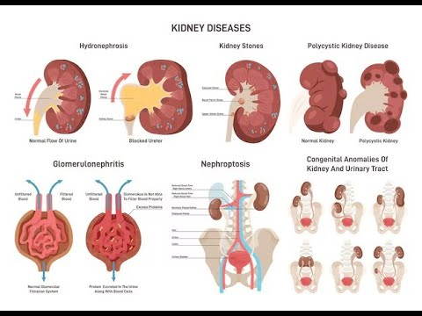
Pathologies of the Kidney

Slide 41
Kidney Cancer
Affects males more than females, at a 3:2 ratio
Often diagnosed between 50- 70 years of age
Risk Factors: Tobacco Use, Exposure to Asbestos, Cadmium & Trichlorethylene (dry cleaning chemical)
Other risk factors: Obesity, Hypertension, family history
Symptoms: Often silent until quite advanced.
Classic triad: Hematuria, Flank pain & a palpable abdominopelvic mass. Also nonspecific cancer symptoms such as unexplained weight loss, fatigue and anemia.
Treatment: Surgical removal, chemotherapy, immunotherapy.

Slide 42
Glomerulonephritis
Inflammation of the Glomeruli
Acute: occurs 7 - 10 days after another infection - often an Upper Respiratory Infection, particularly Strep. It will usually resolve on its own without significant kidney damage but about 10% of cases can become chronic.
Chronic: leads to gradual, progressive loss of kidney function. Often caused by bacteria such as strep, viruses such as Hep B/C or HIV. May also be caused by systemic diseases such as: hypertension, diabetes, or SLE. Overdoses or long term use of certain medications may also cause this condition, such as: NSAIDs, Lithium, certain antibiotics, Proton pump inhibitors & some chemotherapy drugs.
Symptoms: proteinuria, hematuria and/or oliguria. Urine may look smoky or coffee coloured, or may be foamy. Symptoms will progress to hypertension, generalized edema & lumbar pain.

Slide 43
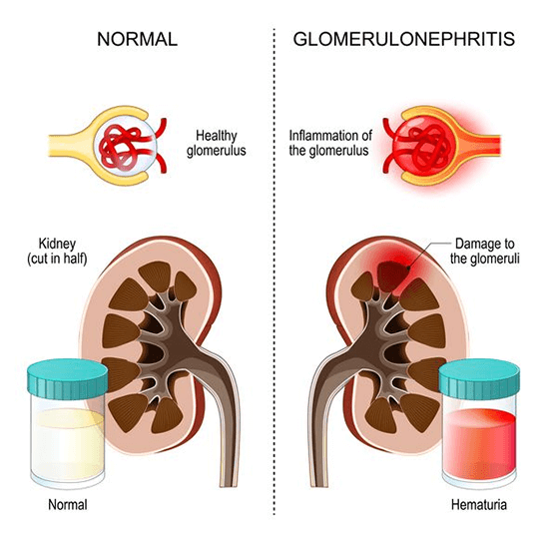
Glomerulonephritis Treatment
Use of medications, such as:
antibiotics (depending on the cause),
corticosteroids,
antihypertensives and diuretics.
The disease may progress
to requiring dialysis
or kidney transplantation.

Slide 44
Polycystic Kidney Disease
Polycystic kidney disease (PKD) is an inherited disorder in which clusters of cysts develop primarily within the kidneys. Cysts are noncancerous round sacs containing water-like fluid. The cysts vary in size and, as they accumulate more fluid, they can grow very large.
Although kidneys usually are the most severely affected organs, polycystic kidney disease can cause cysts to develop in the liver and elsewhere in the body. The disease causes a variety of serious complications.

Slide 45
Types of Polycystic Kidney Disease
There are two types of polycystic kidney disease, caused by different genetic flaws:
  Autosomal dominant polycystic kidney disease (ADPKD).Signs and symptoms of ADPKD often develop between the ages of 30 and 40. In the past, this type was called adult polycystic kidney disease, but children can develop the disorder too.
Only one parent needs to have the disease in order for it to pass along to the children. If one parent has ADPKD, each child has a 50 percent chance of getting the disease. This form accounts for about 90 percent of cases of polycystic kidney disease.
In a smaller percentage of cases where no family history is present, ADPKD results from a spontaneous gene mutation.

Slide 46
Types of Polycystic Kidney Disease
  Autosomal recessive polycystic kidney disease (ARPKD).
This type is far less common but more severe than ADPKD. The signs and symptoms often appear shortly after birth. Sometimes, symptoms don't appear until later in childhood or during adolescence.
Both parents must have abnormal genes to pass on this form of the disease. If both parents carry a gene for this disorder, each child has a 25 percent chance of getting the disease.

Slide 47
Symptoms
Polycystic kidney disease symptoms may include:
  High blood pressure
  Back or side pain
  Headache
  Increase in the size of the abdomen
  Blood in urine (hematuria)
  Frequent urination (polyuria)
  Kidney stones
  Kidney failure
  Urinary tract or kidney infections
Abnormal genes cause polycystic kidney disease, and the genetic defects mean the disease runs in families. Rarely, a genetic mutation can be the cause of polycystic kidney disease.

Slide 48
Complications
Polycystic kidney disease varies greatly in its severity, and some complications are preventable. Lifestyle changes and medical treatments may help reduce damage to the kidneys from complications, such as high blood pressure.
-Loss of kidney function. Progressive loss of kidney function is one of the most serious complications of polycystic kidney disease. Nearly half of those with the disease have kidney failure by age 60.
-High blood pressure. Elevated blood pressure is a common complication of polycystic kidney disease
-Pregnancy complications. Pregnancy is successful for most women with polycystic kidney disease. In some cases, however, women may develop a life-threatening disorder called preeclampsia. Those most at risk are women who have high blood pressure before they become pregnant.
-Growth of cysts in the liver. The likelihood of developing liver cysts for someone with polycystic kidney disease increases with age. While both men and women develop cysts, women often develop larger cysts

Slide 49
Further complications of Polycystic Kidney Disease
Development of an aneurysm in the brain. A balloon-like bulge in a blood vessel (aneurysm) in the brain can cause bleeding (hemorrhage) if it ruptures. People with polycystic kidney disease have a higher risk of aneurysm. The risk is higher if you have a family history of aneurysm or if you have uncontrolled high blood pressure.
Heart valve abnormalities. As many as one in four adults with polycystic kidney disease develop mitral valve prolapse. When this happens, the valve no longer closes properly, which allows blood to leak backward.
Colon problems. Weaknesses and pouches or sacs in the wall of the colon (diverticulosis) may develop in people with polycystic kidney disease.
Chronic pain. Pain is a common symptom for people with polycystic kidney disease. It often occurs in the side or back. The pain can also be associated with a urinary tract infection, a kidney stone or a malignancy.

Slide 50
Diabetic Nephropathy
Kidney disease or damage that occurs in people with diabetes is called diabetic nephropathy. This condition is a complication of diabetes.
Each kidney is made of hundreds of thousands of small units called nephrons. These structures filter the blood and help remove waste from the body.
In people with diabetes, the nephrons slowly thicken and become scarred over time. The kidneys begin to leak and protein (albumin) passes into the urine. This damage can happen years before any symptoms begin.

Slide 51
Risk Factors
Kidney damage is more likely if the person:
  Has uncontrolled blood sugar
  Has high blood pressure
  Has type 1 diabetes that began before the age of 20 years.
  Has family members who also have diabetes and kidney problems
  Smokes
  is African American, Mexican American, or Native American

Slide 52
Signs and Symptoms
Often, there are no symptoms as the kidney damage starts and slowly gets worse. Kidney damage can begin 5 to 10 years before symptoms start.
People who have more severe and long-term (chronic) kidney disease may have symptoms such as:
  Fatigue most of the time
  General ill feeling
  Headache
  Nausea and vomiting
  Poor appetite
  Swelling of the legs
  Itchy skin
Diabetic kidney disease is a major cause of sickness and death in people with diabetes. It can lead to the need for dialysis or a kidney transplant.

Slide 53
Kidney Failure
Occurs when the kidneys become unable to filter waste products from the blood. When the kidneys lose their filtering ability, dangerous levels of wastes may accumulate in the blood.
Acute kidney failure — also called acute renal failure or acute kidney injury — develops rapidly over a few hours or a few days. Acute kidney failure is most common in people who are already hospitalized, particularly in critically ill people who need intensive care.
Chronic Renal Failure - more common presentation. Often caused by damage to the kidneys from long-term, poorly controlled diabetes or high blood pressure. Can also result from glomerulonephritis, repeated kidney infections or kidney stones.

Slide 54
Kidney Failure
It can be fatal and requires intensive treatment. However, acute kidney failure may be reversible. Signs and symptoms of acute kidney failure may include:
  Decreased urine output, although occasionally urine output remains normal
  Fluid retention, causing swelling in the legs, ankles or feet
  Drowsiness
  Shortness of breath
  Fatigue
  Confusion
  Nausea
  Seizures or coma in severe cases
  Chest pain or pressure
Sometimes acute kidney failure causes no signs or symptoms and is detected through lab tests done for another reason.

Slide 55
Causes
Acute kidney failure can occur when:
  There is a condition that slows blood flow to the kidneys
  There is a direct damage to the kidneys
  There is a urine flow blockage
  Severe allergic reaction (anaphylaxis)
  Severe burns
  Severe dehydration
Diseases and conditions that may slow blood flow to the kidneys and lead to chronic kidney failure include:
  Blood or fluid loss
  Blood pressure medications
  Heart attack
  Infection
  Liver failure
  Use of aspirin, ibuprofen (Advil, Motrin IB, others), naproxen (Aleve, others), or related drugs

Slide 56
Damage to the Kidneys
Other causes of damage the kidneys that may lead to kidney failure:
  Medications, such as certain chemotherapy drugs, antibiotics, dyes used during imaging tests and high blood calcium levels (hypercalcemia)
  Toxins, such as alcohol, heavy metals and cocaine
  Multiple myeloma, a cancer of the plasma cells
  Scleroderma, a group of rare diseases affecting the skin and connective tissues
  Systemic Lupus erythematosus
  Thrombotic thrombocytopenic purpura (TTP), a rare blood disorder
  Vasculitis, an inflammation of blood vessels
  Blood clots in the veins and arteries in and around the kidneys

Slide 57
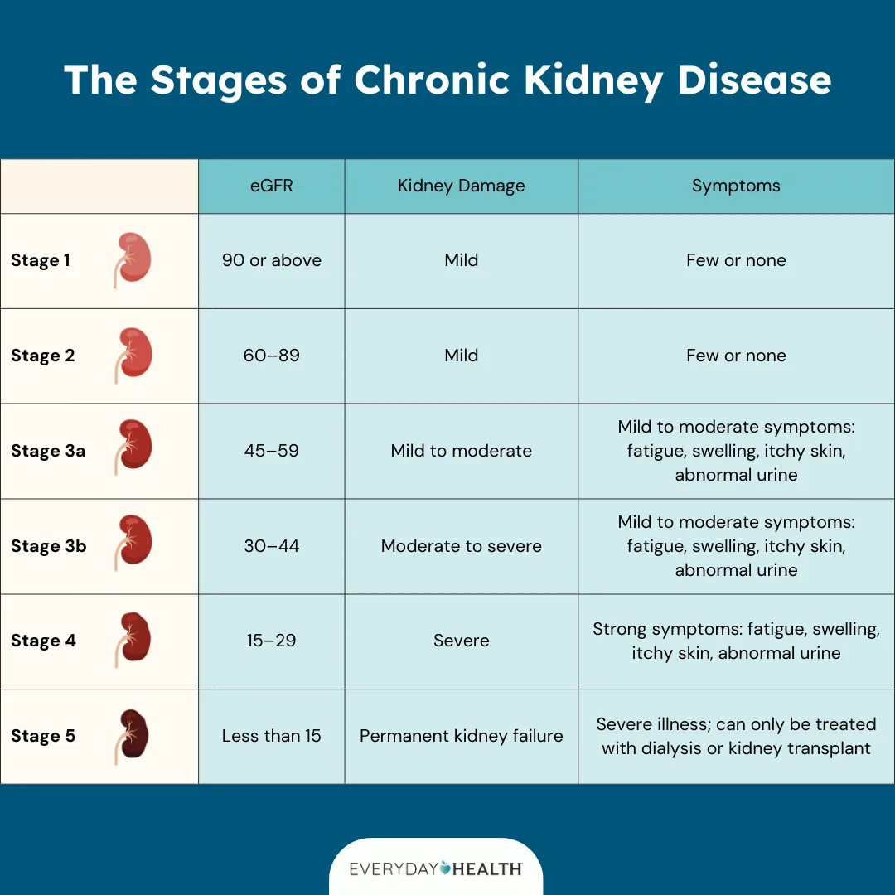

Slide 58
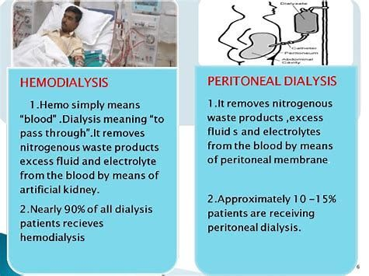
Dialysis
When the kidneys are in stage 5 of Chronic Kidney Disease, and your Glomerular Filtration Rate is under 15-20% , you will generally be placed on a transplant list and dialysis will be initiated to help your kidneys filter your blood.
There are two types of dialysis:
Hemodialysis: Uses a dialyzer machine in a hospital setting. Take 3-4 hours per session and is required about 3 times per week.
Peritoneal: Uses your own peritoneum
as the semi-permanent membrane
& can be administered at home
through a catheter into the abdomen.
This type of dialysis must be done every
day & sometimes multiple times
per day.

Slide 59
References
References:
Lippincott Williams & Wilkins
Pathology for Health Professions/ Ivan Damjanov
www.mayoclinic.org
www.patient.co.uk
www.innerbody.com
www.boundless.com
www.nlm.nih.gov
http://emedicine.medscape.com

