Slide 1
Endocrine Pathologies

Slide 2
Topics Covered
Body Glands and Hormones
Pancreas Pathologies
Pituitary Gland Pathologies
Adrenal Gland Pathologies
Thyroid Gland Pathologies
Parathyroid Gland Pathologies
https://youtu.be/eWHH9je2zG4

Slide 3
Pituitary Gland
Endocrine gland
Helps to Regulate a wide variety of the body's functions by releasing hormones into the bloodstream
Hormones are transported to their target where they usually cause the release of a second hormone
Targets can either be specialized endocrine glands or other types of body tissue such as groups of cells
Called the master gland because it controls several other hormone-releasing glands

Slide 4
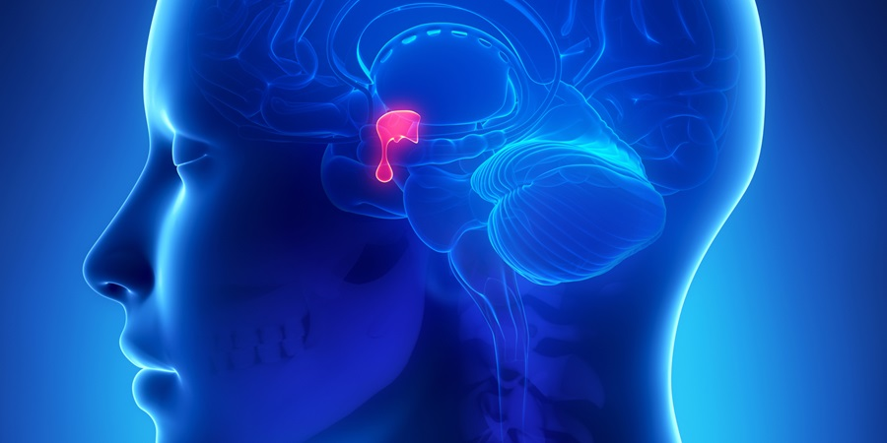

Slide 5
Continued
About the size of a pea, found very close to the hypothalamus.
2 main parts: anterior pituitary and the posterior pituitary. They release different hormones targeting different parts of the body
Hypothalamus receives information from many sources about the basic functions of the body and helps regulate these functions. One of the way it does this is by controlling the pituitary gland by using its own hormones to communicate with the pituitary
The hypothalamus monitors levels of various hormones in the blood. Special cells which receive information from the body indicates how much of each hormone is present in the bloodstream
A drop below a particular level stimulates the hypothalamus to release hormones which travel to the pituitary gland, acting as the signal to the pituitary to produce one or more of its hormones, that will be transported by the bloodstream transports to other endocrine glands, such as the thyroid gland

Slide 6
Continued
Pituitary gland hormones may then stimulate their target endocrine glands to produce their own hormones. These locally produced hormones do the actual work of regulating the body
  Ex. hormones produced by the thyroid increase the body's metabolic rate.
High levels of locally produced hormones stop the hypothalamus and pituitary releasing more of their own hormones (Negative Feedback)
The anterior pituitary produces hormones that regulate a wide range of bodily activities, from growth to reproduction
At least seven different hormones secreted by the anterior pituitary
Posterior pituitary produces just two hormones
https://youtu.be/TVhm2rBGhB0

Slide 7
Anterior Pituitary Hormones
Adrenocorticotropic Hormone (ACTH)
  Target – Adrenal Glands
  Function - Stimulates production of cortisol. important in controlling the metabolism, blood sugar levels and blood pressure. It is also an anti-inflammatory agent, and helps the body to resist certain stresses such as bleeding or fasting
Follicle Stimulating Hormone (FSH)
  Target – Ovaries & Testes
  Function -Stimulates the ovaries to produce an ovum, also causes an increase in the hormone estrogen. Stimulates the testes to produce sperm

Slide 8
Continued
Growth Hormone (GH)
  Target – Many different cells of the body
  Function - The most well-known effect in children is to increase height. In adults and children it helps to control the amount of muscle and fat in the body. It also helps to heal injuries and it promotes the immune system.
Luteinising Hormone ( LH)
  Target – Ovaries & Testes
  Function – Triggers Ovulation, Stimulates the Testes to produce Testosterone

Slide 9
Continued
Melanocyte-stimulating hormone (MSH)
  Target – Brain?
  Function - Exact role in humans is unknown. It may influence brain activity; when too much is present, it may cause darkening of the skin
Prolactin
  Target - Breasts
  Function - Together with other hormones, prolactin stimulates the breasts to produce milk. It is also found in women who aren’t pregnant. Men also have it, but its function is not understood well

Slide 10
Continued
Thyroid Stimulating Hormone (TSH)
  Target – Thyroid Gland
  Function - TSH stimulates the thyroid gland to produce its own hormones, triiodothyronine (T3) and thyroxine (T4).These hormones help to control many bodily functions, including heart rate, temperature and metabolism.

Slide 11
Posterior Pituitary Gland Hormones
Antidiuretic Hormone (ADH)
  Target – Kidneys
  Function - Decreases urine production. (It causes more water filtered by the kidneys to be returned to the blood) ADH also causes a rise in blood pressure
Oxytocin
  Target – Breasts and Uterus
  Stimulates contraction of the uterus during childbirth. Helps breasts to release milk
https://youtu.be/-S_vQZDH9hY

Slide 12
Thyroid
Butterfly-shaped gland that sits low on the front of the neck below Adam’s apple, along the front of the trachea. It has two lobes, connected by a bridge in the middle.
Brownish-red in color, rich with blood vessels. Nerves important for voice quality also pass through the thyroid (recurrent laryngeal nerve)
Thyroid tissue is made up of two types of cells: follicular cells and parafollicular cells. Most of the thyroid tissue consists of the follicular cells, which secrete iodine-containing hormones called thyroxine (T4) and triiodothyronine (T3). The parafollicular cells secrete the hormone calcitonin. The thyroid needs iodine to produce the hormones.
T4 and T3 act throughout the body, influencing metabolism, growth and development, and body temperature. During infancy and childhood, adequate thyroid hormone is crucial for brain development.
The calcitonin hormone works together with the parathyroid hormone to regulate calcium levels in the body.
Levels of hormones secreted by the thyroid are controlled by TSH -
produced by the anterior pituitary

Slide 13
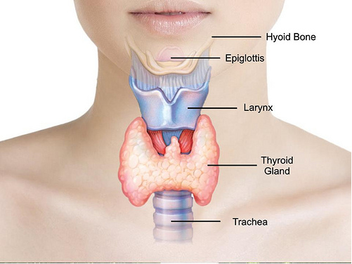

Slide 14
Parathyroid Glands
Four parathyroid gland located just behind the thyroid gland. These glands act as a regulator that controls the blood level of calcium. Calcium is needed inside just about every cell in the body in order to keep that cell functioning properly.
The parathyroids produce a hormone called parathyroid hormone (PTH). PTH raises the blood calcium level by:
  Breaking down the bone and causing calcium release
  Increasing the body's ability to absorb calcium from food
  Increasing the kidney's ability to hold on to calcium that would otherwise be lost in the urine
When the blood calcium level is too low, PTH is released to bring the calcium level back up to normal. When the calcium level is normal or gets little too high, normal parathyroids will stop releasing PTH. Proper calcium balance is crucial to the normal functioning of the heart, nervous system, kidneys, and bones
https://youtu.be/b7JFqGMi9pk

Slide 15
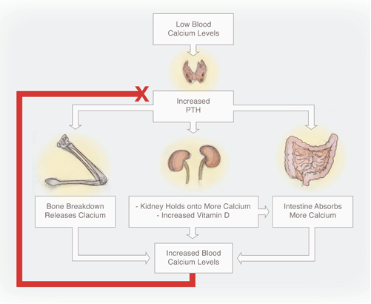

Slide 16
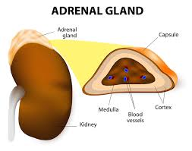
Adrenal Glands
Two, triangular-shaped organs that measure about 1.5 inches in height and 3 inches in length
Sit on top of the kidneys, made up of two distinct parts.
  The adrenal cortex—the outer part of the gland—produces hormones that are vital to life, such as cortisol & aldosterone
  The adrenal medulla—the inner part of the gland—produces non essential hormones, such as adrenaline.

Slide 17
Adrenal Cortex Hormones
Produces two main groups of corticosteroid hormones
  Glucocorticoids
    Their is triggered by the hypothalamus and pituitary gland.
  Mineralocorticoids Mineralocorticoids are mediated by signals triggered by the kidney.
When the hypothalamus produces corticotropin-releasing hormone (CRH), it stimulates the pituitary gland to release ACTH which in turn, alert the adrenal glands to produce corticosteroid hormones

Slide 18
Glucocorticoid Hormones
Hydrocortisone: (AKA cortisol)
  regulates how the body converts fats, proteins, and carbohydrates to energy. Also helps regulate blood pressure and cardiovascular function.
Corticosterone:
  Works with Cortisol to regulate immune response and suppress inflammatory reactions

Slide 19
Mineralocorticoids
The principal mineralocorticoid is aldosterone, which maintains the right balance of salt and water while helping control blood pressure.

Slide 20
Adrenal Cortex Sex Hormones
There is a third class of hormone released by the adrenal cortex, known as sex steroids or sex hormones (Androgens)
The adrenal cortex releases small amounts of male and female sex hormones. However, their impact is usually overshadowed by the greater amounts of hormones (such as estrogen and testosterone) released by the ovaries or testes
https://youtu.be/JlI5N2N4d-k

Slide 21
Adrenal Medulla Hormones
The hormones of the adrenal medulla are released after the sympathetic nervous system is stimulated. The hormones of the Adrenal Medulla contribute to this response
Hormones secreted are:
  Epinephrine: (AKA adrenaline)
    Rapidly responds to stress by increasing the heart rate and rushing blood to the muscles and brain. It also spikes the blood sugar level by helping convert glycogen to glucose in the liver
  Norepinephrine: (AKA noradrenaline)
    Works with epinephrine in responding to stress. However, it can cause vasoconstriction. This results in high blood pressure

Slide 22
Hypothalamus
Maintains homeostasis
It is the link between the endocrine and nervous systems
About the size of an almond.
Produces releasing and inhibiting hormones. It helps stimulate or inhibit many of processes, including:
  Heart rate and blood pressure
  Body temperature
  Fluid and electrolyte balance, including thirst
  Appetite and body weight
  Glandular secretions of the stomach and intestines
  Production of substances that influence the pituitary gland to release hormones
  Sleep cycles

Slide 23
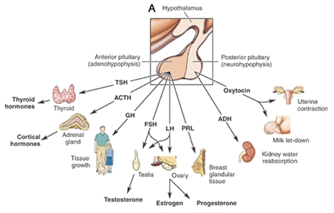
Continued
The hypothalamus is highly involved in pituitary gland function. When it receives a signal from the nervous system, the hypothalamus secretes substances known as neurohormones that start and stop the secretion of pituitary hormones.

Slide 24
Hypothalamus Hormones
Primary hormones secreted by the hypothalamus include:
  Anti-diuretic hormone (ADH): This hormone increases water absorption into the blood by the kidneys.
  Corticotropin-releasing hormone (CRH): CRH sends a message to the anterior pituitary gland to stimulate the adrenal glands to release corticosteroids, which help regulate metabolism and immune response.
  Gonadotropin-releasing hormone (GnRH): GnRH stimulates the anterior pituitary to release follicle stimulating hormone (FSH) and luteinizing hormone (LH), which work together to ensure normal functioning of the ovaries and testes.

Slide 25
Hypothalamus Continued
Growth hormone-releasing hormone (GHRH) - prompts the anterior pituitary to release GH
Growth hormone-inhibiting hormone (GHIH) (AKA somatostatin) – has the opposite effect – inhibits release of GH
Oxytocin: involved in a variety of processes, such as orgasm, body temperature, sleep cycles, and the release of breast milk. Also known as the “love hormone”
Prolactin-releasing hormone (PRH) - prompts the anterior pituitary to stimulate breast milk production through the production of prolactin
Prolactin-inhibiting hormone (PIH) (AKA dopamine):PIH inhibits prolactin
Thyrotropin releasing hormone (TRH): TRH triggers the release of TSH, which stimulates release of thyroid hormones, which regulate metabolism, energy, and growth and development.

Slide 26
Pineal Gland
Located behind the third cerebral ventricle in the midline of the brain
In adults about 0.8 cm (0.3 inch) long and weighs approximately 0.1 gram
It is relatively large in children and begins to shrink with the onset of puberty
Has a rich supply of adrenergic nerves that greatly influence its function
Composed of pinealocytes and supporting cells that are similar to the astrocytes of the brain. In adults, small deposits of calcium often make the pineal body visible on X-rays

Slide 27
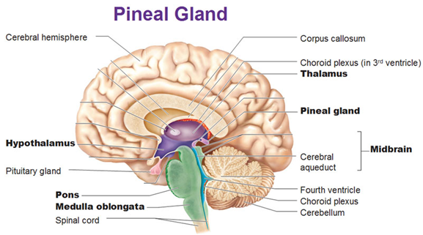

Slide 28
Pineal Gland
Produces hormones that have important endocrine functions
Pineal hormones influence sexual development
contains several neuropeptides and neurotransmitters, such as somatostatin, norepinephrine, and serotonin
The major pineal hormone is melatonin
  Primarily responsible for our circadian rhythms - esp. When to be awake & when to sleep
  Secretion of melatonin is increased by sympathetic nervous system stimulation. In humans, melatonin secretion increases soon after a person is placed in the dark and decreases soon after exposure to light
  Function of melatonin is not well understood. Its production is high in infancy and childhood and declines with age, and abnormally high levels of melatonin in children are associated with delayed sexual development.
https://youtu.be/R0VPDd0JwCE

Slide 29
Pancreas
located in the abdomen
plays an essential role in converting the food we eat into fuel for the body's cells
2 main functions
  exocrine function that helps in digestion
  endocrine function that regulates blood sugar.
Located behind the stomach and is surrounded by the small intestine, liver, and spleen
About six inches long and is shaped like a flat pear. The wide part, called the head of the pancreas, is positioned toward the center of the abdomen; the middle section is called the neck and the body of the pancreas; the thin end is called the tail and extends to the left side
Several major blood vessels surround the pancreas, the superior mesenteric artery, the superior mesenteric vein, the portal vein and the celiac axis, supplying blood to the pancreas and other abdominal organs.

Slide 30
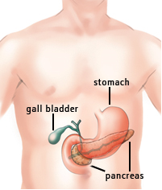

Slide 31
Exocrine Function
Produce enzymes important to digestion. When food enters the stomach, these pancreatic juices are released into a system of ducts that culminate in the main pancreatic duct. The pancreatic duct joins the common bile duct to form the ampulla of Vater which is located at the duodenum
Pancreatic juices and bile that are released help the body to digest fats, carbohydrates, and proteins.

Slide 32
Endocrine Function
The endocrine component of the pancreas consists of islet cells that create and release important hormones directly into the bloodstream.
Two of the main pancreatic hormones
  Insulin - lowers blood sugar
  Glucagon - raise blood sugar
Maintaining proper blood sugar levels is crucial to the functioning of key organs including the brain, liver, and kidneys.

Slide 33
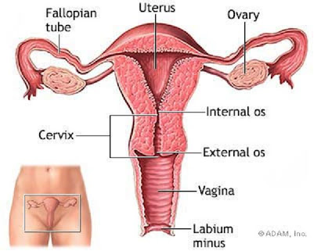
Ovaries
A pair of tiny glands in the female pelvic cavity
Their importance is derived from their role in producing both the female sex hormones that control reproduction and the female gametes that are fertilized to form embryos.

Slide 34
Continued
Small glandular organ about the shape and size of an almond
Located on opposite sides of the uterus and are attached to the uterus by the ovarian ligament, The open ends of the fallopian tubes rest just beyond the lateral surface of the ovaries to transport ova to the uterus.
Two central roles in the female reproductive system by acting as both glands and gonads
  As glands the ovaries produce estrogens and progesterone
    Estrogen controls the development of the mammary glands and uterus during puberty and stimulates the development of the uterine lining during the menstrual cycle
    Progesterone acts on the uterus during pregnancy to allow the embryo to implant and develop in the uterus.

Slide 35
Testes
pair of ovoid glandular organs that are central to the function of the male reproductive system. Responsible for the production of sperm cells and the male sex hormone testosterone.
Located in the scrotum
Each testis is about 1.5 to 2 inches long along its long axis and around 1 inch in diameter
The walls of the seminiferous tubules contain the germ cells, Sertoli cells, and Leydig cells that give the testes their function. The immature sperm cells are supported and protected by Sertoli cells as they travel the length of the seminiferous tubules and slowly mature. Leydig cells at the ends of the seminiferous tubules produce the male hormone testosterone that produces the secondary sex characteristics associated with males.

Slide 36
Kidneys & Hormones
produce and interact with several hormones that are involved in the control of systems outside of the urinary system.
  Calcitriol - Is the active form of vitamin D. It is produced by the kidneys from precursor molecules produced by UV radiation striking the skin. Works together with PTH to raise the level of calcium ions in the bloodstream. When the level of calcium ions in the blood drops below a threshold level, the parathyroid glands release PTH, which in turn stimulates the kidneys to release calcitriol. Calcitriol promotes the small intestine to absorb calcium from food and deposit it into the bloodstream. It also stimulates the osteoclasts of the skeletal system to break down bone matrix to release calcium ions into the blood.

Slide 37
Continued
Erythropoietin (EPO)
  Produced by the kidneys to stimulate the production of red blood cells. The kidneys monitor the condition of the blood that passes through their capillaries, including the oxygen-carrying capacity of the blood. When the blood becomes hypoxic, cells lining the capillaries begin producing EPO and release it into the bloodstream. EPO travels through the blood to the red bone marrow, where it stimulates hematopoietic cells to increase their rate of red blood cell production. Red blood cells contain hemoglobin, which greatly increases the blood’s oxygen-carrying capacity and effectively ends the hypoxic conditions.

Slide 38
Continued
Renin - not a hormone itself, but an enzyme that the kidneys produce to start the renin-angiotensin system (RAS)
The RAS increases blood volume and blood pressure in response to low blood pressure, blood loss, or dehydration. Renin is released into the blood where it catalyzes angiotensinogen from the liver into angiotensin I. Angiotensin I is further catalyzed by another enzyme into Angiotensin II.
Angiotensin II stimulates several processes, including stimulating the adrenal cortex to produce the hormone aldosterone. Aldosterone then changes the function of the kidneys to increase the reabsorption of water and sodium ions into the blood, increasing blood volume and raising blood pressure. Negative feedback from increased blood pressure finally turns off the RAS to maintain healthy blood pressure levels.

Slide 39
Stomach
produces and secretes several important substances to control the digestion of food. Each of these substances is produced by exocrine or endocrine cells found in the mucosa.
  Gastric juice – Main exocrine product - a mixture of mucus, hydrochloric acid, and digestive enzymes. Mixes with food in the stomach to promote digestion.
  Specialized exocrine cells of the mucosa known as mucous cells secrete mucus into the lumen of the stomach. This mucus spreads across the surface of the mucosa to coat the lining of the stomach with a thick, acid- and enzyme-resistant barrier. Stomach mucus is also rich in bicarbonate ions, which neutralize the pH of stomach acid.

Slide 40
Stomach
Parietal cells - produce 2 important secretions
  intrinsic factor - A glycoprotein that binds to the vitamin B12 in the stomach and allows the vitamin to be absorbed in the small intestine. Vitamin B12 is an essential nutrient for the formation of red blood cells
  hydrochloric acid - protects the body by killing pathogenic bacteria naturally found in food. Hydrochloric acid also helps to digest proteins by denaturing them into an unfolded shape that is easier for enzymes to digest. The protein digesting enzyme pepsin is activated by exposure to hydrochloric acid inside the stomach.

Slide 41
Continued
Chief cells produce two digestive enzymes:
pepsinogen - the precursor molecule of protein-digesting enzyme pepsin. Because pepsin would destroy the chief cells that produce it, it is secreted in its inactive pepsinogen form, when it reaches the acidic pH found in the stomach, it changes shape and becomes the active enzyme pepsin. Pepsin then breaks dietary proteins into their amino acid building blocks.
Gastric lipase - an enzyme that digests fats by removing a fatty acid from a triglyceride molecule.

Slide 42
Continued
G cells are endocrine cells found at the bottom of the stomach. G cells release the hormone gastrin into the bloodstream in response to many stimuli, such as:
  Vagus nerve
  Presence of amino acids in the stomach from digested proteins
  Stretching of the stomach wall during a meal
Gastrin travels through the blood to various receptor cells throughout the stomach where it stimulates the glands and muscles of the stomach. Glandular stimulation by gastrin leads to increased secretion of gastric juice to increase digestion. Stimulation of smooth muscles by gastrin leads to stronger contractions of the stomach and the opening of the pyloric sphincter to move food into the duodenum
https://youtu.be/aQX8AkbuzjY

Slide 43
The skin -
Sudoriferous Glands
Sudoriferous glands -exocrine glands found in the dermis commonly known as sweat glands
There are 2 major types of sudoriferous glands:
  Eccrine sweat glands - found in almost every region of the skin and produce a secretion of water and sodium chloride. Eccrine sweat is delivered via a duct to the surface of the skin and is used to lower the body’s temperature through evaporative cooling.
  Apocrine sweat glands - found mainly in the axillary and pubic. Ducts of apocrine sweat glands extend into the follicles of hairs so that the sweat produced by these glands exits the body along the surface of the hair shaft. Inactive until puberty, at which point they produce a thick, oily liquid that is consumed by bacteria living on the skin. The digestion of apocrine sweat by bacteria produces body odor.

Slide 44
The Skin – Sebaceous Glands
Sebaceous glands are exocrine glands found in the dermis of the skin that produce an oily secretion known as sebum. Sebaceous glands are found in every part of the skin except for the thick skin of the palms of the hands and soles of the feet. Sebum is produced in the sebaceous glands and carried through ducts to the surface of the skin or to hair follicles. Sebum acts to waterproof and increase the elasticity of the skin. Sebum also lubricates and protects the cuticles of hairs as they pass through the follicles to the exterior of the body.

Slide 45
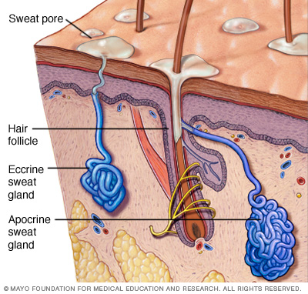

Slide 46
The Skin – Ceruminous Glands
Special exocrine glands found only in the dermis of the ear canals. They produce a waxy secretion known as cerumen to protect the ear canals, by trapping foreign material such as dust and airborne pathogens that enter the ear canal, and lubricate the eardrum
It is made continuously and slowly pushes older cerumen outward toward the exterior of the ear canal where it falls out of the ear or is manually removed.

Slide 47
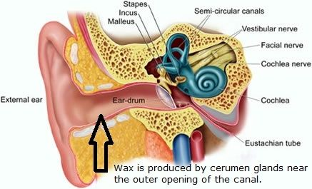

Slide 48
The Heart
produces Natriuretic peptide which is one of the peptides that causes natriuresis (the excretion of an excessively large amount of sodium in the urine). The natriuretic peptides are produced by the heart and vasculature:
  A-type natriuretic peptide is secreted largely by the atrial myocardium in response to dilatation.
  B-type natriuretic peptide is manufactured mainly by the ventricular myocardium.
  C-type natriuretic peptide is produced by endothelial cells that line the blood vessels.

Slide 49
The Placenta
In addition to the transfer of substances, the placenta also acts as an endocrine organ, producing several important hormones during pregnancy. These hormones work together to control the growth and development of the placenta and the fetus, and act on the mother to support the pregnancy and prepare for childbirth.
Produces two steroid hormones
  Estrogen levels rise towards the end of pregnancy. Acts to stimulate the growth of the uterus to accommodate the growing fetus and allows the uterus to contract by countering the effect of progesterone. In this way, it prepares the uterus for labour. It also stimulates the growth and development of the mammary glands during pregnancy, in preparation for breastfeeding.

Slide 50
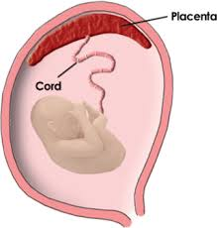
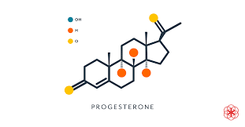
The Placenta
Steroid hormones cont.
Progesterone acts to maintain pregnancy by supporting the lining of the uterus which provides the environment for the fetus and the placenta to grow. Progesterone prevents the shedding of this lining (similar to that which occurs at the end of a menstrual cycle), which would result in pregnancy loss. It also suppresses the uterine wall’s ability to contract, which is important in preventing labour from occurring before the end of pregnancy.

Slide 51
The Placenta
The placenta also releases several protein hormones including:
  Human chorionic gonadotropin
    first hormone to be released from the developing placenta and is the hormone that is measured in a pregnancy test. It acts as a signal to the mother’s body that pregnancy has occurred by maintaining progesterone production from the corpus luteum, another temporary endocrine gland found in the ovary.
  Human placental lactogen
    The function of human placental lactogen is not completely understood, although, it is thought to promote the growth of the mammary glands in preparation for lactation. It is also believed to help regulate the mother’s metabolism by increasing maternal blood levels of nutrients for use by the fetus.
  Placental growth hormone
    Similar effect to HPL - predominates during pregnancy due to suppression of growth hormone produced by the maternal pituitary gland.
  Relaxin
    causes the relaxation of pelvic ligaments and softening of the cervix at the end of pregnancy, which aids the process of labour

Slide 52
Pancreas Pathologies

Slide 53
Pancreatitis
Inflammation of the pancreas
Has various causes
Once the gland becomes inflamed, the condition can progress to swelling of the gland and surrounding blood vessels, bleeding, infection, and damage to the gland. There, digestive juices become trapped and start "digesting" the pancreas itself. If this damage persists, the gland may not be able to carry out normal functions.

Slide 54
Types of Pancreatitis
Acute or Chronic
  Either type can be very severe, even life-threatening and can have serious complications.
Acute pancreatitis
  usually begins soon after the damage to the pancreas begins. An attack lasts for a short time and usually resolves completely as the pancreas returns to its normal state. Some people have only one attack, whereas other people have more than one attack, but the pancreas always returns to its normal state.
Chronic pancreatitis
  begins as acute pancreatitis. If the pancreas becomes scarred during the attack of acute pancreatitis, it cannot return to its normal state. The damage to the gland continues, worsening over time.

Slide 55
Causes/Risk Factors
Occur in people of all ages, very rare in children
Occurs more common in men than in women.
Alcohol abuse and gallstones are the two main causes of pancreatitis, accounting for 80% to 90% of all cases.
  Pancreatitis from alcohol use usually occurs in individuals who have been long-term alcohol drinkers for at least five to seven years.
  Gallstones form from a buildup of material within the gallbladder, A gallstone can block the pancreatic duct, trapping digestive juices inside the pancreas. Pancreatitis due to gallstones tends to occur most often in women older than 50 years of age.
The remaining 10% to 20% of cases of pancreatitis have various causes, including the following:
  medications,
  exposure to certain chemicals,
  injury (trauma), as might happen in a car accident or bad fall leading to abdominal trauma,
  hereditary disease,
  surgery and certain medical procedures,
  Infections such as mumps (not common),
  abnormalities of the pancreas or intestine,
  high fat levels in the blood.
In about 15% of cases of acute pancreatitis and 40% of cases of chronic pancreatitis, the cause is never known.

Slide 56
Acute Pancreatitis Symptoms
Most common symptom of acute pancreatitis is pain
  Pain may come on suddenly or build up gradually. If the pain begins suddenly, it is typically very severe. If the pain builds up gradually, it starts out mild but may become severe.
  Usually centered in the upper middle or upper left part of the abdomen. Often described as if it radiates from the front of the abdomen through to the back.
  Often begins or worsens after eating
  Typically lasts a few days.
  May feel worse when a person lies flat on his or her back.

Slide 57
Continued
People with acute pancreatitis usually feel very sick. Besides pain, people may have other symptoms and signs.
  Nausea (Some people do vomit, but vomiting does not relieve the symptoms.)
  Fever, chills, or both
  Swollen abdomen which is tender to the touch
  Rapid heartbeat (may be due to the pain and fever, dehydration from vomiting and not eating, or it may be a compensation mechanism if a person is bleeding internally.)
In very severe cases with infection or bleeding, a person may become dehydrated and have low blood pressure,
If the blood pressure becomes extremely low, the organs of the body do not get enough blood to carry out their normal functions. This very dangerous condition is called circulatory shock and is referred to simply as shockhttps://youtu.be/UVof2fZdfjY

Slide 58
Chronic Pancreatitis Symptoms
Pain is less common in chronic pancreatitis than in acute pancreatitis.
For those people who do have pain, the pain is usually constant and may be disabling; however, the pain often goes away as the condition worsens. This lack of pain is a bad sign because it probably means that the pancreas has stopped working.
Other symptoms of chronic pancreatitis are related to long-term complications, such as the following:
  Inability to produce insulin (causing diabetes)
  Inability to digest food (causing weight loss and nutritional deficiencies)
  Bleeding (causing anemia)
  Liver problems (causing jaundice)
  https://youtu.be/qUSePCa7878

Slide 59
Diabetes Mellitus
Group of metabolic diseases characterized by high glucose levels that result from defects in insulin secretion, its action, or both
First identified as a disease associated with "sweet urine," and excessive muscle loss in the ancient world. Hyperglycemia lead to spillage of glucose into the urine, hence the term sweet urine.
Blood glucose levels are tightly controlled by insulin which lowers the blood glucose level. When the blood glucose elevates, insulin is released from the pancreas to normalize the glucose level. In patients with diabetes, the absence of insufficient production of, or lack of response to insulin causes hyperglycemia
Diabetes is a chronic medical condition, it can be controlled, but lasts a lifetime.

Slide 60
Continued
Diabetes can lead to blindness, kidney failure, and nerve damage. These are result of damage to small vessels
Diabetes is also an important factor in accelerating atherosclerosis, leading to strokes, coronary heart disease, and other large blood vessel diseases
Affects approximately 26 million people in the United States, 79 million have prediabetes. An estimated 7 million people in the United States have diabetes and don't even know it.
Insufficient production of insulin (either absolutely or relative to the body's needs), production of defective insulin (which is uncommon), or the inability of cells to use insulin properly leads to hyperglycemia and diabetes.
This latter condition affects mostly the cells of muscle and fat tissues, and results in a condition known as insulin resistance. This is the primary problem in type 2 diabetes. In type 2 diabetes, there also is a steady decline of beta cells that adds to the process of elevated blood sugars. Essentially, if someone is resistant to insulin, the body can, to some degree, increase production of insulin and overcome the level of resistance. After time, if production decreases and insulin cannot be released as vigorously, hyperglycemia develops.
The absolute lack of insulin, usually secondary to a destructive process affecting the insulin-producing beta cells in the pancreas, is the main disorder in type 1 diabetes.

Slide 61
Continued
Glucose cannot enter the cells alone and needs insulin to aid in its transport into the cells. Without insulin, the cells become starved of glucose energy despite the presence of abundant glucose in the bloodstream. The abundant, unutilized glucose is wastefully excreted in the urine.
There are two major types of diabetes, called type 1 and type 2. Type 1 diabetes was also formerly called insulin dependent diabetes mellitus (IDDM), or juvenile onset diabetes mellitus. Former name for type 2 is non-insulin-dependent diabetes (NIDDM), or adult onset diabetes.

Slide 62
Type 1 Diabetes
In autoimmune diseases, the immune system mistakenly manufactures antibodies and inflammatory cells that are directed against and cause damage to patients' own body tissues. In
type 1 diabetes, the beta cells of the pancreas, which are responsible for insulin production, are attacked. It is believed that the tendency to develop abnormal antibodies in type 1 diabetes is, in part, genetically inherited, though the details are not fully understood.
Exposure to certain viral infections (mumps and Coxsackie viruses) or other environmental toxins may serve to trigger abnormal antibody responses that cause damage to the pancreas cells where insulin is made
Some of the antibodies seen in type 1 diabetes include anti-islet cell antibodies; anti-insulin antibodies. These antibodies can be detected in the majority of patients, and may help determine which individuals are at risk for developing type 1 diabetes.

Slide 63
Continued
Screening of high risk individuals, such as those with a first degree relative (sibling or parent) with type 1 diabetes should be encouraged.
Tends to occur in young, lean individuals, usually before 30 years of age, however, older patients do present with this form of diabetes on occasion. This subgroup is referred to as latent autoimmune diabetes in adults (LADA). LADA is a slow, progressive form of type 1 diabetes. Of all the people with diabetes, only approximately 10% have type 1 diabetes and the remaining 90% have type 2 diabetes.S

Slide 64
Type 2 Diabetes
Patients can still produce insulin, but do so relatively inadequately for their body's needs, particularly in the face of insulin resistance.
In many cases the pancreas produces larger than normal quantities of insulin
Major feature of type 2 diabetes is a lack of sensitivity to insulin by the cells of the body (particularly fat and muscle cells).
In addition to the problems with an increase in insulin resistance, the release of insulin by the pancreas may also be defective and suboptimal. There is a known steady decline in beta cell production of insulin in type 2 diabetes that contributes to worsening glucose control. (This is a major factor for many patients with type 2 diabetes who ultimately require insulin therapy)
While it is said that type 2 diabetes occurs mostly in individuals over 30 years old and the incidence increases with age, we are seeing an alarming number patients with type 2 diabetes who are barely in their teen years. Most of these cases are a direct result of poor eating habits, higher body weight, and lack of exercise.

Slide 65
Continued
Strong genetic component to developing this form of diabetes, other risk factors :
  the most significant of which is obesity
More common in certain ethnic groups
  7% prevalence in non-Hispanic Caucasians
  8% in Asian Americans
  12% in Hispanics
  13% in blacks
  20 -50% and in certain Native American communities
  Finally, diabetes occurs much more frequently in women with a prior history of diabetes that develops during pregnancy (gestational diabetes).

Slide 66
Signs & Symptoms
Early symptoms of untreated diabetes are related to elevated blood sugar levels, and loss of glucose in the urine. High amounts of glucose in the urine can cause increased urine output and lead to dehydration. Dehydration causes increased thirst and water consumption.
The inability of insulin to perform normally has effects on protein, fat and carbohydrate metabolism. Insulin is an anabolic hormone, that is, one that encourages storage of fat and protein. A relative or absolute insulin deficiency eventually leads to weight loss despite an increase in appetite.
Fatigue, nausea and vomiting.
Prone to developing infections of the bladder, skin, and vaginal areas.
Blurred vision
Extremely elevated glucose levels can lead to lethargy and coma.

Slide 67
Acute Complications of Diabetes
Severely elevated blood sugar levels due to an actual lack of insulin or a relative deficiency of insulin.
Abnormally low blood sugar levels due to too much insulin or other glucose-lowering medications.

Slide 68
Acute Complications of Type 1 Diabetes
Cannot live without a source of exogenous insulin. Without insulin, patients with type 1 diabetes develop severely elevated blood sugar levels. This leads to:
  Increased urine glucose, which in turn leads to excessive loss of fluid and electrolytes in the urine.
  Causes the inability to store fat and protein along with breakdown of existing fat and protein stores. This dysregulation, results in the process of ketosis and the release of ketones into the blood. Ketones turn the blood acidic, a condition called diabetic ketoacidosis (DKA). Symptoms of diabetic ketoacidosis include nausea, vomiting, and abdominal pain. Without prompt medical treatment, patients with diabetic ketoacidosis can rapidly go into shock, coma, and even death may result.
Diabetic ketoacidosis can be caused by infections, stress, or trauma, all of which may increase insulin requirements. Missing doses of insulin is also an obvious risk factor for developing diabetic ketoacidosis. Urgent treatment of diabetic ketoacidosis involves the intravenous administration of fluid, electrolytes, and insulin, usually in a hospital intensive care unit. Dehydration can be very severe, and it is not unusual to need to replace 6-7 liters of fluid when a person presents in diabetic ketoacidosis. Antibiotics are given for infections. With treatment, abnormal blood sugar levels, ketone production, acidosis, and dehydration can be reversed rapidly, and patients can recover remarkably well.

Slide 69
Acute Complications of Type 2 Diabetes
In patients with type 2 diabetes, stress, infection, and medications (corticosteroids) can also lead to severely elevated blood sugar levels. Accompanied by dehydration, severe blood sugar elevation in patients with type 2 diabetes can lead to an increase in blood osmolality (hyperosmolar state). This condition can worsen and lead to coma (hyperosmolar coma). A hyperosmolar coma usually occurs in elderly patients with type 2 diabetes. Like diabetic ketoacidosis, a hyperosmolar coma is a medical emergency. Immediate treatment with intravenous fluid and insulin is important in reversing the hyperosmolar state.
Hypoglycemia means abnormally low blood sugar (glucose). In patients with diabetes, the most common cause of low blood sugar is excessive use of insulin or other glucose-lowering medications. Sometimes, low blood sugar can be the result of an insufficient caloric intake or sudden excessive physical exertion.

Slide 70
Continued
Blood glucose is essential for the proper functioning of brain cells. Therefore, low blood sugar can lead to central nervous system symptoms such as:
  dizziness,
  confusion,
  weakness,
  Tremors.
The actual level of blood sugar at which these symptoms occur varies with each person, but usually it occurs when blood sugars are less than 50 mg/dl. Untreated, severely low blood sugar levels can lead to coma, seizures, and, in the worst case scenario, irreversible brain death.
The treatment of low blood sugar consists of administering a quickly absorbed glucose source. These include glucose containing drinks, such as orange juice, soft drinks (not sugar-free), or glucose tablets in doses of 15-20 grams at a time. If the individual becomes unconscious, glucagon can be given by intramuscular injection.
https://youtu.be/-B-RVybvffU

Slide 71
Pancreatic Cancer
Cancers that develop within the pancreas fall into two major categories:
  cancers of the endocrine pancreas are called "islet cell" or "pancreatic neuroendocrine" cancers . Islet cell cancers are rare and typically grow slowly compared to exocrine pancreatic cancers. Islet cell tumors often release hormones into the bloodstream and are further characterized by the hormones they produce (insulin, glucagon, gastrin, or other hormones).
  cancers of the exocrine pancreas commonly called Pancreatid Adenocarcinomas. Develop from the cells that line the system of ducts that deliver enzymes to the small intestine. Comprises 95% of all pancreatic ductal cancers.
Pancreatic cancer often has a poor prognosis. Typically spreads rapidly and is seldom detected in its early stages, which is a major reason why it's a leading cause of cancer death

Slide 72
Signs & Symptoms
Signs and symptoms may not appear until pancreatic cancer is quite advanced and complete surgical removal isn't possible.When signs and symptoms do appear, they may include:
  Upper abdominal pain that may radiate to the back
  Jaundice
  Loss of appetite
  Weight loss
  Blood clots
The cause of pancreatic cancers are not clear

Slide 73
Risk Factors
Factors that may increase risk of pancreatic cancer include:
  Excess body weight
  Chronic Pancreatitis
  Diabetes
  Family history of genetic syndromes that can increase cancer risk, including Lynch syndrome and familial atypical mole-malignant melanoma (FAMMM)
  Personal or family history of pancreatic cancer
  Smoking
  https://youtu.be/lQAqPlOAYMM

Slide 74
Cystic Fibrosis
Most common fatal genetic disease affecting Canadian children and young adults
No cure
Causes various effects on the body, but mainly affects the digestive system and lungs
Persistence and ongoing infection in the lungs, with destruction of lungs and loss of lung function, eventually causes death in the majority of people who have cystic fibrosis.
Typical complications are difficulty in digesting fats and proteins; vitamin deficiencies due to loss of pancreatic enzymes; and progressive loss of lung function.
It is estimated that one in every 3,600 children born in Canada has cystic fibrosis

Slide 75
Cause
Genetic disease that occurs when a child inherits two abnormal genes, one from each parent
~ one in 25 Canadians carry an abnormal version of the gene responsible for cystic fibrosis. Carriers do not have cystic fibrosis, nor do they exhibit any of the symptoms of the disease.
When two parents who are carriers have a child, there is a 25 percent chance that the child will be born with cystic fibrosis; there is also a 50 percent chance that the child will be a carrier; and a 25 percent chance that the child will neither be a carrier nor have cystic fibrosis.

Slide 76
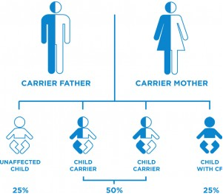

Slide 77
Sign & Symptoms
multi-system disorder that produces a variety of symptoms including:
  Persistent cough with productive thick mucous
  Wheezing and shortness of breath
  Frequent chest infections, which may include pneumonia
  Bowel disturbances, such as intestinal obstruction or frequent, oily stools
  Weight loss or failure to gain weight despite possible increased appetite
  Salty tasting sweat
  Infertility (men) and decreased fertility (women)
  https://youtu.be/VupTywsAGcM

Slide 78
Pituitary Gland Pathologies

Slide 79
Acromegaly
A serious condition that occurs when there is too much GH produced by the pituitary gland in adulthood
Too much growth hormone in the body causes body tissues grow larger than normal which can cause serious disease and even premature death

Slide 80
Signs & Symptoms
The term acromegaly means “extremities” and “enlargement.”
Enlargement of the hands and feet is one of the most common signs of the disease. Other effects include:
  enlargement of jaw and other facial bones
  overgrowth of bone and cartilage in the joints, causing arthritis, back pain, and kyphosis
  swelling of the face, lips, and tongue
  sleep apnea
  thickening of the skin
  carpal tunnel and other nerve entrapment syndromes
  enlargement of body organs such as the heart, thyroid gland (goiter), liver, and kidneys.
Untreated, acromegaly is linked to early heart disease, high blood pressure, heart rhythm disorders, diabetes, and colonic polyps, a precursor of colon cancer.
Development of symptoms in acromegaly is often slow and gradual.

Slide 81
Risk Factors etc.
Acromegaly is a rare disease.
Most common age at diagnosis is 40-45 years
The condition affects all ethnic groups and strikes men and women equally.
When there is too much growth hormone in children it is called gigantism because abnormal growth of the long bones of the arms and legs makes the child unusually tall.
People with acromegaly have almost twice the chance of dying prematurely as healthy people.

Slide 82
Hormones & Acromegaly
Growth hormone is one in a series of hormones that control tissue growth.
The hypothalamus produces growth hormone-releasing hormone (GHRH). GHRH stimulates the pituitary to produce growth hormone
somatostatin that stops secretion of growth hormone.
GH in the bloodstream stimulates the liver to produce another hormone called insulin-like growth factor 1 (IGF-1).
IGF-1 promotes growth of bone and other tissues.
Normally, levels of GHRH, growth hormone, somatostatin, and IGF-1 are tightly controlled by each other in a negative feedback loop Disruption of this and other similar hormone feedback loops causes many different endocrine diseases
Levels of growth hormone and related hormones also are affected by sleep, exercise, stress, food intake, and blood sugar levels.

Slide 83
Continued
Excess GH and IGF-1 in the blood cause most of the physical problems in acromegaly.
Too much IGF-1
  causes the bone growth that leads to changes in physical appearance and function.
  causes thickening of soft tissues such as skin, tongue, and muscles. Enlargement of the tongue can lead to breathing problems and sleep apnea. Overgrowth of muscles can entrap nerves, causing pain syndromes such as carpal tunnel syndrome
  enlargement of organs such as the heart, which can result in heart failure and rhythm disorders.
Excess growth hormone changes the way the body processes sugar and fats. This can cause diabetes and high levels of fats such as triglycerides in the blood. This in turn can lead to atherosclerosis and heart disease.

Slide 84
Causes
In most cases of acromegaly, the excess GH is produced by a tumor of the pituitary gland called adenoma. Secretion of GH by a pituitary tumor is not controlled by the feedback loop. The end result is an excess of IGF-1, which causes abnormal tissue growth. Adenomas are benign tumor, they can grow to considerable size and cause problems by pressing on and invading surrounding tissues.
The remaining cases of acromegaly are caused by other types of tumors that secrete growth hormone or GHRH. Tumors may be in the pituitary gland or elsewhere in the body.
Acromegaly caused by excess growth hormone and acromegaly caused by excess GHRH have the same signs and symptoms.

Slide 85
Symptoms due to Tumor
Symptoms can be divided into 2 groups
  those that are effects of the tumor pressing on surrounding tissues
  those caused by excess growth hormone and IGF-1 in the blood.
Symptoms due to pressure on surrounding tissues depend on the size of the tumor.
  Headaches and partial loss of vision are the most common symptoms. Partial loss of vision may occur in one or both eyes.
Pituitary tumors also can damage the pituitary gland itself, disrupting hormone production
  Hormone imbalances are responsible for symptoms such as impotence, low sex drive, and changes in the menstrual cycle.

Slide 86
Symptoms due to excess GH or IGF - 1
Vary widely
  Increase sweating
  Large tall body (large hands, feet)
  Coarsening or thickening of facial features, especially the nose
  Increased prominence of jaw and/or forehead
  Thickened skin, especially on palms of hands or soles of feet
  Oily skin or acne
  Swelling of tongue
  Thickening or swelling of the neck (due to goiter)
  Arthritis (pain, swelling, or stiffness in any joint)
  Sleep apnea causing poor sleep and excessive sleepiness during the day
  Pain, numbness, tingling, or weakness in hands and wrists (carpal tunnel syndrome)
  Large numbers of skin tags
  https://youtu.be/U5VVSCVJt_w

Slide 87
Pituitary Tumors

Slide 88
Overview
Almost all pituitary tumors are benign glandular tumors called pituitary adenomas. These tumors are considered benign because they don’t spread to other parts of the body, like cancers can do. Still, even benign pituitary tumors can cause significant health problems because of their location near the brain and because many of them secrete excess hormones.
Pituitary cancers (called pituitary carcinomas) are very rare.

Slide 89
Pituitary Adenomas
Benign tumors do not spread outside the skull
Usually remain confined to the sella turcica, sometimes they grow into the walls of the sella turcica and surrounding blood vessels, nerves, and coverings of the brain. They don’t grow very large, but they can have a big impact on a person’s health
If the tumor becomes larger than about a centimeter across, it may grow upward, where it can compress and damage nearby parts of the brain and the nerves that arise from it. This can lead to symptoms such as vision changes or headaches

Slide 90
Types Based on Size
Microadenomas - smaller than 1 centimeter across. Because these tumors are small, they rarely damage the rest of the pituitary or nearby tissues. But they can cause symptoms if they make too much of a certain hormone. Many people actually have small adenomas that are never detected because they never grow large enough or secrete enough hormones to cause a problem.
Macroadenomas - 1 cm across or larger. They can affect a person’s health in 2 ways
  They can cause symptoms if they make too much of a certain hormone
  They can cause symptoms by pressing on normal parts of the pituitary or on nearby nerves, such as the optic nerves.

Slide 91
Type Based on Hormone
Also classified by whether they make too much of a hormone and, if they do, which type they make
If a pituitary adenoma makes too much of a hormone it is called functional. If it doesn’t make enough hormones to cause problems it is called non-functional.

Slide 92
Functional Adenomas
Functional adenomas: Most of the pituitary adenomas that are found make excess hormones. Based on this, adenomas are classified as:
  Prolactin-producing adenomas (prolactinomas), which account for about 4 out of 10 pituitary tumors
  Growth hormone-secreting adenomas, which make up about 2 in 10 pituitary tumors
  Corticotropin (ACTH)-secreting adenomas (about 5% to 10%)
  Gonadotropin (LH and FSH)-secreting adenomas (less than 1%)
  Thyrotropin (TSH)-secreting adenomas (less than 1%)
Some adenomas secrete more than one type of hormone.
The kind of hormone an adenoma produces strongly affects what signs and symptoms the patient has. It also affects which tests are used for diagnosis, the choice of treatment, and the patient’s outlook.

Slide 93
Non Functional Adenomas
Non-functional adenomas: Pituitary adenomas that don’t make excess hormones are called non-functional adenomas or null cell adenomas.
They account for about 3 in 10 of all pituitary tumors that are found. They are usually detected as macroadenomas, causing symptoms because of their size as they press on surrounding structures.

Slide 94
Pituitary Carcinomas
Cancers of the pituitary gland are rare
Most are found in older people
These cancers usually make hormones
Most often it spreads to the brain, spinal cord, meninges or bone around the pituitary. Rarely, these cancers spread to other organs such as the liver, heart, or lungs.

Slide 95
Other Tumors of the Pituitary Region
There are several other types of benign tumors that grow in the region of the pituitary, as well as some malignant ones. All are much less common than pituitary adenomas.
Cancers that start in some other parts of the body (like the breast) can sometimes spread to the pituitary.

Slide 96
Adrenal Gland Pathologies

Slide 97
Cushing Syndrome
A disorder that occurs when the body has a high level of the hormone cortisol.
Most common cause of Cushing syndrome is taking too much glucocorticosteroid medicine
  Ex Prednisone, dexamethasone, and prednisolone
Glucocorticoids mimic the action of the body’s natural hormone cortisol. Used to treat conditions such as asthma, skin inflammation, cancer, bowel disease, joint pain, rheumatoid arthritis.

Slide 98
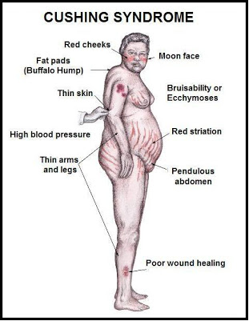
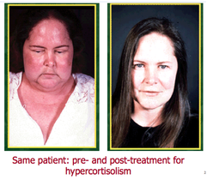

Slide 99
Other Causes
Bodies produce too much cortisol Causes of too much cortisol are:
  Pituitary gland makes too much of the hormone ACTH. ACTH then signals the adrenal glands to produce too much cortisol. A pituitary gland tumor can cause this condition.
  Tumor of the adrenal gland
  Tumors elsewhere in the body that produce ACTH (ectopic Cushing syndrome) (like a certain type of lung cancer which produce ACTH)

Slide 100
Signs & Symptoms
Round, red, full face (moon face)
Slow growth rate in children
Weight gain with fat accumulation on the trunk, but fat loss from the arms, legs, and buttocks (central obesity)
Skin changes that are often seen:
  Skin infections
  Purple marks called striae on the skin of the abdomen, thighs, and breasts
  Thin skin with easy bruising

Slide 101
Continued
Muscle and bone changes include:
  Backache, which occurs with routine activities
  Bone pain or tenderness
  Collection of fat between the shoulders and above collar bone
  Rib and spine fractures caused by thinning of the bones
  Weak muscles, especially of the hips and shoulders

Slide 102
Continued
Women with Cushing syndrome often have:
  Excess hair growth on the face, neck, chest, abdomen, and thighs
  Periods that become irregular or stop
Men may have:
  Decreased or no desire for sex
  Impotence

Slide 103
Continued
Other symptoms that may occur with this disease:
  Mental changes, such as depression, anxiety, or changes in behavior
  Fatigue
  Headache
  Increased thirst and urination
https://youtu.be/ea1sXgd5ui8

Slide 104
Addison’s Disease
AKA adrenal insufficiency, or hypocortisolism
Endocrine disorder
Occurs in all age groups
Affects men and women equally
Characterized by weight loss, muscle weakness, fatigue, low blood pressure, and sometimes darkening of the skin in both exposed and non-exposed parts of the body
Occurs when the adrenal glands do not produce enough cortisol and, in some cases, aldosterone

Slide 105
Functions of Cortisol
Cortisol's most important job is to help the body respond to stress. Other vital tasks include:
  helps maintain blood pressure and heart function
  helps slow the immune system's inflammation response
  helps balance the effects of insulin in breaking down sugar for energy
  helps regulate the metabolism of proteins, carbohydrates, and fats
  helps maintain proper arousal and sense of well-being

Slide 106
Balance of Cortisol
Regulated by the hypothalamus and pituitary gland
First, the hypothalamus sends "releasing hormones" to the pituitary gland. The pituitary responds by secreting ACTH (adrenocorticotropin), a hormone that stimulates the adrenal glands, they respond by producing cortisol. Completing the cycle, cortisol then signals the pituitary to lower secretion of ACTH.

Slide 107
Aldosterone
Aldosterone belongs to a class of hormones called mineralocorticoids
Produced by the adrenal glands
Helps maintain blood pressure and water/salt balance in the body by helping the kidney retain sodium and excrete potassium
When aldosterone production falls too low, the kidneys are not able to regulate salt and water balance, causing blood volume and blood pressure to drop

Slide 108
Causes of Addison’s Disease
Failure to produce adequate levels of cortisol can occur for different reasons.
  Disorder of the adrenal glands themselves (primary adrenal insufficiency)
  Inadequate secretion of ACTH by the pituitary gland (secondary adrenal insufficiency).

Slide 109
Primary Adrenal Insufficiency
Addison's disease affects about 1 in 100,000 people
Most cases are caused by the gradual destruction of the adrenal cortex by the immune system
80% caused by autoimmune disorders
Adrenal insufficiency occurs when at least 90 percent of the adrenal cortex has been destroyed. As a result, often cortisol and aldosterone hormones are lacking
Sometimes only the adrenal gland is affected (idiopathic adrenal insufficiency); sometimes other glands also are affected (polyendocrine deficiency syndrome)

Slide 110
Causes of Primary Adrenal Insufficiency
Tuberculosis can destroy the adrenal glands & accounts for about 20 percent of cases of primary adrenal insufficiency. As the treatment for TB improved the incidence of adrenal insufficiency due to TB of the adrenal glands has greatly decreased.
Less common causes of primary adrenal insufficiency are:
  chronic infection, mainly fungal infections
  cancer cells spreading from other parts of the body to the adrenal glands
  Amyloidosis – abnormal protein amyloid builds up in tissues
  surgical removal of the adrenal glands

Slide 111
Secondary Adrenal Insufficiency
Much more common than primary adrenal insufficiency
Traced to a lack of ACTH. Without ACTH to stimulate the adrenals, the adrenal glands' production of cortisol drops, but not aldosterone
A temporary form of secondary adrenal insufficiency may occur when a person who has been receiving a glucocorticoid hormone such as prednisone for a long time abruptly stops or interrupts taking the medication. Glucocorticoids block the release of both CRH and ACTH. Normally, CRH instructs the pituitary gland to release ACTH. If CRH levels drop, the pituitary is not stimulated to release ACTH, and the adrenals then fail to secrete sufficient levels of cortisol.
Surgical removal of benign, or noncancerous, ACTH-producing tumors of the pituitary gland (Cushing's disease). In this case, the source of ACTH is suddenly removed, and replacement hormone must be taken until normal ACTH and cortisol production resumes

Slide 112
Signs & Symptoms
The symptoms of adrenal insufficiency usually begin gradually. Characteristics of the disease are:
  Chronic, worsening fatigue
  Muscle weakness
  loss of appetite
  Weight loss
  Nausea
  vomiting
  diarrhea
  Low blood pressure that falls further when standing, causing dizziness or fainting
  Skin changes in Addison's disease, with areas of hyperpigmentation, or dark tanning, covering exposed and nonexposed parts of the body; most visible on scars; skin folds; pressure points such as the elbows, knees, knuckles, and toes; lips; and mucous membranes

Slide 113
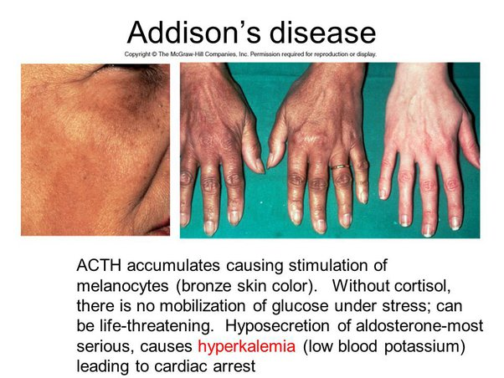

Slide 114
Continued
can cause irritability and depression
Because of salt loss, a craving for salty foods also is common
Hypoglycemia is more severe in children
Menstrual periods may become irregular or stop.
Because the symptoms progress slowly, they are usually ignored until a stressful event like an illness or an accident causes them to become worse. This is called an addisonian crisis, or acute adrenal insufficiency. 25% of patients, symptoms first appear during an addisonian crisis

Slide 115
Symptoms of Addisonian Crisis
Sudden penetrating pain in the lower back, abdomen, or legs
Severe vomiting and diarrhea
Dehydration
Low blood pressure
Loss of consciousness
Left untreated, it can be fatal
https://youtu.be/wqJUifWOGEo

Slide 116
Thyroid Gland Pathologies

Slide 117
Hyperthyroidism
Is a condition in which an overactive thyroid gland is producing an excessive amount of thyroid hormones that circulate in the blood.
Thyrotoxicosis is a toxic condition that is caused by an excess of thyroid hormones from any cause. Can be caused by an excessive intake of thyroid hormone or by overproduction of thyroid hormones by the thyroid gland.
Thyroid hormones stimulate the metabolism of cells. The thyroid gland removes iodine from the blood (which comes mostly from a diet of foods such as seafood, bread, and salt) and uses it to produce thyroid hormones
The two most important thyroid hormones
  thyroxine (T4) 99.9% of thyroid hormone
  Triiodothyronine (T3) 0.1% of thyroid hormone. T3 has the greatest effect on the body
The thyroid is regulated by the pituitary gland which is regulated by a feedback loop and the hypothalamus
Overactivity of Hypothalamus (TRH), Pituitary Gland (TSH) or Thyroid ( T3 and T4) can cause Hyperthyroidism

Slide 118
Causes
Some common causes of hyperthyroidism include:
  Graves' Disease
  Functional adenoma, and toxic multinodular goiter
  Excessive intake of thyroid hormones
  Abnormal secretion of TSH
  Thyroiditis (inflammation of the thyroid gland)
  Excessive iodine intake

Slide 119
Graves Disease
Is caused by a generalized over activity of the thyroid gland, is the most common cause of hyperthyroidism
In this condition, the thyroid gland usually has lost the ability to respond to the normal control by the pituitary gland via TSH
Hereditary
Five times more common among women
Thought to be an autoimmune disease, and antibodies that are characteristic of the illness may be found in the blood.
Triggers for Grave's include:
  stress
  smoking
  radiation to the neck
  medications
  Infectious organisms such as viruses

Slide 120
Continued
Grave's disease may be associated with
  Graves' ophthalmopathy
    Can occur before, after, or at the same time as the hyperthyroidism. Early on, it may cause sensitivity to light and a feeling of "sand in the eyes." The eyes may protrude and double vision can occur. Worsened in those who smoke. Course of the eye disease is often independent of the thyroid disease, and steroid therapy may be necessary to control the inflammation that causes the ophthalmopathy
skin lesions (dermopathy)
  rare and causes a painless, red, lumpy skin rash that appears on the front of the legs
https://youtu.be/RuwM6M5ohW4

Slide 121
Excessive Intake of Thyroid Hormones
Taking too much thyroid hormone medication is actually quite common. Excessive doses of thyroid hormones frequently go undetected due to the lack of follow-up of patients taking their thyroid medicine. Other persons may be abusing the drug in an attempt to achieve other goals such as weight loss

Slide 122
Abnormal Secretion of TSH
A tumor in the pituitary gland may produce an abnormally high secretion of TSH. This leads to excessive signaling to the thyroid gland to produce thyroid hormones. This condition is very rare and can be associated with other abnormalities of the pituitary gland.

Slide 123
Thyroiditis
Inflammation of the thyroid gland may occur after a viral illness (subacute thyroiditis).
Associated with a fever and a sore throat that is often painful on swallowing. The thyroid gland is also tender to touch. There may be generalized neck aches and pains
Inflammation of the gland with an accumulation of lymphocytes (lymphocytic thyroiditis) may also occur
In both of these conditions, the inflammation leaves the thyroid gland "leaky," so that the amount of thyroid hormone entering the blood is increased.

Slide 124
Excessive Iodine Intake
An excess of iodine may cause hyperthyroidism
Iodine-induced hyperthyroidism is usually seen in patients who already have an underlying abnormal thyroid gland
Certain medications, contain a large amount of iodine and may be associated with thyroid function abnormalities.

Slide 125
Signs & Symptoms of Hyperthyroidism
The symptoms usually are related to an increase in the metabolic rate of the body. Common symptoms include:
  Excessive sweating
  Heat intolerance
  Increased bowel movements
  Tremor (usually fine shaking)
  Nervousness; agitation
  Rapid heart rate
  Weight loss
  Fatigue
  Decreased concentration
  Irregular and scant menstrual flow
In older patients, irregular heart rhythms and heart failure can occur. In its most severe form, untreated hyperthyroidism may result in "thyroid storm," a condition involving high blood pressure, fever, and heart failure. Mental changes, such as confusion and delirium, also may occur.

Slide 126
Hypothyroidism

Slide 127
Hypothyroidism
Also called underactive thyroid disease
Common disorder
Thyroid gland does not make enough thyroid hormone.
Most common cause of hypothyroidism is Hashimoto's thyroiditis, an autoimmune disorder. Thyroiditis may also be caused by a viral infection.

Slide 128
Other Causes of Hypothyroidism
Radiation therapy to the neck area
  Treating certain cancers, such as lymphoma, requires radiation to the neck. Radiation damages the cells in the thyroid. This makes it more difficult for the gland to produce hormone.
Radioactive iodine treatment
  This treatment is commonly prescribed to people who have an overactive thyroid gland (hyperthyroidism). However, radiation destroys the cells in the thyroid gland. This usually leads to hypothyroidism.
Certain medications
  Medicines to treat heart problems, psychiatric conditions, and cancer can sometimes affect the production of thyroid hormone. These include amiodarone, lithium.

Slide 129
Continued
Thyroid surgery
  Surgery to remove the thyroid will lead to hypothyroidism. If only part of the thyroid is removed, the remaining gland may still be able to produce enough hormones for the body's needs.
Too little iodine in the diet
  The thyroid needs iodine to produce thyroid hormone. Iodized table salt is rich in iodine. Other food sources of iodine include shellfish, saltwater fish, eggs, dairy products, and seaweed.
Pregnancy
  The reason isn’t clear, but sometimes, inflammation of the thyroid occurs after pregnancy. This is called postpartum thyroiditis. Women with this condition usually have a severe increase in thyroid hormone levels followed by a sharp drop in thyroid hormone production. Most women with postpartum thyroiditis will regain their normal thyroid function.

Slide 130
Continued
Congenital hypothyroidism
  some babies may be born with a thyroid gland that did not develop correctly or does not work properly.
Pituitary gland damage or disorder
  Rarely, a problem with the pituitary gland can interfere with the production of thyroid hormone.

Slide 131
Risk For Hypothyroidism
Older Women
Caucasian or Asian
Autoimmune disorders such as type 1 diabetes, multiple sclerosis, rheumatoid arthritis, celiac disease, Addison's disease, pernicious anemia, or vitiligo
Bipolar disorder
Down syndrome
Turner syndrome

Slide 132
Signs & Symptoms
Changes in the menstrual cycle
Constipation
Depression
Dry hair and hair loss
Dry skin
Fatigue
Greater sensitivity to cold
Slow heart rate
Swelling of the thyroid gland (goiter)
Unexplained weight gain or difficulty losing weight
Carpal tunnel syndrome

Slide 133
Parathyroid Gland Pathologies

Slide 134
Hyperparathyroidism
The main effects of parathyroid hormone are to increase the concentration of plasma calcium byincreasing the release of calcium and phosphate from bone matrix, increasing calcium reabsorption by the kidney, and increasing renal production of D-3 (calcitriol), which increases intestinal absorption of calcium
Overproduction of parathyroid hormone results in elevated levels of plasma calcium
Parathyroid hormone also causes phosphaturia, thereby decreasing serum phosphate levels.
Hyperparathyroidism is usually subdivided into primary, secondary, and tertiary hyperparathyroidism.

Slide 135
Primary Hyperparathyroidism
Primary hyperparathyroidism is the unregulated overproduction of parathyroid hormone (PTH) resulting in abnormal calcium homeostasis.
In approximately 85% of cases, primary hyperparathyroidism is caused by a single adenoma. In 15% of cases, multiple glands are involved (ie, either multiple adenomas or hyperplasia)
Rarely, primary hyperparathyroidism is caused by parathyroid carcinoma. The etiology of adenomas or hyperplasia remains unknown in most cases. Familial cases can occur as part of the multiple endocrine neoplasia syndromes (MEN 1 or MEN 2a).
In primary hyperparathyroidism due to adenomas, the normal feedback on parathyroid hormone production by extracellular calcium seems to be lost, resulting in a change in the set point. However, this is not the case in primary hyperparathyroidism from parathyroid hyperplasia. An increase in the cell numbers is probably the cause.

Slide 136
Symptoms & complications
Chronic excessive resorption of calcium from bone caused by excessive parathyroid hormone can result in osteopenia. In severe cases, this may result in osteitis fibrosa cystica, which is characterized by subperiosteal resorption of the distal phalanges, tapering of the distal clavicles, and salt-and-pepper appearance of the skull. In addition, the chronically increased excretion of calcium in the urine can predispose to the formation of renal stones.
The other symptoms of hyperparathyroidism are due to the hypercalcemia itself and are not specific to hyperparathyroidism. These can include muscle weakness, fatigue, volume depletion, nausea and vomiting, and in severe cases, coma and death. Neuropsychiatric manifestations are particularly common and may include depression, confusion, or subtle deficits that are often characterized poorly and may not be noted by the patient. Increased calcium can increase gastric acid secretion, and persons with hyperparathyroidism may have a higher prevalence of peptic ulcer disease. Rare cases of pancreatitis have also been attributed to hypercalcemia.

Slide 137
References
References:
Lippincott Williams & Wilkins www.patient.co.uk www.medicinenet.com http://umm.edu www.cancer.org www.nlm.nih.gov www.empoweryourhealth.org www.endocrineweb.com www.britannica.com www.innerbody.com www.endocrineweb.com www.mayoclinic.org www.emedicinehealth.com www.yourhormones.infoAAA

