Slide 1
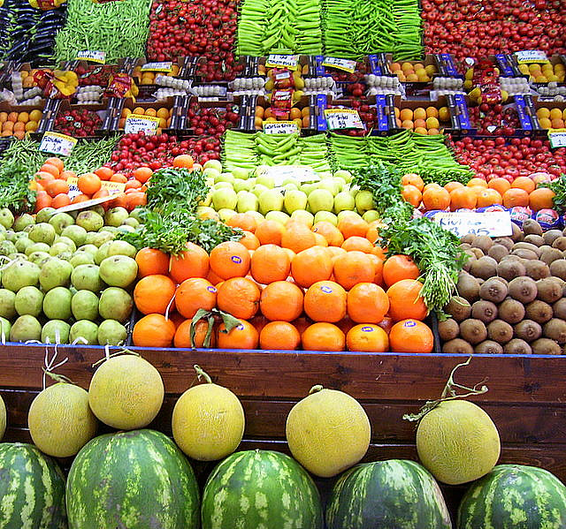

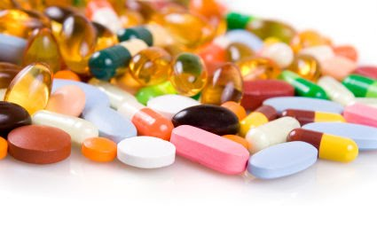
Vitamins

Slide 2
What is a Vitamin?
A substance needed by the body for growth, development, or metabolism that cannot be made by the body & must be obtained from the diet
  Non caloric
  Organic chemical compound
  Essential to cell processes in the body
  Needed in small amounts (in comparison to energy yielding macronutrients)
    Often requirements are listed as milligrams (o.01g), micrograms (0.001g) or international units rather than grams
    International units – not a measure of weight but a quantity that produces a particular biological effect agreed upon as an international standard. Used for fat-soluble vitamins primarily
  Precursors or Provitamins: once inside body they are transformed chemically to one or more active vitamin forms ie. B-carotene to Retinol (Vit A) & Panthenol to Vitamin B5
https://youtu.be/ISZLTJH5lYg

Slide 3
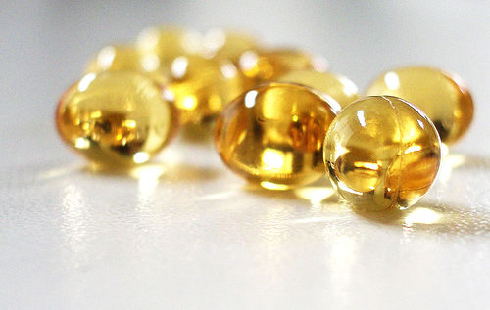
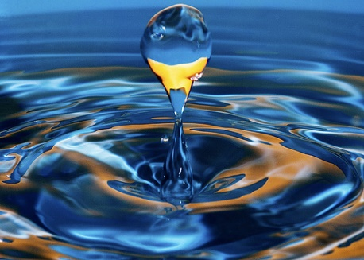
Vitamins – 2 categories
1) Fat Soluble Vitamins: A, D, E, K
2) Water Soluble Vitamins: C and Bs
Fat solubility determines:
Absorption & transportation (through carrier proteins)
Storage in liver and fatty tissues
Potential to build up to toxic levels
(because they can be stored)
Water-soluble vitamins:
Absorbed directly into blood
Excess are excreted in urine (lower risk of toxicity)

Slide 4
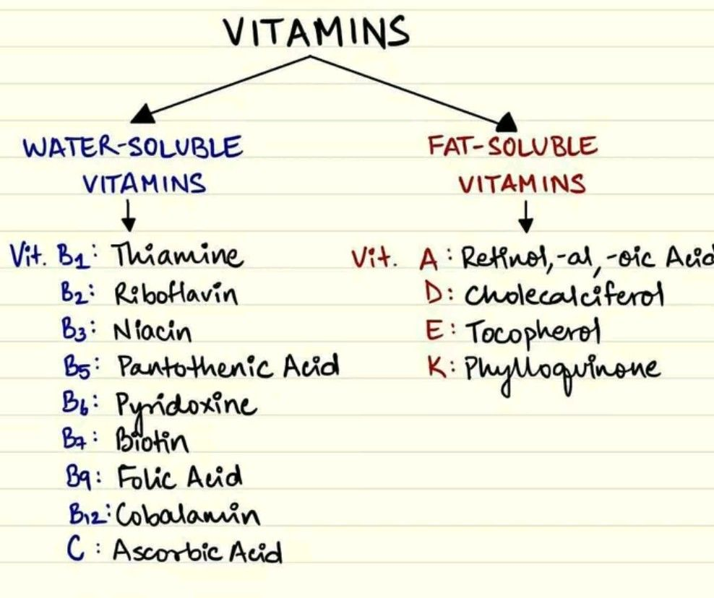

Slide 5
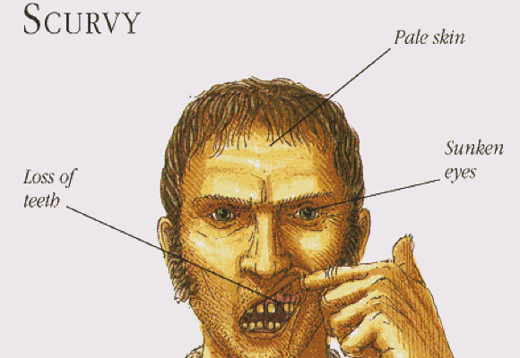
Vitamins in History
https://youtu.be/jXH3TMYug0s
1500 B.C. - Egyptians – feeding liver would cure night blindness (Vitamin A deficiency)
400 B.C. – Hippocrates – ox liver dipped in honey to prevent night blindness
1200 A.D. – Crusades – Crusaders afflicted by scurvy (deficiency Of Vit C)
1492-1600 – scurvy threatened
World exploration
  Est. 2 million seamen
died of scurvy in this time period

Slide 6
Vitamins History
1747 – Scottish surgeon James Lind discovered citrus fruits prevent/cure scurvy. (This theory was not accepted until 20th century.)
1884 – Japanese Navy Takaki Kanehiro – lower ranking officers who ate only polished rice got beriberi (vitamin B1 deficiency) – linked diet to disease but thought protein deficiency caused beriberi
1897 - Christiaan Eijkman – discovered that unpolished rice fed to chickens prevented beriberi
Frederick Hopkins + Christiaan Eijkman 1929 – Nobel Prize for discovery of several vitamins
1930 – beta-carotene (vitamin A precursor) and 1931 – vitamin C discovered

Slide 7
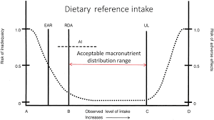
Remember how we define the AMDR?
We use the same concept for micronutrients (vitamins and minerals) Acceptable ranges are known, but optimal intake levels are often still unknown.

Slide 8
The fat-soluble Vitamins
A, D, E, and K: found in fats and oils of foods and require bile & fat digesting enzymes in order to be absorbed
Once absorbed, they are stored in liver and fatty tissue until needed.
Body can survive weeks w/o these vitamins as long as diet provides average minimum amounts
Deficiencies of fat-soluble vitamins occur when diet is consistently low in them
Fat malabsorption (liver disease, low bile production) can impair absorption of vitamins

Slide 9
Fat-soluble Vitamins: Vitamin A
First vitamin to be recognized
Retinols are found in animal sources, Beta-carotene is its plant precursor
Roles in gene expression, vision, maintenance of body linings and skin, immune defenses, growth of bones and of body, reproduction
Recommended daily dose: 700 mcg RAE for women (approx 2333 IU) &
    900 mcg RAE/day for men (approx 3000 IU)
Deficiency can cause: xerophthalmia: dry eyes & night blindness
As well as: dry skin, sickness, death
Overdoses can cause serious problems, esp birth defects in pregnant women
Upper Limit (UL): 3000 ug/10 000 IU/day of retinol form.

Slide 10
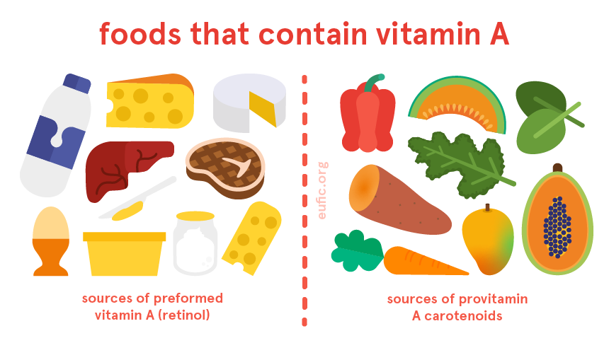
Fat-soluble Vitamins: Vitamin A (cont.)
Beta-carotene: antioxidant, precursor vitamin found in plants
12 ug = 1 ug of retinol (Vit A) to body
Present in:
Deep orange
Dark green vegetables
Are rich in b-carotene
Food Sources of Retinols:
(Animal Sources)
Dairy Products, Eggs
Animal Liver & Liver Oils (such as Cod Liver OIl)
Don’t eat Polar Bear Liver! It contains toxic levels of Vit A
FYI: Vit A can be tested in the blood, but is rarely done.
Normal range is 15 – 60 mcg/dL (Labs will vary somewhat)

Slide 11
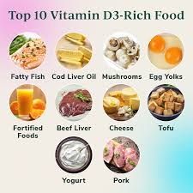
Fat-soluble Vitamins: Vitamin D
Both Vitamin A and D act like hormones, activate gene expression
Roles
It regulates blood calcium and phosphorus levels, maintaining bone integrity
Actions in bones, intestines, kidneys, brain, heart, stomach, pancreas, skin, reproductive organs.
Many inflammatory conditions show low serum
Vit D – causal or correlation?
Deficiency linked to cancers – colorectal, breast,
Prostate, ovarian, multiple myeloma
https://youtu.be/OKOVydqPmTw

Slide 12
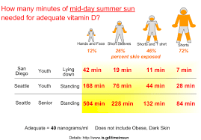
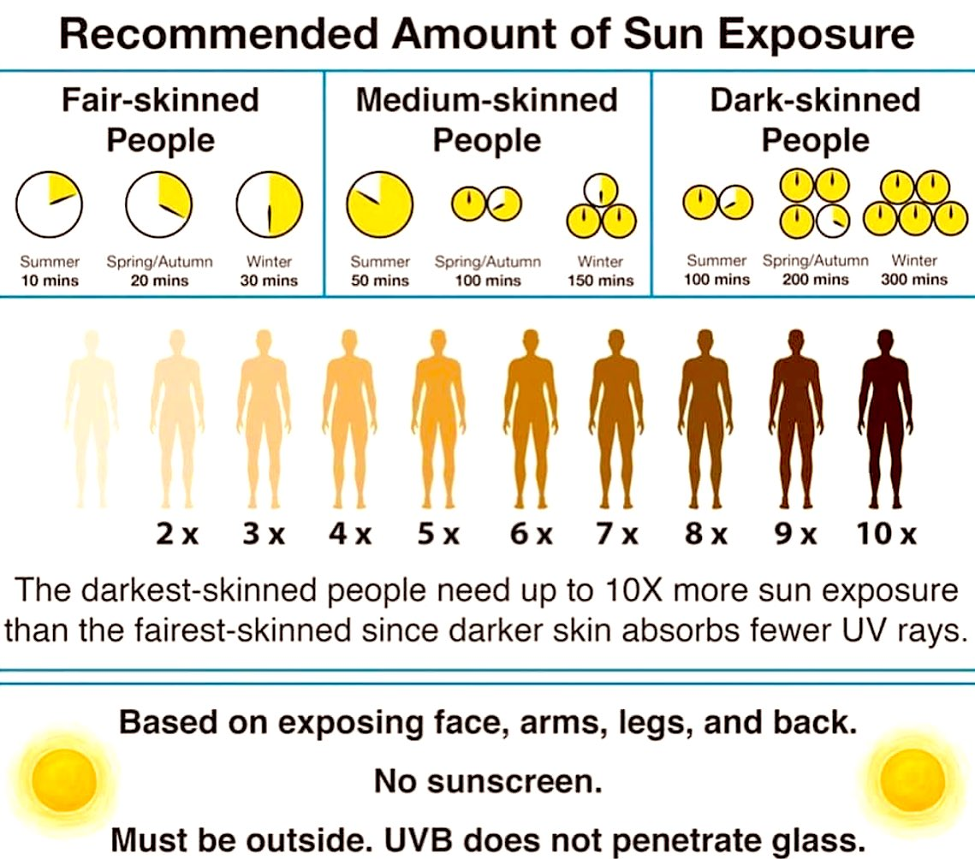
Is Vitamin D really “essential”?
Theoretically, the body can synthesize all it needs of vitamin D with help of sunlight
(So Vit D is not always an“essential” nutrient, as long as there is enough sun exposure each day)
But - As you will see from the graphs below, there are many circumstances where we may not get enough sun exposure to make ALL of our required Vitamin D

Slide 13
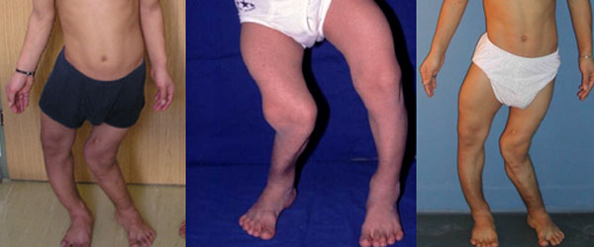
Fat-soluble Vitamins: Vitamin D
Too little Vitamin D= Danger to bones!
Diseases of deficiency:
Rickets (in children): unable to mineralize newly forming bone material: legs bow, knock-kneed, beaded ribs, protruding (pigeon) chest in children
Although not common in Canada, many
children worldwide suffer from rickets due
to inadequate food combined with lack of sunlight
Osteomalacia (adulthood): common in women who have low calcium intakes and little exposure to sun, repeated pregnancies and periods of lactation
SciShow Vit D

Slide 14
Too much Vitamin D: danger to soft tissues
Vitamin D is potentially toxic – if toxic doses are ingested hypercalcemia can result in symptoms of: nausea & vomiting, weakness, & frequent urination. Over time hypercalcemia can progress to kidney problems and bone pain.
If overdose continues, it forces calcium to be deposited in soft tissues
Vit D fortification needs to be monitored: In the 1990s, 2 people died and others became ill after drinking milk that had mistakenly over fortified with up to 500 times the usual dosage of vitamin D
DRI (dietary reference intake): upper intake level of vitamin D = 100 micrograms/day (1,000 IU)
UL is 4000 IU/day. However, there was an extensive research boom on Vit D in the 2000s & studies found dosages of 5000- 10 000 IUs to be well tolerated. UL is likely to be revised in the next few years.
Toxic Doses: 60 000 IUs/day for months – almost impossible to ingest by mistake.
OTC Vit D is available in 400 - 2500 IU dosages.

Slide 15
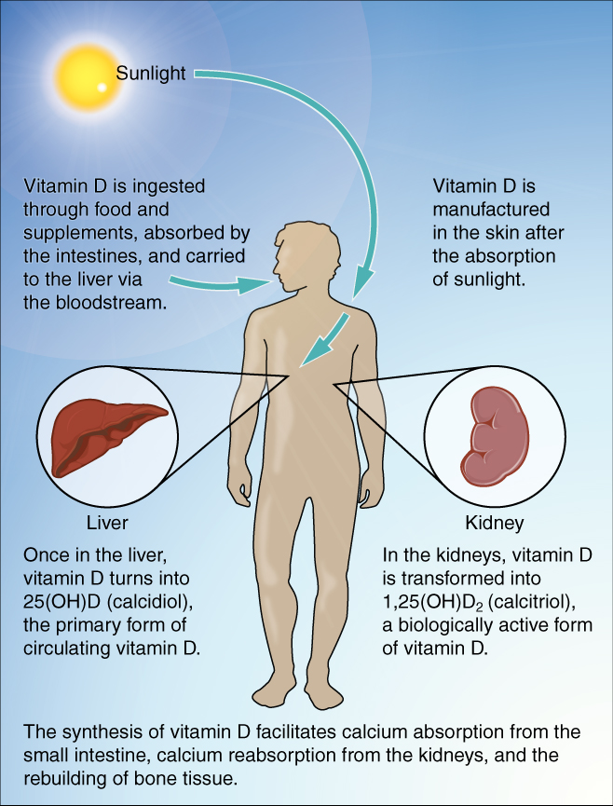
How can people make a vitamin from sunlight?
UV from sunlight transform a cholesterol compound
in human skin into a vitamin D precursor, which is
absorbed into blood
Pigments of dark skin protect from UV but reduce
Vitamin D synthesis
Dark-skinned people require longer exposure to sun (~ 3 hs)
for several days (vs. 20 min for light-skinned people)
FYI: Blood Testing to determine levels:
Less than 30 nmol/L = risk of rickets/osteomalacia
More than 50 nmol/L = usually adequate for bone health
More than 125 nmol/L = risk of toxicity

Slide 16
Vitamin E
Powerful antioxidant (quench free radicals), main defender against oxidative damage
Free radicals: formed during normal cell metabolism, they disrupt cell membranes, DNA and proteins that perform cellular work. If unchecked, free radicals may lead to cancer, heart disease or other diseases
Especially important for cells constantly exposed to high oxygen concentrations (lung, skin and blood)
Deficiency: rare in humans but occur in newborn premature infants
Vitamin E is widely distributed in plant foods; it is destroyed by high heat; toxicity is rare
https://youtu.be/HtF61dxP1zs

Slide 17
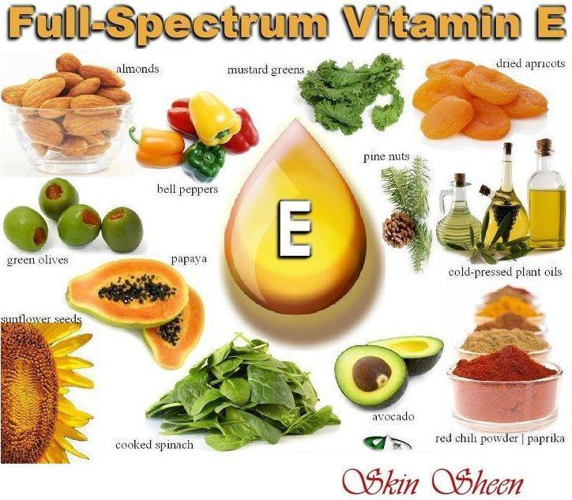
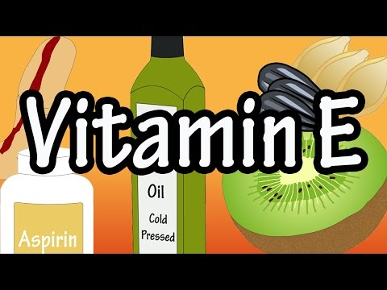
Vitamin E is widespread in foods (although animal fat has almost none)
Recommended daily intake is 15 mg/day (approx 22- 33 IUs)
UL: 1000 mg/ 1500 IUs/day.
Toxicity is very rare. May cause blood thinning/delayed clotting.
FYI: Blood testing can be done, but is rare.
Normal range for alpha-tocopherol is 5.5 mg/L

Slide 18
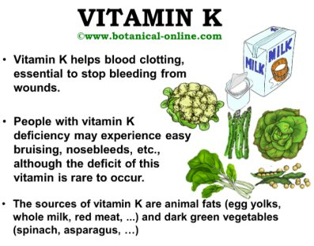
Vitamin K
Necessary for blood clotting
Deficiency causes uncontrolled bleeding
Toxicity causes jaundice (bilirubin released into blood instead of into bile)
DRI: 90- 120 mg/day (for adults)

Slide 19
Vitamin K
Two forms : Vit K1 found in plant foods
Vit K2 found in fermented foods & animal foods
In a healthy gut, probiotic bacteria can convert K1 to the active form of K2.
Toxicity: rare. No UL has been established.
https://youtu.be/vlLC0pUtmTA

Slide 20
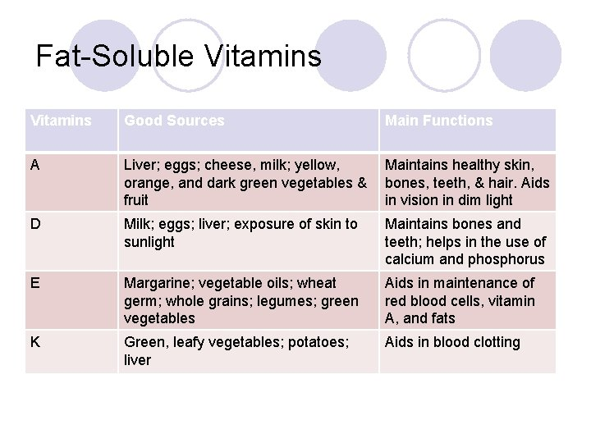

Slide 21
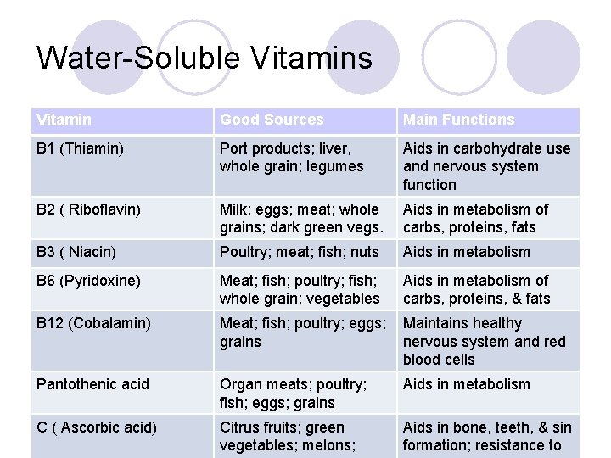
Water–Soluble: Vitamins C and B
They require special consideration in food preparation to avoid losing or destroying them
Body absorbs them easily
and just as easily
excretes them in the urine

Slide 22
Water-soluble vitamins: Vitamin C
Sources: citrus fruit, cabbage, leafy greens, cantaloupe, strawberries, peppers, tomatoes, potatoes, mangoes, papaya, kiwi
Functions:
  Collagen synthesis – blood vessel walls, scar tissue, bone matrix
  Anti-oxidant
  Restores vitamin E to active form
  Hormone synthesis
  Immune function and increase absorption of iron
Deficiencies: Scurvy (anemia, frequent infections, bleeding gums, muscle/bone pain, bruising, slow healing) https://youtu.be/9BdDJV0z-Y4
Toxicities: nausea/digestive cramps, diarrhea, headache, rashes
RDA 75 - 90 mg/day (extra 35 mg/day for smokers)
UL 2000 mg/day - VERY conservative - many people can take up to 10 000 mg/day without any digestive symptoms

Slide 23
Vitamin C
FYI: Testing in blood is possible, but rarely done
Normal range is 0.4 - 2.0 mg/dL
Certain medications including aspirin, tetracycline & oral contraception may increase the need for Vit C
                SCURVY
  During the age of discovery, scurvy was a huge problem for sailors who were out at sea for weeks to years at a time, subsisting on dried meat and fish, biscuits and "pease" - dried peas or lentils, sometimes mixed with oats. Scurvy was a mystery to the sailors and a huge source of shame. Some tried 'earth bathing" when they sighted and, thinking that the sickness was caused by being surrounded by too much water.
  James Lind was a British Naval Surgeon who first connected fresh fruits, limes in particular, with preventing the symptoms of scurvy. https://youtu.be/rb5knx92oww
  Scurvy is now rare, found mostly in malnourished people, and chronic alcoholics.

Slide 24
Water–Soluble: Vitamins B
B vitamins act as coenzymes
Coenzyme: small molecule that activates enzyme
B vitamins help body metabolize carbohydrates, lipids and amino acids.
Several B vitamins, each with special qualities
  Thiamin (B1)
  Riboflavin (B2)
  Niacin (B3)
  Pantothenic Acid (B5)
  Vitamin B6 (pyridoxal -5- phosphate)
  Biotin
  Folate
  Vitamin B12

Slide 25
Thiamine - B1
1st B vitamin discovered
Functions: Metabolism – help release nutrients from food; helps body make ATP for energy at the cellular level. Conduction of nerve signals.
Do NOT directly supply body with energy (no calories) but allow the energy reactions in the body to take place
Sources: pork, fish, nuts, beans, brown rice, whole grains, seafood
Deficiencies: now pretty rare but can occur in anorexia, malnutrition, & Crohn's disease. Dialysis & Loop diuretics such as furosemide (Lasix) may impair B1 absorption.
In chronic alcoholics, "wet brain" or Wernicke-Korsakoff syndrome is related to thiamine deficiency. Symptoms include confusion, difficulty with muscle coordination, and hallucinations.

Slide 26
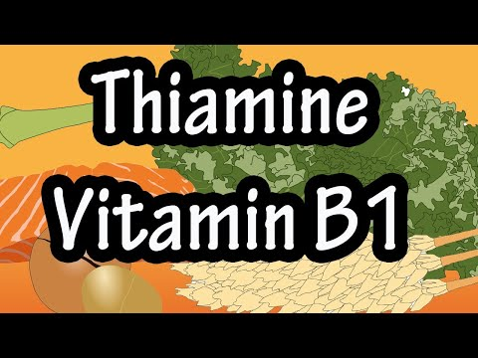
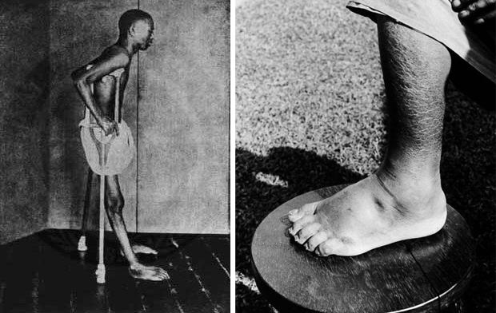
Beri-beri
Vitamin B1 (thiamine) is critical for cell metabolism and nerve cell membranes
B1 was discovered in 1910 in Japan after observing Beri-beri symptoms in sailors eating white rice for an extended period of time. Brown rice was found to reverse the symptoms. https://youtu.be/IzIBpFDRr5g
Beriberi – deficiency of thiamine (eating polishing rice, without brown coat)
DRI = 1.1 to 1.2 mg/day
UL = None established

Slide 27
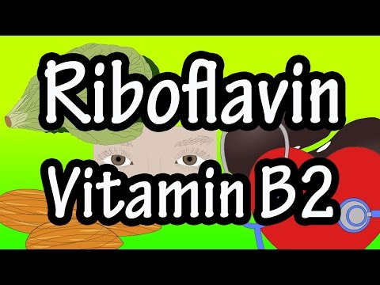
Riboflavin (B2)
Sources: cabbage, cauliflower, spinach, lettuce, leafy greens, breads, pasta, milk, meats
Functions: role in metabolism of all cells
Deficiencies:
  Cracks at corners of mouth, sore throat, hypersensitivity to light, reddening of cornea, skin rash
Toxicities:
  No toxicity symptoms reported
RDA = 1.1 - 1.3 mg/day
UL = None established

Slide 28
Niacin - B3
Sources: liver, chicken, beef, tuna, brown rice, avocados, nutritional yeast, peanuts
Functions: energy metabolism of every cell of body
RDI: 14 –16 mg/day
UL: 35 mg/day
Deficiencies:
  Pellagra: “4 D symptoms”: diarrhea, dermatitis, dementia, death
Toxicities:
  Large doses (3000 mg/day +) can cause nausea, vomiting, liver damage
  Therapeutic Dose for high cholesterol is 1000 – 3000mg/day
  Therapeutic use for some schizophrenics 3 000 - 18 000 mg/day - MOA seems to be promoting conversion of norepinephrine to epinephrine
  These high doses MUST be monitored by a physician

Slide 29
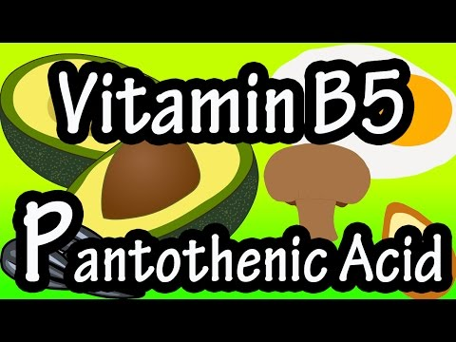
Pantothenic Acid - B5
Functions in the body: converting food into glucose, synthesizing cholesterol, forming red blood cells
- helps synthesize Coenzyme A which the liver uses to metabolize some drugs & toxins
Deficiency: fatigue, depression, hypoglycemia, burning feet
Food Sources: meats, fish, whole grains (not milled), dairy products, legumes
RDI Adults: 5 mg/day
UL : None established
Toxicity: very low. Stomach upset & diarrhea have been reported at doses of
10 000mg/day

Slide 30
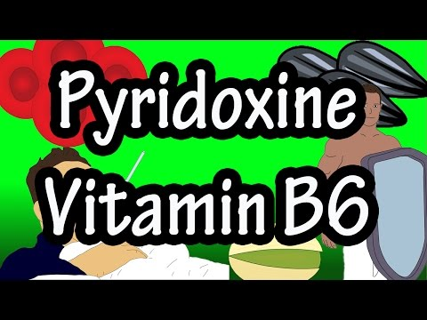
Pyridoxine - B6
RDA: 1.3 - 2.0 mg/day
UL: 100 mg/day
Treatment for: Pregnancy induced nausea (under doctor's supervision)
Food sources: beef liver, tuna, salmon, chickpeas, poultry, fortified grains, dark green leafy vegetables
Toxicity: can occur with large doses (1000 mg/day +) over the long-term . Symptoms are neuropathy of hands & feet, nausea, and ataxia (lack of control of body movements)
Deficiency: rare. Associated with deficiencies of other B vitamins such B12 & folic acid. Can lead to microcytic anemia.
https://youtu.be/UrocSQqC0qU

Slide 31
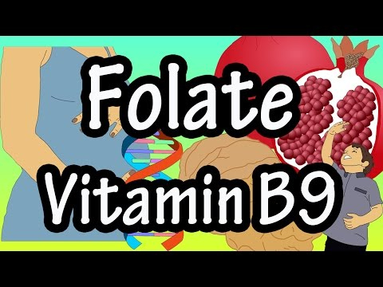
Folate (folic acid) - B9
Sources: asparagus, avocado, leafy green vegetables, beets, seeds, liver, enriched breads, cereal, pasta, grains
Functions: cell metabolism, DNA & RNA synthesis, neural tube development, neurotransmitter production
Deficiencies:
  Megaloblastic Anemia, Neuropathies, birth defects esp. Spina Bifida, suppression of immune system, frequent infections, depression, headache
Toxicities:
  Masks vitamin B12 deficiency
RDA = 400 -600 mcg/day
UL= 1000 mcg/day
https://youtu.be/nvss-sVlRw8

Slide 32
Vitamin B12
Sources: animal products (meat, fish, poultry, milk, cheese, eggs)
Functions: new RBC synthesis, helps maintain nerve cells, DNA & RNA synthesis
Deficiency AKA Pernicious anemia:
Take a long period of deficient intake (years) before showing signs & symptoms OR a deficiency of intrinsic factor in the stomach (needed to absorb B12) - genetic link
  Megaloblastic Anemia, fatigue, depression, long term constipation, sore/red tongue and nerve degeneration (d/t effects on the myelin sheath) progressing to paralysis, tingling or numbness
  Vegans – will need supplementation or to be very mindful of taking in fortified foods (plant milks, cereals). Plant foods are NOT a good source of B12 on their own
RDA : 4 - 6 mcg/day
UL: Not established
Toxicities:
  unknown

Slide 33
Vitamin B12
Supplements can be in two forms:
- Cyanocobalamin which is synthetic & not found in nature but is stable and cost effective
- Methylcobalamin which is a naturally occurring form found in food sources like fish, meat & eggs
B12 is regularly tested in your blood. Normal ranges may vary between labs but are usually between 170 - 600 pmol/L. This range varies between countries - Japan’s normal range is 550 - 1300 pmol/L.
https://youtu.be/1u_XVBwjEyk

Slide 34


