Slide 1
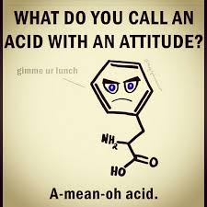
Proteins

Slide 2
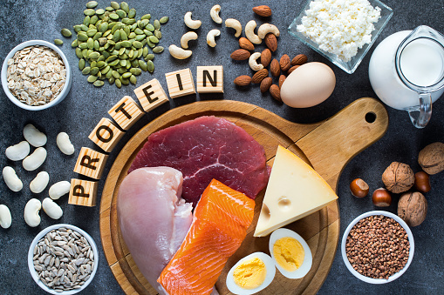
Protein Overview
https://youtu.be/qx-H9zlDeR0?si=M3ogdC0WzxGlqiZM

Slide 3
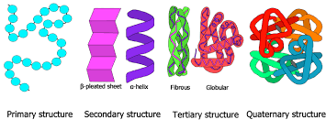
Protein
Proteins are arranged as strands or chains of amino acids
Amino acids – the building blocks of proteins – all types consist of the same basic structure however the side chain changes. 20 different kinds.
Essential amino acids – cannot be synthesized by the body or cannot be synthesized in quantities sufficient to meet body needs. Must be obtained through dietary sources.
Peptide bonds – how amino acids are linked in order to create proteins

Slide 4
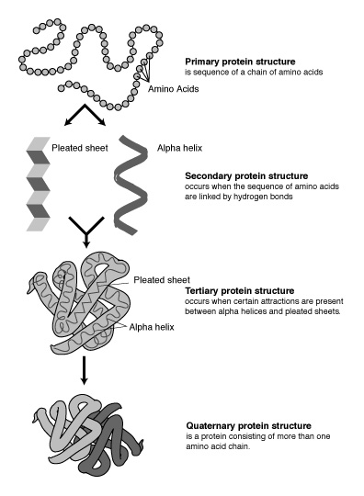
Protein Structures
Primary - chains of amino acids such as in Insulin
Secondary - Interactions between atoms in the backbone of the polypeptide (does not involve R groups) Produces most often a helix or pleated sheet shape.
Tertiary - 3D structure of the protein. Due to interactions between the R groups.
Quaternary - Only some proteins have this shape, when subgroups join together. One example is Hemoglobin, which has four subgroups.
Denaturation - When a protein loses its 3D shaping, & is reduced to its primary structure. Usually makes the protein non-functional. Can sometimes be reversed but often not - think of an egg white which becomes solid & opaque after heating and will not become clear again once cooled.

Slide 5
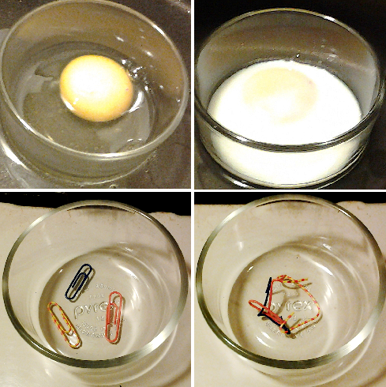
Denaturation
Denaturation – the irreversible (usually) change in a protein’s shape brought about by heat, acids, bases, alcohol, salts of heavy metals, etc.
https://youtu.be/oyzx7ttssss?si=HMqgcXu1zdxVF0n_

Slide 6
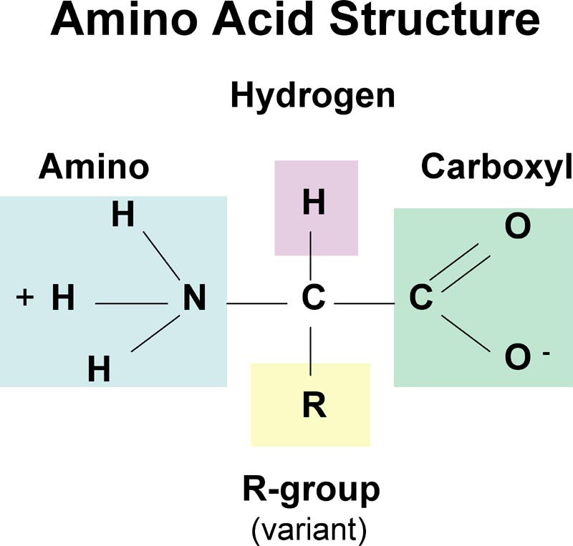
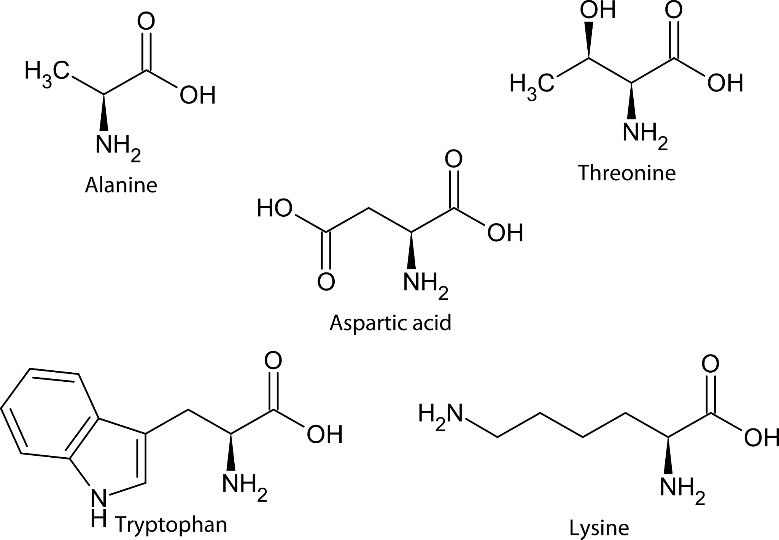
Amino Acid Structure

Slide 7
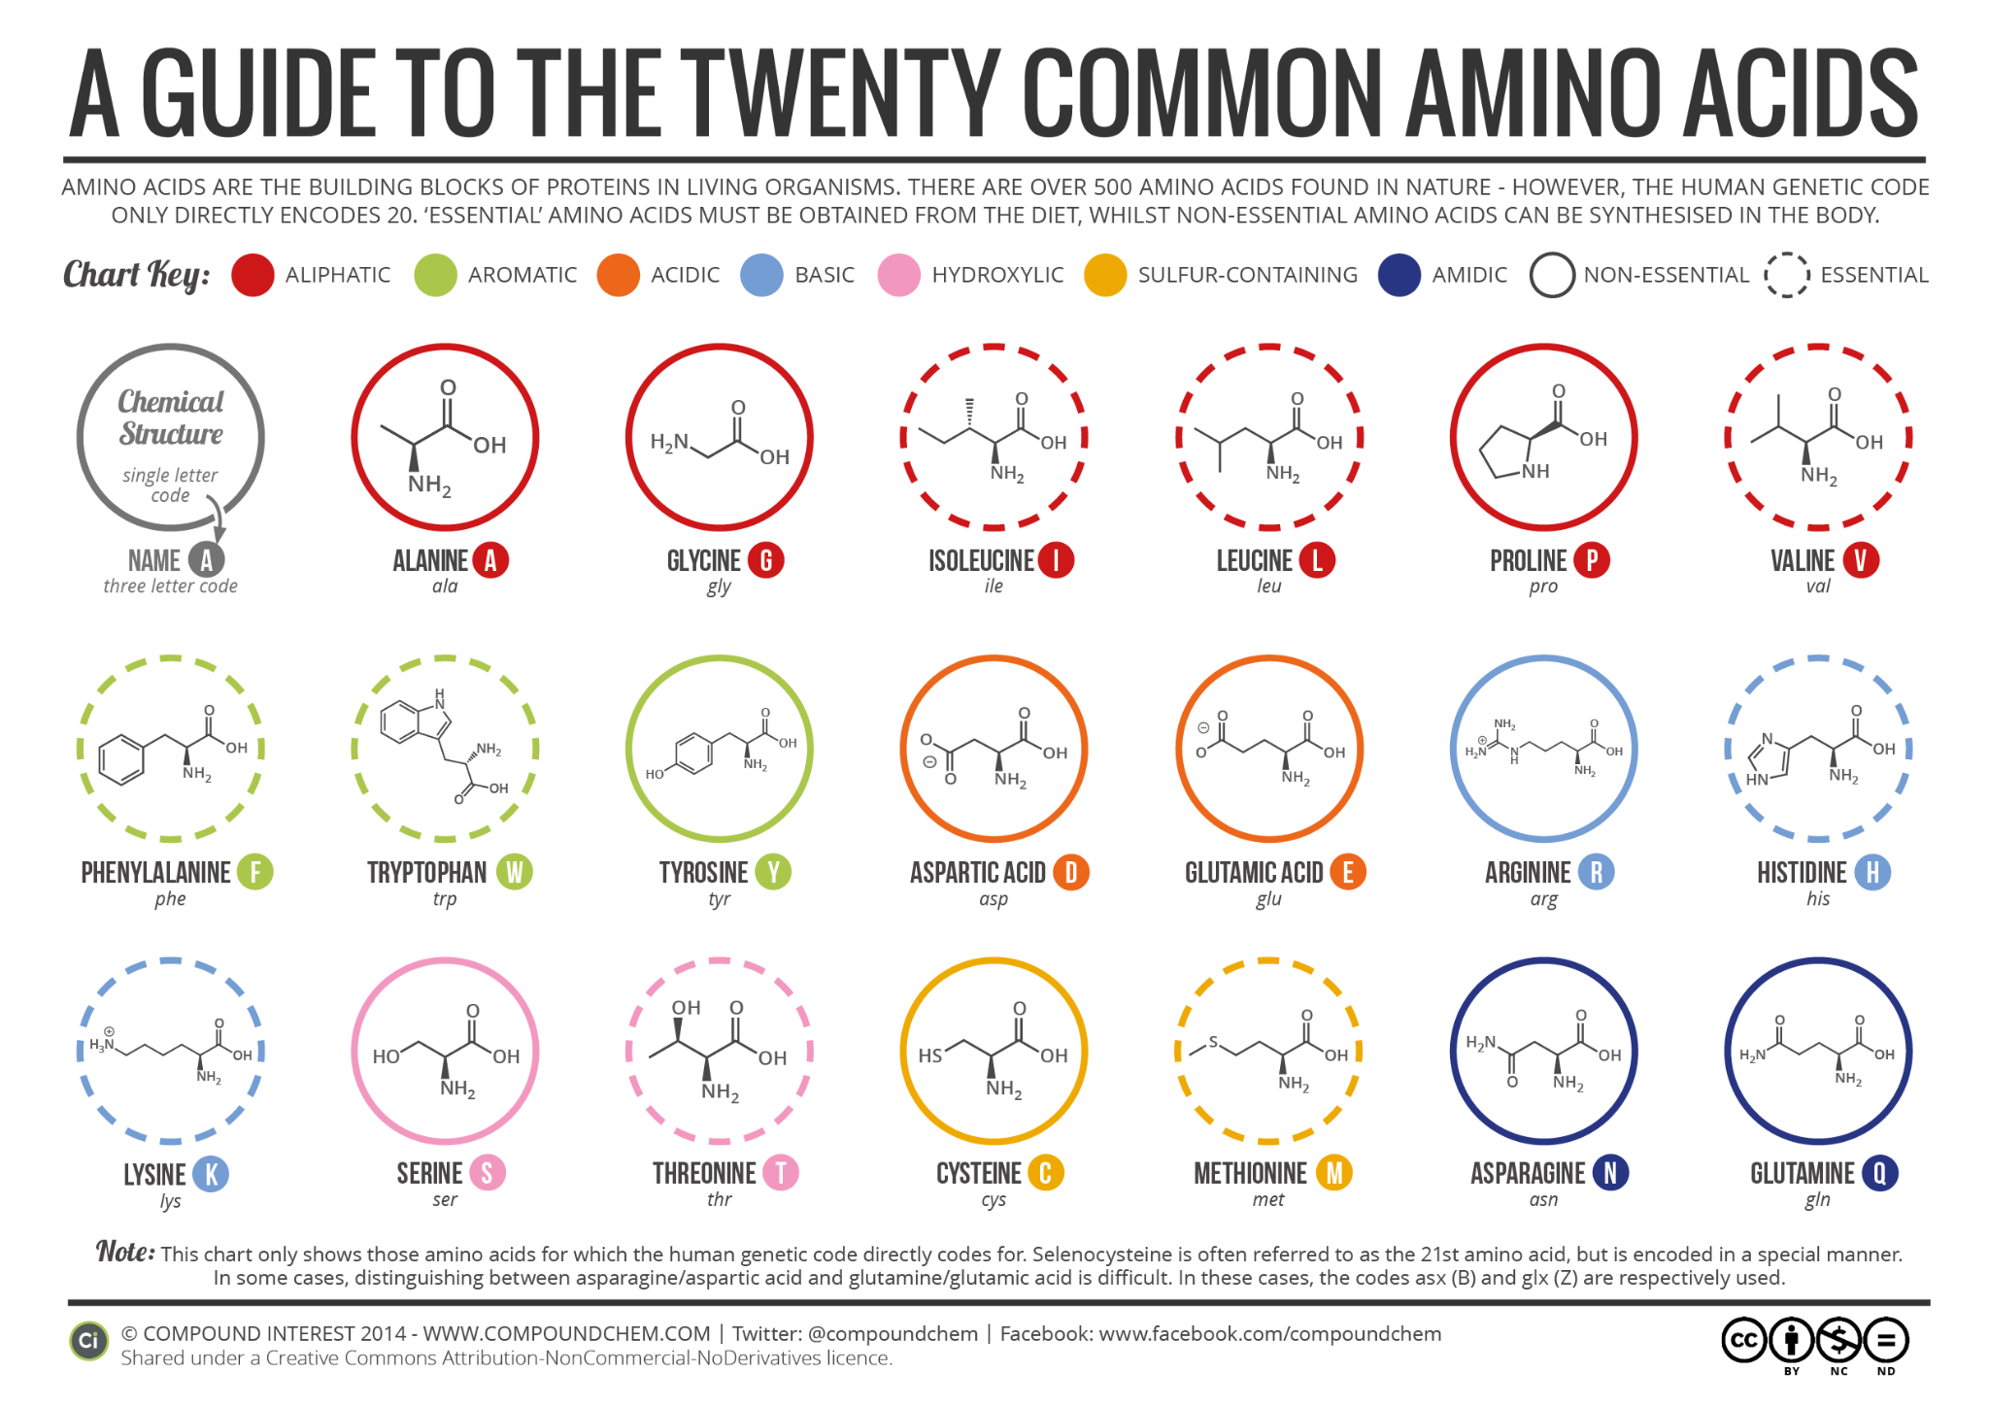
Amino Acids are the building blocks that make proteins.

Slide 8
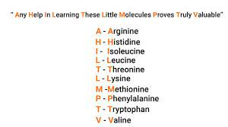
Essential Amino Acids-
MUST get in the diet
PVT TIM HALL (acronym)
  Phenylalanine
  Valine
  Tryptophan
  Threonine
  Isoleucine
  Methionine
  Histidine
  Arginine
  Leucine
  Lysine
*Only Amino Acids starting with P, T & A have some that are essential & some that are not*

Slide 9
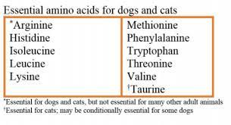
Non-Essential Amino Acids
The Human Body can make these Amino Acids from others:
Alanine
Asparagine
Aspartic Acid
Cysteine
Glutamic Acid
Glutamine
Glycine
Proline
Serine
Tyrosine
FYI - Essential amino acids varies by species

Slide 10
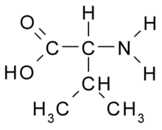
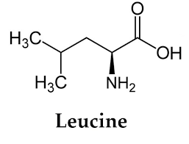
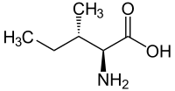
What about BCAAs?
BCAAs or Branched Chain Amino Acids are the essential amino acids leucine, isoleucine & valine. They are present in high concentrations in muscle tissues. Initial studies have shown some benefits to supplementing BCAAs before, during or after exercise to increase muscle growth, decrease post-workout soreness & reduce exercise fatigue. BCAAs have also shown some promise in treating liver disease.

Slide 11
Protein Digestion
Proteins must be broken down into amino acids prior to absorption
Digestive Enzymes are proteins that are resistant to being broken down by acid & other enzymes
Stomach – hydrochloric acid, pepsin
Small intestine – pancreatic proteases, trypsin, chymotrypsin
Brush Border – peptidases
From proteins → polypeptides
Polypeptides → di and tripeptides
Di and Tripeptides → amino acids
Notes:
Isn’t the stomach lining made of proteins too? Yes, but mucous protects these proteins from being denatured by acid. If the mucous barrier is disrupted, an ulcer can form.

Slide 12
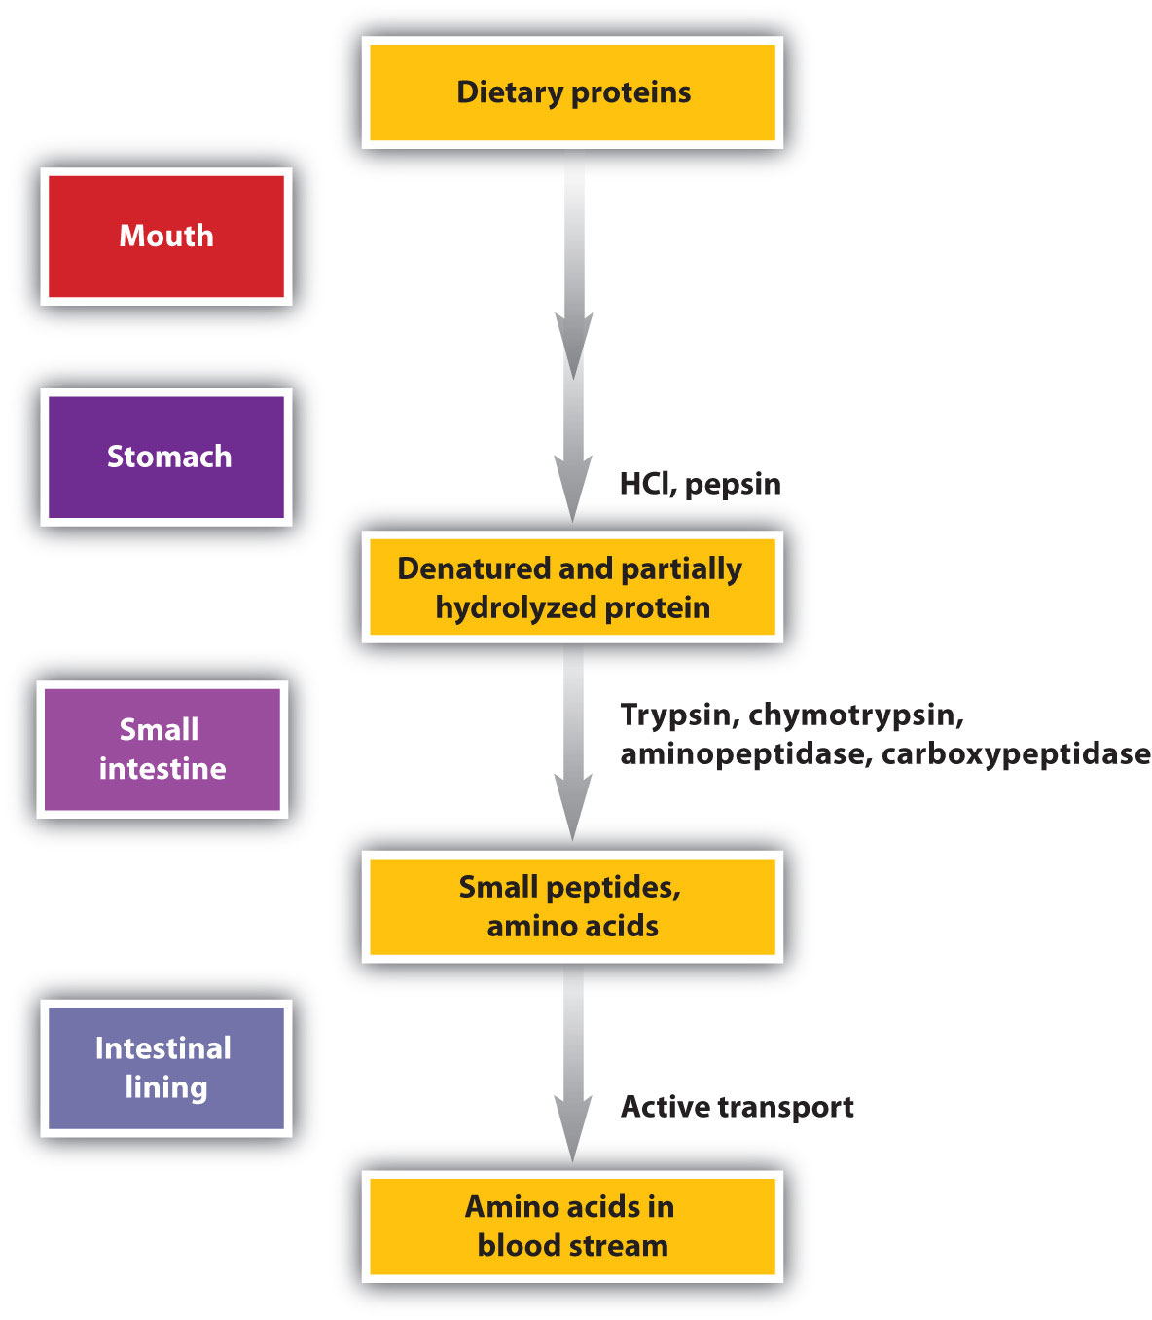

Slide 13
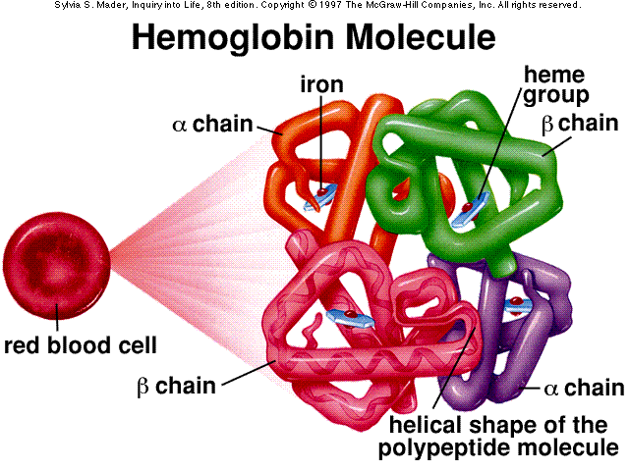
Important Body Proteins
Every cell in the body contains protein.
1) Structural Components:
Actin & Myosin
Collagen
2) Transport &/or Storage:
Hemoglobin
Ferritin
3) Messenger / Hormones:
Growth Hormone
Insulin
4) Antibodies
5) Enzymes https://youtu.be/V_E7mq8bv4g

Slide 14
Important Body Proteins - Structural
The Body contains MANY important structural proteins that provide support, structure and organization to our body’s tissues, such as:
Collagen: The most abundant protein in mammals, providing support and strength to the body’s connective tissues, including the bones, tendons and dermis of the skin.
Elastin: Provides stretch and recoil in CT
Keratin: Provides structure, protection & some waterproofing in our skin, hair & nails
Actin, Myosin & Other Muscle Proteins
Tubulin: The major protein in the cell’s cytoskeleton
Fibrinogen: The protein that forms the skeleton of a blood clot
Notes:
Every:
3 days – every cell in the gastrointestinal tract replaced
3-4 months – new red blood cells (5L of blood in body approximately)

Slide 15
Important Body Proteins - Transport & Storage
Important Transportation Proteins:
Cell Membrane Transport Proteins- make up the ion channel and “pump” type structures for transport across the cell membrane
Hemoglobin/ Myoglobin - Oxygen transportation in the bloodstream or muscle tissue
Albumin - The most abundant protein in the plasma, it helps transport many substances, including fatty acids, some hormones and some vitamins.
Important Storage Hormones:
Ferritin - binds to Iron, helping to store it for when needed
Casein - A protein found in mammal’s milk, rich in amino acids
Notes:
Every:
3 days – every cell in the gastrointestinal tract replaced
3-4 months – new red blood cells (5L of blood in body approximately)

Slide 16
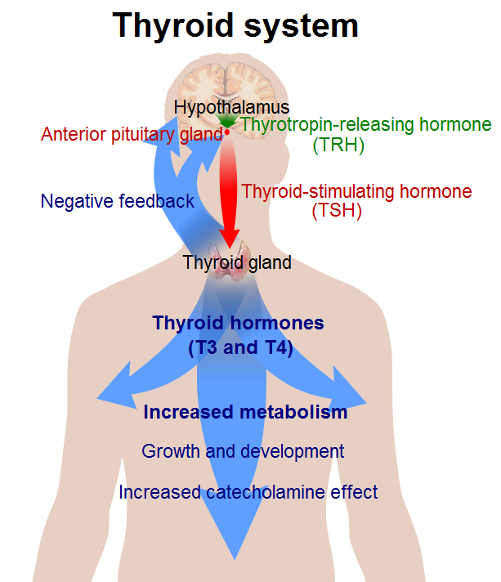
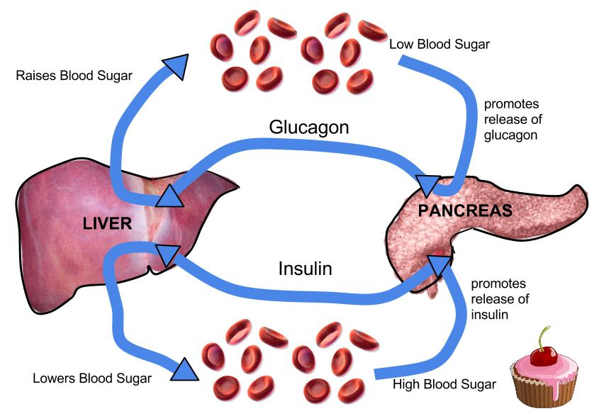
Important Body Proteins - Hormones
Hormones (recall some hormones are made from lipids)
  Eg: Thyroid hormone, insulin, glucagon
Notes:
Every:
3 days – every cell in the gastrointestinal tract replaced
3-4 months – new red blood cells (5L of blood in body approximately)

Slide 17
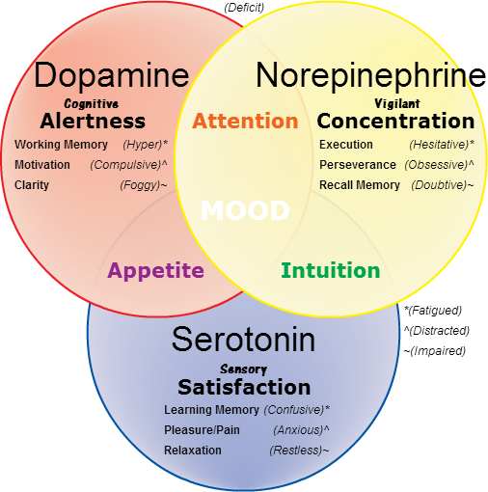
Important Body Proteins - Other Messenger Molecules
Neurotransmitters
Single amino acids, peptides or proteins may act as Neurotransmitters
Ex. Serotonin – “feel good” chemical in the brain – antidepressant medications increase serotonin levels circulating in the brain.
    Made from tryptophan
    Cashews also increase serotonin b/c they are rich in tryptophan
Cytokines - messengers that primarily affect the immune system & process of inflammation
Growth Factors
Notes:
Every:
3 days – every cell in the gastrointestinal tract replaced
3-4 months – new red blood cells (5L of blood in body approximately)

Slide 18
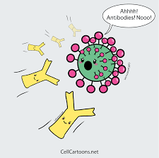
Important Body Proteins
Antibodies
  Formed by the B Lymphocytes (a type of White Blood Cell)
  Recognize every protein that belongs within the human body and leaves these alone
  Identifies foreign proteins that invade the body and attack them (bacteria, virus, toxin)
  When antibodies go “bad”:
    Hyperactive response – allergies develop (trees, grasses, molds, dust, animals, foods)
    Autoimmune diseases – body begins to attack proteins that are “normal” within the body – this is an abnormal process
Notes:
Every:
3 days – every cell in the gastrointestinal tract replaced
3-4 months – new red blood cells (5L of blood in body approximately)

Slide 19
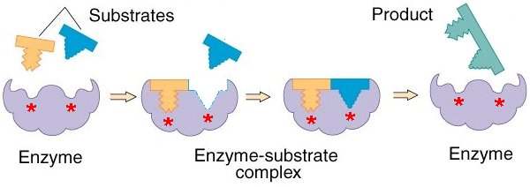
Important Body Proteins - Enzymes
Enzymes - There are many enzymes in the human body that carry out thousands of chemical reactions.
https://youtu.be/7gK-5tLFM50

Slide 20
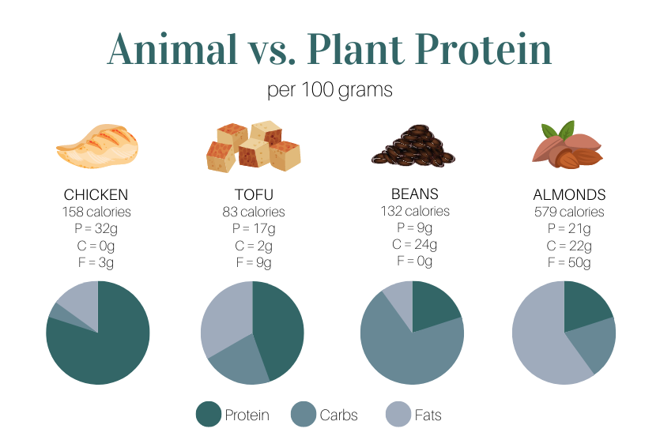
Food Sources of Protein
Digestibility
  Animal protein is highest
  Legumes (beans/lentils) – 80-90%
  Grain and other plant sources – 70-90%
  Cooking with moist heat increases
  Dry heat decreases

Slide 21
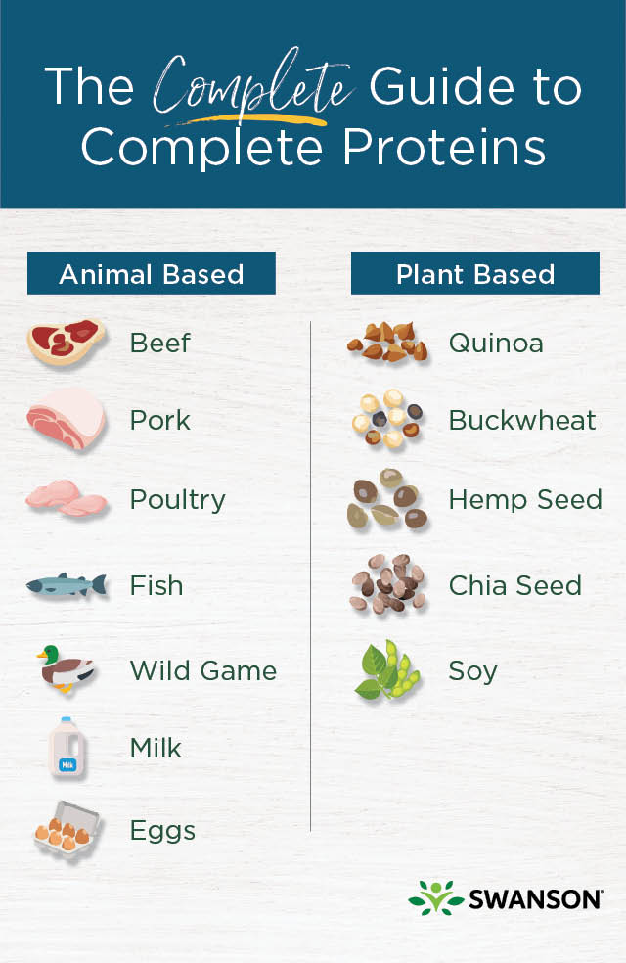
Complete vs Incomplete Proteins
A food that contains all 9 essential amino acids is called a complete protein.
In general, proteins from an animal source such as meat and dairy are usually complete proteins, while many plant proteins can be lacking one or more essential amino acids.
This is one reason why vegan protein powders are usually composed of a blend of plant sources.

Slide 22
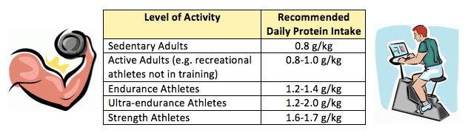
Protein Requirements
EAR -0.6g/kg body weight (remember: half the people will become deficient)
DRI – 0.8g/kg of body weight
AMDR - 10- 35% of total calories (1.05 - 3.67g/kg body weight)

Slide 23
Too much protein is toxic?
For many years, eating too much protein was considered potentially dangerous, especially regarding kidney function. In recent years, research is showing no correlation between kidney stone formation & kidney function in those consuming 20 -30 % of their calories from protein sources without pre-existing kidney disease.. Many nutrition scientists are now recommending eating protein levels above the DRI level & replacing nutrient poor carbohydrates & saturated fats with increased proteins.
https://www.ncbi.nlm.nih.gov/pmc/articles/PMC5347101/#:~:text=The%20Acceptable%20Macronutrient%20Distribution%20Range%20(AMDR)%20(10%E2%80%9335,than%20that%20of%20the%20RDA.
https://brighterworld.mcmaster.ca/articles/myth-busted-researchers-show-that-a-high-protein-diet-does-not-affect-kidney-function/

Slide 24
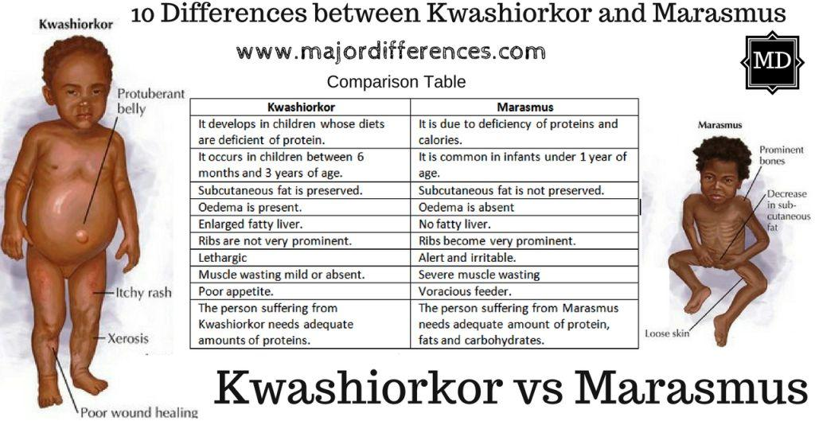
Protein Deficiency diseases = Kwashiorkor and Marasmus

Slide 25
Dietary Macronutrient Review
Carbohydrates - Composed of C,H & O elements.
Types produced by plants include: Fibre, starch and sugars.
Type produced by animals (incl. humans) is Glycogen.
RDA of 130g/day based on brain’s needs.
AMDR (Acceptable macronutrient distribution range) is 45- 65% of total calories. For 2000 kcal/day this works out to be 225 - 325g/day
BUT recall that people can survive on <20 g per day (Brain will get energy from ketone bodies instead)
AI for Fibre is 21 - 38 g/day for adults, varying according to age and sex.

Slide 26
Dietary Macronutrient Review
Lipids (AKA Fats)- Composed of C,H & O elements.
Includes polyunsaturated, unsaturated & saturated fats.
Different structural forms include: Triglycerides, Sterols & Phospholipids
Adequate Intakes are only established for:
Linoleic Acid (Omega 6) of 11 - 17g/day and
Linolenic Acid (Omega 3) of 1.1- 1.6g/day, depending on sex and age.
AMDR for percentage of calories from fat is 20 - 35%.

Slide 27
Dietary Macronutrient Review
Protein - Composed of C, H, O & N elements
RDA is 0.8 g /kg body weight for the majority of adults.
AMDR is 10 - 35% of total calories.
Deficiency of protein specifically is called Kwashiorkor.
No Upper Limits (UL)s are defined for any macronutrients.

Slide 28
Macronutrient Ratios for Specific Goals
Tracking your macros can be an effective way to work towards specific goals. Some specific ratios, based upon nutritional science are:
For weight/fat loss: 50% C:35%P:15% fat
Or 10% C: 20% P: 70% F (keto)
Muscle building: 30%C: 40% P: 30% F
For ”cutting”: 25%C: 35% P: 40% F
“Standard”: 45 - 65%C:10 - 35%P: 20 - 35%F
AMDR

Slide 29
Resources
https://www.mdpi.com/journal/nutrients
https://www.canada.ca/en/health-canada/services/nutrients.html
https://pmc.ncbi.nlm.nih.gov/articles/PMC1479724/#:~:text=Dietary%20reference%20intakes%20suggest%20that,to%20meet%20their%20unique%20needs.

