Slide 1
RESPIRATORY PATHOLOGIES

Slide 2

Introduction
The cells of the human body require a constant stream of oxygen to stay alive. The respiratory system provides oxygen to the body’s cells while removing carbon dioxide, a waste product that can be lethal if allowed to accumulate. There are 3 major parts of the respiratory system: the airway, the lungs, and the muscles of respiration. The airway, which includes the nose, mouth, pharynx, larynx, trachea, bronchi, and bronchioles, carries air between the lungs and the body’s exterior. The lungs act as the functional units of the respiratory system by passing oxygen into the body and carbon dioxide out of the body. Finally, the muscles of respiration, including the diaphragm and intercostal muscles, work together to act as a pump, pushing air into and out of the lungs during breathing.

Slide 3
Anatomy
Nose and Nasal Cavity
The nose and nasal cavity form the main external opening for the respiratory system. The nose is made of cartilage, bone, muscle, and skin that supports and protects the anterior portion of the nasal cavity. The nasal cavity is a hollow space within the nose and skull that is lined with hairs and mucus membrane. The function of the nasal cavity is to warm, moisturize, and filter air entering the body before it reaches the lungs. Hairs and mucus lining the nasal cavity help to trap dust, mold, pollen and other environmental contaminants before they can reach the inner portions of the body. Air exiting the body through the nose returns moisture and heat to the nasal cavity before being exhaled into the environment.

Slide 4
Mouth
The mouth, also known as the oral cavity, is the secondary external opening for the respiratory tract. Most normal breathing takes place through the nasal cavity, but the oral cavity can be used to supplement or replace the nasal cavity’s functions when needed. Because the pathway of air entering the body from the mouth is shorter than the pathway for air entering from the nose, the mouth does not warm and moisturize the air entering the lungs as well as the nose performs this function. The mouth also lacks the hairs and sticky mucus that filter air passing through the nasal cavity. The one advantage of breathing through the mouth is that its shorter distance and larger diameter allows more air to quickly enter the body.

Slide 5
Pharynx
The pharynx, also known as the throat, is a muscular funnel that extends from the posterior end of the nasal cavity to the superior end of the esophagus and larynx. The pharynx is divided into 3 regions: the nasopharynx, oropharynx, and laryngopharynx.
The epiglottis is a flap of elastic cartilage that acts as a switch between the trachea and the esophagus. Because the pharynx is also used to swallow food, the epiglottis ensures that air passes into the trachea by covering the opening to the esophagus. During the process of swallowing, the epiglottis moves to cover the trachea to ensure that food enters the esophagus and to prevent choking.

Slide 6
Larynx
The larynx, also known as the voice box, is a short section of the airway that connects the laryngopharynx and the trachea. The larynx is located in the anterior portion of the neck, just inferior to the hyoid bone and superior to the trachea. Several cartilage structures make up the larynx and give it its structure. The epiglottis is one of the cartilage pieces of the larynx and serves as the cover of the larynx during swallowing. Inferior to the epiglottis is the thyroid cartilage, which is often referred to as the Adam’s apple as it is most commonly enlarged and visible in adult males. Inferior to the thyroid cartilage is the ring-shaped cricoid cartilage which holds the larynx open and supports its posterior end. In addition to cartilage, the larynx contains special structures known as vocal folds, which allow the body to produce the sounds of speech. The vocal folds are folds of mucous membrane that vibrate to produce vocal sounds. The tension and vibration speed of the vocal folds can be changed to change the pitch that they produce.

Slide 7
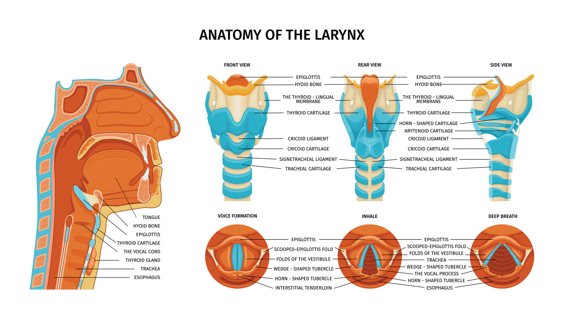
Larynx

Slide 8
Trachea
The trachea, or windpipe, is a 5-inch long tube made of C-shaped hyaline cartilage rings lined with pseudostratified ciliated columnar epithelium. The trachea connects the larynx to the bronchi and allows air to pass through the neck and into the thorax. The rings of cartilage making up the trachea allow it to remain open to air at all times. The open end of the cartilage rings faces posteriorly toward the esophagus, allowing the esophagus to expand into the space occupied by the trachea to accommodate masses of food moving through the esophagus.
The main function of the trachea is to provide a clear airway for air to enter and exit the lungs. In addition, the epithelium lining the trachea produces mucus that traps dust and other contaminants and prevents it from reaching the lungs. Cilia on the surface of the epithelial cells move the mucus superiorly toward the pharynx where it can be swallowed and digested in the gastrointestinal tract.

Slide 9
Bronchi and Bronchioles
At the inferior end of the trachea, the airway splits into left and right branches known as the primary bronchi. The left and right bronchi run into each lung before branching off into smaller secondary bronchi. The secondary bronchi carry air into the lobes of the lungs—2 in the left lung and 3 in the right lung. The secondary bronchi in turn split into many smaller tertiary bronchi within each lobe. The tertiary bronchi split into many smaller bronchioles that spread throughout the lungs. Each bronchiole further splits into many smaller branches less than a millimeter in diameter called terminal bronchioles. Finally, the millions of tiny terminal bronchioles conduct air to the alveoli of the lungs.

Slide 10
Continued
As the airway splits into the tree-like branches of the bronchi and bronchioles, the structure of the walls of the airway begins to change.
The primary bronchi contain many C-shaped cartilage rings that firmly hold the airway open.
As the bronchi branch into secondary and tertiary bronchi, the cartilage becomes more widely spaced and more smooth muscle and elastin protein is found in the walls.
The bronchioles differ from the structure of the bronchi in that they do not contain any cartilage at all. The presence of smooth muscles and elastin allow the smaller bronchi and bronchioles to be more flexible and contractile.

Slide 11
Continued
The main function of the bronchi and bronchioles is to carry air from the trachea into the lungs.
Smooth muscle tissue in their walls helps to regulate airflow into the lungs. When the body requires greater volumes of air, such as during exercise, the smooth muscle relaxes to dilate the bronchi and bronchioles. The dilated airway provides less resistance to airflow and allows more air to pass into and out of the lungs. The smooth muscle fibers are able to contract during rest to prevent hyperventilation.
The bronchi and bronchioles also use the mucus and cilia of their epithelial lining to trap and move dust and other contaminants away from the lungs.

Slide 12
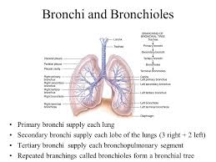

Slide 13
Lungs
The lungs are a pair of large, spongy organs found in the thorax lateral to the heart and superior to the diaphragm.
Each lung is surrounded by a pleural membrane that provides the lung with space to expand as well as a negative pressure space relative to the body’s exterior. The negative pressure allows the lungs to passively fill with air as they relax.
The left and right lungs are slightly different in size and shape due to the heart pointing to the left side of the body. The left lung is therefore slightly smaller than the right lung and is made up of 2 lobes while the right lung has 3 lobes.

Slide 14
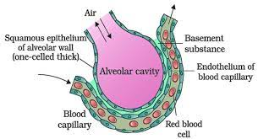
Continued
The interior of the lungs is made up of spongy tissues containing many capillaries and around 30 million tiny sacs known as alveoli.
The alveoli are cup-shaped structures found at the end of the terminal bronchioles and surrounded by capillaries. The alveoli are lined with thin simple squamous epithelium that allows air entering the alveoli to exchange its gases with the blood passing through the capillaries.

Slide 15
Muscles of Respiration
The principal muscle of respiration in the human body is the diaphragm, a thin sheet of skeletal muscle that forms the floor of the thorax. When the diaphragm contracts, it moves inferiorly a few inches into the abdominal cavity, expanding the space within the thoracic cavity and pulling air into the lungs. Relaxation of the diaphragm allows air to flow back out the lungs during exhalation.
Between the ribs are many small intercostal muscles that assist the diaphragm with expanding and compressing the lungs.
These muscles are divided into 2 groups: the internal intercostal muscles and the external intercostal muscles. The internal intercostal muscles are the deeper set of muscles and depress the ribs to compress the thoracic cavity and force air to be exhaled from the lungs.
The external intercostals are found superficial to the internal intercostals and function to elevate the ribs, expanding the volume of the thoracic cavity and causing air to be inhaled into the lungs.

Slide 16
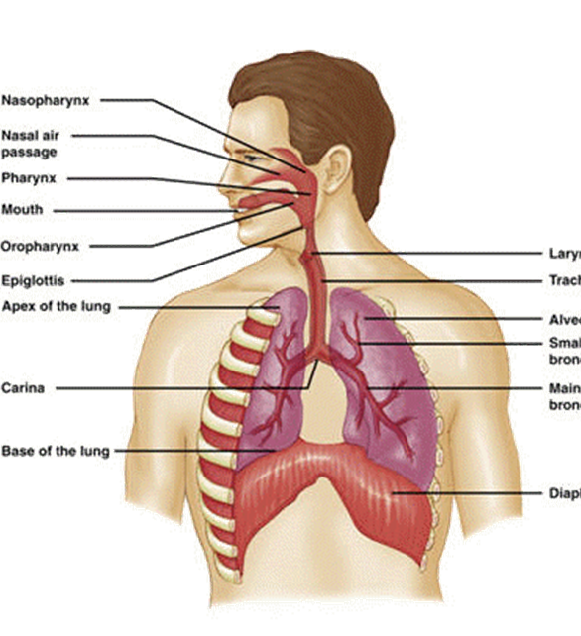
https://youtu.be/0fVoz4V75_E

Slide 17
Mechanics of Breathing
Pulmonary ventilation is the process of moving air into and out of the lungs to facilitate gas exchange. The respiratory system uses both a negative pressure system and the contraction of muscles to achieve pulmonary ventilation
. The negative pressure system of the respiratory system involves the establishment of a negative pressure gradient between the alveoli and the external atmosphere. The pleural membrane seals the lungs and maintains the lungs at a pressure slightly below that of the atmosphere at rest. This results in air following the pressure gradient and passively filling the lungs at rest. As the lungs fill with air, the pressure within the lungs rises until it matches the atmospheric pressure. At this point, more air can be inhaled by the contraction of the diaphragm and the external intercostal muscles, increasing the volume of the thorax and reducing the pressure of the lungs below that of the atmosphere again.

Slide 18
Exhalation
To exhale air, the diaphragm and external intercostal muscles relax while the internal intercostal muscles contract to reduce the volume of the thorax and increase the pressure within the thoracic cavity.
The pressure gradient is now reversed, resulting in the exhalation of air until the pressures inside the lungs and outside of the body are equal. At this point, the elastic nature of the lungs causes them to recoil back to their resting volume, restoring the negative pressure gradient present during inhalation.

Slide 19
External Respiration
External respiration is the exchange of gases between the air filling the alveoli and the blood in the capillaries surrounding the walls of the alveoli.
Air entering the lungs from the atmosphere has a higher partial pressure of oxygen and a lower partial pressure of carbon dioxide than does the blood in the capillaries. The difference in partial pressures causes the gases to diffuse passively along their pressure gradients from high to low pressure through the simple squamous epithelium lining of the alveoli.
The net result of external respiration is the movement of oxygen from the air into the blood and the movement of carbon dioxide from the blood into the air. The oxygen can then be transported to the body’s tissues while carbon dioxide is released into the atmosphere during exhalation.

Slide 20
Internal Respiration
is the exchange of gases between the blood in capillaries and the tissues of the body.
Capillary blood has a higher partial pressure of oxygen and a lower partial pressure of carbon dioxide than the tissues through which it passes. The difference in partial pressures leads to the diffusion of gases along their pressure gradients from high to low pressure through the endothelium lining of the capillaries. The net result of internal respiration is the diffusion of oxygen into the tissues and the diffusion of carbon dioxide into the blood.

Slide 21
Transportation of Gases
The 2 major respiratory gases, oxygen and carbon dioxide, are transported through the body in the blood.
Blood plasma has the ability to transport some dissolved oxygen and carbon dioxide, but most of the gases transported in the blood are bonded to transport molecules.
Hemoglobin is an important transport molecule found in red blood cells that carries almost 99% of the oxygen in the blood. Hemoglobin can also carry a small amount of carbon dioxide from the tissues back to the lungs.
However, the vast majority of carbon dioxide is carried in the plasma as bicarbonate ion. When the partial pressure of carbon dioxide is high in the tissues, the enzyme carbonic anhydrase catalyzes a reaction between carbon dioxide and water to form carbonic acid. Carbonic acid then dissociates into hydrogen ion and bicarbonate ion. When the partial pressure of carbon dioxide is low in the lungs, the reactions reverse and carbon dioxide is liberated into the lungs to be exhaled.

Slide 22
Homeostatic Control of Respiration
Under normal resting conditions, the body maintains a quiet breathing rate and depth called eupnea.
Eupnea is maintained until the body’s demand for oxygen and production of carbon dioxide rises due to greater exertion. Autonomic chemoreceptors in the body monitor the partial pressures of oxygen and carbon dioxide in the blood and send signals to the respiratory center of the brain stem. The respiratory center then adjusts the rate and depth of breathing to return the blood to its normal levels of gas partial pressures.

Slide 23
Neural control of breathing
No autorhythmic pacemaker cells for respiration, as in the heart.
Exact mechanism for setting the rhythm of respiration remains unknown
Breathing depends on repetitive stimuli of skeletal muscles from brain
Neurons in medulla oblongata and pons control unconscious breathing
Voluntary control provided by motor cortex
Inspiratory neurons fire during inspiration
Expiratory neurons fire to inhibit inspiratory neurons during eupnoea

Slide 24
Innervation
-Phrenic nerve supplies the diaphragm
-Intercostal nerves supply the intercostal muscles
The rate at which the nerves discharge is influenced by the concentration of oxygen, carbon dioxide and the acidity of the blood.
The normal respiratory rate in adults is between 14 and 18 breaths per minute on average.

Slide 25
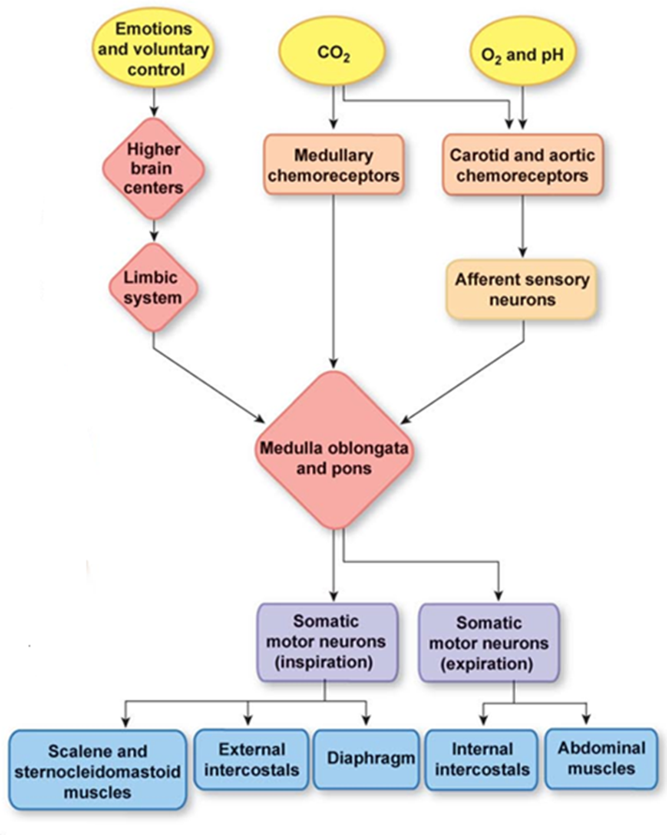

Slide 26
Effects of Exercise on Breathing
During exercise, the muscle cells respire more than they do at rest. This means: Oxygen and glucose must be delivered to them more quickly; Waste carbon dioxide must be removed more quickly
This is achieved by increasing the breathing rate and heart rate. The stroke volume also increases – this is the volume of blood pumped each beat. The total cardiac output can be calculated using the equation:
Cardiac output = stroke volume x heart rate
During hard exercise, the oxygen supply may not be enough for the needs of the muscle cells. When this happens, anaerobic respiration takes place, as well as aerobic respiration.

Slide 27
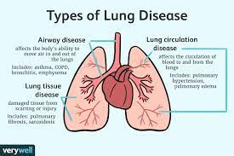
Respiratory Pathologies

Slide 28
Upper Respiratory Conditions
Common Cold
The common cold is a viral infection of the upper respiratory tract — nose and throat. A common cold is usually harmless, although it may not feel that way at the time. If it's not a runny nose, sore throat and cough, it's the watery eyes, sneezing and congestion — or maybe all of the above. In fact, because any one of more than 100 viruses can cause a common cold, signs and symptoms tend to vary greatly.
Preschool children are at greatest risk of frequent colds, but even healthy adults can expect to have a few colds each year. Most people recover from a common cold in about a week or two.

Slide 29
Symptoms
Symptoms of a common cold usually appear about one to three days after exposure to a cold-causing virus. Signs and symptoms of a common cold may include:
Runny or stuffy nose
Itchy or sore throat
Cough
Congestion
Slight body aches or a mild headache
Sneezing
Watery eyes
Low-grade fever
Mild fatigue
The discharge from the nose may become thicker and yellow or green in color as a common cold runs its course.

Slide 30
Causes
Although more than 100 viruses can cause a common cold, the rhinovirus is the most common culprit, and it's highly contagious.
A cold virus enters the body through the mouth, eyes or nose. The virus can spread through droplets in the air when someone who is sick coughs, sneezes or talks. But it also spreads by hand-to-hand contact with someone who has a cold or by sharing contaminated objects (vehicles of transmission), such as utensils, towels, toys or telephones.

Slide 31
Sinusitis
Sinusitis: is an inflammation, or swelling, of the tissue lining the sinuses. Normally, sinuses are filled with air, but when sinuses become blocked and filled with fluid, germs (bacteria, viruses, and fungi) can grow and cause an infection. Conditions that can cause sinus blockage include the common cold, allergic rhinitis, nasal polyps (small growths in the lining of the nose), or a deviated septum (a shift in the nasal cavity). There are different types of sinusitis, including:
  Acute sinusitis: A sudden onset of cold-like symptoms such as runny, stuffy nose and facial pain that does not go away after 10 to 14 days. Acute sinusitis typically lasts 4 weeks or less.
  Subacute sinusitis: An inflammation lasting 4 to 8 weeks.
  Chronic sinusitis: A condition characterized by sinus inflammation symptoms lasting 8 weeks or longer.
  Recurrent sinusitis: Several attacks within a year.

Slide 32
Symptoms of Sinusitis
Some of the primary symptoms of acute sinusitis include:
Facial pain/pressure
Nasal stuffiness
Nasal discharge
Loss of smell
Cough/congestion
Fever
Bad breath
Fatigue
Dental pain

Slide 33
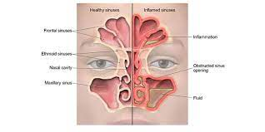
Sinusitis

Slide 34
Otitis Media
middle ear infection that is most common in infants and young children, especially those between the ages of 6 months and 3 years. By the age of one year, most children will have had one or more middle ear infections. Although a middle ear infection can occur at any age, it's much less common in older children and adults. Ear infections do not spread from person to person and they most commonly occur with a cold. Antibiotics are often used to treat ear infections.
The middle ear is connected to the throat by a small tube called the eustachian tube. It's protected from the outside by a thin shield called the tympanic membrane, or eardrum. Viruses and bacteria that normally live in the throat can sometimes cross into the middle ear through the eustachian tube, causing an infection.

Slide 35
Types
Middle ear infections can be categorized as acute, chronic or serous.
Common symptoms of acute otitis media are fever, pain, and irritability. Other symptoms can include difficulty sleeping, tugging on the ear and loss of or decreased hearing. In children, the ear infection often begins after the child has had a cold for several days.
It's more difficult to detect signs of ear infection in young babies. You may notice a change in mood or feeding, and the infant will most likely have a fever. Because ear infections are usually painful, many babies will be irritable.
If fluid builds up in the ear, the infection is called serous otitis media. (That's serous, referring to fluid, not serious.) This occurs when the eustachian tube becomes blocked, and pressure in the middle ear drops. Under these circumstances, the child might experience hearing loss or impairment in the infected ear. This is usually only temporary.

Slide 36
Risk Factors
Some factors that increase a child's risk for middle ear infections include:
Crowded living conditions
Attending daycare
Exposure to secondhand smoke
Respiratory illnesses such as the common cold
Close contact with siblings who have colds
Having a cleft palate
Allergies that cause congestion on a chronic basis
Premature birth
Not being breast-fed
Bottle-feeding while lying down

Slide 37
Continued
Chronic otitis media refers to a long-lasting ear infection. This is often complicated by (or caused by) a hole in the eardrum (perforation) from any one of the following:
  Acute infection
  Blocked eustachian tube
  Heat or chemical burns
  Injury from sudden air pressure changes
  Injury from an object entering the ear
Chronic ear infections often flare up after a cold, or, if the eardrum is perforated, when water enters the ear during swimming or bathing. Repeated or long-lasting infections can destroy the small bones in the middle ear, leading to long-term hearing loss. More serious complications include spread to nearby organs, facial paralysis, and brain infections (encephalitis or brain abscesses)

Slide 38
Tonsillitis
At the back of the throat, two masses of lymph tissue called tonsils act as filters, trapping germs that could otherwise enter the airways and cause infection. They also produce antibodies to fight infection. But sometimes the tonsils themselves become infected. Overwhelmed by bacteria or viruses, they swell and become inflamed, a condition known as tonsillitis.
Tonsillitis is common, especially in children. The condition can occur occasionally or recur frequently. Bacterial and viral infections can cause tonsillitis. A common cause is Streptococcus bacteria. Other common causes include:
  Adenoviruses Epstein-Barr virus
  Influenza virus Parainfluenza viruses
  Enteroviruses Herpes simplex virus

Slide 39
Symptoms
The main symptoms of tonsillitis are inflammation and swelling of the tonsils, sometimes severe enough to block the airways. Other symptoms include:
Throat pain or tenderness Redness of the tonsils
A white or yellow coating on the tonsils Bad breath
Hoarseness or loss of voice Headache
Loss of appetite Ear pain
Difficulty swallowing or breathing through the mouth
Swollen glands in the neck or jaw area Fever, chills

Slide 40
Pharyngitis
Or sore throat, is discomfort, pain, or scratchiness in the throat. It often makes it painful to swallow. It is caused by swelling in the back of the throat (pharynx) between the tonsils and the larynx.
Most sore throats are caused by colds, the flu, coxsackie virus or mononucleosis. Bacteria can cause pharyngitis in some cases.
  Strep throat is caused by group A streptococcus.
  Less commonly, bacteria such as gonorrhea and chlamydia can cause sore throat.
Most cases of pharyngitis occur during the colder months. The illness often spreads among family members and close contacts. The main symptom is a sore throat. Other symptoms may include:
  Fever
  Headache
  Joint pain and muscle aches
  Skin rashes

Slide 41
Pharyngitis
Treatment: Salt water gargling and honey are two old remedies that have some effectiveness against many pathogens.
Strep Throat should be treated with antibiotics to avoid possible complications including rheumatic fever.
Pharyngitis can also be caused by allergens or irritants, in which case treatment would involve antihistamines.
Pharyngitis (& laryngitis) may also occur from overuse of the voice as in excessive singing or yelling. Treatment would involve rest, and soothing strategies such as lozenges, honey, tea or ice chips.

Slide 42
Laryngitis
Inflammation of your voice box (larynx) from overuse, irritation or infection. Inside the larynx are the vocal cords — two folds of mucous membrane covering muscle and cartilage. Normally, the vocal cords open and close smoothly forming sounds through their movement and vibration.
But in laryngitis, the vocal cords become inflamed or irritated. This swelling causes distortion of the sounds produced by air passing over them. As a result, the voice sounds hoarse. In some cases of laryngitis, the voice can become almost undetectable.
Laryngitis may be short-lived (acute) or long lasting (chronic). Signs and symptoms can include:
Hoarseness Weak voice or voice loss
Tickling sensation and/or rawness of the throat
Sore & Dry throat Dry cough

Slide 43
Causes of Laryngitis
Causes of acute laryngitis include:
  Viral infections similar to those that cause a cold
  Vocal strain, caused by yelling or overusing your voice
  Bacterial infections, such as diphtheria, although this is rare
Laryngitis that lasts longer than three weeks is known as chronic laryngitis. This type of laryngitis is generally caused by exposure to irritants over time. Chronic laryngitis can cause vocal cord strain and injuries or growths on the vocal cord (polyps or nodules).
These injuries can be caused by:
Inhaled irritants, such as chemical fumes, allergens or smoke (Smoking)
Acid reflux, also called gastroesophageal reflux disease (GERD)
Chronic sinusitis Excessive alcohol use
Habitual overuse of the voice (such as with singers or cheerleaders)

Slide 44
Influenza
commonly called the flu, is a respiratory disease that affects the nose, throat and lungs. A virus that is easily passed from person to person causes it.
Seasonal influenza is the annual influenza that affects people in Canada during the winter, between November and April.
  Seasonal influenza viruses change slightly from year to year.
Various strains of influenza virus circulate throughout the world each year and new strains can emerge and spread.
Most healthy people are able to recover from influenza without severe complications.
As with other viral illnesses, antibiotics do not work against an influenza virus. Antiviral medications may be used for treatment or prevention of influenza.
Influenza lowers the body’s ability to fight other infections. It can lead to bacterial infections, such as pneumonia, and even death especially in the elderly, children (6–60 months), pregnant women, and people with chronic medical conditions.

Slide 45
Symptoms
People develop symptoms of influenza from 1–4 days after exposure.
They can pass on the virus from the day before they have the first symptoms until at least 5–7 days after the symptoms start. Symptoms include:
Fever of 38 C (100.4 F) or higher that starts suddenly;
A dry cough that can last for weeks;
Headache;
An aching body especially in the lower back and legs;
Feeling very weak and tired.
Chills;
Loss of appetite;
Sore throat;
Runny or stuffy nose;
Some people may have nausea, vomiting and diarrhea.

Slide 46
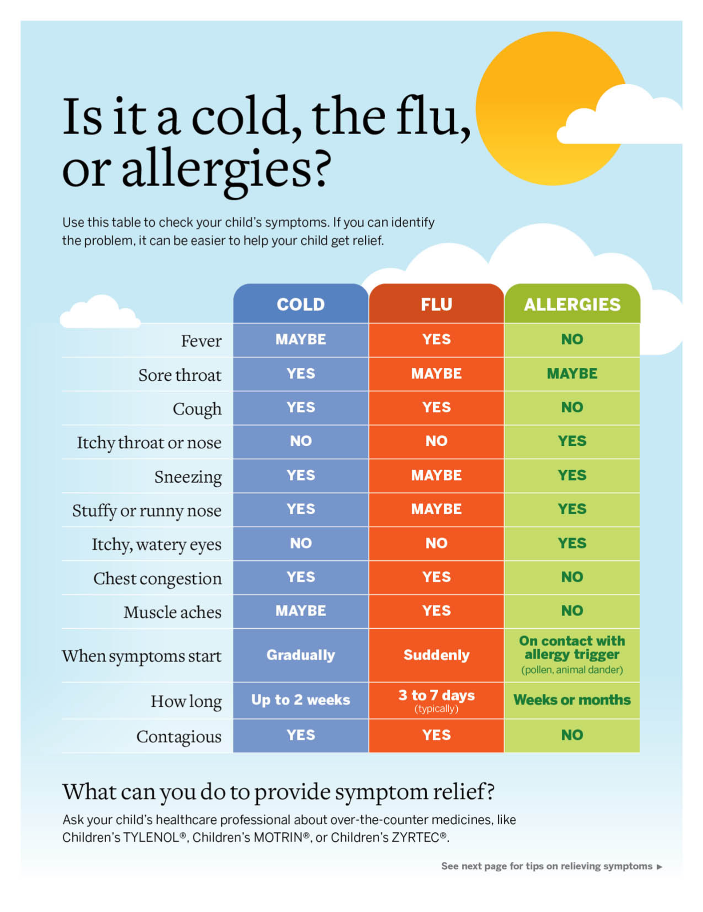

Slide 47
Lower Respiratory Disease
Bronchiolitis
a common lung infection in young children and infants.
It causes congestion in the small airways (bronchioles) of the lung. A virus almost always causes Bronchiolitis. Typically, the peak time for bronchiolitis is during the winter months.
Bronchiolitis starts out with symptoms similar to those of a common cold but then progresses to coughing, wheezing and sometimes difficulty breathing.
Symptoms of bronchiolitis can last for several days to weeks, even a month.
Most children get better with supportive care at home. A very small percentage of children require hospitalization.

Slide 48
Symptoms
For the first few days, the signs and symptoms of bronchiolitis are similar to those of a common cold:
Runny nose
Stuffy nose
Cough
Slight fever (not always present)
After this, there may be a week or more of breathing difficulty or a whistling noise when breathing out (wheezing). Many infants will also have an ear infection (otitis media). The viral infection makes the bronchioles swell and become inflamed. Mucus collects in these airways, which can make it difficult for air to flow freely into and out from the lungs.

Slide 49
Causes
Most cases of bronchiolitis are caused by the respiratory syncytial virus (RSV).
RSV is a common virus, which infects just about every child by the age of 2. Seasonal outbreaks of RSV infection occur every winter.
Bronchiolitis can also be caused by a variety of other viruses, including those that cause the flu or the common cold. It is a contagious condition.

Slide 50
Acute Bronchitis
Acute bronchitis
  Acute bronchitis is inflammation of the bronchial tubes, which are the airways that allow air to pass from the mouth to the lungs. It is a general term that describes inflammation of the bronchi that is usually caused by viruses or bacteria. A cough lasting 5 or more days suggests acute bronchitis as a cause. People with recurrent acute bronchitis may develop chronic bronchitis.

Slide 51
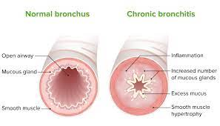
Causes of Acute Bronchitis
The most common causes of acute bronchitis are viruses.
Influenza, parainfluenza, RSV, rhinovirus, and corona viruses, but many people develop fairly mild symptoms so often the viral genus is never determined. Bacteria are less common the causative agents of acute bronchitis.

Slide 52
Symptoms and Risk Factors
Coughing is the most common symptom of acute bronchitis. The coughing begins early in the disease and usually lasts about 10 to 20 days as it gradually subsides. About 50% of individuals have a productive cough with either clear, yellow, greenish, or occasionally blood tinged sputum. The other symptoms may include: sore throat, nasal congestion, headache, muscle aches, and fatigue.
Risk factors for acute bronchitis are the same as those for getting viral and bacterial infections; being in close contact with people that are coughing, sneezing, and touching items that infected persons recently handled. People that are exposed to air pollution, tobacco smoke, and to chemicals that are aerosolized are at higher risk for acute bronchitis. Unfortunately, many people worldwide are at risk; as many as 44 per 1000 individuals may develop acute bronchitis per year. The highest risks for the disease are the winter months.

Slide 53
Chronic Bronchitis
Chronic bronchitis is defined as a cough that occurs every day with sputum production that lasts for at least 3 months, 2 years in a row
In chronic bronchitis, the lining of the airways is constantly irritated and inflamed. This causes the lining to thicken. Lots of thick mucus forms in the airways, making it hard to breathe.
Most people who have COPD have both emphysema and chronic bronchitis. Thus, the general term "COPD" is more accurate. COPD is a major cause of disability, and it's the third leading cause of death in the United States.. Many more people may have the disease and not even know it. COPD develops slowly. Symptoms often worsen over time and can limit ability to do routine activities. Severe COPD may prevent the person from doing even basic activities like walking, cooking. Most of the time, COPD is diagnosed in middle-aged or older adults. The disease isn't passed from person to person. COPD has no cure yet, and doctors don't know how to reverse the damage to the airways and lungs. However, treatments and lifestyle changes can help the patient feel better, stay more active, and slow the progress of the disease.

Slide 54
Chronic Obstructive Pulmonary Disease (COPD)
COPD, or chronic obstructive pulmonary disease, is a progressive disease that makes it hard to breathe. "Progressive" means the disease gets worse over time. COPD can cause coughing that produces large amounts of mucus, wheezing, shortness of breath, chest tightness, and other symptoms. Cigarette smoking is the leading cause of COPD. Most people who have COPD smoke or used to smoke. Long-term exposure to other lung irritants—such as air pollution, chemical fumes, or dust—also may contribute to COPD. In COPD, less air flows in and out of the airways because of one or more of the following:
The airways and air sacs lose their elastic quality.
The walls between many of the air sacs are destroyed.
The walls of the airways become thick and inflamed.
The airways make more mucus than usual, which can clog them.
https://youtu.be/Y29bTzKK_P8?feature=shared

Slide 55
Continued
The term "COPD" includes two main conditions—emphysema and chronic bronchitis. In emphysema, the walls between many of the air sacs are damaged. As a result, the air sacs lose their shape and become floppy. This damage also can destroy the walls of the air sacs, leading to fewer and larger air sacs instead of many tiny ones. If this happens, the amount of gas exchange in the lungs is reduced.
https://youtu.be/TEuSV_7gWA8?feature=shared

Slide 56
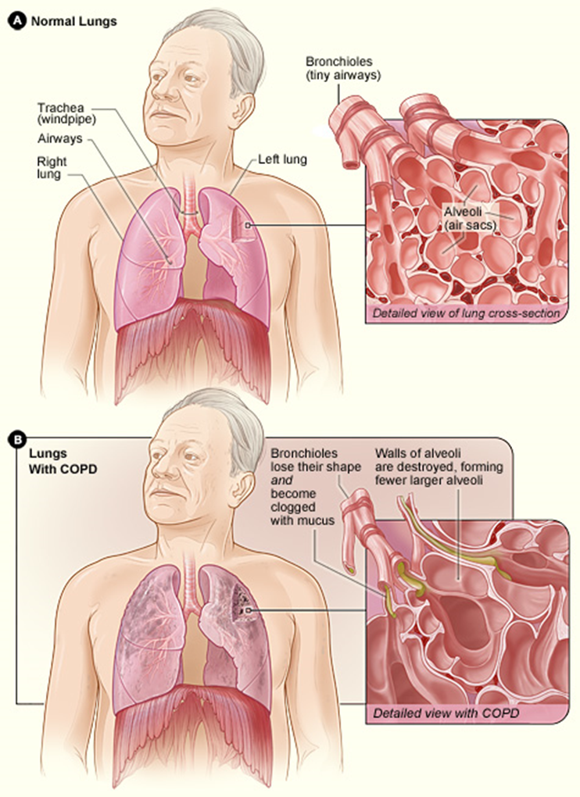

Slide 57
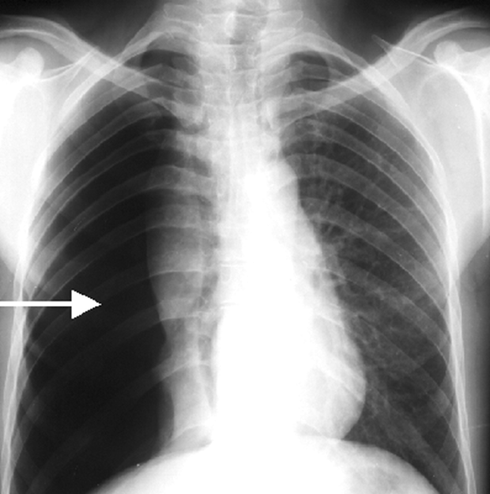

Slide 58
Pneumonia
https://youtu.be/IAQp2Zuqevc
Inflammation of the lung tissue. It is usually due to infection. Pneumonia tends to be more serious than bronchitis. Sometimes bronchitis and pneumonia occur together, which is called bronchopneumonia.
Pneumonia is commonly caused by an infection with a bacterium, virus or fungi. Other germs such as yeasts, or protozoa can sometimes also cause pneumonia. Rarely, inhaling poisons or chemicals causes non-infective pneumonia.
Most common causes are Strep. Pneumoniae – “typical pneumonia” (sudden onset, crackles, fever, productive cough)
Mycoplasma pneumoniae, Chlamydophila pneumoniae – “atypical pneumonia” (gradual onset, unproductive cough, crackles may not be present)
& Legionella pneumophila (Legionnaire’s disease https://youtu.be/x1ELZC9SdEM?feature=shared
“Walking pneumonia” – NOT a medical term, just refers to a milder form. Often an atypical pneumonia caused by Mycoplasma

Slide 59
Symptoms
Typical symptoms are cough with sputum, the sputum may become yellow/green colored and is sometimes bloodstained, fever, sweats, shivers, and feeling generally unwell. Headaches and aches and pains are common, breathless, tight chest. A sharp pain in the side of the chest may develop if the infection involves the pleura.
A person may breathe in some bacteria, viruses, or other germs. If he/she is normally healthy a small number of germs usually doesn't matter. They will be trapped in his/her sputum and killed by his/her immune system. Sometimes the germs multiply and cause lung infections. This is more likely to happen if a person is already in poor health. For example: if s/he is frail or elderly, if s/he has a chest disease, or if s/he has a low immunity to infection. Such things as alcohol dependence, HIV/AIDS, or another serious illness can cause low immunity. However, even healthy people sometimes develop pneumonia.

Slide 60
Tuberculosis
https://youtu.be/6P6zBHpWiGA
a potentially serious infectious disease that mainly affects your lungs. The bacteria that cause tuberculosis are spread from one person to another through tiny droplets released into the air via coughs and sneezes. Many strains of tuberculosis resist the drugs most used to treat the disease. People with active tuberculosis must take several types of medications for many months to eradicate the infection and prevent development of antibiotic resistance.
  Latent TB. In this condition, a person has a TB infection, but the bacteria remain in his body in an inactive state and cause no symptoms. Latent TB, also called inactive TB or TB infection, isn't contagious. It can turn into active TB, so treatment is important for the person with latent TB and to help control the spread of TB in general.
  Active TB. In this condition the person is sick and can spread infection to others. It can occur in the first few weeks after infection with the TB bacteria, or it might occur years later.

Slide 61
Signs and Symptoms of Active TB
Coughing that lasts three or more weeks
Coughing up blood
Chest pain, or pain with breathing or coughing
Fatigue
Fever/Chills
Night sweats
Loss of appetite/Unintentional weight loss
Tuberculosis can also affect other parts of the body, including the kidneys, spine or brain. When TB occurs outside the lungs, signs and symptoms vary according to the organs involved. For example, tuberculosis of the spine may give back pain, and tuberculosis in kidneys might cause blood in urine. Bacteria that spread from person to person through microscopic droplets released into the air, cause tuberculosis. This can happen when someone with the untreated, active form of tuberculosis coughs, speaks, sneezes, spits, or laughs.

Slide 62
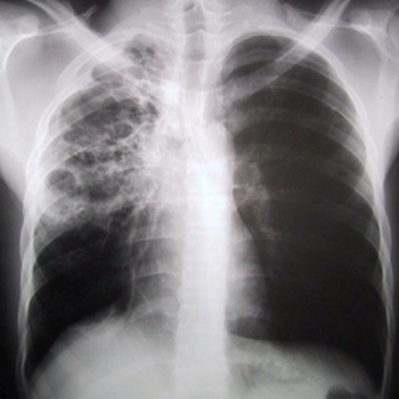

Slide 63
Asthma and its effects on Respiration
Asthma is a chronic inflammation of the bronchial tubes (airways) that causes swelling and narrowing (constriction) of the airways.
The result is difficulty breathing. The bronchial narrowing is usually either totally or at least partially reversible with treatments. Bronchial tubes that are chronically inflamed may become overly sensitive to allergens (specific triggers) or irritants (nonspecific triggers). The airways may become "twitchy" and remain in a state of heightened sensitivity. This is called "bronchial hyperreactivity" (BHR). It is likely that there is a spectrum of bronchial hyperreactivity in all individuals. However, it is clear that asthmatics and allergic individuals (without apparent asthma) have a greater degree of bronchial hyperreactivity than nonasthmatic and nonallergic people

Slide 64
Continued
In sensitive individuals, the bronchial tubes are more likely to swell and constrict when exposed to triggers such as allergens, tobacco smoke, or exercise. Amongst asthmatics, some may have mild BHR and no symptoms while others may have severe BHR and chronic symptoms. Asthma affects people differently. Each individual is unique in their degree of reactivity to environmental triggers. This naturally influences the type and dose of medication prescribed, which may vary from one individual to another.
Asthma causes a narrowing of the breathing airways, which interferes with the normal movement of air in and out of the lungs. Asthma involves only the bronchial tubes and does not affect the air sacs or the lung tissue. The narrowing that occurs in asthma is caused by three major factors: inflammation, bronchospasm, and hyperreactivity

Slide 65
Inflammation
The first and most important factor causing narrowing of the bronchial tubes is inflammation. The bronchial tubes become red, irritated, and swollen. This inflammation increases the thickness of the wall of the bronchial tubes and thus results in a smaller passageway for air to flow through.
The inflammation occurs in response to an allergen or irritant and results from the action of chemical mediators (histamine, leukotrienes, and others). The inflamed tissues produce an excess amount of "sticky" mucus into the tubes. The mucus can clump together and form "plugs" that can clog the smaller airways.

Slide 66
Bronchospasm
The muscles around the bronchial tubes tighten during an attack of asthma. This muscle constriction of the airways is called bronchospasm. Bronchospasm causes the airway to narrow further. Chemical mediators and nerves in the bronchial tubes cause the muscles to constrict. Bronchospasm can occur in all humans and can be brought on by inhaling cold or dry air.

Slide 67
Hyperactivity (Hypersensitivity)
In patients with asthma, the chronically inflamed and constricted airways become highly sensitive, or reactive, to triggers such as allergens, irritants, and infections. Exposure to these triggers may result in progressively more inflammation and narrowing.
The combination of these three factors results in difficulty with breathing out, or exhaling. As a result, the air needs to be forcefully exhaled to overcome the narrowing, thereby causing the typical "wheezing" sound. People with asthma also frequently "cough" in an attempt to expel the thick mucus plugs. Reducing the flow of air may result in less oxygen passing into the bloodstream, and if very severe, carbon dioxide may dangerously accumulate in the blood

Slide 68
Common Asthma Triggers:
Allergens
Common asthma triggers: Allergens
"Seasonal" pollens
Year-round dust mites, molds, pets, and insect parts
Foods, such as fish, egg, peanuts, nuts, cow's milk, and soy
Work-related agents, such as latex, epoxides, and formaldehyde

Slide 69
Irritants
Respiratory infections, such as those caused by viral "colds," bronchitis, and sinusitis
Drugs, such as aspirin, other NSAIDs (nonsteroidal anti-inflammatory drugs), and beta blockers (used to treat blood pressure and other heart conditions)
Tobacco smoke
Outdoor factors, such as smog, weather changes, and diesel fumes
Indoor factors, such as paint, detergents, deodorants, chemicals, and perfumes
GERD (gastroesophageal reflux disorder)
Exercise, especially under cold dry conditions
Work-related factors, such as chemicals, dusts, gases, and metals
Emotional factors, such as laughing, crying, yelling, and distress
Hormonal factors, such as in premenstrual syndrome

Slide 70
Pneumoconiosis
a lung condition that is caused by inhaling particles of mineral dust, usually while working in a high-risk, mineral-related industry. At first, irritating mineral dust can trigger lung inflammation, which causes areas of the lung to be temporarily damaged. Over time, these areas can progress to form tough, fibrous tissue deposits. This stage of pneumoconiosis is called fibrosis. Fibrosis stiffens the lungs and interferes with the lung's normal exchange of oxygen and carbon dioxide.

Slide 71
Types
Asbestosis — Asbestos is the general name for a family of irritating fibrous minerals that are mined from underground deposits and used in the manufacture of home insulation, fireproof materials, tiles for floors and ceilings, automobile brake linings, and other products. Workers with the highest asbestos exposure include miners, construction workers, demolition workers, shipbuilders and auto mechanics who work with brakes. Asbestos exposure also can affect people who live or work in buildings where asbestos-containing building products are deteriorating. In most cases, signs of asbestosis do not develop for 20 or more years after a person is first exposed to asbestos dust.
Silicosis — this form of pneumoconiosis affects people who work with silica, usually in the form of quartz that is found in sand, sandstone, slate, some clays, granite and other ores. Workers with the highest exposure to silica include sandblasters, miners, tunnel builders, silica millers, quarry workers, foundry workers and those who make ceramics or glass. Silicosis can cause progressive fibrosis in the lung with a significant decrease in lung function, especially in cigarette smokers.

Slide 72
Continued
Coal worker's pneumoconiosis — this form of pneumoconiosis is caused by inhaling carbon particles from coal, graphite, lamp black or carbon black. It most often affects people who mine, process or ship coal; graphite miners; and workers who manufacture synthetic graphite, lamp black or carbon black. Like silicosis, coal worker's pneumoconiosis can cause significant fibrosis, primarily in miners who have worked for decades without protective equipment.
Talc pneumoconiosis — this is caused by exposure to talc dust, usually during talc mining. Talc pneumoconiosis also can lead to lung fibrosis.
Siderosis of the lung — this pneumoconiosis, also known as welder's lung or silver polisher's lung, is caused by inhaling iron particles. Although welder's lung often looks abnormal on a chest X-ray, it usually does not cause any symptoms.

Slide 73
Symptoms
Pneumoconiosis sometimes does not cause any symptoms. When symptoms develop,they can include: Cough (with or without mucus), Wheezing, Shortness of breath, especially during exercise
If pneumoconiosis causes severe lung fibrosis, breathing can become extremely difficult. When this happens, the patient's lips and fingernails may have a bluish tinge. In very advanced disease, there also may be signs of leg swelling caused by too much strain on the heart.

Slide 74
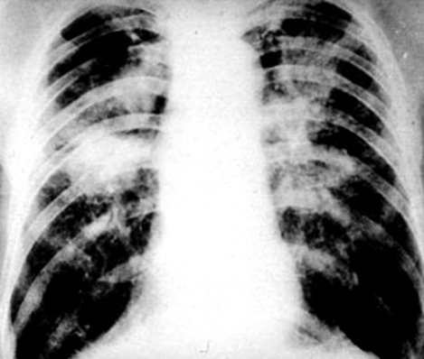

Slide 75
Carcinoma of the Lung
estimated that up to 90% of all lung cancer cases are the result of cigarette smoking. Lung cancer accounts for the majority of all cancers worldwide, in both men and women. Besides cigarette smoking, other tobacco products such as pipe tobacco and cigars also contribute to the pathophysiology of lung cancer. Other toxins, such as radon, arsenic, and asbestos also seem to play a role, as does second-hand smoke. The World Health Organization (WHO) estimates that approximately 1.2 million cases of cancer worldwide are due to lung cancer.
There are other contributing risk factors as well including diet, and genetic disposition. A diet high in fat intake has been found to contribute to an increased risk. Conversely, a diet high in fruits and vegetables has been associated with a reduced risk.

Slide 76
Classifications
Lung cancers are generally classified as either small cell lung cancer (SCLC) or non-small cell lung cancer (NSCLC). Non-small cell lung cancers account for approximately 85% of all lung cancers.
NSCLCs are further divided into three subcategories: adenocarcinoma, large cell carcinoma, and squamous cell carcinoma. Adenocarcinoma is the most common type of NSCLC among non-smokers & it is also considered the most treatable type of lung cancer. NSCLCs tend to grow and spread more slowly than SCLCs.
SCLC is the lung cancer most associated with smoking, and almost all patients who have SCLC have a history of smoking.

Slide 77
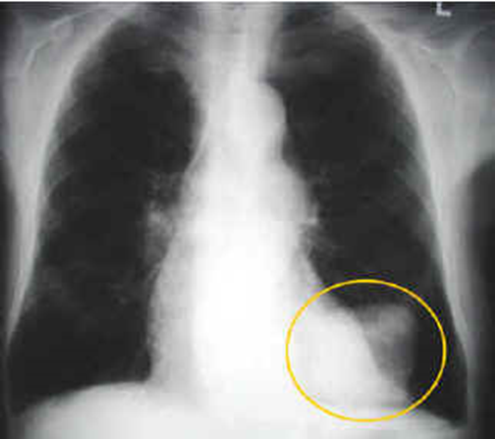

Slide 78
Pleural cavity disease
Pleurisy, Pneumothorax, and
Pleural effusion
Pleurisy: Pleurisy is inflammation of the parietal pleura that typically results in characteristic pleuritic pain and has a variety of possible causes.
The visceral pleura does not contain any nociceptors ( pain receptors). The parietal pleura is innervated by somatic nerves that sense pain when the parietal pleura is inflamed. Inflammation that occurs at the periphery of the lung parenchyma can extend into the pleural space and involve the parietal pleura, thereby activating the somatic pain receptors and resulting in pleuritic pain.
Parietal pleura of the outer rib cage and lateral aspect of each hemidiaphragm are innervated by intercostal nerves.

Slide 79
Pleurisy Continued
Pain is localized to the cutaneous distribution of those nerves. The phrenic nerve supplies innervations to the central part of each hemidiaphragm; when these fibers are activated, the sensation of pain is referred to the ipsilateral neck or shoulder. Patients with pleuritic pain present in different ways depending on the underlying cause. Pleuritic pain typically is localized to the area that is inflamed or along predictable referred pain pathways. Patients' descriptions of the pain are consistent in most cases of pleurisy. The classic feature is that forceful breathing movement, such as taking a deep breath, talking, coughing, or sneezing, exacerbates the pain. Patients often relate that the pain is sharp and is made worse with movement. Typically, they will assume a posture that limits motion of the affected area. Pain with respiration may cause patients to complain of shortness of breath or dyspnea.
https://youtu.be/fIJW9K9K0BY

Slide 80
Pneumothorax
defined as the presence of air or gas in the pleural cavity (ie, the potential space between the visceral and parietal pleura of the lung), which can impair oxygenation and/or ventilation.
The clinical results are dependent on the degree of collapse of the lung on the affected side. If the pneumothorax is significant, it can cause a shift of the mediastinum and compromise hemodynamic stability. Air can enter the intrapleural space through a communication from the chest wall (ie, trauma) or through the lung parenchyma across the visceral pleura

Slide 81
Types
Osmosis Pneomothorax
The presentation of patients with pneumothorax varies depending on the following types of pneumothorax and ranges from completely asymptomatic to life-threatening respiratory distress:
  Spontaneous pneumothorax: No clinical signs or symptoms in primary spontaneous pneumothorax until a bleb ruptures and causes pneumothorax; typically, the result is acute onset of chest pain and shortness of breath, particularly with secondary spontaneous pneumothorax
  Iatrogenic pneumothorax: Symptoms similar to those of spontaneous pneumothorax, depending on patient’s age, presence of underlying lung disease, and extent of pneumothorax. Caused by a medical intervention.
  Tension pneumothorax: Hypotension, hypoxia, chest pain, dyspnea
  Pneumomediastinum: Must be differentiated from spontaneous pneumothorax; patients may or may not have symptoms of chest pain, persistent cough, sore throat, dysphagia, shortness of breath, or nausea/vomiting

Slide 82
Pleural Effusion
an abnormal amount of fluid around the lung. It can result from many medical conditions. Most pleural effusions are not serious by themselves, but some require treatment to avoid problems.The pleura is a thin membrane that lines the surface of the lungs and the inside of the chest wall outside the lungs. In pleural effusions, fluid accumulates in the space between the layers of pleura. Normally, only very small amount of watery fluid are present in the pleural space, allowing the lungs to move smoothly within the chest cavity during breathing. Numerous medical conditions can cause pleural effusions.
Some of the more common causes are:
  Congestive heart failure Pneumonia
  Liver disease (cirrhosis) End-stage renal disease
  Nephrotic syndrome Cancer
  Pulmonary embolism Lupus and other autoimmune conditions

Slide 83
Symptoms
Pleural effusions often cause no symptoms. Symptoms are more likely when a pleural effusion is moderate or large-sized, or if inflammation is present. Symptoms of pleural effusions may include:
  Shortness of breath(dyspnea)
  Chest pain, especially on breathing in deeply (pleurisy, or pleuritic pain)
  Fever
  Cough
Because pleural effusions are usually caused by underlying medical conditions, symptoms of these conditions are also often present.

Slide 84
Pulmonary Edema
a condition caused by excess fluid in the lungs. This fluid collects in the numerous air sacs in the lungs, making it difficult to breathe. In most cases, heart problems cause pulmonary edema. But fluid can accumulate for other reasons, including pneumonia, exposure to certain toxins and medications, trauma to the chest wall, and exercising or living at high elevations. Pulmonary edema that develops suddenly (acute pulmonary edema) is a medical emergency requiring immediate care

Slide 85
Symptoms
Depending on the cause, pulmonary edema symptoms may appear suddenly or develop over time.
Sudden (acute) pulmonary edema symptoms
Extreme shortness of breath or difficulty breathing (dyspnea) that worsens when lying down
A feeling of suffocating or drowning
Wheezing or gasping for breath
Anxiety, restlessness or a sense of apprehension
A cough that produces frothy sputum that may be tinged with blood
Chest pain if pulmonary edema is caused by heart disease
A rapid, irregular heartbeat (palpitations)

Slide 86
Symptoms
Long-term (chronic) pulmonary edema symptoms:
Having more shortness of breath than normal when you're physically active.
Difficulty breathing with exertion.
Difficulty breathing when lying flat.
Wheezing.
Awakening at night with a breathless feeling that may be relieved by sitting up.
Rapid weight gain when pulmonary edema develops as a result of congestive heart failure.
Swelling in lower extremities.
Fatigue.

Slide 87
Symptoms of and Mechanisms Leading to Infant and Adult Respiratory Distress Syndrome
Acute respiratory distress syndrome (ARDS) in adult: occurs when fluid builds up in the alveoli in the lungs. More fluid in the lungs means less oxygen can reach the bloodstream. This deprives organs of the oxygen they need to function.
ARDS typically occurs in people who are already critically ill or who have significant injuries. Severe shortness of breath — the main symptom of ARDS — usually develops within a few hours to a few days after the original disease or trauma.

Slide 88
Continued
Many people who develop ARDS don't survive. The risk of death increases with age and severity of illness. Of the people who do survive ARDS, some recover completely while others experience lasting damage to their lungs.
Signs and symptoms of ARDS can vary in intensity, depending on its cause and severity. They include:
  Severe shortness of breath
  Labored and unusually rapid breathing
  Low blood pressure
  Confusion and extreme tiredness
  https://youtu.be/l6FMNRmz_A8

Slide 89
Cause
The mechanical cause of ARDS is fluid leaked from the smallest blood vessels in the lungs into the alveoli. Normally, a protective membrane keeps this fluid in the vessels. Severe illness or injury, however, can cause inflammation that undermines the membrane’s integrity, leading to the fluid leakage of ARDS.
The most common underlying causes of ARDS include:
  Sepsis. The most common cause of ARDS is sepsis, a serious and widespread infection of the bloodstream.
  Inhalation of harmful substances. Breathing high concentrations of smoke or chemical fumes can result in ARDS, as can inhaling (aspirating) vomit.
  Severe pneumonia. Severe cases of pneumonia usually affect all five lobes of the lungs.
  Head or chest injury. Accidents, such as falls or car crashes, can directly damage the lungs or the portion of the brain that controls breathing.

Slide 90
Infant Respiratory Distress Syndrome
IRDS is a hyaline membrane disease: Neonatal or infant respiratory distress syndrome (RDS) is a problem often seen in premature babies. The condition makes it hard for the baby to breathe. Neonatal RDS occurs in infants whose lungs have not yet fully developed. The disease is mainly caused by a lack of a slippery substance in the lungs called surfactant. This substance helps the lungs fill with air and keeps the air sacs from deflating. Surfactant is present when the lungs are fully developed. Neonatal RDS can also be due to genetic problems with lung development.
Most cases of RDS occur in babies born before 37 weeks. The less the lungs are developed, the higher the chance of RDS after birth. The problem is uncommon in babies born full-term (at 40 weeks).

Slide 91
Risk Factors
Other factors that can increase the risk of RDS include:
  A brother or sister who had RDS
  Diabetes in the mother
  Cesarean delivery or induction of labor before the is full-term
  Problems with delivery that reduce blood flow to the baby
  Multiple pregnancy (twins or more)
  Rapid labor

Slide 92
Symptoms
Most of the time symptoms appear within minutes of birth. However, they may not be seen for several hours. Symptoms may include:
  Bluish color of the skin and mucus membranes (cyanosis)
  Brief stop in breathing (apnea)
  Decreased urine output
  Grunting
  Nasal flaring
  Rapid breathing
  Shallow breathing
  Shortness of breath and grunting sounds while breathing
  Unusual breathing movement (such as drawing back of the chest muscles with breathing)

Slide 93
Respiratory Failure
a syndrome in which the respiratory system fails in one or both of its gas exchange functions: oxygenation and carbon dioxide elimination. In practice, it may be classified as either hypoxemic or hypercapnic.
Type I - Hypoxemic respiratory failure (type I) is characterized by an arterial oxygen tension (Pa O2) lower than 60 mm Hg with a normal or low arterial carbon dioxide tension (Pa CO2). This is the most common form of respiratory failure, and it can be associated with virtually all acute diseases of the lung, which generally involve fluid filling or collapse of alveolar units. Some examples of type I respiratory failure are cardiogenic or noncardiogenic pulmonary edema, pneumonia, and pulmonary hemorrhage.

Slide 94
Type II
Hypercapnic respiratory failure (type II) is characterized by a PaCO2 higher than 50 mm Hg.
Hypoxemia is common in patients with hypercapnic respiratory failure who are breathing room air. The pH depends on the level of bicarbonate, which, in turn, is dependent on the duration of hypercapnia. Common etiologies include drug overdose, neuromuscular disease, chest wall abnormalities, and severe airway disorders (eg, asthma and chronic obstructive pulmonary disease [COPD]).

Slide 95
Causes
Common causes of type I (hypoxemic) respiratory failure include the following:
COPD, Pneumonia, Pulmonary edema, Pulmonary fibrosis, Asthma, Pneumothorax, Pulmonary embolism, Pulmonary arterial hypertension, Pneumoconiosis, Cyanotic congenital heart disease, Bronchiectasis, Acute respiratory distress syndrome (ARDS), Fat embolism syndrome, Kyphoscoliosis, Obesity.
Common causes of type II (hypercapnic) respiratory failure include the following:
COPD, Severe asthma, Drug overdose, Poisonings, Myasthenia gravis, Polyneuropathy, Poliomyelitis, Primary muscle disorders, Head and cervical cord injury, Pulmonary edema, Myxedema, Tetanus.

Slide 96
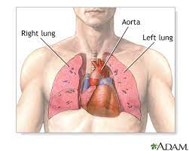
Circulatory Problems that affect the lungs

Slide 97
Pulmonary Embolism
Sudden blockage of a major blood vessel (artery) in the lung, usually by a blood clot. In most cases the clots are small and are not deadly, but they can damage the lung. But if the clot is large and stops blood flow to the lung, it can be deadly. Quick treatment could save the life or reduce the risk of future problems.
SIgns & Symptoms- Sudden shortness of breath.
Sharp chest pain that is worse with cough or a deep breath.
A cough that brings up pink, foamy mucus.
Pulmonary embolism can also cause more general symptoms. For example, the patient may feel anxious or on edge, sweats a lot, feels lightheaded or faints, or has a fast heart rate or palpitations.

Slide 98
Causes
In most cases, pulmonary embolism is caused by a blood clot in the leg that breaks loose and travels to the lungs. A blood clot in a vein close to the skin is not likely to cause problems. But having blood clots in deep veins (deep vein thrombosis) can lead to pulmonary embolism. Other things can block an artery, such as tumors, air bubbles, amniotic fluid, or fat that is released into the blood vessels when a bone is broken. But these are rare.
Some people are born with blood that clots too quickly. Other things that can increase the risk include:
  Being inactive for long periods. Like staying in bed after surgery or a serious illness, or sitting for a long time on a flight or car trip.
  Recent surgery that involved the legs, hips, belly, or brain.
  Some diseases, such as cancer, heart failure, stroke, or a severe infection.
  Pregnancy
  Taking birth control pills or hormone therapy.
  Smoking.
  Overweight

Slide 99
Pulmonary Arterial Hypertension
Pulmonary hypertension is a type of high blood pressure that affects the arteries in the lungs and the right side of the heart.
It begins when tiny arteries in the lungs, called pulmonary arteries, and capillaries become narrowed, blocked or destroyed. This makes it harder for blood to flow through the lungs, and raises pressure within the lungs' arteries. As the pressure builds, the heart's lower right chamber (right ventricle) must work harder to pump blood through the lungs, eventually causing the heart muscle to weaken and eventually fail. Pulmonary hypertension is a serious illness that becomes progressively worse and is sometimes fatal.

Slide 100
Signs and Symptoms
The signs and symptoms of pulmonary hypertension in its early stages may not be noticeable for months or even years. As the disease progresses, symptoms become worse.
Pulmonary hypertension symptoms include:
Shortness of breath (dyspnea), initially while exercising and eventually while at rest
Fatigue
Dizziness or fainting spells (syncope)
Chest pressure or pain
Swelling (edema) in the ankles, legs and eventually in the abdomen (ascites)
Bluish color to the lips and skin (cyanosis)
Racing pulse or heart palpitations

Slide 101
Causes
Causes of pulmonary hypertension include:
Idiopathic
Blood clots in the lungs (pulmonary emboli)
Chronic obstructive pulmonary diseases, such as emphysema
Connective tissue disorders, such as scleroderma or lupus
Sleep apnea and other sleep disorders
Congenital heart defects
Sickle cell anemia
Chronic liver disease (cirrhosis)
HIV/AIDS
Lung diseases such as pulmonary fibrosis, a condition that causes scarring in the tissue between the lungs' air sacs.
Left-sided heart failure
Living at altitudes higher than 8,000 feet (2,438 meters)
Use of certain stimulant drugs, such as cocaine

Slide 102
Causes
Causes:
Coronary artery disease
Cardiomyopathy
Heart valve problems.
High blood pressure (hypertension)
Acute respiratory distress syndrome (ARDS)
High altitudes.
Adverse drug reaction
Viral infections
Smoke inhalation.
Near drowning

Slide 103
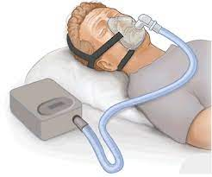
Other Pathologies affecting respiration

Slide 104
Bronchiectasis
Describes damage to the walls of the bronchial tubes with loss of the smooth muscle and loss of elasticity of segments of the bronchi. The resultant airway distortion prevents secretions from being adequately cleared from the lung. Bronchiectasis may be congenital or acquired. Cystic fibrosis is the most common cause of congenital bronchiectasis. An increased amount of sputum production, recurrent infections, and gradual loss of lung function leading to shortness of breath characterize it.

Slide 105
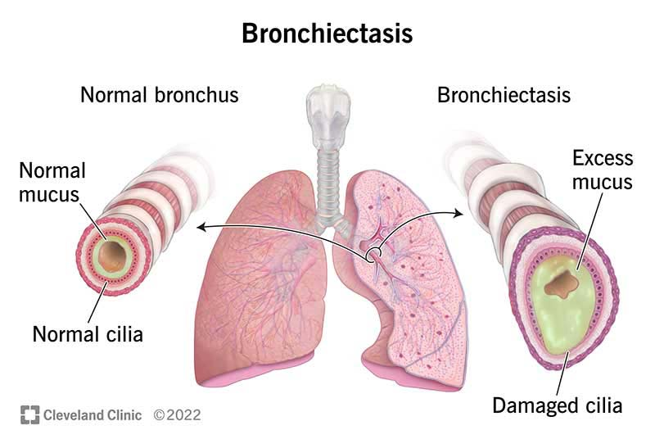
Causes
Congenital (cystic fibrosis)
Recurrent infection
Aspiration of foreign bodies
or other materials
Inhalation of toxic gases like ammonia
Alcohol and drug abuse
Tuberculosis

Slide 106
Symptoms
Common symptoms include recurrent cough and sputum production. Usually the mucus is clear, but it may be bloody due to bronchial wall injury or green or yellow if infection is present. Shortness of breath and fatigue develop as lung function decreases. Wheezing may or may not be present. If the disease progresses or if it is poorly controlled, the amount of work required to breathe increases and weight loss and diminished quality of life may occur.

Slide 107
Cystic Fibrosis
https://youtu.be/CqFsAwCFvCM
a life-threatening disorder that causes severe damage to the lungs and digestive system. An inherited condition, cystic fibrosis affects the cells that produce mucus, sweat and digestive juices. These secreted fluids are normally thin and slippery. But in cystic fibrosis, a defective gene causes the secretions to become thick and sticky. Instead of acting as a lubricant, the secretions plug up tubes, ducts and passageways, especially in the lungs and pancreas.
Cystic fibrosis is most common in white people of Northern European ancestry, but also occurs in Hispanics, African-Americans and some Native Americans. It is rare in people of Asian and Middle Eastern origin.
In cystic fibrosis, a defect (mutation) in a gene changes a protein that regulates the movement of salt in and out of cells. The result is thick, sticky mucus in the respiratory, digestive and reproductive systems, as well as increased salt in sweat. Many different defects can occur in the gene. The type of gene mutation is associated with the severity of the condition.

Slide 108
Symptoms
Cystic fibrosis signs and symptoms vary, depending on the severity of the disease. Even in the same person, symptoms may worsen or improve as time passes. In some children, symptoms begin during infancy. Other people may not experience symptoms until adolescence or adulthood. People with cystic fibrosis tend to have a higher than normal level of salt in their sweat. Parents often can taste the salt when they kiss their children. Most of the other signs and symptoms of cystic fibrosis affect the respiratory system or the digestive system.
Respiratory signs and symptoms: The thick and sticky mucus associated with cystic fibrosis clogs the tubes that carry air in and out of your lungs. This can cause:
A persistent cough that produces thick spit (sputum) and mucus
Wheezing
Breathlessness
A decreased ability to exercise
Repeated lung infections
Inflamed nasal passages or a stuffy nose

Slide 109
Digestive Signs and Symptoms
The thick mucus can also block tubes that carry digestive enzymes from your pancreas to your small intestine. Without these digestive enzymes, your intestines can't fully absorb the nutrients in the food you eat. The result is often:
  Foul-smelling, greasy stools
  Poor weight gain and growth
  Intestinal blockage, particularly in newborns (meconium ileus)
  Severe constipation
Frequent straining while passing stool can cause part of the rectum to protrude outside the anus, (rectal prolapse). When this occurs in children, it may be a sign of cystic fibrosis.

Slide 110
Sleep Apnea
A potentially serious sleep disorder in which breathing repeatedly stops and starts. A person may have sleep apnea if he snores loudly and feels tired even after a full night's sleep. There are two main types of sleep apnea:
Obstructive sleep apnea, the more common form that occurs when throat muscles relax
Central sleep apnea, which occurs when the brain doesn't send proper signals to the muscles that control breathing
Treatment is necessary to avoid heart problems and other complications. The signs and symptoms of obstructive and central sleep apneas overlap, sometimes making the type of sleep apnea more difficult to determine.

Slide 111
Symptoms
The most common signs and symptoms of obstructive and central sleep apneas include:
Excessive daytime sleepiness (hypersomnia)
Loud snoring, which is usually more prominent in obstructive sleep apnea
Episodes of breathing cessation during sleep witnessed by another person
Awakening with a dry mouth or sore throat
Morning headache
Attention problems
Abrupt awakenings accompanied by shortness of breath, which more likely indicates central sleep apnea
Difficulty staying asleep (insomnia)
https://youtu.be/cjQPGs_tvDY

Slide 112
FYI: Self Tests for Obstructive Sleep Apnea
FYI: Self Test for Sleep Apnea from our favourite physios: https://youtu.be/uDyyPSa85BE
From Harvard.edu-
These four yes-or-no "STOP" questions can help you determine your risk for sleep apnea:
S: Do you snore loudly (louder than talking or loud enough to be heard through closed doors)?
T: Do you often feel tired, fatigued, or sleepy during the day?
O: Has anyone observed you not breathing during sleep?
P: Do you have or have you been treated for high blood pressure?
The questionnaire has an even higher predictive value when you answer four more questions:
B: Is your Body Mass Index more than 35 kg/m²?
A: Is your age more than 50 years old?
N: Is your neck circumference greater than 40 cm?
G: Is your gender male?
You have a high risk of sleep apnea if you have answered 3 or more questions with a YES – you should discuss the possibility of a sleep study with your healthcare provider

Slide 113
References
References:
Lippincott Williams & Wilkins www.innerbody.com www.patient.co.uk
www.nlm.nih.gov www.livestrong.com http://www.lung.ca
www.mayoclinic.org www.bbc.co.uk www.health.alberta.ca
www.aafp.org http://emedicine.medscape.com
www.drugs.com www.wisegeekhealth.com
www.lung.ca www.nhlbi.nih.gov
www.onhealth.com http://www.webmd.com
http://radiopaedia.org http://chealth.canoe.ca

