Slide 1
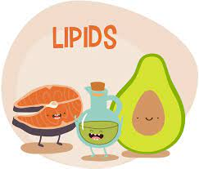
Lecture 5 - The lipids:
Fats, oils, phospholipids, and sterols

Slide 2
Lipids/Fats
Lipid – not soluble in water; an organic compound
Fat – a solid lipid (at room temperature) – in this course used interchangeably with the term lipid unless specified
Oil – a liquid lipid (at room temperature)
3 Main categories of dietary lipids:
  Triglyceride: ~ 95% of lipids in human body
  Phospholipid: soluble in water and fat. Used as an emulsifier (mixes fat and water – eg. Lecithin). Present in all cell membranes.
  Sterol: example: cholesterol
  https://youtu.be/69-eGO7XDfU

Slide 3
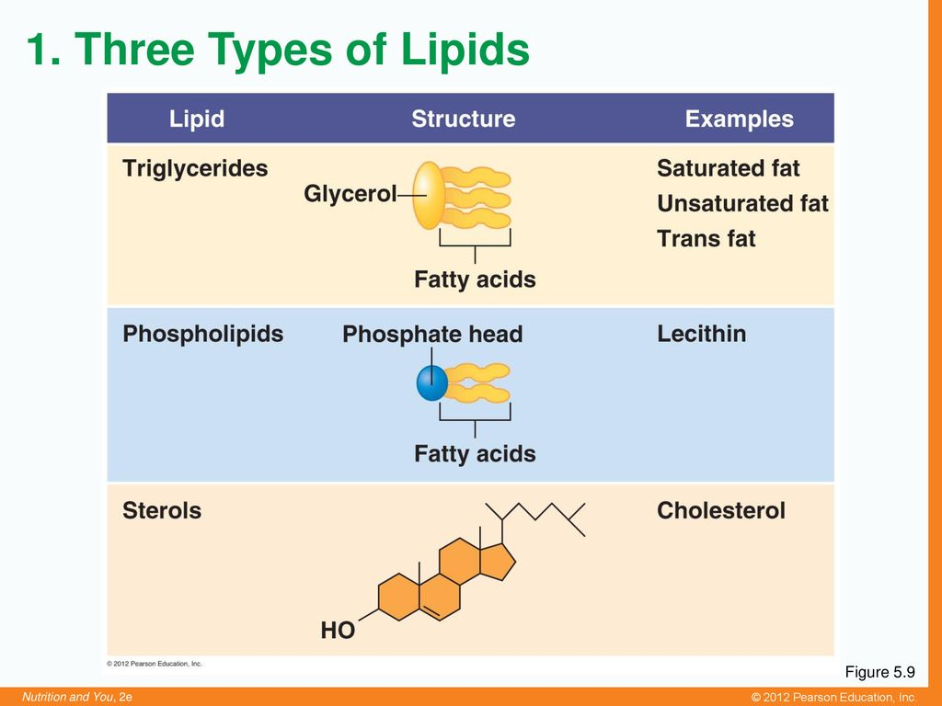

Slide 4
Usefulness of fats in the body
Why is glucose is not the body’s major form of stored energy?
Glucose is stored as glycogen – we have limited quantities stored in our liver & muscles. Enough for 1 – 48 hrs depending on activity level
Glucose attracts water, so our weight would double if we stored the same amount of energy as glycogen rather than fat.
Fat cells/Adipocytes: specialize in fat storage (fat tissue secretes hormones that regulate appetite and influence other body functions) Fats pack tightly together without water and can store much more energy in a small space
Gram for gram: fats provide more than twice energy of carbs
Lipids serve as energy reserves
Can produce ATP energy through Beta-oxidation

Slide 5
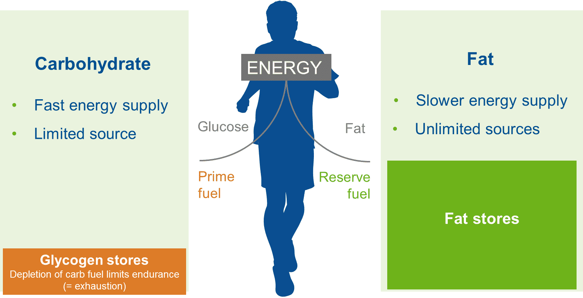

Slide 6
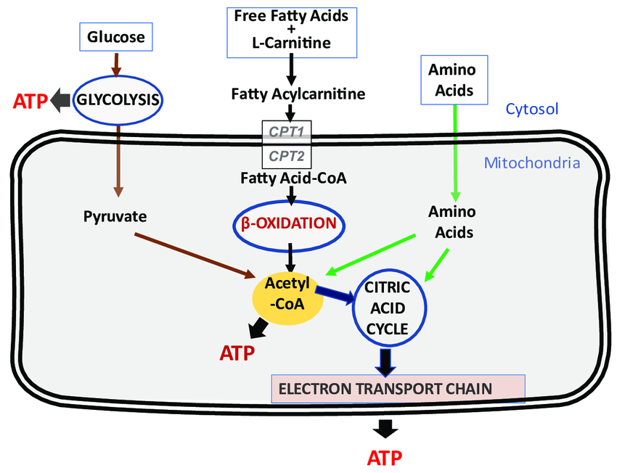
FYI

Slide 7
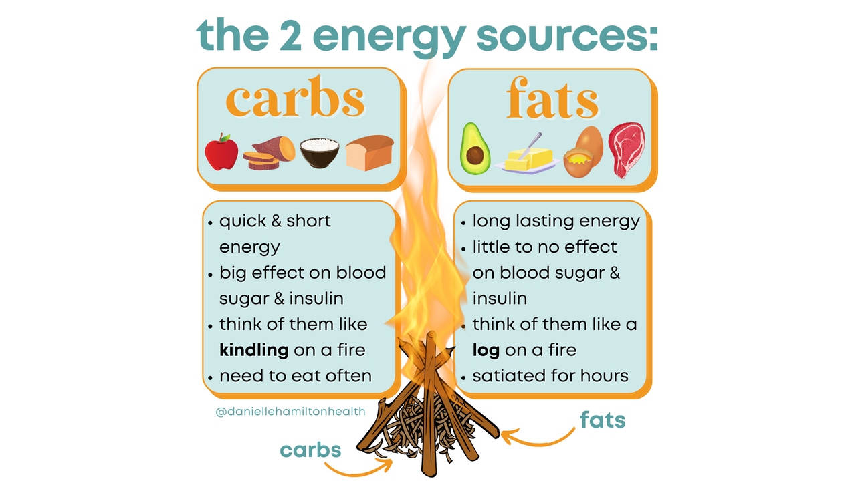

Slide 8
Usefulness of fats
Fats in food: provide nutrition, provide energy, transport fat soluble vitamins, contribute to taste and mouthfeel of foods, feelings of satiety
Fats in the body:
They also cushion vital organs
Insulate body from temperature extremes,
Carry fat-soluble vitamins (A, D, E, K)
Essential fatty acids are raw materials necessary for making other molecules - steroid hormones, bile, Vit D
Phospholipids: present in all cell membranes
Sterols: Cholesterol forms the basis of steroid hormones & myelin sheaths

Slide 9
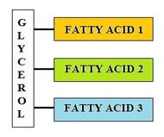
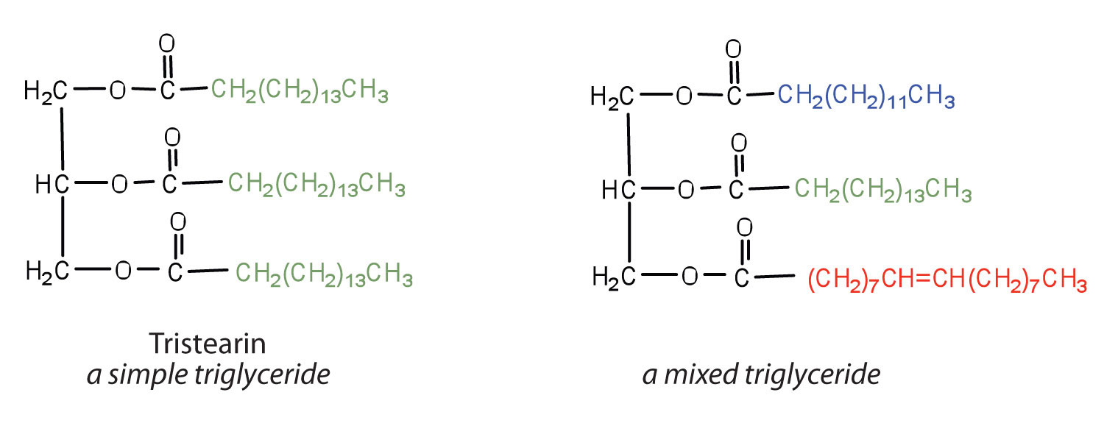
Triglycerides: storage of fat

Slide 10
Biochemistry of Fats
Fats and oils are composed of triglycerides - a Glycerol backbone with three fatty acids attached
Fatty acids can be: Short chain (2 - 5 Carbons)
Medium Chain (6 -12 Carbons) or
Long chain (13 or more Carbons)
Fatty Acids may also be Saturated, Monounsaturated or Polyunsaturated (see next slide)
Fats Osmosis

Slide 11
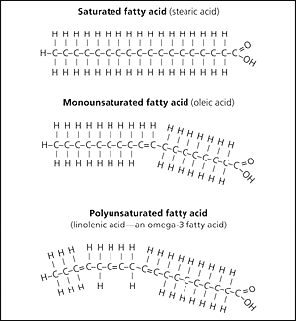
Saturated vs. unsaturated Fatty Acids (filled with H or not)
Saturation refers to whether a fatty acid chain is holding all of the hydrogen (H) atoms it can hold. If every available bond from the carbons (C) is holding an H, the chain forms a saturated fatty acid (filled to capacity with H)
Unsaturated fatty acid contains one or more points of unsaturation.
One point of unsaturation is a Monounsaturated fatty acid.
With 2 or more points of unsaturation, it is a polyunsaturated fatty acid.
Point of unsaturation: the chain has a place where H are missing
(an “empty spot”)
Degree of saturation of fatty acids in a fat affects temperature at which the fat melts (it determines the fat’s softness or hardness)
In general, animal fats tend to be saturated, while plant fats are likely unsaturated. Ted Ed
Notes:
Monounsaturated = 1 double bond
Polyunsaturated = more than 1 double bond
The greater the number of double bonds, the greater the tendency for an oil to become rancid
In general plant based lipids contain less saturated fat (exceptions are coconut and palm oil)
The number of double bonds affects the temperature at which a lipid becomes liquid. (Eg. Olive oil is liquid at room temperature but butter is not)

Slide 12
Effects of processing on unsaturated fats
What is “hydrogenated vegetable oil”?
https://youtu.be/brs2nMubr84
Hydrogenation of fats makes them stay fresher longer and also changes their physical properties
Hydrogenated fats resist rancidity better, are firmer textured, have a higher smoking point (for frying) than unsaturated oils
BUT Hydrogenated fats also lose health benefits of unsaturated oils
PARTLY HYDROGENATED OILS = TRANS FATS

Slide 13
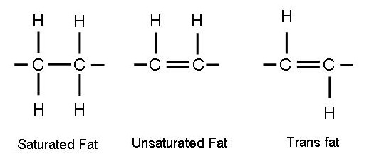
Trans fatty acids –are they harmful?
Through partial hydrogenation, some of the unsaturated oils end up changing their shapes instead of becoming saturated
Trans fats raise LDL and lower HDL,
as well as promote inflammation
Trans fats act somewhat like saturated
fats in the body
Lipid Review:
https://youtu.be/BVxeeiR7JB0

Slide 14
Essential polyunsaturated fatty acids
Recall that Essential means we must get these fatty acids through the diet
Linoleic acid and linolenic acid: they must be supplied by diet (essential nutrients)
Raw materials necessary to make eicosanoids: hormone-like, affect wide range of diverse body functions, such as muscle relaxation and contraction; blood vessel dilation and constriction, blood clot formation, blood lipid regulation, immune responses, inflammation, pain
Aspirin (NSAIDs) relieves fever, inflammation and pain by slowing synthesis of eicosanoids such as prostaglandins & thyroxine
Whats Up Dude Fatty Acids

Slide 15
Omega-6 and Omega-3 fatty acid families
Linoleic acid: parent member of the omega-6 fatty acid; example of omega-6 is arachidonic acid (necessary to make eicosanoids).
LinoleNic acid: parent member of the omega-3 fatty acid family; examples: EPA and DHA (abundant in oils of certain fish, lower risk of heart disease).
Native peoples of Greenland and Alaska: diet high in fat but abundant in fish and fish oils, they have very low rate of death by heart disease.
Omega-3s are also beneficial to immune system, joint health, skin health and protective against some cancers
https://youtu.be/ZnvOSs7sODo

Slide 16
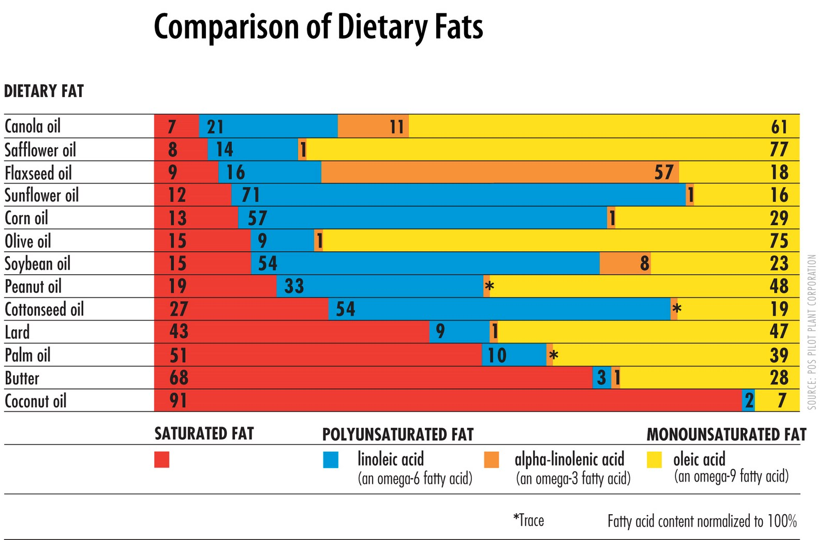
Dietary fatty acids
Notes:
In general plant based lipids contain less saturated fat (exceptions are coconut and palm oil)
The number of double bonds affects the temperature at which a lipid becomes liquid. (Eg. Olive oil is liquid at room temperature but butter is not)

Slide 17
How to choose which oil to use?
Use fresh oils -within 30 - 60 days after opening. Oils will begin to oxidize & form free radicals
Choose glass bottles for max freshness
Choose an oil with the correct smoke point- heating an oil beyond its smoke point will cause free radical formation.
High smoke point oils are: Avocado, Camellia, Almond, Ghee (clarified butter) & canola.
Olive oil, coconut oil & sesame oil are medium heat oil (sauteing, baking)
Avoid chemical extractants - choose cold-pressed oils instead of expeller pressed or refined oils

Slide 18
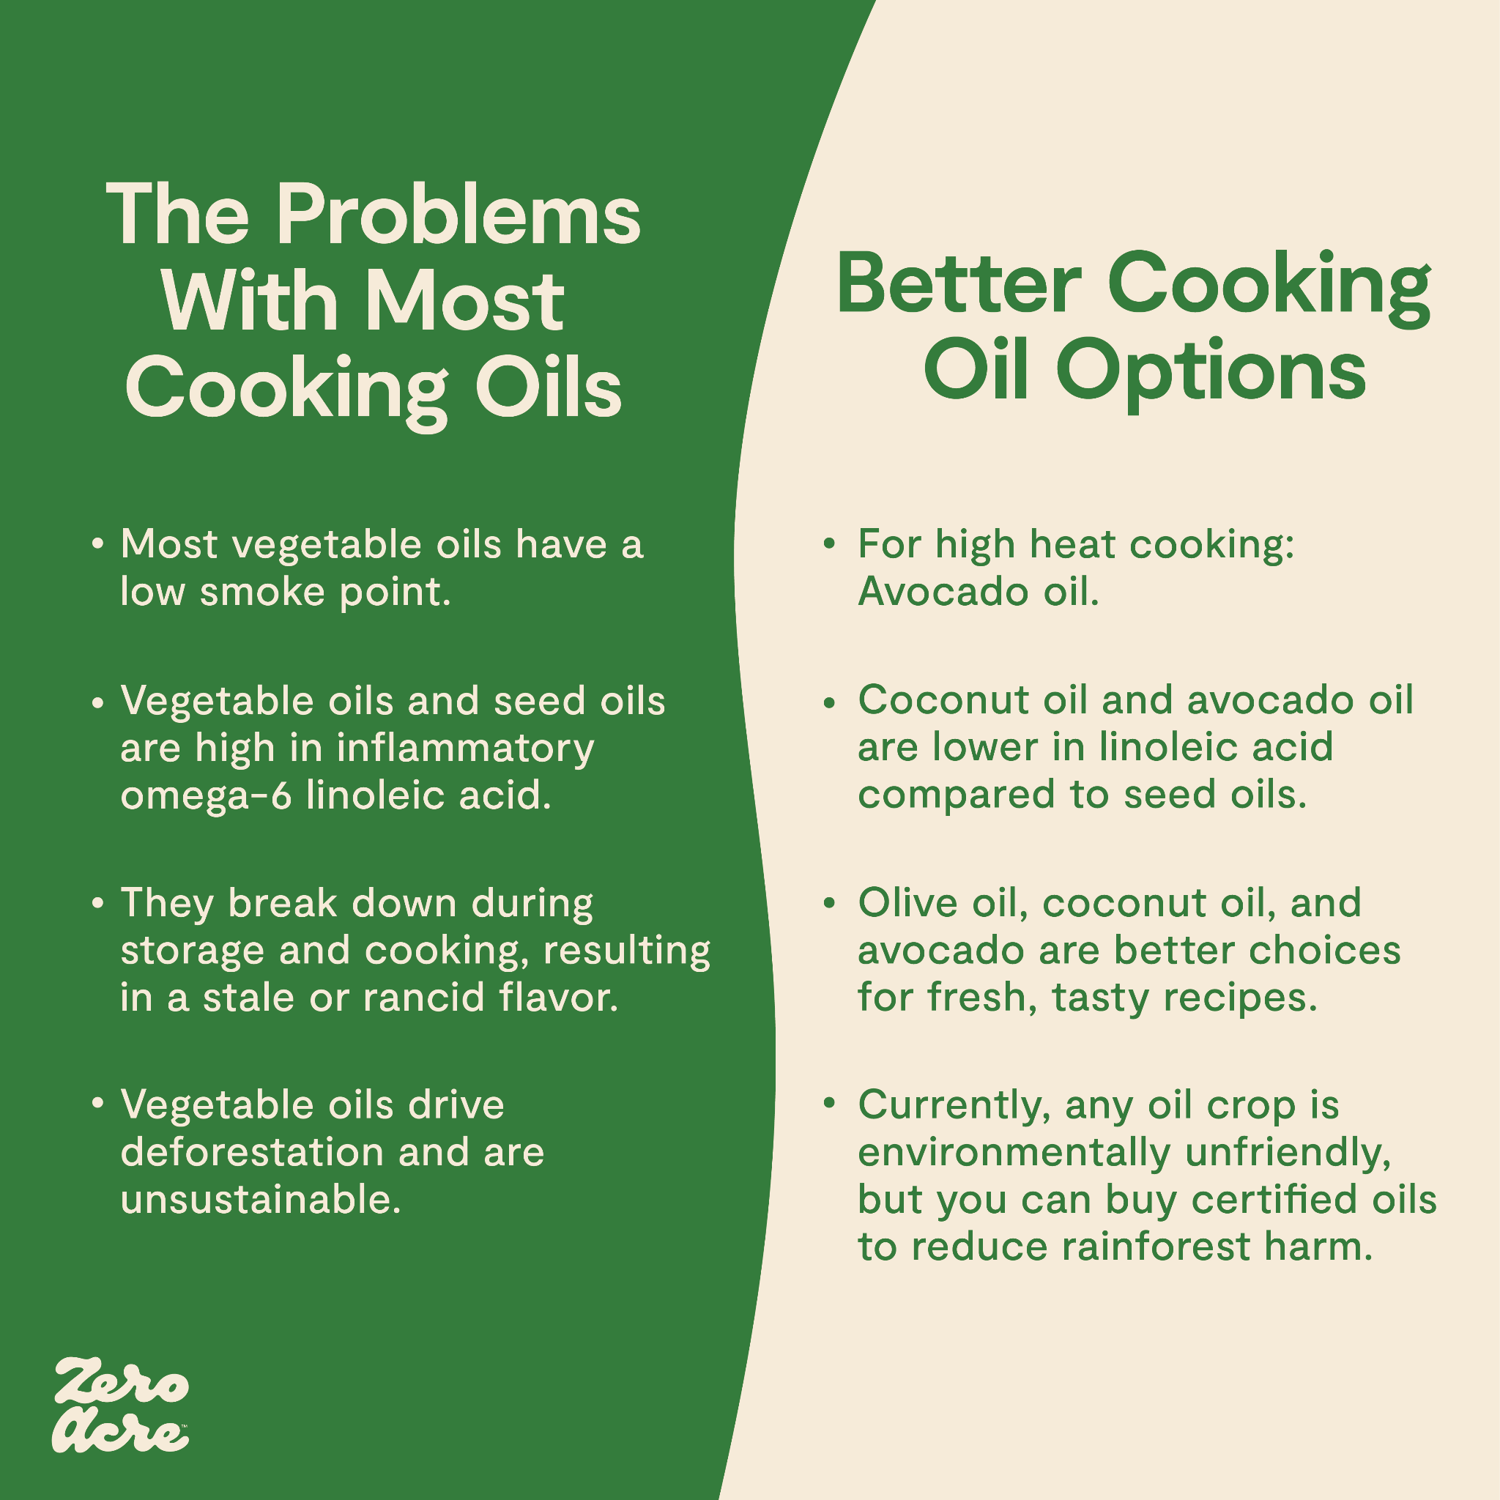

Slide 19
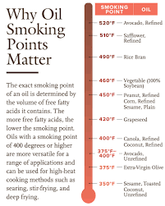
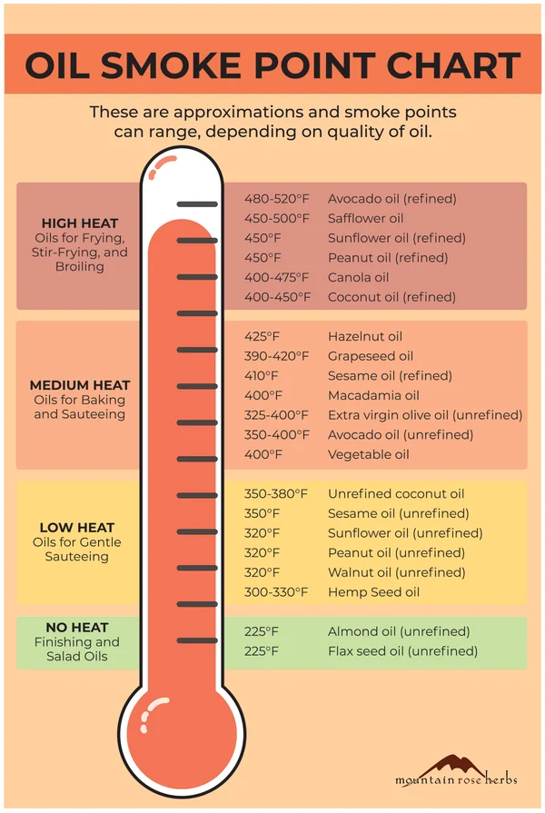
FYI - Smoke points of Oils and Fats

Slide 20
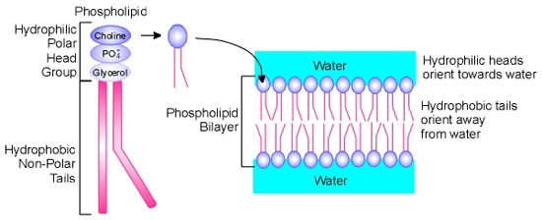
Phospholipids
Phospholipid: also formed of a molecule of glycerol with fatty acids attached but 2 rather than 3 fatty acids In place of the third is a molecule containing phosphorus, which makes the phospholipid soluble in water (while its fatty acid makes it soluble in fat)
Notes:
Phospholipids are major components of cell membranes. They form lipid bilayers

Slide 21
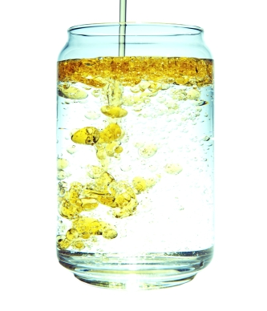
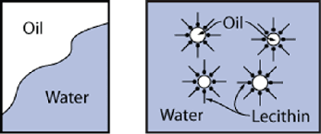
Phospholipids: water-loving and fat-loving characteristics
Emulsifier: a substance that mixes with both fat and water and permanently disperses fat in water, forming an emulsion.
Bile: emulsifier made by liver. Bile doesn’t digest fat as enzymes do but emulsifies it so enzymes in watery fluids may contact it and split the fatty acids from glycerol for absorption
https://youtu.be/TNG-RRzwBVU

Slide 22
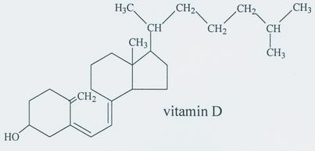
Sterols
Such as cholesterol are large, complicated molecules in the shape of rings of C with side chains of C, H and O

Slide 23
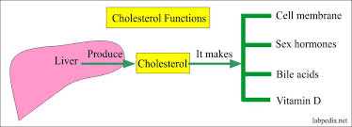
Sterols -examples
Cholesterol is an emulsifier – the key emulsifier in bile (secreted by the gallbladder)
Vitamin D is also an important sterol made from cholesterol in the body
Steroid hormones, including cortisol and sex hormones such as testosterone and estrogen are also made from cholesterol
Cholesterol:
Forms cell membranes and it is necessary
for body’s functioning
It is not an essential nutrient
It is a major component of plaques that
narrow arteries in atherosclerosis

Slide 24
Digestion of Lipids
Fat does not mix well with saliva or stomach acid
Stomach – gastric lipase begins to digest triglycerides into fatty acids
Gallbladder secretes bile – emulsifies fats and helps them to dissolve in the small intestine
Pancreatic enzymes – pancreatic lipase breaks lipids into smaller particles for digestion (triglycerides → fatty acids, monoglycerides)
https://www.youtube.com/watch?v=TZOCQko8iDg (1:52 min)

Slide 25
Digestion of Lipids (cont.)
Once intestine’s contents are emulsified, fat-splitting enzymes act on triglycerides to split fatty acids from glycerol backbones
Free fatty acids, glycerol and monoglycerides cling together in spherical particles (micelles) surrounded by bile
Bile shuttles lipids across watery mucus layer to absorptive cells of intestinal villi
Cells extract lipids
Bile may be absorbed and reused by body, or it may exit with feces (gives brown colour)
Digestive tract absorbs triglycerides from a meal with up to 98% efficiency (little fat is excreted by a healthy system)

Slide 26
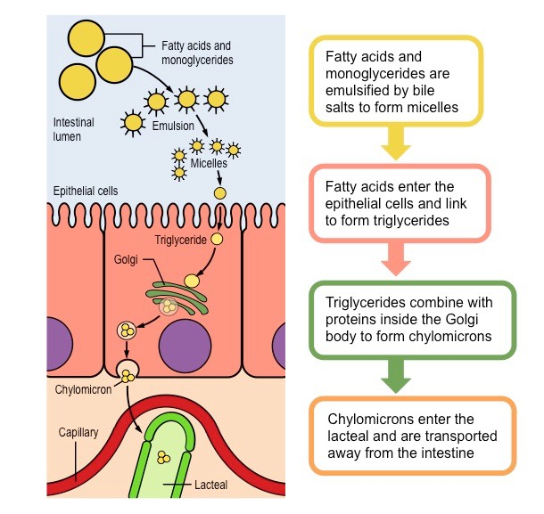

Slide 27
Absorption and transport of fats
Smaller products of lipid digestion (glycerol, short chain fatty acids) pass directly to blood, travelling unassisted to the liver
Larger lipids (monoglycerides and long chain fatty acids) would float in water: instead they are transported as “passengers” in lipoproteins (assembled packages of lipids + proteins) before being released into lymph lthat leads to blood
Inside intestinal cells, they cluster with proteins and phospholipids to form chylomicrons
Tissues of body can extract fat from chylomicrons passing by in the blood. Remnants are picked up by liver, which dismantles and reuses its parts
https://www.youtube.com/watch?v=i0kHf_5s3J8 (10:07 min)

Slide 28
Major Lipoproteins: VLDL, LDL, HDL
In addition to chylomicrons, the body uses 4 other types of lipoproteins to carry fats:
Very low-density lipoproteins (VLDL): carry triglycerides made in liver to body cells for their use
Intermediate -density lipoproteins (IDL), similar to LDL, can contribute to atherosclerosis
Low-density lipoproteins (LDL), aka “bad” cholesterol transport cholesterol and other lipids to tissues. LDL are made from VLDL after they have donated many of their triglycerides to body cells
High-density lipoproteins (HDL): aka “good” cholesterol - critical for carrying cholesterol away from body cells to liver for disposal
LDL and HDL difference: in proportions of lipids they contain and tasks they perform (not in type of cholesterol they carry)

Slide 29
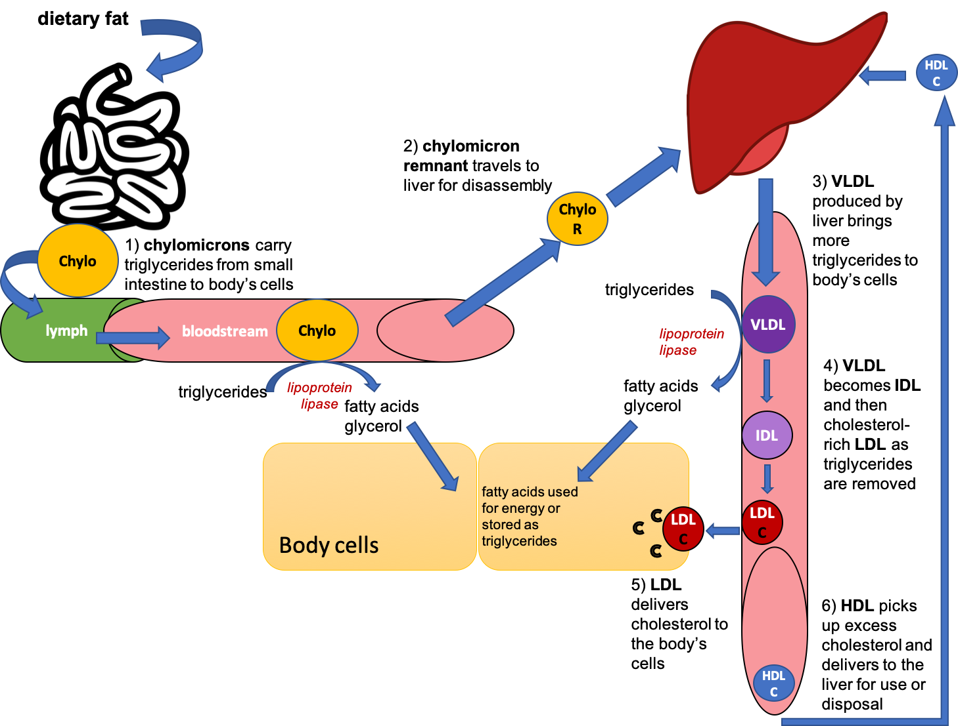

Slide 30
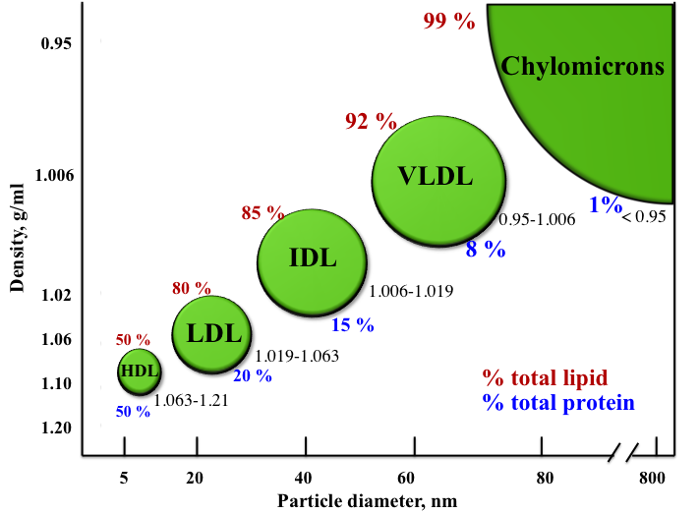
Lipoproteins
Notes:
Chylomicrons transport lipids from the intestine to the rest of the body
VLDL: transport endogenous products. They convert in bloodstream to LDL
Intermediate-density lipoproteins (IDLs) belong to the lipoprotein particle family and are formed from the degradation of very low-density lipoproteins. They are similar to LDL in that they can contribute to atherosclerosis
LDL (low-density lipoproteins, also known as “bad cholesterol”) particles pose a risk for cardiovascular disease
HDL (high-density lipoproteins) are also known as “good cholesterol” because they can transport fat molecules (including cholesterol, triglycerides, etc.) out of artery walls, reducing macrophage accumulation, and thus helping prevent, even regress atherosclerosis

Slide 31
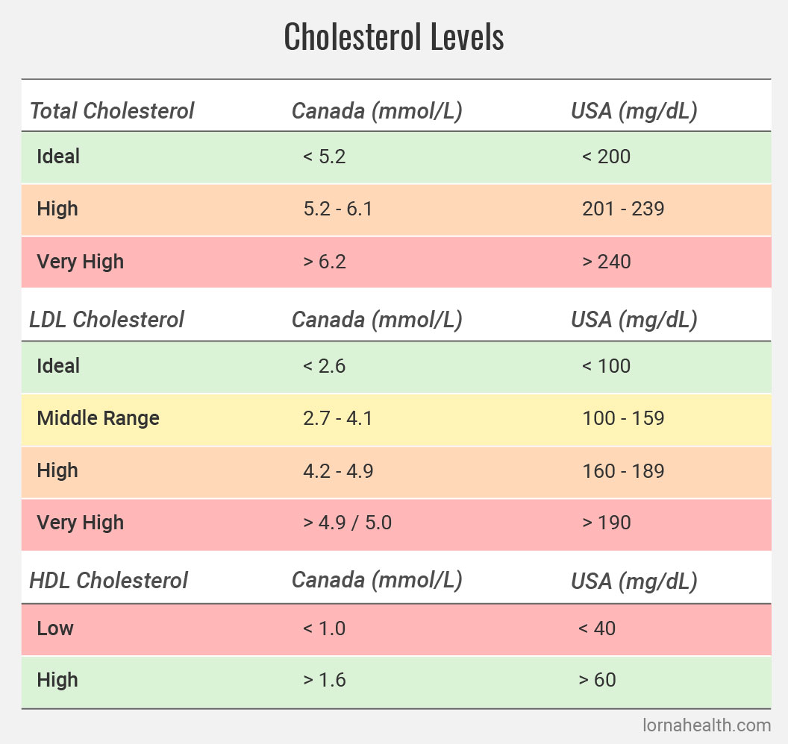
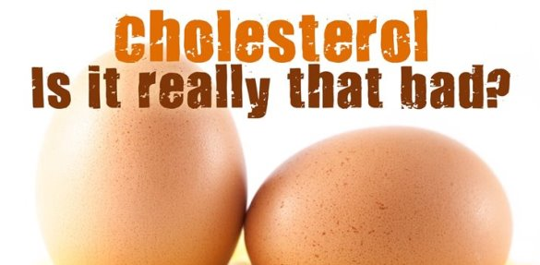
Cholesterol theory:
“Cholesterol is the major cause behind heart disease”
https://youtu.be/YGSbs-Wri1A

Slide 32
General Recommendations for Lipids
20 – 35% of the diet; 44 – 78g based on a 2000 cal diet
Focus on getting more PUFAs, less saturated fats, trans fats as low as possible (WHO)
PUFAs -
DRI Linoleic acid (omega 6) (5-10% total Calories) 17g/day young men, 12 g/day young women
DRI Linolenic acid (omega 3) (0.6% - 1.2% tot Cal) 1.6g/day for men & 1.1g/day women
Ensure healthy ratio omega 6 to Omega 3 fats
Many studies have shown that humans evolved eating a diet that had equal amounts of omega 6 & Omega 3 fats. However, the standard Western diet often s closer to a 16 to 1 ratio of omega 6s to 3s. DRI recommendations are at a ratio of approx. 10 to 1. Many studies have tried lower ratios such as 5:1 or 3:1 & found benefits in many kinds of inflammatory diseases. Research is ongoing.
Special diets:
Keto diets recommend ~70-80% of your calories should come from fats
Low fat diets 15 – 20% calories; popularly recommended for CVD & weight loss in the 80s to 2000s; less common now

Slide 33
Which of the following is not one of the ways fats are useful in foods?
Fats contribute to the taste and smells of foods
Fats carry fat-soluble vitamins
Fats provide a low-calorie source of energy compared to carbohydrates
Fats provide essential fatty acids

Slide 34
Generally speaking, vegetable and fish oils are rich in which of these?
Polyunsaturated fat
Saturated fat
Cholesterol
Trans fatty acids

Slide 35
A benefit to health is seen when ______is used in place of ______in the diet
saturated fat; monounsaturated fat
saturated fat; polyunsaturated fat
monounsaturated fat; saturated fat
polyunsaturated fat; saturated and trans fats

Slide 36
Chylomicrons, a class of lipoproteins, are produced in the
Gallbladder
Small intestinal cells
Large intestinal cells
Liver

Slide 37
The roles of the essential fatty acids include
Form part of cell membranes
Support infant growth and vision development
Support immune function
All of the above

Slide 38
LDL deliver triglycerides and cholesterol from the liver to the body’s tissues
T
F

Slide 39
Consuming large amounts of trans fatty acids lowers LDL cholesterol and thus lowers the risk of heart disease and heart attack
T
F

