Slide 1
The Human Body in Health and Illness, 8th ed.
Barbara Herlihy,
BSN, MA, PhD (Physiology), RN

Slide 2
Chapter 20
Lymphatic System
The Human Body in Health and Illness,
8th ed.
Barbara Herlihy

Slide 3
Lesson 20.1
List three functions of the lymphatic system.
Describe the composition and flow of lymph.
List the lymphatic organs and lymphatic nodules.
Describe the lymph nodes and state the location of the cervical nodes, axillary nodes, and inguinal nodes.

Slide 4
The Lymphatic System
Three main functions:
  The lymphatic vessels absorb fluid and protein from the tissue spaces and return it to the blood.
  Specialized lymphatic vessels play an important role in the intestinal absorption of fats and fat-soluble vitamins.
  Lymphatic tissue helps the body to defend itself against disease.

Slide 5
Lymph and Lymphatic Circulation
(1 of 2)
What Is Lymph?
  A clear pale-yellow fluid that resembles plasma
  Composed primarily of water, electrolytes, waste from metabolizing cells, and protein that has leaked out of the capillaries and into the tissue space
  Tissue fluid that is not reabsorbed into the blood capillaries is drained by the lymphatic capillaries forming lymph

Slide 6
Lymph and Lymphatic Circulation
(2 of 2)
Lymphatic vessels
  Lymphatic capillaries
  Larger lymphatic vessels

Slide 7
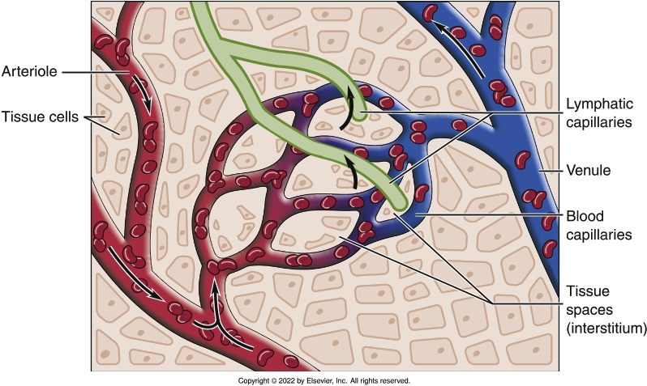
Lymphatic Capillaries and Blood Capillaries
Notes:
Textbook Figure 20.2: Lymphatic Capillaries and Blood Capillaries.

Slide 8
Lymphatic Tissue
(1 of 3)
Lymphatic organs
  Lymph nodes
    Pea-shaped patches of lymphatic tissue
    Located to filter the lymph as it flows through the lymphatic vessels
  Thymus gland
    Located in the mediastinum of the thoracic cavity
    Home of many lymphocytes
    Secretes hormones called thymosins
      Thymosins promote the proliferation and maturation of lymphocytes in lymphatic tissue throughout the body
  Spleen

Slide 9
Lymphatic Tissue
(2 of 3)
Lymphatic organs
  The spleen:
    Is the largest lymphatic organ in the body
    Contains white pulp and red pulp
    Filters blood rather than lymph
    Acts as a storage or reservoir of blood
    Stores platelets and removes malformed platelets from the circulation
    Removes and dismantles old worn-out red blood cells (RBCs)
    Is the site of fetal erythropoiesis

Slide 10
Lymphatic Tissue
(3 of 3)
Lymphatic nodules
  Tonsils
    Palatine, pharyngeal, lingual
  Mucosa-associated lymphatic tissue (MALT)
    Scattered throughout the body within its mucous membranes
  Peyer patches
    Found in the lower part of the small intestine
  Appendix
    An outpouching located within the large intestine
    Contains lymphatic nodules

Slide 11
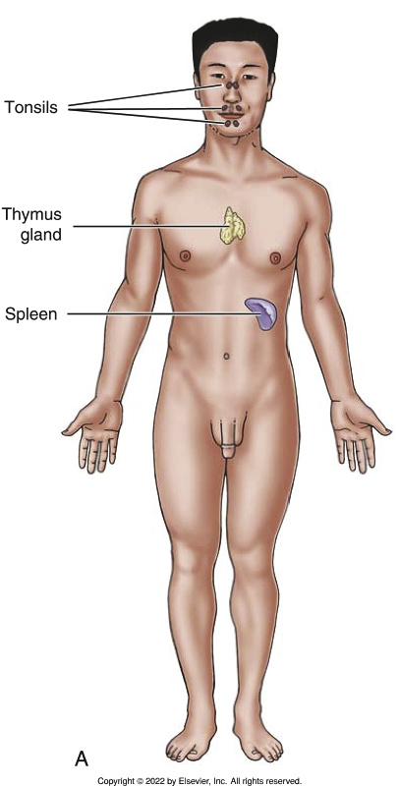
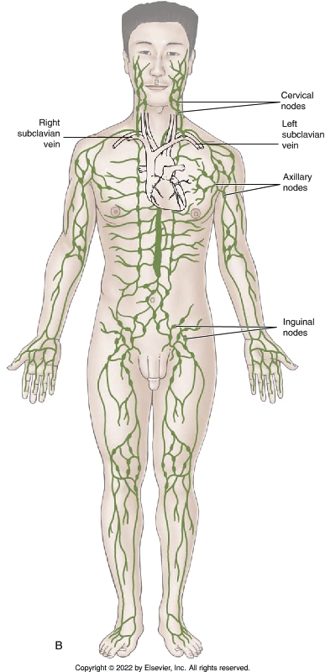
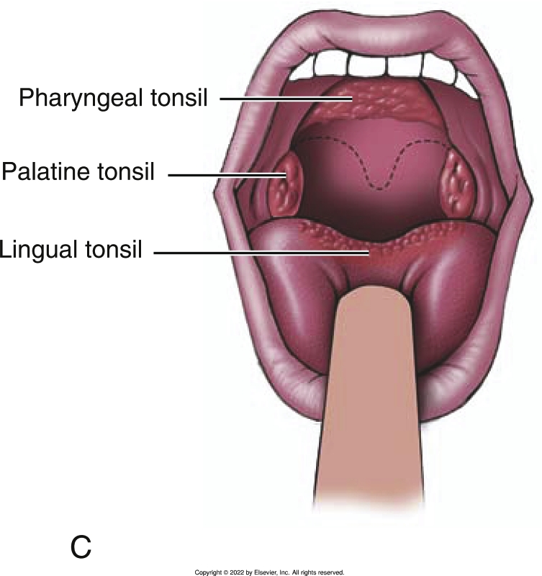
Location of Lymphatic Tissue
Notes:
Textbook Figure 20.6: Location of Lymphatic Tissue. (A) Lymphatic organs. (B) Distribution of lymph nodes. (C) Tonsils.

