Slide 1
The Human Body in Health and Illness, 8th ed.
Barbara Herlihy,
BSN, MA, PhD (Physiology), RN

Slide 2
Chapter 18
Anatomy of the Blood Vessels and Special Circulations
The Human Body in Health and Illness,
8th ed.
Barbara Herlihy

Slide 3
Lesson 18.1
(1 of 2)
Describe the pulmonary and systemic circulations.
Describe the structure and function of arteries, capillaries, and veins, including the following:
  List the three layers of tissue found in arteries and veins.
  Explain the functions of conductance, resistance, exchange, and capacitance vessels.

Slide 4
Lesson 18.1
(2 of 2)
List the major arteries of the systemic circulation that are branches of the ascending aorta, aortic arch, and descending aorta.
List the major veins of the systemic circulation.
Describe the following special circulations: blood supply to the head and brain, hepatic circulation, and fetal circulation.
Explain pulse and its use as an assessment tool.

Slide 5
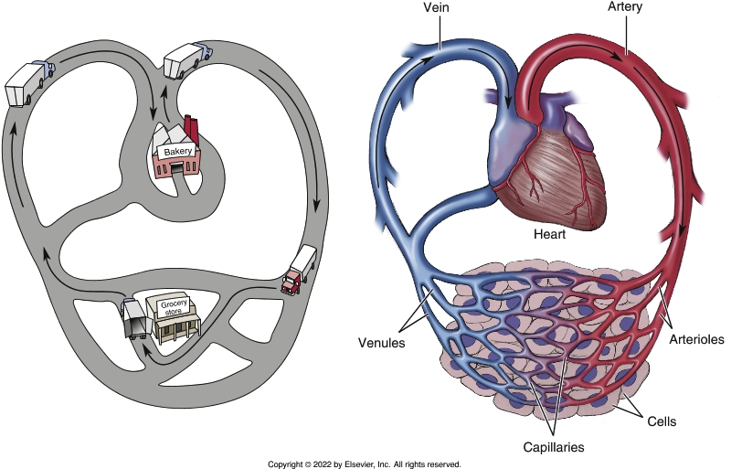
Circles, Circuits, and Circulations
Notes:
Textbook Figure 18.1: A Circuit or Route: The Circulatory System.

Slide 6
Blood Vessels
(1 of 3)
Naming the blood vessels
  Arteries
    Blood vessels that carry blood away from the heart.
  Capillaries
    Smallest and most numerous of all the blood vessels
  Veins
    Blood vessels that carry blood back to the heart.

Slide 7
Blood Vessels
(2 of 3)
Blood vessel walls: the layered look
  Tunica intima
    Innermost layer, an endothelium
  Tunica media
    Middle layer, elastic tissue and smooth muscle
  Tunica adventitia
    Outer layer, connective tissue

Slide 8
Blood Vessels
(3 of 3)
Blood vessels: what they do
  Arteries: conductance vessels
  Arterioles: resistance vessels
  Capillaries: exchange vessels
  Veins and venules: capacitance vessels
Skeletal muscle pump

Slide 9
Major Arteries of the Systemic
Circulation
(1 of 2)
Aorta
  Mother of all arteries
Branches of the aorta
  Branches of the ascending aorta
  Branches of the aortic arch
  Branches of the descending aorta (thoracic aorta)
  Branches of the descending aorta (abdominal aorta)

Slide 10
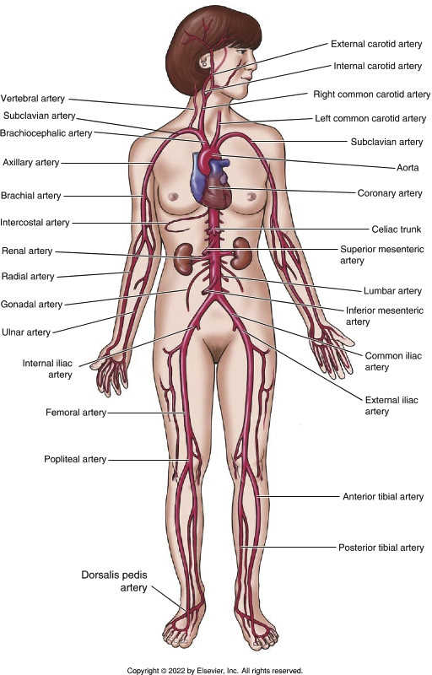
Major Arteries of the Systemic
Circulation
(2 of 2)
Notes:
Textbook Figure 18.5: Major Arteries.

Slide 11
Major Veins of the Systemic
Circulation
Vena cavae
  Veins that empty into the superior vena cava
    Cephalic, basilic, median cubital, axillary, subclavian, jugular, subclavian, azygos
  Veins that empty into the inferior vena cava
    Tibial, popliteal, femoral, iliac, great saphenous, renal, hepatic

Slide 12
Special Circulations
(1 of 3)
Blood supply to the head and brain
  Arteries of the head and neck
    Circle of Willis
  Venous drainage of the head and neck

Slide 13
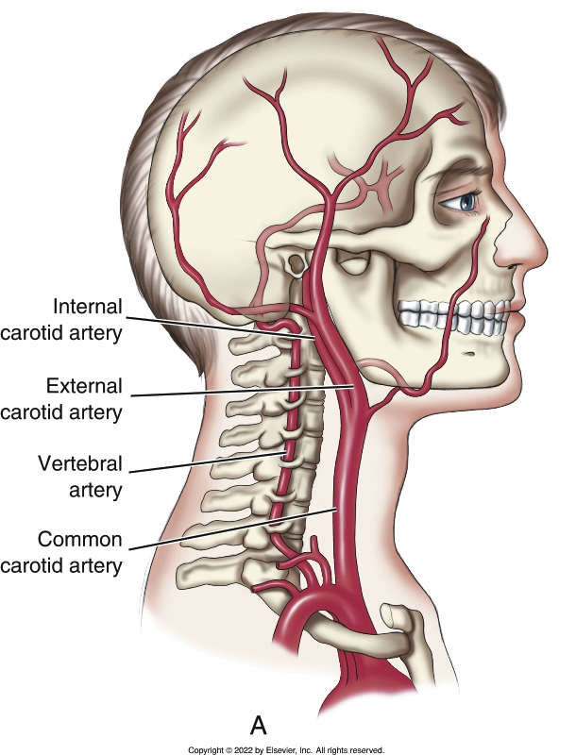
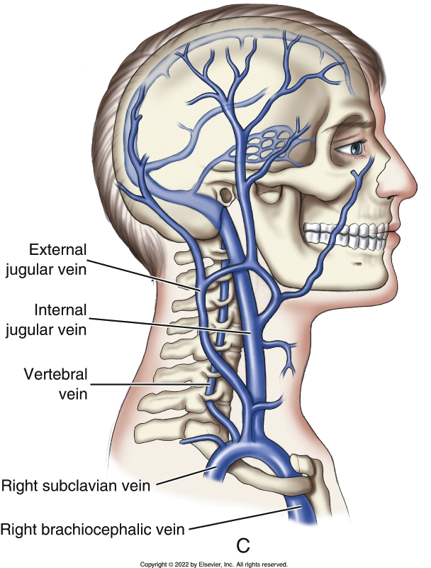
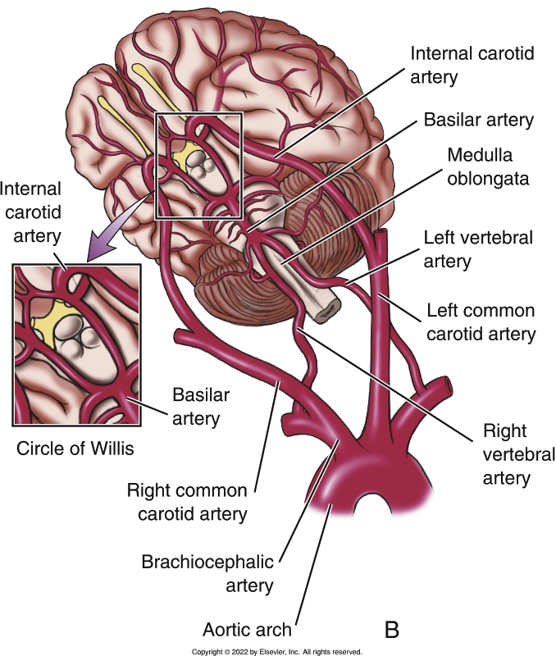
Blood Supply to the Head and the Brain
Notes:
Textbook Figure 18.7: Blood Supply to the Head and the Brain. (A) The head is supplied by the common carotid and the vertebral arteries. (B) The circle of Willis. (C) Venous drainage of the brain and head.

Slide 14
Special Circulations
(2 of 3)
Blood supply to the liver and hepatic portal circulation
  Hepatic blood vessels
    Hepatic portal system
  Hepatic sinusoids
  Kupffer cells

Slide 15
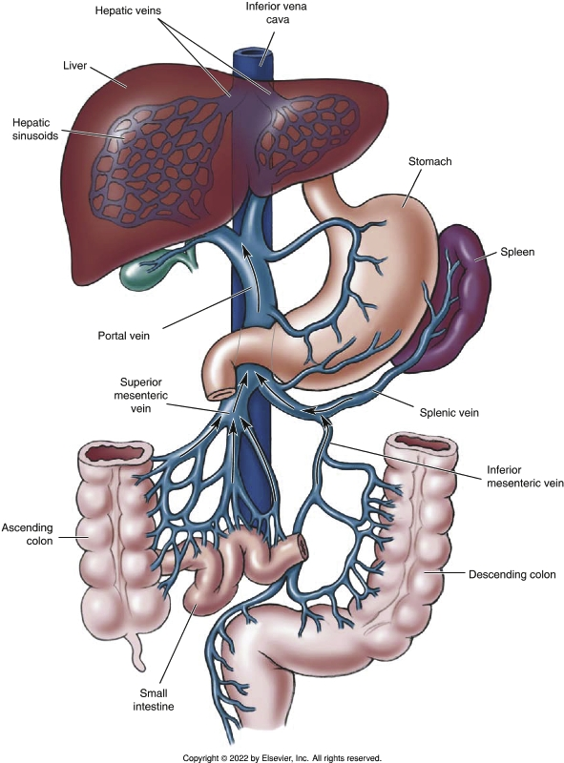
Hepatic Portal Circulation
Notes:
Textbook Figure 18.8: Hepatic Portal Circulation.

Slide 16
Special Circulations
(3 of 3)
Fetal circulation
  Umbilical vein
  Umbilical arteries
  Ductus venosus
  Foramen ovale
  Ductus arteriosus

Slide 17
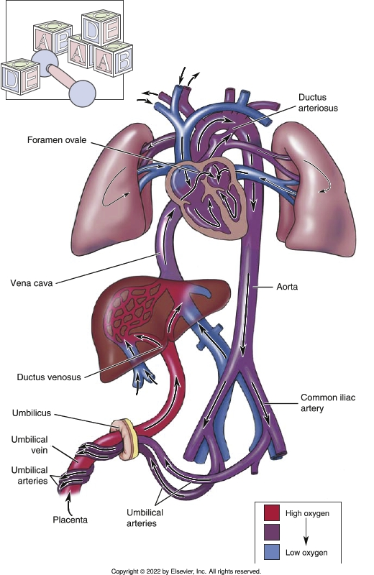
Fetal Circulation
Notes:
Textbook Figure 18.9: Fetal Circulation. Locate the ductus arteriosus, foramen ovale, and ductus venosus.

Slide 18
Pulse
(1 of 2)
What is a pulse?
  Pressure wave caused by alternating expansion and recoil of the arteries with each beat of the heart
  Can be felt in any artery lying close to the surface
  Radial artery in the wrist area is the most often used
What can you learn about a patient by feeling the pulse?
  Heart rate, rhythm, and strength

Slide 19
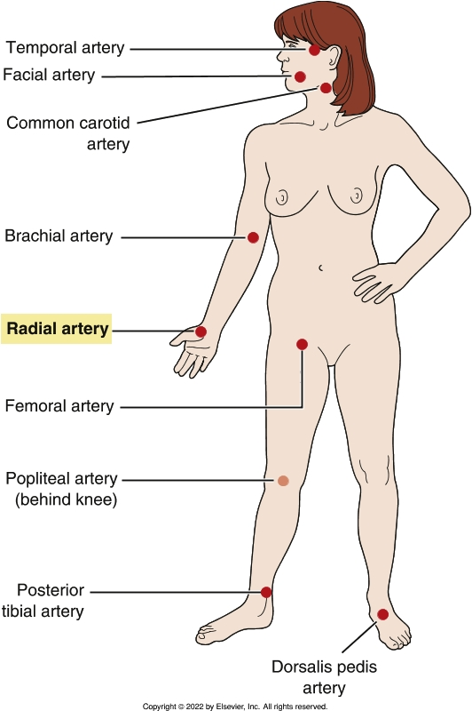
Pulse Points
Notes:
Textbook Figure 18.10 Pulse Points. Radial pulse is most commonly used site.

