Slide 1
The Human Body in Health and Illness, 8th ed.
Barbara Herlihy,
BSN, MA, PhD (Physiology), RN

Slide 2
Chapter 14
Endocrine System
The Human Body in Health and Illness,
8th ed.
Barbara Herlihy

Slide 3
Lesson 14.1
(1 of 2)
List the functions of the endocrine system.
Discuss the role and function of hormones in the body, including the following:
  Define hormone.
  Explain the process by which hormones bind to the receptor sites of specific tissues (targets).
  Explain the three mechanisms that control the secretion of hormones.
Discuss the pituitary gland, including the following:
  Describe the relationship of the hypothalamus to the pituitary gland.
  Describe the location, regulation, and hormones of the pituitary gland.

Slide 4
Lesson 14.1
(2 of 2)
Identify the other major endocrine glands and their hormones, and explain the effects of hyposecretion and hypersecretion.

Slide 5
Endocrine Glands
(1 of 4)
Functions
  Regulate metabolic processes
  Play an important role in growth and reproduction
  Regulate water and electrolyte balance
  Help the body during infection, trauma, and stress

Slide 6
Endocrine Glands
(2 of 4)
Hormones
  Chemical substances
Classification of hormones
  Steroids (secretions from adrenal cortex and sex glands)
  Proteins and protein-related substances (all other hormones)

Slide 7
Endocrine Glands
(3 of 4)
Targets
  Each hormone binds to a specific tissue
Hormone receptors
  Types
    Membrane receptors
    Intracellular receptors
  Lock-and-key mechanism
  Second messenger

Slide 8
Endocrine Glands
(4 of 4)
Control of hormone secretion
  Feedback loops
    Negative
    Positive
  Biorhythms
    Rhythmic alteration in a hormone’s rate of secretion
Control by the central nervous system
  Activation of the hypothalamus
  Stimulation of the sympathetic nervous system

Slide 9
Pituitary Gland and the Hypothalamus
(1 of 2)
Hypothalamus
  Controls pituitary function
Anterior pituitary gland
  Growth hormone
  Prolactin
  Tropic hormones
Posterior pituitary gland
  Antidiuretic hormone
  Oxytocin

Slide 10
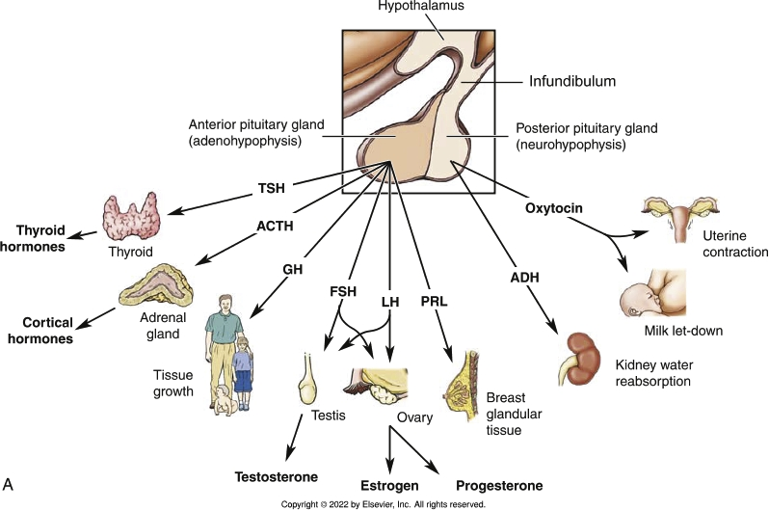
Pituitary Gland and the Hypothalamus
(2 of 2)
Notes:
Textbook Figure 14.4: Pituitary Gland. (A) Hormones and target organs of the anterior and posterior pituitary glands.

Slide 11
Thyroid Gland
(1 of 4)
Thyroid gland
  Location: anterior neck
  Two large lobes connected by the isthmus
  Types of cells
    Follicular cells
    Parafollicular cells

Slide 12
Thyroid Gland
(2 of 4)
Thyroid follicles
  Secretory units
  Cavity in each follicle is filled with colloid
  Thyroid hormones: T₃ and T₄

Slide 13
Thyroid Gland
(3 of 4)
Thyroid hormones T₃ and T₄
  T₃ and T₄ have similar functions
    T₃ is more potent
  Thyroid hormones regulate all phases of metabolism
    Basal metabolic rate
Regulation of secretion
  The hypothalamus secretes a hypothalamic releasing hormone, which stimulates the anterior pituitary to secrete TSH.
  TSH stimulates the thyroid gland to secrete T₃ and T₄

Slide 14
Thyroid Gland
(4 of 4)
Need for Iodine
  Synthesis of thyroid hormone
    Requires iodine salts called iodides
  Iodine deficiency
    T₃ and T₄ production decreases
Calcitonin
  Helps regulate blood levels of calcium and phosphate

Slide 15
Parathyroid Glands
(1 of 2)
Parathyroid glands
  Four tiny glands located along the posterior surface of the thyroid gland
  Secrete PTH, the main hormone the body uses to maintain calcium homeostasis

Slide 16
Parathyroid Glands
(2 of 2)
Parathyroid hormone deficiency and hypocalcemic tetany
  Insufficient PTH causes hypocalcemia
  Nerve and muscle membranes continuously fire electrical signals, causing muscles to remain contracted (tetany)
  Sustained contractions of the muscles of the larynx (laryngospasm) and the breathing muscles causes asphyxiation and death

Slide 17
Adrenal Glands
(1 of 2)
Adrenal medulla
  Inner region of the adrenal gland
  Extension of the sympathetic nervous system
  Secretes catecholamines: epinephrine and norepinephrine

Slide 18
Adrenal Glands
(2 of 2)
Adrenal cortex
  Outer region of the adrenal gland
  Secretes steroids
    Glucocorticoids (regulate sugar)
      Cortisol
    Mineralocorticoids (regulate salt)
      Aldosterone
    Sex hormones (regulate sex)
      Estrogens
      Androgens
  Negative feedback

Slide 19
Pancreas
(1 of 2)
Pancreas
  Long, slender organ
  Lies transversely across the upper abdomen
  Functions as an exocrine gland and an endocrine gland
  Secretes at least five hormones, including insulin and glucagon
    Islets of Langerhans
      Alpha cells: glucagon
      Beta cells: insulin

Slide 20
Pancreas
(2 of 2)
Insulin
  Secretion and effects
    Helps transport glucose into most cells
    Helps control carbohydrate, protein, and fat metabolism in the cell
    Can only work if it first binds to the insulin receptors on the target cell membrane
Glucagon
  Raises the blood glucose level in two ways:
    Stimulating the conversion of glycogen to glucose in the liver
    Stimulating the conversion of proteins into glucose

Slide 21
Additional Endocrine Glands
Gonads
  Ovaries: estrogen and progesterone
  Testes: testosterone
Thymus
  Thymosins
Pineal gland
  Melatonin

Slide 22
Other Hormones
(1 of 3)
Organ-specific hormones
  Numerous hormone-secreting cells are scattered throughout the body
  These hormones usually control the activities of a particular organ

Slide 23
Other Hormones
(2 of 3)
Prostaglandins
  Produced by many tissues
  Act locally, near their site of secretion
  Involved in the regulation of smooth muscle contraction and the inflammatory response
  Thought to increase sensitivity to pain

Slide 24
Other Hormones
(3 of 3)
Adipose tissue hormones
  Excess adipose tissue acts as a gland that secretes hormones called cytokines
  Cytokines make the obese person resistant to insulin

