Slide 1
The Human Body in Health and Illness, 8th ed.
Barbara Herlihy,
BSN, MA, PhD (Physiology), RN

Slide 2
Chapter 13
Sensory System
The Human Body in Health and Illness,
8th ed.
Barbara Herlihy

Slide 3
Lesson 13.1
State the functions of the sensory system.
Define the five types of sensory receptors.
Describe the four components involved in the perception of a sensation and two important characteristics of sensation.
Describe the five general senses.
Describe the special senses of smell and taste.

Slide 4
Receptors and Sensation
(1 of 3)
Sensory system
  Allows us to experience the world
  Keep track of what is happening within our own bodies
Cells that detect stimuli
  Chemoreceptors
  Nociceptors
  Thermoreceptors
  Mechanoreceptors
  Photoreceptors

Slide 5
Receptors and Sensation
(2 of 3)
Sensation and perception
  Sensation: conscious or unconscious awareness of incoming sensory information
  Perception: conscious awareness of a sensation
Experiencing a sensation
  Stimulus
  Receptor
  Sensory nerve
  Special area of the brain

Slide 6
Receptors and Sensation
(3 of 3)
Characteristics of sensation
  Projection
  Adaptation
Groups of senses
  General/somatic senses: proprioception, pain, touch, heat, cold, pressure
  Special senses: taste, smell, sight, hearing, balance

Slide 7
General Senses
(1 of 3)
Pain
  Receptors: nociceptors
  Free nerve endings
  Pain triggers
    Tissue injury
    Deficiency of oxygen
    Stretched or deformed tissues
  Referred pain

Slide 8
General Senses
(2 of 3)
Touch
  Mechanoreceptors
  Found mostly in skin
Pressure receptors
  Mechanoreceptors
  Located in the skin, subcutaneous tissue, and deep tissue

Slide 9
General Senses
(3 of 3)
Temperature
  Heat and cold thermoreceptors
  Pain receptors are stimulated at both temperature extremes
Proprioception
  Sense of orientation, or position
  Receptors are located in muscles, tendons and joints and in the inner ear, where they function in balance and equilibrium.

Slide 10
The Special Senses:
Smell and Taste
(1 of 3)
Sense of smell: the nose
  Olfactory cell, chemoreceptor
Sense of taste: the tongue
  Gustatory cell, chemoreceptor

Slide 11
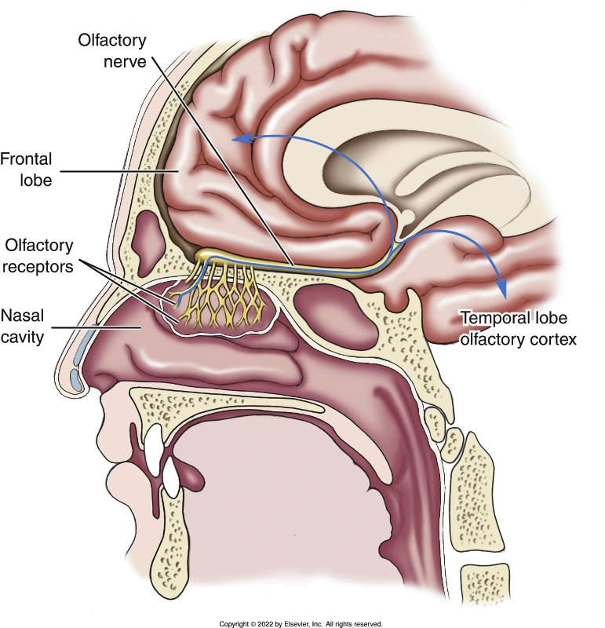
The Special Senses:
Smell and Taste
(2 of 3)
Notes:
Textbook Figure 13.5: Sense of smell: olfactory receptors, olfactory nerve, and olfactory cortex of temporal and frontal lobes.

Slide 12
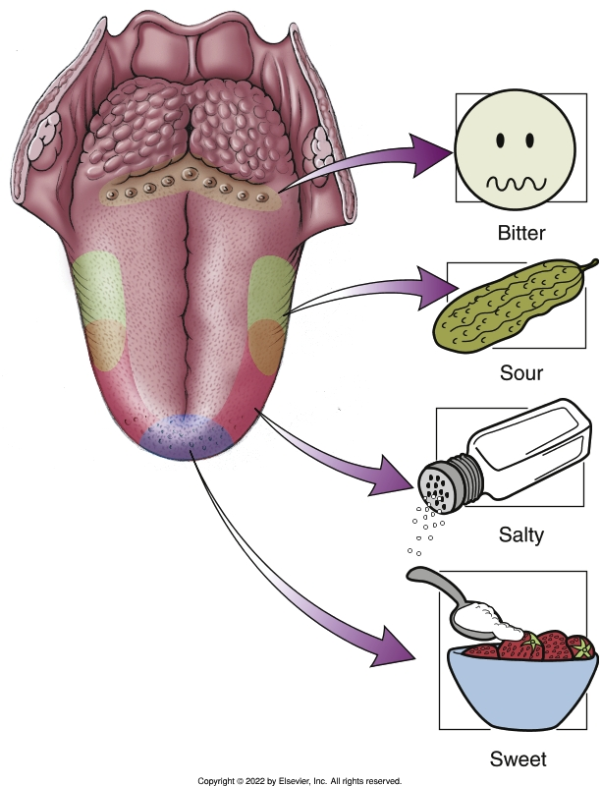
The Special Senses:
Smell and Taste
(3 of 3)
Notes:
Textbook Figure 13.6: Sense of Taste. The four taste sensations are bitter, sour, salty, and sweet.

Slide 13
Lesson 13.2
Describe the sense of sight, including the following:
  The structure of the eye.
  The movement of the eyes.
  How the size of the pupils changes.
Describe the sense of hearing, including:
  Describe the three divisions of the ear.
  Describe the functions of the parts of the ear involved in hearing.
  Explain the role of the ear in maintaining the body’s equilibrium.

Slide 14
The Special Senses: Vision
(1 of 6)
Sense of sight: the eye
  Visual accessory organs
    Eyebrows
    Eyelids
    Eyelashes
    Conjunctiva
    Lacrimal apparatus
    Extrinsic eye muscles

Slide 15
The Special Senses: Vision
(2 of 6)
Sense of sight: the eye (cont’d)
  The eyeball
    Sclera
    Choiroid
    Retina
    Cavities and fluid
  Muscles of the eye
    Extrinsic eye muscles
    Intrinsic eye muscles

Slide 16
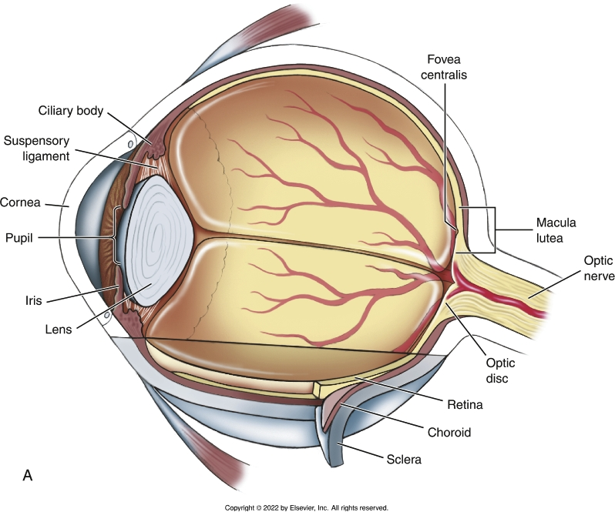
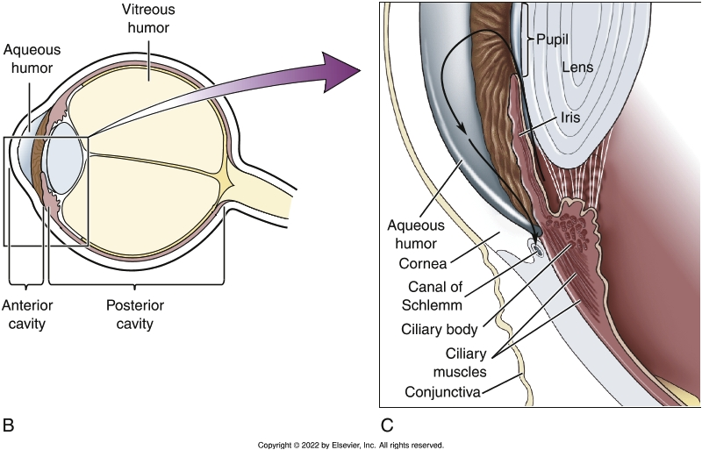
The Special Senses: Vision
(3 of 6)
Notes:
Textbook Figure 13.8 (A) Structure of the eyeball. (B) Cavities and fluids. (C) Flow of aqueous humor from the ciliary body to the canal of Schlemm (arrow).

Slide 17
The Special Senses: Vision
(4 of 6)
Sense of sight: the eye (cont’d)
  Pathway of light
    Cornea, aqueous humor, pupil, lens, vitreous humor, retina
  Refraction and accommodation
    Refraction: bending of light waves
    Accommodation: ability of the lens to change its shape to focus on a close object
  Stimulation of the photoreceptors
    Night vision
    Color vision

Slide 18
The Special Senses: Vision
(5 of 6)
Sense of sight: the eye (cont’d)
  Informing the brain: the visual pathway
    Visual pathway: pathway from the retina to the brain
  Vision loss
    Any defect along the pathway from the cornea to the brain can interfere with vision

Slide 19
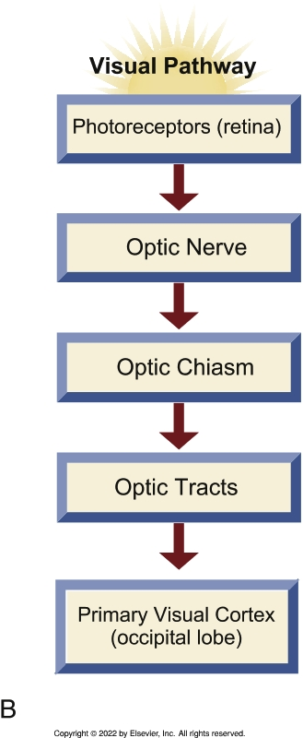
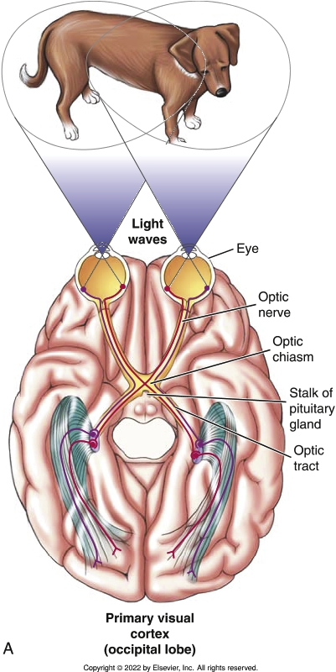
The Special Senses: Vision
(6 of 6)
Notes:
Textbook Figure 13.12 Visual Pathway. (A) From retina to primary visual cortex (occipital lobe). Note the optic chiasm and the pituitary gland (behind the optic chiasm). (B) From retina to primary visual cortex (occipital lobe).

Slide 20
The Special Senses: Hearing
(1 of 4)
Sense of hearing: the ear
  Structure of the ear
    External ear
    Middle ear
    Inner ear
  Hearing
    Sound waves
    Organ of Corti
    Temporal lobe

Slide 21
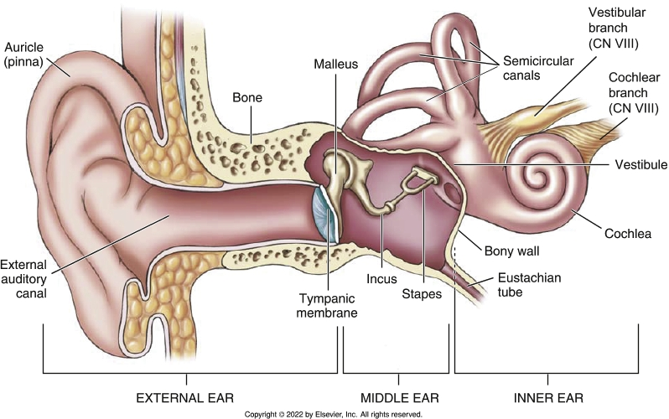
The Special Senses: Hearing
(2 of 4)
Notes:
Textbook Figure 13.13: Three divisions of the ear: external, middle, and inner. Structures within the ear.

Slide 22
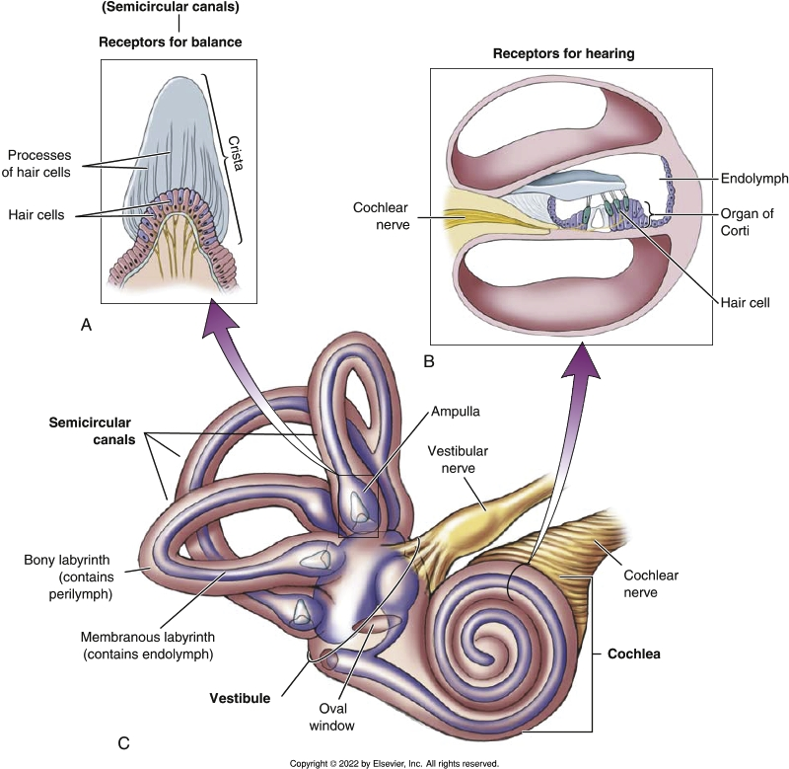
The Special Senses: Hearing
(3 of 4)
Notes:
Textbook Figure 13.14: Inner Ear. (A) The receptors for balance. (B) The receptors for hearing (organ of Corti). (C) Structures of the inner ear.

Slide 23
The Special Senses: Hearing
(4 of 4)
Sense of balance: the ear
  Static equilibrium
    Maculae
  Dynamic equilibrium
    Semicircular canals

