Slide 1
The Human Body in Health and Illness, 8th ed.
Barbara Herlihy,
BSN, MA, PhD (Physiology), RN

Slide 2
Chapter 11
Nervous System: Spinal Cord and Peripheral Nerves
The Human Body in Health and Illness,
8th ed.
Barbara Herlihy

Slide 3
Lesson 11.1
Describe the anatomy of the spinal cord, and list its three functions.
Discuss reflexes, and list four components of the reflex arc.
List and describe the functions of the 12 pairs of cranial nerves.
Do the following regarding the peripheral nervous system:
  Identify the classification of spinal nerves.
  List the functions of the three major plexuses.
  Describe a dermatome.
  Provide the functional classification of the peripheral nervous system.

Slide 4
What the Spinal Cord Is
Location and size
  Continuation of the brain stem
  Tubelike structure within the spinal cavity
Gray on the inside, white on the outside
  Gray matter
    Located in the center
    Shaped like a butterfly
  White matter

Slide 5
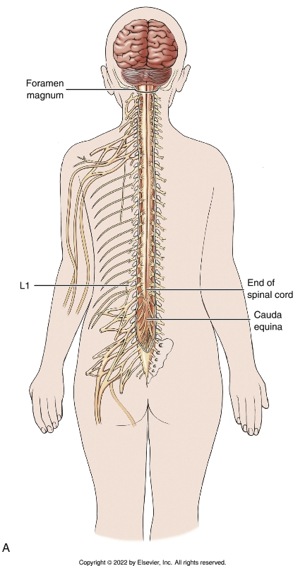
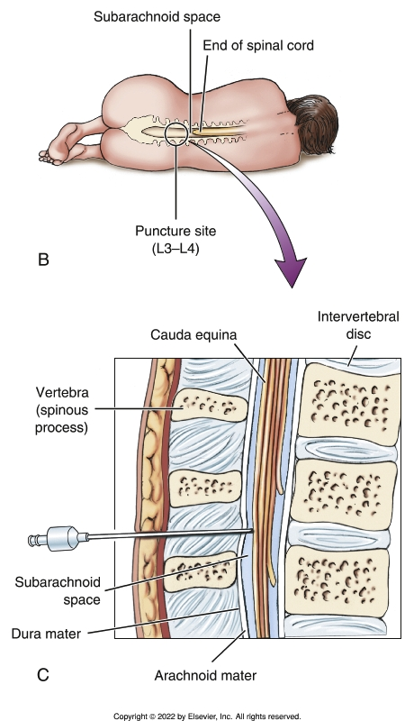
Spinal Cord
Notes:
Textbook Figure 11.1: (A) Location and length of the spinal cord. (B and C) Lumbar puncture (spinal tap).

Slide 6
What the Spinal Cord Does
Ascending tracts
  Sensory
  Spinothalamic
  Dorsal column
  Spinocerebellar
Descending tracts
  Motor
  Pyramidal
  Extrapyramidal
Decussation
  Crossing over

Slide 7
Reflexes
What reflexes are
  Involuntary response to stimuli
Reflex arc
  Sensory receptor
  Afferent or sensory neuron
  Efferent or motor neuron
  Effector organ
Many, many reflexes
  Withdrawal reflex
  Organ reflexes

Slide 8
Peripheral Nervous System
(1 of 3)
Nerves
  Neuron: single nerve cell
  Nerve: many neurons bundled with blood vessels and wrapped in connective tissue
    Sensory
    Motor
    Mixed

Slide 9
Peripheral Nervous System
(2 of 3)
Classifying the peripheral nervous system
  Structural classification
    Cranial nerves
      Names and numbers of cranial nerves
      Functions of cranial nerves
    Spinal nerves
      Names and numbers of spinal nerves
      Spinal nerve plexuses
      Dermatomes

Slide 10
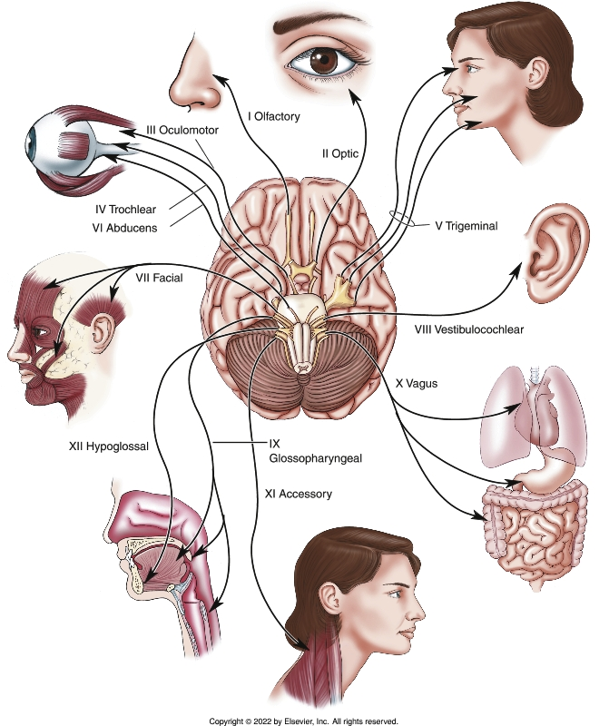
Cranial Nerves
Notes:
Textbook Figure 11.7: Cranial Nerves. Cranial nerves (12 pairs) are known by their numbers (Roman numerals) and names.

Slide 11
Peripheral Nervous System
(3 of 3)
Classifying the peripheral nervous system (cont’d)
  Functional classification
    Afferent nerves
      Bring sensory information from the different parts of the body to the CNS
    Efferent nerves
      Bring motor information from the CNS to the skeletal muscles
    Autonomic nervous system
      Composed of nerves that supply the organs, smooth muscle and glands

