Slide 1
The Human Body in Health and Illness, 8th ed.
Barbara Herlihy,
BSN, MA, PhD (Physiology), RN

Slide 2
Chapter 10
Nervous System: Nervous Tissue and Brain
The Human Body in Health and Illness,
8th ed.
Barbara Herlihy

Slide 3
Lesson 10.1
Define the two divisions of the nervous system.
List three general functions of the nervous system.
Discuss the cellular composition of the nervous system, including the following:
  Compare the structure and functions of the neuroglia and neuron.
  Explain the function of the myelin sheath.
  Explain how a neuron transmits information.
Describe the structure and function of a synapse.

Slide 4
The Nervous System: Structure and Function
Divisions of the nervous system
  Central nervous system (CNS)
    Brain and spinal cord
  Peripheral nervous system (PNS)
    Nerves that connect the CNS with the rest of the body
Functions of the nervous system
  Sensory
  Integrative
  Motor

Slide 5
Cells that Make Up the
Nervous System
(1 of 2)
Neuroglia
Neurons
  Part of a neuron
    Dendrites
    Cell body
    Axon
  Types
    Sensory (afferent) neurons
    Motor (efferent) neurons
    Interneurons

Slide 6
Cells that Make Up the
Nervous System
(2 of 2)
White matter versus gray matter
  White matter
    Myelinated axons
  Gray matter
    Unmyelinated axons
    Cell bodies
    Interneurons
    Synapses

Slide 7
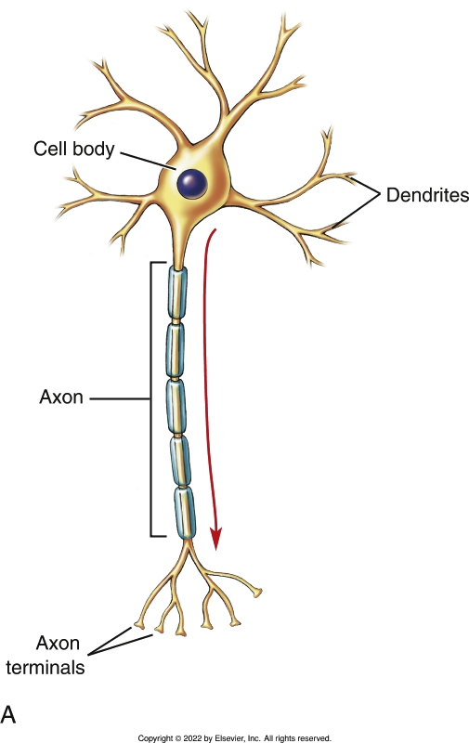
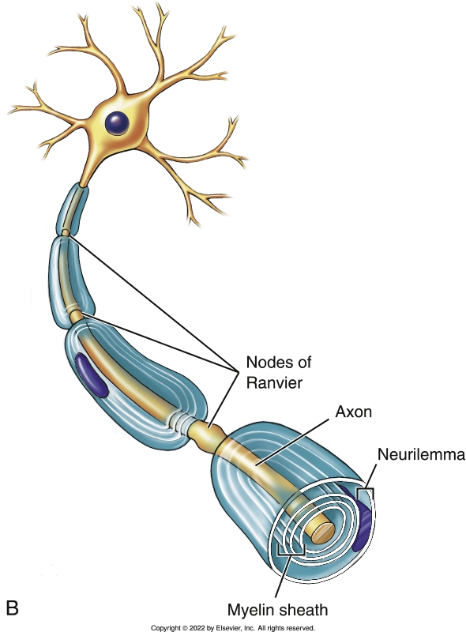
Structure of a Neuron
Notes:
Textbook Figure 10.4: Structure of a Neuron. (A) Dendrites, cell body, axon, and axon terminals. (B) Structure surrounding the axon, showing the myelin sheath, the nodes of Ranvier, and the neurilemma.

Slide 8
The Neuron Carrying Information
(1 of 4)
The nerve impulse: what it is
  Action potential
    Resting membrane potential
    Depolarization
    Repolarization
  Threshold potential

Slide 9
The Neuron Carrying Information
(2 of 4)
The nerve impulse: what causes it
  Polarization
    K+ leaks from neuron
    Determines resting membrane potential
  Depolarization
    Na+ rushes in
  Repolarization
    K+ rushes out

Slide 10
The Neuron Carrying Information
(3 of 4)
The nerve impulse: what causes it to move
  Action potential
    Forms at axon’s beginning
    Regenerates along axon’s length
    Enters axon terminal
    Releases ACh from vesicles

Slide 11
The Neuron Carrying Information
(4 of 4)
The nerve impulse: what causes it to move quickly
  Myelin insulates axon
  Myelin exposes some axonal membrane—nodes of Ranvier
  Action potentials jump quickly from node to node, like a kangaroo

Slide 12
Synapse Across Neurons
Part of a synapse
  Synaptic cleft
  Receptors
  Neurotransmitters
  Inactivators

Slide 13
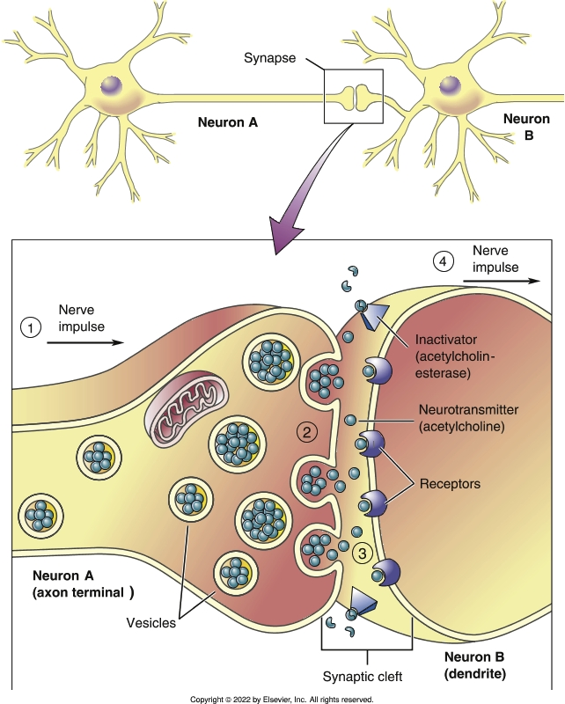
Parts of a Synapse
Notes:
Textbook Figure 10.10: Parts of a Synapse. The steps in the transfer of information across the synapse.

Slide 14
Events at the Synapse
(1 of 2)
The nerve impulse travels along neuron A to its axon terminal.
The nerve impulse causes the vesicles to fuse with the membrane of the axon terminal.
  The vesicles open and release the neurotransmitter into the synaptic cleft.

Slide 15
Events at the Synapse
(2 of 2)
The neurotransmitter diffuses across the synaptic cleft and binds to the receptor site.
  The binding of the neurotransmitter to the receptor site causes a change in the membrane potential of the dendrite of neuron B, thereby developing a nerve impulse.
  The neurotransmitter then vacates the receptor and is degraded.
Electrical information travels toward the cell body and axon of neuron B.
  What has happened at the synapse?
  Information from neuron A has been transmitted chemically to neuron B.

Slide 16
Lesson 10.2
Describe the functions of the four major areas of the brain and the four lobes of the cerebrum.
Describe how the skull, meninges, cerebrospinal fluid, and blood–brain barrier protect the central nervous system.

Slide 17
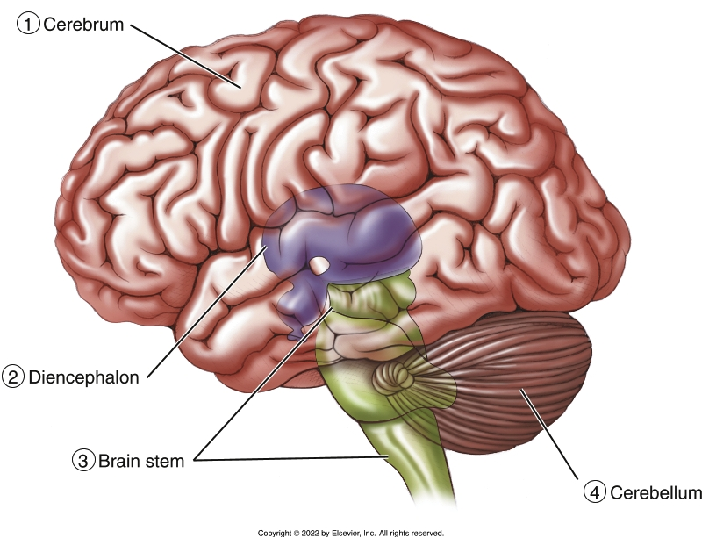
Brain: Parts and Function
Notes:
Textbook Figure 10.11: Four Major Areas of the Brain: Cerebrum, Diencephalon, Brain Stem, and Cerebellum.

Slide 18
Cerebrum: Gray on the Outside, White on the Inside
Cerebral cortex
  Made up of gray matter
  Outermost portion of the cerebrum
White matter
  Makes up the bulk of the cerebrum
  Located right below the cerebral cortex

Slide 19
Markings of the Cerebrum
Gyrus (convolution)
Fissures (sulci)
  Central
  Lateral
  Longitudinal

Slide 20
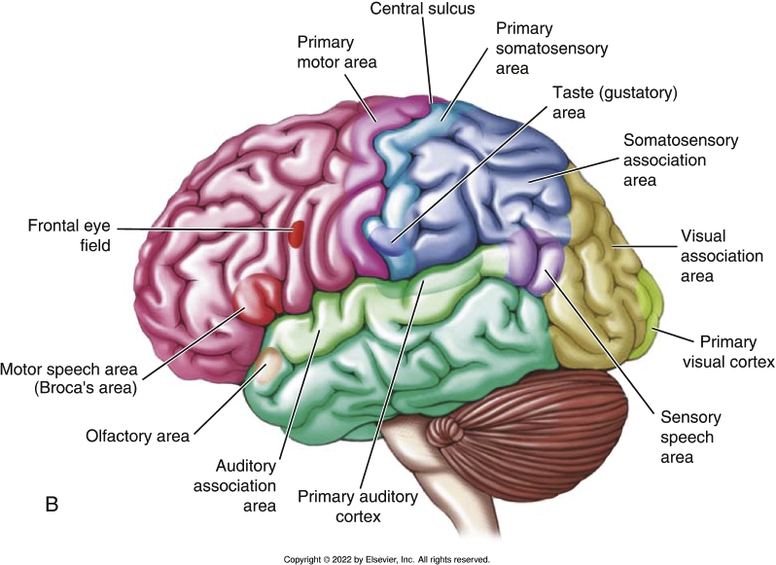
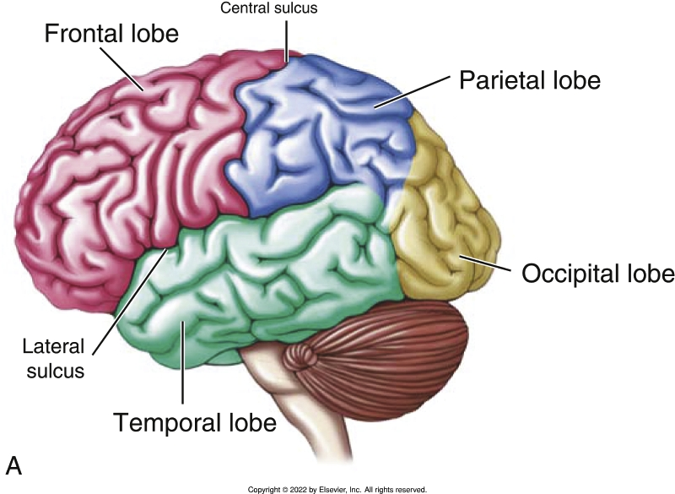
Lobes and Functions of the Cerebrum
Notes:
Textbook Figure 10.12: (A) Lobes of the cerebrum: frontal lobe, parietal lobe, temporal lobe, and occipital lobe. (B) Functional areas of the cerebrum.

Slide 21
Functions of the Cerebrum
Functions involving many cerebral lobes
  Speech
  Reading
  Vision
Association areas
  Analyzing, interpreting, and integrating
Patches of gray
  Basal nuclei

Slide 22
Areas of the Brain
Diencephalon
  Thalamus
  Hypothalamus
Brain stem
  Midbrain
    Reflex center
  Pons
  Medulla oblongata
    Vital center
    Vomiting center
  Cerebellum

Slide 23
Structures Across Divisions of the Brain
Limbic center
  Emotional brain
Reticular formation
  Reticular Activating System
    Wakefulness, Sleep, and Coma
  Sleep
  Dreaming
Memory areas

Slide 24
Protecting the Central Nervous
System
Bone
  First layer of protection
Meninges
  Second layer of protection
Cerebrospinal fluid
  Third layer of protection
Blood—brain barrier
  Fourth layer of protection

