Slide 1
The Human Body in Health and Illness, 8th ed.
Barbara Herlihy,
BSN, MA, PhD (Physiology), RN

Slide 2
Chapter 7
Integumentary System and Body Temperature
The Human Body in Health and Illness,
8th ed.
Barbara Herlihy

Slide 3
Lesson 7.1
(1 of 2)
List seven functions of the skin.
Discuss the structure of the skin, including the following:
  Describe the two layers of skin: the epidermis and the dermis.
  Define stratum germinativum and stratum corneum.
  List the two major functions of the subcutaneous layer.

Slide 4
Lesson 7.1
(2 of 2)
List the factors that influence the color of the skin.
Describe the accessory structures of the skin: hair, nails, and glands.
Define thermoregulation, and describe the way that the body conserves and loses heat.
Differentiate between insensible and sensible perspiration.

Slide 5
Functions of the Integumentary System
Serves as mechanical and chemical barrier
Protects internal structures
Participates in the immune response
Performs excretory function
Acts as a gland for vitamin D synthesis
Performs a sensory role by housing sensory receptors
Helps regulate body temperature

Slide 6
Structure of the Skin
Layers
  Epidermis
    Stratum germinativum
    Stratum corneum
    Keratinization
  Dermis
  Subcutaneous
    Insulates
    Anchors skin to underlying structures
  Accessory structures

Slide 7
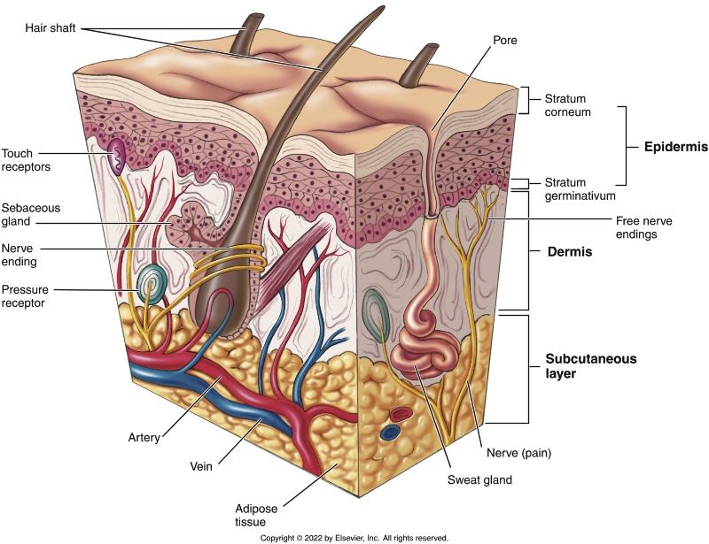
The Skin
Notes:
Textbook Figure 7.1: The Skin.

Slide 8
The Skin: Drugs and Chemicals
Drug absorption routes
  Transdermal
  Intradermal
  Topical
  Subcutaneous

Slide 9
Skin Color
(1 of 2)
Dark pigment: Melanin
  Secreted by melanocytes in the epidermis
  Melanocyte malfunctions: Albinism, vitiligo, moles
Yellow pigment: Carotene
  Presence of melanin overshadows carotene’s tint in most people

Slide 10
Skin Color
(2 of 2)
Physiological changes
  Blushing: Blood vessel dilation
  Pallor: Blood vessel constriction
Pathological changes
  Cyanosis or bluish tint: Poor oxygenation
  Jaundice or yellowing: Bilirubin deposition
  Bronzing: Melanin overproduction
  Ecchymosis: Black and blue bruising

Slide 11
Accessory Structures of the Skin
(1 of 2)
Hair
  Function- detect insects, protect eyes, keep dust out of lungs, reduce heat loss
  Color - influenced by type and amount of melanin
  Texture - determined by shape of shaft
  Arrector pili muscles - influenced by type and amount of melanin
  Hair loss

Slide 12
Accessory Structures of the Skin
(2 of 2)
Nails
  Structure- protect tips of fingers and toes from injury
Glands
  Sebaceous - secrete sebum into the hair follicle
  Sweat - secrete sweat through pores
    Apocrine- usually associated with hair follicles; activated by emotional stress; become more active during puberty
    Eccrine - involved in temperature regulation; responsible for sensible perspiration
  Modified sweat glands
    Mammary - Secrete milk
    Ceruminous - Secrete ear wax

Slide 13
Body Temperature
(1 of 2)
Normal body temperature: 98.6° F
Normal range: 97° to 100° F
Core temperature vs shell temperature
Thermoregulation
  Regulation of body temperature
  Failure results in:
    Hypothermia
    Hyperthermia

Slide 14
Body Temperature
(2 of 2)
Heat production
  Metabolism
    Metabolic processes release thermal energy
    Most heat produced by muscles, liver, and endocrine glands
    Affected by food consumption, hormonal secretion, and physical activity
    Heat produced by cells warms blood, which distributes it throughout body

Slide 15
Body Temperature
Heat loss
  Radiation - from body to cooler air surrounding it
  Conduction- from warm body to cooler object in contact with it
  Convection - by air currents moving over skin’s surface
  Evaporation - by liquid becoming a gas and evaporating from skin’s surface
Sites of heat loss: skin (80%); lungs and excretion (20%)

Slide 16
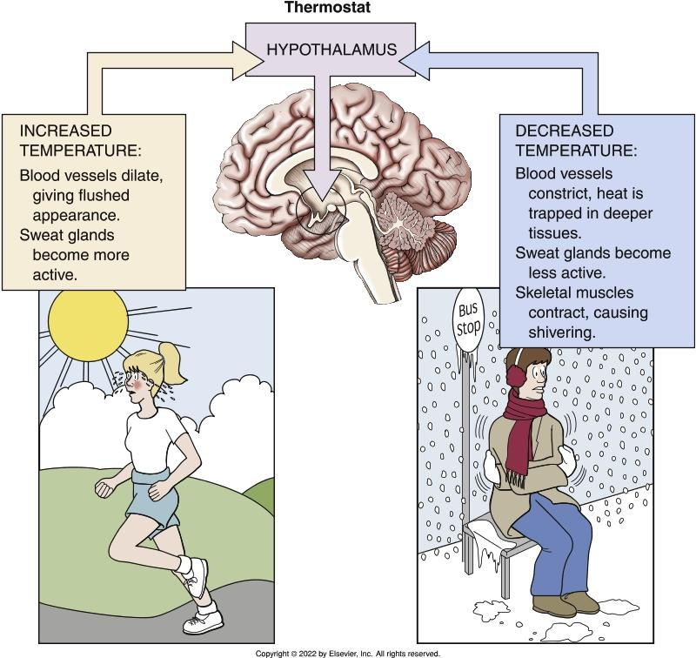
Temperature Regulation
Notes:
Textbook Figure 7.5: Temperature Regulation.

Slide 17
More About Sweating and Chilling
Perspiration
  Sensible perspiration -form of perspiration in which the body is able to sense the watery fluid as moist on the skin
  Insensible perspiration - A kind of perspiration in which the water in sweat evaporates soon before the body perceives it as a moisture on the skin
Chilling (animals)
  Waving tails (squirrels) or ears (elephants)
  Panting (dogs)
  Excreting waste along its own legs (vulture)

Slide 18
Newborns and Body Temperature
Neonates lose more heat than they produce
  Large surface area
  Thin layer of subcutaneous fat
  Cannot shiver
  Nonshivering thermogenesis: metabolism of brown adipose tissue (BAT) generates heat when needed
Neonates also have a very limited capacity to dissipate heat

Slide 19
When Skin is Burned
Partial thickness burns
  First-degree
  Second-degree
Full-thickness burn
  Third-degree
Rule of nines - assessment tool
Eschar -dead burned tissue that forms a scab-like layer over burned surface
  Acts like a tourniquet
  Becomes a breeding ground for bacteria
  Secretes toxins into blood

Slide 20
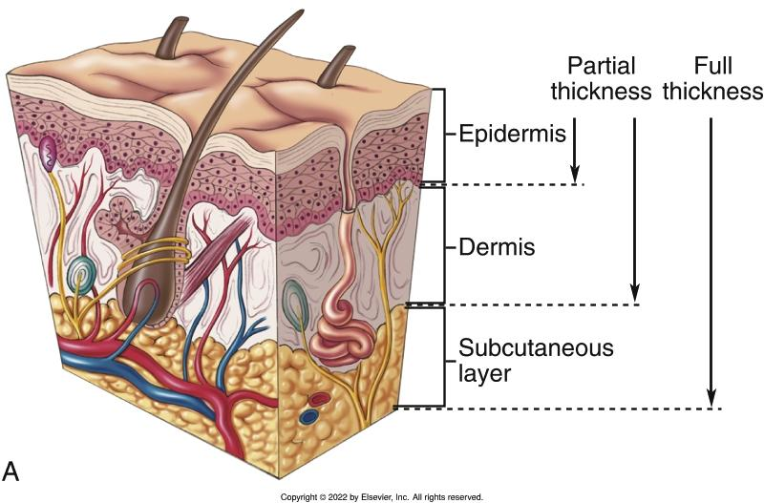
Parts of the Skin Damaged by Burns
Notes:
Textbook Figure 7.6A: (A) Parts of the skin damaged by burns. Partial-thickness (first- and second-degree burns) and full-thickness burns (third-degree burns).

