Slide 1
The Human Body in Health and Illness, 8th ed.
Barbara Herlihy,
BSN, MA, PhD (Physiology), RN

Slide 2
Chapter 3
Cells
The Human Body in Health and Illness,
8th ed.
Barbara Herlihy

Slide 3
Lesson 3.1
(1 of 2)
Label and diagram the main parts of a typical cell, and do the following:
    Explain the role of the nucleus.
    Describe the functions of the main organelles of the cell.
    Identify the components of the cell membrane.
Do the following regarding transport mechanisms:
    Describe the active and passive movements of substances across a cell membrane.
    Define tonicity and compare isotonic, hypotonic, and hypertonic solutions.

Slide 4
Lesson 3.1
(2 of 2)
Describe the phases of the cell cycle, including mitosis.
Explain what is meant by cell differentiation.
Explain the processes and consequences of uncontrolled and disorganized cell growth and apoptosis.

Slide 5
Cells Are Specialized
Cells are basic units of living matter.
Cells vary considerably in size, shape, and function.
Cell structures reflect their specialized functions.
Each specialized cell possesses some or all of the properties of the typical cell.

Slide 6
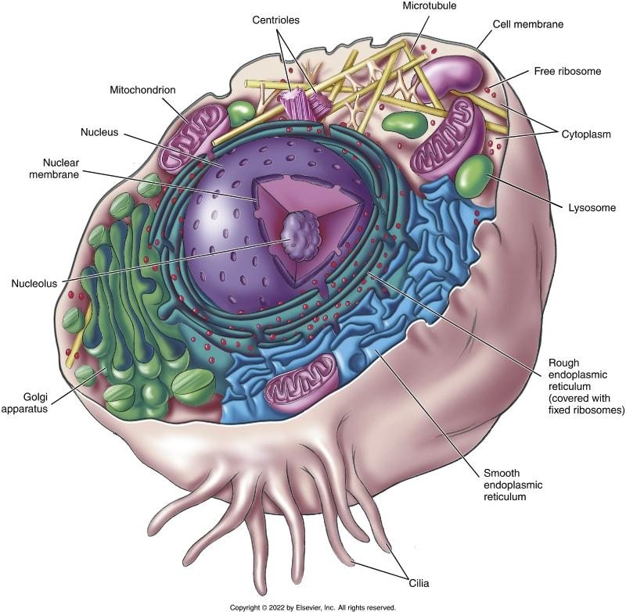
A Typical Cell
Notes:
Textbook Figure 3.2, A Typical Cell.

Slide 7
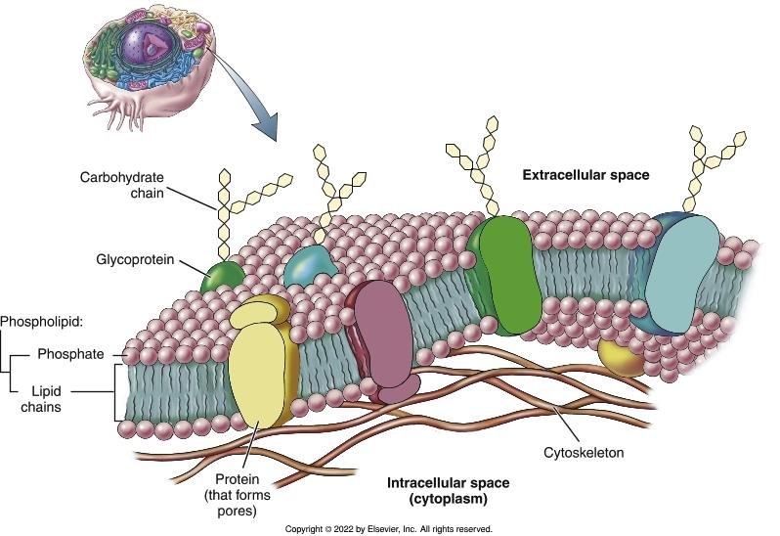
Cell Membrane
Notes:
Textbook Figure 3.3, Structure of the Cell Membrane: Phospholipid Bilayer and Protein.

Slide 8
Inside the Cell
(1 of 3)
https://youtu.be/URUJD5NEXC8?si=guSRgcGUNoUxjWT9
Nucleus
  Control center of the cell
  Contains nucleoplasm
    Nucleolus
    Chromatin
Cytoplasm
  Cytoplasmic gel
    Cytosol
    Organelles

Slide 9
Inside the Cell
(2 of 3)
Cytoplasmic organelles
  Mitochondria
    Power plants of the cell
  Ribosomes
    Site of protein synthesis
  Endoplasmic reticulum
    Channels substances, especially newly synthesized protein
  Golgi apparatus
    Packages protein

Slide 10
Inside the Cell
(3 of 3)
Cytoplasmic organelles (cont’d)
  Lysosomes
    Break down intracellular waste and kill ingested bacteria using powerful enzymes
  Cytoskeleton
    Helps maintain the cell’s shape and assists with cellular movement
  Centrioles
    Form the spindle apparatus in a dividing cell

Slide 11
On the Cell Membrane
Microvilli
  Involved with the movement of large amounts of water and its dissolved solutes
  Folds increase surface area, enabling better absorption of fluid
Cilia
  Move substances across a cell’s surface
Flagella
  Help move the cell
  Enable sperm to swim

Slide 12
Movement Across the Cell Membrane
(1 of 3)
Passive transport mechanisms
  Diffusion
    Movement of a substance from an area of high concentration to an area of low concentration
  Facilitated diffusion
    Helper molecule assists movement of substances from area of high concentration to area of low concentration
  Osmosis
    Diffusion of water (solvent) from an area with more water to an area with less water; separated by a semipermeable membrane
Passive Transport

Slide 13
Movement Across the Cell Membrane
(2 of 3)
Passive transport mechanisms (cont’d)
  Tonicity: ability of a solution to affect the volume and pressure within a cell
    Isotonic solution: has the same concentration as intracellular fluid
    Hypotonic solution: causes RBCs to burst (lyse)
    Hypertonic solution: causes RBCs to shrink (crenate)
  Filtration
    The pushing of water and dissolved substances from an area of high pressure to an area of low pressure; the water and dissolved substances are pushed

Slide 14
Movement Across the Cell Membrane
(3 of 3)
Active transport mechanisms
  Active transport pump
    Moves a substance uphill (from an area of low concentration to an area of high concentration); requires an input of energy (adenosine triphosphate)
  Endocytosis
    Taking in of substances by the cell membrane
    Phagocytosis (Engulfing of solid particles by the cell membrane)
    Pinocytosis (Engulfing of liquid droplets)
  Exocytosis
    Secretion of cellular products out of the cell
Active Transport

Slide 15
Cell Division
Mitosis
  Splitting of one mother cell into two identical daughter cells
Meiosis
  Occurs only in sex cells

Slide 16
Cell Cycle
Interphase
  First gap phase (G₁)
  Phase (S)
  Second gap phase (G₂)
Mitosis
  Four phases: Prophase, metaphase, anaphase, telophase
  Chromosomes line up and split into two identical sets (chromatids)
  Ends with cytokinesis: Cell membrane pinches to create two identical cells
Cell division

Slide 17
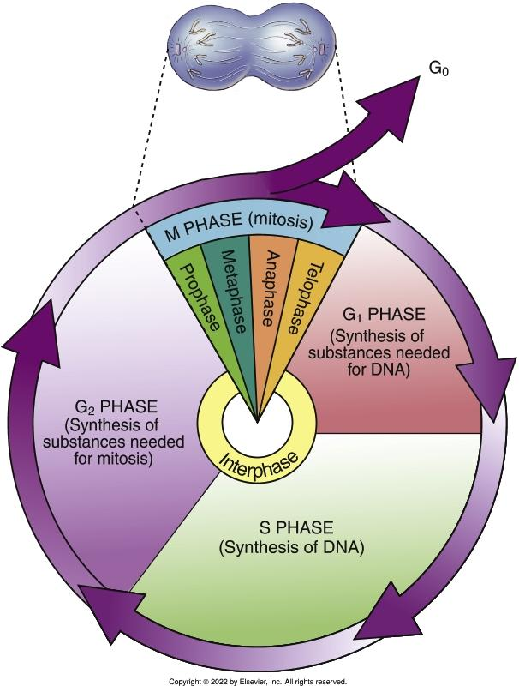
Cell Cycle: Interphase and Mitosis
Notes:
Textbook Figure 3.13, Cell Cycle: Interphase and Mitosis.

Slide 18
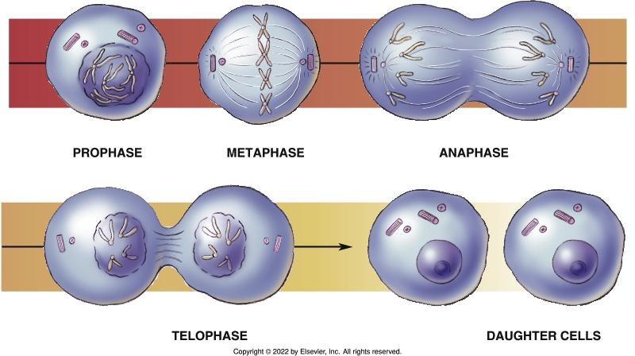
Stages of Mitosis
Notes:
Textbook Figure 3.14, Stages of Mitosis.

Slide 19
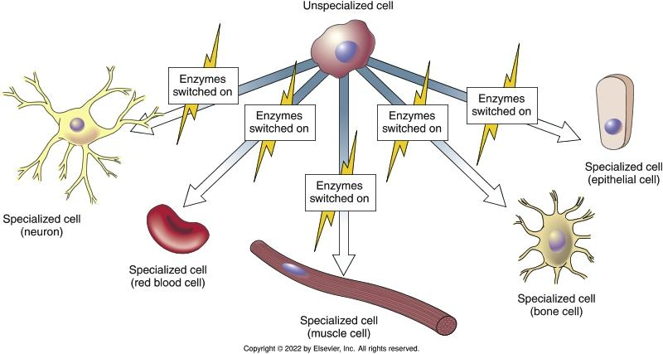
Cell Differentiation
Notes:
Textbook Figure 3.15, Cell Differentiation.

Slide 20
Stem Cells
Relatively undifferentiated or unspecialized cells whose only function is the production of additional unspecialized cells
The rate of stem cell division varies with the tissue type
  The stem cells within the bone marrow and skin are capable of dividing more than once a day
  The stem cells in adult cartilage may remain inactive for years

Slide 21
Disorders of Cellular Growth
Abnormal cell growth creates tumors
  Benign (noncancerous)
  Malignant (cancerous)
Cells extend and invade surrounding tissue
Apoptosis leads to cell death
  Helps rid the body of old, unnecessary, and unhealthy cells
Necrosis
  Death of cells or groups of cells

