Slide 1
PATHOPHYSIOLOGY 2
MUSCULOSKELETAL PATHOLOGIES
Presented by:Dr. Jil Simmons BSc ND

Slide 2
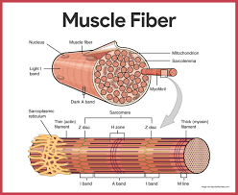
Muscle Physiology Review
https://youtu.be/Ktv-CaOt6UQ

Slide 3
FYI- Imaging of the Body
Xray - https://youtu.be/gsV7SJDDCY4
  -pro: low cost, easily accessible, good visualization of bone & other dense tissue
  Cons: Radiation exposure, no soft tissue visualization
CT Scan - https://youtu.be/aQZ8tTZnQ8A
  Pro: Quick scan so better in emergencies, better visualization of soft tissues, organs
  Con: radiation exposure, more costly, less available than x-ray
MRI - https://youtu.be/g-jj4KrmYPI
  Pros: No radiation, most detailed images of soft tissue, ok in pregnancy
  Cons: noisy, some people experience claustrophobia, cannot be used with any metal implants, costs more than CT
Ultrasound - https://youtu.be/4JLNb8-LOB0?feature=shared
  Pros: painless, no radiation, can distinguish between fluids and solids in cysts or blood clots
  Cons: lack of detail

Slide 4
Strain
What is it?
  Torn or overused MUSCLE FIBRES & TENDONS
Cause
  Normally chronic, cumulative overuse patterns with no specific onset, fatigue
    Sports like rowing, tennis, golf, or baseball
    Repetitive work or maintaining a prolonged position
    Poor posture
  Can be caused by Trauma
    Slip or lose your footing
    Jump, run, or throw
    Lift something heavy or in an awkward position

Slide 5
Signs & Symptoms
Sudden onset of pain
Soreness, pain on resisted and passive movement
Limited range of movement
Bruising or discoloration
Possibly Swelling (severe strain, which may also have heat)
A "knotted up" feeling
Muscle spasms
Stiffness
Weakness
Symptoms of mild to moderate muscle strains are usually gone within a few weeks. More severe strains may take months to heal.

Slide 6
Grade of Injury
First Degree - mildly painful and don’t seriously impede function
Second Degree - more damage to your muscle or tendon, and it is weaker than it was before the injury, painful and can impede function
Third Degree – Involve ruptured muscles, and possibly avulsed bony attachment sites
  Diagnostic imaging may be necessary to learn the extent of the damage to your muscle. Physical therapy may be recommended. In severe cases, surgical repair may be necessary.

Slide 7
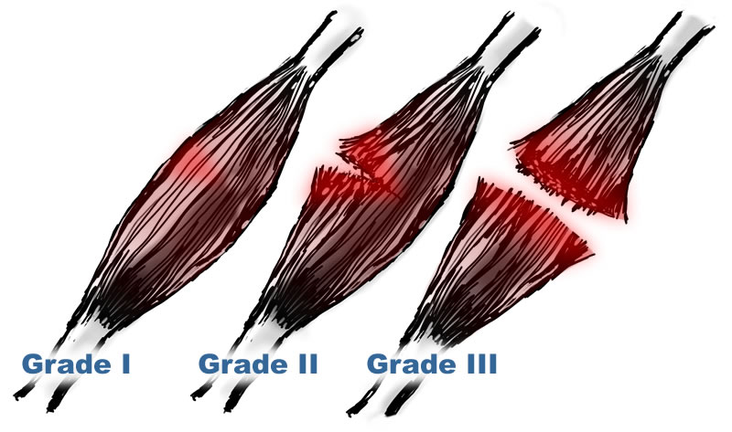

Slide 8
Continued
In the case of a mild strain, a torn muscle may feel slightly stiff, but still flexible enough for use. A severe muscle strain is when the muscle is severely torn, resulting in pain and very limited movement.
An acute muscle strain is when your muscle tears suddenly and unexpectedly. This can be due to:
  Not warming up properly before physical activity
  Poor flexibility
  Poor conditioning
  Overexertion and fatigue

Slide 9
Implications of a strain
Good blood supply aids healing however, an accumulation of scar tissue can have different implications for muscles then for tendons and ligaments
These include
  Impaired Contractility - When muscle attempts to contract it bears the weight of bones and muscle fibers, muscle fibres that are repaired (by masses of collagen being laid down) it binds the fibres up, which significantly increases the load on uninjured muscle tissues that increase changed of repeated injury

Slide 10
Implications of a strain - Continued
Adhesions – Collagen manufactured around an injury is not laid down in perfect alignment with muscle fibres, instead deposited quickly and haphazardly
Random collagen fibres tend to bind up different layers that are meant to be separated. These are adhesions
These can occur wherever layers of connective tissue come into contact with each other. They may occur within a muscle or between muscles; when muscle sheaths stick to each other (Hamstrings)
Adhesions limit mobility and increase the chance of injury

Slide 11
Sprains

Slide 12
Sprains
What is it?
  A sprain is a tear or stretch to a ligament
Cause
  A sprain is caused by direct or indirect trauma (a fall, a blow to the body, etc.) that knocks a joint out of position, and overstretches and, in severe cases, ruptures the supporting ligaments. Typically, this injury occurs when an individual lands on an outstretched arm; slides into a base; jumps up and lands on the side of the foot; or runs on an uneven surface.

Slide 13
Grades of Sprains
Grade 1
  Involve just a few fibres
Grade 2
  Involve many fibres
Grade 3
  Involve all fibres – the entire structure has been ripped off

Slide 14
Distinguishing Features from a Strain
Injured ligaments – not muscles or tendons
More serious than strains and tendinosis – tendons and muscles more elastic and less densely arranged, muscles have a better blood supply
Sprains tend to swell – acute sprains tend to swell much more than acute strains or tendinosis. Injury to a ligament may cause a joint to swell as well based on its location
http://youtu.be/2MO-4B_qz6c

Slide 15
Tendinopathies
Tendinitis - inflammation of a tendon and tendon muscle attachments, which can lead to pain and tenderness. Tendinitis can affect any of the tendons in the body, but it most commonly occurs around the shoulders, elbows, wrists and heels.
Symptoms: Tenderness and pain, worse with movement or full, passive stretch
Etiology: Repetitive motion, direct trauma, underlying conditions of inflammation or collagen problems.
Tendinosis - Tendon degeneration without inflammation. This can be related to aging or conditions that affect collagen production & maintenance. Degraded tendons are prone to injury, so the condition will often progress to Tendinitis.

Slide 16
Osgood Schlatter Disease
Patellar tendonitis at the tibial tuberosity that occurs in immature bone.
Most commonly affects young athletes aged 11 - 14 participating in sports involving running, jumping & sudden changes of direction.
Etiology: Trauma to growth plate of the tibial tuberosity from pulling force of quadriceps
Signs & symptoms: pain & inflammation worse with knee extension and/or trauma to the knee. The tibial tuberosity often becomes prominent and tender to touch.
Generally fully resolves once puberty (& bone growth) are completed.

Slide 17
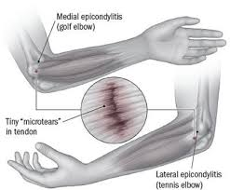
Epicondylitis
Inflammation of a tendon where it attaches to an epicondyle. Most commonly occurs at the elbow
Lateral epicondylitis AKA Tennis elbow- inflammation of the common extensor tendons
Medial epicondylitis
AKA Golfer’s elbow-
inflammation of the
common flexor tendons

Slide 18
Tenosynovitis
Tendons are surrounded by protective sheaths, which are lined with a substance called tenosynovium. Tenosynovium releases a fluid that helps the tendon smoothly glide through the tendon sheath.
The lining of the tendon sheath can become inflamed and is then called tenosynovitis. Tenosynovitis most often affects the hands, wrists and feet. Pain and tenderness result when a person moves or touches the affected area.

Slide 19
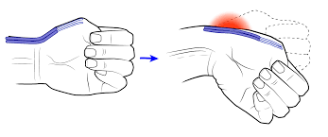
De Quervain Tenosynovitis
Most common type of Tenosynovitis. Inflammation of the synovial sheath of the radial (thumb) side of the hand. This sheath surrounds two muscles - the abductor pollis brevis & the extensor pollis brevis.
Symptoms are most notable when grasping with the hand or turning the wrist.
Etiology: repetitive hand or wrist movements, picking up a baby, sustained weight bearing while the wrist is in a static position

Slide 20
Tendon Ruptures
Tendon ruptures: In some rare instances, tendons can snap or rupture. Conditions that make a rupture more likely include the injection of steroids into a tendon, certain diseases (such as gout or hyperparathyroidism), and having type O blood.
The most common areas of tendon rupture in the leg are as follows:
  Quadriceps.
  Achilles

Slide 21
Continued
Although fairly uncommon, a tendon rupture can be a serious problem and may result in excruciating pain and permanent disability if untreated. Each type of tendon rupture has its own signs and symptoms and can be treated either surgically or medically depending on the severity of the rupture and the confidence of the surgeon.

Slide 22
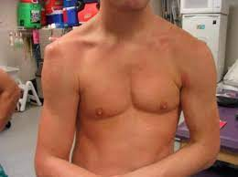
Dislocations
A joint dislocation, or luxation, occurs when there is an abnormal separation in the joint. A partial dislocation is referred to as a subluxation. Dislocations are often caused by sudden trauma on the joint like an impact or fall. A joint dislocation can cause damage to the surrounding ligaments, tendons, muscles, and nerves. Dislocations can occur in any joint, major (shoulder, knees, etc.) or minor (toes, fingers, etc.).
The most common joint dislocation is a shoulder dislocation.
Once a joint has been dislocated, it is more at risk for dislocations in the future.
In many scenarios, you will be able easily to see a dislocation when it has occurred. The area may be swollen or look bruised. You may notice that the area is red or discolored. It may also have a strange shape as a result of the dislocation. Some of the other symptoms associated with dislocated joints include:
  Loss of motion
  Pain during movement
  Numbness around the area
  Tingling feeling

Slide 23
Loose Bodies
Healthy joints move easily because of a smooth, slippery tissue called articular cartilage. The joint capsule is lined with a thin membrane called the synovium.
In synovial chondromatosis, the synovium grows abnormally and produces nodules made of cartilage. These nodules may break off from the synovium and become loose inside the joint.
https://youtu.be/t5XXEx623Ek

Slide 24
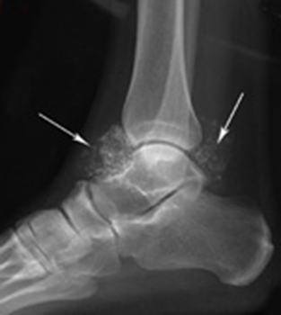
Continued
The loose cartilage bodies in the joint may vary in size from a few millimeters (such as the size of a small pill) to a few centimeters (the size of a quarter). The synovial fluid nourishes the loose bodies and they may grow, calcify, or ossify (turn into bone). They can then roll around like loose marbles and damage the articular cartilage, causing osteoarthritis. In osteoarthritis, damaged cartilage becomes worn and frayed. Moving the bones along this exposed surface is painful.

Slide 25
Continued
In severe cases, the loose bodies may grow large enough to occupy the entire joint space or penetrate into adjacent tissues. Synovial chondromatosis most often occurs in the knee, followed by the hip, elbow, and shoulder. In most cases, only one joint in the body is affected.
Most cases of synovial chondromatosis occur in middle-aged people between the ages of 30 and 50. Men are affected twice as often as women.
Loose bodies may also have as their primary cause some condition, such as osteoarthritis or Charcot's disease, but the secondary cause is direct or indirect trauma.
Trauma, direct or indirect, is essential to the production of a loose body. Surgery offers the only permanent relief, and the general condition of the patient being satisfactory, the bodies should be removed.

Slide 26
Osteochondritis Dissecans
Occurs primarily in very active children & teens
Ages 10 -20.
Etiology: Bone under cartilage dies from lack of blood flow & the bone & cartilage can break loose. Reduced blood flow may be due to acute injury or repetitive motion trauma, such as repeated jumping and running. There may be a genetic component.
Having this injury predisposes you to develop osteoarthritis later on.
Signs & Symptoms:
Pain in the affected joint, worse with exercise
Swelling
Stiffness and/or a sensation of locking or catching during movement
Treatment: Activity modification. Rest from high impact activities. May require surgery.

Slide 27
Complex Regional Pain Syndrome
(CRPS) is a chronic pain condition most often affecting one of the limbs (arms, legs, hands, or feet), usually after an injury or trauma to that limb.
CRPS is believed to be caused by damage to, or malfunction of, the peripheral and central nervous systems.
CRPS is characterized by prolonged or excessive pain and mild or dramatic changes in skin color, temperature, and/or swelling in the affected area.

Slide 28
Continued
There are two similar forms, called CRPS-I and CRPS-II, with the same symptoms and treatments. CRPS-II (previously called causalgia) is the term used for patients with confirmed nerve injuries. Individuals without confirmed nerve injury are classified as having CRPS-I (previously called reflex sympathetic dystrophy syndrome). Some research has identified evidence of nerve injury in CRPS-I, so the validity of the two different forms is being investigated.
CRPS symptoms vary in severity and duration. Studies of the incidence and prevalence of the disease show that most cases are mild and individuals recover gradually with time. In more severe cases, individuals may not recover and may have long-term disability.
https:youtu.be/wu-n5xaV16Q

Slide 29
Pelvic Girdle Pain/Symphysis Pubis Dysfunction
It is estimated that one in five women suffer with Pelvic Girdle Pain (PGP) during or after pregnancy. PGP is the term now being used by the medical community to describe what was previously known as Symphysis Pubis Dysfunction (SPD). It is the name given to a group of symptoms arising from the joints at the front and/or back of the pelvis.
Common symptoms are:
  Pain walking and standing
  Difficulty climbing stairs
  Pain and difficulty turning over in bed
  Having to sit to dress
  Pain getting in and out of the car or bed
  Pain with squatting
  Pain on lifting one leg to step over something
Previous falls or accidents as well as a sedentary job or lifestyle can weaken the muscles around the pelvis leading onto poor posture which could increase the chances of developing PGP.
https://youtu.be/AmDxtQtJV_0

Slide 30
Pelvic Girdle Pain Continued
Postural and hormonal changes do contribute to PGP. The most common postural changes are due to the weight of the growing baby, the enlarging breasts, and secondary weight gain. Hormones released during pregnancy cause softening and relaxation of the ligaments and joints. This makes the pelvic joints and muscles more prone to injury and pain.
PGP can be caused by: irritation or inflammation of the joints or unilateral stiffness/laxity in the ligaments that provide the crucial stability to the pelvic joint complex.
The involved joints are the sacroiliac and the symphysis pubis, so a dysfunction in one can turn into pain and torsion in the other.
Any movement that causes one side of the pelvis to move against the other, for example, aggravates PGP. This action results in "gapping" movements of the symphysis pubis.

Slide 31
Myopathies
Myopathy is any muscle disease unrelated to any disorder of innervation or neuromuscular junction.
These conditions have widely varying etiologies, including congenital or inherited, idiopathic, infectious, metabolic, inflammatory, endocrine, and drug-induced or toxic.
Symptoms include:
Muscle fatigue and weakness
Muscle stiffness, cramping and pain
https://youtu.be/tQ_NKlh7P9k

Slide 32
Congenital/Primary Myopathies
a)Muscular dystrophies, like Duchenne muscular dystrophy or Becker Muscular Dystrophy (DMD)
b)Congenital myopathies
c) Metabolic myopathies, hereditary muscle disorders caused by enzymatic defects (usually considered to be inborn errors of metabolism affecting the three major pathways of ATP supply)
https://youtu.be/DGOmN6rnsNk

Slide 33
Acquired Myopathies
a)Secondary metabolic and endocrine myopathies: like Thyroid disease, Parathyroid dysfunction, Pituitary dysfunction, Biochemical(potassium deficiency), Diabetes mellitus.
b)Dermatomyositis and polymyositis - these are inflammatory myopathies (possible autoimmune basis) with weakness, endomysial inflammation and elevated muscle enzymes:
https://youtu.be/WXLnd15kunE
c) Drug-induced myopathy ie. Statin(cholesterol lowering) induced
d) Infectious causes ie. Influenza, Epstein-Barr virus

Slide 34
Muscle Atrophy (muscle wasting)
loss of muscle tissue
Common Causes included
  Little or no physical exercise and a sedentary lifestyle (disuse atrophy)AKA Sarcopenia
    Other common causes of disuse atrophy include medical conditions that decrease mobility, such as rheumatoid arthritis (chronic autoimmune disease characterized by joint inflammation) or osteoarthritis, and injuries, such as broken bones and burn The aging process often leads to slow but progressive muscle atrophy.
    https://youtu.be/CPdexPfqiDc
  Muscle atrophy caused by a nerve problem is called neurogenic atrophy.
    Common causes include neuromuscular diseases, such as spinal cord atrophy, multiple sclerosis (disease that affects the brain and spinal cord causing weakness, coordination, balance difficulties, and other problems), amyotrophic lateral sclerosis (ALS); a severe neuromuscular disease that causes muscle weakness and disability, or Guillain-Barre syndrome (autoimmune nerve disorder). Diabetic neuropathy, nerve damage associated with diabetes, may also lead to atrophy of the muscles

Slide 35
Muscle Atrophy
In some cases, muscle atrophy can be a symptom of serious malnutrition or alcohol-related muscle disease.
Injuries or trauma to nerves due to spinal cord injury, burns, or stroke can also lead to muscle atrophy.
Depending on the cause, atrophy may occur in one muscle, a group of muscles, or the entire body, and it may be accompanied by numbness, pain or swelling, as well as other types of neuromuscular or skin symptoms.

Slide 36
Cachexia
Cachexia is also known as “wasting syndrome”
Seen in the late stages of diseases such as Cancer, AIDS, COPD, kidney disease and Congestive Heart Failure
Extreme muscle wasting, due to metabolic changes designed to help give your brain enough energy by breaking down muscle & fat
https://youtu.be/no3s63y5-2A

Slide 37
Myalgia
can range from mild to excruciating. Though it often goes away in a few days, sometimes muscle pain can linger for months.
Muscle pain can develop almost anywhere in the body, including the neck, back, legs and the hands. The most common causes of muscle pain are tension, stress, overuse and minor injuries. This type of pain is usually localized, affecting just one or more muscles or parts of the body.
Systemic muscle pain is different. It's more often the result of an infection, an illness or a side effect of a medication

Slide 38
Common causes of muscle pain
Chronic exertional compartment syndrome
Chronic fatigue syndrome
Claudication https://youtu.be/0lbjDeqXXBo
Dermatomyositis
Dystonia https://youtu.be/J8tFxXkQH3Q
Fibromyalgia
Hypothyroidism
Influenza (flu)
Lupus (Systemic Lupus Erythematosus)
Lyme disease
Medications, especially statins
Muscle cramp

Slide 39
Continued
Muscle strain or rupture
Myofascial pain syndrome
Polymyalgia rheumatica
Polymyositis (See PPT 1)
Porphyria https://youtu.be/CVz0t_LzKgc
Repetitive strain injuries
Rhabdomyolysis, a potentially life-threatening condition in which muscle fibers break down and enter the bloodstream — sometimes as a side effect of using statin drugs
Rheumatoid arthritis (PPT 1)
Rocky Mountain spotted fever https://youtu.be/0tAkOX4O8S4
Viral infections

Slide 40
Compartment Syndromes
Compartment syndrome is a serious condition that involves increased pressure in a muscle compartment. It can lead to muscle and nerve damage and circulatory disorders.
Thick layers of fascia separate groups of muscles in the arms and legs. Inside each layer of fascia is a confined space, called a compartment. The compartment includes the muscle tissue, nerves, and blood vessels. Fascia surrounds these structures, similar to the way in which insulation covers wires.
Fascia does not expand. Any swelling in a compartment will lead to increased pressure in that area, which will compress the muscles, blood vessels, and nerves. If this pressure is high enough, blood flow to the compartment will be blocked. This can lead to permanent injury to the muscle and nerves. If the pressure lasts long enough, the muscles may undergo necrosis and need to be amputated.

Slide 41
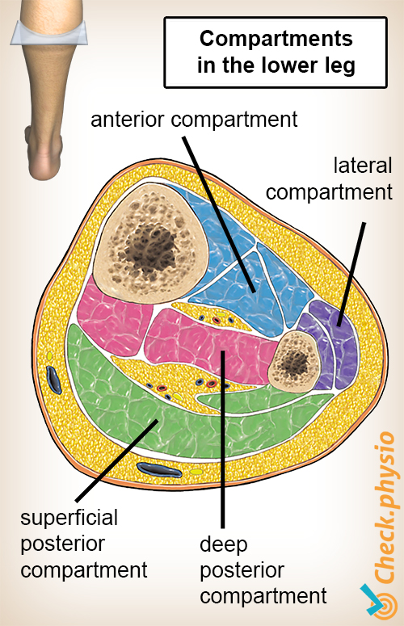

Slide 42
Acute vs Chronic Compartment Syndrome
ACUTE: Swelling that leads to compartment syndrome occurs from trauma such as a car accident or crush injury, or surgery. Swelling can also be caused by complex fractures or soft tissue injuries due to trauma.
CHRONIC compartment syndrome can be caused by repetitive activities, such as running. The pressure in a compartment only increases during that activity. At first, the symptoms will go away at rest but eventually they will become constant.
Compartment syndrome is most common in the lower leg and forearm, although it can also occur in the hand, foot, thigh, and upper arm.
https://youtu.be/oO9GqanB0s8?feature=shared

Slide 43
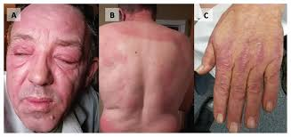
Dermatomyositis
uncommon inflammatory disease marked by muscle weakness and a distinctive skin rash. It affects adults and children alike.
In adults, dermatomyositis usually occurs from the late 40s to early 60s.
In children, the disease most often appears between 5 and 15 years of age. Dermatomyositis affects more females than males.

Slide 44
Dermatomyositis Signs and Symptoms
Skin changes. A violet-colored or dusky red rash develops, most commonly on the face and eyelids and on areas around the nails, knuckles, elbows, knees, chest and back. The rash, which can be patchy with bluish-purple discolorations, is often the first sign of dermatomyositis.
Muscle weakness. Progressive muscle weakness involves the muscles closest to the trunk, such as those in the hips, thighs, shoulders, upper arms and neck. The weakness affects both the left and right sides of the body, and tends to gradually worsen. The exact cause of dermatomyositis is unknown, but the disease shares many characteristics with autoimmune disorders. Small blood vessels in muscular tissue are particularly affected in dermatomyositis. Inflammatory cells surround the blood vessels and eventually lead to degeneration of muscle fibers.

Slide 45
Complications of Dermatomyositis
Difficulty swallowing. which in turn may cause weight loss and malnutrition.
Aspiration pneumonia, which can lead to pneumonia.
Breathing problems. Such as shortness of breath.
Raynaud's phenomenon. This is a condition in which the fingers, toes, cheeks, nose and ears turn pale when exposed to cold temperatures.
Other connective tissue diseases. Other conditions, such as lupus, rheumatoid arthritis, scleroderma and Sjogren's syndrome, can occur in combination with dermatomyositis.
Cardiovascular disease.
Lung disease. Interstitial lung disease refers to a group of disorders that cause scarring (fibrosis) of lung tissue, making the lungs stiff and inelastic. Signs and symptoms include a dry cough and shortness of breath.
Cancer. Dermatomyositis in adults has been linked to an increased likelihood of developing cancer, particularly of the cervix, lungs, pancreas, breasts, ovaries and gastrointestinal tract. Risk of cancer increases with age.
Smilar to Polymyositis (PPT1) but with skin symptoms as well.

Slide 46
Fibromyalgia
A disorder characterized by widespread musculoskeletal pain accompanied by fatigue, sleep, memory and mood issues. Researchers believe that fibromyalgia amplifies painful sensations by affecting the way the brain processes pain signals. Symptoms sometimes begin after a physical trauma, surgery, infection or significant psychological stress. In other cases, symptoms gradually accumulate over time with no single triggering event.
Women are much more likely to develop fibromyalgia than are men. Many people who have fibromyalgia also have tension headaches, temporomandibular joint (TMJ) disorders, irritable bowel syndrome, anxiety and depression.

Slide 47
Symptoms
Widespread pain. The pain associated with fibromyalgia often is described as a constant dull ache that has lasted for at least three months. To be considered widespread, the pain must occur on both sides of the body and above and below the waist.
Fatigue. People with fibromyalgia often awaken tired, even though they report sleeping for long periods of time. Sleep is often disrupted by pain, and many patients with fibromyalgia have other sleep disorders, such as restless legs syndrome and sleep apnea.
Cognitive difficulties. Impairment of the ability to focus.
Other problems. Many people who have fibromyalgia also may experience depression, headaches, and pain or cramping in the lower abdomen.

Slide 48
Possible Causes
Genetics
Infections
Physical or emotional trauma
https://youtu.be/yDVOBf9krkQ

Slide 49
Necrotizing Fasciitis
AKA “Flesh Eating Disease”
A serious bacterial infection that spreads rapidly and destroys the body's soft tissue. this rare disease can be caused by more than one type of bacteria. These include group A Streptococcus (group A strep), Klebsiella, Clostridium, E. coli, and Staphylococcus aureus, among others. Group A strep is considered the most common cause of necrotizing fasciitis.
Usually, infections from group A strep bacteria are generally mild or moderate and are easily treated. But sometimes toxins made by these bacteria destroy the tissue they infect, causing it to die. Accurate diagnosis and prompt treatment with antibiotics through a vein and surgery are important.

Slide 50
The most common way of getting necrotizing fasciitis is when the bacteria enter the body through a break in the skin, like a cut, scrape, burn, insect bite, or puncture wound. Most people who get necrotizing fasciitis have other health problems that may lower their body's ability to fight infection. Some of these conditions include diabetes, kidney disease, cancer, or other chronic health conditions that weaken the body's immune system.

Slide 51
Continued
In cases of necrotizing fasciitis, bacteria spread rapidly once they enter the body. They infect flat layers of a membrane known as the fascia, connective bands of tissue that surround muscles, nerves, fat, and blood vessels. The infection also damages the tissues next to the fascia.
The symptoms often start within hours after an injury and may seem like another illness or injury. Some people infected with necrotizing fasciitis may complain of pain or soreness, The skin may be warm with red or purplish areas of swelling that spread rapidly. There may be ulcers, blisters or black spots on the skin. Patients often describe their pain as severe and way out of proportion to how the painful area looks when examined by a doctor. Fever, chills, fatigue or vomiting may follow the initial wound or soreness.

Slide 52
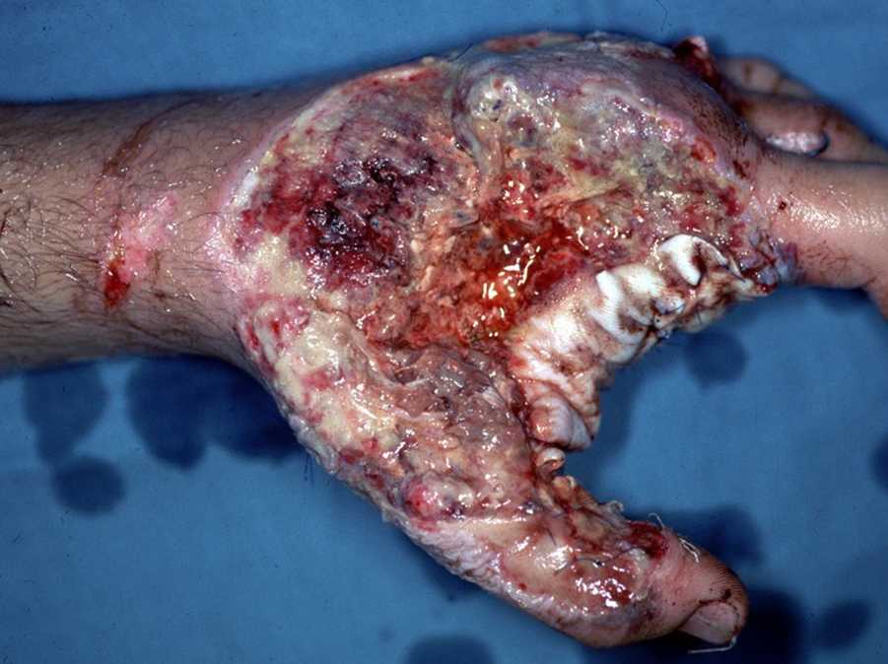
Continued

Slide 53
Dupuytren’s Contracture
a hand deformity that usually develops slowly, over years. It is idiopathic disease. Dupuytren's contracture affects a layer of tissue that lies under the skin of the palm. Knots of tissue form under the skin — eventually forming a thick cord that can pull one or more of the fingers into a flexion position.
Once this occurs, the fingers affected by Dupuytren's contracture can't be straightened completely, which can complicate everyday activities.
Dupuytren's contracture most commonly affects the ring and the little fingers, and occurs most often in older men of Northern European descent. It can occur in both hands, though one hand is usually affected more severely than the other.
https://youtu.be/LDUs_BgOY9U

Slide 54
Myositis Ossificans
is a benign process characterised by ossification usually within large muscles. Most cases of myositis ossificans occur as a result of trauma, Another group which are particularly prone to myositis ossificans are paraplegics, usually without evidence of trauma.
Typically presents as a painful, tender, enlarging mass, which in 80% of cases is located in large muscles of the extremities, often following recognized local trauma, although a definite traumatic event is not always recalled. In the case of paraplegics, recognized episodes of trauma are often absent, and the disease occurs particularly around the knees and hips.
Myositis ossificans is essentially extraosseous bone formation (without inflammation) which occurs in muscle. It has a zonal organization.
  peripheral well organized mature lamellar bone
  intermediate osteoid region
  central immature non-ossified cellular focus
Unfortunately the histologically of myositis ossificans can appear similar to osteosarcoma, and thus can actually lead to inappropriate management. https://youtu.be/ykhkWmpaN6o

Slide 55
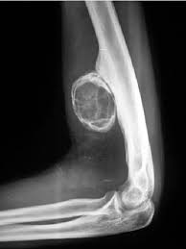
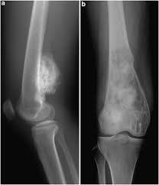
Myositis Ossificans vs Osteosarcoma
“Egg like” appearance - “Sunburst” appearance
“hollow” look in middle - Solid in middle

Slide 56
Developmental Abnormalities
Cerebral palsy is one of the most common congenital disorders of childhood. About 500,000 children and adults of all ages in the United States have the condition. Cerebral palsy affects muscle control and coordination, so even simple movements — like standing still — are difficult. Other vital functions that also involve motor skills and muscles — such as breathing, bladder and bowel control, eating, and learning — may also be affected when a child has CP. Cerebral palsy does not get worse over time.
https://youtu.be/Qq_Tzj8mUe8?feature=shared
Developmental hip dislocations and developmental hip dysplasia – deformity of the hip that can occur before, during, or weeks after birth. In mild cases of DDH, the femoral head subluxes or dislocates, causing a child to have an unstable hip. In the most severe cases, the femoral head may not even reach the acetabulum.
  Gait Abnormalities
  Limb length discrepancy
  Toeing-in/toeing-out
  Knock knees
  Clubfoot
  https://youtu.be/jftmsn4haJE

Slide 57
Developmental Abnormalities of the Foot
Toe Deformities
Claw toes: involves abnormal positions of all three joints in the toe. It consists of an extension contracture with dorsal subluxation of the metatarsophalangeal (MTP) joint, together with flexion deformities of the proximal interphalangeal (PIP) and distal interphalangeal (DIP) joints.
Hammer toes: shows extension of the MTP joints and the DIP joints. The PIP joints are hyperflexed.
Mallet toes: shows a flexed DIP joint, most commonly of the second toe.

Slide 58
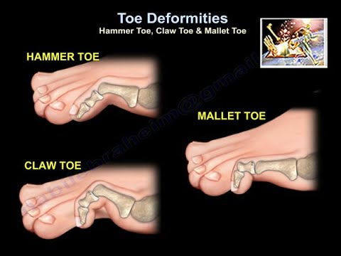
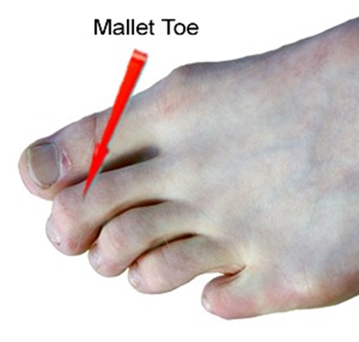
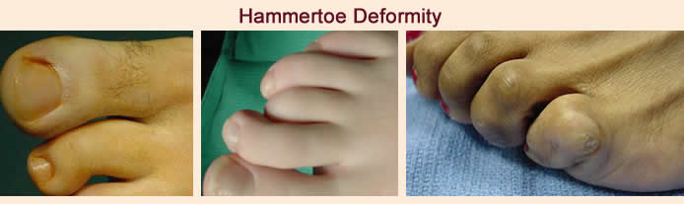

Slide 59
Pes Cavus
Describes a foot with a high arch that does not reduce with weight bearing.
may originate in the hindfoot, the forefoot, or both.
There are many variations in associated soft tissue and bony abnormalities that occur. These alignment abnormalities are usually secondary to muscular imbalances, caused by congenital or idiopathic lesions of the nervous system.
One of the more common causes is Charcot-Marie-Tooth disease. Other less common causes are myelodysplasia, poliomyelitis, and Freidrich's ataxia.

Slide 60
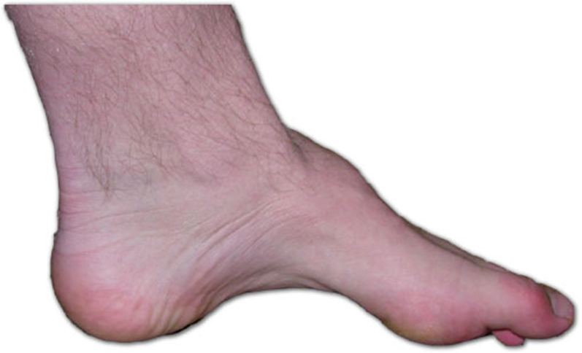

Slide 61
Pes Planus
the loss of the medial longitudinal arch of the foot. There are various types and causes of flat feet.
Usually, treatment is only needed if PP is new, painful or progressing, or when there is a fixed deformity or other associated problem. The flat arch does not occur in isolation, but affects the dynamics of the foot. So, patients standing on a flat foot will usually have:
  Valgus position of the heel (turned outwards).
  Pronation of the midfoot, usually referred to as 'hyperpronation' (the midfoot turns inwards).
  Valgus (turned out) position of the forefoot.
Pes planus (PP) can be part of normal development :Infants typically have a minimal arch. Patients may present with noticeable pes planus (PP), parental concerns, or foot pain.

Slide 62
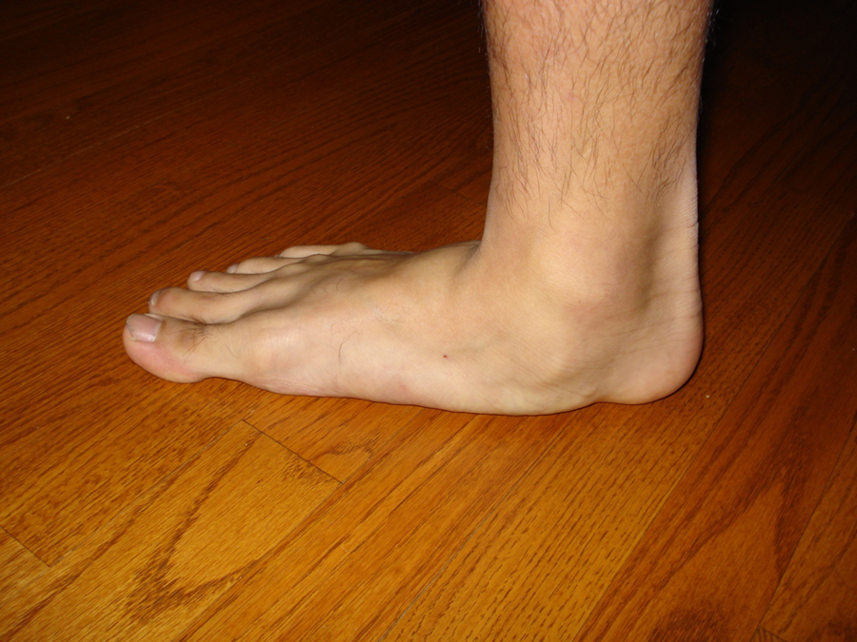

Slide 63
Avascular necrosis
(AVN or Osteonecrosis)
is the death of bone tissue due to a lack of blood supply. Also called osteonecrosis, avascular necrosis can lead to tiny breaks in the bone and the bone's eventual collapse.
The blood flow to a section of bone can be interrupted if the bone is fractured or the joint becomes dislocated. Avascular necrosis of bone is also associated with long-term use of high-dose steroid medications and excessive alcohol intake.
The hip is the joint most commonly affected by avascular necrosis. While avascular necrosis of bone can happen to anyone, it usually occurs in men between the ages of 30 and 60. Many people have no symptoms in the early stages of avascular necrosis of bone.
Pain can be mild or severe and usually develops gradually. Joints most likely to be affected are the hip, shoulder, knee, hand and foot. Pain associated with avascular necrosis of the hip may be focused in the groin, thigh or buttock. Some people experience avascular necrosis bilaterally — for example, in both hips or in both knees.

Slide 64
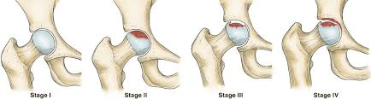
Causes
• Joint or bone injury. A traumatic injury, such as a dislocated joint, may reduce the blood supply to a section of bone, leading to bone death. Cancer treatments involving radiation also can weaken bone and harm blood vessels.
• Pressure inside the bone. Some medical conditions, such as sickle cell anemia or Gaucher's disease, can increase the pressure inside the bone — making it more difficult for fresh blood to enter.

Slide 65
Risk Factors
Risk of developing avascular necrosis can be increased by certain diseases, medical treatments or excessive drinking.
Several alcoholic drinks a day for several years This can restrict the flow of blood to the bones.
medications, Examples include:
  Steroids. Taken at high doses and for long periods of time, corticosteroids, such as prednisone.
  Osteoporosis drugs. People who take bisphosphonates — a type of medicine used to help strengthen bones weakened by osteoporosis — sometimes develop osteonecrosis

Slide 66
More Risk Factors for AVN
underlying medical conditions They include:
  HIV/AIDS
  Lupus
  Diabetes
  Sickle cell anemia
Several types of medical procedures Examples include:
  Cancer treatments such as radiation
  Dialysis
  Kidney and other organ transplants

Slide 67
References
Lippincott Williams & Wilkins
www.ssa.gov www.brianjogrady.com
www.spine-health.com www.medicinenet.com
www.arthritis.ca www.learningradiology.com
www.blackberryclinic.co.uk www.columbianeurosurgery.org
www.orthop.washington.edu www.carolinashealthcare.org
www.patient.co.uk www.uwmsk.org
https://mywiserhealth.com www.emedicinehealth.com
http://radiopaedia.org www.mayoclinic.org

