Slide 1
The Human Body in Health and Illness, 8th ed.
Barbara Herlihy,
BSN, MA, PhD (Physiology), RN

Slide 2
Chapter 24
Urinary System
The Human Body in Health and Illness,
8th ed.
Barbara Herlihy

Slide 3
Lesson 24.1
(1 of 2)
List four organs of excretion.
Describe the major organs of the urinary system.
Describe the location, structure, blood supply, nerve supply, and functions of the kidneys.
Explain the role of the nephron unit in the formation of urine.

Slide 4
Lesson 24.1
(2 of 2)
Explain the three processes involved in the formation of urine: filtration, reabsorption, and secretion.
Describe the hormonal control of water and electrolytes by the kidneys.
List the normal constituents of urine.
Describe the structure and function of the ureters, urinary bladder, and urethra.

Slide 5
Excretion
(1 of 3)
Organs of excretion
  Kidneys
  Sweat glands
  Lungs
  Intestines

Slide 6
Excretion
(2 of 3)
Urinary system organs
  Two kidneys
  Two ureters
  Urinary bladder
  Urethra

Slide 7
Excretion
(3 of 3)
Urinary system terms
  Renal: refers to the kidney
  Renal physiology: study of kidney function
  Nephrology: also the study of kidney function
  Urology: study of the urinary system

Slide 8
Kidneys
(1 of 2)
Location
  On the posterior wall of the abdominal cavity, behind the parietal peritoneum
Structure
  Renal cortex
  Renal medulla
  Renal pelvis
Blood supply
  Renal artery
Nerve supply

Slide 9
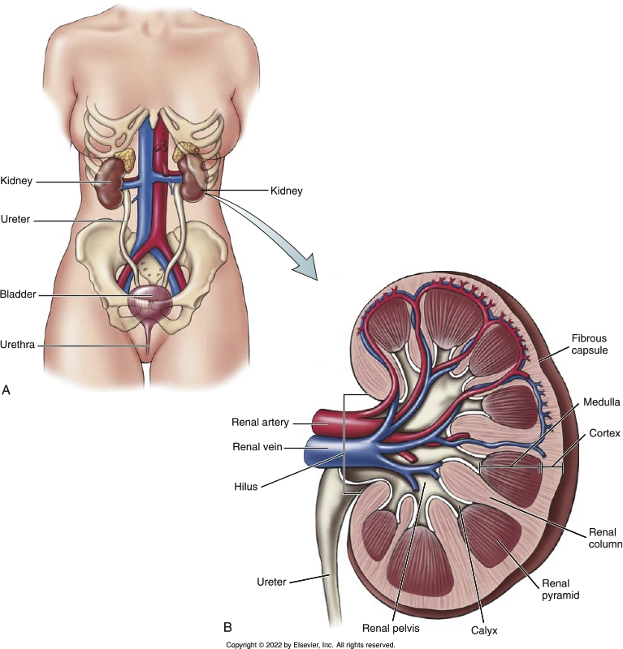
Organs of the Urinary System
Notes:
Textbook Figure 24.1: (A) Organs of the urinary system. (B) Internal structure of a kidney.

Slide 10
Kidneys
(2 of 2)
Functions of the kidneys
  Excrete nitrogenous waste such as urea, uric acid, ammonia, and creatinine
  Regulate blood volume by determining the amount of water excreted
  Help regulate the electrolyte content of the blood
  Play a major role in the regulation of acid–base balance (blood pH) by controlling the excretion of hydrogen ions (H+)
  Involved in long-term regulation of blood pressure
  Play a role in the regulation of red blood cell production through the secretion of erythropoietin

Slide 11
Urine Making: The Nephron Unit
(1 of 2)
Structures
  Renal tubules
  Renal blood vessels (vascular structures)
Urine formation
  Glomerular filtration
    Why filtration occurs
      Glomerular filtration pressure
    What substances are filtered
      Glomerular filtrate
      Ultrafiltrate
      Glomerular filtration rate (GFR)

Slide 12
Urine Making: The Nephron Unit
(2 of 2)
Tubular reabsorption
  Process whereby water and dissolved substances (glomerular filtrate) move from the tubules into the blood of the peritubular capillaries
Tubular secretion
  Process that moves very small amounts of select substances from the blood into the tubules

Slide 13
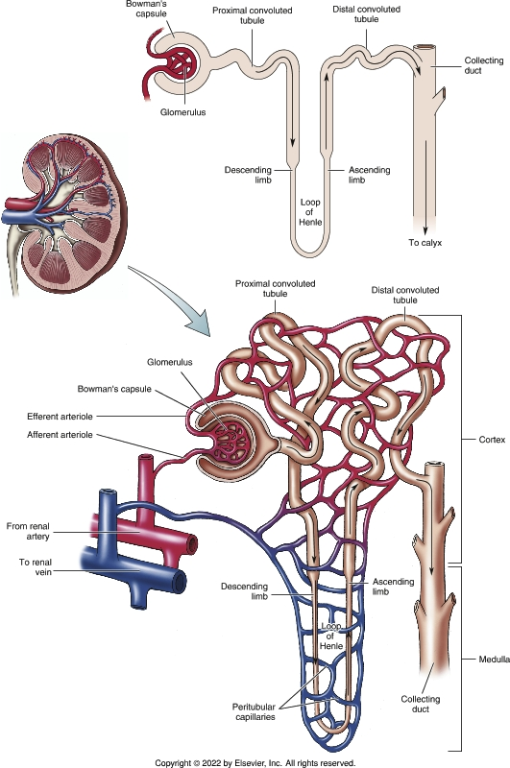
The Nephron Unit
Notes:
Textbook Figure 24.2: The Nephron Unit: Tubular and Vascular Structures.

Slide 14
Hormones that Work on the Kidneys
Aldosterone
Antidiuretic hormone
Natriuretic peptides
Parathyroid hormone and calcitonin

Slide 15
Composition of Urine
(1 of 2)
Urine
  Fluid composed mostly of water (95%), nitrogen-containing waste, and electrolytes
    Nitrogenous waste includes urea, uric acid, ammonia, and creatinine
    Urochrome: pigment formed from the breakdown of hemoglobin in the liver
  Oliguria
    Urine output of less than 400 mL/day
  Specific gravity
    Ratio of the amount of solute to volume

Slide 16
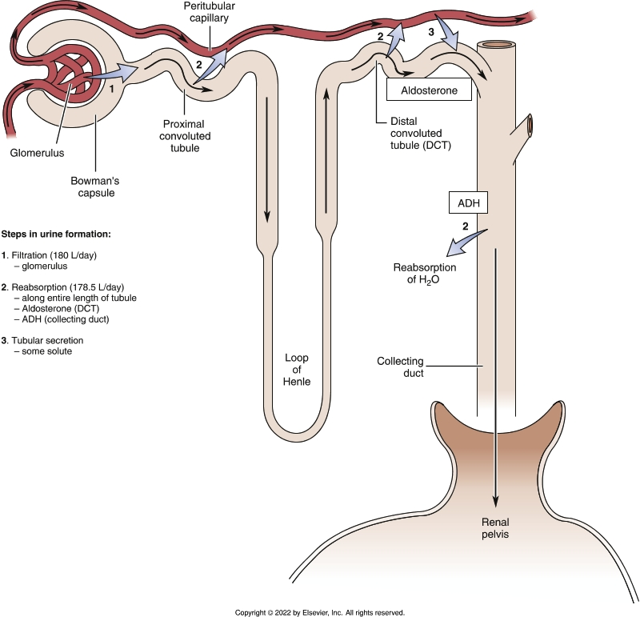
Steps in Urine Formation
Notes:
Textbook Figure 24.4: Steps in urine formation—filtration, reabsorption, and secretion—and the effects of aldosterone and antidiuretic hormone.

Slide 17
Composition of Urine
(2 of 2)
Uremia and dialysis
  Uremia
    Substances that should have been excreted in the urine remain in the blood
  Dialysis
    Artificial kidney
    Peritoneal cavity

Slide 18
Your Plumbing
Ureters
Urinary bladder
Urination (micturition, voiding)
  Micturition reflex
Urethra
An autonomic moment
  Pharmacology issues
    Muscarinic agonists
    Medications that have antimuscarinic side effects

Slide 19
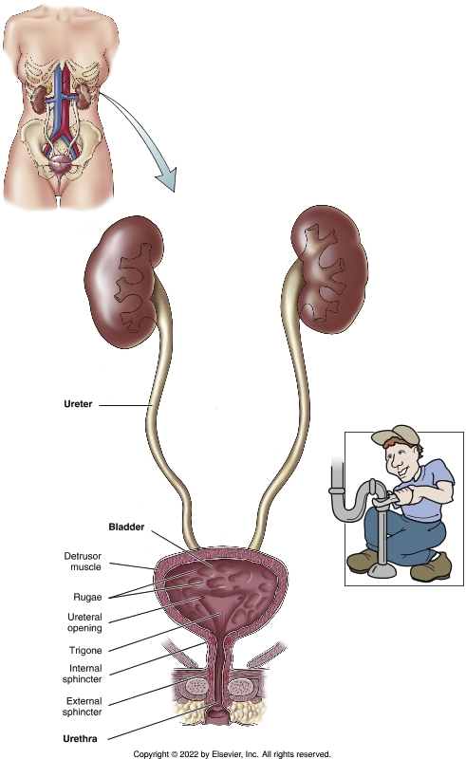
Organs of the Urinary Tract
Notes:
Textbook Figure 24.6: Organs of the Urinary Tract: Ureters, Bladder, and Urethra (Your “Plumbing”).

