Slide 1
The Human Body in Health and Illness, 8th ed.
Barbara Herlihy,
BSN, MA, PhD (Physiology), RN

Slide 2
Chapter 23
Digestive System
The Human Body in Health and Illness,
8th ed.
Barbara Herlihy

Slide 3
Lesson 23.1
Discuss the basic anatomy and physiology of the digestive system, including the following:
  The four functions of the digestive system
  The processes of digestion and absorption
  The four layers, nerves, and membranes of the digestive tract
Describe the structure and functions of the organs and accessory organs of the digestive tract.

Slide 4
Overview of the Digestive System
(1 of 2)
Digestion and absorption
  Digestion
    Process by which food is broken down into smaller particles suitable for absorption
  Absorption
    Process whereby the end products of digestion move across the walls of the digestive tract into the blood and lymph for distribution throughout the body

Slide 5
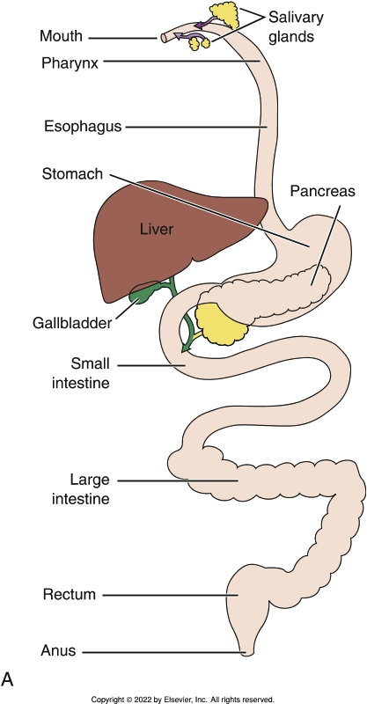
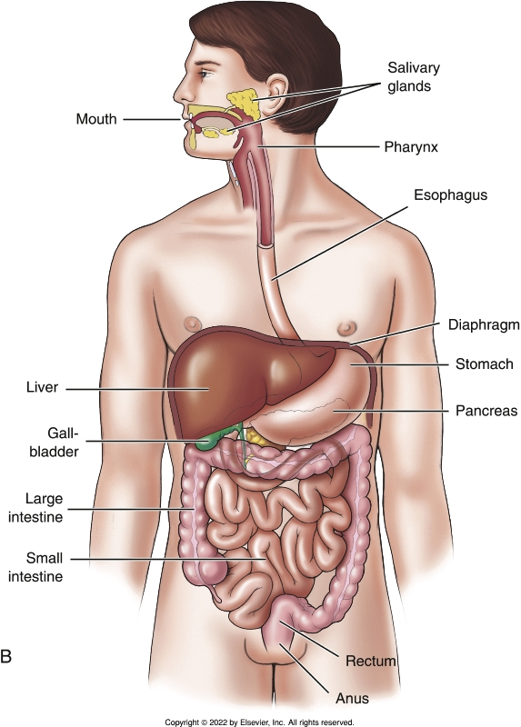
The Digestive System
Notes:
Textbook Figure 23.1: The Digestive System. (A) Hollow tube from mouth to anus. (B) Anatomical arrangement of organs of the digestive system.

Slide 6
Overview of the Digestive System
(2 of 2)
Layers and membranes of the digestive tract
  Mucosa
  Submucosa
  Muscle layer
    Segmentation
    Peristalsis
  Serosa
  Innervation of the digestive tract
    Enteric nervous system

Slide 7
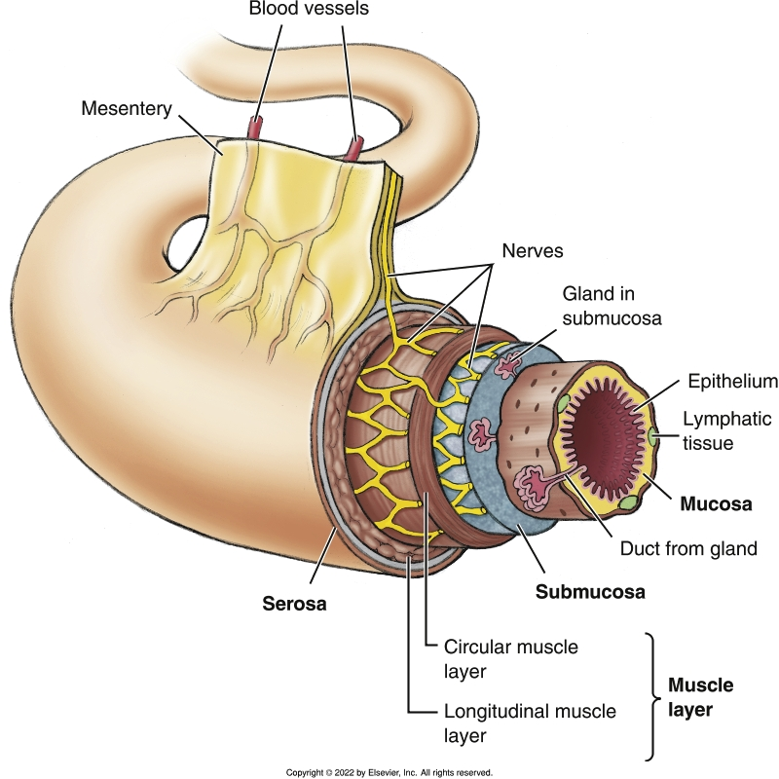
Layers of the Digestive Tract
Notes:
Textbook Figure 23.2: Layers of the Digestive Tract.

Slide 8
Structures and Organs
(1 of 7)
Mouth
  Teeth
    Mastication
  Tongue
  Salivary glands
  Other structures within the mouth
    Hard and soft palates
    Uvula
    Palatine tonsils

Slide 9
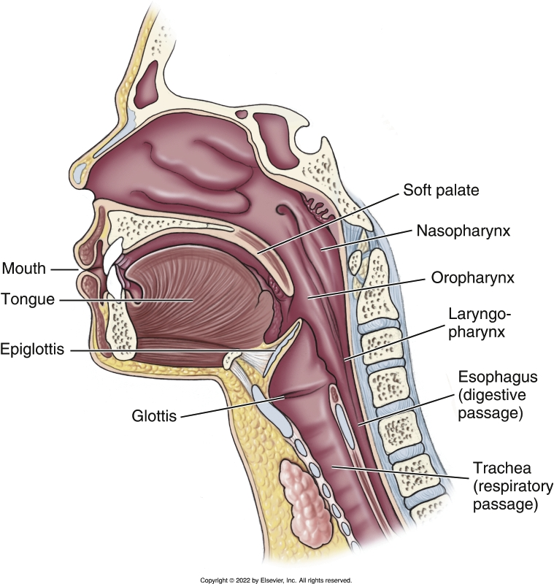
Eating and Swallowing Structures
Notes:
Textbook Figure 23.4: Eating and Swallowing Structures From Mouth to Pharynx to Esophagus.

Slide 10
Structures and Organs
(2 of 7)
Pharynx
Esophagus
Stomach
  What it does
    Regulates the rate at which the partially digested food is delivered to the small intestine
    Secretes gastric juice
    Digests food
    Absorbs small quantities of water and dissolved substances
    Secretes gastric hormones

Slide 11
Structures and Organs
(3 of 7)
Stomach (cont’d)
  Regions of the stomach
  Muscles of the stomach
  Glands of the stomach
  Vomiting

Slide 12
Structures and Organs
(4 of 7)
Small intestine
  The small intestine performs three functions:
    It receives chyme from the stomach and digestive juices from the liver (bile) and pancreas (digestive enzymes); the process of digestion is completed within the small intestine.
    It absorbs the end products of digestion and key substances such as iron and vitamins.
    It moves the unabsorbed content into the large intestine.
  Location: central and lower abdominal cavity and is held in place by the mesentery
  Three parts: the duodenum, the jejunum, and the ileum

Slide 13
Structures and Organs
(5 of 7)
Small intestine (cont’d)
  Segments of the small intestine
    Duodenum
    Jejunum
    Ileum
  The wall of the small intestine and absorption
    Villi and microvilli
    Peristalsis and absorption in the small intestine

Slide 14
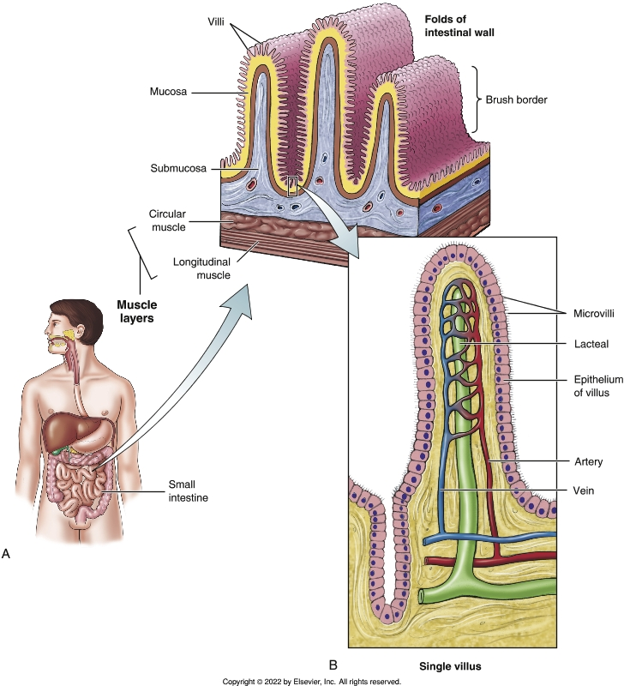
Small Intestine
Notes:
Textbook Figure 23.6: Small Intestine. (A) Folds of the intestinal wall. (B) Single villus showing the blood capillaries and the lacteal.

Slide 15
Structures and Organs
(6 of 7)
Large intestine
  Segments of the large intestine
    Cecum
    Ascending colon
    Appendix
    Transverse colon
    Sigmoid colon
    Rectum
    Anal canal
    Anus

Slide 16
Structures and Organs
(7 of 7)
Large intestine (cont’d)
  Functions of the large intestine
    Absorption of water and electrolytes
    Synthesis of certain vitamins by the intestinal bacteria (especially vitamin K and some B vitamins)
    Temporary storage site of waste (feces)
    Elimination of waste from the body (defecation)
  Peristalsis and absorption
  Inside the gut: microbiota
  Intestinal gas

Slide 17
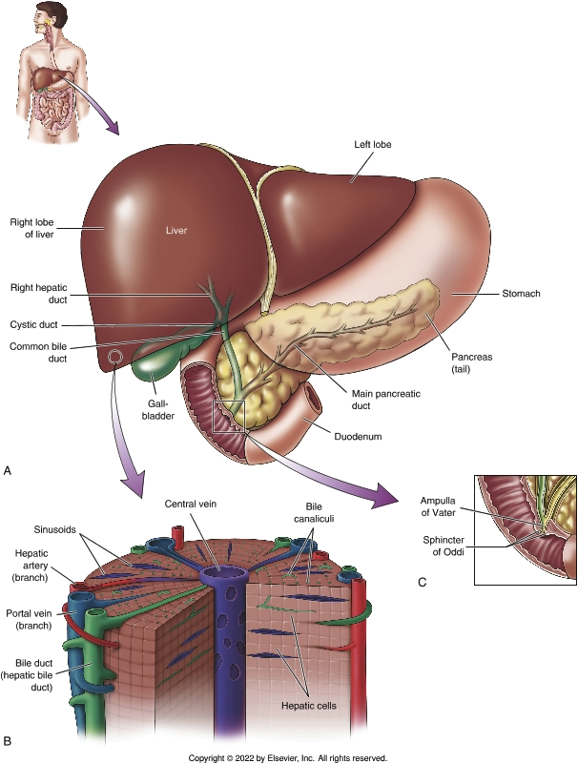
Liver, Gallbladder, Bile Ducts, and Pancreas
Notes:
Textbook Figure 23.8: (A) Liver, gallbladder, bile ducts, and pancreas. (B) Liver lobule. (C) The entrance of the common bile duct into the duodenum (ampulla of Vater and sphincter of Oddi).

Slide 18
Accessory Digestive Organs
(1 of 2)
Liver
  What the liver does
    Synthesis of bile salts and secretion of bile
    Synthesis of plasma proteins
    Storage
    Detoxification
    Excretion
    Metabolism of carbohydrates
    Metabolism of protein
    Metabolism of fats
    Phagocytosis

Slide 19
Accessory Digestive Organs
(2 of 2)
Liver (cont’d)
  Blood supply to the liver
    Blood supply and the hepatic portal system
  Liver lobules
  Bile
  Biliary tree
Gallbladder
Pancreas

Slide 20
Lesson 23.2
Explain the physiology of digestion and absorption, including the following:
  The effects of amylases, proteases, and lipases
  The role of bile in the digestion of fats
  The effects of the hormones gastrin, cholecystokinin, and secretin
Discuss nutrition concepts, including the following:
  The five categories of nutrients
  The importance of a balanced diet

Slide 21
Digestion and Absorption
(1 of 3)
Carbohydrates and carbohydrate-splitting enzymes
  Monosaccharides
  Disaccharides
  Polysaccharides
  Amylases

Slide 22
Digestion and Absorption
(2 of 3)
Proteins and protein-splitting enzymes
  Amino acids
  Peptide
  Poly-peptide
  Proteases

Slide 23
Digestion and Absorption
(3 of 3)
Fats, bile, and fat-splitting enzymes
  Fats: long-chain fatty acids attached to glycerol
  Lipases
  Bile
    Emulsification
    Bile salts

Slide 24
Nutrition: Concepts to Know
(1 of 3)
Carbohydrates
  Simple sugars
  Complex carbohydrates
Proteins
  Amino acids
  Complete
  Incomplete

Slide 25
Nutrition: Concepts to Know
(2 of 3)
Fats (lipids)
  Triglycerides
  Saturated
  Unsaturated
Vitamins
  Fat soluble
  Water soluble
Minerals

Slide 26
Nutrition: Concepts to Know
(3 of 3)
Health and a balanced diet
  A balanced diet
  Poorly balanced diet and disease
  Appetite control and the couch potato

