Slide 1
The Human Body in Health and Illness, 8th ed.
Barbara Herlihy,
BSN, MA, PhD (Physiology), RN

Slide 2
Chapter 22
Respiratory System
The Human Body in Health and Illness,
8th ed.
Barbara Herlihy

Slide 3
Lesson 22.1
Describe the structure and functions of the organs of the respiratory system and trace the movement of air from the nostrils to the alveoli.
Explain why lungs collapse or expand and the role of pulmonary surfactants.

Slide 4
Structure: Organs of the
Respiratory System
(1 of 8)
Upper and lower respiratory tracts
  Upper respiratory tract
    Nose and nasal cavities, pharynx, larynx, and upper trachea
  Lower respiratory tract
    Lower trachea, bronchi, bronchioles, and alveoli
    Pleural membranes and the muscles that form the chest cavity

Slide 5
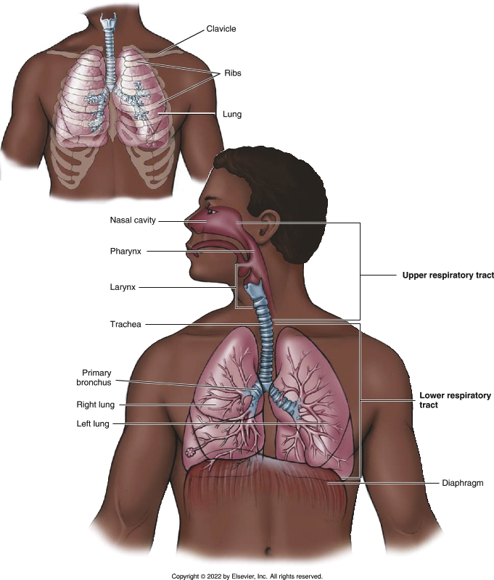
Organs of the Respiratory System
Notes:
Textbook Figure 22.1: Organs of the Respiratory System: Upper Respiratory Tract and Lower Respiratory Tract.

Slide 6
Structure: Organs of the
Respiratory System
(2 of 8)
Nose and nasal cavities
  Nose
  Nasal cavities
  Nasal septum
  Nostrils, or nares
  Olfactory receptors
  Nasal conchae
  Ciliated mucous membranes
  Paranasal sinuses: maxillary, frontal, ethmoidal, and sphenoidal

Slide 7
Structure: Organs of the
Respiratory System
(3 of 8)
Pharynx
  Nasopharynx (upper section)
  Oropharynx (middle section)
  Laryngopharynx (lower section)
  Openings from the eustachian tubes (auditory tubes)
  Tonsils

Slide 8
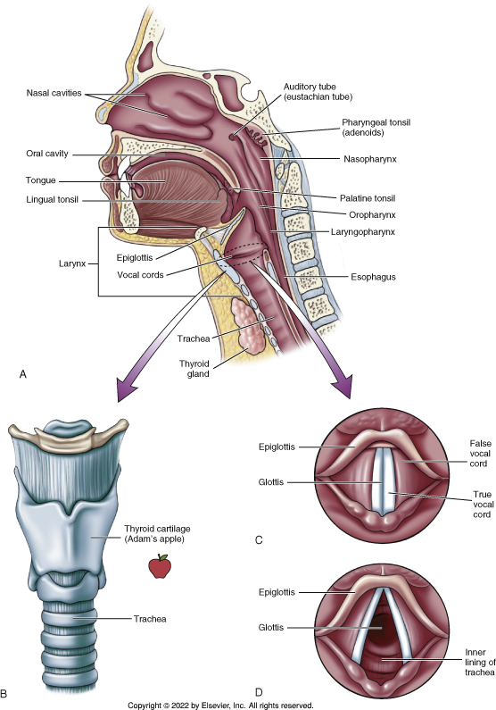
Organs of the Upper Respiratory Tract
Notes:
Textbook Figure 22.2: (A) Organs of the upper respiratory tract. (B) Larynx, showing the thyroid cartilage (Adam’s apple). (C) Vocal cords and glottis (closed). (D) Vocal cords and glottis (open).

Slide 9
Structure: Organs of the
Respiratory System
(4 of 8)
Larynx
  Passageway for air
  Produces sound (your voice)
  Prevents food and other foreign objects from entering the distal respiratory structure
Vocal cords
  True
  False

Slide 10
Structure: Organs of the
Respiratory System
(5 of 8)
Trachea
  Extends from the larynx downward into the thoracic cavity, where it splits into the right and left bronchi
    Carina
  C-shaped rings of cartilage keep the trachea open

Slide 11
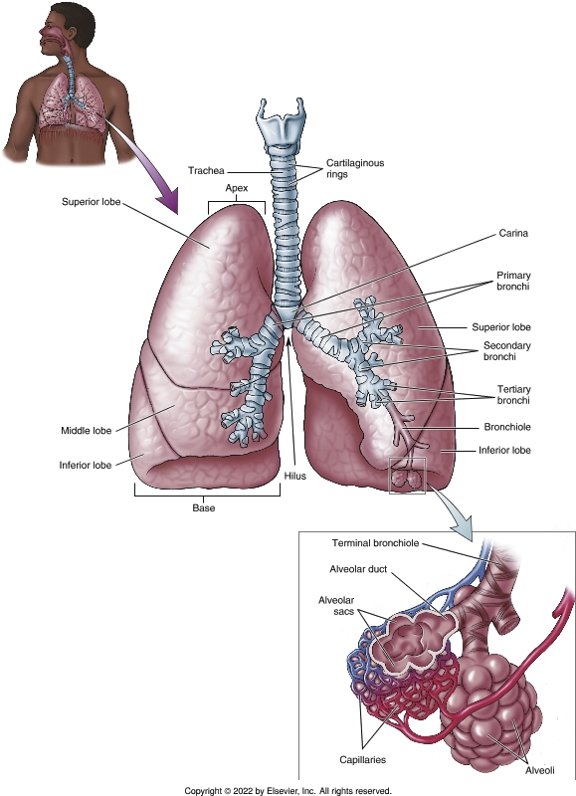
Trachea and Bronchial Tree
Notes:
Textbook Figure 22.3: Trachea and Bronchial Tree (Bronchi, Bronchioles, and Alveoli).

Slide 12
Structure: Organs of the
Respiratory System
(6 of 8)
Bronchi
  Right and left primary bronchi
  Hilus
Bronchioles
  Smooth muscle
Alveoli
  Alveolar ducts

Slide 13
Structure: Organs of the
Respiratory System
(7 of 8)
Lungs
  Pleural cavities
  Right lung lobes
    Superior, middle and inferior
  Left lung lobes
    Superior and inferior
  Apex
  Base

Slide 14
Structure: Organs of the
Respiratory System
(8 of 8)
Pleural membranes
  Pleura
    Visceral pleura
    Parietal pleura
  Intrapleural space
    Pleural effusion
    Empyema

Slide 15
Collapsed and Expanded Lungs
Why lungs collapse
  Elastic recoil
  Surface tension: surfactants
Why lungs expand
  Lung expansion depends on pressure within the intrapleural space
    Atmospheric pressure
    Intrapulmonic pressure
    Intrapleural pressure
Compliance
  Measure of elastic recoil

Slide 16
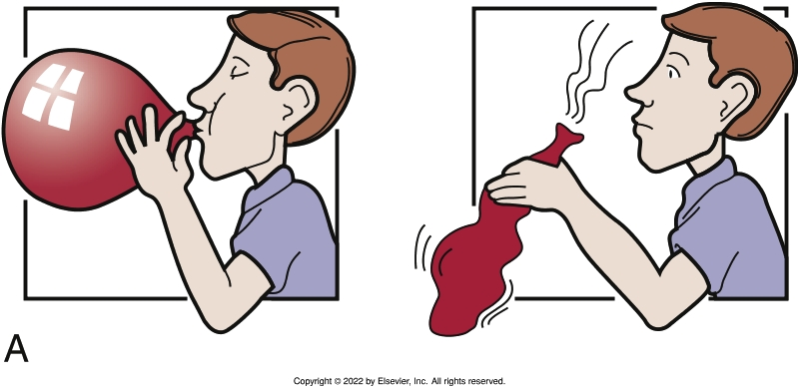
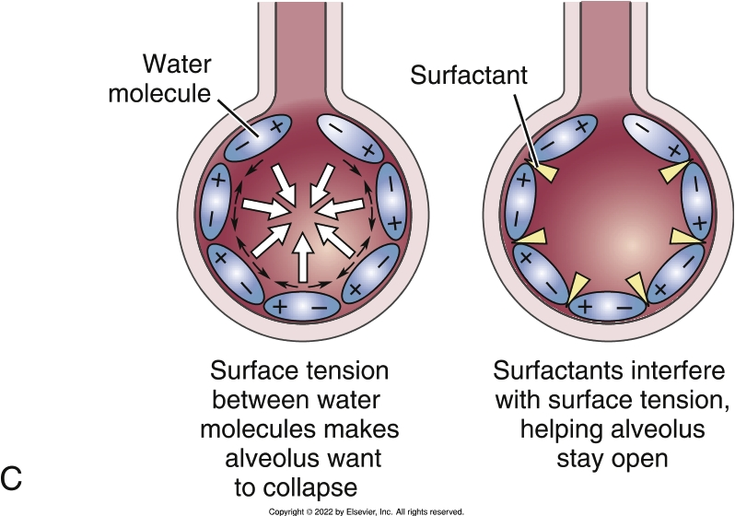
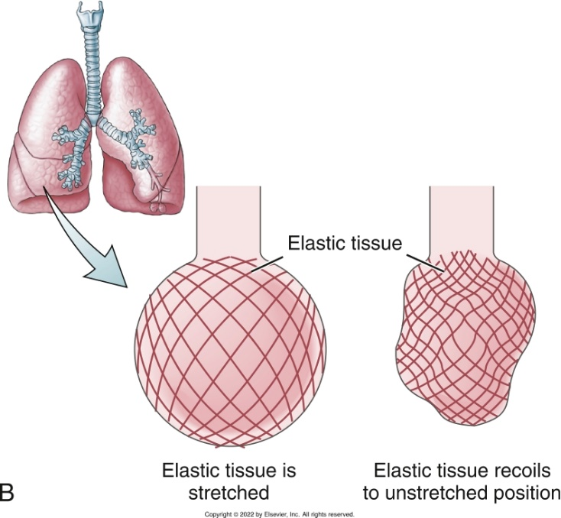
Elastic Recoil and Surface Tension
Notes:
Textbook Figure 22.5: (A and B) Elastic recoil. (C) Surface tension: water and the effect of surfactants.

Slide 17
Lesson 22.2
Discuss the three steps in respiration, including the following:
  The relationship of Boyle’s law to ventilation
  How respiratory muscles affect thoracic volume
  Three conditions that make the alveoli well suited for the exchange of oxygen and carbon dioxide
List lung volumes and capacities.
Discuss the voluntary and involuntary control of breathing, including the following:
  The neural and chemical control of breathing
  Common variations and abnormalities of breathing

Slide 18
Respiratory Function
(1 of 7)
Three steps in respiration
  Step 1: ventilation, or breathing
    What it is: movement of air into and out of the lungs
      Inhalation
      Exhalation
    Boyle’s law: pressure and volume
      The smaller the volume, the higher the pressure.
      The greater the volume, the lower the pressure.
      If volume changes, the pressure changes.

Slide 19
Respiratory Function
(2 of 7)
Three steps in respiration
  Step 1: ventilation, or breathing (cont’d)
    Boyle’s law and breathing
      As lung volume increases on inhalation, the intrapulmonic pressure decreases and air flows into the lungs.
      On exhalation, lung volume decreases, intrapulmonic pressure increases, and air flows out of the lungs.
      Inhalation is associated with an increase in thoracic volume; exhalation is associated with a decrease in thoracic volume.

Slide 20
Respiratory Function
(3 of 7)
Three steps in respiration
  Step 1: ventilation, or breathing (cont’d)
    Muscles of respiration
      Respiratory muscles
      Diaphragm
      Intercostal muscles
    Nerves that supply the respiratory muscles
      Phrenic nerve
      Intercostal nerves

Slide 21
Respiratory Function
(4 of 7)
Three steps in respiration
  Step 2: exchange of oxygen and carbon dioxide
    Exchange occurs at two sites: in the lungs and at the cells
  Why the lungs are good gas exchangers
    Large surface area
    Thin alveolar and pulmonary capillary walls
    Closeness of the alveoli to the pulmonary capillaries
  Partial pressures and the diffusion of gases
    Diffusion: from areas of higher pressure to areas of lower pressure
    Partial pressures within the lungs
    Partial pressures at the cells

Slide 22
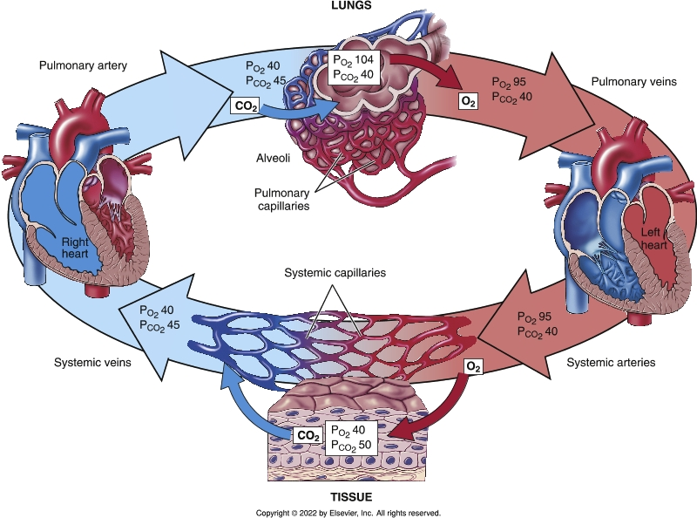
Partial Pressure
Notes:
Textbook Figure 22.10: Partial pressures of oxygen (PO₂) and carbon dioxide (PCO₂) within the lungs and at the cellular level (in millimeters of mercury).

Slide 23
Respiratory Function
(5 of 7)
Three steps in respiration
  Step 3: transport of oxygen and carbon dioxide
    Oxygen transport
      98% is transported by the hemoglobin in red blood cells
      2% oxygen is dissolved in plasma
    Carbon dioxide transport
      70% is converted to the bicarbonate ion (HCO₃−)
      20% combines with hemoglobin to form carbaminohemoglobin
      10% is dissolved in plasma

Slide 24
Respiratory Function
(6 of 7)
Amounts of air
  Lung volumes
    Tidal volume
    Inspiratory reserve volume
    Expiratory reserve volume
    Residual volume
  Lung capacities
    Vital capacity
  Dead space

Slide 25
Respiratory Function
(7 of 7)
Control of breathing
  Neural control of breathing
  Chemical control of breathing

Slide 26
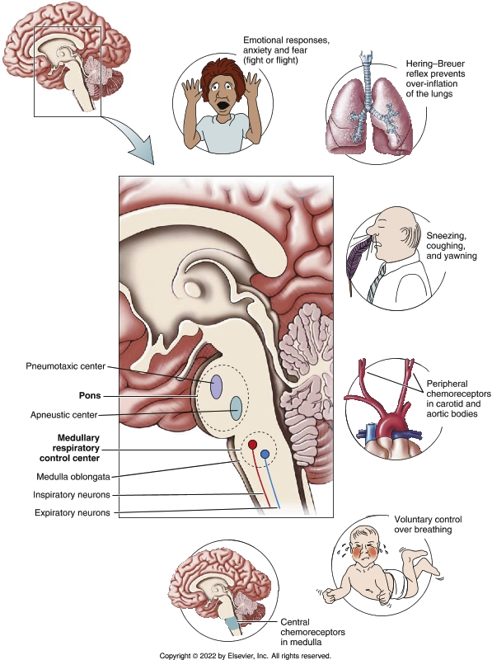
Neural and Chemical Factors That Influence Breathing
Notes:
Textbook Figure 22.12: Neural and Chemical Factors That Influence Breathing.

