Slide 1
ANATOMY OF THE CERVICAL SPINE

Slide 2
BONES OF THE UPPER CERVICAL SPINE
The cervical spine is made up the following bones:
  Occiput
    Base of skull surrounding the foramen magnum
    Pair of occipital condyles
  Vertebrae C1 – C7
    Atlas Vertabra (C1)
    Axis Vertarbra (C2)

Slide 3
FORAMEN MAGNUM
Foramen
  passages or openings between two cavities of an organ or hole in bones for passage of blood vessels, nerves, ligaments, etc.
Structures that pass through it are the
  Medulla oblongata & its membranes
  CN XI
    ???
  Vertebral and spinal arteries

Slide 4
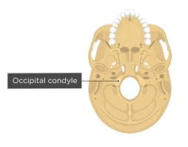
OCCIPITAL CONDYLES
undersurface facets of the occipital bone
they articulate with the superior facets of the atlas of the vertebra

Slide 5
TYPICAL VERTEBRAE
the spine varies in size, shape, & some details, but are similar enough in structure and function
Typical vertebra consist of
  Vertebral body
    thick, disc shaped anterior portion is the weight bearing portion of a vertebra
  Superior and inferior surfaces are attachment sites for the intervertebral discs
  Anterior and lateral surface contain nutrient foramina
    where blood vessels supply nutrients and oxygen, remove wastes and carbon dioxide

Slide 6
TYPICAL VERTEBRA CONT
Vertebral Arch
  Two short & thick processes
    the pedicles (foot like structure ) project posteriorly from the vertebral body and unite with the flat laminae to form the vertebral arch
    It extends posteriorly from the body of the vertebrae,
    together the body and the arch surround the vertebral foramen
    this foramen contains the spinal cord, adipose tissue, areolar connective tissue and blood vessels
    collectively the vertebral foramina of all the vertebrae form the vertebral canal
  Pedicles have superior and inferior indentations called vertebral notches
    when stacked on top of each they form an opening between adjoining vertebra on both sides of the column
    this is the intervertebral foramen it permits the passage of a single spinal nerve which carries information to and from the spinal cord

Slide 7
TYPICAL VERTEBRAE CONT.
Processes – Seven processes arise from the vertebral arch
  Transverse process
    formed from the point where the lamina and pedicle meet
    one transverse process extends laterally on each side
  Spinous process
    projects posteriorly from the junction of the laminae
  The 2 transverse processes and spinous process serve as attachment site for muscles
The remaining 4 processes form joints with vertebrae above and below. They are:
  superior articular processes (2) and they articulate with:
  inferior articular processes on the vertebrae immediately above
    each inferior articular process articulates with the superior articular process below
The articulating surfaces of the superior and inferior articular processes are referred to as facets
  covered in hyaline cartilage
  these articulations of superior and inferior facets are known as the intervertebral joints

Slide 8
ATLAS VERTEBRA (C1)
The first cervical vertebra of the spine
named after Atlas from Greek mythology because it supports the “globe” of the head
together with the axis (C2) it forms the joint which connects our skull and our spine
no body
  consists of anterior and posterior arch with two lateral masses
superior surfaces of the lateral mass are superior articular facets and are concave and articulate with the condyles of the occipital bone
  this creates the atlantoccipital joint
  allows you to nod your head yes

Slide 9
ATLAS CONTINUED
The inferior surface of the lateral mass is the inferior articular facet
  they articulate with the axis (C2) vertebra
No spinous process
Looks like a ring in appearance
lateral masses create the majority of the bone mass
located laterally from these masses you will find the transverse foramina
  transverse foramina
    an opening in the transverse process of each cervical transverse process where the vertebral artery and accompanying vein and nerve fibers pass through
the transverse process and transverse foramina of the atlas are quite large

Slide 10
C1 ATLAS BONY LANDMARKS
Posterior tubercle (no spinous process)
Posterior Arch
Anterior Arch
Anterior Tubercle
Lateral Mass (no vertebral body)
Transverse Process
Transverse Foramen
Articular surface for Dens
Articular Process (inferior & Superior)
Superior articular facet

Slide 11
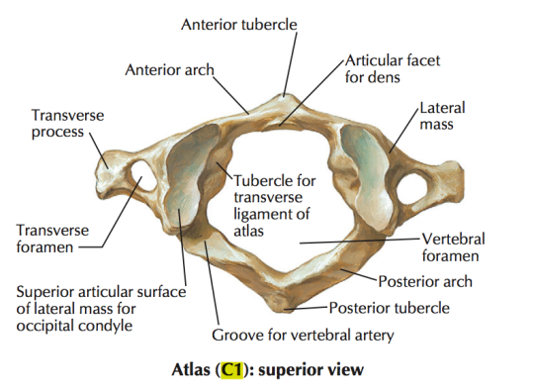
C1 ATLAS VERTEBRA

Slide 12
AXIS VERTEBRA (C2)
Axis (C2) is the 2nd vertebra of the cervical spine
It has a vertebral body
a peg like process known as the dens (or odontoid process) projects superiorly through the anterior portion of the vertebral foramen of the atlas
the dens creates a pivot on which the Atlas and head rotate
allows for moving your head side to side (shake your head no)
the articulation between the anterior arch of the atlas, the dens of the axis and their articular facets is called the atlantoaxial joint

Slide 13
C2 AXIS VERTEBRA BONY LANDMARKS
Dens (odontoid Process)
Spinous process
Lamina
Transverse Process
Superior articular Facet
Body
Pedicle
Transverse Foramen
Inferior articular Facet
Facet for anterior arch of C1

Slide 14
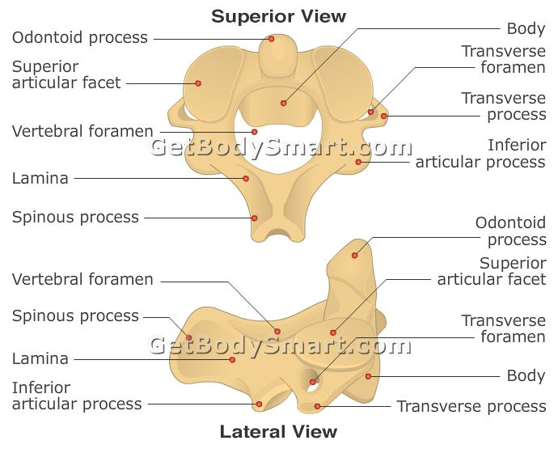
C2 AXIS VERTEBRA

Slide 15
LOWER CERVICAL SPINE – VERTEBRAE C3 – C7
also known as sub axial spine
  as it is located below the axis
  includes the C3 – C7 vertebrae
lower cervical are generally very similar in anatomical structure to each other
  smaller than all other vertebrae except those that form the coccyx
  their vertebral arches are larger
  the vertebral foramina is the largest is cervical region due to the cervical enlargement of the spinal cord
  each transverse process in the cervical spine has a transverse foramen
  the spinous processes C2 – C6 are often bifid
    branch into two small projections at the tips
  Source Tortora

Slide 16
LOWER CERVICAL VERTEBRAE – C7
C7 is also known as the vertebra prominens
it has a large, non bifid spinous process that can be easily seen and palpated at the base of the neck
otherwise C7 is a typical cervical vertebra

Slide 17
TYPICAL CERVICAL VERTEBRA
BONY LANDMARKS
Spinous Process
Lamina
Transverse Process
Transverse Foramen
Body
Pedicle
Superior articular process/facet
Inferior articular process/facet
Vertebral canal

Slide 18
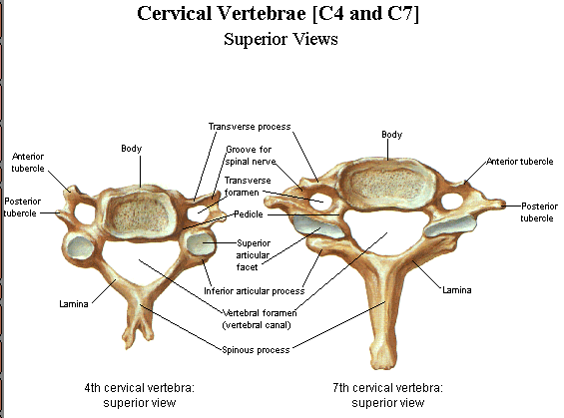
TYPICAL CERVICAL VERTEBRA

Slide 19
Joints of the Cervical Spine

Slide 20
ATLANTOCCIPITAL JOINT
Joint Classification
  synovial, condyloid
Functional joint classification
  diarthrosis, joint permitting free motion
occipital (C0) condyles (convex) articulate with the superior articular facet of the atlas (on concave)
Motions
  flexion and extension of the head
  slight lateral flexion of the head (controversial)
    lateral flexion is limited at this joint by the contact of the occiput on the dens

Slide 21
ATLANTOAXIAL JOINT
Joint classification
  synovial, pivot (allows rotation only)
Functional joint classification
  diarthrotic
The articular surfaces are
  between dens of axis and anterior arch of atlas
  between lateral masses of atlas and axis facets are convex on convex
    like two balls balancing on each other
Motions
  rotation

Slide 22
ZYGAPOPHYSEAL FACET JOINT
Joint classification
  synovial, plane
Functional joint classification
  diarthrosis
Articular surfaces
  inferior Articular Facets
  superior Articular Facets
  these Facets are more flattened in the cervical spine and accommodate a variety of motions
Motions include
  Flexion and Extension
  Side bending
  Rotation
facet joints are highly innervated and when dysfunctional may be a primary cause of deep aching pain

Slide 23
INTERVERTEBRAL ARTICULATIONS
made up of two vertebral bodies and an intervertebral disc
  aka: ???
THERE ARE NO DISCS BETWEEN C0-C1, C1-C2
intervertebral disc is made up of the annulus fibrosus surrounding a nucleus pulposus
the outer ring is made up of collagen fibers and joins two vertebral bodies together
motions
  Flexion, extension
  Lateral flexion
  Rotation of vertebral column

Slide 24
Ligaments

Slide 25
LIGAMENTS
Supraspinous Ligament
  starts at SP of C7 and follows SP to the sacrum
  slightly limits spinal flexion
Nuchal ligament (Ligamentum Nuchae)
  Continuation of supraspinous ligament
  extends from C7 – occiput
  supports the head, fan shaped
Anterior longitudinal ligament
  begins at the occipital bone or anterior tubercle of the atlas (C1) and travels to the sacrum
  located on the anterior surface of vertebral bodies but does not attach to the intervertebral discs
  limits spinal extension
Posterior longitudinal ligament
  begins at the occipital bone and runs posterior surface of vertebral bodies, travels to sacrum
  attaches to intervertebral discs and upper and lower margins of vertebral bodies, limits flexion of the spine and protects the disc

Slide 26
LIGAMENTS CONTINUED
Capsular ligaments (zygapophyseal ligament)
  Covers joint capsule of each facet
  limits gliding motion (opening and closing) of the facets
Ligamentum Flavum
  NON CONTINUOUS ligament
  extends from posterior vertebral arch to posterior vertebral arch
  always under tension – even at rest, stretched more during flexion
  plays a role in returning the spinal column to an erect position

Slide 27
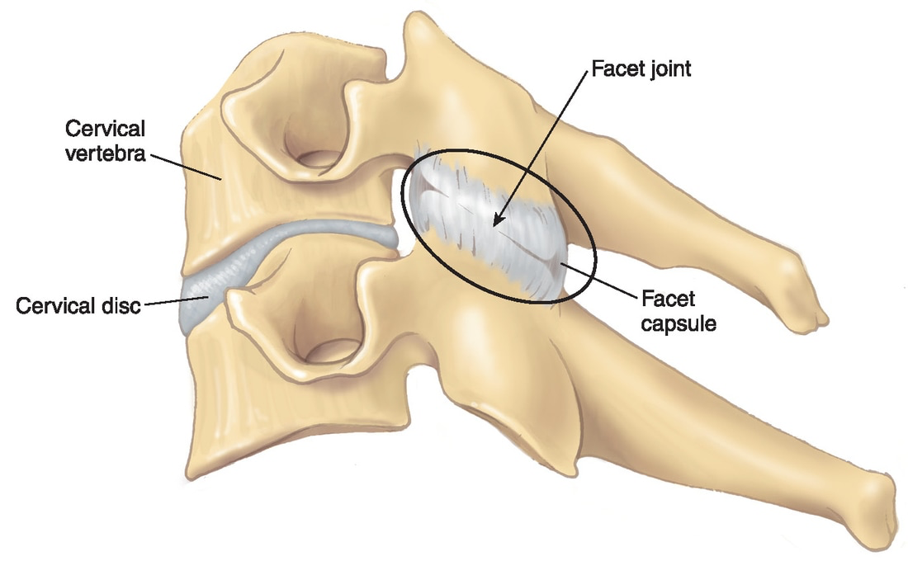

Slide 28
UPPER CERVICAL LIGAMENTS
Alar ligaments
  attaches on the lateral dens travel to medial occipital bone
  holds the dens in place so it doesn’t interfere with medulla oblongata
  damage of this ligament can lead to VBI
Transverse Atlantal Ligament/Atlantal Cruciform Ligament
  Divides atlas in into two parts
    large posterior part that the spinal cord runs through
    a smaller portion anterior portion that accommodates the dens of the C2
    this ligament has an anterior cartilage which attaches to the dens
    then its fibers branch off to attach the axis to the occiput
    it gives the appearance of a cross/or crucifix
    responsible for holding the dens of axis in close approximation to the atlas C1 & prevents anterior displacement of C1 on C2
Apical Ligament
  extends from the apex of dens to the anterior margin of the foramen magnum between the alar ligaments
  merges deep with the deep anterior atlanto-occipital membrane and superior crus of the transverse ligament of the atlas

Slide 29
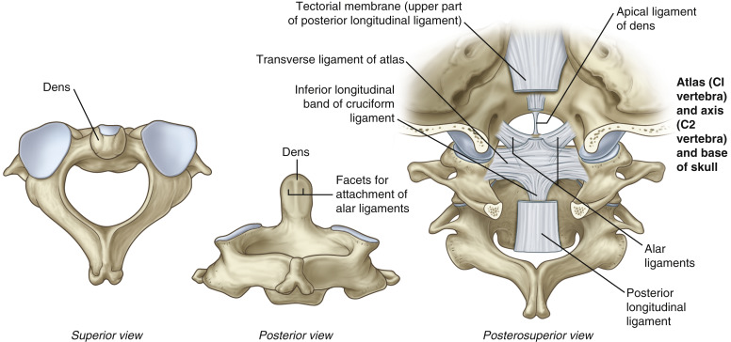

Slide 30
MEMBRANES
Posterior atlanto-occipital membrane
  Attaches upper border of the posterior arch of the atlas to the outer margin of the foramen magnum
Posterior atlantoaxial membrane
  Continuous with the ligamentum Flavum, attaches the posterior arches of the atlas and the axis
Anterior atlantoaxial membrane
  Continuous with anterior longitudinal ligament, attaches anterior arches of the atlas and dens of axis
Anterior Atlanto-occipital membrane
  Joins upper border of the anterior arch of atlas to outer margin of the foramen magnum
Tectorial membrane
  Continuous with posterior Longitudinal ligament, attaches posterior side of Dens of axis(C2) to occiput

Slide 31
INTERVERTEBRAL DISCS
Made up of outer & inner ring of collagen fibers
  outer: annulus fibrosus
  inner: nucleus pulposus
Annulus fibrosus
  appears to be made up of collagen rings with inner fibers more diagonal and the outer rings more vertical, making for a very strong and stable outer ring
Disc growth completed by adulthood
Discs do not have a large blood supply, not easily repaired, receives nutrients from diffusion through the bone – this occurs best during activity
Discs held into place by 4 ligaments on vertebra above and 4 ligaments on vertebra below
https://youtu.be/RNUpMNd_u1U

Slide 32
INTERVERTEBRAL DISCS
made up of 80% water
  decreases with age and also throughout the day, as water content percentage decreases it becomes thinner and more worn
  this can decrease the length of the spine but does not cause pain
  water and nutrients is replenished during sleep
herniated discs are when the annulus fibrosus becomes damaged and the nucleus pulposus leaks out is difficult to repair
if the pulposus causes pressure on a nerve pain or neurological sensations may be felt
along with the pain, muscle spasm may occur which leads to lack of mobility and can cause more damage to the disc
discs become thinner as you move up the spine

Slide 33
Cervical Spine Anatomy (eOrthopod)
VIDEO

Slide 34
NERVES

Slide 35
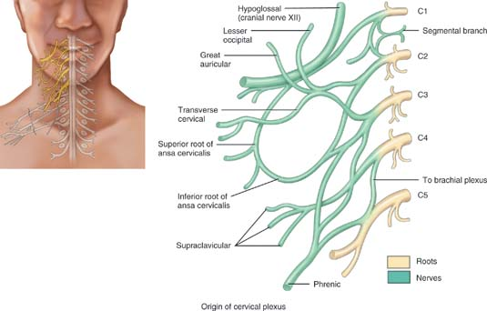
CERVICAL PLEXUS

Slide 36
CERVICAL PLEXUS CONTINUED
The cervical plexus is formed by the ventral rami of C1-C4 (and some contribution from C5)
There is a cervical plexus on each side of the neck
It lies anteromedial to the levator scapula and middle scalene muscles and deep to the SCM

Slide 37
STRUCTURES SUPPLIED BY THE CERVICAL PLEXUS
Superficial (sensory Branches NERVE | ORIGIN | DISTRIBUTION
Lesser Occipit | C2 | Skin of scalp posterior and superior to the ear
Great Auricular | C2 – C3 | Skin anterior, inferior, over ear and over parotoid gland
Transverse Cervical | C2 – C3 | Skin over posterior aspect of the neck
Supraclavicular | C3 – C4 | Skin over superior portion of chest and shoulder
Skin and muscles of head, neck and superior part of shoulders and chest.

Slide 38
STRUCTURES SUPPLIED BY THE CERVICAL PLEXUS
Deep (Largely Motor) Branches Nerve | Origin | Distribution
Ansa Cervicalis |  | Divides into Superior and Inferior roots
Superior Root | C1 | Infrahyoid and Geniohyoid muscles of the neck
Inferior Root | C2 – C3 | Infrahyoid muscle
Phrenic Nerve | C3 – C5 | Diaphragm
Segmental Branch | C1 – C5 | Prevertebral (deep) muscles of the neck, levator scapulae and middle scalene muscles

Slide 39
Cervical Plexus - Anatomy Tutorial
VIDEO

Slide 40
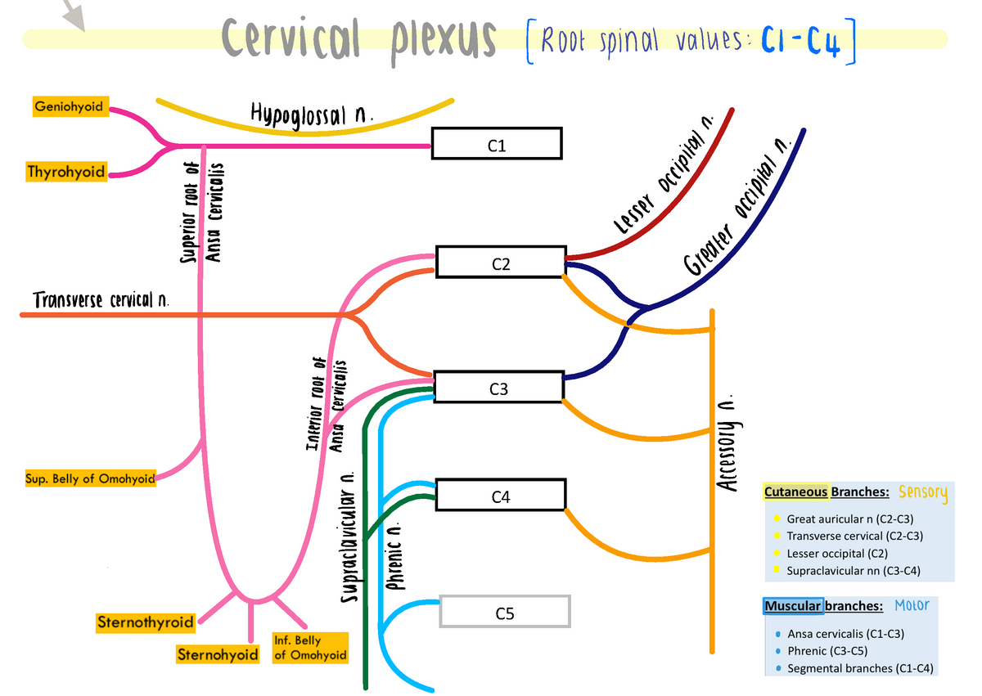

Slide 41
PHRENIC NERVE
“C3,4,5 keeps the diaphragm alive”
Phrenic nerves are formed at the lateral borders of the anterior scalene muscles
They then descend anterior to the anterior scalene deep to the internal jugular veins and the SCM’s
They pass between the subclavian arteries and veins and proceed to the thorax to supply the diaphragm

Slide 42
SPINAL NERVES C1 – C8
Although there are seven cervical vertebrae there are eight cervical nerves C1–C8
All cervical nerves except C8 emerge above their corresponding vertebrae, while the C8 nerve emerges below the C7 vertebra
Elsewhere in the spine, the nerve emerges below the vertebra with the same name.

Slide 43
SPINAL NERVES C1 – C8 CONT.
Nerve | Function
C1 | Head & Neck
C2 | Head & Neck
C3 | Diaphragm
C4 | Diaphragm, shoulder shrug
C5 | Deltoid/Bicep
C6 | Wrist Extensors
C7 | Triceps
C8 | Hands and fingers

Slide 44
BLOOD AND LYMPH
The vertebral artery
  Arises from subclavian artery and runs between the longus colli and anterior scalene
  enters the transverse foramen of C6 and travels up to the axis
  then travels medial to the rectus capitis lateralis and curves backwards behind the lateral mass of the atlas
  lies in a groove on the posterior arch of c1 and enters the spinal canal
  the artery pierces the dura and arachnoid mater and travels to the front of the medulla oblongata where it unites with the other vertebral artery (from the opposite side of the body)
  here it becomes the BASILAR ARTERY
  branches from the vertebral artery enter the spinal cord through nutrient foramen

Slide 45
Anatomy Tutorial - The Vertebral Artery
VIDEO

Slide 46
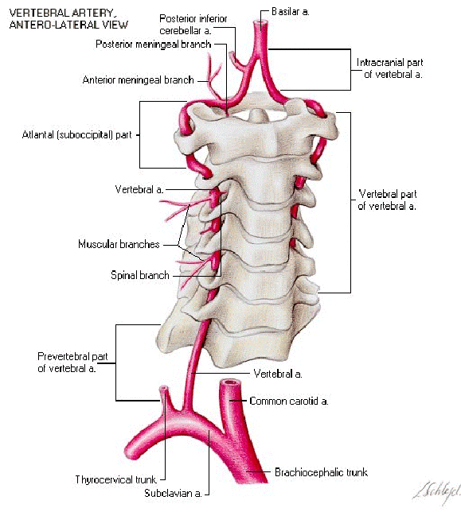

Slide 47
CONTINUED
Common Carotid Artery
  Arises posterior to the SC Joint and travels to the superior edge of thyroid cartilage (Adam's apple)
  it divides into the internal and external carotid artery
Internal jugular vein
  arises from the jugular foramen on the posterior cranial fossa and travels inferior leaving the neck deep to the Sternocleidomastoid
Lymph ducts
  The cervical area is rich in lymph nodes, which are primarily located along jugular veins and SCM muscle

Slide 48
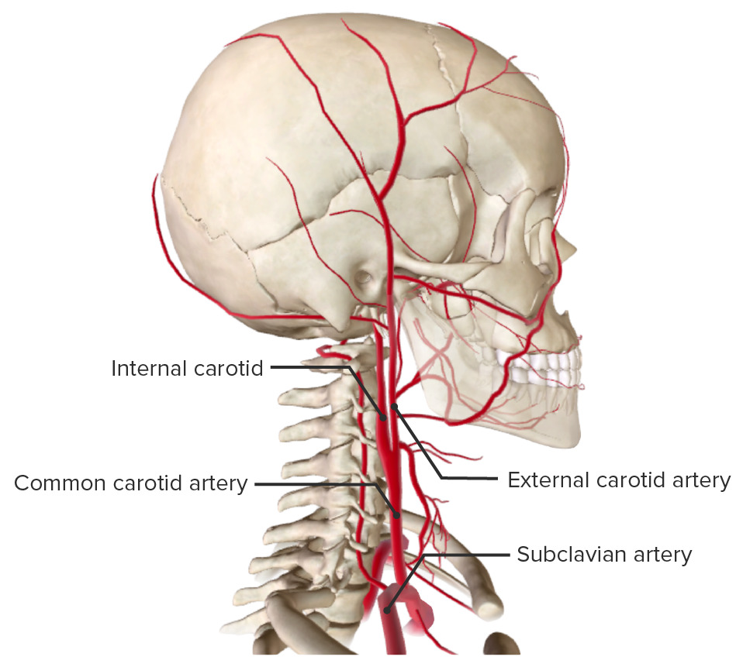

Slide 49
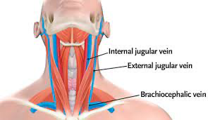

Slide 50
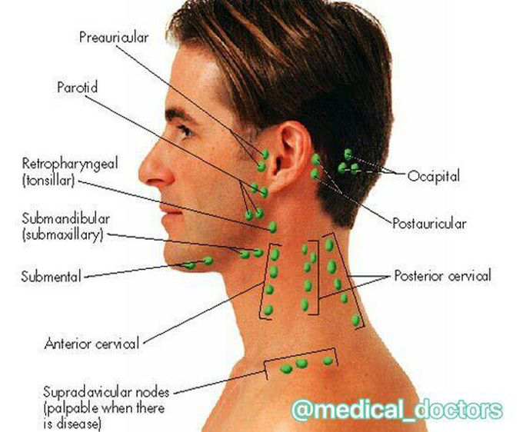

Slide 51
MUSCLES

Slide 52
Neck Musculature

Slide 53
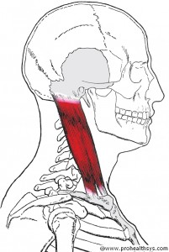
STERNOCLEIDOMASTOID – (NAMED BY ATTACHMENT SITES)
Origin – Sternal Head – Manubrium of Sternum
Clavicular Head – Medial 1/3 of clavicle
Insertion – Mastoid process of temporal bone
Action – Unilateral - Rotation of head to contralateral side, lateral flexion to same side
Bilateral – neck flexion and Capital extension
Nerve – Motor Spinal Accessory (CN XI)
Blood – Occipital & posterior auricular arteries, superior thyroid artery

Slide 54
Palpation
Supine, neck and head rotated contrlateral
Have client lift head and neckinto air toward ceiling, SCM will be visible
Palpate attachment to attachment

Slide 55
SCALENE MUSCLES
There are generally four scalene muscles
  Scalenus Minimus (commonly absent)
  Anterior Scalene
  Middle Scalene
  Posterior Scalene
Scalene origins are the TP of Cervical Vertebrae
  Anterior 3-6
  Middle 2-7
  Posterior 5-7

Slide 56
SCALENES AND BRACHIAL PLEXUS
The brachial plexus generally runs between the anterior and middle scalenes, however there are other anatomical variations that may occur
  66% between anterior and middle scalenes
  33% have brachial plexus roots that penetrate the anterior scalene
  1% have subclavian artery that passes behind or peirces through the anterior scalene
  If the scaleneus minimus is present may cause symptoms of brachial plexus compression
  Cervical ribs may influence scalene function
Tightness or contracture of scalenes can compress the brachial plexus which can cause symptoms of numbness, tingling, and muscle weakness in the upper limb and can also be a contributing factor with Thoracic outlet syndrome

Slide 57
MAJOR FUNCTIONS
As a group they flex and laterally flex the neck, or elevate first and second ribs
Considered prime move of the lateral flexion
They can be a muscle of forced inspiration

Slide 58
OTHER INFORMATION
Superficial muscles in the posterior triangle
Middle scalene is longest and largest, posterior scalene shortest and smallest
Brachial plexus and subclavian artery exit between the anterior and middle scalene
Often part of whiplash injuries
Anterior scalene syndrome (one of the four types of thoracic outlet syndrome) occurs if tightness causes the nerves or artery to become entrapped between the middle and anterior scalene
Tight scalenes can also contribute to Costoclavicular syndrome (another type of TOS) when the nerves/artery is trapped between the clavicle and the first rib. Tight scalenes pull the first rib up and against the clavicle

Slide 59
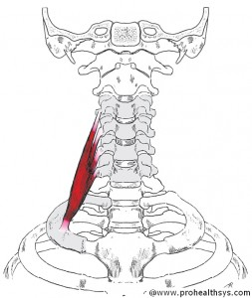
ANTERIOR SCALENE
Origin – TP’s of C3-C6
Insertion – 1st rib
Action – Flexion and same side lateral flexion, contralateral rotation (weak)
RMA elevation of 1st rib
Nerve – Cervical spinal nerves C4 – C6
Blood – Ascending cervical artery

Slide 60
Palpation
Seated or supine, place fingers superior to clavicle and lateral to the lateral border of clavicle head of SCM
Have client take short deep breaths through nose and feel contraction, the middle scalene will contract also (it is lateral to the anterior)
Take caution due to proximity of brachial plexus

Slide 61
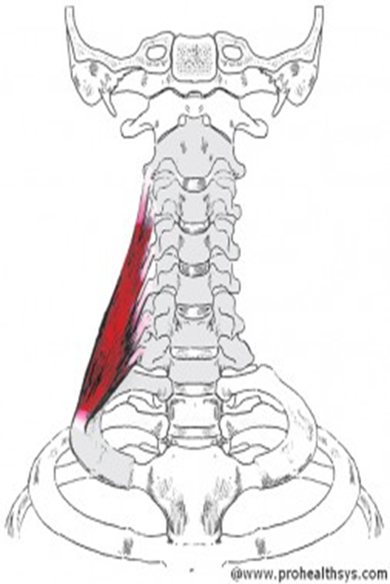
MIDDLE SCALENE
Origin – TP’s C2 – C7
Insertion – 1st rib ~ behind anterior scalene
Action – Flexion and lateral flexion to same side
RMA elevation of 1st rib
Nerve – Cervical Spinal nerves C3-C8
Blood – Transverse Cervical Artery

Slide 62
Seated or supine, place fingers superior to clavicle and lateral to the lateral border of clavicle head of SCM
Have client take short deep breaths through nose and feel contraction, the anterior scalene will contract also (it is medial to the middle)
Take caution due to proximity of brachial plexus
Palpation

Slide 63
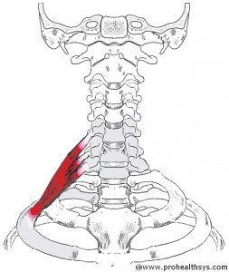
POSTERIOR SCALENE
Origin – TPs C5 – C7
Insertion – 2nd Rib
Action – Same side lateral flexion
RMA - Elevation of 2nd rib
Nerve – Cervical spinal nerves C6-C8
Blood – Transverse cervical

Slide 64
Seated or supine, place fingers superior to clavicle in the middle of the posterior triangle (b/w SCM and upper trapezius)
Have client take short deep breaths through nose and feel contraction of middle scalene, the posterior scalene is lateral to the middle scalene
Take caution due to proximity of brachial plexus
Palpation

Slide 65
PREVERTEBRAL GROUP
Four muscles deep in the anterior neck
“Prevertebral” they are situated just before the vertebral column
They are the
  Longus Colli
  Longus capitis
  Rectus Capitis Lateralis
  Rectus capitis Anterior
Important because they help stabilize the head and neck
Are clinically important because they are commonly injured in whiplash injuries
When injured or overused can give the feeling of a sore throat when swallowing

Slide 66
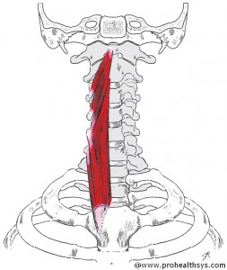
LONGUS COLLI (REFERS TO THE NECK)
Origin – Anterior vertebral bodies and TPs C3-T3
Insertion – Anterior vertebral bodies & TP’s of C2- C6 anterior arch of C1
Action – Flexion of Neck;
lateral flexion of neck
Nerve – Cervical spinal nerves C2 – C8
Blood – inferior thyroid, vertebral and ascending pharyngeal arteries

Slide 67
dsddsfdsss
Palpation
Seated or supine, place fingers just medial to medial border of SCM
Press gentle and but firmly into clients anterior neck in posterior and medial direction feeling for bodies and TP’s of cervical spine
Have client flex head and neck against gentle resistance, feel for contraction
Determining b/w Longus Colli and Capitis is difficult
Take caution due to proximity of common carotid artery, larynx and trachea

Slide 68
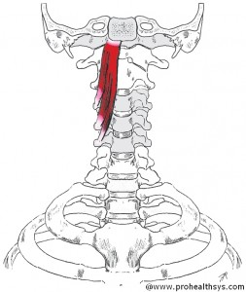
LONGUS CAPITIS
Origin – TP’s C3 – C5
Insertion – Occipital bone anterior to foramen magnum
Action – Flexion of Head and neck
Nerve – Cervical spinal nerves C1- C3
Blood -Inferior thyroid, vertebral and ascending pharyngeal arteries

Slide 69
Palpation
Seated or supine, place fingers just medial to medial border of SCM
Press gentle and but firmly into clients anterior neck in posterior and medial direction feeling for bodies and TP’s of cervical spine
Have client flex head and neck against gentle resistance, feel for contraction
Determining b/w Longus Colli and Capitis is difficult
Take caution due to proximity of common carotid artery, larynx and trachea

Slide 70
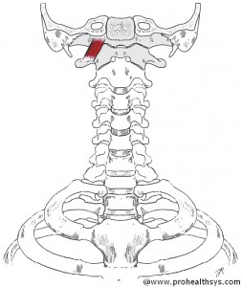
RECTUS CAPITIS ANTERIOR (STRAIGHT, HEAD, IN FRONT)
Origin – Atlas anterior base of TP
Insertion – Occipital bone (Basilar part anterior to foramen magnum)
https://goo.gl/images/nuUzXQ
Action – Flexion of HEAD
Nerve – Cervical Spinal nerves C1 – C2
Blood – Vertebral artery

Slide 71
Palpation
Located very deep and high in the anterior neck between atlas and occipit and usually not palpable

Slide 72
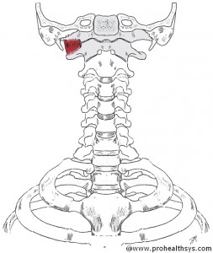
RECTUS CAPITIS LATERALIS
Origin –Atlas ~Superior Surface of TP
Insertion – Occipital Bone (Jugular process)
Action – Lateral Flexion of head
Nerve – Cervical Spinal nerves C1-C2
Blood – Vertebral and occipital arteries

Slide 73
Palpation
Seated or Supine, place fingers superior to TP of C1 (posterior to the ramus of the mandible and anterior to mastoid process, inferior to the ear)
Palpate supriorly to TP of the atlas and a bit deeper and feel for RCL
Can be difficult to feel from other structures
Styloid process is close to this area do not use too much pressure as it is a delicate structure

Slide 74
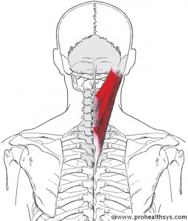
SPLENIUS CAPITIS (SPLENIUS – BANDAGE, CAPITIS – REFERS TO HEAD)
Origin – SP’s of C3-T4 & Nuchal Ligament (lower portion)
Insertion – Mastoid Process of temporal bone & superior nuchal line
Action- extension, lateral flexion, ipsilateral rotation
Nerve – Cervical Spinal Nerves (dorsal rami)
Blood – Occipital Artery

Slide 75
Palpation
Seated,place hand in the superior aspect of posterior triangle
Have client rotate head and neck and feel for contraction on the same side. Resistance can be added
Attempt to palpate to either attachment

Slide 76
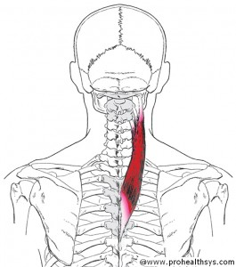
SPLENIUS CERVICIS
Origin – SP’s of T3-T6
Insertion – TP’s of C1 – C3
Action – Unilateral – Ipsilateral rotation and Lateral flexion
Bilateral – Extension of the neck
Nerve – Cervical Spinal Nerves (Dorsal Rami)
Blood – Occipital Artery

Slide 77
Palpation
Seated,place hand in the superior aspect of posterior triangle
Have client rotate head and neck and feel for contraction on the same side. Resistance can be added
Attempt to palpate to either attachment
It is difficult to determine from other musculature

Slide 78
SUBOCCIPITAL GROUP
A group of short muscles located deep in the posterior suboccipital region
  Rectus Capitis Posterior Major
  Rectus Capitis Posterior Minor
  Obliquus Capitis Inferior
  Obliquus Capitis Superior
The names of the of the muscle generally describe the muscle fiber direction
  Rectus meaning straight
  Obliquus means slanted

Slide 79
FUNCTIONS
The primary functions of the suboccipital group are extension and anterior translation (aka protraction) of the head/neck at the AOJ
Obliquus capitis inferior rotates the atlas on the axis at the AAJ
Thought to be more important as posture stabilization muscles, providing fine control of the head

Slide 80
MISCELLANEOUS
Not the only muscles located in the suboccipital region. Tight muscles can also be the superior attachments of the trapezius, splenius capitis, splenius cervicis and semispinalis capitis
If suboccipital muscles are chronically tight tension headaches are often the result

Slide 81
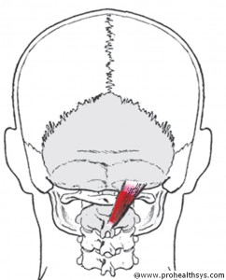
RECTUS CAPITIS POSTERIOR MAJOR
Origin – Spine of Axis
Insertion – Lateral portion of the inferior nuchal line
Action – Extension, Ipsilateral rotation & lateral flexion of the head
Nerve- Suboccipital nerve
Blood – Occipital Artery, deep cervical artery & muscular branches of vertebral artery

Slide 82
Palpation
Supine relaxed as possible
Fingers slightly superior and lateral to SP of C2 (most prominent in Upper Cervical region)
Feel for the fibres of RCPM running superolateral from SP of Axis to Occiput

Slide 83
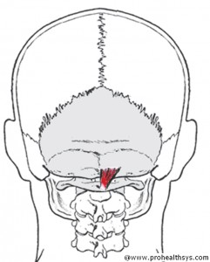
RECTUS CAPITIS POSTERIOR MINOR
Origin – Posterior tubercle of Atlas
Insertion – Medial portion of inferior nuchal line
Action – Protraction at the AOJ
Extension, Ipsilateral lateral flexion of head (weak)
Nerve – Suboccipital nerve
Blood – Occipital Artery, deep cervical artery, muscular branches of vertebral artery

Slide 84
Palpation
Supine relaxed as possible
Place palpating fingers just inferior to occiput and very slightly to midline
Feel for fibres running superiorly from posterior tubercle toward to occiput

Slide 85
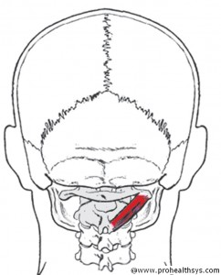
OBLIQUUS CAPITIS INFERIOR
Origin – Spine of Axis
Insertion – TP of Atlas
Action – Ipsilateral rotation of head
Nerve – Suboccipital nerve
Blood – Occipital Artery, deep cervical artery, muscular branches of vertebral artery

Slide 86
Palpation
Supine, relaxed as Possible
Place fingers on SP of C2, feel for fibres of OCI running laterally and slightly superior from SP of axis toward TP of Atlas
Have client gently rotate head and neck to the same sideand feel for contraction, resistance may be applied

Slide 87
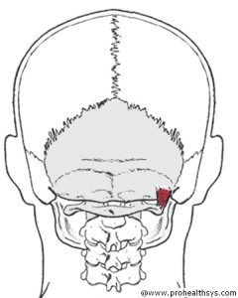
OBLIQUUS CAPITIS SUPERIOR
Origin – TP of Atlas
Insertion – Occiput b/w superior & inferior nuchal line
Action – Protraction at AOJ, Extension, lateral flexion of the head, Contralateral rotation of the head at AOJ
Nerve – Suboccipital nerve
Blood – Occipital Artery, deep cervical artery & muscular branches of the vertebral artery

Slide 88
Palpation
Supine and relaxed as possible
Place fingers inferior to Occiput b/w TP of C1 and Occiput. Feel for fibres of OCS running superior and medially
This muscle is challenging to palpate and differentiate from adjacent musculature

Slide 89
HYOID MUSCLES

Slide 90
HYOID GROUP
Group of 8 muscles in the anterior neck
Divided into two groups
  Suprahyoids
    Diagastric
    Mylohyoid
    Geniohyoid
    Stylohyoid
  Infrahyoids
    Sternohyoid
    Sternothyroid
    Thyrohyoid
    Omohyoid

Slide 91
CONTINUED
Except Sternothyroid all hyoid muscles have an attachment to the hyoid bone
  Supra’s are superior
  Infra’s are inferior
Involved in movement of the mandible at the TMJ

Slide 92
SUPRAHYOIDS

Slide 93
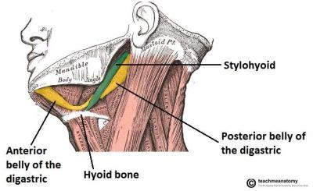
DIGASTRIC
Origin – posterior belly: mastoid notch of temporal bone
Anterior belly: digastric fossa of internal mandible
Insertion – Body of hyoid
Action –Depression of mandible, stabilize hyoid bone for infrahyoid muscle action, neck and head flexion
Nerve – posterior belly – Facial CN VII
Anterior belly – Trigeminal Nerve CN V
Blood – Occipital, posterior auricular & facial arteries

Slide 94
Palpation
Supine
Place fingers b/w SCM and ramus of mandible
Have client depress the mandible against gentle resistance and feel for digastric, it will be pencil thin muscle running horizontally
Feeling the posterior belly of digastric from Stylohyoid is difficult

Slide 95
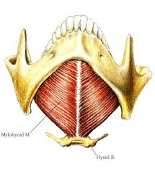
MYLOHYOID (MYLO REFERS TO MOLAR TEETH)
Origin – mylohyoid line of mandible
Insertion – Anterior surface of Hyoid bone Action - Depression of mandible, head and neck flexion
RMA Elevation of Hyoid bone
Nerve – Trigeminal Nerve(CN V)
Blood – Alveolar Artery

Slide 96
Palpation
Supine
Place fingers under the chin
Have client depress mandible against resistance or push the tip of tongue against roof of mouth. Feel for contraction

Slide 97
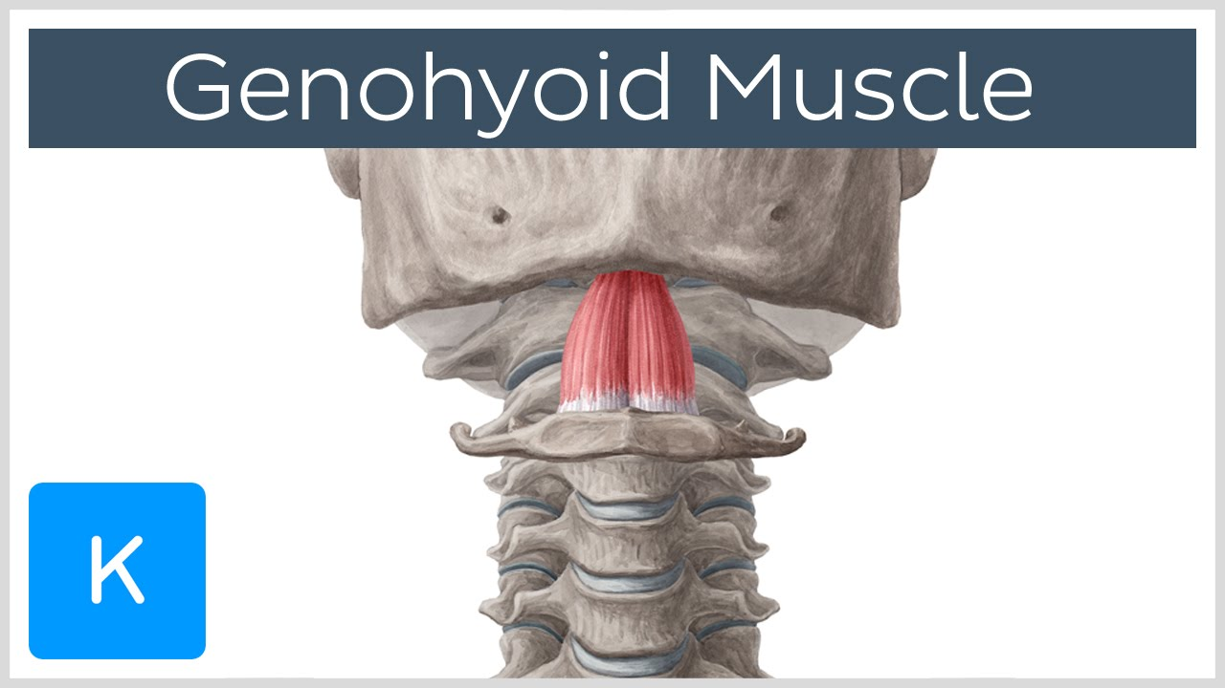
GENIOHYOID (GENIO = CHIN)
Origin – Inner surface of mandible
Insertion – Anterior surface of Hyoid body
Action – Depression of mandible, flex head and neck
RMA Elevation of hyoid bone
Nerve – Hypoglossal Nerve CN XII
Blood – Lingual Artery

Slide 98
Palpation
Supine, place fingers on underside of chin in the midline
Have client gently depress mandible with gentle resistance or touch tip of tongue to roof of mouth and feel for contraction
It is difficult to differentiate between superficial mylohyoid

Slide 99
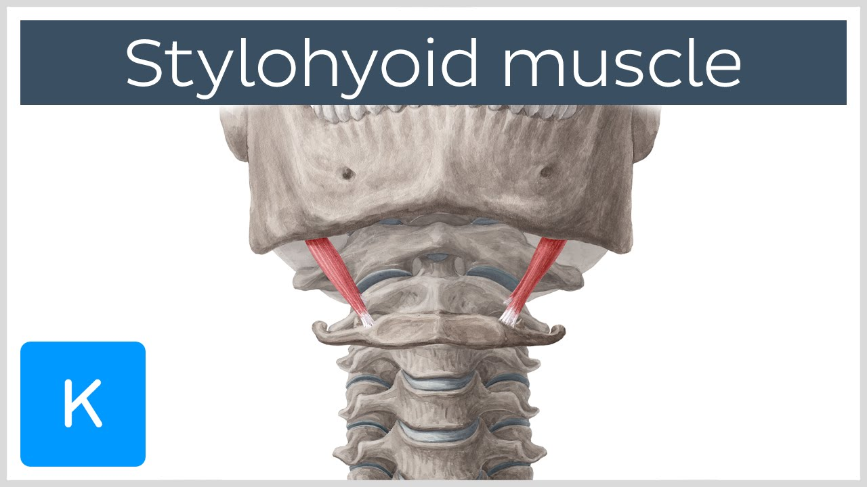
STYLOHYOID (STYLO = STYLOID PROCESS)
Origin – Styloid process of temporal bone
Insertion – lateral margin of hyoid body
Action – Elevation of Hyoid bone
Nerve – facial Nerve CN VIII
Blood – occipital, posterior auricular and facial arteries

Slide 100
Palpation
Supine, place fingers b/w SCM and styloid process of temporal bone (keep pressure light)
Have client swallow and feel for contraction
It is a pencil thin muscle located next to digastric
Can be challengin to differentiate from posterior belly of digastric

Slide 101
INFRAHYOIDS

Slide 102
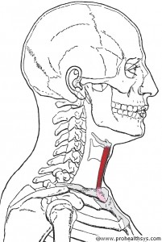
STERNOHYOID
Origin –Posterior surfaces of Manubrium & medial clavicle
Insertion – Inferior surface of Body of hyoid
Action – Depression of hyoid, flexes head and neck
Nerve – Ansa Cervicalis (C1,2,3)
Blood – superior thyroid arteries

Slide 103
Palpation
Supine
Place fingers superior to manubrium, slightly lateral to midline but medial to SCM
Gently resist client from depressing mandible and feel for contraction
Palpate superiorly toward hyoid bone using light pressure over thyroid gland (superficial in the anterior lower neck)

Slide 104
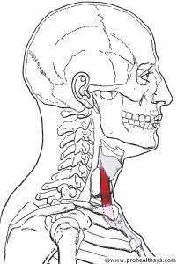
STERNOTHYROID
Origin –Posterior surface of manubrium and cartilage of the first rib
Insertion – Thyroid Cartilage
Action – Depression of thyroid cartilage flexes head and neck
Nerve – Ansa Cervicalis
Blood – Superior thyroid Artery

Slide 105
Palpation
Supine, best palpated with Sternohyoid
Does not extend superiorly beyond thyroid cartilage

Slide 106
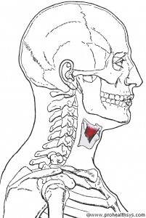
THYROHYOID
Origin – Thyroid Cartilage (oblique line)
Insertion – Inferior hyoid bone
Action – Depression of hyoid bone, flexes head and neck
Nerve- C1 (via hypoglossal nerve)
Blood - superior Thyroid arteries

Slide 107
Palpation
Best palpated along Sternohyoid
Does not extend inferiorly beyond thyroid cartilage

Slide 108
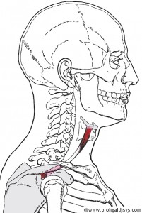
OMOHYOID (OMO = SHOULDER)
Origin – Inferior belly – superior border of scapula
Superior belly - clavicle
Insertion – Inferior belly – clavicle
Superior belly – Inner surface of the Hyoid bone
Action – Depression of hyoid, flexion of head and neck
Nerve – Ansa cervicalis (C1,2,3)
Blood - Superior thyroid and transverse cervical arteries
https://youtu.be/-21QCWqLviQ

Slide 109
Palpation
Supine, place fingers lateral to SCM just superior to clavicle, feel for fibres of Omohyoid running horizontally (Scalenes will run more vertically)
Have the client depress mandible against mild resistance and feel for contraction, palpate as much as possible

