Slide 1
Pathophysiology 1
Sections 3 & 4
IMMUNE SYSTEM, LYMPHATIC SYSTEM & INFECTIOUS DISEASE
PRESENTED BY: DR. JIL SIMMONS BSC ND

Slide 2
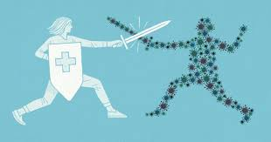
The Immune System & Lymphatic System- Unit 3
References:
Ch. 9 Mosby’s Pathology for Massage Professionals & Ch. 21 of The Human Body in Health and Illness

Slide 3
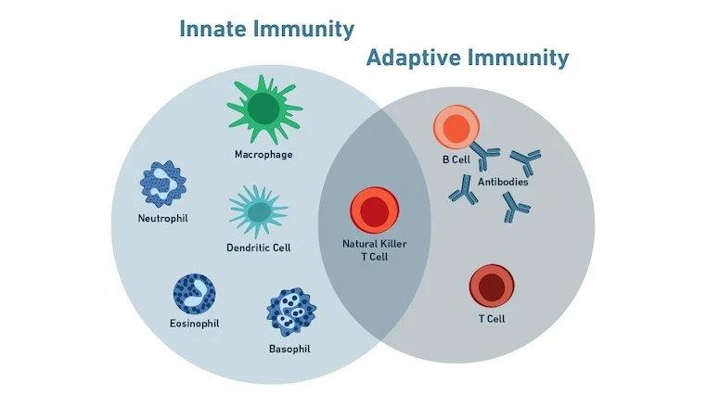
Immune System overview
https://youtu.be/GIJK3dwCWCw
https://youtu.be/2DFN4IBZ3rI
https://youtu.be/rd2cf5hValM

Slide 4
Non – Specific Immunity AKA Innate Immunity
Defenses that you are born with.
1st Line of Defense:
1) Mechanical barriers such as skin, mucous membranes
2) Chemical barriers such as lysozyme in tears and saliva, stomach acid, pancreatic enzymes
3) Reflexes such as sneezing, coughing, vomiting, diarrhea

Slide 5
Non – Specific Immunity AKA Innate Immunity
2nd Line of Defense:
1)Phagocytosis:
Neutrophils roam the bloodstream and gobble up foreign invaders, then they die & become pus.
  Macrophages- Monocytes after they leave the bloodstream & enter the tissue. Can be free or fixed – in organs such as the liver, lungs, spleen & lymph nodes. After consuming the pathogen, they will stay alive and display antigens on their surface, stimulating adaptive immunity.
  https://youtu.be/AU0-R82Xhmw
  2) Protective Proteins:
    Interferon – produced by cells infected with viruses. Sends messages to neighbor cells to protect them.
    Complement proteins- Circulate in blood. When activated, can punch holes in bacteria. Also play a role in hypersensitivity reactions.

Slide 6
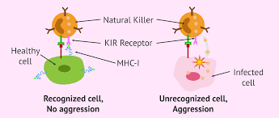
Innate Immunity AKA Non-Specific Immunity
2nd line of defense cont.
3) Natural Killer Cells – special “assassin” lymphocytes. Roam the bloodstream targeting foreign invaders and cancer cells.

Slide 7
Innate or N0n-Specific Immunity
2nd Line of Defense Cont.
4) Inflammation-
Any injury, including an invasion by microorganisms, causes inflammation in the affected area.
Inflammation is a complex reaction where damaged tissue releases substances that cause inflammation and direct the immune system to do the following:
  Attack and kill any invaders
  Dispose of dead and damaged tissue
  Begin the process of repair
Inflammation may not be enough to overcome large numbers of microorganisms.
https://youtu.be/uc6IV85mf3s

Slide 8
OVERVIEW OF INFLAMMATION
Inflammation is characterized by 4 features: Redness, swelling, heat & Pain.
During inflammation,the blood supply increases, causing the
infected area near the surface of the body becomes red and warm.
Walls of blood vessels become more porous, allowing fluid and white blood cells (in the process of diapedesis) to pass into the affected tissue.
Increase in fluid causes the inflamed tissue to swell.
White blood cells attack the invading microorganisms and release substances that continue the process of inflammation.
Other substances trigger clotting in the capillaries in the inflamed area, which delays the spread of the infecting microorganisms and their toxins.
Many of the substances produced during inflammation stimulate the nerves, causing pain.
Reactions to the substances released during inflammation include the chills, fever, and muscle aches that commonly accompany infection.

Slide 9
Innate Immunity Cont.
5) Fever AKA Pyrexhia
Body temperature increases as a protective response to infection and injury. An elevated body temperature (fever) enhances the body's defense mechanisms
The hypothalamus controls body temperature. Fever results from an actual resetting of the hypothalamus's thermostat.
The body raises its temperature to a higher level by shunting blood from the skin surface to the interior of the body (reduces heat loss)
Shivering (chills) may occur to increase heat production through muscle contraction.
Later, when the thermostat is reset to its normal level, the body eliminates excess heat through sweating and shunting of blood to the skin.
Certain people (such as alcoholics, the very old, and the very young) are less able to generate a fever. These people may experience a drop in temperature in response to severe infection
https://youtu.be/jRvxnpfCDSo

Slide 10
Innate Immunity Review
1st Line of Defense:
Physical barriers
Chemical Barriers
Reflexes
2nd Line of Defense
Phagocytosis
Protective Proteins
Natural Killer Cells
Inflammation
Fever

Slide 11
Specific Immunity AKA Adaptive Immunity
AKA 3rd Line of Defense
Specific or Adaptive Immunity refers to the immunity that you develop over your lifetime, by being exposed to different pathogens
There are two main ways that you develop specific immunity:
1)Active Immunity – immunity that you develop through exposure to pathogens, stimulation of your B lymphocytes to produce antibodies
Naturally by having by being exposed to the pathogen
Artificially by vaccination
2) Passive Immunity- immunity that you are given by resources that your body did not produce - your own B lymphocytes do NOT produce antibodies
    Naturally by getting antibodies from your mother in the womb & through breastmilk
    Artificially by getting IV Immunoglobulin (someone else’s antibodies)

Slide 12
ADAPTIVE IMMUNITY Cont.
There are two main types of Adaptive immunity: Cell- mediated & Antibody-mediated
1)Cell-Mediated Immunity - T lymphocytes attack pathogens directly
T cells originate in the bone marrow, but mature in the thymus
There are 4 types of T lymphocytes:
Helper Ts (CD4) - Help stimulate both B & T lymphocyte into action
Cytotoxic Ts (CD8) - Release substances that can kill pathogens
Regulatory Ts - Help shut down the adaptive immune response when pathogen levels drop
Memory Ts - Long-lived cells that help stimulate a faster response when the pathogen is encountered again

Slide 13
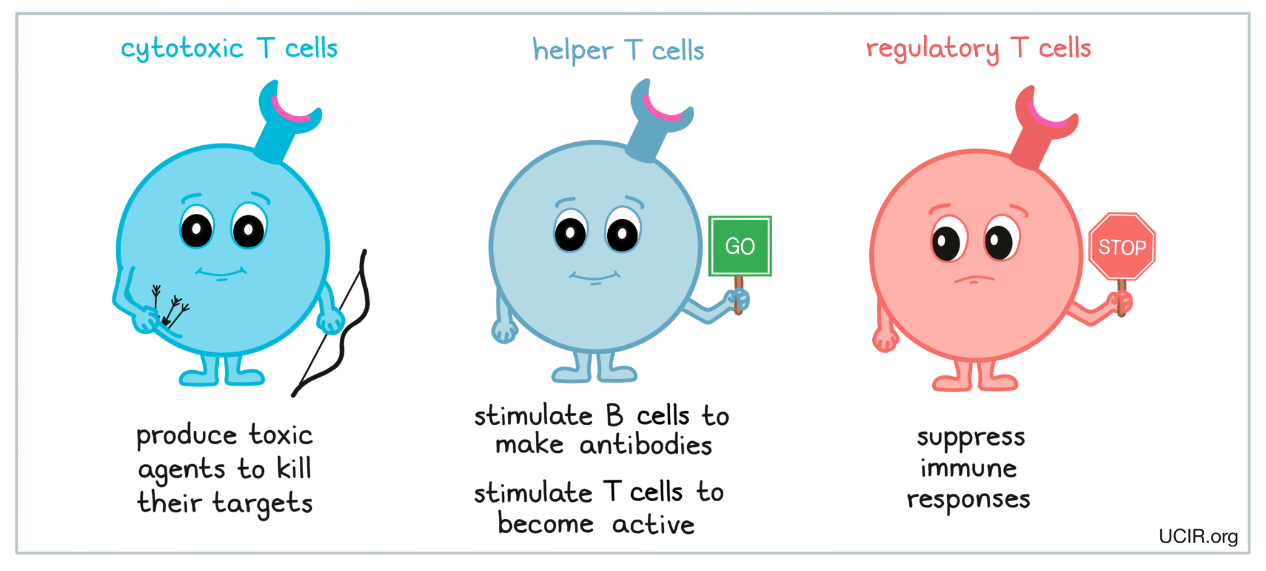
Adaptive Immunity
Cell - Mediated Immunity

Slide 14
ADAPTIVE IMMUNITY cont
2) Antibody Mediated Immunity (aka Humoral Immunity)
- B Lymphocytes produce antibodies to attack pathogens
B Cells originate and mature in the bone marrow.
Types of B cells:
  Naïve B cells – B cell not yet exposed to an antigen. After exposure, it will turn into a plasma cell or a memory B cell.
  Plasma cell – secretes a single type of antibody. (remember cancer of these cells is multiple myeloma)
  Memory B cells – long-lived cells that live in our lymph tissue (nodes, Peyer’s patches, tonsils etc) Can change into plasma cells quickly upon exposure to a familiar antigen

Slide 15
Antibodies
The antibodies produced by B lymphocytes are also known as Immunoglobulins.
There are 5 main types:
IgG- the most common & plentiful type, present in plasma and can cross the placenta and blood brain barrier. Very effective against some bacteria, viruses & toxins.
IgA - Found in exocrine secretions (tears, saliva, sweat, gastric juice & breast milk)
IgM - found in plasma & surface of RBCs, associated with blood type.
IgD - found on the surface of B cells
IgE - Found in exocrine secretions. Not much of a role in pathogen defense but a huge role in allergies.

Slide 16
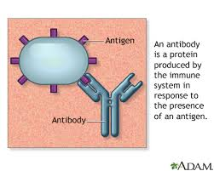
Antibodies cont.
Antibodies destroy antigens - usually proteins or sugars that may be found on: toxins, chemicals, bacteria, viruses, pollens & even certain types of our own cells.
Antibodies can attack an antigen directly by binding to it in a process called agglutination. The new antibody-antigen complex that is formed is large and stimulates phagocytosis.
Antibodies may also attack
a pathogen indirectly,
by stimulating
complement proteins.

Slide 17
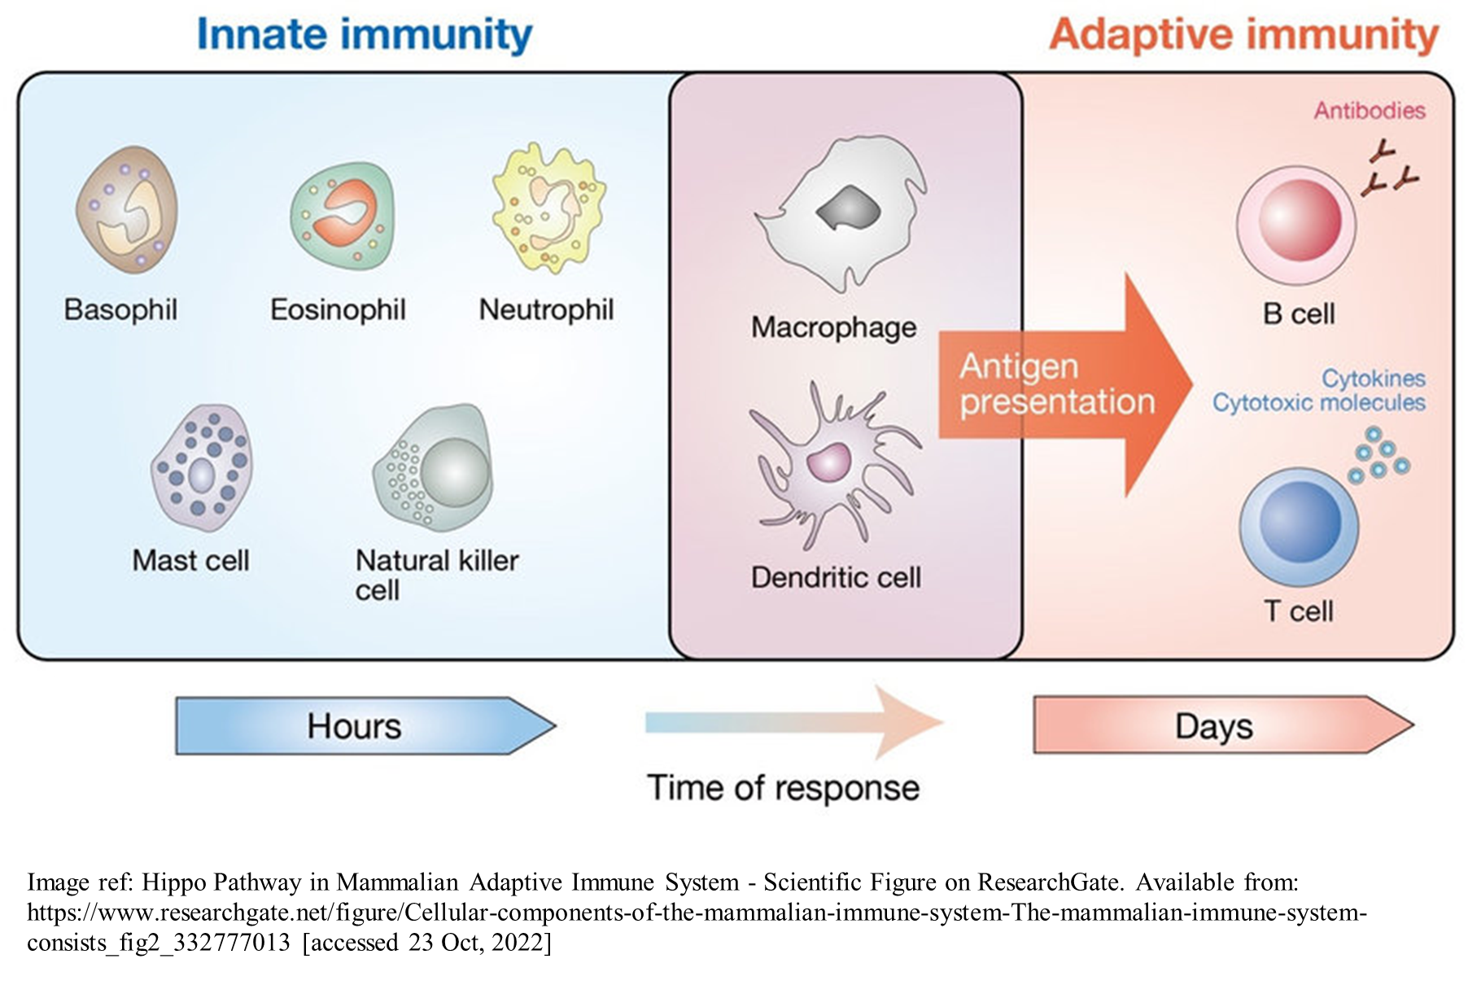
Immune System Timeline

Slide 18
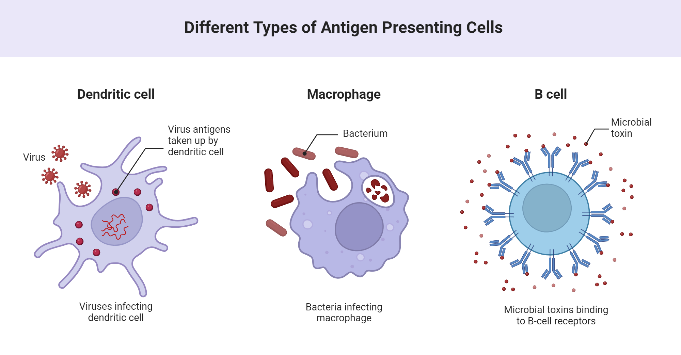
How does your immune system know what to target?
Antigen Presenting Cells - the bridge between your innate & your adaptive immune system.
APCs include macrophages, B cells and dendritic cells. They ingest foreign invaders or damaged cells, digest them & present pieces of them “antigens” on their cell membranes, bound to MHC proteins.
These “tags” or “shark tooth necklaces” tell the B & T lymphocytes which cells to target for destruction.

Slide 19
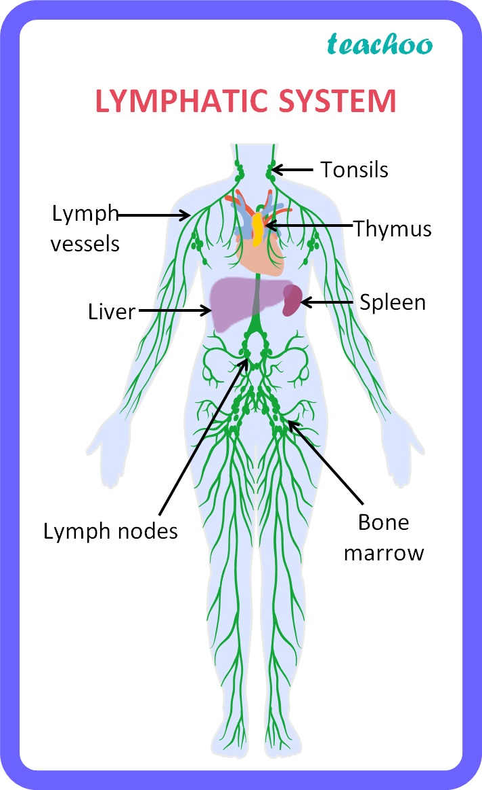
Lymph System
Lymph - a colourless liquid containing white blood cells that bathes the tissues and drains through the lymphatic system back into the bloodstream. It is formed of the approx. 15% of extracellular fluid that did not get reabsorbed into a venous capillary.
Lymph System - a collection of channels, lymph nodes, and lymphoid tissue in organs that carries the lymph fluid. It acts as a filter against pathogens, organic wastes, toxins & other debris.
Lymph Organs = Spleen, Thymus Gland & Lymph nodes.

Slide 20
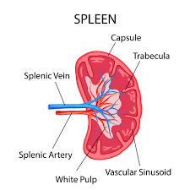
Lymph Organs
Spleen - Located in the LUQ of the abdomen.
Consists of red pulp - which contains venous sinuses filled with blood, as well as lymphocytes & fixed macrophages which will filter the blood of pathogens and misshapen blood cells
Also consists of white pulp - lymphoid tissue that contains many lymphocytes
If injured, the spleen can be removed.
A person can live without a spleen,
but their immunity will be
compromised

Slide 21
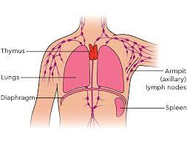
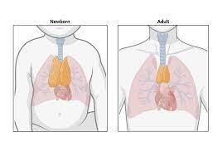
Lymph Organs Cont
Thymus - Located in the mediastinum, behind the sternum.
Quite large in childhood, it begins to shrink after puberty.
Contains many lymphocytes, which will mature into T lymphocytes.
Also secretes thymosins which are hormones that encourage growth & development of T lymphocytes in lymphatic tissue throughout the body.

Slide 22
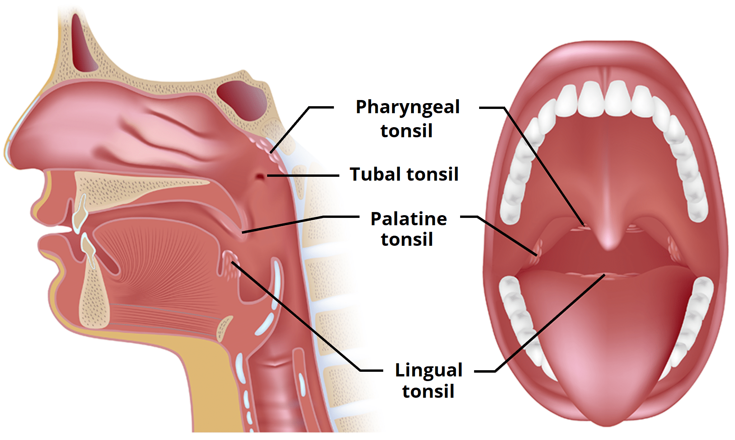
Lymphatic Nodules
Includes the tonsils, MALT, Peyer’s patches & the appendix.
Tonsils- Partially encapsulated lymph nodes in the throat area.
Palatine tonsils - 2, located one on each side of the throat. Removed in a tonsillectomy.
Pharyngeal/Adenoid - located near the opening of the nasal cavity into the pharynx. Removal is
an adenoidectomy.
Lingual - 2 located
at the back of the tongue.
Tubal - 2 located where
The Eustachian tube
Meets the nasopharynx

Slide 23
Lymphatic Nodules Cont.
MALT- Mucosal-Associated Lymphatic Tissue
Scattered throughout the body in its mucous membranes.
Wherever the body is open to the external environment.
Peyer's Patches- Lymph nodules found in the lower part of the small intestine
Appendix - Outpouching of the intestine that occurs where the large intestine begins.

Slide 24
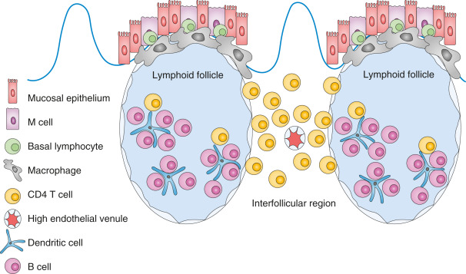
FYI: MALT diagram

Slide 25
Lymph Nodes
Lymph Nodes - pea- shaped patches of lymph tissue, that consist of many lymph sinuses surrounded by macrophages and lymphocytes. The lymph fluid is thus filtered when it passes through these nodes. There are about 800 lymph nodes in the human body.
Important locations of lymph nodes:
Cervical- Approx. 300 nodes that drain & filter the lymph of the head & neck
Axillary - 20 - 30 nodes that drain & filter lymph from the arms, shoulders & breast/chest.
Inguinal - About 10 nodes located in the groin area that drain & filter lymph from the legs & external genitalia.

Slide 26
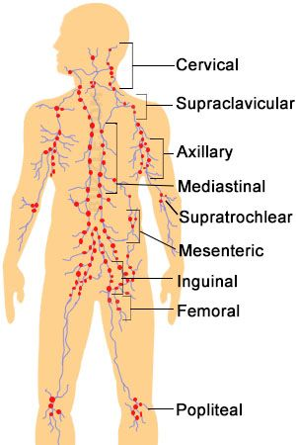
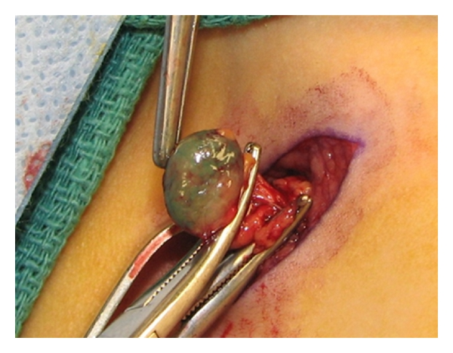
Lymph Nodes

Slide 27
Lymph Vessels
Lymph vessels consist of capillaries & larger vessels that mirrors the venous circulatory system.
Lymph capillaries- have a single celled epithelial walls that overlap to create “flaps” -
when the interstitial pressure is higher than in the lymph capillary, the flaps will open & allow interstitial fluid into the lymph capillary
When the pressure inside the lymph capillary is higher, the flaps will stay closed.
Lymph will move into larger lymphatic vessels until it reaches either the right lymphatic duct which drains lymph from the right arm, head & thorax into the right subclavian vein OR
The thoracic duct which drains lymph from everywhere else in the body into the left subclavian vein.

Slide 28
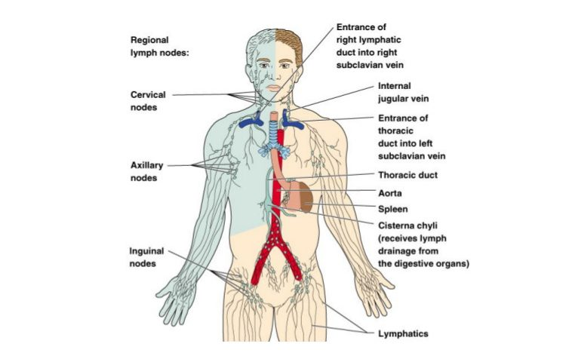
Lymph Drainage

Slide 29
Movement of Lymph
Similar to veins, lymph does not have the pressure of the heart of a thick layer of muscle in its vessel walls, so it relies upon the following for movement ;
The “milking” action of the skeletal muscle
The movement of the chest during respiration. The expanding chest creates a low pressure environment that helps draw lymph fluid towards it.
The rhythmic contraction of the smooth muscle within the walls of the lymphatic vessels
The presence of valves. Like in veins, they prevent backflow.

Slide 30
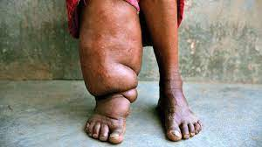
Pathologies of the Immune & Lymph Systems

Slide 31
Pathologies of the Immune System -
Allergic Reactions
A person who is overly reactive to a substance that is tolerated by most others is said to be hypersensitive or allergic. Whenever an allergic reaction occurs, there is tissue injury. The antigens that induce an allergic reaction are called allergens.
There are four basic types of hypersensitivity reactions (remember with the acronym ACID):
1. Type I (Allergy):
Allergy results from the interaction of allergens with IgE antibodies on the surface of mast cells and basophils. Develops within 20 mins of exposure. Can be mild or can progress to anaphylaxis, which is the most severe type of allergy. Anaphylaxis may progress to anaphylactic shock, involving wheezing and shortness of breath as airways constrict and extremely low blood pressure due to vasodilation and fluid loss from blood. This is a life-threatening emergency.
Type I reactions are often associated with eating potentially allergenic food such as peanuts, tree nuts, shellfish, or eggs. Also associated with bee and wasp stings. Pollen exposure usually causes milder symptoms.

Slide 32
Immune System Pathologies -
Allergic Reactions cont.
2. Type II (cytotoxic) reactions are caused by antibodies (IgG or IgM) directed against a person’s blood cells or tissue cells. The reaction of antibodies and antigens usually leads to activation of complement. Type II reaction, which may occur in incompatible blood transfusion reactions, damage cells by causing lysis.
3. Type III (immune complex) aka Autoimmune reactions involve antigens (not part of a host tissue cell), antibodies (IgA or IgM), and complement.Antibody-antigen complexes then deposit in tissue, causing symptoms. Some type III conditions include glomerulonephritis, systemic lupus erythematosus, and rheumatoid arthritis.

Slide 33
Immune System Pathologies - Allergic Reactions
4. Type IV (delayed/cell-mediated) reactions or delayed hypersensitivity reactions usually appear 12-72 hours after exposure to an allergen and occur when allergens are taken up by antigen-presenting cells that migrate to lymph nodes and present the allergen to T cells. Intracellular bacteria, such as the one that causes tuberculosis, trigger this type of cell-mediated immune response. IgG antibodies are involved.
Some examples are: contact dermatitis from a nickel jewelry allergy or poison ivy, or delayed food reactions such as celiac disease, or sensitivities to foods such as soy or nightshade vegetables.

Slide 34
Immune System Pathologies -
Autoimmune Disorders
In an autoimmune disease the immune system fails to display self-tolerance and attacks the person’s own tissue. These diseases usually arise in early adulthood and are common, affecting an estimated 5-8% of adults in North America and Europe. Females suffer from autoimmune diseases twice as often as males. Some disorders that you will look at in greater detail in future courses include: multiple sclerosis, diabetes mellitus, rheumatoid arthritis, and ulcerative colitis.
There are around 100 different known autoimmune conditions. Most of them share the characteristic feature of “waxing and waning” - Periods of remission when the disease gets better and exacerbation or “flare-ups” when the symptoms are worse

Slide 35
Immune System Pathologies - Autoimmune
Systemic Lupus Erythematosus
Systemic lupus erythematosus (lupus or SLE)
A chronic autoimmune, inflammatory disease that affects multiple body systems.
Characterized by periods of active disease and remission, and symptoms range from mild to life threatening.
Develops between the ages of 15-44, and is 10-15 times more common in women than men.
Signs and symptoms include: joint pain, muscle pain, chest pain with deep breaths, headaches, pale or purple fingers or toes, kidney dysfunction, low blood cell count, nerve or brain dysfunction, slight fever, fatigue, oral ulcers, weight loss, swelling in the legs or around the eyes, enlarged lymph nodes and spleen, photosensitivity, rapid loss of large amounts of scalp hair, and sometimes an eruption across the bridge of the nose and cheeks called a “butterfly rash” or malar rash.
Renal failure is the most common cause of death.
There is no cure, but drug therapy can minimize symptoms, reduce inflammation, and forestall flare-ups.
https://youtu.be/ift0xga6bhA

Slide 36
Immune System Pathologies - HIV Infection
The HIV (Human Immunodeficiency Virus) was first identified in 1984, three years after the disease that it causes was named AIDS (acquired immunodeficiency disease)
HIV probably evolved from a similar virus that affects chimpanzees and seems to have started to affect humans as far back as the 1930s. Genetic studies have shown that it first entered the U.S. in the late 1970s.
In the early 1980s, clusters of cases began to appear in New York, with the gay male community most heavily impacted. A huge stigma affected those with the virus and disease, which finally started to relent after development of treatment in 1987, Princess Diana’s public handshake and touch of AIDS patients in the late 80s, Magic Johnson coming forward with his diagnosis in 1991 & the Oscar winning movie Philadelphia coming out in 1993.

Slide 37
Immune System Pathologies - HIV
Since 1981, when doctors first recognized HIV/AIDS as a new illness, scientists have learned much about how a person becomes infected with HIV. The virus is spread through contact with an infected person's body fluids, especially through blood, semen and vaginal fluids. HIV can be transmitted:
  During sex (anal, vaginal and oral)
  By contaminated blood (by sharing or accidentally being stuck with a contaminated needle)
  Through blood transfusions (before blood products started being screened for HIV in 1985)
  By being born to a mother who is infected with HIV

Slide 38
Immune System Pathologies - HIV
Once inside the body, HIV particles invade CD4 (Helper T) cells and use the cell's' own building materials to produce billions of new HIV particles. These new particles cause the infected CD4 cells to burst (lyse). The new particles can then enter the bloodstream and infect other cells.
Once someone is infected with HIV, the number of their CD4 cells continues to decrease. HIV is actively copying itself and killing CD4 cells from the time the infection starts. Eventually, the number of CD4 cells drops below the threshold level needed to defend the body against infections (200 per mm3 of blood), and the person develops AIDS.

Slide 39
Continued
According to the World Health Organization (WHO), just under 40 million people worldwide are living with HIV. Survival has improved dramatically in developed countries. But that is not the case in many underdeveloped countries.
https://www.who.int/teams/global-hiv-hepatitis-and-stis-programmes/hiv/strategic-information/hiv-data-and-statistics
It is important for people infected with HIV to know their status so they can get medical treatment before AIDS develops and they can take steps to prevent passing the virus to someone else. In 2023, the WHO found only 86% of people were aware of their HIV status.

Slide 40
HIV Symptoms
In its early stages, HIV infection often causes transient flu-like symptoms, such as fever, sore throat, rash, nausea and vomiting, diarrhea, fatigue, swollen lymph nodes, muscle aches, headaches, and joint pain. Doctors call this acute HIV infection.
The symptoms of acute HIV can be mild. So, the person or doctor may attribute the symptoms to a routine cold or flu. However, sometimes people will describe acute HIV infection as the “Worst flu of their life”

Slide 41
HIV Symptoms
After the acute HIV infection symptoms have receded, the person now enters the latent period/chronic HIV infection.
This period can last a decade or longer, even without treatment, as the HIV virus is slowly replicating & killing off CD4 (Helper T) cells. If a person knows that they are positive, and starts the HAART medication regimen, this stage may last indefinitely.
Without treatment, the viral load (amount of virus) will continue to increase and the CD4 cells will continue to decrease, leading to reduced immunity & frequent infections, including opportunistic infections (infections by organisms that are unlikely to cause disease in healthy individuals). Many opportunistic infections are caused by fungi.

Slide 42
Development of AIDS
Finally, with further decreases in the levels of CD4 cells, the person develops AIDS. For an HIV-infected person, some signs that AIDS has developed (known as AIDS-defining conditions) are:
  The CD4 cell count has decreased to fewer than 200 cells per cubic milliliter of blood.
  A severe opportunistic infection has developed, indicating that the immune system is severely weakened. These types of infections include: PCP pneumonia, Candida respiratory infections, Burkitt lymphoma & Kaposi’s sarcoma (an otherwise incredibly rare form of cancer)

Slide 43
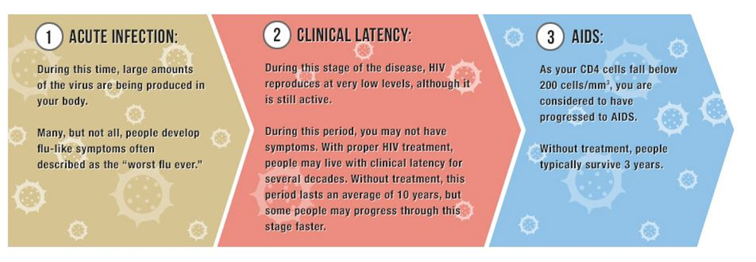
STAGES OF HIV INFECTION

Slide 44
Diagnosis
Doctors usually ask the patients about possible HIV risk factors, such as previous sexual partners, intravenous drug use, blood transfusion and occupational exposure to blood, such as accidentally being stuck by needles.
If a person has been diagnosed with HIV by an antibody test, the doctor will order additional tests including a viral load and CD4 cell count.
To diagnose people with acute HIV, a viral load blood test is needed, as they may not yet be producing a significant amount of antibodies.

Slide 45
Expected Duration
HIV infection is a lifelong illness. There is no known cure for HIV. However, advances in treatment have changed the thinking about HIV as a fatal disease. Doctors now consider HIV a chronic condition that can be controlled with medications and healthy lifestyle choices.
https://youtu.be/hor8xLVpCg
https://youtu.be/ng22Ucr33aw

Slide 46
Prevention
HIV infection can be passed from person to person in any of the following ways:
  Unprotected sexual intercourse (heterosexual or homosexual and anal, vaginal or oral sex) with an infected person
  A contaminated transfusion (extremely rare in the developed countries since 1985, when blood products started being tested for HIV)
  Needle sharing (if one intravenous drug user is infected)
  Occupational exposure (needle stick with infected blood)
  Artificial insemination with infected semen
  Organ transplant taken from an HIV-infected donor
  Newborns can catch HIV infection from their mothers before or during birth or through breastfeeding.

Slide 47
Continued
There is no evidence that HIV can be spread through the following: kissing; sharing food utensils, towels or bedding; swimming in pools; using toilet seats; using telephones; or having mosquito or other insect bites. Casual contact in the home, workplace or public spaces poses no risk of HIV transmission.
Although several HIV vaccines are being tested, none has been yet approved. We can decrease our chances of being infected with HIV by avoiding high-risk behaviors

Slide 48
Continued
To decrease the risk of HIV infection:
  Have sex with only one partner at a time who is also committed to having sex with only you. Consider getting tested together for HIV.
  Use condoms with each act of sexual intercourse.
  If you use intravenous drugs or inject steroids, never share needles.
  If you are a health care worker, strictly follow universal precautions (the established infection-control procedures to avoid contact with bodily fluids).
  If you are a woman thinking about becoming pregnant, have a test for HIV beforehand, especially if you or your partner have a history of behaviors that could have put you at risk of HIV infection. Pregnant women who are HIV-positive need special prenatal care and medications to decrease the risk that HIV will pass to their newborn babies.
  If you believe you may have been exposed to HIV (through sexual contact or through exposure to blood, such as through a needle containing infected blood), medications may help prevent HIV infection before it takes hold in the body. The medication should be taken as soon as possible but not more than 72 hours (3 days) after exposure.

Slide 49
Treatment
Today, most experts recommend starting treatment immediately after the diagnosis is confirmed.
The doctor will choose a combination of drugs called antiretrovirals to fight the HIV infection. To control the reproduction of HIV in the body, several medications must be used together, often called highly active antiretroviral therapy (HAART).
These medications attack HIV at multiple points in its growth cycle and are more effective in suppressing the virus. Combining drugs also limits the risk that HIV will become resistant to drugs.

Slide 50
Prognosis
The average time for HIV infection to progress to AIDS is 10 to 11 years for people who do not take antiretrovirals. In people with very high HIV viral load, AIDS may develop sooner (within 5 years after infection). Once HIV infection has progressed to AIDS, there is an increased risk of death that varies dramatically from person to person. For example, some people with AIDS have died shortly after they were diagnosed, whereas others have lived 12 years or more.
Today, the life expectancy for many people with HIV is close to that of people that don't have the infection. The outlook is especially good for those who begin antiretrovirals at an early stage of the disease.
The AIDS-related death rate in some parts of the developing world, however, remains staggeringly high due to lack of access to life-saving antiretrovirals.

Slide 51
Massage Therapy in HIV/AIDS
Massage therapy has shown benefits for people with HIV/AIDS, including increases in Natural Killer Cell activity and in CD4 & CD8 cell levels.
See Massage Therapy for HIV patients handout
Safety: You are not allowed to ask patients their HIV status on a standard intake form, although they may disclose their status to you. So treat all patients as if they may have HIV by upholding the highest standards of cleanliness and care.
The client’s health is the primary concern - please reschedule if you are unwell.

Slide 52
Lymph Disorders
Lymphedema- swelling caused by damaged or missing lymphatic channels
1)Primary - Rare, congenital missing or deformed lymphatics.
2)Secondary - Damaged or removed lymphatic vessels - usually a consequence of surgery or radiation therapy. Can also be caused by Elephantiasis - a parasitic nematode transmitted by mosquito bites. It is endemic to tropical and subtropical areas.
Potential Complications-
Lymphangitis - a bacterial infection of the lymph vessels
Cellulitis - Bacterial infection of the skin & underlying tissue

Slide 53
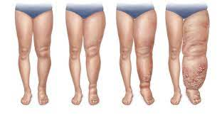
Lymphedema

Slide 54
Edema
Edema is swelling caused by fluid trapped in your body’s tissues, with no damage to the lymphatic system.
There are many different types of edema:
Generalized - affects most areas of the body
Localized - confined to a specific area or organ such as: pulmonary edema (lungs), cerebral edema (brain)
Dependant - edema in gravity dependant areas such as ankles and feet when standing.
Ascites - abdominal swelling due to excessive fluid in the peritoneal cavity. Most common in advanced liver disease & cancer.
https://youtu.be/VToE_p_tcPc

Slide 55
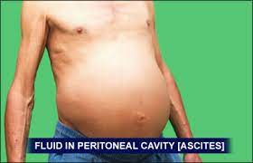
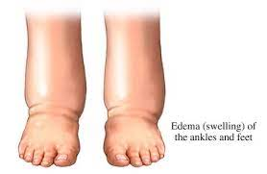
Edema

Slide 56
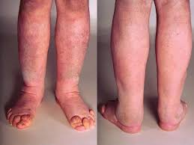
Pitting vs Non-Pitting Edema
Non-pitting edema: No indentation is left in the tissue upon applying pressure.
Extracellular fluid is high in proteins and salts.
Causes: Hypothyroid or lymphatic conditions.
Treatments:address underlying conditions, elevation of limbs, compression stockings

Slide 57
Pitting Edema
Pitting Edema: an indentation is left behind when finger pressure is applied. This is because the edema fluid is mostly water.
The degree of pitting can be graded as follows:
1+ Slight pitting of 2 mm
  Rebounds rapidly (slight)
2+ Roughly 4 mm
  Rebounds in few sec (mild)
3+ Roughly 6 mm
  Rebounds in 10-20 sec (moderate)
4+ Very deep pit of 8 mm or deeper
  Rebound in 20 sec to several min (severe)

Slide 58
Pitting Edema Cont.
Causes: many, ranging from mild to severe
Venous insufficiency- such as varicose veins or valve failure
Poor circulation- may be caused by inactivity, obesity, pregnancy, low protein levels
Nutritional causes - too much salt intake, deficiency of Vit B1
Medication side effects: Estrogens, Steroids, NSAIDs, etc
Kidney Disease
Congestive Heart Failure
Liver Disease
DVT - sudden onset, one-sided edema (usually of a limb)

Slide 59
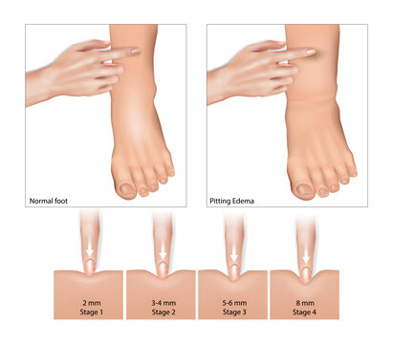

Slide 60
Angioedema
Angioedema- a sudden fluid build up in the subcutaneous, dermal or submucosal layers of tissue. It is usually caused by exposure to an allergen and the body’s subsequent release of histamine causing leaky blood vessels. It can be part of anaphylaxis and when the larynx & pharynx are involved, it can be fatal.
It most commonly affects the eyes, lips and face. It can also affect the GI system and genitals.
Non allergic types of angioedema can be: drug-induced (esp. With ACE inhibitors and NSAIDs), hereditary (related to genes that affect complement response), or idiopathic.
Treatment: immediate referral to emergency care, antihistamine, corticosteroids

Slide 61
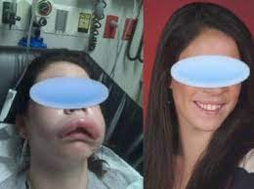
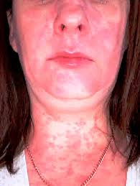
Angioedema examples

Slide 62
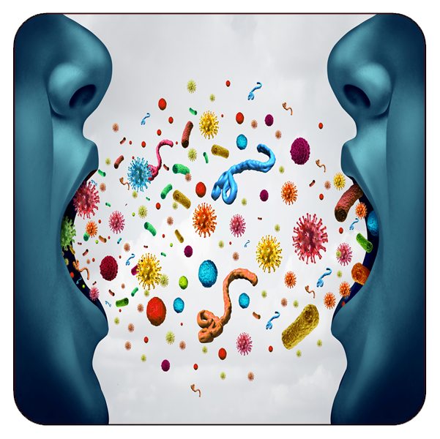
Infectious Diseases - Unit 4

Slide 63
Source of Infection
Infections are a significant problem that human beings have to face. They can affect the body in the most unpleasant ways and they also have a multitude of causes, some of the completely uncontrollable.
In many parts of the world, infections are a huge problem.
Infections can be of numerous types, mostly depending on the most common sources of infection.
Infections may be asymptomatic infections while other symptoms are obvious.
Knowing which the sources of infections are, can help you protect yourself better and avoid exposure as much as possible.
https://youtu.be/9axOFtPqS0c

Slide 64
Infectious Disease as Cause of Death
In 2019, 13·7 million people worldwide died from infectious syndromes, 5·2 million of which co-occurred with non-communicable diseases. 3 million of these deaths occurred in children under the age of 5 years. Globally, respiratory infections and bloodstream infections are the deadliest. Regional disparities are stark, with a death rate of 52·6 per 100 000 for bloodstream infections in sub-Saharan Africa, compared with 37·7 per 100 000 in high-income countries. The burden varies across age groups: adults aged 50–69 years face the highest burden from bloodstream infections, whereas children under the age of 5 years are most burdened by respiratory infections. - The Lancet
https://ourworldindata.org/causes-of-death#all-charts

Slide 65
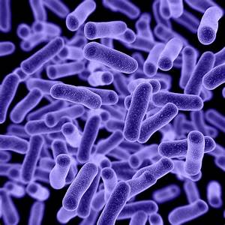
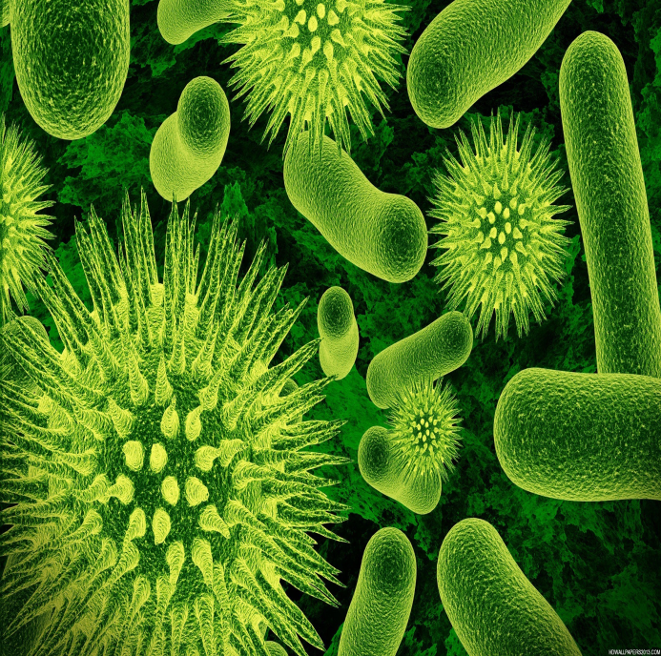
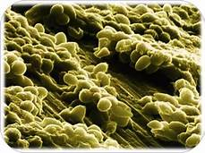
Agents of infectious Disease

Slide 66
Agents of Infectious Disease
Viruses
Bacteria incl. Rickettsia
Fungi
Parasites
  - Protozoa
  -Worms/Helminths

Slide 67
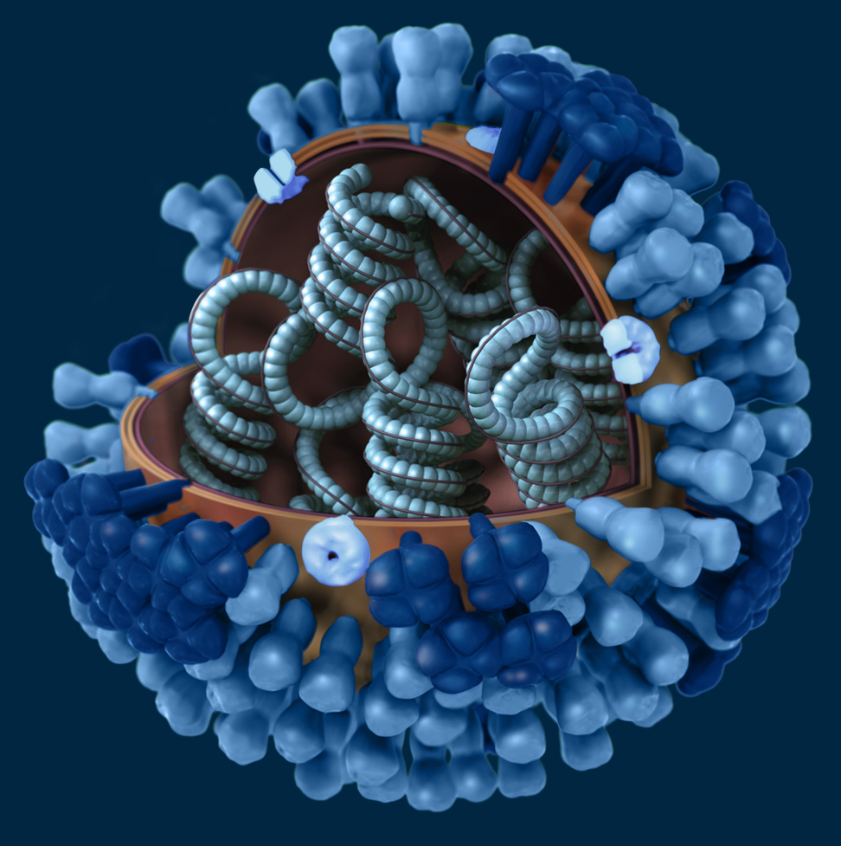
Viruses
Smallest pathogens
Have no organized cellular structure
Consist of a protein coat surrounding a nucleic acid core of DNA or RNA
Are incapable of replication outside a living cell
Don’t respond to antibiotics.

Slide 68
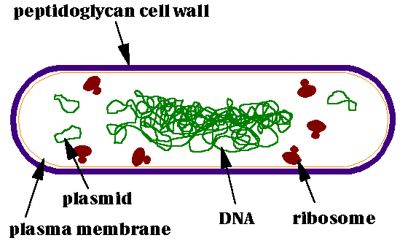
Bacteria
microscopic single-celled organisms that thrive in diverse environments
entire organism consists of a single cell with a simple internal structure.
lack membrane-bound organelles
contain ribosomes
bacterial cells are generally surrounded by two protective coverings: an outer cell wall and an inner cell membrane. However, certain bacteria, like the mycoplasmas do not have a cell wall at all. Some bacteria may even have a third, outermost, protective layer called the capsule
bacterial surfaces can be covered by whip-like extensions: flagella or pili

Slide 69
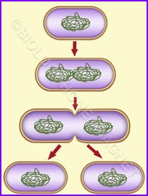
Bacterial Reproduction
Most bacteria multiply by a process called binary fission. A single bacterial cell, the "parent," makes a copy of its DNA and grows large in size by doubling its cellular content. The doubled contents are pushed out to either end of the cell. Then a small fissure emerges at the center of the parent, eventually splitting it into two identical "daughter" cells.

Slide 70
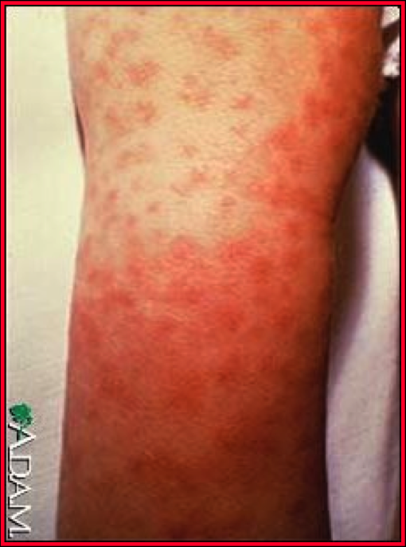
Rickettsia
Rickettsia are strictly intracellular (Gram –ve)bacteria
These bacteria multiply by binary fission in the cytoplasm of eukaryotic host cells
Transmitted by the bite of infected lice or fleas or feces of infected lice/fleas
Rocky mountain spotted fever spread by tick
https://youtu.be/frdd_AvA5lo

Slide 71
Gram –ve vs Gram +ve Bacteria
Bacteria react to the Gram stain differently based upon what their cell walls are made of.
Gram +ve bacteria have thick cell walls made of peptidoglycan (proteins & starch)
  they will stain purple
  They can release Exotoxins which can have devastating effects
  eg. Staph aureus, Anthrax, Clostridium botulinum, Clostridium tetani, Strep.mutans, Lactobacillus acidophilus
Gram –ve bacteria have thinner cell walls made with more lipopolysaccharides (fats & starches)
    They will stain pink
    More resistant to antibodies
    Release Endotoxins upon cell death leading to fever, chills, & muscle aches or possibly DIC
    Eg. Escheria coli, Chlamydia trachomatis, Yersinia pestis, Neisseria gonorrhoeae

Slide 72
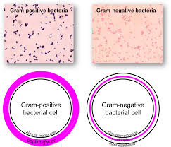
FYI: Gram + vs Gram -

Slide 73
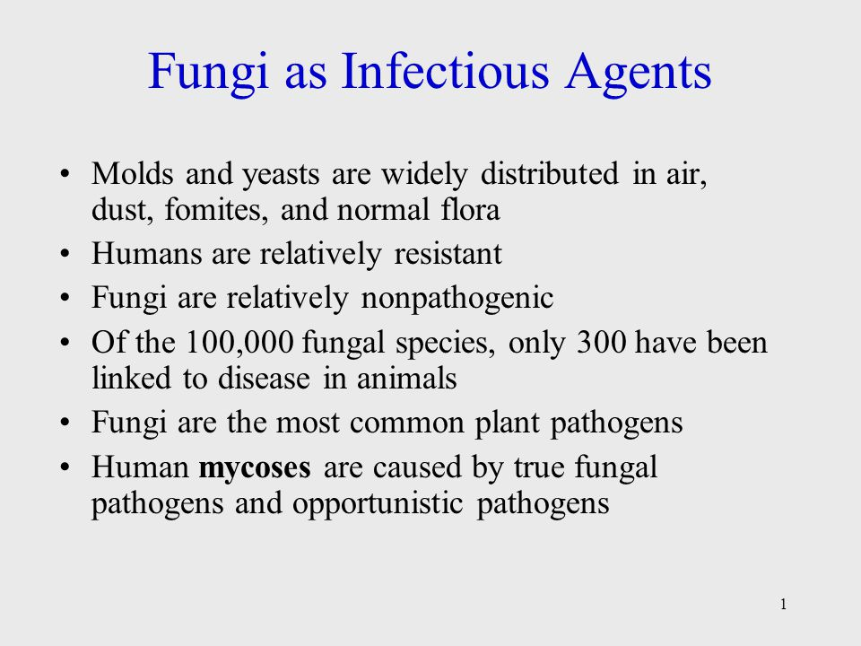
Fungi

Slide 74
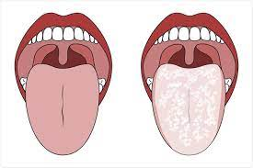
Fungi - Opportunistic
Although fungal diseases (mycoses) are relatively rare in humans, we are prone to opportunistic infections from Candida and Tinea.
Candida albicans is a normal part of our gut flora, it is present in the mouth, throat & vaginal environments. It is also present on our skin, esp. in warm, moist areas such as the underarm. When it overgrows, it’s responsible for thrush – a candida infection of the mouth & throat, more common in babies and children. Also responsible for vaginal yeast infections & skin yeast infections (heat rash), esp. in any folds of skin.

Slide 75
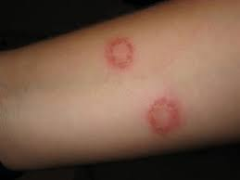
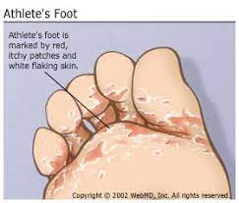
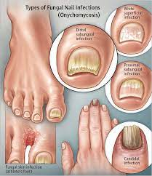
Fungal - opportunistic
Tinea spp. are fungal varieties that cause skin infections of various areas. Tinea pedis is athlete’s foot, Tinea unguium is a nail infection, Tinea cruris causes jock itch & Tinea corporis is ringworm.
Topical or oral antifungal medications such as fluconazole/Diflucan, nystatin, & miconazole (Monistat) are usually effective treatments, although these infections may reoccur & may take a while to resolve.

Slide 76
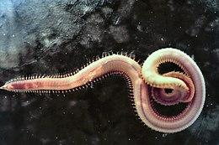
Parasites- Helminths (AKA Nematodes/Worms)
A parasite is any organism that lives and feeds off of another organism
Some examples of helminth parasites include roundworms, tapeworms, pinworms, whipworms, hookworms, and more. Because parasites come in so many different shapes and sizes, they can cause a very wide range of problems. Some consume your food, leaving you hungry after every meal and unable to gain weight.
Others feed off of your red blood cells, causing anemia. Some lay eggs that can cause itching, irritability, and even insomnia
https://youtu.be/ABeBqbBy2Lo

Slide 77
Parasites - Protozoa
Single cell organisms –not all protozoa are parasitic.
Amoeba: move with pseudopods
Flagellates: move with a single tail like structure
Ciliates (move by beating multiple hair-like structures)
Can live in soil, water, moss. Can survive in resting cysts during dry periods.
Not all protozoa are parasites- about 1/3rd of protozoans are parasites
-Cause serious disease that affects many people around the world –
African Trypanosomiasis “Sleeping Sickness”
Amoebic dysentery
Toxoplasmosis https://youtu.be/uOBw_zK3BJ4
Giardia https://youtu.be/jlvXtvWm80A?feature=shared

Slide 78
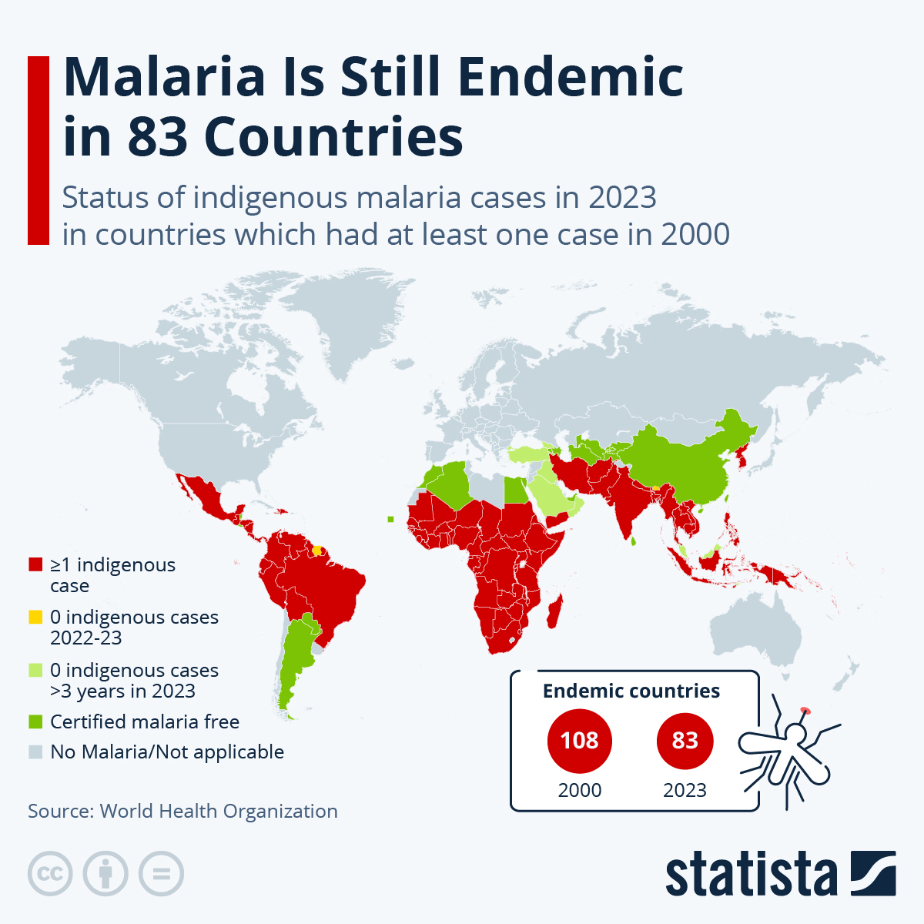
Parasites - Protozoa
Malaria –
The Anopheles mosquito transmits the Plasmodium protozoa that causes malaria.
Symptoms of the disease will occur in humans about 10 - 15 days after the mosquito bite.
Symptoms include: high fever, fatigue, and headaches but it can progress to jaundice, seizures, coma and death
It remains a leading cause of death in sub-Saharan Africa. In 2023, there were 263 million cases and 597 000 deaths from malaria worldwide.
https://youtu.be/qw6jnFqZ-Hk

Slide 79
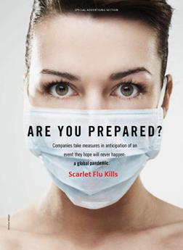
Patterns and Defenses Against Infection

Slide 80
Infection - A Battle between Pathogen and Host
Just because a person comes in contact with a pathogen does not mean that they will become sick.
In general, whether or not a person develops an infection from pathogen depends on:
1)The strength of the person (host)’s immune system
2)The amount of pathogens they are exposed to
3)The route of entry - anything that bypasses the first line of defense is more problematic
4)The pathogenicity of the organism
In this section, we’ll review the host’s defenses to all pathogens & talk specifically about the things that make bacteria more pathogenic

Slide 81
Physical Barriers AKA the 1st Line of Defense
Physical barriers are designed to keep microorganism from entering the body in the first place
Physical barriers include
  the skin
  mucous membranes
  tears
  Earwax
  mucus
  stomach acid
  normal flow of urine washes out microorganisms that enter the urinary tract

Slide 82
Physical Barriers/1st Line of Defense
Usually, skin prevents invasion by microorganisms unless it is damaged by an injury, insect bite, or burn
Mucous membranes, lining of the mouth, nose, and eyelids. Typically, mucous membranes are coated with secretions that fight microorganisms.
  mucous membranes of the eyes are bathed in tears, contain an enzyme called lysozyme attacks bacteria and helps protect the eyes from infection.
Airways filter out particles that are present in the air that is inhaled
  Mucous coats linings particles stick to it and are expelled by coughing, sneezing blowing nose
  Mucous removal is aided by cilia

Slide 83
Immune System - 1st line of defense
Digestive tract barriers include
  stomach acid
  pancreatic enzymes
  bile
  intestinal secretions
Contractions of the intestine (peristalsis) and the normal shedding of cells lining the intestine help remove harmful microorganisms.
Bladder is protected by the urethra
  In males older than 6 months, the urethra is long enough that bacteria, unless the bacteria are unintentionally placed there by catheters or surgical instruments
  females, the urethra is shorter, occasionally allowing external bacteria to pass into the bladder
In both sexes, when the bladder empties, it flushes out any bacteria that reach it.

Slide 84
IMMUNE RESPONSE - Second & Third Lines of Defense
If a pathogen is able to get past the physical, chemical and reflex barriers of the first line of defense, we have many other components to help us resist.
The second line of defense consists of: Phagocytic cells, protective proteins, fever, inflammation and Natural Killer Cells.
After a couple of days, the Adaptive Immune response kicks in and T lymphocytes target foreign invaders with toxins and B lymphocytes produce antibodies.

Slide 85
Host Susceptibility
Susceptibility to bacterial infections depends on the physiologic and immunologic condition of the host and on the virulence of the pathogen.
The normal bacterial flora of the skin and mucosal surfaces also serves to protect the host against colonization by bacterial and fungal pathogens.
Development of effective specific immunity (such as an antibody response to the bacterium) may require several weeks upon first exposure, so we rely on our first and second lines of defense to prevent a pathogen from taking hold.
In most healthy individuals,pathogens that occasionally penetrate the body are cleared by the host’s immune system. In contrast, individuals with defective immune responses are prone to frequent, recurrent infections with even the least virulent bacteria. The best-known example is HIV/AIDS patients

Slide 86
HOST RESISTANCE MECHANISMS
Resistance mechanisms can be altered by many other processes. For example
  Aging - weakens both nonspecific and specific defense systems so that they can no longer effectively combat the challenge of bacteria from the environment.
  Infants - adaptive immune systems are not yet fully developed and cannot mount a protective immune response to important bacterial antigens.
  Genetic defects of the complement system or cellular defenses.
  Granulocytopenia - result of a predisposing disease, such as cancer, or immunosuppressive chemotherapy for organ transplants or cancer.
  Trauma ex. Deep wounds, burns & Underlying diseases ex cystic fibrosis - which affects ciliary function & makes you more vulnerable to respirat
  Contact with a vector (tick – Lyme Disease) OR anything else that allows the pathogen to bypass the first line of defense such as IV exposure.

Slide 87
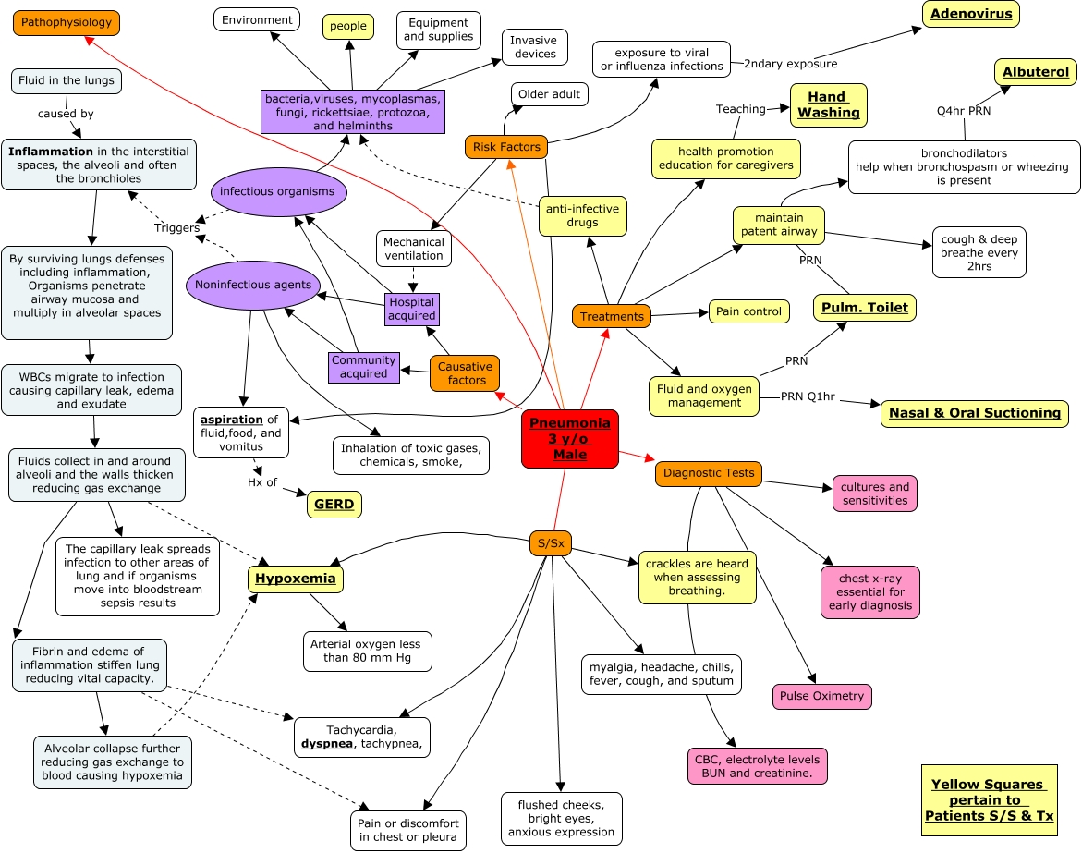
Pathogenesis of Bacterial Infections

Slide 88
Pathogenesis of Bacterial Infections
Infection is the invasion of the host by microorganisms, which then multiply in close association with the host's tissues.
Infection is distinguished from disease (diabetes)
Bacteria can cause a multitude of different infections, ranging in severity from unapparent to worsening quickly.
The capacity of a bacterium to cause disease reflects its relative pathogenicity.

Slide 89
BACTERIA
Bacteria can be organized into three major groups.
  Frank or primary pathogens - considered probable agents of disease (e.g., when exposed to the Salmonella bacteria, many will develop food poisoning)
  Opportunistic pathogens - these bacteria usually do not cause disease in a healthy host, but may when a host’s defense mechanisms have been compromised. They may be the agents of disease (e.g., in patients who have been predisposed to urinary tract infections with Escherichia coli by catheterization).
  Nonpathogens - such as Lactobacillus acidophilus, rarely or never cause human disease. Their categorization as nonpathogens may change, however, because of the adaptability of bacteria.

Slide 90
Virulence
Virulence is a pathogen’s ability to cause damage to a host.
it is affected by numerous variables
  number of infecting pathogens
  route of entry into the body
  Factors used to adhere & promote colonization
  Ability to evade immune defenses – passively or actively
  Bacterial toxins
ID50 – the number of organisms required for 50% of the population to show signs of infection
LD50 – the number of organisms needed to kill 50% of a population
Therefore, the lower an organism’s ID50 and LD50 are the more virulent it is.
Notes:
Pathogenesis refers both to the mechanism of infection and to the mechanism by which disease develops

Slide 91
Virulence Factors
Factors that are produced by a microorganism and evoke disease are called virulence factors.
1) Avoiding or Compromising Host Defenses
  Passive – Bacterial Cell Walls/Capsules
  Active- Enzymes such as Leukocidins, Hemolysins, , Coagulase
2) Establishment – Pathogens use fimbriae, adhesin proteins, biofilm production or bore into the tissue (eg Treponema bacteria that causes syphilis)
https://youtu.be/twxPyvdc-EE?feature=shared

Slide 92
ENDOTOXINS & EXOTOXINS
3) Bacterial Toxins –
  EXOTOXINS- Usually produced by Gram + Bacteria
    Can be quite lethal.
    Neurotoxins- affect nerves https://youtu.be/yaqpoNi5dog
    Enterotoxins- affect lining of digestive system https://youtu.be/U7yq-GwbcgE
    Cytotoxins – kill cells
    Ex. Anthrax, Botulinum, Tetanus,, E.coli, Vibrio (Cholera)
    ENDOTOXINS – Usually produced by Gram – bacteria
    -released by bacterial cell walls at cell death – Usually not as severe as Exotoxins
    - Cause chills, fever, muscle weakness & aches
    - Worst case – DIC Disseminated Intravascular Clotting
    https://youtu.be/Gmh01S0msfY

Slide 93
Treatments
Drugs have been developed to treat bacterial infections.
Antimicrobial agents are most effective when the infection is also being fought by healthy phagocytic and immune defenses.
Some reasons for this situation are
  poor diffusion of antibiotics into certain sites (prostate gland)
  ability of many bacteria to multiply or survive inside cells (where many antimicrobial agents have little or no effect)
  bacteriostatic rather than bactericidal action of some drugs, and the capacity of some organisms to develop resistance to multiple antibiotics.
Notes:
Static – stops from reproducing not necessarily killing cidal kills bacteria

Slide 94
Antibiotic Resistance
MRSA & other Antibiotic Resistant Bacteria are the result of decades of often unnecessary antibiotic use.
Antibiotics have been prescribed for colds, flu and other viral infections that don't respond to these drugs.
When antibiotics are used inappropriately, they contribute to the rise of drug-resistant bacteria because they don't destroy every germ they target.
Bacteria live on an evolutionary fast track, so germs that survive treatment with one antibiotic soon learn to resist
https://youtu.be/ZvhFeGEDFC8

Slide 95
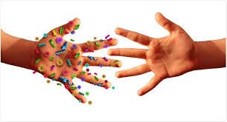
Spread of Infection

Slide 96
How infection Spreads
Direct: Direct physical contact (body surface to body surface) between infected or colonized individual and susceptible host. Examples of transmission: Shaking hands; kissing; coitus. Examples of infections: Common cold; sexually transmitted diseases. Precautions: Hand hygiene; masks; condoms.
Indirect: infectious agent deposited onto an object or surface and survives long enough to transfer to another person who subsequently touches the object (fomite). Examples of transmission: Not washing your hands between patients; contaminated instruments Examples of infections: Norwalk; rhinovirus; perhaps influenza. Precautions: Sterilizing instruments; disinfect surfaces and toys in school
Droplet: Contact, but transmission is through the air. Examples of transmission: Sneezing & coughing. Examples of infections: Meningococcus; pertussis; influenza (maybe: there is some debate); respiratory viruses. Precautions: Masks; cover mouth.

Slide 97
Continued
Airborne: Transmission via aerosols (airborne particles <5µm) that contain organisms in droplet nuclei or in dusts. Can be spread via ventilation systems. Examples of transmission: Via ventilation system in a hospital; Examples of infections: TB; varicella; measles; chickenpox; smallpox (and maybe influenza: controversial, as more likely via droplets). Precautions: Masks; negative pressure rooms in hospitals
Vehicle: A single contaminated source spreads the infection (or poison) to multiple hosts. This can be a common source or a point source. Examples of transmission : Food-borne outbreak from infected batch of food; IV fluid; medical equipment. Precautions: Normal safety and disinfection standards.
Vector borne: Transmission by insect or animal vectors. Example of infections: Mosquitoes and malaria. Precautions: Protect via barriers (window screens, bed nets); insect sprays.

Slide 98
How Infections Spread
Blood borne Infections
Many health care workers have risk to exposure to bloodborne pathogens.
Direct contact of infected patient blood with skin cut in hands can be potential source of transmission.
Accidental needle pricks with infected blood can also be a mode transmission.
Examples of Blood Borne Infections:
  Hepatitis B virus
  Hepatitis C
  HIV

Slide 99
How Infections Spread - Sexually Transmitted Infections (STIs)
Many diseases can be sexually transmitted by infected persons to their partners.
Examples
  Gonorrhea
  Chlamydia
  Hepatitis C, Hepatitis B
  HIV (Human immunodeficiency virus)
  HPV (Human Papillomavirus)
  HSV (Herpes Simplex Virus II)
  Trichomoniasis

Slide 100
Sexually Transmitted Infections - Syphilis
Syphilis - caused by the bacterium Treponema palladium, which has a unique corkscrew shape and action.
It is an ancient disease, with archeological evidence dating back nearly 10, 000 years. It has infected or caused the death of many historical figures, including: the pirate Blackbeard, Author Leo Tolstoy, German philosopher Nietzsche, Dracula author Bram Stoker and gangster Al Capone.
There are four stages:
Primary - One or more painless sores called a Chancres develops at the site of infection 1 - 12 weeks exposure & the person is very contagious.
Secondary- Lymph nodes swell and a rash develops on the soles and palms. Still very contagious.
Latent: Syphilis is still present, but symptoms are not too noticeable. May be spread, but not as contagious. May last years - decades.
Tertiary: Severe damage occurs to the heart, blood vessels and brain, causing severe symptoms including dementia. Fatal without treatment.
Syphilis in History:
https://youtu.be/gnwKRHBiWb4?feature=shared
https://youtu.be/fdjBBGJvem0?feature=shared

Slide 101
Endogenous vs Exogenous Infections
The source of infection is the origin from which a host acquires the infection
sources of infection can be classified as endogenous and exogenous.
Endogenous infections, the agent causing the problem comes from the human body. Some of the microorganisms living there exceed their limits and start causing damage. This might happen because the immunity is compromised and it is very common in patients who have had surgery or in undernourished people.
Exogenous sources of infections imply the fact that microorganisms from outside the human body find their way inside and cause illnesses or diseases, usually the source can be identified as an individual, animal environmental or object in a specific place, and at a specific time.
https://youtu.be/JYRkXhT1XEs

Slide 102
Direct Contact
Some diseases can be transmitted via direct contact with infected patients. Varicella zoster (chicken pox, shingles) can be transmitted via direct contact with ruptured vesicles containing active virus.
Erysipelas (intradermal pyogenes infection) can be transmitted by touching the infected skin of patient with bare hands.
This can also cause self-inoculation to distant sites which causes spread of the infection to other places of the body (Autoinfection) https://youtu.be/GWAQjaC0VGw

Slide 103
Fecal-Oral Transmission
Food borne disease are usually transmitted via contamination of drinking water or food with feces (either by people not washing their hands before preparing food, or untreated sewage being released into a drinking water supply) and the people who eat and drink them become infected.
In developing countries most sewage is discharged into the environment or on cropland; even in developed countries there are periodic system failures resulting in a sewer overflow.
This is the typical mode of transmission for the infectious agents of Cholera, Hepatitis A, Polio, Rotavirus, Salmonella, Shigella and Campylobacter jejuni (most common source of food poisoning).

Slide 104
Health care Employees as a source of Infection
A person releases about 10 million particles within a day. The release rate is roughly about 10 000 particles/min. About 5-10% of the particles carry bacteria. The most common bacteria where employees become carriers are Staphylococcus aureus, Staphylococcus epidermidis.
Men (9-13%) tend to be more common carriers of S. aureus compared to women (1-1.5%). These bacteria often become causes of postoperative wound infections.
Staphylococcus aureus most important source of surgical site infections.
We now face the problems of resistant bacteria with antibiotics-Methicillin Resistant Staphylococcus Aureus (MRSA). MRSA spread mainly by direct contact from hands of health care personals. Ventilation systems have also been found to be source of MRSA outbreaks.

Slide 105
Continued
Staphylococcus epidermidis is also an important source of surgical site infections. This is due to the development of methicillin resistant strains (MRSE). A recent Swedish study indicated that as many as 43% of male and 25% of female operating room staff members were dispersers of MRSE. MRSE was also detected in the air of the operating room in spite of high ventilation rate.
https://youtu.be/qC_tkzz2Yak

Slide 106
Environment as a Source
Legionella pneumophila can be found in warm water systems, such as showers, cooling towers and humidifiers. Stagnant water especially in dead end pipes provides amplification sites for organism. Legionellosis (Legionnaires disease) outbreaks have occurred in several hospitals.

Slide 107
Animal as source of infection
They cause infections similar way to man. Diseases that can be transmitted from animals to man are called zoonosis
Example: Anthrax, Salmonella, Toxoplasmosis, Plague, Rabies https://youtu.be/_tMORbU5c3Y?feature=shared
Reservoir of infection: Any person, animal, plant, soil or substance in which an infectious agent normally lives and multiplies. The reservoir typically harbors the infectious agent without injury to itself and serves as a source from which other individuals can be infected
Reservoir: Sheep, goat, ducks, pigeons, cats, deer, rodents

Slide 108
Objects as source of infection
Objects may be sources of infection; food, water, air-conditioning systems, showers, medical instruments, recreational waters, door knobs, cotton handkerchiefs …etc.
Fomite- Objects or materials which can carry infectious agents from one host to a new host, such as: splinters, door knobs, barbed wire, clothes, needles, utensils, phones, bedding, etc.
How long a pathogen can survive on a surface is variable. Research has shown influenza virus can be active on stainless steel 24 hours after exposure Porous surfaces (cloth, paper) are less likely to be fomites of long duration because their fibers will hold on to the pathogen.
Most man-made products that may be sources of infection are required to be produced while limiting the risk of contamination.
In most outbreak investigations, the principal objective is to identify the source of the infection. Source of infection should be distinguished from source of contamination (e.g. overflow of a septic tank, contaminating a water supply).

Slide 109
Person as source of Infection
A person can be the source of infection in the following stages:
  During the incubation period of a disease- in some infections the agent is secreted during the incubation period this is important as the infection is usually not known (e.g. Hep A and B)
  Sick man- the majority of infections spread when a person is exhibiting clinical symptoms
  Convalescent – secretion of agents occurs during convalescence (gradual recovery of health and strength after illness) i.e. as in pertussis
  Carriers- short term (salmonella), long term (typhoid fever) or intermittent (secretions at certain periods) HTTPS://YOUTU.BE/THLZPWJMK7M (Typhoid Mary)

Slide 110
Stories of Disease
THE PLAGUE:
HTTPS:YOUTU.BE/MYNMXECHI7U
TUBERCULOSIS:
https://youtu.be/6P6zBHpWiGA?feature=shared
HEPATITIS FORMS:
HTTPS://YOUTU.BE/MVXMJGFPP6W
HOW COVID 19 WORKS: HTTPS://YOUTU.BE/5DGWOJXSXQG

Slide 111
Cholera & the Start of Epidemiology and Public Health
THE STORY OF CHOLERA & THE BEGINNINGS OF EPIDEMIOLOGY:
HTTPS://YOUTU.BE/TLPZHHBFRHY
HTTPS://YOUTU.BE/1JLSYUCUWPO
HTTPS://YOUTU.BE/9NVT6IZP2QG

Slide 112
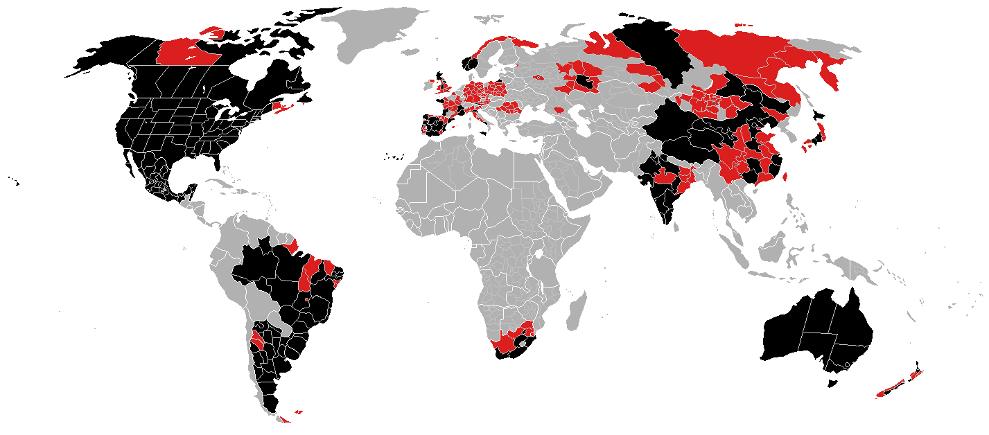
“Demics”
Endemic: found in a particular geographic region
Epidemic: abrupt and unexpected increase in the incidence of disease over endemic rates
Pandemic: spread of disease beyond continental boundaries

Slide 113
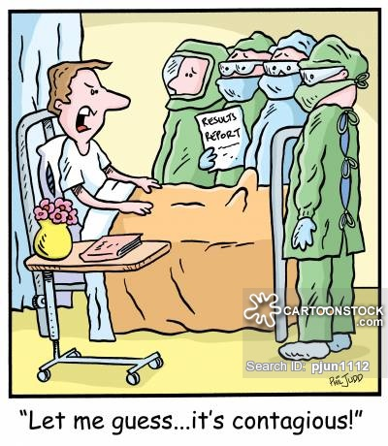
Infections

Slide 114
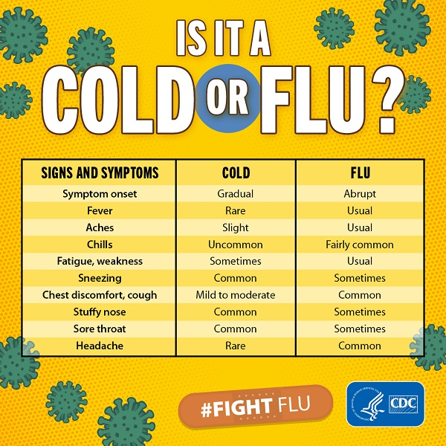
How to tell cold from influenza or “flu”
IN GENERAL, A FLU COMES ON FASTER & IS MORE OF A “FULL-BODY” SET OF SYMPTOMS
COLDS CAUSED BY RHINOVIRUSES, CORONAVIRUSES
- INFLUENZA CAUSED BY INFLUENZA VIRUS:
A : VARIETIES CAUSE SEASONAL FLUS & PANDEMICS SUCH AS H1N1
B: SEASONAL FLUS, MILDER ILLNESSES
C & D: LESS COMMON, LESS SEVERE

Slide 115
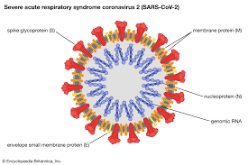
COVID & Coronaviruses
  - Coronaviruses are RNA Viruses
  7 human Coronaviruses have been discovered so far
  Range from mild to severe
  https://youtu.be/D9tTi-CDjDU
  MRNA Vaccine Development:
  https://youtu.be/XPeeCyJReZw

Slide 116
Streptococcus
GRAM +VE COCCI (SPHERES)
-LIVE ON BODY, IN MOUTH, NOSE & THROAT
-S.MUTANS ASSOC. WITH TOOTH DECAY, CAVITIES
GROUP A STREP CAN CAUSE STREP THROAT
USU. MORE PAINFUL THAN TYPICAL SORE THROAT, ENLARGED LYMPH NODES, WHITE PATCHES ON TONSILS/THROAT. CAN BE DIAGNOSED WITH A RAPID STREP TEST
SERIOUS POTENTIAL COMPLICATIONS OF STREP: MENINGITIS, RHEUMATIC FEVER (CAN AFFECT JOINTS OR HEART VALVES), KIDNEY DAMAGE
HTTPS://YOUTU.BE/ATCSWZFAWT4

Slide 117

Staphlococcus aureus
-GRAM +VE
-ROUND SHAPED (COCCI)
-FOUND ON HUMAN SKIN: ARMPITS, GROIN AND IN THE NOSE
-CAN CAUSE FOLLICULITIS, IMPETIGO, MIDDLE EAR INFECTIONS, MASTITIS (MILK DUCTS)
CAN ALSO BE RESPONSIBLE FOR MORE SERIOUS INFECTIONS: PNEUMONIA, SEPTIC ARTHRITIS, TOXIC SHOCK SYNDROME
HTTPS://YOUTU.BE/DKWFVQ0QHHS

Slide 118
Antibiotic Resistant Infections

Slide 119
MRSA Infections
Methicillin-resistant Staphylococcus aureus (MRSA) infection
  caused by a strain of staph bacteria that's become resistant to many antibiotics
Most MRSA infections occur in people who've been in hospitals or other health care settings. it's known as health care-associated MRSA (HA-MRSA).
  associated with invasive procedures or devices, such as surgeries, intravenous tubing or artificial joints.
Another type of MRSA infection has occurred in the wider community — among healthy people. Community-associated MRSA (CA-MRSA), often begins as a painful skin boil. It's spread by skin-to-skin contact.

Slide 120
Symptoms
Generally start as small red bumps that resemble pimples, boils or spider bites
Can quickly turn into deep, painful abscesses that require surgical draining
Bacteria can remain confined to the skin, can also burrow deep into the body, causing potentially life-threatening infections in bones, joints, surgical wounds, the bloodstream, heart valves and lungs
Warm to the touch
Full of pus or other drainage
Accompanied by a fever

Slide 121
Cause
Different varieties of Staphylococcus aureus bacteria, commonly called "staph," exist. Staph bacteria are normally found on the skin or in the nose of about one-third of the population. The bacteria are generally harmless unless they enter the body through a cut or other wound, and even then they usually cause only minor skin problems in healthy people.
According to the CDC less than 2 percent of the population carries the type of staph bacteria known as MRSA.

Slide 122
Risk factors for HA-MRSA
Being hospitalized. MRSA remains a concern in hospitals, where it can attack those most vulnerable — older adults and people with weakened immune systems.
Having an invasive medical device. Medical tubing — such as intravenous lines or urinary catheters — can provide a pathway for MRSA to travel into the body.
Residing in a long-term care facility. MRSA is prevalent in nursing homes. Carriers of MRSA have the ability to spread it, even if they're not sick themselves.

Slide 123
Risk factors for CA-MRSA
IV Drug Use/ Needle Sharing
Living in crowded or unsanitary conditions. Outbreaks of MRSA have occurred in military training camps, child care centers and jails.
Participating in contact sports. MRSA can spread easily through cuts and abrasions and skin-to-skin contact.
Men having sex with men. Homosexual men have a higher risk of developing MRSA infections.

Slide 124
Complications
MRSA infections can resist the effects of many common antibiotics, so they are more difficult to treat. This can allow the infections to spread and sometimes become life-threatening.
MRSA infections may affect the:
  Bloodstream
  Lungs
  Heart
  Bones
  Joints

Slide 125
Preventing HA-MRSA
In the hospital, people who are infected or colonized with MRSA often are placed in isolation as a precaution to prevent the spread of MRSA. Visitors and health care workers caring for people in isolation may be required to wear protective garments and must follow strict hand hygiene procedures. Contaminated surfaces and laundry items should be properly disinfected.

Slide 126
Preventing CA-MRSA
Wash hands. Careful hand-washing remains the best defense against germs. Scrub hands briskly for at least 15 seconds, then dry them with a disposable towel and use another towel to turn off the faucet. Carry a small bottle of hand sanitizer containing at least 62 percent alcohol for times when you don't have access to soap and water.
Keep wounds covered. Keep cuts and abrasions clean and covered with sterile, dry bandages until they heal. The pus from infected sores may contain MRSA, and keeping wounds covered will help keep the bacteria from spreading.
Keep personal items personal. Avoid sharing personal items such as towels, sheets, razors, clothing and athletic equipment. MRSA spreads on contaminated objects as well as through direct contact.
Shower after athletic games or practices. Shower immediately after each game or practice. Use soap and water. Don't share towels.
Sanitize linens. If you have a cut or sore, wash towels and bed linens in a washing machine set to the hottest water setting (with added bleach, if possible) and dry them in a hot dryer. Wash gym and athletic clothes after each wearing.
https://youtu.be/F-aqHhXeipo

Slide 127
Vancomycin-resistant Staph aureus/Vancomycin intermediate Staph aureus (VRSA/VISA)
Vancomycin intermediate Staphylococcus aureus (also called VISA) and Vancomycin-resistant Staphylococcus aureus (also called VRSA) are specific types of antimicrobial-resistant bacteria. Persons who develop this type of staph infection may have underlying health conditions (such as diabetes and kidney disease), tubes going into their bodies (such as catheters),previous infections with methicillin-resistant Staphylococcus aureus (MRSA) and recent exposure to vancomycin and other antimicrobial agents.

Slide 128
What are the signs and symptoms of a VRSA infection?
The signs and symptoms depend on where an infection is located. The patient may have any of the following:
  Red, warm skin around a wound
  Soreness, swelling, and drainage from a wound
  Fever, chills, and body aches
  Weakness
  Cough

Slide 129
How do we prevent the spread of VRSA?
Wash the hands often. Use soap and water. Wash the hands after using the bathroom, change diapers, or sneeze. Wash the hands before preparing or eating food.
Keep the wound clean and covered with a bandage until it is healed, or as directed.
Do not share items, such as eating utensils, brushes, or keys, with others.
Clean surfaces well. Use germ-killing cleaner when you clean surfaces, such as counters, doorknobs, or sink faucets. Ask which cleaner is best to kill VRSA bacteria.
Wash contaminated laundry with hot water and soap in the washing machine. Dry them in clothes dryer on the hot setting.

Slide 130
Helicobacter Pylori
(H. pylori) is a type of bacteria. These germs can enter your body and live in your digestive tract. After many years, they can cause sores, called ulcers, in the lining of the stomach or the upper part of the small intestine. For some people, an infection can lead to stomach cancer.
Infection with H. pylori is common. About two-thirds of the world’s population has it in their bodies. For most people, it doesn’t cause ulcers or any other symptoms. There are medicines that can kill the germs and help sores heal.
As more of the world gets access to clean water and sanitation, fewer people than before are getting the bacteria. With good health habits, we can protect ourselves and our children from H. pylori.
https://youtu.be/HO9sAUctPEI

Slide 131
How H. pylori Makes You Sick
For decades, doctors thought people got ulcers from stress, spicy foods, smoking, or other lifestyle habits. But when scientists discovered H. pylori in 1982, they found that the germs were the cause of some stomach ulcers.
https://youtu.be/HP6Zf1ff7Sw
After H. pylori enters the body, it attacks the lining of the stomach, which usually protects the stomach from the acid the body uses to digest food. Once the bacteria have done enough damage, acid can get through the lining, which leads to ulcers. These may bleed, cause infections, or keep food from moving through the digestive tract.
We may get H. pylori from food, water, or utensils. It’s more common in countries or communities that lack clean water or good sewage systems. We may also pick up the bacteria through contact with the saliva or other body fluids of infected people.

Slide 132
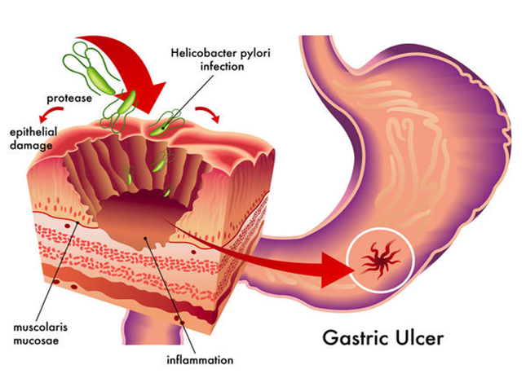
H. PYLORI
Many people get H. pylori during childhood, but adults can get it, too. The germs live in the body for years before symptoms start, but most people who have it will never get ulcers. Doctors aren’t sure why only some people get ulcers after an infection
https://youtu.be/jX7nbfClY-w

Slide 133
Symptoms
If a person has an ulcer, he may feel a dull or burning pain in his belly. It may come and go, but he’ll probably feel it most when his stomach is empty, such as between meals or in the middle of the night. It can last for a few minutes or for hours. He may feel better after he eats, drinks milk, or takes an antacid.
Other signs of an ulcer include:
  Bloating
  Burping
  Not feeling hungry
  Nausea
  Vomiting
  Weight loss for no clear reason

Slide 134
ULCERS
Ulcers can bleed into the stomach or intestines, which can be dangerous to the health. Other symptoms which may indicate a serious problem include:
Stool that is bloody, dark red, or black
Trouble breathing
Dizziness or fainting
Feeling very tired for no reason
Pale skin color
Vomit that has blood or looks like coffee grounds
Severe, sharp stomach pain

Slide 135
ULCER -> CANCER
It’s not common, but H. pylori infection can cause stomach cancer. The disease has few symptoms at first, such as heartburn. Over time, the person may notice:
Belly pain or swelling
Nausea
Not feeling hungry
Feeling full after you eat just a small amount
Vomiting
Weight loss for no reason
https://youtu.be/asfPabKR5PE

Slide 136
Diagnosis
Medicines like non-steroidal anti-inflammatory drugs (NSAIDs) can also damage the stomach lining, so it’s important to find out what’s causing the symptoms so the patient can get the right treatment.
• Tests of the blood and stool, which can help find an infection
• Urea breath test. The patient will drink a special liquid that has a substance called urea. Then he’ll breathe into a bag, which his doctor will send to a lab for testing. If the patient has H. pylori, the bacteria will change the urea in his body into carbon dioxide, and lab tests will show that his breath has higher than normal levels of the gas.

Slide 137
IMAGING
Also the doctor may use:
Upper gastrointestinal endoscopy. In a hospital, a doctor will use a tube with a small camera, called an endoscope (Gastroduodenoscopy), to look down the throat and into the stomach and the upper part of the small intestine (Duodenum). The patient may be asleep or awake during the procedure, but some medicine usually given to make the patient more comfortable.
Upper GI tests (Barium meal). In a hospital, the patient will drink a liquid that has a substance called barium, then an abdominal X-ray taken. The fluid coats the oesophagus, stomach and duodenum and makes them stand out clearly on the image.
Computed tomography (CT) scan. It’s a powerful X-ray that makes detailed pictures of the inside of the body.

Slide 138
Treatment for H. pylori
If a person has ulcers caused by H. pylori, he’ll need treatment to kill the germs, heal the stomach lining, and keep the sores from coming back. It usually takes 1 to 2 weeks of treatment to get better.
Doctors will probably advise the patient to take Triple Therapy : 2 antibiotics – Clarithromycin, Amoxicillin &/or Metronidazole PLUS a Proton Pump Inhibitor (one type of acid reducer) such as Omeprazole (Losec/Prilosec)
Treatment could mean patient will take 14 or more pills per day for a few weeks, which seems like a lot of medicine. If the patient doesn’t take antibiotics the right way, bacteria in his body can become resistant to them, which makes infections harder to treat.
About a month after the treatment, the doctor may test the breath or stool again to make sure the infection is gone.

Slide 139

The End

