Slide 1
Sacroiliac joint
474

Slide 2
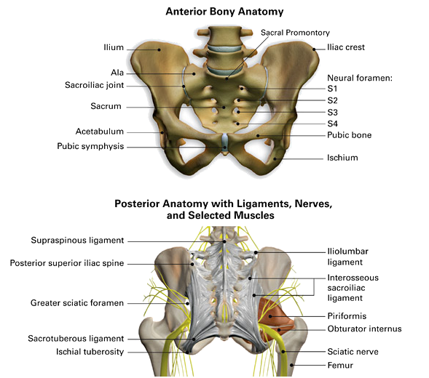
The sacroiliac or SI joint is the joint connection between the spinal column and the pelvis. It is a large joint made up of the sacrum and the two innominates of the pelvis. Each innominate is formed by the fusion of the three bones of the pelvis: the ilium, ischium, and pubic bone. Sprins to the si occur in 10%-33% of the population.

Slide 3
Function of the spinal column
To carry and support the thoracic cage
To provide attachment sites for the shoulder and pelvic girdle muscles
To anchor the muscles that move the spine and support the trunk
Surround and protect the spinal cord
Absorb shock
It’s flexibility allows the spine to produce and transmit forces

Slide 4
Function of the pelvis
To surround and protect pelvic organs
Support body weight and transmit it through the femurs in standing or the ischial tuberosities in sitting
To rotate side to side in walking
To provide muscle attachment sites
To provide bony support to the birth canal

Slide 5
Motion
The main function of the SI joint is to provide stability and transmit forces to the lower extremities. The strong ligamentous system of the joint makes it better designed for stability and limits the amount of motion available.

Slide 6
Nutation
Occurs as the sacrum tips anteriorly while the coccyx moves posteriorly relative to the ilium. This is the most stable position for the sacrum and the most efficient position for transferring load. Nutation is opposed by the wedge shape of the sacrum, the ridges and depression of the articular surfaces and the friction of the joint surface. This position tightens the interosseous, and sacrotuberous ligaments that are also supported by muscles that insert into the ligaments.

Slide 7
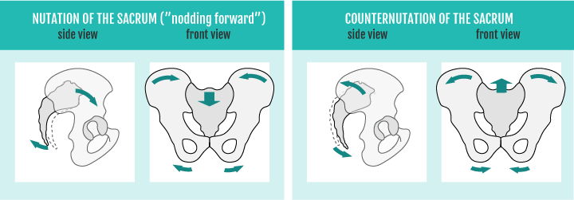
Counternutaion
Occurs as the sacrum tips posteriorly while the coccyx moves anteriorly relative to the ilium. This motion is opposed by the posterior sacroiliac ligament that is supported by the multifidus. This motion allows for appropriate mobility of the lumbo-pelvic region. It tightens the long dorsal sacroiliac ligament.

Slide 8
Joints of the pelvis
Sacroiliac – synovial and fibrous
-becomes more fibrous with age
Sacrococcygeal – secondary cartilaginous joint
-only flexion & extension available
-movement declines with age
Symphysis Pubis – secondary cartilaginous joint
-no movement except during pregnancy

Slide 9
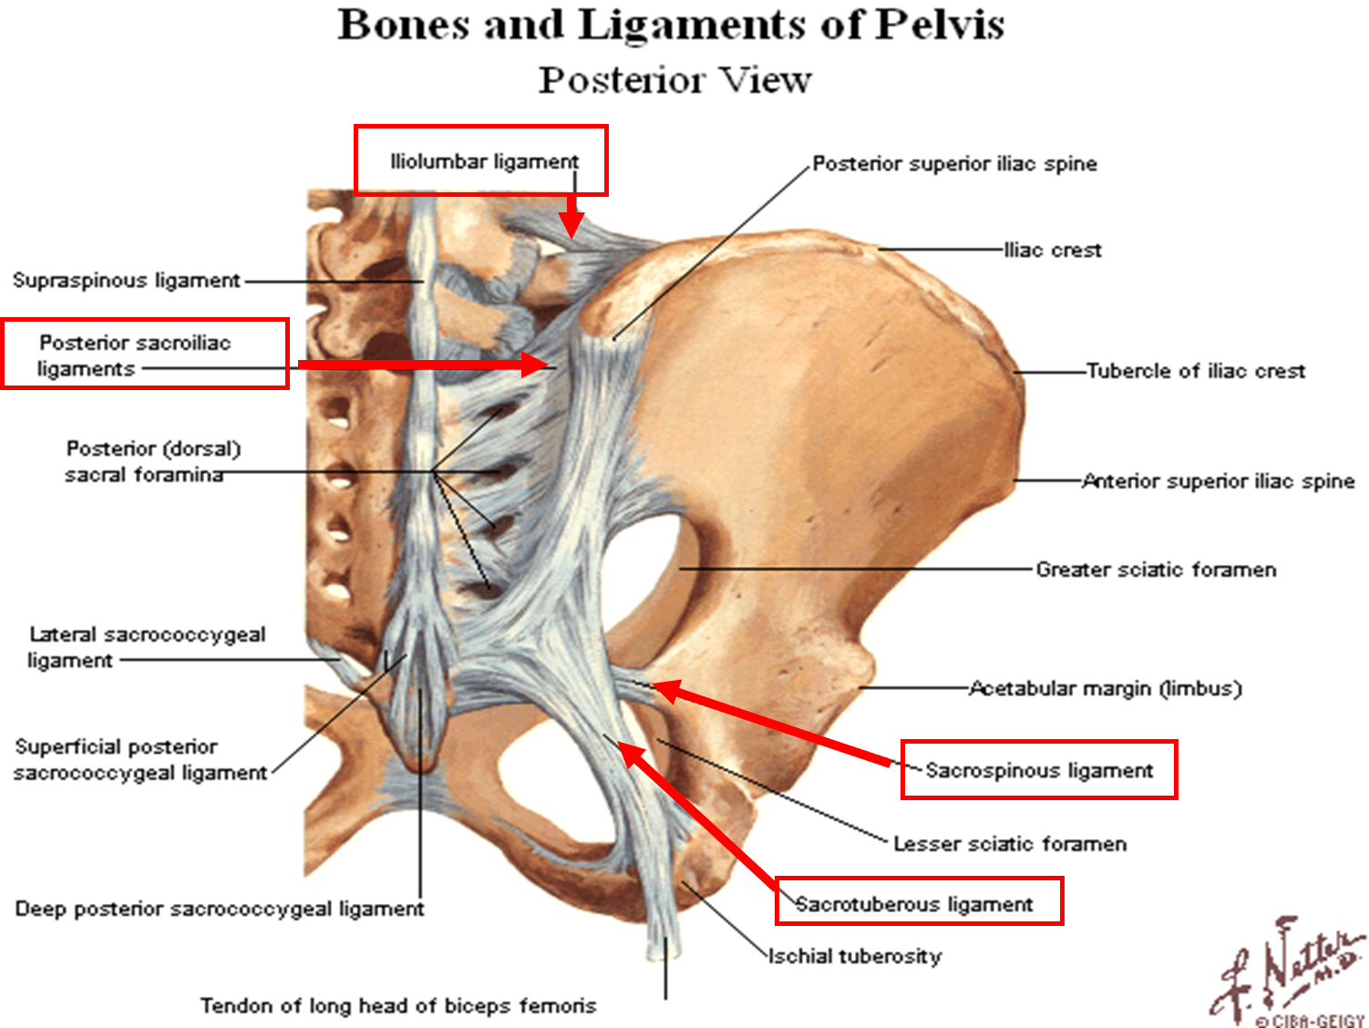
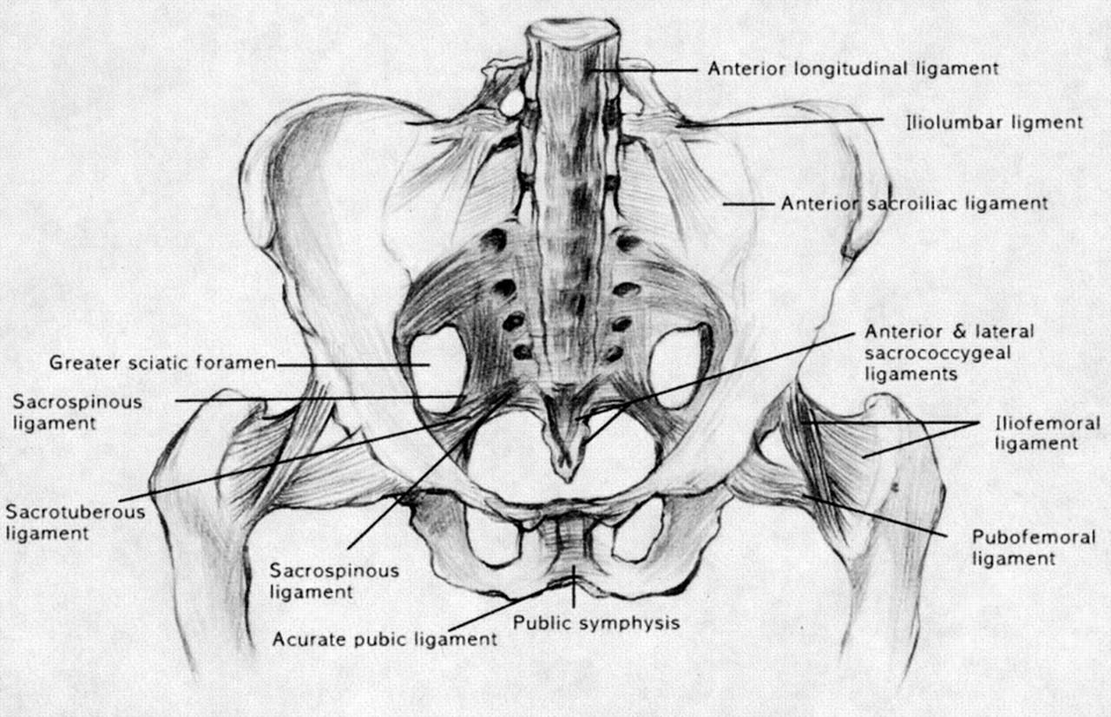
ligaments

Slide 10
The ligaments stabilizing the SI joint are the strongest ligaments in the body. They are as follows:
Anterior Sacroiliac
Anteroinferior thickening of the fibrous capsule that is weak and thin when compared to other ligaments of the joint.
Connects third sacral ligament to lateral side of the preauricular sulcus and is better developed closer to PSIS.
Is injured most often and is a common source of pain because of its thinness.
Interosseus Sacroiliac
Forms the major connection between the sacrum and the innominate and is a strong, short ligament deep to the posterior sacroiliac ligament.
It resists anterior and inferior movement of the sacrum.

Slide 11
Posterior (Dorsal) Sacroiliac
Connects PSIS with the lateral crest of the third and fourth segments of the sacrum and is very strong and tough.
Nutation slackens the ligament.
Counternutation will make the ligament taut.
Can be palpated directly below the PSIS and can often be a source of pain.
Sacrotuberous
Consists of three large fibrous bands and is blended with the posterior (dorsal) sacroiliac ligament.
It stabilizes against nutation of the sacrum and counteracts against posterior and superior migration of the sacrum during weight bearing.

Slide 12
Sacrospinous
Triangular shaped and thinner than the sacrotuberous ligament
Goes from the ischial spine to the lateral parts of the sacrum and coccyx and then to the ischial spine laterally.
Along with the sacrotuberous ligament, it opposes forward tilting of the sacrum on the innominates during weight bearing.

Slide 13
Local stabilizers
Transverse Abdominis
Lumbar multifidus
Pelvic Floor
Diaphragm

Slide 14
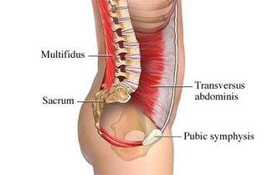
The TA
Stabilizes by aiding in increasing intra abdominal pressure
Tensions the thoracolumbar fascia and abdominal aponeurosis
Compresses the SI joint

Slide 15
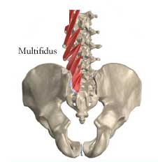
The lumbar multifidus
Creates compression across SI joint
Nutates sacrum
Tenses thoracolumbar fascia
Helps maintain lumbar lordosis
Controls fine movements of each lumbar segment

Slide 16
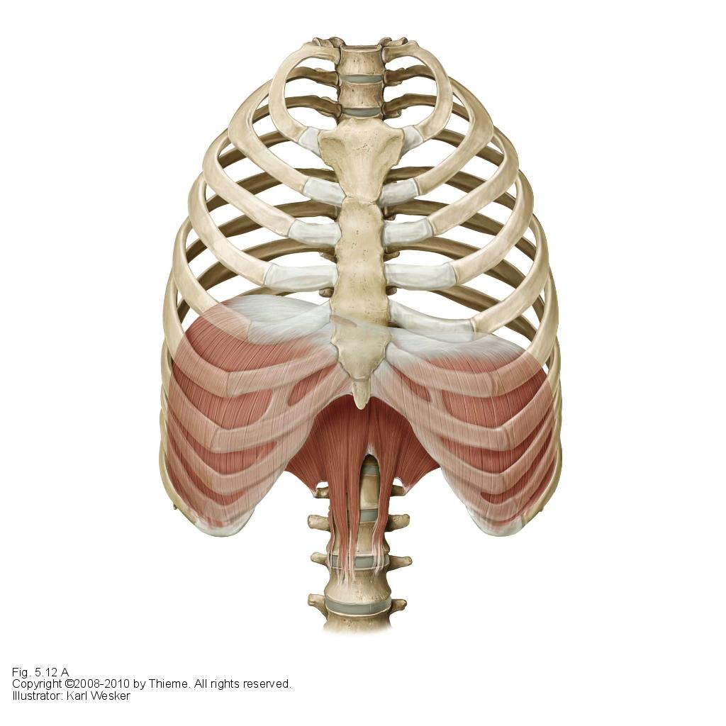
The diaphragm
Aids in increasing intra abdominal pressure

Slide 17
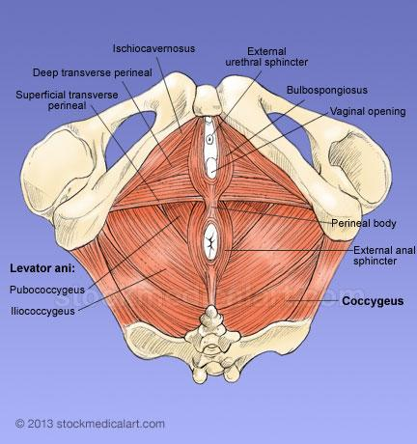
The pelvic floor
Aids in increasing intra abdominal pressure
Hypothesized to co-activate with TA to help prevent shearing at pubic symphysis
Cueing the Pelvic floor will aid most clients in activating their TA
Look at the glute formation as an indication if the pelvic floor is tight upside down heart good, right side up heart not so good

Slide 18
Global stabilizers
Posterior Oblique System (Posterior Sling)
Deep Longitudinal System
Anterior Oblique System (Anterior Sling)
Lateral System

Slide 19
The Posterior sling consists of the Latissimus Dorsi, the contralateral gluteus maximus and the intervening thoracolumbar fascia. It can compress the SI joint and help with load transfer during rotation and gait. If this sling is not firing properly, the body will tend to slump forward, as the anterior sling will take over.

Slide 20
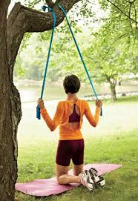
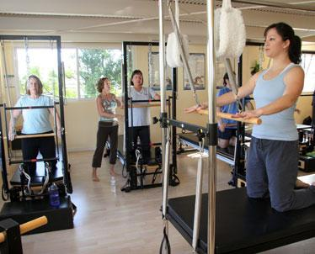
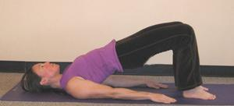
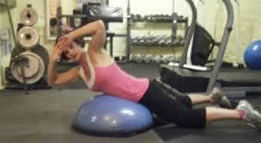
Exercise examples
Lat pull downs with band
Lat press on pilates reformer
Bridging
Prone spinal rotation on bosu (can be done on ball)

Slide 21
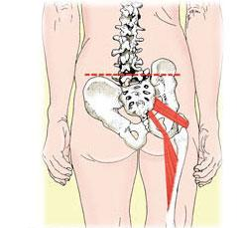
The Deep Longitudinal System consists of the peroneii, biceps femoris, the sacrotuberous ligament, the deep lamina of the thoracolumber fascia and the erector spinae. By increasing tension on the thoracolumbar fascia, this system helps compress the SI joint. Biceps Femoris can contribute to nutation because of its connection to the sacrotuberous ligament

Slide 22
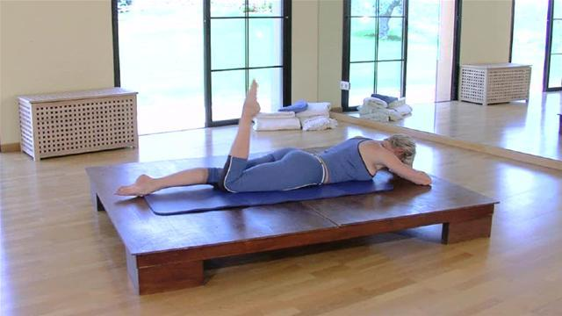
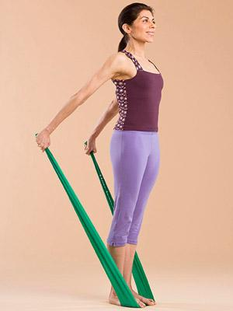
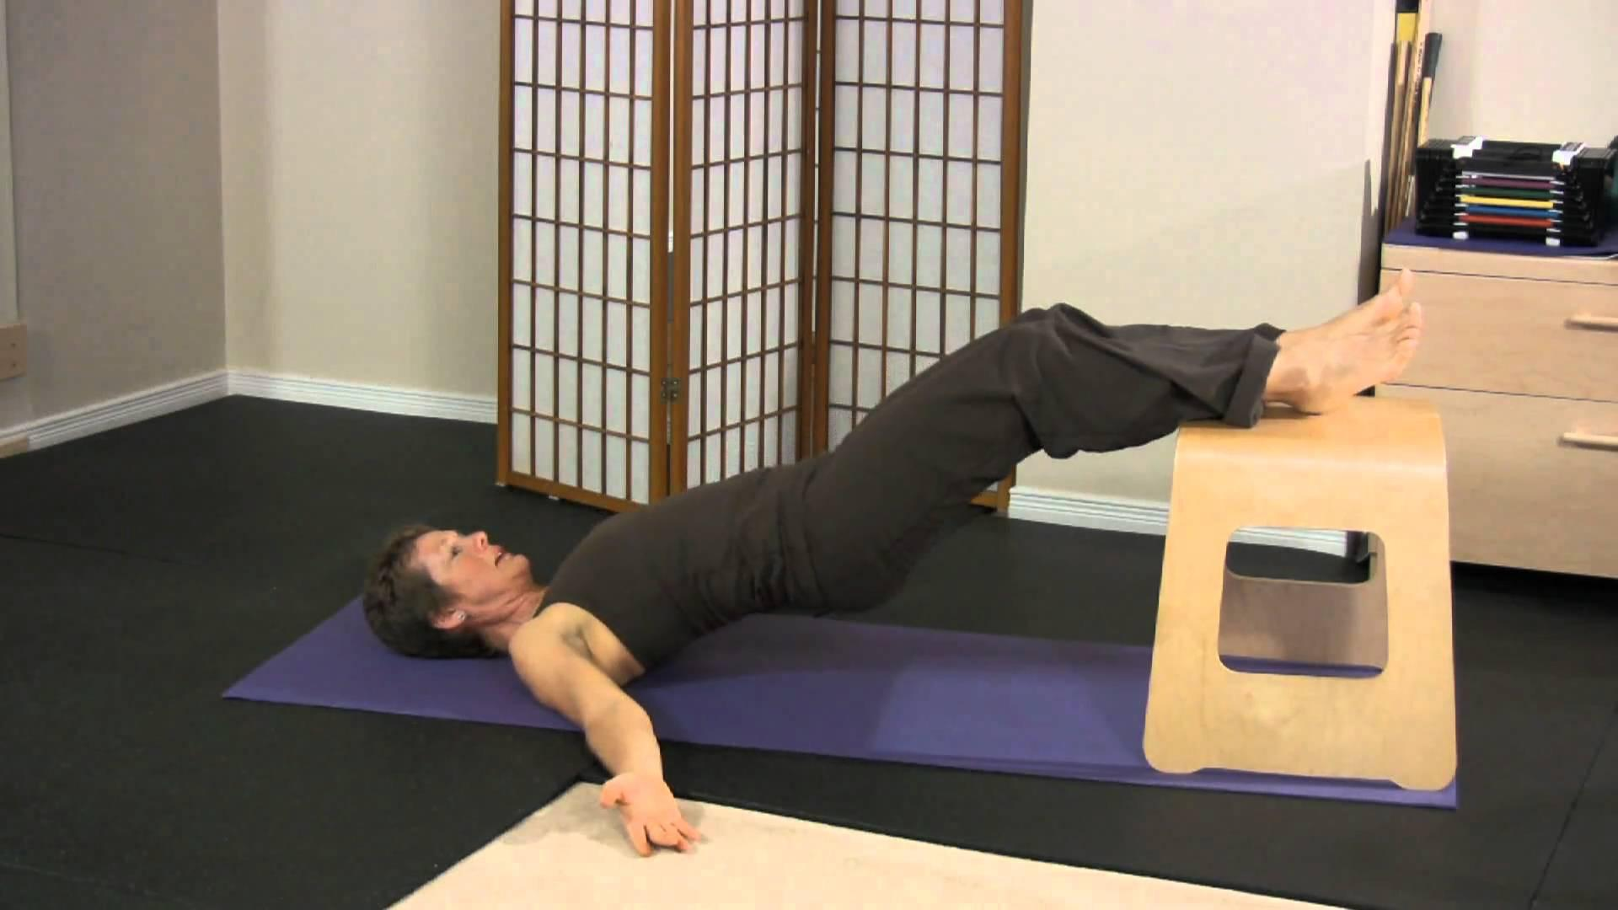
Exercise examples
One Leg Kick
-Pulse the foot toward the buttock,
alternating between plantar and dorsifelexion
Chest Expansion
Hip raises

Slide 23
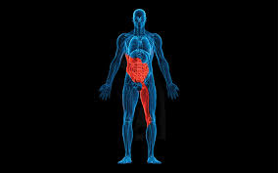
The Anterior Sling consists of the internal and external obliques, the contralateral adductors and the intervening abdominal fascia. These muscles support the front of the pelvis and the symphysis pubis. They work to transfer force connections from the soles of the feet to the spine.

Slide 24
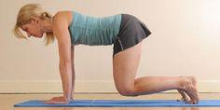
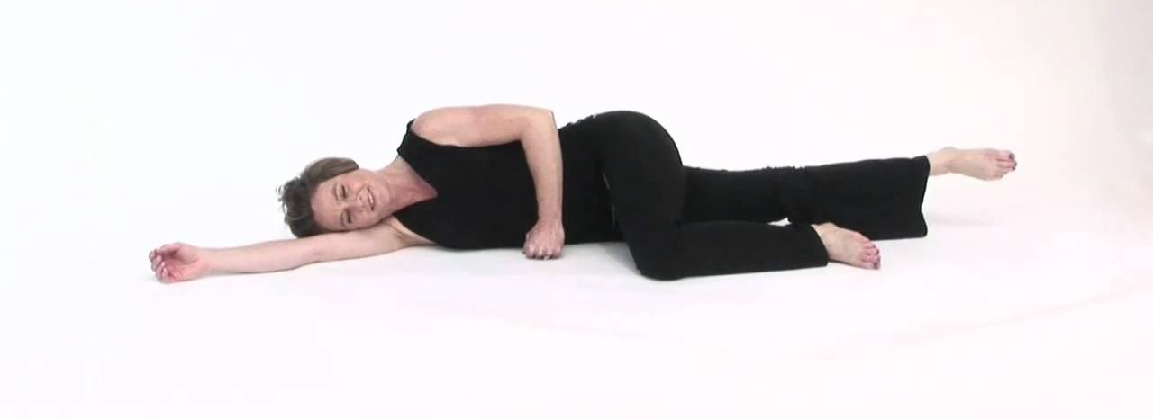
Exercise examples
Knee Lift with small space Side-Lying Adductor Lift
between knees
You can also employ exercises already discussed in other lectures, such as the Supine Bend & Stretch with a band. With one leg in a 90° tabletop position, place a band around the sole of the foot, holding the ends in your hands, elbows anchored next to body. Exhale to gently compress the abdomen as you push into the band to extend the leg and resist the pull of the band to return to tabletop.

Slide 25
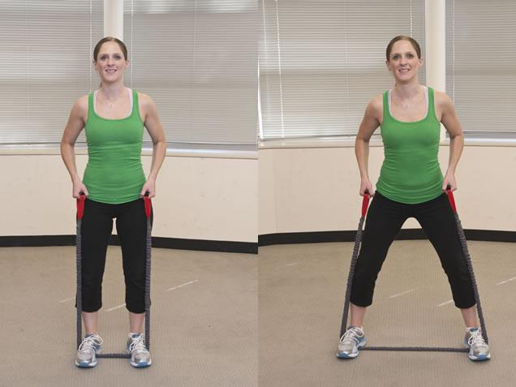
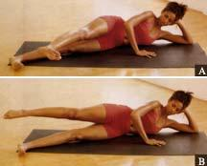
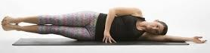
The Lateral System consists of the gluteus medius & minimus, the tensor fascia latae and the contralateral adductors. These muscles all assist in keeping the pelvis stable during weightbearing and gait.
Exercise Examples:
Side-stepping on a band
You can also include lateral exercises from the Hip Lecture, such as Clamshell and Side leg lifts. You could also add double leg lifts and leg swings if they are strong.
Double leg lift - watch that obliques support Leg Swings – best to rest head on
on bottom side and pelvis doesn’t hike. pillow. Can bend bottom leg for
additional support.

Slide 26
Global mobilizers
Rectus abdominus
Hamstrings
Iliocostalis
QL
TFL
Adductor longus
Gracilis
Rectus femoris
Latissimus dorsi

Slide 27
Optimal function of lumbo-pelvic region
Local and global stabilizers work together to provide stability without creating postural rigidity or allowing for collapse
Inner and outer work together to create stability and efficient mobility
If any particular system is out of balance, firing patterns and motor control may be compromised
For movement to be functional and controlled, adequate muscle strength and endurance is required, along with the proper firing sequence by the nervous system
Idea alignment of this region has the ASIS and pubic symphysis in a vertical plane in standing, and a horizontal plane in supine. The lumbar spine has a neutral curve and the ASIS and PSIS are approximately level in a horizontal plane. The hip joint should be in neutral alignment. Ideally, there would be symmetry, both muscular and bony, between the sides with no spinal rotation or lateral flexion and no pelvic tilt or rotation.

Slide 28
Dysfunctions of the lumbo-pelvic region
Nerve impingement
SI joint dysfunction
Degenerative conditions of the spine
Facet syndrome
Spinal stenosis
Spondylolysis & Spondylolisthesis
Instability
Degenerative disc disease
Herniated disc
Osteoarthritis
Spinal fusions

Slide 29
Nerve entrapment
Usually involves Sciatic nerve or Obturator nerve. Sciatic entrapment results in sensation along lateral and posterior parts of the leg and the dorsal and plantar surface of the foot, along with possible weakness of the leg muscles and foot. Obturator entrapment usually results in sensation along medial aspect of the thigh with possible adductor weakness.
Avoid painful movements that could cause a flare
Strengthen surrounding structures, especially lateral hip if weak

Slide 30
SI joint dysfunction
Usually result of stress on surrounding tissues. Joint itself can be painful during pregnancy, which can be alleviated with support like tape or an SI belt.
Focus on low load, closed chain exercise in non-weightbearing positions where possible. Address any muscle imbalances and ensure core is working.

Slide 31
Degenerative conditions
Due to facet joint synovitis (loss of fluid,) hypermobility and/or progressive degeneration due to age and poor biomechanics causing repeated microtrauma.
Avoid extension, rotation and any combination of the two. Avoid flexion combined with rotation and allow only minor flexion.

Slide 32
Facet joint syndrome
The first stage of the degenerative cycle involving inflammation of the joint capsule. Symptoms include LBP with inactivity and radiating symptomology due to nerve impingement.
Flexion is most comfortable as it opens the joints and separates the facets
Recumbent bikes are better than treadmills
Will likely do imprinted position as opposed to neutral
Place a pillow under the hips for prone
Work toward a neutral position over time
If eventually reintroducing rotation and extension, it must be slow and controlled
Try a cat stretch, flexion to neutral only, no extension
Try a small hip roll (start rolling pelvis up towards a bridge, but very small range. Barely off the mat.)

Slide 33
Spinal stenosis
Is either acquired or congenital and involves a narrowing of the spinal canal causing impingement of the nerves. This is usually caused by disc degeneration, arthritis or subluxation. Symptoms tend to be vague and often present in weightbearing and are relieved by sitting.
Flexion is likely most comfortable as it opens the spine giving more room for neural supply
Some clients may never be able to work in neutral, begin in imprint
If able to eventually introduce rotation and extension, must be slow and controlled
Ab prep in imprint with supported legs, seated rowing with straight arms and bent arms using a band around the knees

Slide 34
Spondylosis and spondylolisthesis
Spondylolysis is a hairline fracture of the body of the vertebra. Spondylolisthesis is forward slippage of one vertebrae on another and is a progression of the spondylolysis. Symptoms are pain in changing position and pain is usually localized.
Avoid painful positions, generally extension
Emphasize segmental control
Use low load to strengthen multifidus
Work towards neutral, but will need flexion for a long time
May be able to eventually introduce rotation and extension, but slow and controlled
Leg slides, side-lying leg work, back rowing seated with band

Slide 35
Spinal instability
Also known as mechanical low back pain. Poor segmental control in varying planes of motion. Symptoms are pain with position changes and poor endurance in static positions, especially sitting.
Work on segmental control
Focus on neutral
Begin in closed chain with short levers
No rotation in the direction of the instability
Work towards achieving function in all planes of motion

Slide 36
Degenerative disc
End stage of overuse, instability, muscles strain and ligament sprain. Fluid content decreases and the discs begin to change from gelatinous to fibrocartilaginous. The disc spaces narrow and the ligaments slacken. Symptoms are pain or rising and pain may radiate to lower extremities.
Focus on segmental control
Work in neutral as much as possible
Avoid long levers, rotation and open chains at first
Ab prep with supported legs
Breast stroke prep (thoracic extension prone)
4-point swimming

