Slide 1
Review 1

Slide 2
Stages of Healing…
Acute
Early SubAcute
Late SubAcute
Chronic
What are some important points to remember?
  Timelines are not set in stone
  Severity of injury/trauma will determine timeline
MOST IMPORTANT THING TO REMEMBER ABOUT HEALING??
Notes:
MOST IMP THING? Do not break the cycle! Once the cycle is broken, it must start again! Meaning… ACUTE stage – be very very careful.

Slide 3
Contusion pg. 265 Rattray
Def’n?
  Crush injury to a muscle
W or W/O hematoma?
  Area of local hemorrhage – pooling of blood causing swelling and P
Myositis ossificans – calcifications form as a complication of the hematoma
Causes are endless
Conditions to highlight?
What principle of massage is most prevalent with contusions?
Tx Highlights?

Slide 4
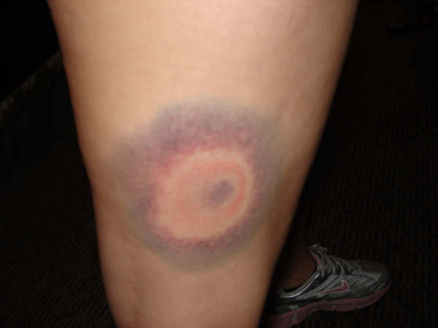

Slide 5
Spasm pg 193
Def’n
Involuntary, sustained contraction of a muscle
“cramp” common – lay term for a painful, prolonged muscle spasm
Reflex mm guarding – present in acute stage – FUNCTIONAL SPLINT
DO NOT REMOVE in acute stage!
DO NOT Passive Stretch mm.
No hot hydro – WHY?
Goal of tx – to not completely remove spasm, but decrease it, to decrease P
Agonist contraction – gastroc spasm
GTO
O’s & I’s
MM approximation

Slide 6
GTO Release pg 38
What is GTO?
Proprioceptive nerve receptors located in the musculotendinous junction
Detect “load” placed on tendon
Protective reflex to prevent mm injury or rupture
Most effective on long tendons that are easily palpable. Examples?
Technique; hold for a min of 30 seconds, or until mm relaxes.
C or s bow can be used
Rate = slow
Pressure = mod to deep
Effects; decrease mm tone and spasm
CI’s = any local acute condition, local pain, hypotonic/atonic mm’s, fragile tissue, CT pathologies, skin lesions

Slide 7
O’s & I’s pg. 39
Uses : same as GTO, utilizes musculotendinous junction to dec hypertonicity
If muscle belly is painful
Makes tx more effective
If some tendonitis is present, can be painful
Technique – gentle kneading (thumb or fingertips) depending on muscle
CI’s – same as GTO
Another notable technique : muscle approximation

Slide 8
Frictioning
Small, deep manipulation, rapid rate and rhythm, can be invasive, creates a small, controlled inflammatory response (chems released causing reorganization of CT)
Moves subcutaneous tissue
No medium
Do not slide over skin – can cause blistering
Not used for deep structures
Done for 1-2 mins, evoke an analgesic effect, 30 sec – 20 mins
Eff after
ice massage – CBAN
No frictioning in the acute stage
Uses: tendonitis, scars, post trauma (late sub – chronic) to prevent adhesions
CI’s – acute injury, RA, anti-inflamms, anti-coags, long term steroid med use, fragile skin

Slide 9
Manual Lymphatic Drainage pg 35
IF severe lymphedema is present – refer out!
Pitted edema test
Edema can be sign of what condition?
String
Takes a lot of time and patience
Slow rate, rhythmic, no medium, baby powder if hairy
Minimum 5-7 times, overlapping, unidirectional strokes
Principles of massage
Nodal pump

Slide 10
Myofascial Release pg 45
What is fascia?
Superficial – just below skin – loosely knit, mobile, potential to accumulate fluid
Deeper – denser, tighter, tougher, surrounds muscle and viscera
Subserous – loose areolar tissue covering viscera, supports organs, provides lubrication so the can slide against eachother
Assess – skin roll, glide, positional test - ?
Positional – passive – why? Fascial barrier before ligamentous, or capsular
What layer are you treating? This will determine depth
Enough stretch on fascia, hold for effectiveness – burn
Hyperemia

Slide 13
MFR Techs
Skin rolling
Crossed hand
Spreading
Cutting
Torquing
S/C bowing
J stroke

Slide 14
Tendinitis pg 431
Inflammation of a tendon
Cause: chronic overload of the tendon – microtearing and inflammatory response
Contributing factors: mm imbalance, poor biomechanics, lack of flexibility, poor blood supply, improper equipment, training errors
4 Grades of severity
Grade 1 – pain after activity
Grade 2 – pain before and after activity; goes away during
Grade 3 – pain before, during, and after, P may restrict activity
Grade 4 – pain with ADL’s
Tendinosis – degenerative changes occurring with chronic overuse tendon injuries, tennis elbow. Aging and lack of circ can be contributing factors

Slide 15
Common Locations for Tendinitis
SIS of SITS pg 433
Long head biceps tendon
Tennis elbow/golfer’s elbow
DeQeurvain’s tenosynovitis
Patellar
Achilles

Slide 16
Tx
Know your anatomy!
O’s and I’s
Treat the full muscle
Gentle passive movements/stretch
Dec TP’s, adhesions, HT
Proper Hydro
Maintain ROM
AIT

Slide 17
Selfcare for tendinitis

