Slide 1
General Principals of Remedial Exercise

Slide 2
Anatomical Planes
Based on 4 imaginary planes that intersect the body in the anatomical position
Sagittal Plane
  The vertical plane passing longitudinally though the body
  Divides the body into right and left halves
  Mid-Sagittal Plane divides the body into equal right and left sides
  The plane intersects the midline of the anterior and posterior surfaces of the body
  Sometimes called midline
Para-Sagittal Plane
  Vertical plane passing through the body parallel to the sagittal plane
  This plane divides the body unequally into right and left sides, not at the midline.
  It is helpful to name the structure intersected when referring to a para-saggital plane (ie. Para-Saggital plane through midline of the right clavicle)

Slide 3
Anatomical Planes Continued
Frontal or Coronal Plane
  Vertical plane passing through the body at right angles to the median or sagittal plane
  Dividing the body into anterior and posterior parts
  A point of reference is helpful to indicate the position of the plane (ie. Frontal plane through the heads of mandible)
Transverse Plane
  Planes passing through the body at right angles to the median and frontal planes
  Dividing the body into superior and inferior parts
  It is helpful to give a reference point to identify the level of the plane (ie. transverse plane through umbilicus)

Slide 4
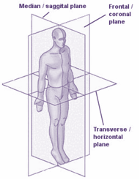
Anatomical Planes Continued

Slide 5
Axis of the Body
Tranverse – Travels left to right, rotation occurs around axis top to bottom. Intersects with Sagittal Plane. Flexion and Extension
Longitundinal– Travels top to bottom, rotation occurs around axis left and right. Intersects with transverse plane. Internal and External rotation
Sagittal - Travels front to back, rotations occurs around axis clockwise and counter clockwise. Intersects with the Frontal/Coronal Plane. Abduction and Adduction, Lateral Flexion
https://youtu.be/yq8cE-EDtuE

Slide 6
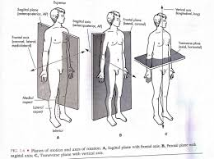
Axes and Planes
X
Z
Y

Slide 7
Movements in the Body
Active ROM
  Is movement of a segment within the unrestricted ROM that is produced by active contraction of the muscles crossing it
Passive ROM
  Is movement of a segment within the unrestricted ROM that is produced entirely by an external force
  There is little to no voluntary muscle contraction
  The external force may be from gravity, a machine, another individual or another part of the individuals own body

Slide 8
Continued
Active-Assisted ROM
  Is a type of active ROM in which assistance is provided manually or mechanically by an outside force because the prime mover muscles need assistance to complete the motion
End Feel
  Is the sensation transmitted at the very end of a joints range
  The quality of the end feel will depend on the joint and its condition

Slide 9
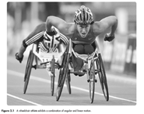
Types of Motion
Rotary Angular Motion
  Movement of an object around a fixed axis in a curved path
  Called rotary because every point on a segment adjacent to the joint follows the arc of a circle, the center of which is the joint axis

Slide 10
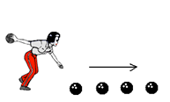
Continued
Translatory Linear Motion
  Movement of a body in which all its parts move in the same direction with equal velocity
  Occurs in a straight line

Slide 11

Continued
Curvilinear Motion
  Rotation of a linear object through space (throw a ball)
  Combination of rotation and gliding occurs at joint surfaces

Slide 12
Continued
General Plane Motion
  Type of curvilinear motion where the object is segmented and free to move rather than rigid or fixed
  Object rotates about an axis while the axis is translated in space by motion of an adjacent segment
• Ie. Person brings cup to mouth, the humerus is translating forward while the elbow is rotating the forearm/hand segment

Slide 13
Osteokinematics
These are motions that we see
Also known as physiological movements or normal movements
  Flexion/extension
  Abduction/Adduction
  Medial/lateral rotation
  Lateral flexion
  Circumduction

Slide 14
Directions of Motion
Flexion and Extension – occur in the sagittal plane around a coronal ( Transverse) axis
Abduction and Adduction – occur in the frontal plane around a Sagittal (Anteroposterior) Axis
Lateral Flexion – these motions occur in the frontal plane around a Sagittal (anteroposterior) Axis
Medial and Lateral Rotation – motion occurs in the transverse plane around a Longitudinal (vertical) axis

Slide 15
Arthokinematics
Definition –The study of the motions that occurs within joint spaces during bone movements. They are motions you can feel not see
These accessory motions take place with all active and passive motion and are required for full, pain free range of motion
These motions can not occur independently, or voluntarily and if restricted can limit normal movement
For the most part synovial joints in the body have a convex and concave relationship

Slide 16
Roll, Spin and Glide
Three primary motions occur in the joint space of a synovial joint are
  Roll
  Spin
  Glide/Slide

Slide 17
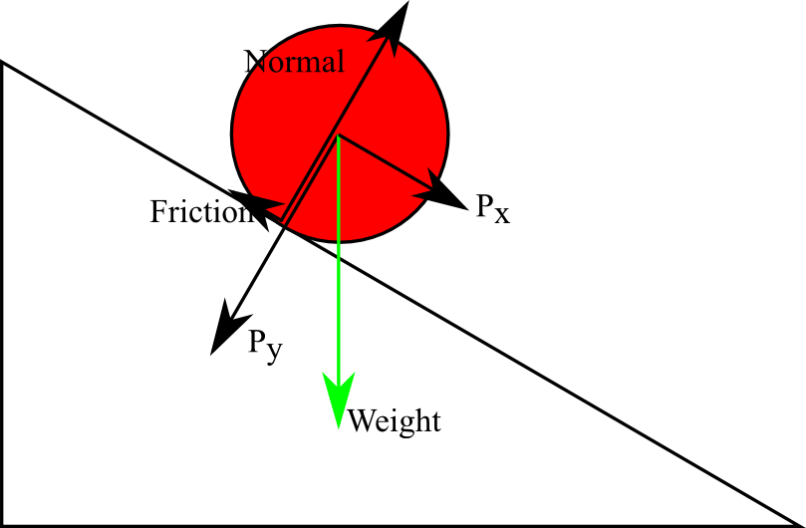

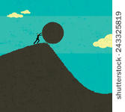
Roll
Roll – New points on one surface touch new points on another surface. An example is a car wheel or ball rolling along the ground. It only occurs when joint surfaces are incongruent.

Slide 18
Spin
Rotation where one point of contact spins in one stationary spot around a longitudinal axis, clockwise or counter clockwise. An example would be a tire losing traction

Slide 19
Glide/Slide
Translatory motion in which one constant point on one surface is making contact with new points on the other surface. Similar to a car tire braking and sliding along a surface. Also known as translation. Pure glides occur on congruent flat surfaces or congruent curved surfaces

Slide 20
Glide and Roll
https://youtu.be/PGF2B01qekY
Because no joint is completely congruent Glide and roll must occur together for all motions
Glide and roll occur simultaneously but are not necessarily proportionate
The more congruent the more glide
The more incongruent the more roll
https://youtu.be/XMzh37kwnV4

Slide 21
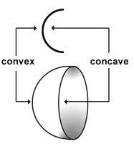
Convex/Concave
https://youtu.be/gz0aJWnZEJU
Convex – Male, rounded or arched, more cartilage in the centre
Concave – Female, hollowed or shallow, more cartilage on the edges

Slide 22
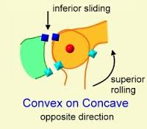
Convex on Concave Rule
When a Convex surface is moving on a stationary concave surface the motion of glide and roll occur in the opposite direction
Examples
  Glenohumeral joint

Slide 23
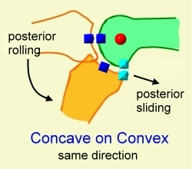
Concave on Convex Rule
When a concave surface moves on a stationary convex surface, Glide and Roll occur in the same direction
Example Tibofemoral joint

Slide 24
Open Chain Exercises
Exercise in which a distal segment of the body moves freely in space
Independent joint movements (no predictable motion in adjacent joints) – Usually but not always occurs at one joint
Muscle activation occurs predominantly in the prime mover and is isolated to muscles of the moving joint
Typically performed in non-weight bearing positions
Resistance is applied to the moving distal segment
External stabilization usually required (manually or with equipment)

Slide 25
Closed Chain Exercises
Exercise in which the distal end of the segment is fixed and proximal segment moves over the fixed part (ie. Squats )
Interdependent joint movements (relatively predictable movement patterns in adjacent joints)
Movement of body segments may occur distal and/or proximal to moving joint
Muscle activation occurs in multiple muscle groups, both distal and proximal to moving joint
Typically but not always performed in weight bearing positions
Resistance is applied simultaneously to multiple moving segments
Use of axial loading (Application of weight or force along the course of the long axis of the body.)
Internal stabilization by means of muscle action, joint compression and congruency and postural control

Slide 26
Open and closed chain Exercises
Continued
Both open and closed chain exercises should be incorporated into a good exercise or rehab plan
Most open chain exercises occur in the upper body, but not all, examples include
  Bicep curls
  Lateral raises
  Shoulder Pendulum swing
Closed Chain of the upper body examples include
  Push ups
  Ball stabilizations
  Forward Planks
Homework read about open and closed chain exercises in your text page 175 then pages 186-192, there will be an inclass reading assignment next class

Slide 27
Continued
Examples of Lower body open chain exercises include
  Knee curls or extensions
  Hip Abduction and ADDuction
Primarily used during rehab or in weightlifting to promote growth, lessens the chance of additional or incurring injury
Examples of lower body closed chain exercises include
  Squats
  Lunges
  Stairclimbing
Primarily used sport specific training and simulations of ADL’s during advanced rehab

Slide 28
Kinetics
Defintion - the branch of mechanics that deals with the actions of forces in producing or changing the motion of masses.

Slide 29
Components of Kinetics
Stability
  The stability of a mass depends on:
    Its weight
    The size of its base of support
    The height of its center of gravity above its base of support
    The location of the gravity line within the base of support

Slide 30
Continued - Force
Is a pull or push exerted by one material object or substance on another
External forces - gravity, wind, water, floor
Internal forces – muscles, ligaments, bones
Internal forces serve to counter-act those external forces that jeopardize the integrity of human joint structure

Slide 31
Continued – Centre of Gravity
Lies approximately anterior to the second sacral vertebra (In men, the center of gravity lies at or above the navel, while in women, it is located below the navel, close to the hips.)
Will change as the body moves or carries an object
Closer the center of gravity is to the base of support, the more stable the object
Center of gravity will shift toward the additional weight

Slide 32
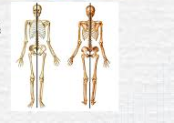
Continued – Line of Gravity
Plumb line
Plumb line should fall through the location of the center of gravity listed above

Slide 33
Newton’s Laws
Law of Inertia
  States that every body continues in its state of rest or persists in its state of motion in a straight line, unless it is compelled to change by external forces exerted upon it
Example - When walking hip flexors start to swing leg and hamstrings stop it. Muscle force needed to start action or change speed therefore less energy required to keep steady pace like a jog.

Slide 34
Law of Acceleration
States that the rate of change of momentum (acceleration of a body with a constant mass) is proportional to the force causing it and takes place in the direction in which the force acts.
** ACCELERATION is proportional to FORCE divided by MASS **

Slide 35
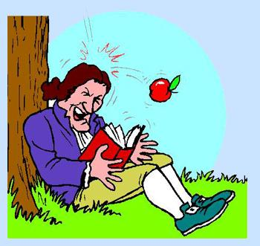
Law of Reaction
States that for every action there is an equal and opposite reaction

Slide 36


Law of Gravitation
States that any two particles attract one another with a force directly proportional to the product of their masses and inversely proportional to the square of the distance between them
This means that a greater force is required to move a large mass than a small one.
https://youtu.be/kKKM8Y-u7ds

Slide 37
Levers
“ FRE123”
The letters represent the center of the lever and the numbers represent the corresponding class of lever. Ie. Fulcrum in the centre=1st class lever. Resistance in the middle=2nd class.**
F = Fulcrum
R= Resistance (Often interchanged with the word Load)
E= Effort (often interchanged with the word Force)

Slide 38
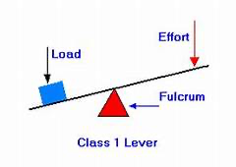
Definitions
Fulcrum – The support, or point of rest, on which a lever turns in a moving body (Dictionary.com)

Slide 39
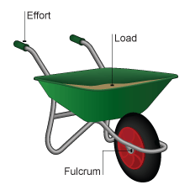
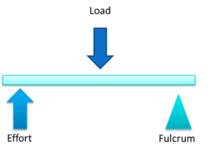
Resistance (Load)
Resistance – 1) The act of opposing, resisting or withstanding 2) The opposition, by one thing to another (dictionary.com)

Slide 40
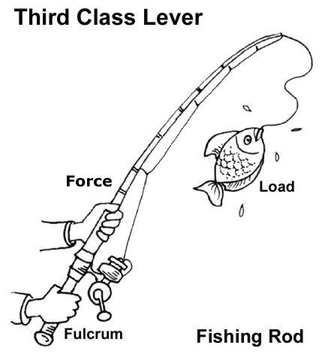

Effort
Effort – 1)Exertion of physical power 2) An earnest or strenuous attempt 3) Something done by hardwork or exertion (Dictionary.com)

Slide 41
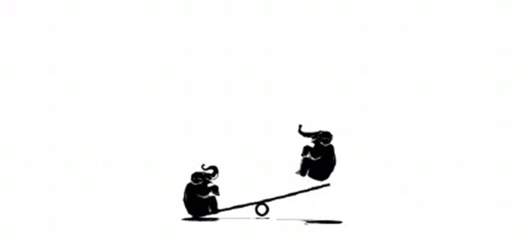
First Class Lever (See Saw)
F = 1 Fulcrum in the middle of Resistance and Effort
Very few in the human body
The fulcrum is located between the Effort and the Resistance
Exists whenever 2 resultant forces are applied on either side on an axis at some distance from that axis, creating rotation in opposite directions
Rotation of the lever will always occur in the direction exerted by the effort force (force attempting to cause motion)

Slide 42
First Class Lever Example
When the upper limb straightens at the elbow, the forearm bones again serve as the rigid bar, the hand as the resistance, and the elbow joint as the pivot. the triceps brachii supplies the Effort. A tendon of this muscle is attached to the olecranon process of the ulna bone at the point of the elbow. Since the parts of the lever are arranged resistance-Fulcrum-Effort, it is a first-class lever

Slide 43
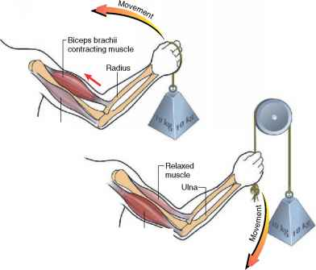
Tricep Example

Slide 44
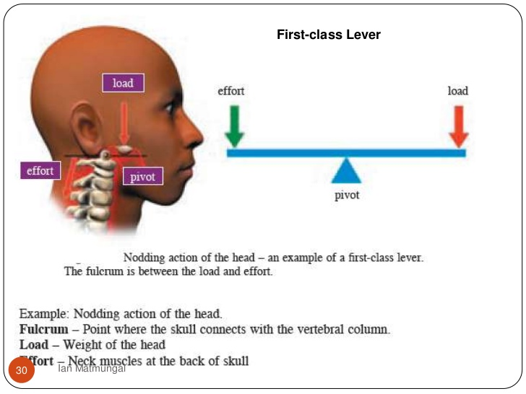
Other Examples
atlanto-occipital joint where head is balanced by neck extensor muscle force

Slide 45
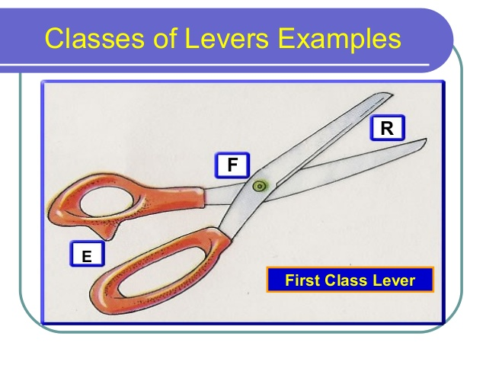
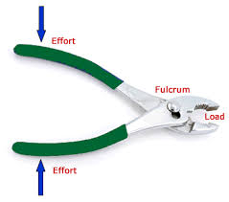
Continued
Other examples included scissors and pliers

Slide 46
Second Class Levers
R = 2 Resistance is in the middle in a 2nd class Lever
Commonly occurs in the human body when gravity is the effort force (force attempting to cause motion)and muscles are the resistance (force opposing motion)
Resistance lies between the fulcrum and the force
The result is movement of the proximal rather than distal lever

Slide 47
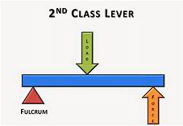
2nd Class Lever Continued

Slide 48
Example of 2nd class Lever in the body
The gastrocs lifting the body around the axis of the toes, since the muscles are the effort and the body weight is the resistance, a 2nd class lever is formed. When rising onto the toes, the fulcrum is the point of contact with the ground, the Effort is applied at the heel and the resistance is at the ankle joint where the body weight is transferred to the foot

Slide 49
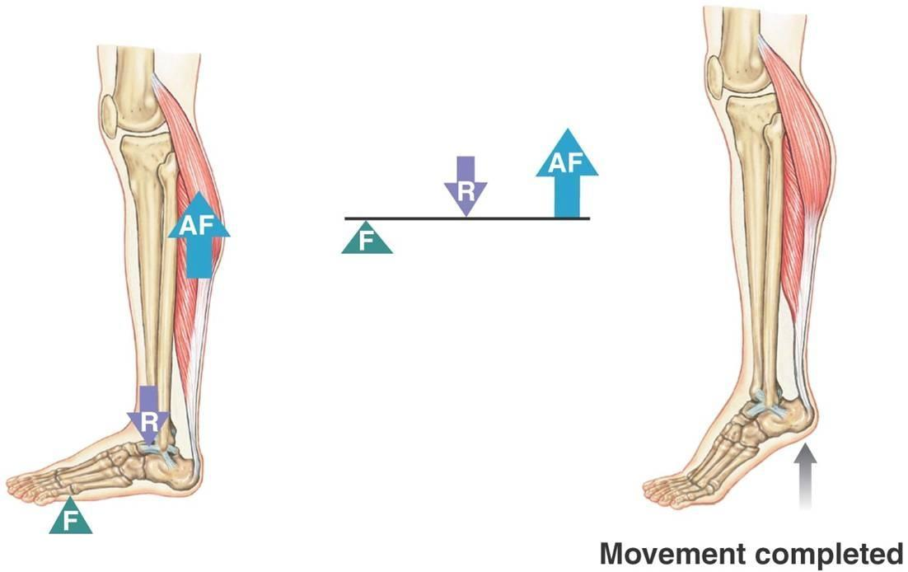
Continued
Notes:
AF - Active Force

Slide 50
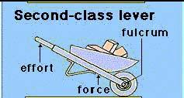
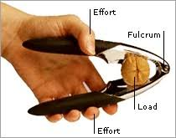
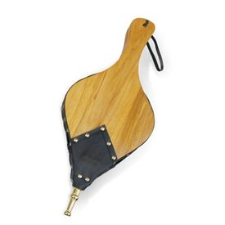
Other Examples
wheel barrow, nut cracker, fire bellows

Slide 51
Third Class Levers
E = 3, Effort is in the middle of the resistance and the Fulcrum. Most common Lever type in the Body
Most muscles creating rotation of their distal segments are part of a 3rd class lever system
The force is applied between the fulcrum and the resistance
The point of attachment of the muscle causing the motion is almost always closer to the joint axis than the external force, which is usually the resisting motion

Slide 52
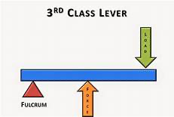
Example
Found in most open chain motions of the extremities
Example (1) bicep (2) tibialis anterior acting on ankle joint (3) ECR acting on the wrist

Slide 53
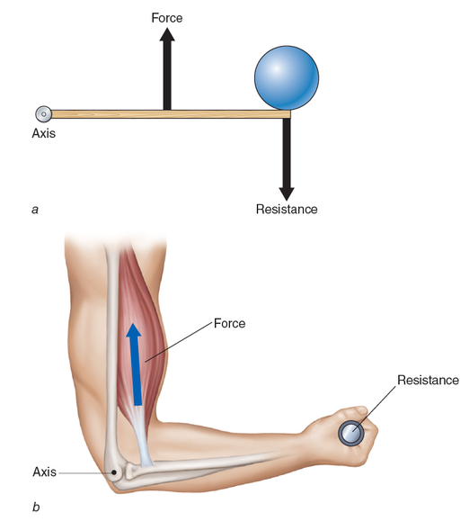

Slide 54
Videos
https://www.youtube.com/watch?v=iezOKl3Uawc

Slide 55
Types of Muscles
Agonist
  Responsible for producing desired motion at a joint
Antagonist
  Is the opposing group of muscles to the agonist
Fixator
  Muscle which anchors steadies or supports a bone providing an active muscle with a firm base of support.
Synergists
  Muscles that help the agonist to perform their action
  biceps

Slide 56
Continued
Spurt Muscles
  Have a proximal attachment that is far from the joint axis and distal attachment that is close to joint axis
  Usually able to produce a wide range of motion of the bony lever to which they are attached
  Ie. Biceps brachii, hamstrings
Shunt Muscles
  Have a proximal attachment that is close to joint axis and distal attachment that is far from the joint axis
  Helps maintain joint stability since a large component of their force is towards the joint and compresses the joint surfaces
  Ie. Brachioradialis

Slide 57
Continued
Tonic Muscles
  Similar characteristics to shunt muscles
  High proportion slow twitch fibers
  Do not fatigue easily
  Often called postural muscles
  React rapidly to training
  React to overstress by shortening
  Demonstrate slow reaction to immobilization
  Eg. Iliopsoas

Slide 58
Continued
Phasic Muscles
Similar characteristics to spurt muscles
High proportion of fast twitch
Produce large ROM
Fatigue more rapidly
Slower to recover after high intensity exercise
React slower to training
React to overstress by weakening
Demonstrate immediate reaction to immobilization
Eg. Gluteal muscles

Slide 59
Types of Muscle Fibers
Slow Twitch (type 1)
  Recruited for endurance tasks
  Activities of low intensity and long duration
  Fatigue resistant / aerobic
  Stabilizing muscles and posture
Fast Twitch Oxidative (type 2 a)
  Recruited for speed, power and endurance
  Rely on energy sources intrinsic to muscle (glycogen)
  Opposite end of spectrum / anaerobic
Fast Twitch Glycolytic (type 2b)
  Recruited for speed and power tasks of short duration
  https://youtu.be/3L9JUfzh66I

Slide 60
Types of muscle Contractions
Concentric Contraction
  As the velocity of muscle shortening increases, the force the muscle can generate decreases
  Torque decreases as a muscle shortens at faster contractile velocities
  the force generated is sufficient to overcome the resistance, and the muscle shortens as it contracts
Eccentric Contractions
  As the velocity of active muscle lengthening increases, force production in the muscle initially also increases but then quickly levels off
  The force generated is insufficient to overcome the resistance placed on the muscle and the muscle fibers lengthen as they contract or an eccentric contraction is used as a means of decelerating a body part or an object.

Slide 61
Isometric Contraction
Occurs when the muscle remains the same length despite building tension; an example of this is muscle contraction in the presence of an after load. Ie. Maintaining the joint angle, but increasing the workload. Occur when carrying an object in front of you. Also seen in yoga poses held for a length of time so that the muscles begin to fatigue

Slide 62
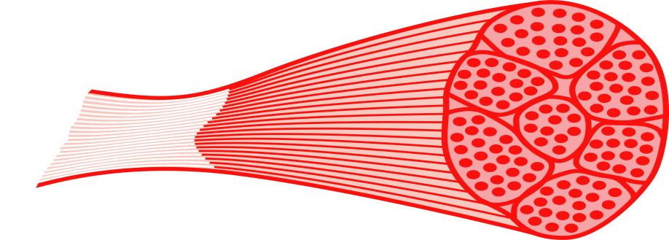
Isotonic Contraction
Occur when tension in the muscle remains constant despite a change in muscle length
This can occur only when a muscle's maximal force of contraction exceeds the total load on the muscle
Ie. Bicep curls; tension is maintained during the concentric contraction, as well as the eccentric
https://youtu.be/T3OiOJ6-x34

Slide 63
What do you remember?
1 What are the 4 main types of muscle contractions we discussed?
2 Are open chain generally weight bearing or non weight bearing?
3 What are Kinetics?
4 What is the Convex on concave rule?
5 What are the 3 accessory arthokinetic motions?
6 List 4 osteokinetic motions?
7 name one of newtons laws?
8 What are the three types of muscle fibers?
9 What two accessory motions must occur together for motion to occur correctly?
10 Movement of a body in which all its parts move in the same direction with equal velocity that occurs in a straight line is what type of motion?

Slide 64
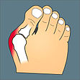
Valgus/Varus Angles
A Valgus Angle or position is one where the more distal end of the bone is placed more laterally
A Varus Angle or position is one where the more distal end of the bone is placed more medially
Valgus
Varus

Slide 65
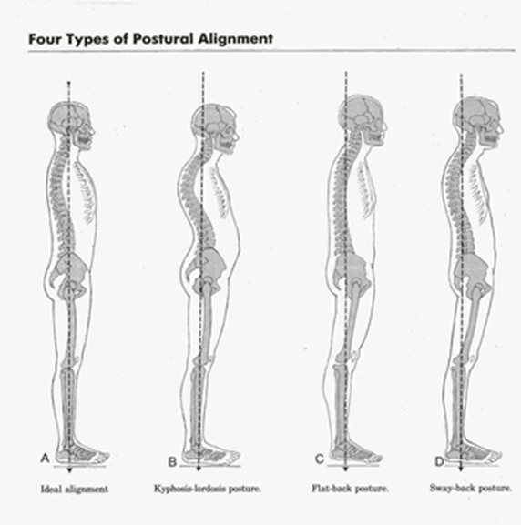
Postural Alignment
Five main types of Postures
  Ideal Alignment
  Kyphotic – Lordotic
  Sway Back
  Military
  Flat Back

Slide 66
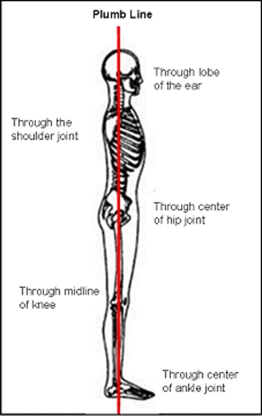
Plumb Line
Side view passes through
  earlobe
  Shoulder joint
  Centre of hip joint
  Midline of knee
  Centre of ankle joint

Slide 67
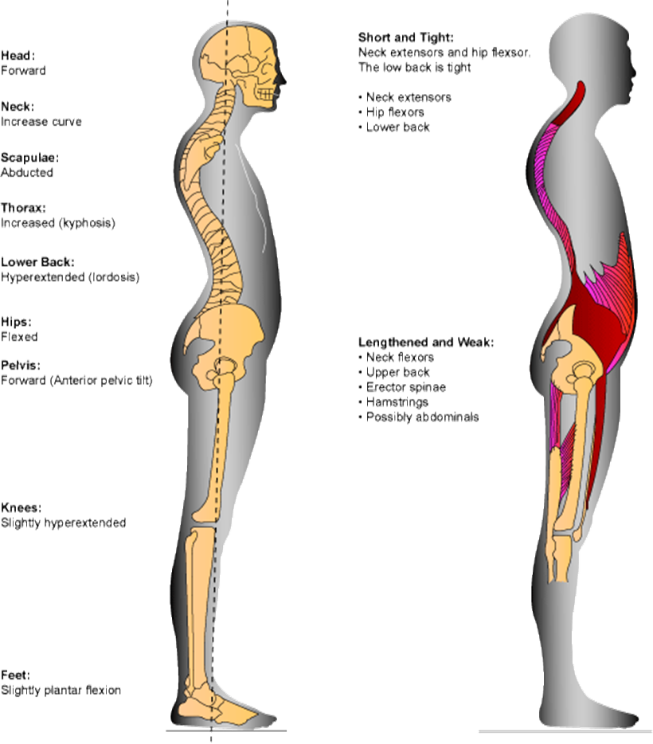
Kyphotic/Lordotic
Muscles Lengthened and weak
  Neck Flexors
  Upper Back
  Erector Spinae
  Hamstrings
  Possible Abdominals
Muscles shortened and Tight
  Neck Extensors
  Hip Flexors
  Lower Back

Slide 68
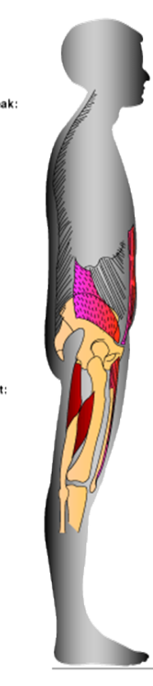
Flat Back Posture
Muscles lengthened and weak
  Hip Flexors
Muscles Shortened and Tight
  Hamstrings
  Abdominals to a certain degree

Slide 69
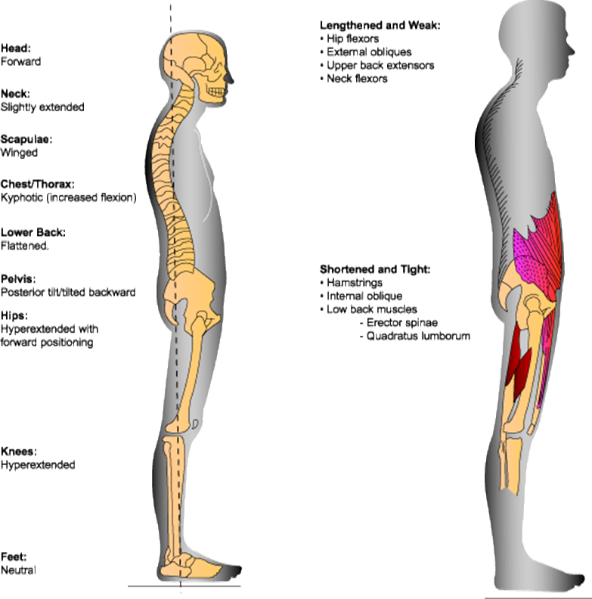
Sway Back Posture
Muscles Lengthened and weak
  Hip Flexors
  Upper back extensors
  Neck Flexors
  External obliques
Shortened and Tight
  Hamstrings
  Internal obliques
  Low back – Erector Spinae and QL

Slide 70
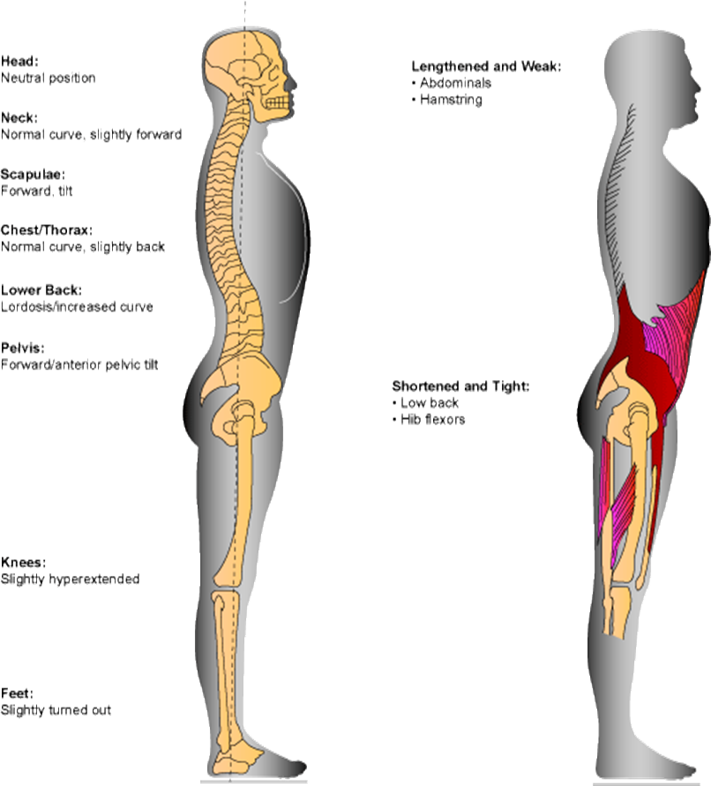
Military Posture
Muscles Lengthened and Weak
  Abdominals
  Hamstrings
Muscles Short and Tight
  Low Back
  Hip Flexors

Slide 71

Question Time??
11) What are the names of the three lever Classifications?
12) What is the mnemonic to remember the levers and what does it tell you?
13) What muscles are short and tight in a kyphotic lordotic posture
14) What are lengthened and weak in a sway back posture?

Slide 72
Gait Review
Video – Review of Gait https://youtu.be/1u6d1CX7o9c
Examination of Gait
lower limb pathologies are more prominent during gait
two phases of normal gait:
  stance phase - foot is on ground; 60% of normal cycle with 25% of this phase in double stance
  swing phase - foot is moving forward; 40% on normal cycle
both of the above phase can be broken down into subdivisions:
  stance phase - heel strike, foot flat, midstance, push-off (toe off),
  swing phase - acceleration, midswing, deceleration

Slide 73
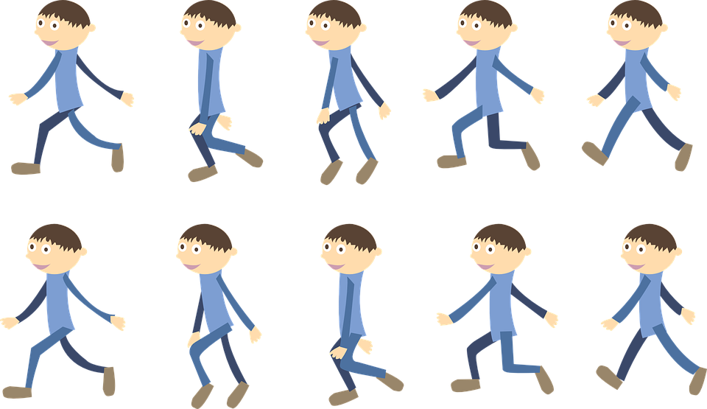
Gait Review
most pathologies are more prominent during stance phase, since weight bearing is occurring during most of the phase and therefore the greatest amount of stress is being applied
remember gait analysis begins as soon as the client walk into your line of sight

Slide 74
Gait Examination
observe and pinpoint involved components/structures
  width of base: 2-4 inches from heel to heel
  center of gravity: 2inch in front of 2nd sacral vertebra, and should only oscillate no more than 2inches (in the vertical direction)
  knee flexed during stance phase - prevent excessive vertical displacement of the center of gravity
  lateral shift of pelvis and trunk: 1inch toward weight bearing side during gait to center the weight over the hip - gluteus medius weakness will result in increase shift
  step length: average 14-16inch: age, pain, pathology, and fatigue, may cause step length to decrease
  normal cadence: 90-120 steps per minute with an average of 100 calories being used per minute per mile; note that with age, fatigue, pain, and slippery surface to walk on ones cadence may decrease
  the pelvis rotates 40degrees in swing phase - which leaves the opposite extremity, which is in stance phase, to act as a fulcrum for rotation

Slide 75
Problems in Phases of Gait
STANCE PHASE:
  Antalgic gait is most commonly seen in this phase as result from pain (Anti=against Alge=pain) Stance phase is abnormally shortened relative to swing phase.
  quick to remove weight form the affected extremity (pain with weight bearing)
  this phase is also commonly affected by improper foot wear, causing pain and discomfort through the entire phase

Slide 76
Stance Phase Continued
heel strike→ pain may be caused by: heel spur; a protective bursa may develop:
knee extended on heel strike, if quads are weak resulting in unstable knee gait, the knee will not extend
knee is fused in flexion, the client may push attempt to push the knee into extension with hand - if this in not possible then the knee will remain unstable through the phase

Slide 77
Stance Phase Continued
flat feet - tibialis anterior, extensor digitorum longus, and extensor hallucis longus permit plantar flexion through eccentric elongation so that the foot flattens smoothly on floor surface, therefore if the dorsiflexors are weak or non-functioning the client will have “slap foot” instead of smooth contact with the floor; note: clients with fused ankles may not be able to reach flat foot until midstance

Slide 78
Stance phase Continued
Midstance
foot- fallen arches may be evident by painful calluses over the metatarsal heads; pes planus and subtalar arthritis will have increased pain when walking on uneven surfaces; corns may be painful during this phase due to rubbing against shoe as the toes start to grip:
knee - weak quads may result in hyperflexion and instability of knee
Hip - weakened glut medius forces the client to lurch toward the involved side placing the center of gravity over the hip-- aka gluteus medius lurch; weakened glut maximus forces the thorax to thrust posteriorly to maintain hip extension

Slide 79
Stance Phase Continued
push-off –foot -lateral forefoot push off may indicate osteoarthritis or fused metatarsophalangeal joint: knee - gastrocnemius, soleus and flexor hallucis longus are strong push-off muscles therefore weakness = flat feet

Slide 80
Swing Phase
less pathologies will be evident in this phase due to non weight bearing phase
Acceleration –foot - dorsiflexors are active throughout swing phase:
knee-max flexion of 65% is reached
hip-quads contract before toe-off to initiate forward swing of leg, therefore if the quads are weak rotation of the pelvis will be present anteriorly to promote forward thrust of the leg

Slide 81
Swing Phase Continued
Midswing –foot - if dorsiflexors are weak shoe scraping will occur, flexion of the hip with bending of the knee will be present to permit the foot to clear the ground
deceleration - knee -hamstrings contract and slow down swing prior to heel strike to maintain control with smooth contact of the ground; therefore if hamstrings are weak then heel strike may become harsh with hyperextended knee
examination of gait should include examination of the lower limb
and remember to assess the entire body - arm swing in tandem etc....
https://youtu.be/GsRkYpE_fX4

Slide 82
Remedial Exercise
Massage therapy is frequently considered to be passive exercise because while simply lying on a table and being treated the client may as well experience: circulation greatly increased thus waste removal increased, soft tissues stretched, soft tissues change tone, soft tissue strengthened
Even with the above you are encouraged to promote active exercise for your clients - this is to promote general health and increase heart rate, circulation, and respiratory functions. Remedial exercises are those the client does at home to encourage healing and improvement with their presenting condition

Slide 83
Benefits of Active Excercise
Muscles:
  Increase the blood flow (and therefore nutrition and waste removal) in working muscles
  Increase muscle metabolism
  Create muscle hypertrophy (increase in size) as the muscle adapt to the demands put on them
  Increase muscle elasticity and extensibility with pre and post exercise stretching
If a muscle, particularly a weak one, is overworked, the result will be muscle strain, characterized by undue fatigue, inflammation and tenderness

Slide 84
Benefits of Active Exercises
Bones and joint:
  Increase nutrition to bones
  Maintain or increase the mobility of joints and increase bone density to meet the demands of the exercise placed upon them
Heart:
  Heart contractions become stronger and more rapid, increasing the cardiac output
  The heart muscle may become stronger and function more efficiently
  Pulmonary circulation is also enhanced

Slide 85
Benefits of Active Excercise
Arterial Circulation:
  Increase the arterial flow to working muscles through vasodilation and the law of supply and demand
  Increased cardiac output tends to increase the arterial blood pressure until further arterioles and capillary beds become vasodilated to process the extra blood, thus decreasing arterial blood pressure
Venous and Lymphatic Circulation:
  Through alternate stretching and compression or pumping of the blood vessels, active exercise increases the flow of venous and blood and lymph ( through muscle contraction, they compress the veins and lymphatic vessels, forcing blood and lymph toward the heart)

Slide 86
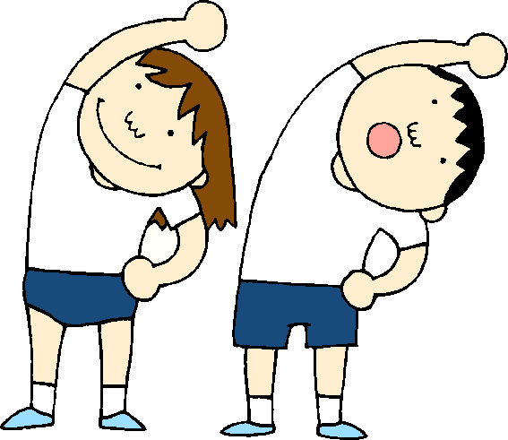
Types of Exercise
Endurance – improves cardiovascular fitness
Strength – Increases muscle strength
Balance – Prevents falls, helps in older individuals to maintain independence
Flexibility – stretches muscles, provides greater freedom of movement

Slide 87

Quiz 1 next class

