Slide 1
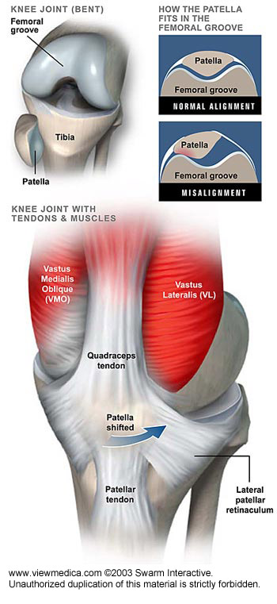
The Knee
Pg. 769

Slide 2
Exercise Guidelines for Knee Instabilities
Biomechanical faults and neuromuscular imbalances in the trunk and lower extremities need to be improved.
Restore muscle length and strength with concentric and eccentric foot, calf, thigh and gluteal work. Ensure that Vastus Medialis is firing properly to ensure that the patella is tracking during knee motion in both weight-bearing and non-weight bearing activities.

Slide 3
Training Dynamic Stability:
To train dynamic stability and help prevent or recover from ligament injuries, neuromuscular control must be repetitively challenged.
Training programs utilizing an unstable base of support have had considerable success at returning athletes with anterior cruciate ligament deficiencies to high level activities. It is also important to train proper landing techniques if required.
Variables of predictability, direction, speed and intensity should be introduced into the training program for extra dynamic challenge when the knee is ready for it.

Slide 4
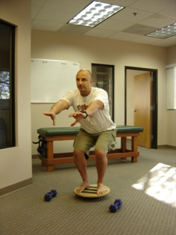
Wobble Board Squats
Exercises on an unstable surface can help re-educate the reflex response of nerves and muscles, helping to establish or re-establish normal proprioceptive and neuromuscular response to stimuli.

Slide 5
Agility Training
Agility training, with special attention to sport specific movements is important for improving knee dynamic stability. Bosu balls, stability balls, foam pads or rotational disks all have an unstable base of support and therefore require dynamic stability of the lower extremities. Drills using an unstable base of support should start at 50% effort and build towards greater effort.
Anyone with ligamentous insufficiency should wear a knee brace while performing these types of advanced exercises.
Clients with ligamentous knee injuries should avoid postures that strain the knee area, such as sitting cross-legged, kneeling or 4-point kneeling.

Slide 6
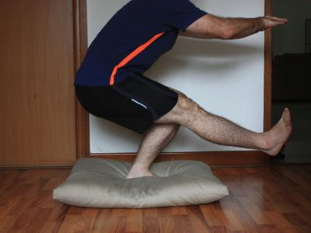
Single Leg Squats on a cushion
Something as simple as a cushion can be used as an unstable surface if a bosu
or wobble board is unavailable to a client. They can also purchase thick pieces of foam from fabric or upholstery stores to use. In that case, they may also need a wooden board on top so they don’t sink in.

Slide 7
Ligamentous Sprain Grades 1-3
Often occur from a fall, blow or sudden start/stop
Severe sprains may require bracing or surgery
Follow principles of tissue healing and rehabilitation and any medical recommendations

Slide 8
Anterior Cruciate Ligament Tears
Physiotherapy treatments likely required to control symptoms
Emphasize neutral control
Adding resistance should progress as able and according to medical advice
Emphasize heel slides, hip & knee flexion in supine and standing as able.

Slide 9
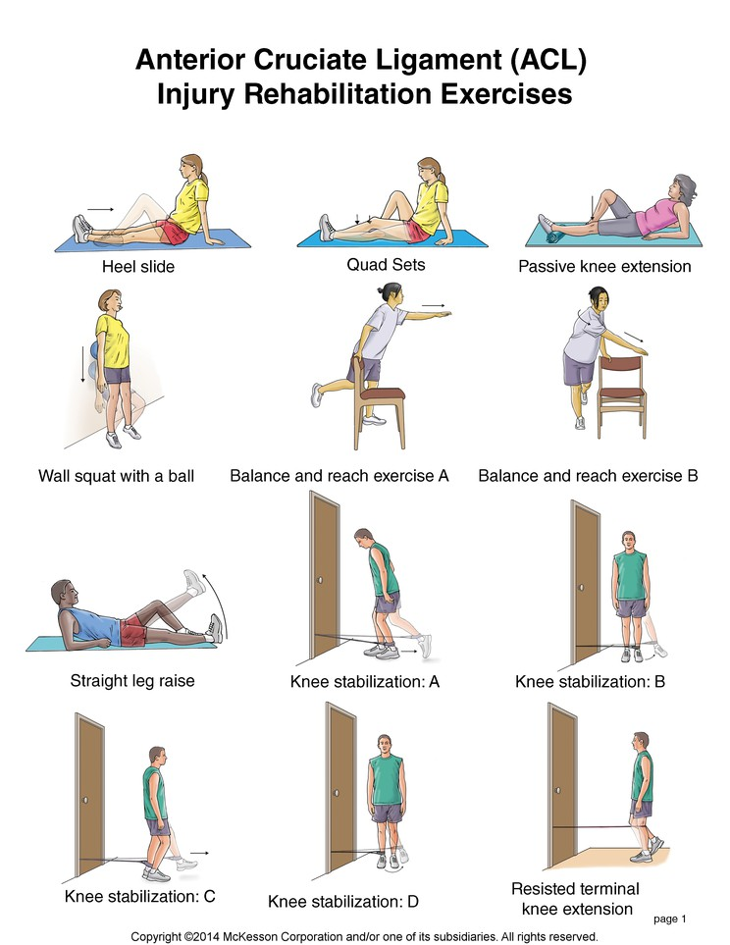

Slide 10
Posterior Cruciate Tears
Usually occur from hyperextension injuries
Generally managed conservatively by medical professionals
Exercises should address quadriceps strengthening

Slide 11
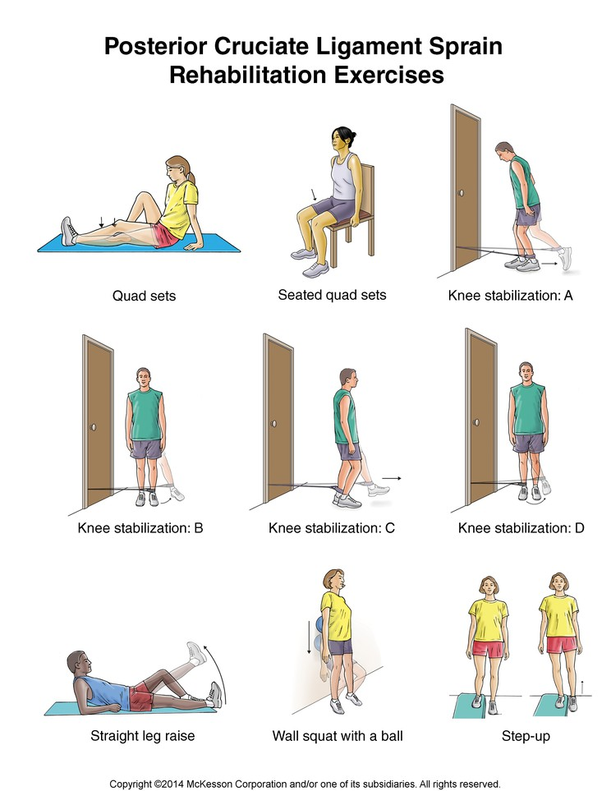

Slide 12
Collateral Ligament Tears
Managed conservatively
Within first 3 months, knee may need to be wrapped or braced depending on severity
Focus on maintaining neutral control of knee through knee and body movements, as the joint will have lost medial or lateral stability, depending on the collateral ligament that is damaged

Slide 13
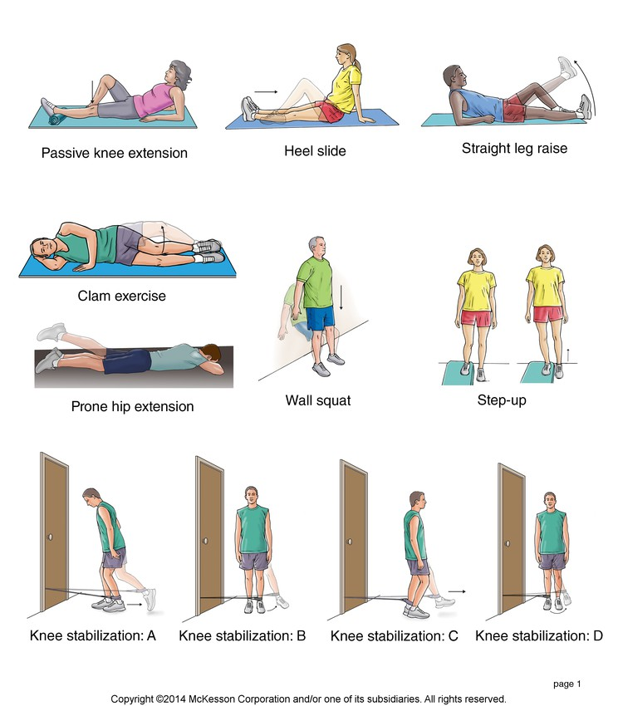
Medial/Lateral Collateral Ligament Rehabilitation Exercises

Slide 14
Meniscal Tears
May or may not require arthroscopic surgery
Knee needs to be rehabilitated to full function before returning to intense activity
Follow normal rehabilitation guidelines and increase tolerance to weightbearing

Slide 15
How a meniscal tear is treated is dependent on the severity of the tear. In terms of exercises, work within medical advice and focus on strengthening the quads, the hamstrings, calves and hips. Exercises should only be done if they can be done relatively pain-free
The list below contains specific exercises that are helpful in recovering from meniscal tears:
  Heel Slides
  Straight Leg raises supine
  Prone Leg extension
  Hamstring curls
  Bridging
  Standing Knee bends or Wall Slides

Slide 16
Patellofemoral Pains
Most often due to biomechanical abnormalities, overuse or growth changes
Patella excursion, (path of the kneecap in flexing and extending,) is controlled by the quadricep muscle group, particularly by vastus medialis and vastus lateralis. Some research has surmised the vastus medialis needs to fire earlier to overcome the abnormal tracking pattern.

Slide 17
Patellofemoral Pains
Abnormal foot biomechanics should be corrected
Tightness in lateral retinaculum needs to be stretched. Since it is difficult to target this area, you can get a secondary stretch by focusing on stretching quadriceps, hamstrings and ITB.
The lateral retinaculum is the fibrous tissue on the lateral side of the patella. The kneecap has both a medial and a lateral retinaculum, and these help to support the kneecap in its position in relation to the femur bone underneath it.

Slide 18
Patellofemoral Pains
All muscle imbalances need to be corrected
Strength & coordination of vasti muscles should be assessed in weightbearing to see its true function
Restore hip flexibility, as restrictions in hip impair control of posterior fibers of gluteus medius to stabilize the lateral pelvis & control external hip rotation, which directly affects the patello-femoral joint.
Vastus medialis coordination can be improved using closed chain exercises

Slide 19
Patellofemoral Pains
When attempting to increase range of motion and strength, mechanics of tibio-femoral joint and patello-femoral joints must be respected
Heavy resistance against quads in open chain or with knees at greater than 30 degrees of flexion should be avoided to prevent compressive forces to patellar cartilage until healing is complete.
Muscle training is specific to limb positioning
Add weightbearing exercises slowly as tolerated and with pelvic control

Slide 20
Patello-Femoral Instability
A lateral instability that allows the patella to slip laterally in certain movements.
May require bracing or even crutches if severe
Treatment and exercise is similar to those for patellofemoral pains.

Slide 21
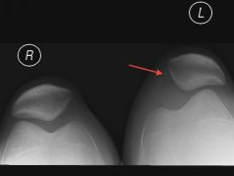
Patellar subluxation
-Resulting from lateral instability

Slide 22
Patellar Tendinopathy
Anterior knee pain aggravated by jumping, hopping, leaping or bounding activities. (Also known as Jumper’s knee.)
All biomechanical problems and muscle imbalances in pelvis and lower extremities need to be addressed.
Common to find calf weakness and quadricep and/or hamstring tightness
There may be increased neural tension that needs to be relieved

Slide 23
Patellar Tendinopathy
The calf muscle must be able to accept the load when landing a jump. Ensure your client is doing a forefoot landing, as opposed to a flat foot landing as this reduces ground reaction forces substantially.
Graduate to single leg exercises eventually to avoid unloading forces on to the unaffected tendon when working the legs bilaterally
Progress load, speed and height only after a lengthy rehabilitation period

Slide 24
Quadriceps Tendinopathy
Pain occurs on quadriceps tendon where it attaches to the patella
There will be pain and tenderness on resisted quadricep contraction
Approach to recovery is similar to patellar tendinopathy

Slide 25
Knee Bursitis
Most commonly affected is prepatellar bursa (housemaid’s knee)
Superficial swelling of anterior aspect of knee
Correct all abnormal biomechanics, muscle imbalances and reduce training that may make it worse
Avoid kneeling or forceful weightbearing activities such as running or walking/standing for long periods
Focus on lateral hip stabilizer strengthening

Slide 26
Osteoarthritis
Generally seen in 50+ population
May have history of acute ligament injury that predisposed knee to OA due to cartilage damage causing bone to rub on bone
Pain, muscle weakness and joint limitations increase over time
Modify activities to decrease stress on joint, ie. Reduce amount of stair climbing, avoid sitting in low chairs

Slide 27
Osteoarthritis
As a rule, avoid any and all kneeling exercises
Mobilize the knee to 90 degrees flexion before proceeding to resistance exercises
Strengthen hamstrings and quadriceps
Client may be required to lose weight to reduce forces on the knee joint

Slide 28
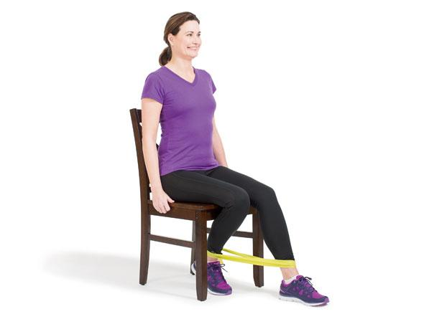

Slide 29
ITB Friction Syndrome
Causes pain in lateral knee with repeated flexion and extension, as in running where ITB rubs against lateral epicondyle of the femur
Pain, aching, swelling on the lateral aspect of the knee and popping may occur
Vastus lateralis may be overdeveloped, placing increase load on the ITB
Excessive pronation causes internal rotation of tibia, which places stress on the ITB

Slide 30
ITB Friction Syndrome
Release ITB with foam rolling
Stretch shortened TFL and gluteus maximus

Slide 31
Exercise techniques to increase flexibility and ROM

Slide 32
Increase knee extension
Page 830
PNF stretching techniques
Gravity-assisted passive stretching techniques
Prone hang
Supine heel prop
Self-stretching technique

Slide 33
Increase knee flexion
Page 831
PNF stretching techniques
Gravity-assisted passive stretching technique
Self-stretching techniques
Gravity-assisted supine wall slides
Self-stretching with uninvolved leg
Rocking forward on a step
Sitting

Slide 34
Increase mobility of the ITB at the knee
Page 832
Foam roller fascial release

Slide 35
Exercises to develop and improve muscle performance and functional control

Slide 36
Open-chain exercises
Page 833
To develop control and strength of knee extension (quadriceps femoris)
Quadriceps setting (quad sets)
Straight leg raise
straight -leg lowering
Multiple-angle isometric exercises
Short-arc terminal knee extension
Full-arc extension

Slide 37
Cont…. Page 835
To develop control and strength of knee flexion (hamstrings)
Hamstring setting (hamstring sets)
Multiple-angle isometric exercises
Hamstring curls

Slide 38
Closed-chain exercises
Page 836
Closed-chain isometric exercises
Setting exercises for co-contraction
Alternating isometrics and rhythmic stabilization
Closed-chain isometrics against elastic resistance

Slide 39
Cont… page 837
Closed-chain dynamic exercises
Scooting on a wheeled stool
Unilateral closed-chain terminal knee extension
Partial squats, minisquats, and short-arc training
Standing wall slides
Forward, backward, and lateral step-ups and step-downs
Partial and full lunges

Slide 40
References
http://www.health.harvard.edu
http://www.physioworks.com.au
Injuries & Special Populations Support Material. Toronto: Merrithew Corp., 2009
Dawson, Anne. Injuries and Special Populations Resource Guide. Toronto: Merrithew Corp., 2003.

