Slide 1
Hip

Slide 2
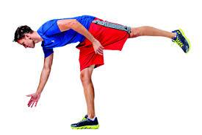
The hip is designed to operate under loads that exceed 3 times the normal body weight. In order to balance the wide ROM allowed at the joint with the forces placed upon it, it is controlled by muscles of enormous power and coordination.

Slide 3
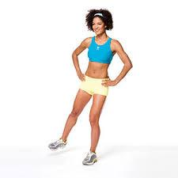
The largest forces at the hip joint are those resulting from muscular contraction. Consider the muscles required to stand on one leg: Gluteus medius and minimus, TFL, superior portions of Gluteus maximus, as well as passive tensions in the fascia latae and ITB. All of these contract in order to prevent the dropping of the contralateral side of the pelvis. This action produces a compressive force of up to 3-4 times the body weight, and an even greater force when walking or running.

Slide 4
There are several mechanisms that aid the body in managing the forces around the hip joint. Passive mechanisms may include bone or cartilage deformation while active mechanisms are neuromuscular and affect joint motion and muscle lengthening under tension. Joint motion includes knee flexion, foot pronation, internal rotation of the hip and adduction of the hip during heel strike. Contraction of the global stabilizers and mobilizers absorb the load and stabilize all the joints in the lower extremity. These mechanisms allow for optimal control of joint function.

Slide 5
Hip Conditions

Slide 6
Impairment patterns of the hip
Faulty mechanics may arise due to an imbalance in muscle length/strength, resulting in compressive forces on the back, hip and knee joints. Various impairment patterns correlate to overuse pathologies. These pathologies may be seen singularly or in groups and movement dysfunctions may exist alone or as part of a complex combination.

Slide 7
Decreased flexibility
Hyperlordosis – shortened iliopsoas and rectus femoris, lengthened / weak abdominals and hamstrings
Flat back – Shortened gluteus maximus and hamstrings, lengthened / weak rectus femoris and abdominals

Slide 8
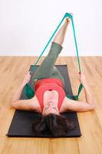
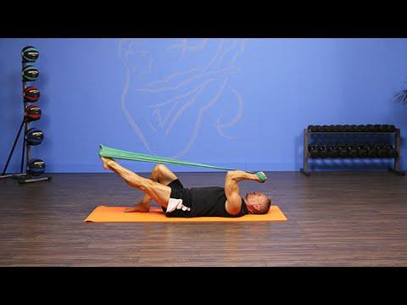
Hip clicking
Can indicate a weakness or dysfunction in the stabilizers, tendons snapping over joints, tears in the labrum
The Plan: Unload (remove gravity), decrease ROM, find neutral and focus on control while maintaining it, make use of short levers first, use proprioceptive tools where possible
Exercise Examples: Bend and Stretch with band, One Leg Circle with band (shorten the lever by bending the knee), hip flexor stretch, quadriceps stretch
Patellofemoral pain
Is associated with weak gluteus medius and minimus.
Piriformis syndrome
Is associated with weak hip abductors and extensors.

Slide 9
Osteoarthritis
Space in the hip joint has decreased
Joint has degenerated, as well as surrounding tissue
ROM limited, particularly flexion
Deep hip and groin pain, pain down inner thigh and into medial knee
Pain increases after weightbearing
May result in hip replacement surgery
The Plan: avoid compression of the joint, focus on neutral, work in a mid-range. Increase length of warm-up and work to improve biomechanics.
Exercise Examples: Begin with AROM exercises, bridging, hip extension standing, gentle fascial movements like Tai Chi, gentle glute max, hip flexor and adductor stretches

Slide 10
Hip replacement
End result of severe arthritis, hip/femur fractures or avascular necrosis of the femoral head, resulting from compromised blood flow to the femoral head
A full replacement involves both an acetabular replacement, as well as a femoral component
It restores movement and eliminates pain
The Plan: restore normal biomechanics as able, avoid flexion beyond 90°, and do not combine flexion, adduction and internal rotation. Build towards weightbearing, avoid side-lying on the affected side, and use a prop to maintain knees hip distance apart. Do not let the lumbar spine take over to increase limited hip extension, avoid impact
Exercises Examples: Single Leg extension prone on folded pillow, heel slides, knee tips, hamstring stretches, gentle glute stretches

Slide 11
Nerve Dysfunction
May result from nerve entrapment or injury
The sciatic nerve may be aggravated by inflammation in the piriformis
The Plan: Rebalance the muscles around the hip, work in parallel and hip distance apart, mobilize and release the hip joint gently
Exercise Examples: Hip Release, Windswept knees, small standing hip hikes, bridging, Standing Cowboy, Ball sit, Thread the Needle stretch

Slide 12
Specific Stretch & Strength
P. 750-763

Slide 13
Exercise intervention for the hip region
No matter what the cause, muscle strength or flexibility imbalance in the hip can lead to abnormal lumbopelvic and hip mechanics, which can contribute to low back, SI or hip pain. Abnormal hip mechanics from muscle flexibility and strength imbalances may also affect knee and ankle during weight-bearing activities, potentially causing overuse syndromes or increased stress in these regions.

Slide 14
Increase hip extension
Open textbook to page 751
Prone press up
“Thomas test” stretch
Modified fencer stretch
Kneeling fencer stretch

Slide 15
Increase hip flexion
Page 751
Bilateral knee to chest stretch
Unilateral knee to chest stretch
Quadruped (all fours) stretch
Short -sitting stretch

Slide 16
Increase hip abduction
Page 752
Fig. 20.13

Slide 17
Increase hip abduction and external rotation simultaneously
Page 752
Fig. 20.14

Slide 18
Increase hip internal rotation
Page 753
Fig. 20.15

Slide 19
Rectus femoris stretches
Page 753
“Thomas test” stretches
Prone stretch
Standing stretch

Slide 20
Hamstring stretches
Page 753-754
Straight leg raising
Hamstrings stretch in doorway
Hamstrings stretch on chair or table
Bilateral toe touching

Slide 21
TFL and ITB stretches
Page 755
Supine stretch
Side-lying stretch
Standing stretch

Slide 22
Open-chain exercises

Slide 23
Develop control and strength of hip abduction
Page 756
Supine abduction
Side-lying abduction
Standing abduction

Slide 24
Develop control and strength of hip extensors
Page 757
Gluteal muscle setting
Standing leg lifts with trunk support
Quadruped leg lifts
Standing extension

Slide 25
Develop control and strength of hip external rotation
Page 757-758
Prone isometrics
Clam shell exercise
Side-lying external rotation
Sitting: external rotation

Slide 26
Develop control and strength on hip flexion
Page 758
Supine heel slides
Hip and knee flexion
Straight-leg hip flexion

Slide 27
Develop control and strength of hip adduction
Page 758
Side-lying abduction
Standing adduction

Slide 28
Closed-chain exercises

Slide 29
Closed-chain isometric exercise
Page 759
Alternating isometrics and rhythmic stabilization
Stabilization in single-leg stance

Slide 30
Closed-chain dynamic exercises
Page 760
Hip hiking/pelvic drop
Bridging
Wall slide
Partial squats/mini-squats
Single-limb deadlift
Step-ups and step-downs
Partial and full lunges
Resisted side stepping
Resisted side sliding

