Slide 1
Application of Therapeutic Exercise

Slide 3
Therapeutic Exercise?
Therapeutic exercise is described as a procedural intervention that is intended to reduce impairments, functional limitations or disabilities that interfere with a client’s ability to perform physical tasks.
The word “Remedial” refers to supplying a remedy intended to correct or improve deficient skills.

Slide 4
Role of Therapeutic Exercise
Remediate or prevent impairments
Improve, restore or enhance physical function
Prevent or reduce health related risk factors
Optimize overall health status, fitness or sense of well-being

Slide 5
Prescribing Remedial Exercise
•Positive and negative effects must be told to client
•Why you have prescribed the exercise - what is it for
•Demonstrate to client and have them demonstrate the exercise back to you - so you know they are performing it correctly
•Give: frequency, duration, reps/sets
•When the client is demonstrating the exercise can they feel the proper goal of the exercise → strengthen or stretch in appropriate muscle(s)
• Remind the client if they forget or become uncomfortable at home with the exercise given to discontinue and wait until you have a chance to discuss it with them → NEVER put the client at risk

Slide 6
Determinants of Health
The clients socioeconomic status
  income, employment, social status, support networks, education and status in the workplace
The physical environment they exist in
  Physical factors in their natural and human-made environment
Personal Health Practices:
  Risk-taking behavior (smoking) vs. health enhancing behaviors (yoga, jogging)
Coping Skills & Personality
  Physiological and psychological characteristics related to an individual; personal competence, coping skills, genetic/biological characteristics, feelings of sense of control
Health Services
  Access to services to restore and maintain health (massage, physiotherapy, nutritionist, etc.)

Slide 7
Types of Therapeutic Exercise & Uses
Range of Motion
Uses
To determine limitations of motion, joint stability and muscle/soft tissue elasticity
Preparation for stretching
Maintain elasticity and contractility of muscle
Provide sensory feedback from contracting muscle
Increase circulation
Develop coordination and motor skills

Slide 8
Reasons for loss of ROM
Systemic, joint, neurological or muscular diseases
Surgery
Trauma
Inactivity
Immobilization
Notes:
Edema, Scar tissue, postural dysfunctions

Slide 9
ROM types used for remedial Exercise
AFROM – Active Free Range of Motion – Client does complete movements under there own strength
AAROM - Active Assisted Range of Motion – Client requires assistance from an outside source to complete the movement
PROM – Passive Range of Motion – Movement is created completely from an outside source
Review Principals and Procedures page 53 & 54

Slide 10
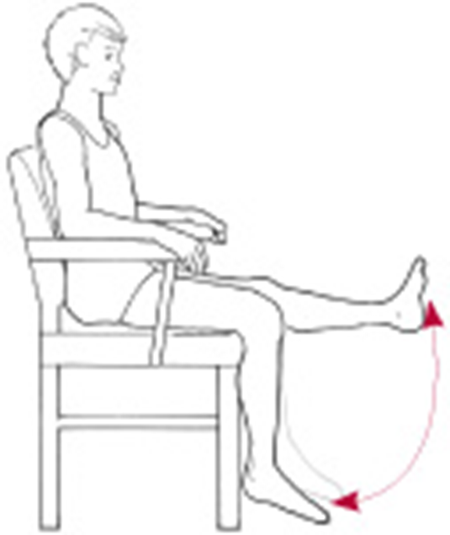
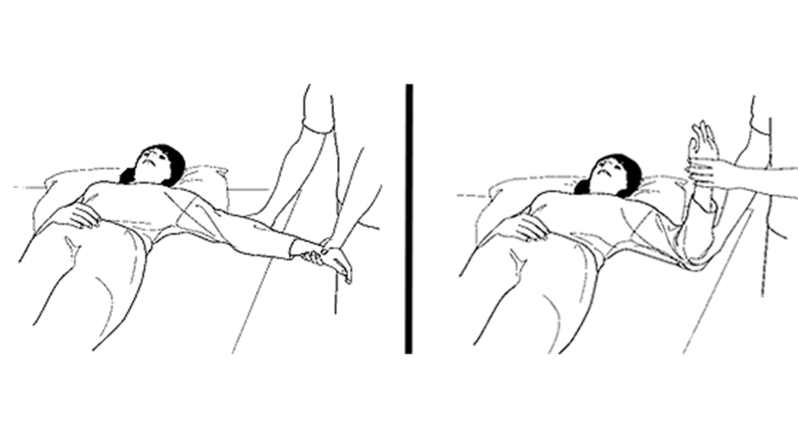
ROM Exercises
Active
Passive

Slide 11
Contraindications to ROM Exercise
Any circumstance when motion to a part is disruptive to the healing process
Acute tears, fractures surgery – small passive controlled motion well with pain tolerance can be allowed
ROM needs to be carefully monitored after incidents or surgery involving the cardiovascular system
Notes:
Review stages of healing…

Slide 12
PROM
What is the difference between PROM and stretching?
When using it for ROM we are remaining in the pain free ROM and not extending past therefore not creating a stretch on the muscles

Slide 13
Indications for PROM
Acute and inflamed tissue, when Active ROM would be detrimental to healing
When client cannot or is not supposed to actively move a segment(s) of the body

Slide 14
Goals of PROM
Maintain joint and connective tissue mobility
Minimize the effects of the formation of contractures
Maintain mechanical elasticity of muscle
Assist circulation and vascular dynamics
Enhance synovial movement – cartilage nutrition and diffusion of materials in the joint
Decrease or inhibit pain
Assist with the healing process after injury or surgery
Maintain patients awareness of movement

Slide 15
Limitations of PROM
Prevent muscle atrophy
Increase strength or Endurance
Assist circulation in the same way active exercise or voluntary muscle contraction would

Slide 16
Goals of AFROM & AAROM
Maintain physiological elasticity and contractility of the participating muscles
Provide sensory feedback from the contracting muscle
Provide a stimulus for bone and joint tissue integrity
Increase circulation and prevent thrombus formation
Develop coordination and motor skills for functional activities

Slide 17
Limitations of AFROM
Does not maintain or increase strength
does not develop skill or coordination, with the exception of movement patterns used

Slide 18
When is AFROM used?
when patient is able to contract muscle actively and move a segment with or without assistance
can be used for aerobic condition programs
relieves stress from sustained postures
When a segment of the body is immobilized for a period of time AAROM is used above and below the immobilized segment to maintain the areas in as normal of condition as possible and to prepare for new activities such as walking with crutches

Slide 19
When is AAROM used?
AAROM – When patient is unable to completely move through a full range of motion due to weakness. AAROM would be used until patient can regain control of their ROM
Both can be used when a body segment is immobilized AROM can be used above and below that body segment to maintain these areas in as normal condition as possible to prepare for new activities (crutches ex)

Slide 20
Principles & Procedures for Applying ROM Techniques
Examine and evaluate the patients impairments and level of function, determine any precautions and their prognosis; plan the intervention
Determine the ability of the Patient to participate in the ROM activity, and whether PROM, AFROM or AAROM can meet the immediate goals
Determine the amount of motion that can be applied safely for the condition of the tissues and health of the individual

Slide 21
Continued
Decide what patterns can best meet the goals. ROM techniques may be performed
  Anatomic Planes of motion
  Muscle range of Elongation
  Combined patterns – Diagonal motions or movements that incorporate several planes of motion
  Functional patterns – motions used in activities of daily living

Slide 22
Continued
Monitor the patients general condition and responses during and after the examination and intervention: note any change in vital signs, warmth and colour of segment, ROM of patient, or quality of the movement
Document and communicate findings and intervention
Re-evaluate and modify the intervention as necessary

Slide 23
Patient Preparation
Communicate with patient, describe plan, method of intervention to meet goals
Free the region from restrictive clothing, linen, splints and dressings. Drape Patient as necessary
Position the patient in a comfortable position, with proper body alignment and stabilization but that allows you to move the segment through the required ROM
Position yourself so proper body mechanics are used

Slide 24
Application of Techniques
To control movement, grasp the extremity around the joints. If the joints are painful, modify the grip, still providing support necessary for control
Support areas of poor structural integrity, such as hypermobile joint, recent fracture, or paralyzed limb segment
Move limb through it’s complete pain-free ROM to the point of tissue resistance. DO NOT force beyond available range as this becomes a stretching techniques
Perform the motions smoothly and rhythmically, with 5 – 10 repetitions. The number of reps depends on the objectives of the program and the patients condition and response to treatment

Slide 25
Application of PROM
During PROM the force of movement is external. When appropriate a patient may be taught to move the part with a normal extremity
No active resistance or assistance is given by the patients muscles that cross the joint
The motion is carried out with the free ROM – range available without forced motion or pain

Slide 26
Application of AFROM
Demonstrate motion using PROM, then ask patient to perform motion, place your hands in a position to assist or guide if necessary
Provide assistance only as needed for smooth motion, when there is weakness, assistance may be required only at the beginning or end when the effect of gravity

Slide 27
Stretching Interventions

Slide 28
What is Stretching
a form of physical exercise in which a specific muscle or tendon (or muscle group) is deliberately flexed or stretched in order to improve the muscle's felt elasticity and achieve comfortable muscle tone

Slide 29
Definitions
Flexibility: ability to move smoothly and easily though an unrestricted pain free ROM
Dynamic flexibility: the degree that an muscle contraction moves a body segment
Passive flexibility: the degree that a muscle can be passively moved through ROM
  Passive flexibility is a prerequisite for dynamic flexibility, but doesn’t ensure it

Slide 30
Stretching as an Intervention
When should stretching be used as an intervention?
  restricted mobility adversely affects function and increased risk of injury
  promote wellness and reduce risk of re-injury in sport specific conditioning programs
  Limited ROM due to decreased soft tissue extensibility, adhesions, scar tissue
  As a component of fitness or sport specific activity

Slide 31
Stretching
Benefits of stretching (page 72 – 77)
  Increased flexibility and ROM
  Improve general fitness
  Injury prevention
  Reduced post exercise muscle soreness
  Enhanced performance

Slide 32
Types of Stretching
ballistic stretching
dynamic stretching
active stretching
passive (or relaxed) stretching
static stretching
isometric stretching
PNF stretching (Neuromuscular Stretching) AKA?
Muscle Energy Techniques
Manual/Self Stretching
Passive joint mobilization
https://youtu.be/i4PJi7eimwM
https://youtu.be/PONnbd4Lc_A

Slide 33
Contraindications
Bony block
Recent fracture
Acute inflammation , infection or edema
Sharp acute pain with movement
Hematoma or trauma
Hypermobility
Short tissue provides joint stability
Short tissue allows specific movements to occur
Do not go beyond normal ROM
Caution with osteoporosis
Caution with joints that have been immobilized for a long period of time
Progress dosage gradually

Slide 34
Goals
increase flexibility and ROM
General fitness
MAY decrease DOMS

Slide 35
Factors that affect Stretching
Alignment
  Proper body position for the muscles being stretched
Stabilization
  Stabilizing the proximal or distal attachment site of the muscle. Helps in proper alignment
Intensity
  The amount of load placed on a muscle. Stretching should be low intensity.

Slide 36
Duration
Duration
  The length of time the force (stretch) is held.
  Low intensity, long duration is considered safest.
  Still debate over how long to hold a stretch (see box 4.5 pg. 88)
General rule
  2 x 30 second stretches at low intensity
    Twice a week to maintain mobility
  More frequently to achieve increases in ROM
  Will depend on client tolerance

Slide 37
Speed
To reduce muscle contraction and risk of injury the rate of stretching should be SLOW
  Ballistic stretching (rapid forced stretching) should only be done in healthy populations where that type of movement is necessary for activity. Example?

Slide 38
Frequency
The number of times you stretch in an day / week
Not a lot of research on frequency
Depends on goals and client tolerance

Slide 39
Procedural Guidelines for Stretching Interventions
Warm up before applying stretches with heat or massage
Move slowly into the stretch
Hold at low intensity level
Release stretch slowly
Use diaphragmatic breathing through the stretch

Slide 40
Preparation for stretching
Review goals and desired outcomes of stretching program with patient, obtain consent
Select the most effective stretching techniques
Warm up soft tissues by local heat or active low intensity exercise
Have patient assume a COMFORTABLE AND STABLE position in the correct plane of motion to perform the stretch
Explain the procedure and be sure client understands
Free the area of any restrictive clothing, bandages or splints
Have client attempt to remain as relaxed as possible and that we are wanting to remain within their pain tolerance

Slide 41
Application of Manual Stretching Procedures
Move the extremity slowly through the free range to the point of tissue restriction
Grasp the areas proximal and distal to the joint in which the motion is to occur. Grasp should be firm but not uncomfortable. Use broad surfaces of your hands to apply all forces
Firmly stabilize your proximal segment and move the distal segment
Stretching a multi joint muscle, stabilize either the proximal or distal segment – stretch one joint at a time and then over all joints simultaneous

Slide 42
Continued
To avoid joint compression during the stretching procedure, apply a gentle distraction to the moving joint
Apply a low intensity stretch in a slow, sustained manner. When stretching adhesions, patients may experience a stinging sensation
Maintain the stretch for 30 seconds or longer, when tension decreases move the extremity a little further. For a fascial stretch, stretch at least two minutes to effect or affect the fascia
Gradually release the stretch force and allow therapist and patient rest momentarily while maintaining the range limiting tissues comfortably elongated position. Repeat sequence several times

Slide 43
Continued
If the patient does not seem to tolerate a sustained stretch use several very slow, intermittent stretches with the muscle in a lengthened position
If deemed appropriate, apply selected soft tissue mobilization procedures, such as fascial massage or cross fiber massage at or near the sites of adhesion during the stretching maneuver

Slide 44
Reading and assignment
Fascia Handout Review as a class
Pg 85 Determinants and type of stretching exercises to the end of agonist contraction page 95
Pg 97 procedural guidelines for application of stretching intervention to cold on page 102
Make notes of important points
In group of 3 go through manual stretching techniques in anatomical planes of motion. Everyone should perform each of these stretches. As a group determine and write down the correct muscles that are being stretched with each technique. All group members should perform and have each stretch performed to them

Slide 45
Resistance Exercise for Impaired Muscle Performance

Slide 46
What is muscle performance
Refers to the capacity of a muscle to do work
Complex component of functional movement and influenced by all of the body systems
Includes all of the morphological qualities of muscle
Necessary for a person to carry out physical demands of everyday life in a safe and efficient manner
Key elements of muscular performance
  Strength, Power and endurance

Slide 47
Strength, Power & Endurance
If any of these elements are impaired the possible results are
  Activity limitations
  Participation restriction
  Increase risk of dysfunction

Slide 48
Factors that result in decreased Muscle Performance
Injury
Disease
Immobilization
Disuse
Inactivity
Muscle atrophy

Slide 49
Resisted Exercise
Any form of active exercise in which dynamic or static muscle contraction is resisted by an outside force either manual or mechanically. Also known as Resistance training
Essential part of Rehab program and an important part of any program to improve conditioning or maintain health of physical well being
Strength, power or endurance can all be enhanced by some form of resistance exercise

Slide 50
Benefits of Resistance Exercise
Page 158 and 159
Benefits
Increase muscle strength and other connective tissues
Enhance muscle performance
Increase bone mineral density
Decrease joint stress during physical activity
Reduce risk of future soft tissue damage
Positive changes in body composition

Slide 51
Muscle Strength
Broad term that refers to ability of contractile tissues to produce tension and a resultant force based on the demands placed of the muscle
Insufficient muscle strength can contribute to major loss of function losses of even the most basic activities of daily living

Slide 52
Strength Training
Systematic procedure of a muscle or muscle group lifting, lowering or controlling heavy loads (aka resistance) for a relatively low number of reps over a short time

Slide 53
Uses of Strength Training
To improve muscle strength & rate of performance
Increase muscle strength and other connective tissues
Enhance muscle performance
Increase bone mineral density
Decrease joint stress during physical activity
Reduce risk of future soft tissue damage
Positive changes in body composition

Slide 54
Principles of Strengthening
Overload principle: demands on a muscle must progressively increase in order for the muscle to continue to achieve gains.
Can be done through increasing sets, reps, weight

Slide 55
SAID Principle
Specific Adaptation to Imposed Demands
  specificity is needed when designing an exercise program
Strengthening programs should try to mimic functional needs

Slide 56
Reversibility Principle
Reversibility Principle
  If you don’t use it you loose it!
Increases or gains in strength and endurance will diminish unless they are maintained

Slide 57
Factors That affect Strengthening
Energy stores and blood supply
Fatigue (muscle or cardiopulmonary)
Recovery from exercise
Age
Psychological / cognitive factors

Slide 58
Considerations in Strengthening
Alignment
  Proper body position for the muscles being strengthened
Stabilization
  Stabilizing the proximal or distal attachment site of the muscle.
Intensity
  The amount of load placed on a muscle.

Slide 59
Continued
Volume
  The number of sets / reps in a session
Exercise order
  The sequence that muscle groups are exercised
Frequency
  The number of exercise sessions per week / day
Rest interval
  The time between sets and sessions of exercise

Slide 60
Continued
Duration
  Total time frame of a resistance training program
Mode of exercise
  Type of muscle contraction, client position, type of resistance
Velocity
  of the exercise

Slide 61
Types of Resistance Training
Based on your examination determine the type of exercise that is appropriate by evaluating:
  What is the extent of the deficit
  Are there any underlying pathologies
  What are the goals
  Are there any contraindications
  Can they perform the exercise safely

Slide 62
Continued
Manual resistance exercises: These are resistance exercises where the therapist provides the resistance\
Used at the beginning of rehab, when the muscle is weak and can only overcome a minimal force
  What are other manual Resistance exercises?

Slide 63
Continued
Isometric exercises: muscle contraction with no associated movement
Used when needed functionally for a specific activity like holding a grocery bag
What are other isometric Exercises?

Slide 64
Continued
Muscle setting exercises: low intensity isometric exercise that is used in the acute stage to decrease muscle pain, promote relaxation and increase circulation
Muscle setting exercises DO NOT increase strength but the delay muscle atrophy and maintain mobility between muscle fibers

Slide 65
Continued
Stabilization exercises: an isometric exercise that uses less than maximal force over a sustained period of time. Used to increase postural or joint stability
Example: scapular stabilization

Slide 66
Effects of Isometric Training
Use 60% of the max force of the muscle contraction to increase strength
Hold for 6-10 sec
Repeat contraction
Adjust angle of contraction
Can be performed with or without equipment, example?

Slide 67
Precautions and Contraindications
People will often hold their breath during isometric exercises this can create a valsalva maneuver causing a rapid increase in blood pressure
High intensity isometrics may be contraindicated for patients with a history of cardiac or vascular disorders.

Slide 68
Dynamic Exercise
concentric and eccentric
  Dynamic exercises cause joint movement
Concentric exercise?
Eccentric exercise?

Slide 69
Continued
Concentric contractions are used to accelerate body segments
Eccentric contractions are used to decelerate body segments and as shock absorption during high impact
Eccentric exercise is essential to rehab and sport specific training

Slide 70
Adding Resistance
Resistance can be applied in various ways:
Constant resistance ex: _____________
A weight machine that provides variable resistance
An isokinetic device that controls the velocity of movement
Precaution – there is greater stress on the cardiovascular system with eccentric exercises

Slide 71
Open/Closed Chain Excercises
Open chain – Where the distal segment is free to move in space. Example?
Closed chain - Where to distal segment is fixed and the body moves. Example
Both are beneficial in a rehab program and both should be incorporated based on client ability and need
Table 6.8

Slide 72
Implementation of Open and Closed Exercises
Open chain is typically performed in non weight bearing and can be the only option for early rehab
Progression of closed chain exercises:
Partial to full weight bearing
Wide to narrow base of support
Stable to unstable surface
External support to no support
Small limb range to larger limb range
Uniplanar to multiplanar
Slow to fast

Slide 73
Examination and Evaluation
Before you prescribe any form of resistance training:
  Take health history and assessment
  Determine baselines of ROM, strength and general ability to function
  Determine what type of resistance exercise is indicated
  Periodically evaluate progress

Slide 74
Preparation for Strength Training
Warm up – ie: walk on treadmill for 5-10 minutes
Type of resistance – body weight, theraband etc.
Stabilization – make sure no unwanted movement occurs
Intensity – movements should be smooth and pain free with proper alignment

Slide 75
Reps/Sets
8-12 repetitions of an exercise are performed (one set)
Rest 30-60 seconds
Attempt another set
To progress first increase reps, then sets then resistance

Slide 76
Additional Info
Instructions should be both written and verbal
Cool down should be performed (walking / cycling)
Stretching is appropriate after strength exercises

Slide 77
Precautions
Appropriate temperature
No pain should occur during exercise
Initiate exercise with minimal to moderate force
Avoid having client hold their breath
Ensure stabilization occurs
Avoid heavy resistance in children older adults and those with osteoporosis
Ballistic movements
Medications that can alter response to exercise
Avoid cumulative fatigue

Slide 78
Contraindications
across an unstable joint
Distal to fracture site
Pain / dizziness / shortness of breath
Recent eye surgery
Inflammation
Severe cardiopulmonary disease

Slide 79
Overtraining
A decline in physical performance in healthy people participating in high intensity strength and endurance activities.
Caused by inadequate rest between exercise sessions, inadequate diet and fluid intake

Slide 80
Exercise Induced Muscle Soreness
Most people who aren’t used to exercise will experience some muscle soreness. There are 2 types of muscle soreness.
Acute muscle soreness: develops during or directly after exercise. Usually burning or aching. Due to a build up of metabolites
Delayed onset muscle soreness: Exercise induced muscle tenderness that occurs 24- 48 hours after vigorous exercise. Occurs more severely with high intensity eccentric contractions

Slide 81
Manual Resistance Exercise
Apply appropriate amount of resistance, do not overpower
Resistance should be smooth
Use simple directions
See pages 200 – 207 in Therapeutic Exercise

Slide 82
Special Considerations for 65+
Muscle performance decreases with age
Strengthening programs are designed to increase or maintain the ability to function independently
DOMS is more common in older adults, therefore resistance should be increased gradually
Avoid high load resistance as it stresses the joints

Slide 83
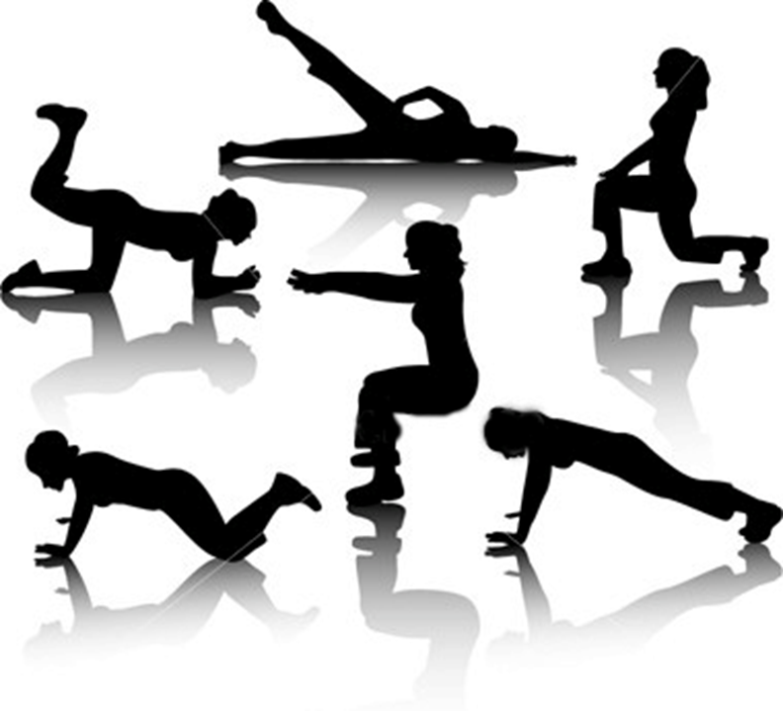
Examples of Strength Exercises
From Left to Right:
Butt Lift
Side Leg Lift
Lunges
Plank
Squats
Push-ups
Questions:
  What is each of these exercises strengthening? Keeping that in mind….
  Come up with an alternative exercise for each option and demonstrate.
Read pages 158 and 159 we will look at resistance training in more depth later
Stabilizers and mobilizers Handout

Slide 84
Endurance
Broad term that refers to the ability to perform low intensity, repetitive or sustained activities over a prolonged period of time
Total body Endurance – associated with repetitive dynamic motor activities (involve large muscles of the body)
Muscular Endurance (local endurance) ability of a muscle to contract repeatedly against a load, generate and sustain tension and resist fatigue over an extended period of time
Almost all daily living activity require some degree of muscle and total body endurance

Slide 85
Endurance Exercises
Page 159 last paragraph 173
Positive impact on improving function of muscle
Minimizes adverse effects on the joints
Produces less irritation to soft tissues
Creates an overall feeling of well being
Improved balance

Slide 86
Aerobic Exercises – Key Terms
Physical fitness - The ability to perform physical work, measured by the maximum oxygen consumption
(VO2 max)
(VO2 max) – The amount of oxygen used per minute when a person has reached maximum effort
Endurance – The ability to do physical work over a period of time
Aerobic training – the improvement of the muscle’s ability to use energy
Adaptation – the increased ability of the cardiovascular system to work as it changes to the demands placed upon it
Deconditioning - decreases in VO2 max and cardiac output as a result of disuse

Slide 87
Energy Systems
Energy systems are metabolic systems that the body uses to create ATP (adenosine triphosphate), carbon dioxide and water. Cells use the energy produced from the conversion of ATP to ADP. Muscle cells use this energy during muscle contraction.
There are three major energy systems
  ATP – PC system
  Anaerobic glycolytic system
  Aerobic system

Slide 88
ATP-PC
ATP – PC system
ATP is the fuel source
No oxygen is required
When muscle is rested the ATP gets replenished
Used in short, quick bursts of activity
Major source of energy for first 30 seconds of intense exercise

Slide 90
Anaerobic Glycolytic
System
Glycogen (glucose) is the fuel source
No oxygen is required
Lactic acid is produced
Used in activities of moderate intensity and short duration
Major source of energy from the 30th to 90th second of intense exercise

Slide 91
Aerobic System
Glycogen (glucose) fat and protein are the fuel sources
Oxygen is required
This system predominates over the other energy systems after the second minute of exercise

Slide 92
Functional Implications
Each energy system works with the others to some degree
Depending on what type of activity is engaged in you need to train a specific system
Is training in sprinting going to help you in a marathon?

Slide 93
Benefits of Cardiovascular Training
Increase exercise capacity
Enhance cardiac function, which may delay coronary heart disease
Increase metabolic activity
Relieve stress and anxiety

Slide 94
Guidlines
Children ages 6 to 17 – 60 minutes of moderate to vigorous activity a day
Adults ages 18 to 65 – 30 minutes moderate intensity 5 days a week
Ages 65+ - 30 minutes moderate intensity 5 days a week
Activity can be broken down into 10 minute segments

Slide 95
Heart Rate
The best way to determine maximum heart rate without testing is using the formula 220 – age
Calculate your maximum heart rate
In healthy young individuals a 70% max heart rate is needed for conditioning. What is 70% of your max heart rate?
In people with lower fitness levels a heart rate of 50-60% is needed
In completely deconditioned individuals a heart rate of 40-50% of max heart rate will begin to improve conditioning

Slide 96
Exercise Program
Should include a warm up (10 min)
Aerobic exercise which can be:
  Continuous
  Interval
  Circuit
Cool down period (5-10 min)

Slide 97
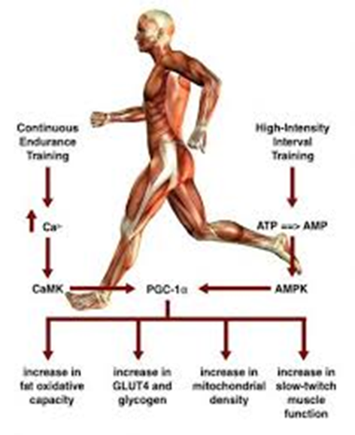
Muscular Endurance Training
Characterized by having a muscle contract and lift or lower a light load for many repetitions or sustain a muscle contraction for an extended period of time. Key parameters include low intensity contraction, large number of contractions over a long period of time

Slide 98
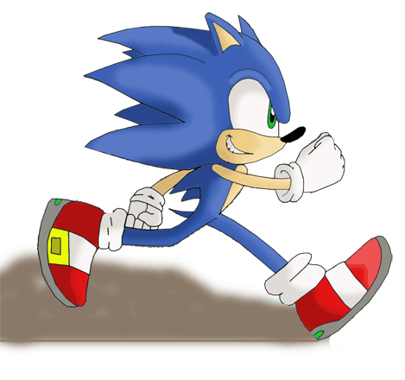
Endurance In Class Assignment
Running is not a viable endurance training option for all people due to the amount of impact involved.
What are 5 other endurance training options that your clients might consider?

Slide 99
Muscle Power
Related to the strength and speed of movement and is defined as the work produced by a muscle per unit of time (rate of performing work)
Can be expressed as a single burst of high intensity activity or repeated bursts of less intense muscle activity
Many motor skills are composed of movements that are explosive and involve both strength and speed. May be an important priority in rehab plan. Muscle strength is a necessary foundation to developing muscle power

Slide 100
Power Training
Can be enhanced by increasing the work a muscle must perform during a specified period of time or reducing the amount of time required to produce a given force
The greater the intensity of an exercise and the shorter time to generate the force, the greater the muscle power

Slide 101
Balance Training

Slide 102
What is it?
Generic term used to describe the dynamic process by which the body’s position is maintain in equilibrium. The body is most stable when the Centre of Gravity is maintained over the base of support.

Slide 103
Key Terms
Balance – The process that the body’s position is maintained in equilibrium
Equilibrium is either static when the body is at rest, or dynamic when the body is in motion
Centre of gravity – the vertical line through the point of equilibrium
Base of support – the perimeter of the contact area between the body and the surface it is supported on
As long as a person maintains their centre of gravity within the base of support they will not fall – this is called the limit of stability

Slide 104
Balance Control
Balance control requires input from the nervous system in the form of sensory processing and sensorimotor integration.
The musculoskeletal system plays a role in balance including postural alignment, flexibility, muscle strength and ROM
The environment that you are in also plays a role in balance. For example the type of shoes you are wearing, the surface you are standing on or the amount of lighting in the room

Slide 105
Balance During Lifting
It is common to lose balance when lifting heavy or large objects off the floor. This is we have to shift our centre of mass quite low to lift something from the ground.
Lifting style is not important to proper lifting. Having knees extended can be beneficial for people with weak quads.
If balance is an issue a semi-squat are safer as is widening your base of support

Slide 106
Impaired Balance
Sensory input impairments
Sensorimotor integration impairments
Biomechanical impairments
Deficits with aging
Deficits from medications

Slide 107
Sensory Balance Impairments
A decrease in proprioceptive deficits
Often follows a lower body injury
Neuropathies in the lower limb can affect proprioception
Deficits in vision or damage the vestibular system can cause balance issues

Slide 108
Sensorimotor Balance Impairments
Damage to the Basal ganglia or cerebellum can result in difficulty processing sensory information

Slide 109
Biomechanical Balance Impairments
Balance issues caused by the musculoskeletal system. For example hyperkyphosis or limited joint ROM, contractures

Slide 110
Aging
Due to decline in all sensory systems and sensory motor integration
Falls are a major cause of mortality in those 65+

Slide 111
Common Risk factors for falls among elderly
Muscle weakness
History
Gait issues
Balance deficit
Use of assistive devise
Arthritis
Vision problems
Arthirits
Impaired ADL
Depression
Cognitive function
Over 80 year of age

Slide 112
Medications
Certain medications can increase the likelihood of falling ie: sedatives / antidepressants
An increased chance of falling if you are on 4 or more medications
Have medications reviewed by a doctor if falls occur or loss of balance while on medications

Slide 113
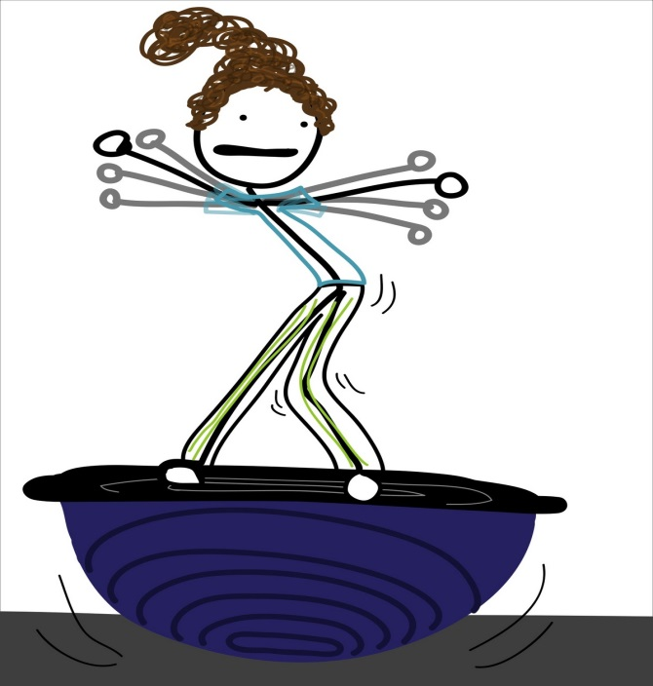
Balance Training Benefits
Improve ability to perform daily activities
Improve postural alignment
Improve motor performance
Improve ability to perform daily/functional activit
Reduce risk of falls

Slide 114
Balance Interventions
Multisystem approach
  Some areas may need stretching interventions while others require strengthening
Important to determine the areas and types of balance where improvement is required
Because these exercises challenge stability it is important that safety is considered
Safety is very important with balance training, having a way for a person to regain balance quickly is important

Slide 115
Assessing Balance
Static postures
Dynamic – seated to standing
Anticipatory – reaching, catching, lifting
Reactive – response to pushes / pulls
Sensory organization – reduce visual inputs
Balance during functional activity – multitask
Safety during gait – envrionment modifications

Slide 116
Safety First!
Perform exercises nearing a railing or bars where they are able to grab on when necessary
Do not perform exercises near sharp edges or equipment
Use two people when working with high risk patients
Check that equipment is operating correctly
Guard or assist when getting on or off equipment
Ensure floor is clean and free of debris

Slide 117
Static Balance control
Activities that promote non moving balance
Examples
  Sitting, half kneeling, tall kneeling
Activities can be progressed by working on soft surfaces, narrowing base of support, moving arms or closing the eyes

Slide 118
Dynamic Balance Control
Maintaining balance while in motion
Examples
  Mainting balance while working on a moving surface such as
    Theraputic ball, bosu ball, wobble board or mini trampoline
Progress exercising by shifting body weight, vary arm position, size of steps, hopping or skipping, base of support

Slide 119
Anticipatory Balance control
complex motor control ability that human use at workplace and other everyday physical activities
Involves having your client reach in all directions to touch objects, catching a ball or kicking
Progress by using a variety of postures, use functional tasks using multiple body parts, varying speeds and weights or using obstacle course

Slide 120
Reactive Balance Control
Automatic movement patterns that occur when balance is disturbed
Activities to improve reactive balance control can include swaying in different directions on a firm surface
Depend on the body area there are different strategies that can be used including balance beams, stepping up or cross stepping

Slide 121
Balance training for Functional Activities
Have them perform activities similar to those they are having difficulty with, ex reaching
Progress by performing two or more task at once
Use recreational activities the client enjoys to increase their enjoyment of functional training

Slide 122
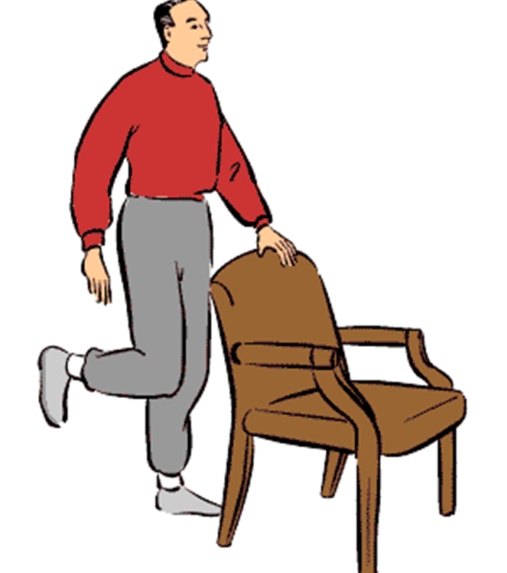
Balance Training In Class Assignment
Come up with 3 balance exercises. Keep in mind that they do not necessarily need to occur in standing.
How might you make a basic exercise more challenging?

Slide 123
Proprioception – What is it?
Proprioception is the sense of knowing where your body part is in space.
Most proprioception occurs subconsciously.
Your proprioception capabilities can be impaired when joints are injured, such as with ligament sprains. When you lose proprioception of your joint after a sprain, you may experience an unstable sensation of the joint. Your joint may even give-out.
The most common symptom of reduced proprioception is poor balance. In this respect, most people can understand the concept that poor balance can be a result of poor proprioception. However, even your spinal posture has a proprioception component telling you whether or not you are sitting or standing upright. Good posture, for example, could be thought of as perfect spinal balance!
Every injury has the potential to decrease your proprioception and subsequently your balance. However, you can quickly improve both your proprioception and balance with proprioception and balance exercises. That's where your physiotherapist is an expert and can help you.

Slide 124
Proprioception
Every injury has the potential to decrease your proprioception and subsequently your balance. However, you can quickly improve both your proprioception and balance with proprioception and balance exercises.

Slide 125
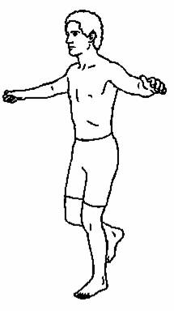
Proprioception and Coordination
Improve ability to perform daily activities
Improve ability to perform exercises accurately
Improve balance
Page 190

Slide 126
Examples of Proprioception exercises
Most closed chain exercises
Balance and proprioception exercises are often similar, for example wobble board can be used as both proprioceptive and balance exercise

Slide 127
Example of proprioception progression
Static Balance: Begin on 2 feet. Try placing the feet one in front of the other heel to toe. Balance for 30 seconds with arms down or raised, eyes open. Repeat with eyes closed.
Graduate to single leg balances
Dynamic Balance: Balancing on an unstable surface; a wobble board, a cushion or an exercise ball, (depending on the position,) and have some movement to challenge their stability. Ie. Mini-squats on a Bosu, hip abduction on a cushion, leg raises prone on a ball.
Later, Coordination and Agility may be added, but since this involves stops & starts and jumping and twisting activities, this is best left to a qualified fitness professional if possible

Slide 128
Developing a therapeutic exercise plan
Therapeutic exercise must be dynamic and responds to changing demands
Will account for potential changes in status of the client based on physiological response to exercise plan and/or progression of the active pathology
Client status may also change with progression through various health care settings (hospital, rehab center, home)
Ongoing physical examination and evaluation must be taken into consideration as well as functional goals and problems that arise

Slide 129
Ongoing Examination and Evaluation
Re-evaluations are all performed in the same methods used for the initial evaluation
Interview, observations, tests and measurements can all be included
Therapist should document the findings (positive or negative)
List all problems, if any, that have arisen

Slide 130
Determination of Functional
Goals
Functional Goals are defined as those meaningful activities that, because of active pathology, the individual is unable to do and for which that individual seeks therapy.
Allow the client to state the reason for seeking out therapy
The task of the therapist is to help the client frame their issues into achievable goals
Be sure to allow each goal to have a measure of progress
Every client will have a different achievable goal
Therapist must determine what the individual is hoping to gain from the plan and the types of things the client hopes to be able to accomplish after the plan is complete
Each goal must be linked to a problem/issue the client has
Each goal must be measurable and address short and long term goals

Slide 131
Aquatic Exercise
The use of water to facilitate the application of therapeutic exercises including strengthening, stretching, balance and endurance.

Slide 132
Goals and Indications
Facilitate ROM
Start resistance training
Start weight bearing exercises
Facilitate cardiovascular exercise
Minimize risk of injury
Enhance patient relaxation

Slide 133
Precautions
Fear of water
Neurological disorders
Ataxic patients many have more trouble controlling movement
Some MS patients have not tolerate heat (33+)
Respiratory disorders
Immersion in water may affect breathing of a client with a respiratory disorder because of the hydrostatic pressure on the chest wall
Cardiac dysfunction
Clients with abnormal BP, angina and heart disease need to be monitored closely
Open wounds need to be covered with water proof bandages

Slide 134
Contraindications
Open wounds
Unstable heart conditions
Severe respiratory dysfunction
Severe kidney disease
Uncontrolled bowel / bladder
Infectious disease
Uncontrolled seizures

Slide 135
Properties of Water
Buoyancy – the upward force that works opposite gravity
Buoyancy provides relative weightlessness and unloads joints
Provides resistance to movement
The amount of air in the lungs and amount of body fat affect buoyance
At the ASIS weight bearing in 50%, at the xiphoid it is 33% and at C7 it is 10%

Slide 136
Continued
Hydrostatic pressure – The pressure exerted by the water on the body
Reduces or limits effusion, assists in venous return
Viscosity - friction that occurs in the water
Provides resistance
Surface tension – The surface fluid acts as a membrane under tension
Movement at the surface creates more tension

