Slide 1
Grammar
Confusing Words
and
Homonyms

Slide 2
Words Often Confused
Some words are not used correctly because they are confused with other words with a similar spelling
Some words are not used correctly because they just don’t sound right
Refer to pages 61-124 (Blue Book)

Slide 3
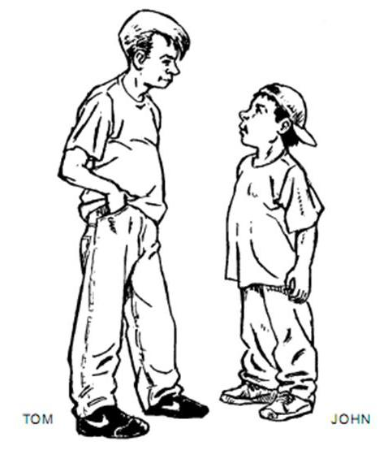
Words Often Confused
Than vs Then
Tom is taller than John. (comparison)
We had lunch, then we went shopping. (indicates time, shows a sequence of events)

Slide 4
Words Often Confused
All ready vs Already
We are all ready for the meeting.
(everyone is ready)
They already know what to do.
(refers to time: It happened sooner than expected.)

Slide 5
Words Often Confused
Between vs Among
The money was divided between Anna and Jenna. (only two)
The money was divided among the six children. (three or more)

Slide 6
Words Often Confused
Number vs Amount
The number of students absent each day is increasing. (for something countable)
The amount of work I do each week has doubled. (for something uncountable)

Slide 7
Words Often Confused
Assistants vs Assistance
We now have two assistants in our department. (people)
I really appreciate your assistance. (help)

Slide 8
Words Often Confused
Board vs Bored
The board will meet early next week. (group of people or a piece of wood)
I’m bored. I’ve got nothing to do.
(not interested)

Slide 9
Words Often Confused
Every day vs Everyday
I learn something new every day.
(each day)
These are my everyday clothes.
(ordinary)

Slide 10
Words Often Confused
Less vs Fewer (comparisons)
Unfortunately I have less time to play Facebook. (refers to an uncountable amount)
We now have fewer employees in our office.
(countable)

Slide 11
Words Often Confused
Heard vs Herd
Yes, I heard you. (to listen)
The students moved through the mall like a herd of horses. (group of animals)

Slide 12
Words Often Confused
Lay vs Lie
Present (Now) | Past | Past with Helper
Lay (to put) | Laid | ( ) Laid
Lie (recline, rest) | Lay | ( ) Lain
Lie (tell an untruth) | Lied | ( ) Lied

Slide 13
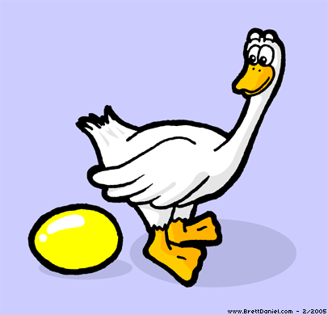
Words Often Confused
Lay (to put or set something)
Sally will lay the groundwork for the new project.
The workers laid the carpet in the new office.
The goose laid a golden egg!

Slide 14
Words Often Confused
Lie (to recline, to rest)
I have to lie down. (not lay down)
Terri lay there for more than an hour.
(not laid)
The cat has lain under my desk all morning.
(not has laid)

Slide 15
Words Often Confused
Lie (to tell an untruth)
Did you lie to me this morning?
Yes, he lied to you.
He has lied on every questionnaire so far.
p.89

Slide 16
Words Often Confused
Advice vs Advise
I would like your advice.
(opinion or recommendation)
I will advise you when we make a decision. (to tell, to inform)
p.90

Slide 17
Words Often Confused
Their, There, They’re
The students checked their answers carefully.
(possession)
I put the broom there so you could find it.
(location)
They’re often late for class. (they are)
p.91

Slide 18
Homonyms
More Confusing Words and Homonyms
Read P. 61-124
Quiz 1 - p.141 Quiz 2 p. 142

Slide 19
End

