Slide 1
Grammar
Adjectives and Adverbs

Slide 2
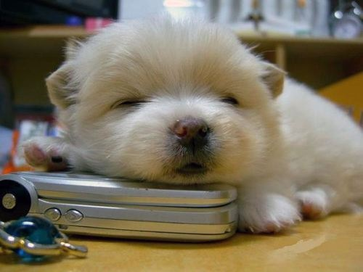
Adjectives
Adjectives are words that describe nouns or pronouns
cute puppy
tall man
difficult exam
lazy student

Slide 3
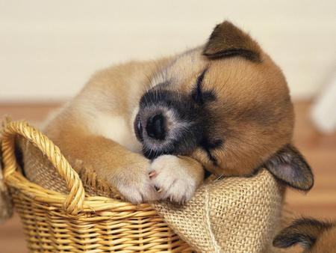
Adjectives
Adjectives generally come before the words they describe
The cute puppy is sleeping.
Stella has a new jacket.
I recorded exam grades on the computer.

Slide 4
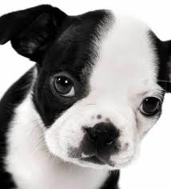
Adjectives
… but they may come after the words they describe
That puppy is cute.
The jacket is warm.
I am not comfortable with the decision.

Slide 5
Practice
Find the adjectives:
The company lawyer has arrived.
You have a beautiful car.
They are putting up a ten-storey building.
I’ve lost my black pen.
Her blouse is blue and white.
These boxes are heavy.

Slide 6
Adverbs
Adverbs are words that describe (modify) everything except nouns and pronouns
speak slowly
work quickly
very beautiful
really hectic
really slowly

Slide 7
Adverbs
Examples:
Tai is walking slowly.
You must work quickly.
The flowers are very beautiful.
I’m having a really hectic afternoon.
Now Tai is walking really slowly!

Slide 8
Adverbs
Examples:
Tai is walking slowly.
How is he walking? Slowly.
Tai is walking slow.
Incorrect.
If you are describing how the action is performed, use –ly.

Slide 9
Adverbs
Examples:
You must work quickly.
How must you work? Quickly.
You must work quick.
Incorrect.
If you are describing how the action is performed, use –ly.

Slide 10
Adverbs
Examples:
I’m having a really bad day.
How bad? Really bad (or very bad).
I’m having a real bad day.
Incorrect.
If you are qualifying the degree or extent of a description, use –ly.

Slide 11
Practice
Find the adverbs:
We will fill your order immediately.
The truck braked suddenly.
We will be there soon.
This report wasn’t done very well.
She was really happy with her results.

Slide 12
Good vs Well
Good is an adjective
Well is an adverb

Slide 13
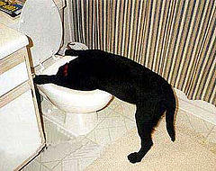
Good vs Well
You did a good job.
Good describes the job.
You did the job well.
Well answers how you did it.
You smell good today.
Good describes your scent, not how you use your nose.
I don’t feel well.
Well is used when referring to one’s health.

Slide 14
Making Comparisons
Describing only 1 | Comparing 2 | Comparing 3 or More
Sweet | Sweeter | Sweetest
Strong | Stronger | Strongest
Efficient | More efficient | Most efficient
Patient | More patient | Most patient
Good | Better | Best
Bad | Worse | Worst
Soon | Sooner | Soonest
Empty | -- | --

Slide 15
Common Errors
Watch out for these errors:
I feel badly about what happened.
We had a real good time at the party.
I’m feeling poorly this afternoon.
This package will go quicker by Priority Post.

Slide 16

Practice
Pages 85 – 86
Quiz 1 & 2

Slide 17
End

