Slide 1
Grammar
Pronouns

Slide 2
Pronouns
A noun is a person, a place, or a thing
A Pronoun takes the place of a noun
A pronoun can be a person , place or thing and objective or possessive

Slide 3
Pronoun Case
Subject | Object | Possessive
I, We | Me, Us | My, mine, our, ours
You | You | Your, yours
He | Him | His
She | Her | Her, hers
They | Them | Their, theirs
It | It | Its
Who | Whom | Whose

Slide 4
Subject Pronouns- person ,place or thing
Subject pronouns are the subject of the sentence or the subject of a verb
I am feeling better today.
You should speak politely on the phone.
He was promoted to manager last week.
They are not coming until Thursday.
It is Monday today, right?

Slide 5
Object Pronouns
Object pronouns appear immediately after a verb or a preposition
They put me on hold!
Did Anna tell you what happened?
Jean talked to her about it.
Put them down!

Slide 6
Possessive Pronouns
Possessive pronouns show ownership
These pronouns never need apostrophes
This is my pen. This pen is mine.
Is it your pen? I think this book is yours.
What was his answer? Yup, the answer is his.
You should call them. Go ahead, take it.

Slide 7
Other Examples
It was they who called. (formal)
It was them who called. (conversational)
Daniel is taller than I (am). (formal)
Daniel is taller than me. (conversational)

Slide 8
Is the message clear?
What do these sentences mean?
Aman would rather talk to Jay than I.
Aman would rather talk to Jay than me.

Slide 9
Is the message clear?
What do these sentences mean?
Aman would rather talk to Jay than I (would).
I’m not as interested in talking to Jay, so Aman
will do it.
Aman would rather talk to Jay than (to) me.
Aman isn’t interested in talking to me. She’d
prefer to talk to Jay.

Slide 10
Who vs. Whom
Use the he/him trick to decide which one to use: he = who him = whom
(Who, Whom) wrote this letter?
He wrote this letter. Therefore, who is correct.
(Who, Whom) should I vote for?
I should vote for him. Therefore, whom is correct.

Slide 11
Who vs. Whom
Try these:
(Who, Whom) has the new iPhone?
(Who, Whom) did you send the cheque to?
I don’t know (who, whom) put these here.
I asked (who, whom) was responsible.
Would you see (who, whom) is at the door?

Slide 12
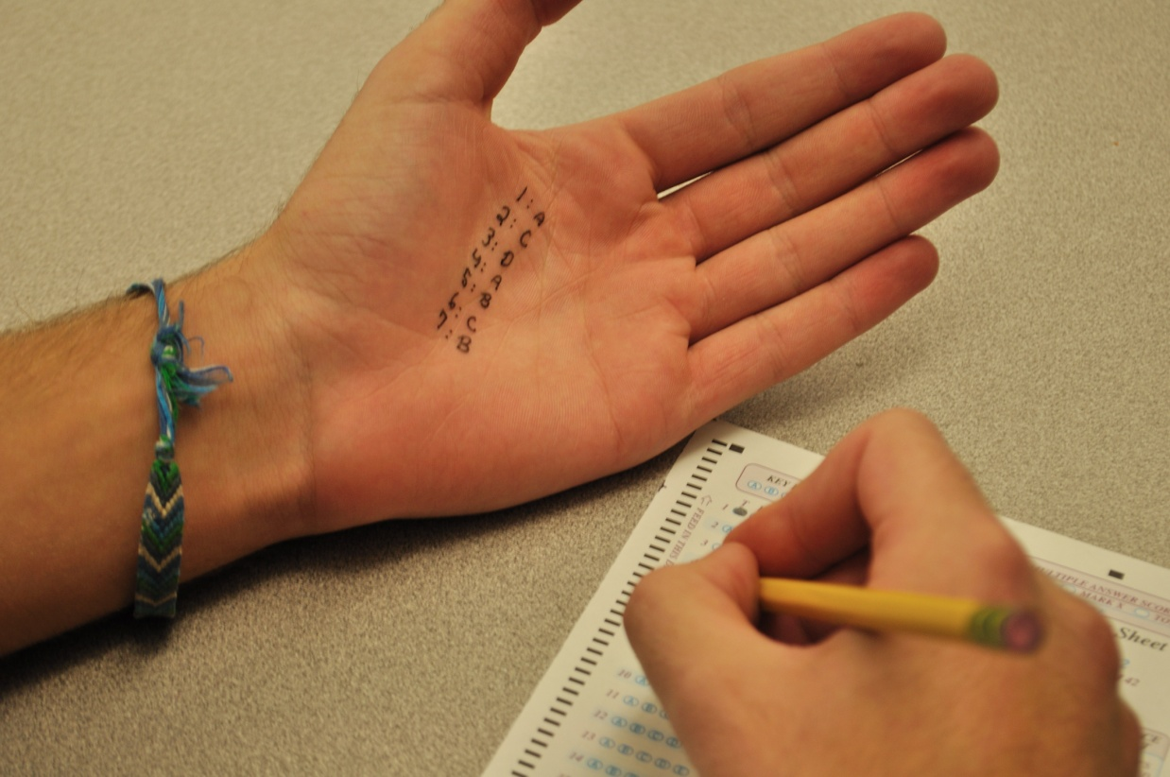
Practice
Page 81 in The Blue Book
Do Quiz 1

Slide 13
End

