Slide 1
Grammar
Subjects & Verbs

Slide 2
Sentence
What is a sentence?
  A group of words that expresses a complete thought.

Slide 3
Sentence
A sentence has two main parts.
  A subject
  A verb

Slide 4
Sentence
Subject
    Identifies what the sentence is all about
Verb
    Indicates what action is performed (or state of being)

Slide 5
Subject
What is the subject of this sentence? Who or what is this sentence about?
He ran around the park.

Slide 6
Subject
What is the subject of this sentence? Who or what is this sentence about?
The young woman hurried through the shopping mall.

Slide 7
Subject
What is the subject of this sentence? Who or what is this sentence about?
New ink cartridges have been ordered.

Slide 8
Subject
What is the subject of each sentence?
The bouquet of flowers is quite beautiful.
Max and Teesha are absent today.
I like ice cream.
Stop talking!
(You)

Slide 9
Verb
Verbs express action
    read write swim cry scream
Verbs show state of being
    am is are was were be been
  He ran around the park.
  She is here.

Slide 10
Verb
Find the verb in each sentence.
  The young woman hurried through the shopping mall.
  New ink cartridges have been ordered.
  I like ice cream.
  Call me tomorrow.

Slide 11
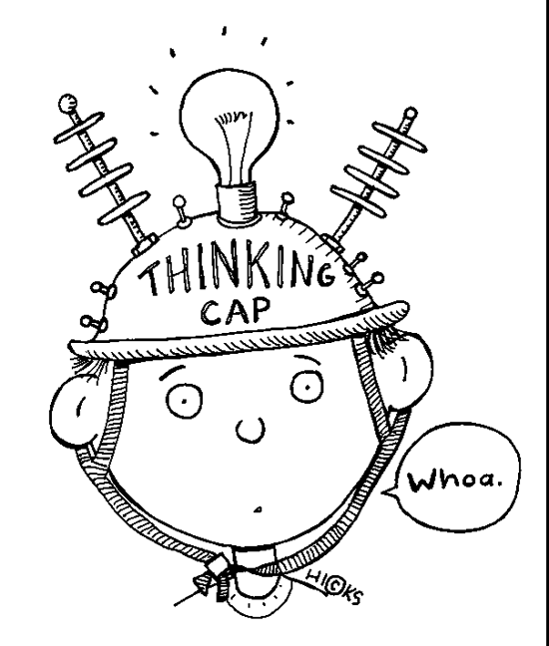
Practice
Page 78 in The Blue Book
Do Quiz 1

