Slide 1

Business Communications
Chapter 11:
Giving Oral Presentations

Slide 2

There are 5 main points to focus on for a professional presentation:
  Preparation
  Organization
  Audience Rapport
  Visual Aids
  Delivery

Slide 3
Understand your audience
The more you know about your audience, the better you can tailor your presentation to their interests and needs.
  Know your purpose. State it.
  How can I relate this information to them?
  How can I earn their respect?
Notes:
Defining your purpose and understanding your audience are key to preparing for any presentation. Consider your purpose and prepare a statement (similar to a mission statement) to determine how best you will present your information. A purpose such as, “To educate co-workers about the new information system over a lunch break” will yield a much different presentation than one with the purpose of “Educating IT professionals about programming requirements for the new software program”.
Considering factors such as age, experience, education and audience size will help you tailor your presentations to your audience. Make the information relatable, and as best as possible, earn the respect of the audience. This can be accomplished by using professional looking slides and handouts, as well as proper grammar and delivery style.

Slide 4

Understand your audience
  How can I make my point?
    Statistics? Personal experience? Humour? Illustrations? Analogies?
  How can I make it memorable?
    Share information they can relate to
Notes:
Remember that certain information is best presented numerically, others graphically, still other information is best related verbally. Consider the use of stories or humor where appropriate, and even audience participation if the situation calls for it, in order to capture the audience, and ensure they understand your topic.
Asking the audience for their experience can make the presentation more personal, and will ensure your audience recalls your information when necessary.

Slide 5
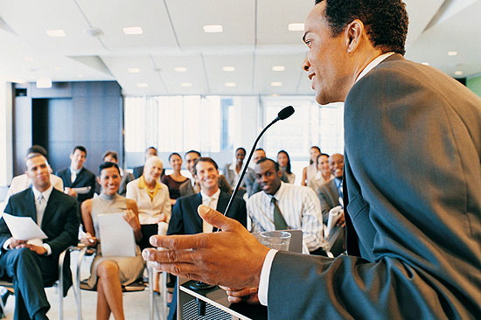
Understand your audience
Friendly audiences are easy!
  They already like you and your topic
  Use lots of eye contact, smiles, humour
  Involve the audience
Notes:
Consider that your audience may view your presentation from one of 4 viewpoints. Audiences can be classified as Friendly, Neutral, Uninterested, or even Hostile.
Friendly audiences are easy, and will help you as a presenter if you are nervous. Make eye contact, use humor, and ask for audience participation.

Slide 6

Understand your audience
Neutral audiences need to be convinced.
  Be controlled, but avoid being showy
  Use a pro-con, problem-solution pattern
  Use facts, stats, comparisons
  Avoid humour and personal stories
Notes:
Neutral audiences like to appear objective, but often their minds are already decided on an issue. For theses audiences, it is best to present both sides of an issue where applicable, and illustrate the pros and cons of each. They are not looking to be impressed, so avoid fancy presentations or visuals. Use facts, statistics, and expert opinion, and make sure to save time for questions.
Ask for an example of a neutral audience

Slide 7
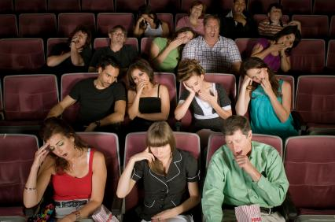
Understand your audience
Uninterested audiences have a short attention span.
  Be brief
  Be dynamic, entertaining; move around
  Use humour, visuals, startling stats
  Avoid standing motionless; don’t use handouts
Notes:
Uninterested audiences are those who really don’t want to be there. Try to keep your presentation as brief as possible, and use 3 or less points. Avoid pro/con comparisons or lists. Plan to keep their attention with movements and gestures, don’t bother with handouts or lengthy slides. Use humor, cartoon illustrations and powerful stats to hold their attention. Be sure not to darken the room, and don’t stand still. Lastly, don’t expect audience participation or you could be disappointed.
Ask for an example

Slide 8
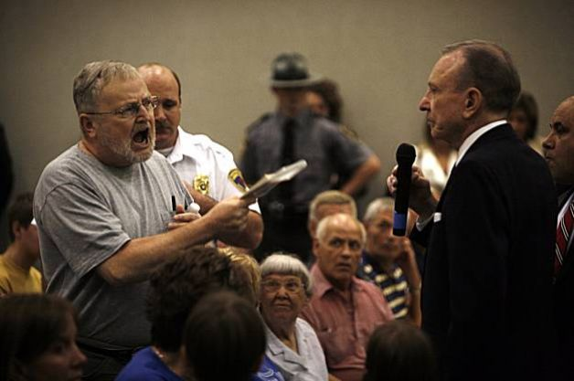
Understand your audience
Hostile audiences are defensive and emotional.
  Use a non-controversial pattern
  Be calm, controlled, confident
  Speak evenly and slowly
  Avoid personal stories, humour
  Avoid Q&A periods, if possible
Notes:
Hostile audiences are the most difficult. Keep your delivery style calm and evenly paced, avoid anecdotes, stories or humor. Where possible, avoid question periods, or if they are in fact necessary, utilize a moderator, or questions that are pre-selected.
Example?

Slide 9

Organizing the Presentation
Capture their attention
  Get them involved from the first moment
  Identify yourself and establish your credibility
  Preview your main points
Notes:
The most popular, and likely effective planning technique is to :
Tell the audience what you are going to say
Say it
Tell them what you just said
Start by capturing attention. You could start by telling a joke, asking a question, or showing an impactful slide.
Some other techniques are listed on page 311, but using these means will capture attention and ensure your listeners are engaged.

Slide 10
Organizing the Presentation
Organize the body
  Only 2 – 4 main points should be discussed
    Too many points become too boring or too complex for the audience to follow
  Arrange the discussion chronologically, by geography, by function, by value/size, by order of importance, by problem/solution, by level of complexity
  Stay on topic
Notes:
Depending on your topic, usually 2 -4 points work well. For the in class PPT presentations, your information will come mainly from the text, but should be supplemented with other resources. Find a logical method to arrange your information, and stay on topic as you go. Make sure examples, stories and jokes are relevant to the point you are trying to make. Some presenters still find it useful to organize their thoughts on paper, and then progress to slides. The process is up to you, but the final product must be coherent.

Slide 11
Organizing the Presentation
Citations
  Properly cite all sources, photos etc.
Summing up
  Conclude by reiterating the main points
Notes:
Citations – we will cover proper citations tomorrow, but for now, just remember that where you are quoting material directly, be sure to credit your sources.
Once you’ve worked thru the body of the presentation, summarize be recapping the major points. A summary is the most memorable part of the presentation, and allows the listeners to piece together the information they’ve just heard. It is not, however, a chance to recap all of the details you’ve given – just stick to the highlights. I like to think of the TSN sports highlights – I can tell you what happened in every major game of the day, by watching 5 minutes of TV late at night. This is what you are striving to do.

Slide 12

Building Audience Rapport
Use Imagery (Analogies, metaphors etc.)
Use verbal signposts
  Keep the audience informed where you are along the path
    The next thing I want to talk about…
    So far, we’ve talked about…
    Let me review the key points…
Nonverbal messages
  What are you saying?
Notes:
Building Audience rapport creates successful presentations. Just as we gravitate to the person in the room who is engaging, smiling and approachable, speakers who build rapport are interesting to listen to.
Use imagery, anecdotes, and statistics based on the type of audience you are working with.
Guide your listeners throughout the presentation using verbal signposts. Give them an outline, if appropriate, to help them keep pace, and to serve as a take-away for them.
Be purposeful about the non-verbal messages you are sending….discuss examples (my stance, my apparel, walking around the room, facial expressions)

Slide 13
Visual Aides
Know your technology, and how to use
Arrive early and test it out, where possible
Consider PowerPoint, handouts, electronic polling software if available, videos and other means to keep attention
Ensure the audience can see & hear what you are doing!
Notes:
There are many tools that can be used in giving a presentation. PowerPoint and hand outs will be employed in our class presentations, but feel free to incorporate others if possible. However, be careful that your technology is working. Remember you may not have access to adequate WIFI to run videos you embed. An example of a recent conference I was at…(give example of phone polling, but didn’t work bc the slide with the information was removed before everyone could log in)

Slide 14

Delivery
Prepare to succeed
  memorize, rehearse, Location!
Present professionally
  Pause, eye contact, go slowly
Wrapping up
  Distribute handouts, business cards
  Answer questions
  Summarize and thank
Notes:
The delivery is the most feared portion of public speaking. Being prepared can ease some of your fears before you even start. It’s not suggested to memorize your entire presentation, however, specific portions, such as the joke you open with, or your closing, should be memorized as that will allow you to make eye contact, and build rapport. Often taking a few minutes before presenting to check out the room will ease your fears, as you will understand how close you are to the listeners, how loud you’ll need to speak, and how you will operate the computer for your slides.
The spoken part of your presentation should be well rehearsed. Speak slowly and clearly – remember a pause in your mind seems much longer to you, than to your audience. Watch the audience – are they straining to hear you? Should you slow down or speak up? Or are they bored, in which case add some liveliness to your voice. Make eye contact with your listeners – you’ll always find a few safe people who are interested, and focus on them to ease your nerves.
If appropriate, once you finish you can handout business cards or handouts and answer questions. In class, both will be expected, but I leave it up to you to determine if you handouts are best done before (like mine was) or after (like this one). If there are questions posed, be sure that everyone in the room can hear them – rephrase or repeat if you are unclear. Once question period is done, thank the audience for their attention.

Slide 15


