Slide 1
BUSINESS COMMUNICATIONS
Chapter 10
Communicating in Person & by Telephone

Slide 2
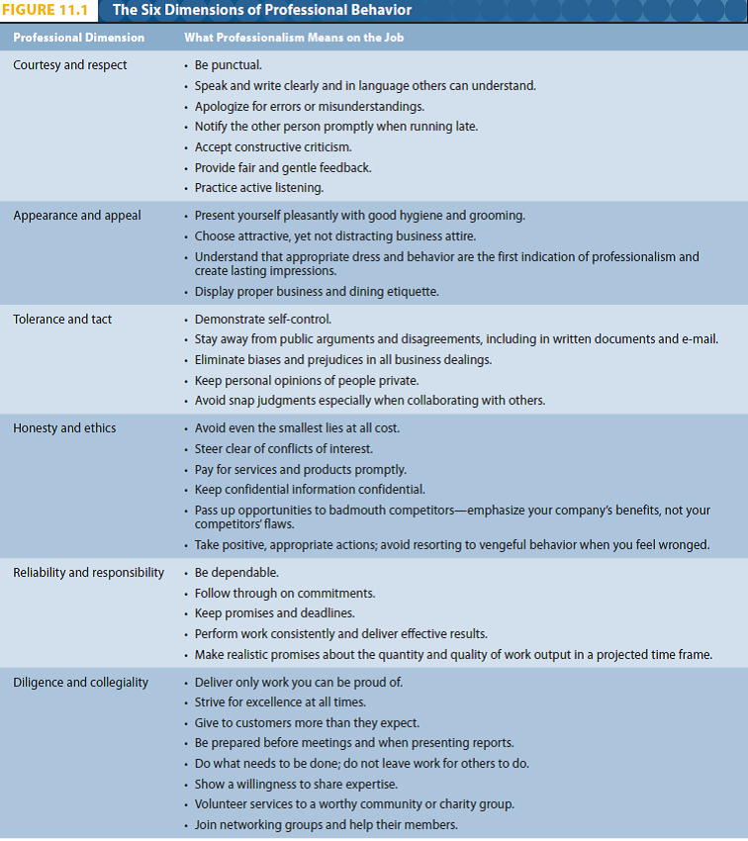
ETHICS AND PROFEsSIONAL BEHAVIOUR
Professionalism = ethics and integrity
Notes:
The wide definition of professionalism also encompasses another crucial quality in a businessperson: Ethics and integrity.
The difference between ethics and etiquette is minimal in the workplace. Ethics suggests that no sharp distinction between ethics and etiquette exists. How we approach small events at work will reflect how we can handle bigger events. We should always conduct ourselves with professionalism and ethics.
This chart summarizes many components of professional workplace behaviour. It identifies 6 main dimensions and if you try to follow these guidelines it can help with success in the job.

Slide 3
ETHICS AND PROFESSIONAL BEHAVIOUR

Slide 4
WHAT EMPLOYERS WANT
Team skills
Verbal and written communication
Interpersonal, Organizational and Teamwork skills
People skills
Notes:
Employers want team players who can work together productively. If you look at job adds you will generally find the requirements that businesses are looking for.
Some examples are:
Proven team skills to help deliver on-time, on-budget results
Strong verbal and written communication skills as well as excellent presentation skills
Excellent interpersonal, organizational, and teamwork skills
Interpersonal and team skills plus well-developed communication skills
Good people skills and superior teamwork abilities.
Also alot of employers are looking for people who show enthusiasm, an eager to learn, volunteer for hard tasks and have a positive attitude.

Slide 5
USING YOUR VOICE
The effectiveness of your voice is determined by your…
Pronunciation – saying words clearly with the accepted sounds and accented syllables
Tone – communicates your mood, your level of interest, your friendliness
Pitch – highness and lowness of the voice; provides “attractiveness” to the voice quality
Notes:
Like an actor you can change your voice to be a more powerful communication tool.
The effectiveness of your voice is determined by your:
Pronunciation: This involves saying words correctly and clearly. Some common errors with pronunciation is adding, omitting and substituting vowels or consonants. If you mispronounce words or slur your speech your risk being misunderstood as well as it can give a poor impression of yourself.
Tone: Tone sends a nonverbal message to listeners. It identifies your personality and mood.
Pitch: Effective speakers will have a relaxed, controlled, well-pitched voice that will attract listeners to their message. Pitch is sound vibration frequency that indicates the highness or lowness of our voice. When speaking voices are more attractive when they have a range of pitch. If you are monotone it can be boring. In businesses communicators strive for lower voices as it is more pleasing and professional.

Slide 6
USING YOUR VOICE…
Volume, Rate – the loudness and speed with which you speak
Emphasis – stressing key words or phrases in the message
Notes:
Volume and Rate: Volume is the loudness or intensity of sound and rate is the speed with which you speak. When speaking face to face you will generally be able to tell if you are speaking to loud or not by seeing if the person can hear you. Also with your rate if speak to slow listeners will be bored but if you speak to quickly listeners won’t be able to understand you.
Emphasis: emphasizing or stressing certain words can change the meaning of what you are saying. To make messages meaningful and interesting make sure to use emphasis appropriately.
Also in a business setting avoid using uptalk. Uptalk is when you make your sentence sound like a question when it shouldn’t be. It can make you look weak and tentative as well as it lacks conviction and authority. To sound confident and competent try to avoid using it.

Slide 7

POSITIVE WORKPLACE RELATIONS
Conversations in the workplace can make or break your relationships with your co-workers. Always think about what you say and how you say it.

Slide 8
POSITIVE WORKPLACE RELATIONS
Use correct names and titles
Choose appropriate topics of conversation
    Avoid topics that could lead to arguments
Avoid negative remarks
    Don’t be critical of others behind their backs
Listen to learn
    Be attentive; learn from what you are hearing
Give sincere and specific praise

Slide 9

OFFERING CONSTRUCTIVE CRITICISM
Mentally outline what you will say
    Think about the words you will use and how you will use them
Focus on improvement
    “Next time, you could…”
Offer to help
Be specific; don’t generalize
    Use specific details to give focus to the problem and the suggested solution
Notes:
No one likes receiving criticism and most people don’t like to give it.
Here are some helpful tips for when you must deliver constructive criticism:
Mentally outline your conversation: Think about the words you will use and how you will use them.
Generally, use face-to-face communication: Constructive criticism should be done in-person not over email or phone.
Focus on improvement: Don’t attack, use language that offers alternative behaviour such as “Next time you could..”
Offer to help: offer to help solve or fix the issue. Criticism will be better accepted this way.
Be specific and avoid broad generalizations: Dont use vague words explain the situation. Also don’t use words such as Should, never, always. Those type of words could cause the listener to shut down.

Slide 10


OFFERING CONSTRUCTIVE CRITICISM
Discuss the behaviour, not the person
  “You seem to think you can…”
  “When this happens, we lose…”
Use “we”, not “you”
  “You need to be a team player.”
  “We all need to be team players.”
Avoid anger, sarcasm, and a raised voice
Keep it private
Notes:
Discuss the behaviour, not the person
Use the word we rather than you: Emphasize organizational expectations rather than personal ones. Also avoid sound accusatory.
Encourage two-way communication: Criticism is hard to hear whether it is constructive or not. Sometimes it can surprise or hurt the person therefore it is always good to end off with letting them know that you are wanting to hear their thoughts and that you are listening.
Avoid anger, sarcasm, and a raised voice: if your temper starts to flare criticism will turn bad. Make sure you control your anger and speak in a low, controlled, and sincere tone.
Keep it private: Offer praise in public and criticism in private. Public criticism is never a good idea.

Slide 11

RESPONDING TO CRITICISM
Listen without interrupting
Acknowledge what you are hearing
Ask for more information, if necessary
Agree—if the comments are accurate
If you must disagree, do it respectfully and constructively
Look for middle ground;
compromise
Notes:
No one likes receiving criticism as it can make us feel like we are being attacked and we tend to have that fight or flight response.
Here are some tips for how to positively react to criticism so you can benefit from it:
Listen without interrupting: Make sure you hear what they are saying and don't interrupt them.
Determine the speakers intent: focus on what is being said instead of some of the poor choices of word as generally criticism is constructive.
Acknowledge what you are hearing: Respond with a nod or neutral statement. Do not disagree, counterattack, or blame as it can escalate the situation.
Paraphrase what was said: Restate in own words what you heard.
Ask for more information, if necessary: clarify what was said, stay focused on the main idea instead of injecting side ideas.
Agree-if the comments are accurate: If an apology is in order give it. Explain what you plan to do differently.
Disagree respectfully and constructively - if you feel the comments are unfair
Look for a middle position: Look for a compromise.

Slide 12
WORKPLACE CONFLICTS
Normal in every workplace, but not always negative.
Can improve decision making, clarify values, increase group cohesiveness, stimulate creativity, decrease tension, and reduce dissatisfaction
Unresolved conflict can destroy productivity and reduce morale

Slide 13
CONFLICT RESPONSE PATTERNS
Avoidance/withdrawal
Accommodation/smoothing
Compromise
Competition/forcing
Collaboration/problem solving
Notes:
Avoidance/withdrawal: instead of trying to resolve the issue someone withdraws which will create a lose-lose situation. The only time this might work is if an issue is trivial.
Accommodation/smoothing: Someone gives in to quickly. THis can be the meat method however for minor issues or if a relationship will be damaged, or if tempers are to hot for productive discussion.
Compromise: People end up giving up something to gain something more important. Can be good if both parties are going to gain something.
Competition/forcing: Who will come out on top, but results in one person failing. It will end the conflict but someone’s feelings could get hurt.
Collaboration/problem solving: both parties lay their cards on the table and attempt to reach a consensus/agreement. Is good when both parties have common goals but can’t agree on how to reach them.

Slide 14
SIX-STEPS TO DEALING WITH CONFLICT
Listen
Understand
Show concern
Look for common ground
Problem-solve
Reach an agreement
Notes:
Listen: make sure you understand the problem.
Understand: Understand the other point of view. Show you understand by asking questions and paraphrasing.
Show concern: Show a concern for the relationship. Focus only on the problem and not the person. Show an understanding of the other person's needs and a willingness to come to an agreement.
Look for common ground: Identify your interests and help the other person identify their interests. Look for a solution you can both agree on.
Problem-solve: Invent new problem-solving options. Work together to brainstorm ways to solve the problem.
Reach an agreement: Reach an agreement that is fair to both people and make sure to chose the best option.

Slide 15
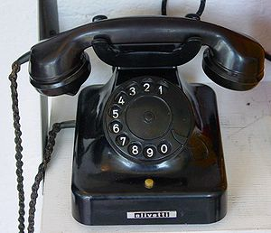
THE TELEPHONE
Notes:
The telephone is the most important equipment in offices today. It is our primary contact to customers and the outside world.

Slide 16

THE TELEPHONE
Good telephone manners reflect on you
and on your company
Identify yourself immediately
Speak clearly
Be responsive and helpful
Be cautious when answering for others
  Don’t give out confidential information
Take messages carefully
Explain what you’re doing when transferring calls or looking up something on the computer

Slide 17

THE TELEPHONE
Cell Phone Etiquette
Be courteous to those around you
Respect wireless-free quiet areas
  Theatres, restaurants, museums, classrooms, meetings, etc
  Set your cell phone to “vibrate”
Speak in low tones
  There is no need for “cell yell”
Avoid noisy areas
Drive now, talk later

Slide 18
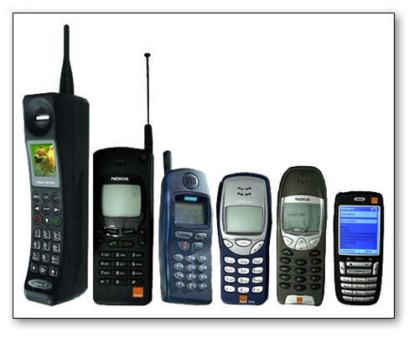
End

