Slide 1
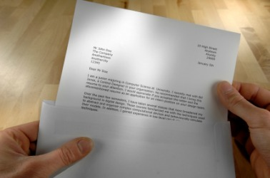
BUSINESS COMMUNICATIONS
Chapter 5
Routine Letters

Slide 2
WRITING ROUTINE LETTERS
Most business correspondence consists of routine letters
    Requesting information or action
    Making claims (such as for damaged goods)
    Ordering goods or services
    Responding to customers’ inquiries
    Responding to customers’ orders
    …and others
E-mail is the most common method of communication today, but it should be no less formal than a typical business letter

Slide 3
POWER OF BUSINESS LETTERS
Produce a permanent record
Can be confidential
Convey formality and sensitivity
Deliver persuasive, well considered messages
Notes:
Letters help businesses everyday convey goodwill to outsiders. Letters can go to suppliers, government agencies, other business and even customers. Letters remain one o f the most powerful and effective ways to get our message across.
Produce a permanent record: Many business transactions require a permanent record and letters can fulfill this function. Examples are contracts, and negotiation agreements.
Can be confidential: Email can get hacked, therefore writing letters can be more secure.
Convey formality and sensitivity: If a letter is written on business letterhead it can show formality and importance which you can’t do with email.
Deliver persuasive, well considered messages: If you aren’t able to talk to someone in person a letter can help deliver a persuasive message. Letters can persuade people to change their actions, adopt new beliefs, make donations, contribute time, and try new products.

Slide 4
BASIC LETTER STRUCTURE
Opening: State directly what you want without sounding blunt or rude; avoid negatives
Body: Give additional information logically and courteously. Ask questions if necessary.
Closing: Request a specific action with an end date, if appropriate; show appreciation

Slide 5
THE OPENING
State directly what you are writing about
Don’t use weak, indirect openings like
    I am writing to you today…
    I have a question I would like to ask…
    My name is Mary Contraree and I am the manager of…
The opening paragraph is often just 2 – 3 lines

Slide 6
THE OPENING
Example 1:
  Can the Delta Winnipeg provide meeting rooms and accommodations for about 250 GeoTech sales representatives from May 25 to May 29, 2013?
Example 2:
  I would like to receive information about your new PG-Power stainless steel and titanium golf caddy carts.

Slide 7
THE BODY
Explain fully, clearly and logically; but keep the message concise
Use bullet points if several questions are asked or several items are being addressed

Slide 8
THE BODY
Example 1:
  Your hotel received a strong recommendation because of its excellent resort and conference facilities. Our spring sales conference is scheduled for next May and I am currently collecting information for our planning committee.
Example 2:
  I was impressed by the golf carts I saw on your website and am exploring the possibility of establishing a Canadian distribution arrangement with PG-Power.

Slide 9
THE CLOSING
Ask for a specific action
Set a deadline, if appropriate
Express thanks or appreciation

Slide 10
THE CLOSING
Example 1:
  I would appreciate a response by December 1st as our planning committee will meet in mid-December to finalize details.
Example 2:
  Your prompt response would be very much appreciated.

Slide 11

End of Part 1

Slide 12
REQUEST LETTERS
A request letter…
  Asks for information, or
  Asks for something to be done (action)
  Is generally positive, even in a negative situation
  Is concise
  Is worded as you would say it

Slide 13
REQUEST LETTERS
¶ 1: Ask the most important question first or express a polite command (request)
¶ 2: Explain further; include all necessary details; be logical and thorough; be concise
¶ 3: Request a specific action; state a deadline date; show appreciation

Slide 14
REPLYING TO REQUEST LETTERS
Responding to a request letter…
  Check facts and figures carefully
  Any letter written on company stationery is considered a legally binding contract
  If something needs approval seek approval first before writing the letter

Slide 15
REPLYING TO REQUEST LETTERS
¶ Subject Line: Identify previous correspondence
¶ Opening: Deliver the most important information first
Body: Arrange information logically and answer each inquiry fully
¶ Closing: Include a pleasant closing remark that shows willingness to help the reader

Slide 16
YOUR ASSIGNMENT… PART 1OF 4
Page 138
5.7 Information Request: Backpacking Cuisine
  Write this letter requesting information about freeze-dried food.

Slide 17
YOUR ASSIGNMENT… PART 2 OF 4
Page 140
5.14 Information Response: Backpacking Cuisine
  Read the situation carefully
  Write the claim response in a polite, positive tone
  Inform him where his products are available and that if a large order he can place through you. As well as that you will offer a 5% discount on direct orders with yourself.

Slide 18
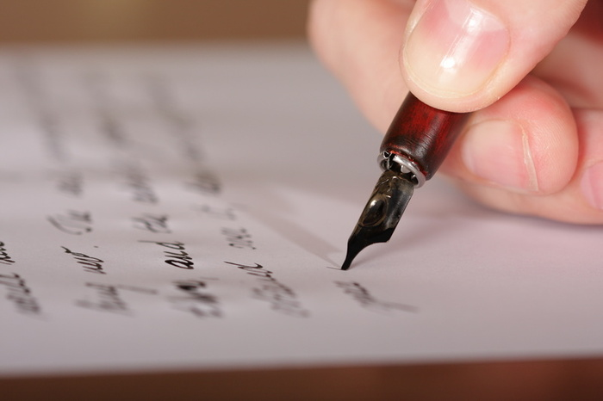
End of Part 2

Slide 19
CLAIM LETTERS
A claim letter…
  Identifies a problem, giving full details
  Includes reference to pertinent documents, such as invoices, receipts, contracts, etc.
  Requests a reasonable solution
  Expresses appreciation for consideration
A claim letter does not…
  Show anger
  Jump to conclusions
  Fail to suggest a reasonable solution

Slide 20
CLAIM LETTERS
¶ 1: Describe clearly what you want them to do to resolve the problem
¶ 2: Give all supporting detail for the claim; explain how the claim is justified
¶ 3: End pleasantly with a goodwill statement and set a deadline

Slide 21
CLAIM LETTERS
Example:
  Page 123: Read the sample letter at the top of the page.
      What is wrong with this letter?
      If you received this letter, what would your reaction be?

Slide 22
REPLYING TO CLAIM ETTERS
Responding to a claim letter…
  Rectify the wrong, if one exists
  Regain confidence of the customer
  Promote future business and goodwill

Slide 23
REPLYING TO CLAIM LETTERS
Subject Line (optional): Identify previous correspondence
Opening: Grant request or announce the adjustment immediately. Include resale or sales promotion if appropriate
Body: Provide details about how you are complying with the request. Try to regain the customers confidence.
Closing: End positively with a forward-looking thought, express confidence in future business relations, and avoid referring to unpleasantness

Slide 24
YOUR ASSIGNMENT… PART 3 OF 4
Page 139
5.11 Claim Letter: Deep Desk Disappointment
  Read the situation carefully
  Write the claim letter in a polite, positive tone
  Add any details that would be helpful to this claim

Slide 25
YOUR ASSIGNMENT… PART 4 OF 4
Page 141
5.18 Claim Response: Deep Desk Disappointment
  Read the situation carefully
  Write the claim response in a polite, positive tone
  Add any details that would be helpful to this response

Slide 26
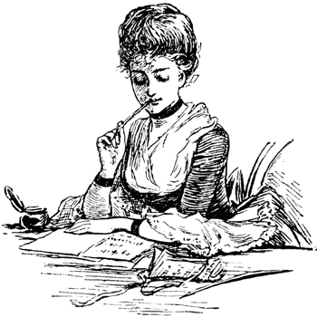
End

