Slide 1

Business Communications
CHAPTER 1
COMMUNICATION FOUNDATIONS
Notes:
Ask students – how do we communicate with others? If non-verbal doesn’t come out as an option, give an example (ie. Sit on desk and look bored) Wait for responses, then flip to next slide

Slide 2
Succeeding in the Changing World of Work
Why is it important to develop communication skills?
Technology (we communicate rapidly)
Flattened management hierarchy (more employees making decisions)
Global competition (interaction with other cultures)
New work environments (telecommuting)
Knowledge economy (growth of business)
Notes:
The work world is changing dramatically constantly. Many of the changes revolve around processing and communicating information. Having highly developed communication skills will allow you to be successful. The following business trends illustrate the importance of excellent communication skills:
Innovative communication technologies: Email, instant messaging, the Web, mobile technologies, audio- and video conferencing mean that you will be communicating more often and more rapidly.
Flattened management hierarchies: There are less managers now a days which will mean you have to make decisions and communicate them with the customers, fellow employees and executives.
Heightened Global competition: In business today you could be interacting with many people from different cultures. You will want to learn how to be able to communicate with the different cultures to be successful.
New Work environments: Mobile technologies and the desire for a work/family life balance have resulted in more flexible working arrangements. Working away from the office will require more exchange in email communications.
The Move to a Knowledge Economy: Businesses are constantly growing and will require you to have excellent communication skills.

Slide 3
Communicating
How do we communicate our messages to others?
Speaking (in person, on the phone)
Writing (letters, texts, emails)
Listening (or not!)
Body language
Taking action / Doing nothing
Notes:
Text has a few pages on written communication, and mentions the use of templates, the importance of editing, and databases.

Slide 4
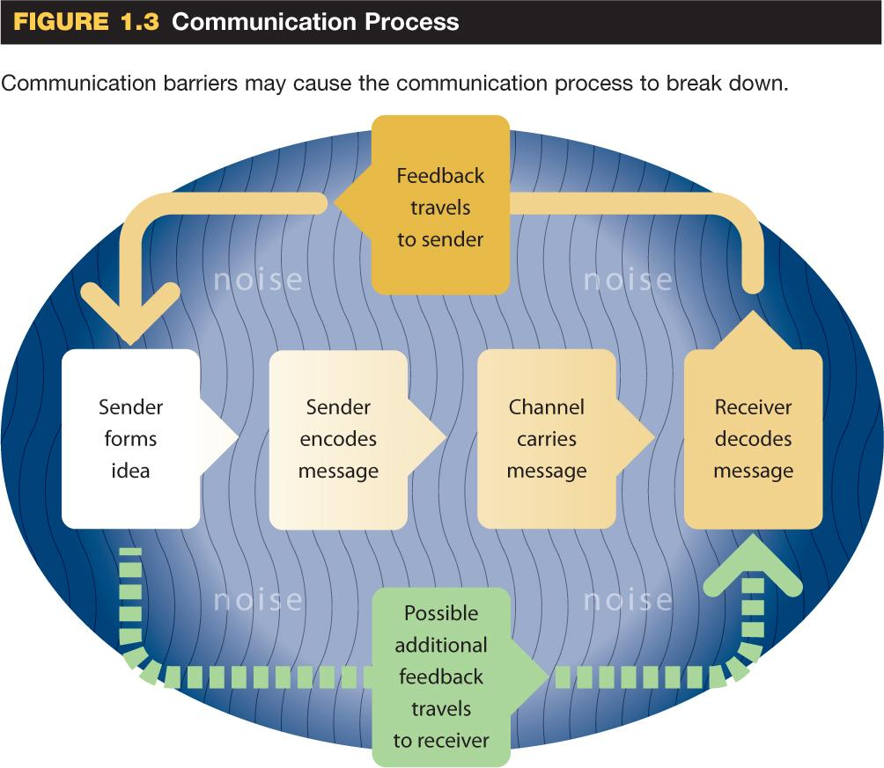
Communication Process
Notes:
Communication is the transmission of information between sender and receiver.
Purpose of communicating is to deliver meaning (though there are several factors that can interfere)
Five essential steps in all forms of communication:
Sender forms idea influenced by a number of factors.
Sender encodes idea in a message by using spoken or written words.
Message travels over a channel, which could include e-mail, letter, text message, etc.
Receiver decodes message and understands the meaning.
Feedback travels to sender through a nod or responding message.

Slide 5
Listening
What are barriers to effective listening?
Physical barriers
  Hearing impairments, poor acoustics, noise
Personal barriers (individual attitudes)
Language problems
    Unfamiliar words
    Different pronunciation
Notes:
Physical Barriers: you can’t listen if you don’t hear what is being said. Physical impediments include hearing impairments, poor acoustics, and noisy surroundings. It’s also hard to listen if you are ill, tired, uncomfortable, or worried.
Personal Barriers: Everyone has their own culture, ethical and personal values. We all have an idea of what is right and what is important. Others might not believe the same as we do and it can cause us to lose interest in what they are communicating and makes us not hear them properly.
Language Problems: Unfamiliar words, different pronunciations or accents can lead to issues understanding what is being said.

Slide 6
Listening…
Nonverbal distractions
    Unconventional appearance, speech and body mannerisms, facial piercings, tattoos, etc.
Thought speed
  Thinking ahead, not paying attention to the speaker
Faked attention
    Pretending to pay attention but not concentrating
  ...
Notes:
Nonverbal Distractions: Some people can find it hard to listen if the speaker isn’t who they were expecting. Unusual clothing, different speech and body mannerisms, body twitches, or a radical hairstyle can distract us from hearing what the person is saying.
Though Speed: Our thoughts can be alot faster than the person speaking. Sometimes we become bored and let our mind wander.
Faked Attention: Most of us have learned to pretend to be listening even when we are not but by doing this it threatens our effective listening skills.

Slide 7

Listening…
Grandstanding
    Talking instead of listening
Technological barriers
    Checking cell phones
    Poor connections
    Background noise and distractions on call etc.
Notes:
Grandstanding: Talking instead of listening to someone. Sometimes you want to be heard or you want your ideas out there so you're not listening to the person but more so listening to a break in their speaking to be able to talk yourself.
Technological Barriers: Listening skills can be effected by wanting to constantly check your phone, or if you are talking to someone on the phone it could be affected by a poor connection which causes the person to cut in and out therefore you miss information. Lastly if you are in a loud area talking to someone on the phone and lots of distractions around you, you might not be fully listening to the person on the phone.
See list on page 12/13 – ask for examples of when Students have experienced these challenges

Slide 8
Listening…
Active listening tips:
  Stop talking
  Control the surroundings
  Receptive mindset
  Keep an open mind
  Listen for main points
  Capitalize on lag time
  Listen for feelings and facts
  Judge ideas not appearances
  Be patient
  Take notes
  Feedback
Notes:
Listing on page 13- applicable to all areas of life – classwork, job interviews and work environment, personal world and relationships.
Consider it a compliment to be called a good listener, not only well spoken.
STOP HERE FOR DAY 2

Slide 9
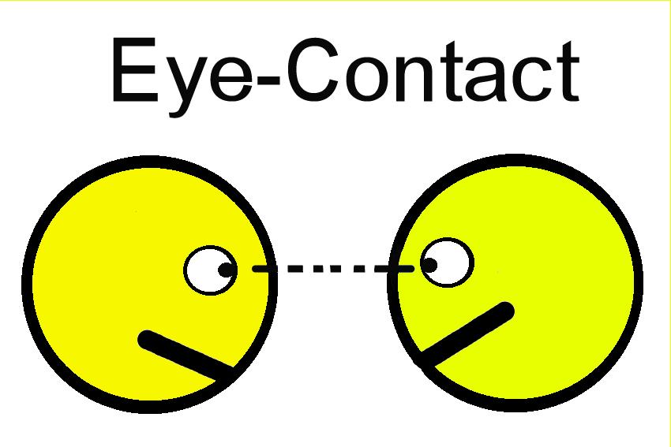
Silent Messages
Your eyes, face and body send silent messages
Eye contact
  Good eye contact suggests trust, admiration
  Poor eye contact signals fear, stress or lack of trust
Facial expression
  Raising/lowering eyebrows
  Rolling eyes
  Squinting
  ...
Notes:
PICKUP HERE FOR DAY 6
Messages are delivered beyond words. Nonverbal cues are as, if not more, important than verbal cues.
Eye Contact: Your eyes can tell the person you are talking to your true feelings. Most people cannot look people in the eyes and lie to them. Therefore we tend to believe that people who look directly at us are sowing trust and admiration. Good eye contact allows you to tell if the person you are talking to is paying attention, showing respect, responding favourably, or feeling distressed.
Facial expressions: The expressio on people’s faces can be almost as revealing as their eyes. Some people have poker faces where they can hide their feelings but most people have tells and arent able to hide how they are feeling. Examples of this are raising our eyebrows, squinting eyes, swallowing nervously, clenching the jaw, etc. These expressions can add to or entirely replace verbal messages.

Slide 10
Silent Messages…
Posture
  Sitting up or slouching in your chair
Body language
  Crossing your arms
  Rubbing your head
  Picking your nose
  Checking cell phone while attending to a customer
  Yawning
  Others?
Notes:
Posture: A persons posture can convey status and self confidence to shyness and submissiveness. Examples of posture are:
leaning towards a speaker suggest attraction and interest
Pulling away or shrinking back denotes fea, distrust, anxiety, or disgust

Slide 11
Time, Space, and Territory
Time
  Length of meeting determines importance of discussion?
Space
  Arrangement of furniture
  Open concept offices
Territory
  `personal bubble` (see p 15)
Notes:
These three external elements convey information in the communication process.
Time: How we structure and use time tells observers about our personality and attitudes. If we schedule more time for a meeting it shows we respect and interest in what the person we are talking to.
Space: How we arrange the space around us tells something about ourselves and objectives. Generally the more formal the arrangement, the more formal the conversation. If you have an open concept office it will allow for unrestricted flow of communication and worg among others.
Territory: We all have our own area that we feel is our territory whether its a specific spot or the area around us. We all have our own personal bubble that we don’t like people to intrude
Ask where are you more likely to desire an awkward conversation to take place? Does it depend on who is delivering/receiving the message?

Slide 12
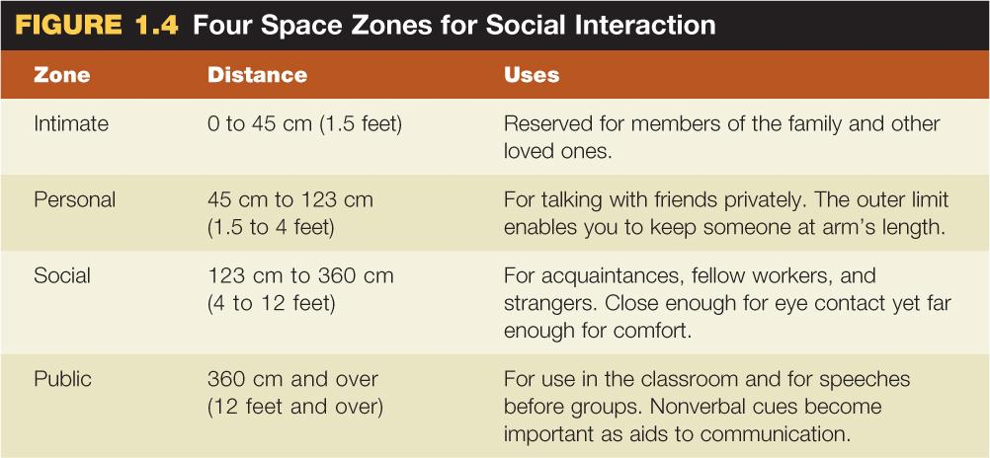
Zones of Privacy
Notes:
Ask where are you more likely to desire an awkward conversation to take place? Does it depend on who is delivering/receiving the message?
Interesting chart on pg 15 re; Personal space – bring measuring stick and do experiment

Slide 13
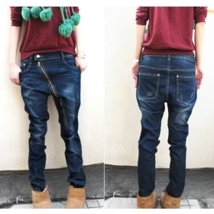
How Appearance Sends Silent Messages
Business Documents
  Should be organized, readable, and correct
Appearance of People
  Hair, teeth, fingernails
  Tattoos, piercings
  Clothing: fashion choice
  Clothing: clean, pressed, fit
Notes:
The physical appearance of a business document as well as the personal appearance of an individual, transmits immediate and important nonverbal communication.
Business Documents: The way an email, letter, memo, or report looks can have a positive or a negative effect on the person receiving it. If the document is sloppy it shows that you don’t care or that you were in a hurry.
Appearance of People: The way you look - your clothing, grooming, and posture - send a nonverbal message about YOU! People make quick judgments just off of what they can see.

Slide 14
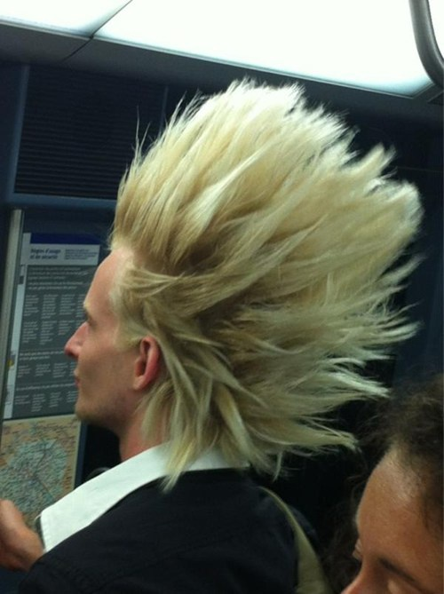
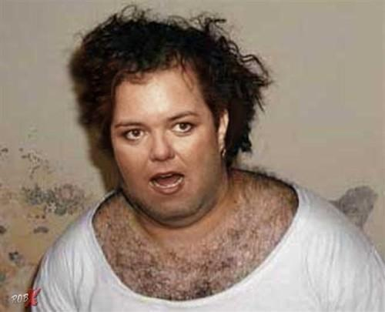
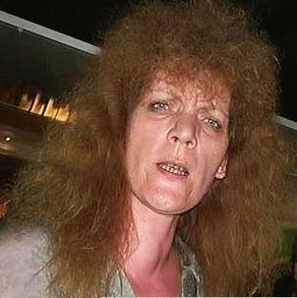
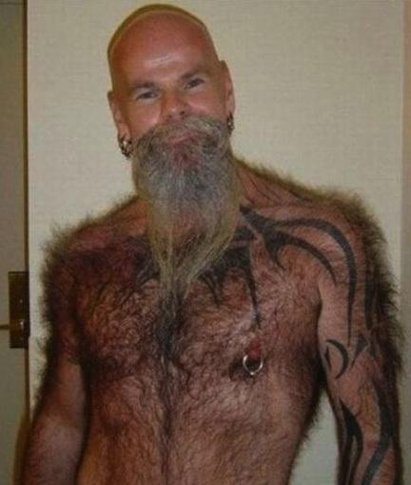
How do people read us?
What do people think when they first see us?
Notes:
Meet John – what are your first impressions? Do you think this is acceptable for a Marina? What about a Dr’s office? Library? Etc.

Slide 15
Tips for Improving Your Nonverbal Skills
Establish and maintain eye contact
Use posture to show interest (look alert)
Associate with people from diverse cultures (learn their customs)
Appreciate the power of appearance (maintain professionalism)

Slide 16
Culture Affects Communication
Must be sensitive to others
Learn customs and traditions of other cultures when doing business with them
Canadians value collective decision making and tolerance of others
Americans value individualism (common among most Western cultures)
Notes:
Anyone ever watched the TV Show “The Office”? It’s almost a how-to-manual for doing the wrong things when it comes to different cultures, gender, and backgrounds in the context of a professional office.
Review article re: article “Doing business abroad? Simple faux pas can sink you” by Gary Stoller in USA TODAY at http://www.usatoday.com/money/industries/travel/2007-08-23-faux-pas_N.htm.

Slide 17
Comparing Key Cultural Values in Canada
Individualism vs Collectivism (more collectivist than the United States)
Formality (less emphasis on tradition)
Communication Style (straightforward, polite)
Time Orientation
Notes:
Individualism vs Collectivism: Individualism is an attitude of independence and freedom from control, and collectivism is the idea that the group or nation is more important than its individual citizens.
Formality: Canadians place less emphasis on tradition, values, ceremony, and social rules than do some people in other cultures. Our lack of formality is often characterized by a directness in our business dealings. Indirectness we feel, wastes time which is a valuable commodity.
Communication Style: We value straightforwardness and are suspicious of evasiveness and distrust people who have a hidden agenda or play their cards to close to their chest. We are more polite and reserved in our communication.
Time Orientation: We consider time a precious commodity to be conserved. We equate time with productivity, efficiency, and money. Keep people waiting wastes time and is rude.

Slide 18
Culture Affects Communication
Ethnocentrism
    The belief in the superiority of one’s own culture
Stereotypes
    The belief (or expectation) that all members of a particular group share the same qualities or attributes
      Germans are formal and blunt
      Americans are loud and impatient
      Canadians are polite and tolerant
      Bikers are gangsters

Slide 19
Tips for Minimizing Written Miscommunication
Adopt local styles
Consider hiring a translator
Use short sentences and short paragraphs
Avoid ambiguous writing (idioms, acronyms, etc.)
Cite numbers carefully (especially with dates)
Notes:
Adopt Local Styles: Learn how documents are formatted and how letters are addressed. Use local formats and styles.
Consider hiring a translator: Engage a translator if (1) you document is important, (2) your document will be distributed to many readers, or (3) you must be persuasive.
Use short sentences and paragraphs: Sentences with fewer than 15 words and paragraphs with fewer than 5 lines are most readable.
Avoid ambiguous writing: Avoid idioms such as once in a blue moon, slang (my presentation really bombed), acronyms (ASAP for as soon as possible), abbreviations (DBA doing busines as), and jargon (inout, output, bottom line). Make sure to use action specific vers (purchase a printer rather than get a printer)
Cite numbers carefully: Always convert money into local currency. Avoid using figure to express the month of the year for clarity spell the month out to not confuse it with the day.
Ask students to explain in simple English what the following idiomatic expressions mean. Have them assume that they are explaining them to people for whom English is a second language.
a. let the cat out of the bag (reveal a secret carelessly or by mistake)
b. take the bull by the horns (to deal with a difficult situation in a very direct or confident way)
c. he is a tightwad (a close or miserly person.)
d. putting the cart before the horse (to do things in the wrong order)
e. to be on the road (Traveling away from one's home or usual place of work)
f. lend someone a hand (to provide help)
g. with flying colours (with an overwhelming victory, triumph, or success)
h. turn over a new leaf (to alter your behavior in a positive way. to start fresh. to change course)
(page 26)

Slide 20
End

