Slide 1

Customer Service
Chapter 11
Technology and
Customer Service

Slide 2
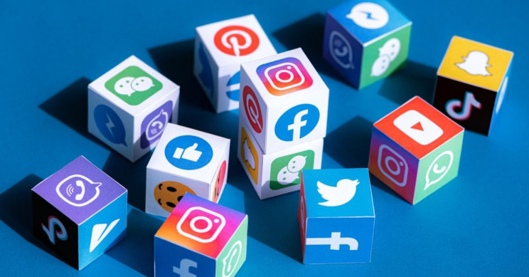
Social Media
Electronic communication used by consumers to share ideas, information, opinions, and personal messages
No or very little cost
Ever-changing opportunity to serve customers
Notes:
Social media is electronic communication used by consumers to share ideas, information, opinions, and personal messages.
Examples can be facebook, twitter, instagram, etc. The list goes on and customers are embracing these opportunities.
Social media is pushing companies to reevaluate and redefine they serve their customers. Using social media can be a cost effective way to to advertise as it is a lot cheaper than regular advertisement Social media can have no or very little cost associated. If your business starts to grow than you might put some money into it by promoting your posts but other than that it could cost you nothing.
The reality nowadays is that social media has become a part of the ever-changing opportunity to serve customers.
It provides companies to have an increased collaboration for problem solving.

Slide 3
Express appreciation
Share information
Status updates for deadlines, events, and opportunities
Link to other resources
Share what’s trending
Notes:
When using social media to interact with customers remember the following:
Express appreciation to customer referrals
Share information
Status updates for deadlines, events, and opportunities
Link to other resources
Share what’s trending

Slide 4
Today’s Customers Expect
Availability: Service designed to meet the customer’s schedule.
Accessibility: When the customer needs to talk, the provider can be reached.
Accountability: Customers prefer quick and accurate answers to service questions.
Notes:
Customers want hassle-free customer experiences that are user friendly and that validate their choices.

Slide 5
Steps for Introducing New Technologies
Prepare your staff
Train supervisors and team leaders first and get them to buy in.
Develop a group of “change champions”.
Sell your vision
Notes:
Prepare your staff: Get the call center staff involved from the start.
Train supervisors and team leaders first and get them to buy in.
Develop a group of “change champions” who will act as advocates for the new technology.
Sell your vision: Convey your enthusiasm and share how much easier work will be.

Slide 6
Steps for Introducing New Technologies
Praise successful use of the new technology
Resist the temptation to complain
Celebrate small successes
Avoid the “shelfware syndrome”.
Notes:
Praise successful use of the new technology
Resist the temptation to complain
Celebrate small successes: Celebrate small milestones along the way to keep all involved excited.
Avoid the “shelfware syndrome”: The temptation to give up and put the new technology on the shelf, never to be used.

Slide 7

Call Centres
Teleselling (or telemarketing)
  Selling products, service or information by phone
Inbound calls
  Calls that originate with the customer
  Catalogue ordering, billing inquiry, tech support
Outbound calls
  Calls that originate from the call centre to the customer
  Selling, market research, follow-up
Notes:
One rustic growth in customer service is the use of call centres. Call centre have a unique advantage of being able to be located anywhere that there is a significant work base. Call centres also allow service cost to be reduced due to not needing one-on-one service but customers do compromise on that service.
Some call centres might include teleselling or telemarketing which is selling products, services, or information via the telephone.
There are two types of calls within call centres:
Inbound calls: Calls that originate with the customer and may include catalogue ordering, billing inquiry, tech support, product use, or other information
Outbound calls: Calls that originate from the call centre to the customer and are usually intended to sell products, conduct market research, follow-up with customers inquiries.

Slide 8
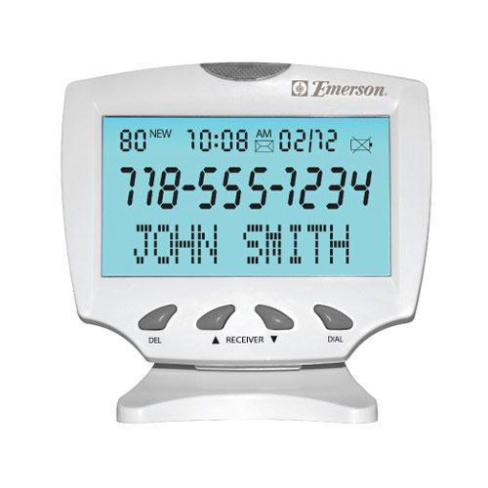
Call Centres
Automatic call distribution
  Computerized systems that automatically routes calls to the next available service provider
Automatic number identification (caller ID)
  Allows the call recipient to identify the incoming number and caller
Notes:
When calling a customer service centre most of them have sophisticated systems that include special call routing systems including Automatic call distribution which is a computerized system that allows calls to be routed to the next available agent. Another thing that call centres have is an automatic number identification (Caller id) which will allow them to see how they are talking to and bring up their contact information on the computer.

Slide 9

CS on the Internet
Online bill paying
  Receiving and paying bills online
Buying/selling goods, services
  Online shopping
Online tutorials
Webinars
  Seminars on the web
  (online training/collaboration)
…
Notes:
Customer have started to rely on the internet for some of their shopping needs.
Some services customers are using are:
Online billing: Receiving and paying their bills online. It decreases the amount of time for paying bills
Buying/selling goods, services: Online shopping is at an all time high This allows customers to search for the best prices or buy and ship to their house.
Online tutorials: Allows customers to access tutorials at all hours and they can repeat them until they understand what it is they are watching.
Webinars: Online collaboration or training.

Slide 10
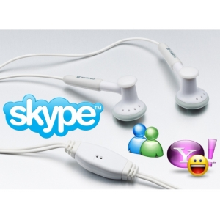
CS on the Internet
…
Technical assistance
Internet phone
  VoIP = Voice over Internet Protocol
  e.g. Skype
Email
Notes:
Technical assistance: assistant via the internet.
Internet phone: VoIP = Voice over Internet Protocol, e.g. Skype
Email

Slide 11
Enhancing Service Experiences
Getting the business name in front of customers often
  Frequent email updates
  Social media
Build a relationship with customers
Customers vote on service with their Business!!
Notes:
Customer loyalty is one of the defining areas of success or failure for service providers. Facebook and email are a good way of getting and keeping customer loyalty. Getting your businesses name out there and in front of customers as possible as often can also increase loyalty. By building a relationship with your customers you can build your loyalty and they can start relying on your for shopping needs.

Slide 12

Quick Quiz
Page 159

Slide 13
End

