Slide 1
Customer Service
Chapter 10
Customer Retention and
Measurement of Satisfaction

Slide 2

Customer Retention
The continuous attempt to satisfy and keep current customers actively involved in conducting business
  Keep them happy!
  Keep them coming back!
Customers are more than just a business contact
Notes:
Customer retention is the continuous attempt to satisfy and keep current customers actively involved in conducting business.
Most business know that this is important but still very few have created an active approach at keeping customers. Most businesses are so worried about gaining new ones that they can sometimes forget about the ones they currently have but we want to remember to keep creating and environment that makes our current customers to want to come back.
As we know it is harder to regain customers once you lose them as well as it is more expensive to get a new customer than it is to retain an exisiting customer.
A well developed plan for customer retention creates an environment in which customers’ needs are met on an ongoing basis and new needs are explored. Customers should be reminded that tier are valued and important. The result of customer retention is that customers will be so satisfied by a company that they are not motivated to seek other opportunities. They want to see that their dollar is well spent and that they are receiving a positive return for their investment. Customers will develop a stronger loyalty to companies that show interest in them as customers.

Slide 3
Existing Customers
They know how we do business
They know our policies
They are familiar with our products/services
They buy without requiring a sales pitch
They will consider new products/services more easily
“Don’t date your customers; marry them.”
Notes:
Existing customers are very important to a business.
Existing customers now us and our policies, how we do business, they are familiar with our products and services, they will frequently buy without requiring a sales pitch, they will not tolerate a decline in our quality, but they will consider new product or service offerings more easily.
We must work to maintain our existing customers.These customers can sometimes be taken for granted.
One thing to remember though is to not date your customers but to marry them. What does this mean? By marrying our customers we are making a commitment and show to them that we are in an ongoing relationship with them. We are showing them that we are concerned about their success ad happiness today and always.

Slide 4
Churn Rate
The number of customers who leave a business in a one-year period divided by the number of new customers in the same period
210 leave ÷ 350 new = 0.6 or 60% churn rate
(The lower the churn rate, the better.)
Notes:
All business whether large or small will have a marketing department that is concerned about attracting new customers. A way to measure the significant value of retaining existing customers is to measure the churn rate, defection rate, and customer lifetime value for a given year.
Churn rate is the number of customers who leave a business in a one-year period divided by the number of new customers in the same period

Slide 5

Defection Rate
The percentage of customers who leave a business in a one-year period
350 leave ÷ 1000 we had = 0.35 or 35% defection rate
(The lower the rate, the better.)
Notes:
Defection rate is the percentage of customers who leave a business in a one-year period.

Slide 6

Customer Lifetime Value
The net present value of the profits a customer generates over the average customer life
$ 3,000 average profit per year per customer
x 8.6 years average life
$25,800 lifetime value
Notes:
Customer Lifetime Value is the net present value of the profits a customer generates over the average customer life.
Once you know how much it costs to lose a customer, you can make a decision regarding investments to retain customers. From this method of determining churn, defection, and customer lifetime value, it is easy to determine that even a small reduction in customer defections can result in a positive profit result.

Slide 7
Improving a
Customer Retention Program
Are you measuring customer satisfaction?
What level of priority is being placed on customer satisfaction?
Do you measure quality standards and communication results with management and staff?
Do you train and retrain customer service providers?
What is your level of employee turnover?
Notes:
To determine if you need to improve your Customer-retention programs ask yourself the following questions:
Are you measuring customer satisfaction?
What level of priority is being placed on customer satisfaction?
Do you measure quality standards and communication results with management and staff?
Do you train and retrain customer service providers?
What is your level of employee turnover?

Slide 8
Improving a
Customer Retention Program
How much do you spend to keep current customers?
What is your cost for acquiring customers?
What is your customer-defection rate?
What do you do to get customers back?
Do you deliver on what you promised to your customers?
Notes:
How much do you spend to keep current customers?
What is your cost for acquiring customers?
What is your customer-defection rate?
What do you do to get customers back?
Do you deliver on what you promised to your customers?
If you do not have an answer for any of the questions it is time to develop a customer retention program within your company.

Slide 9
Developing a
Customer Retention Program
Examine who your customers are and what specific needs they have
Identify specific objectives to be realized
Create a manageable program of customer retention
Create a culture that stimulates customer interest
Set a timetable for evaluation
Notes:
When creating a customer retention program you want to make sure it is manageable and that it supports the goals of the organization.
Some basic approaches to customer retention is follow-up phone calls, face-to-face visits, special events, name recognition, reminder faxes, coupons, newsletters, and the willingness to do something extra.
Customer retention requires initiative. It means as a customer service provider you need to know and understand what the customer needs and be ready to suggest opportunities. You also must create relationship with your customers to convey to them that they are more than just a contract.
When establishing a customer retention program, remember the following:
Examine who your customers are and what specific needs they have: If you understand who they are you can create your retention program to cater to your customers and your business.
Identify specific objectives to be realized by the program: Determine what you want to be accomplished. Objectives should be specific: to increase sales, tom improve communication, or to enhance customer loyalty.
Create a manageable program of customer retention: May need to start small and grow larger as you become more successful.
Create a culture that stimulates customer interest: Management should create and environment where employees encourage customers to keep doing business with us. Management should provide examples of the company’s philosophy of customer service. The company’s philosophy is the company’s ideas and beliefs as to what is important.
Set a timetable for evaluation: This will be when you look at the program and see if it needs any improvements.

Slide 10
Measurement of Satisfaction
Survey customers…
Who are they? (demographics)
How did they begin doing business with us?
Where are they located?
Where do they conduct business with us? (if multiple locations)
When do they do business with us?
What do they like about their experience?
How can we do a better job?
Notes:
Remember as we are trying to provide satisfaction to our customers we need to also measure that satisfaction. TO measure satisfaction we must ask questions that are relevant. Questions we should ask are:
Who are they? (demographics)
How did they begin doing business with us?
Where are they located?
Where do they conduct business with us? (if multiple locations)
When do they do business with us?
What do they like about their experience?
How can we do a better job?
To measure customer satisfaction effectively we have to look at the customers situation from their perspectives. A measurement format should be to the point and shouldn’t take long to complete. If sending by mail as well we should send it with paid postage for them to send back or else they won’t complete it.

Slide 11

Sources of Information
Informal surveys: cashier asks questions
Comment cards
Verbal comments: noting unsolicited comments by customers
Historical data (point-of-sale)
Monitoring dollar sales: are sales increasing or decreasing?
…
Notes:
There are several sources for obtaining information about our customers’ satisfaction. Here are some possible ones:
Informal surveys: cashier asks questions. THis can provide insights of likes and dislikes.
Comment cards: Most popular, do not provide to much detail but can provide immediate feedback.
Verbal comments: noting unsolicited comments by customers.
Historical data (point-of-sale): This will allow you to find out how much a customer has purchased, how often, etc. Doesn’t give current data but allows you to see what is happening.
Monitoring dollar sales: are sales increasing or decreasing?

Slide 12

Sources of Information
…
Corporate-generated surveys
Discussions with internal customers
Focus groups
Toll-free phone numbers
Customer intelligence information
    as discussed in an
    earlier chapter
Notes:
Corporate-generated surveys: Surveys sent to customers. Usually have more detail and are usually statistical. May have a lower response rate though.
Discussions with internal customers: Tend to know who customers like or dislike, they usually know what is not working well.
Focus groups: Random groups of customers or prospective customers brought together to discuss current or future offerings of a business. Can sometimes be challenging to organize.
Toll-free phone numbers: This encourages customers to contact us when problems or questions arise.
Customer intelligence information: the process of gathering information; building a historical database; and developing an understanding of current, potential and lapsed customers. It will allow business to build on information already gathered.

Slide 13
Satisfaction and your Business
Deepen our relationship with our customers.
Show our customers that we are interested in knowing what they think and are willing to strive to satisfy them
Notes:
By measuring customer satisfaction we deepen our relationship with our customers. We consider their level of satisfaction, their expectations, and their perceptions. We ask questions and create an environment that encourages sharing of ideas and concerns. By doing that you convey to your customers that we are interested in knowing what they think and are willing to strive to satisfy them. By seeking feedback from our customers it can result in positive customer retention.

Slide 14
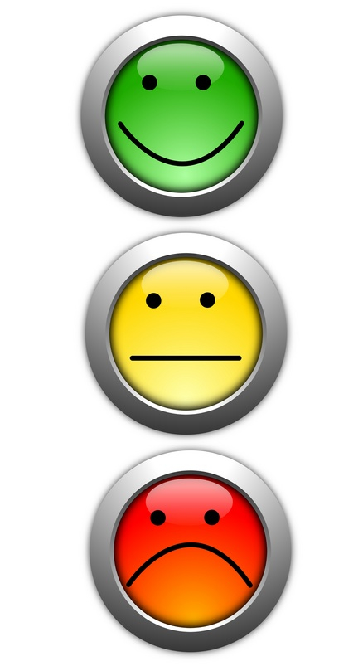
Quick Quiz
Page 147

Slide 15
End

