Slide 1
Customer Service
Chapter 7
Coping with Challenging Customers

Slide 2
Challenging Customers
Who are they?
  Those customers with problems, questions, fears and personalities that require us to work to achieve true communication
  We are often required to spend the greatest amount of our time with them
Notes:
Challenging customers are those customers with problems, questions, fears and personalities that require us to work to achieve true communication. Because all individuals have their own unique personalities and set of past experiences, different people might not find the same person challenging. Although these type of customers are difficult to interact with we just need to remember they are still our customers and our goal is to provide them with excellent customer service.
You will also often find that these type of customers require us to spend the greatest amount of our time with them.

Slide 3
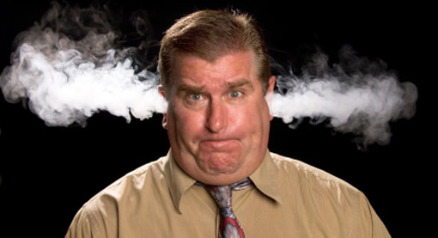
Challenging Customers
Why are they challenging?
  They don’t speak our language
  They don’t understand the product or situation
  They are hostile or impatient
  They show an attitude of superiority
  They can’t make a decision
  …and others
Notes:
Why are customers challenging?
Customers can be challenging for a wide variety of reasons and sometimes they can be challenging without having to do anything to us. Reasons they could be challenging are:
They don’t speak our language, They don’t understand the product or situation, They are hostile or impatient, They show an attitude of superiority, They can’t make a decision, they are visibly upset about something and it may have nothing to do with you, the list goes on.

Slide 4
Challenging Customers
5 Tips to Keep from Creating Challenging Customers
  Respect the customer’s time
  Don’t impose your bad or negative mood on others
  Acknowledge regular customers with a smile, and use their names
Notes:
Respect the customer’s time: Always work at peak efficiency. Stay focused on the customer.
Don’t impose your bad or negative mood on others: Everyone has a bad day every once in awhile but you shouldn't let your customers see that.
Acknowledge regular customers with a smile, and use their names: Customers value the experience they have when doing business with organizations. If they are a frequent customer they would expect that you remember them and their name.

Slide 5

Challenging Customers
5 Tips to Keep from Creating Challenging Customers
  Avoid destructive remarks
  Show initiative
  …and…
  Don’t check your phone
  messages while dealing with
  a customer
Notes:
Avoid destructive remarks: They may seem like like it is satisfying to have the last word but in the long run it doesn't look good on you.
Show initiative: Show customers that you are willing to complete a task or go the extra mile for them.

Slide 6


Challenging Customers
Characteristics of Challenging Customers
  Language / cultural barriers
  Older customers
  Impatient customers
  Angry customers
  Analytical customers
Notes:
Challenging customers can be categorized many ways but here are 10 common ways:
Language/Cultural Barriers: As society evolves with different cultures you will come across many individuals who speak English as a second language or who barely speak it at all. If ever communicating with someone who has difficulty speaking English just remember to talk slow and clearly, avoid using slang terms. If words arent conveying the message try using hand gestures, do not pretend to understand the customer if you didnt actually you can ask them to repeat. Ask questions and repeat what you heard. Try not to become frustrated. Sometimes writing out the message can be the best way to communicate.
Older customers: Society is getting older. What does it mean to be older for business purposes this means customers who are 65 years of age or older. The steretypes around these people are they can’t make a decision for themselves, have not alot of income. But most older customers are independent, active, self-sufficient, and living life to the fullest. So if you are ever dealing with an older customer treat them with respect and attention. Never talk down to them, help them if asked, don’t remind them that they are old, as well as look at them while talking.
Impatient customers: Most people today like to operate at a fast pace and like to accomplish more than one thing at once. Therefore this can cause some customers to be impatient. Just remember that sometimes how they are feeling is beyond our control. Sometimes it could be caused by us. One good tip is if you ever call someone ask them if you are calling at a good time or if they need you to call back as if it isnt a good time they may be impatient with you and not listening. Also if you have this type of customer just reassure them that you are there to work with them.
Angry customers: Anger is a common emotion in customer service. It can happen both internally and externally and is like a stick of dynamite waiting to explode if not properly diffuse. If you have an angry customer try to calm them down and stay calm yourself. Allow them to vent their feelings as it could make them feel better and never interrupt them. Also acknowledge how they are feeling, as they are allowed to feel the way they feel.. Just remember when dealing with an angry customer that you still treat them with respect.Just remember to ask these type of customers to explain their situation and attempt to find an effective solution.
Analytical customers: these type of customers tend to need facts, data and statistics and like to know they are speaking with someone who know what they are talking about. These customers dont care if you like them or not they just care about consistency and proof. When dealing with these type of customers treat them with respect, give them what they want and answer them efficiently.

Slide 7

Challenging Customers
Characteristics of Challenging Customers…
  Noncommittal customers
  Superior customers
  Immature customers
  Talkative customers
  Customers with special needs
Notes:
Noncommittal customers: These type of customers might have trouble making decisions and there are multiple reasons they might not be able to commit including they are seeking information from multiple sources or they have committed once before and it didn’t work out. Just remember when working with this type of customer they aren’t slow because they want to frustrate you. To help them you can provide them with all the information about the product, ask them if there is anything that want explained to them and you can also suggest a timeline on when they need to make a decision by.
Superior customers: These type of customers might think they are superior and better than you. They may be rude or make condescending remarks. Generally these type of people are actually very secure about themselves and feel it is better to put someone else down. Don’t try to compete with these people it is a waste of time. Instead praise them, suggest your solution will help enhance their position. You basically want to help the customer see that they will be the winner in the end.
Immature customers: These type of customers might have many problems like late or unpaid bills, excuses, blaming others for their problems. When interacting with these type of customers you need to let them explain there situation or problem. When responding be frank with them about the consequences that will come from them not paying bills and if they have questions answer them fully. Be firm with these type of customers.
Talkative customers: These type of customers can be fun to be around as they always have cool, fun stories to tell. Sometimes they are like this because they enjoy hearing themself talk. Sometimes this type of customer can be difficult to deal with when trying to help them as they wont stop talking. Just approach them in a positive manner, ask questions and answer there questions for them. Show appreciation for their knowledge. Sometimes with these customers you might have to end the conversation yourself and you can do that by suggesting they are on a time schedule by saying I dont’ want to take any more of your limited time.
Customers with special needs: Sometimes you might have someone that requires additional assistance. It might be hard to tell who is a special needs customer as many individuals who might have a special need do not perceive themselves this way. When communicating with this kind of customer consider the following:
If the person has hearing loss speak directly to them. If they have an interpreter or assistant with them acknowledge that person but speak directly to the customer. Speak clearly and slowly and use appropriate facial expressions.
If a person in a wheelchair try to communicate with them at eye level.Do not touch the wheelchair or walking appliance this is considered a violation of their personal space.
If a person is visually impared, never play with or talk to their guide dog as it will distract the dog from their job.
If a person has a speech impediment, be patient and listen carefully. Avoid temptation to finish their sentences.
Additionally never assume someone needs or wants help, but don’t be afraid to politely inquire.
As always special needs customers should be treated with respect.

Slide 8
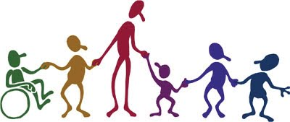
Respect
To give someone recognition or special regard
  Using Mr., Mrs., Ms. when using their names
  Don’t be condescending
  Don’t assume the customer doesn’t understand

Slide 9
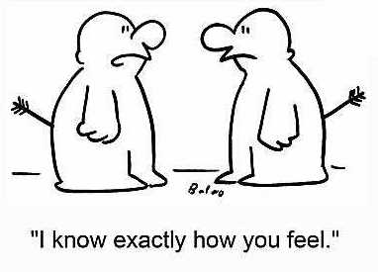
Empathy
The ability to understand what someone is experiencing and to take action to assist
  The focus of empathy is problem solving
  Listen to the customer and ask “What can we do to help you?”

Slide 10
Responsibility Check
Assessing a situation and determining who should have responsibility and who really does have the responsibility
  Sometimes a customer is unhappy with us for not doing something that was really his/her responsibility
  Determine what went wrong and shift the responsibility to the responsible party
  Tact must be used when explaining a customer’s responsibility in the CS process

Slide 11
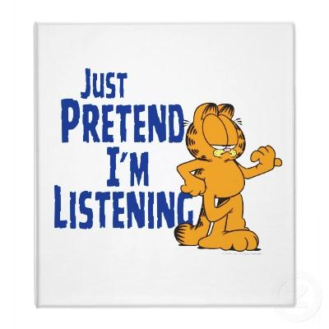
Coping with Challenging Customers
Listen
Ask questions
Show empathy
Solve the problem
Follow up
End on a positive note
Notes:
Listen: Allow customers to express their concern or to share their side of the story.
Ask questions: Seek clarification of the problem. Determine the variables involved.
Show empathy: Attempt to understand what the customer is experiencing and take action to assist in resolving the situation.
Solve the problem: Determine the most appropriate solution to the situation.
Follow up: Restate what has been decided and how the situation is being resolved. Ask the customer if they have any more questions.
End on a positive note: Thank customer for their understanding. Wish them a good day and end the conversation well.
There are numerous benefits of coping with challenging customers.
Just remember as well that it is ok to admit that you are wronng and to never avoid the customer.

Slide 12
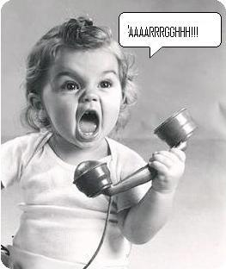
Quick Quiz
Page 101

Slide 13
End

