Slide 1
Customer Service
Chapter 6
Communications in Customer Service

Slide 2
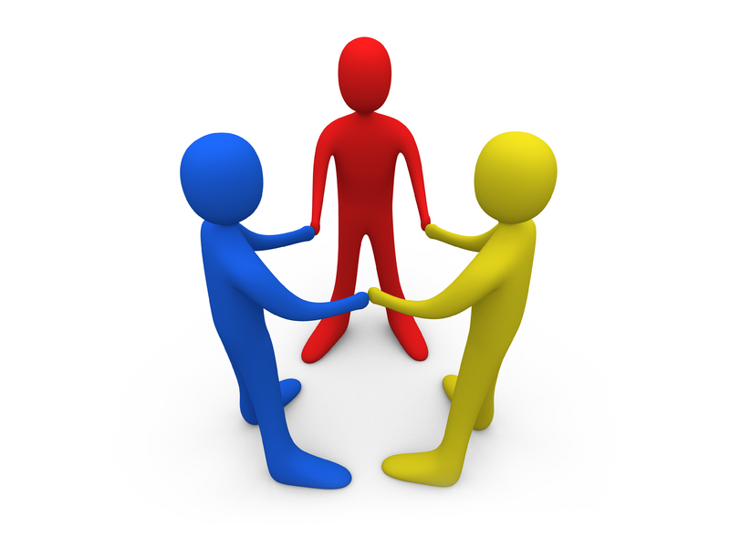
What is communication?
Communication is the sharing of information, ideas and understanding between two or more people

Slide 3
Customer Intelligence
Customer Intelligence is the process of:
  Gathering information
  Building a historical database
  Developing an understanding of current, potential, and lapsed customers
Having reliable intelligence on customers allows businesses to provide tailored service to specific customers
Notes:
Communication can be made difficult when you do not have a good understanding of your customers. One way to develop a good understanding is by building customer intelligence.
Customer intelligence is The process of gathering information, building a historical database, and developing an understanding of current, potential and lapsed customers
This allows business to appropriately tailor services and service approaches.
Most businesses today have recognized why customers are more loyal to one organization versus another especially if both have the same products or services.

Slide 4
Customer Intelligence
Customer intelligence enhances the possibility of improved relationship marketing
Relationship Marketing is the building of a long-term, mutually beneficial relationship with customers
Notes:
Most businesses have a lot of information available to them about their customers they might not have recognized however what they can interpret from the information.
Just remember the more we get to know and understand others, the better we can communicate with them. The more positively and appropriately we approach our communication efforts with customers, the more likely that we will succeed in effectively serving our customers.

Slide 5
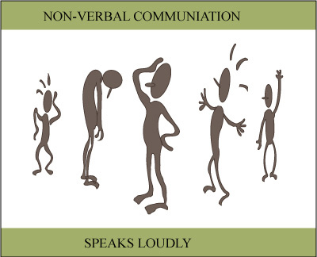
Methods of Communication
Listening
Writing
Talking
Reading
Nonverbal expression
Notes:
There are 5 main methods of communication that are used in effective customer service interactions and they are:
Listening: The ability to hear and understand what the speaker is saying.
Writing: Communicating by using the written word so that others can understand the intended message.
Talking: Speaking, using words and terminology that others comprehend.
Reading, and: The ability to look at and comprehend the written word.
Nonverbal expressions: TOne and inflection of voice, facial expressions, postures and eye contact. Nonverbal communication can contradict the message conveyed through another method of communication.
These five methods of communication are all used in customer service. Listening is thought to be the most important method of communication.

Slide 6
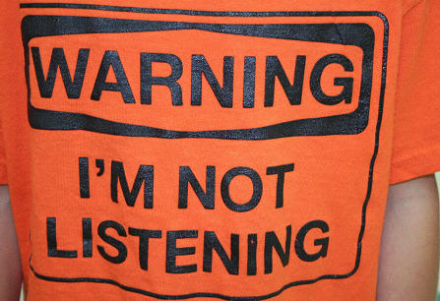
Methods of Communication…
Barriers to Good Listening
  Being distracted
  Having a closed mind
  Talking too much
  Being lazy
Notes:
To listen to your customers is to show them that you care about and respect their questions and concerns. It isn’t easy to be a good listener, and it can take practice and dedication to improve your listening techniques. Listening is a skill that must be continuously developed.
With listening there are several barriers. Those barriers are:
Being distracted: might be distracted from what is being said. We tend to have a short attention span therefore we can find it difficult to pay attention to the speaker and may allow our mind to drift to other things. We can think 10 times faster than we can speak. By not being distracted and focusing on the speaker and what they are saying we are less likely to miss the message being conveyed to us.
Having a closed mind: not being open to what the speaker is saying. This is a challenge to overcome. We as humans all have our own ideas, beliefs, and values. Those things can prevent us from really hearing what is being said. When we open our mind to new ideas and thoughts we have the opportunity to learn new things and to hear different perspectives.
Talking too much: you need to let the customer talk and actually listen to what they are saying. This tends to happen when you interrupt the speaker to get your own words in before they are finished. It has been said that humans have been given two ears and one mouth as humans are supposed to listen twice as much as we speak. Therefore allow the person to finish speaking before you start speaking.
Being lazy: not caring and unwilling to make a commitment to be a good listener.

Slide 7
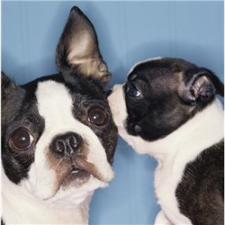
Methods of Communication…
Ways to improve listening skills…
  Focuses on the speaker
  Makes eye contact
  Listens with an open mind
  Rephrases what was said (for clarification)
  Doesn’t show impatience or disapproval
  Waits until the speaker is finished before determining a response
Notes:
How can you be a good listener?
A good listener
Conveys sincerity
Does not interject his or her own thoughts
Nods head
Does not finish the sentence for the speaker
Paraphrases what was said
Leans toward the speaker
Shares positive comments
Shows good eye contact.
To improve your listening skills try the following:
Focuses on the speaker and what he or she is saying.
Look at the speaker and make eye contact when possible. If you are listening on the telephone, make notes as you listen.
Listens with an open mind.
Rephrases what was said to clarify that you understood the intended message.
Control your body language. Doesn’t show impatience or disapproval
Waits until the speaker is finished before determining a response
You want to work to become the best listener you can be.

Slide 8
Using Your Voice
How you use your voice has an impact on how your message is received by the listener
  Avoid using a whiny, nagging tone; mumbling; or talking too fast
  Avoid negatives: can’t, never, you have to, not our policy, I don’t know, etc
  Use good voice inflection
    Varying the pitch (highs, lows), timing, and loudness of the voice
Notes:
Many people have a hard time conveying their spoken message to others. If you are frequently asked to repeat yourself, are cut off before your finished speaking or not taken seriously the problem may be the way you use your voice.
Voice Inflection is a variation in the pitch, timing, or loudness of the voice. Pitch is the highs and lows of the voice. A national study has shown that the most unpleasant voice characteristics when talking are whining, complaining, or nagging tone; a high-pitched, squeaky voice; a loud, grating voice, mumbling; and talking too fast.

Slide 9

Using Your Voice…
Your voice tells a lot about you…
  Level of job satisfaction
  Attitude
  Gender
  Education
  Knowledge level
  Speed that you work and react
  Confidence
  Where you are from
  Energy level
  Mood
Notes:
Your voice and message reveal some very important characteristics about the person you are. Some characteristics revealed are:
Level of job satisfaction
Attitude
Gender
Education
Knowledge level
Speed that you work and react
Confidence
The part of the Country you are from
Status
Energy level
Mood

Slide 10

On the Phone
Smile! The listener can hear it.
Answer the call enthusiastically and professionally
Ask questions if necessary
Give assistance quickly (efficiently)
Thank the caller
Conclude the call in a positive manner
Follow up, if appropriate
Notes:
As an administrative assistant you could be talking on the phone alot. When talking on the phone you need to sell yourself. Customer service providers need to have outstanding telephone skills as wehen talking on the phone you don’t have the face to face communication therefore you aren’t visually able to see each others body language. Therefore, you must depend on your listening skills, the ability to respond effectively to questions and your voice inflection.
Here are some steps to answering a call successfully:
SMILE! Your voice will sound friendlier if you have a smile on your face! And the listener can hear the difference between you smiling and not smiling.
Answer the call with an enthusiastic and professional greeting. Your entire organization is depending on you to make a positive first impression.
Greet the caller
Identify your organization or department
Introduce yourself
Offer your assistance
As question about anything that is not clear to you. If additional information is needed, ask for it and explain why it is needed.
Give answers and assistance as quickly as possible. If you cannot solve the problem or answer the question, let the customer know what will happen next.
Thank the caller. Ask if you may be of any further assistance.
Conclude the call in a positive manner. Think of every call as the beginning of a new relationship.
Follow up on the call to make sure that everything you promised is delivered, but only if appropriate.

Slide 11
Words to Use/Words to Avoid
Words to Use
Please
Yes
May I
Consider this
Do
Let’s negotiate
Will
Thank you
You
Us
Appreciate
Can
Use customer’s name
Would you like
Opportunity
Challenge
Regret
Words to Avoid
Can’t
Never
Don’t
You have to
Don’t tell me no
Won’t
Not our policy
Not my job
Profanity
Vulgarity
Problem
Sorry
Love slang (honey, etc.)
We’ll try
Haven’t had time
I don’t know
Hang on for a second

Slide 12
Power Phrases
Due to your specialized knowledge
What a unique suggestion!
I’d like your considered opinion
Please
You are absolutely right!
If I could borrow just a moment of your time
May I?
As you, of course, know
I’d like your advice
I would appreciate it if you
Notes:
By using powerphrases, we send messages to our customers that they are very important and we value their opinions.

Slide 13
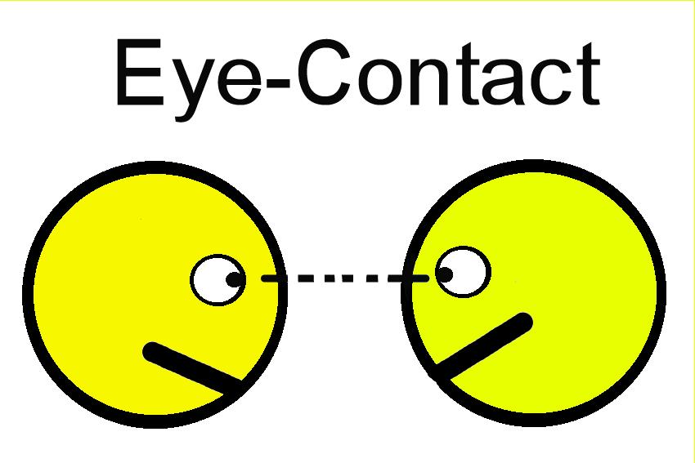
Power of Eye Contact
Eye contact conveys sincerity and interest
Avoiding eye contact may suggest lack of concern or lack of honesty
Notes:
Eye contact is important when communicating with anyone. Eye contact is allowing our eyes to make visual contact with someone else's eyes. In our culture eye contact conveys sincerity and interest. Avoiding it can convey lack of concern or lack of honesty. Our eyes can convey compassions and caring. If you don’t make eye contact it could make your customer think that you are not interested in assisting them.

Slide 14
Communication and Technology
Six main areas of technology:
Internet
Electronic Mail
Automated Phone Systems
Voice Mail
Fax Machines
Texting
Notes:
Customer service has been greatly impacted and enhanced by technology. Therefore we must familiarize ourselves with this technology. There are 6 common areas of technology.

Slide 15
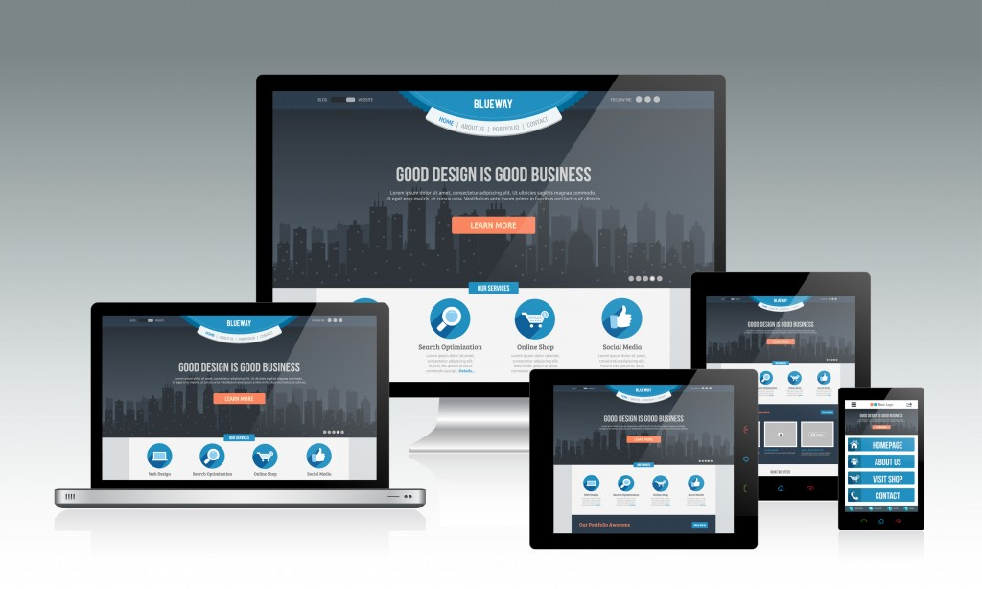
Internet
Important part of consumers everyday life
Great customer service tool
  Needs to be updated and accurate
  Easy to use
Notes:
The internet has become and important part of consumers everyday lives and you can not underestimate it. Customers will go online to find out information about your business, make purchases, comparison shop, check order statuses, check warranties, and the list goes on!
The internet can be a great customer service tool but you need to make sure that the web address on products is accurate, information on your site is up-to-date, and that the site is easy to navigate.

Slide 16
Electronic Mail
NEVER TYPE IN UPPERCASE!
Clean out your mailbox
Avoid sending personal messages
Can’t show any emotion
Ask for confirmation of receival
Notes:
Most businesses use electronic mail which is e-mails. It has in most cases eliminated the need for paper memorandums and clutter on peoples desks as well as it has shortened the time spent on communication between people and departments.
Email is beneficial to allow us to communicate both internally and externally as it allows you to quickly communicate with people and can provide a faster response time. But due to the quicker response time’s sometimes customer will expect a fast answer, therefore, we as customer service providers need to strive to be able to provide the fastest response time possible.
When using your e-mail there are several practices considered appropriate and we will look at some of the most common.
Never type in uppercase. It is considered poor etiquette and is hard to read.
Clean out your mailbox periodically. This will allow you to discard old mail and also remind you of what is pending or currently working on. Also check your junk mail periodically as sometimes things can fall there without you knowing and you wouldn’t want to miss something important.
Avoid sending personal messages. When using e-mail at work it is associated with your business. As well as if sending personal emails with your work email you could accidentally send it to the wrong person. Even a secured email system can get broken into.
Emails aren't able to show how you are saying something and is incapable of emotion, therefore some people will use emoticons or icons that add emotion to the screen just watch when using them as you don’t want to add to many or make it look unprofessional.
Most emails can ask for confirmation that mail has been received via a setting in your email. It is best to turn it on and use whenever possible that way you know the person is actually receiving your emails.
Just remember every company might have a different system they use for email so it is best to familiarize yourself with it especially if you have never used it before.

Slide 17
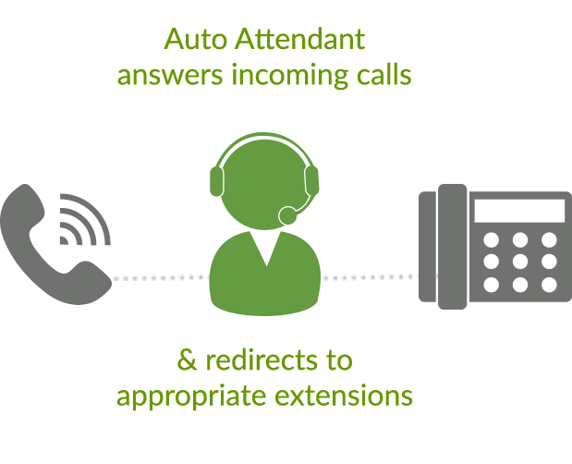
Automated Phone Systems
Replaces the human who used to have to transfer calls.
Needs to be managed properly
Notes:
If you have ever called a 1-800 number has interacted with an automated phone system.
One benefit of an automated system is that it replaces the human that used respond to all incoming calls, answer questions and than connect callers to the right staff member. These systems can save money for the business as it is one less person they need to pay. But us as customers have probably all been caught in the system and went in circles.
To make it easier for the customers companies should call the system themselves and make sure it actually works, that the volume isn’t to loud, the hold music is ok and that it is accurate and precise. If as a customer service provider you ever get feedback about the system you should report and pass the information along. The automated system can be cost effective and an asset but it just needs to be managed properly.

Slide 18
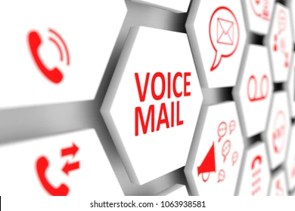
Voice Mail
Tips on leaving a voice mail:
Speak clearly, identify yourself, your company, day, date and time.
State reason for calling
Suggest next steps
Leave name and number to contact
Close with a positive farewell.
Notes:
Most corporations have a voice mail system. You must be comfortable leaving messages and using your own system. The voice mail system is important because it allows you to leave messages for your customers and customers to leave messages for busy customer service providers.
Here are some tips when leaving voice mail messages:
Speak clearly, identify yourself, your company, the day and date, and the time.
State the reason for your call.
Suggest to the customer what the next steps should be. Do they need to call you back or wait for more information?
Leave your name and phone number where you can be reached. Yes you have already given it once but they might not have written it down the first time.
Close with a positive farewell.

Slide 19
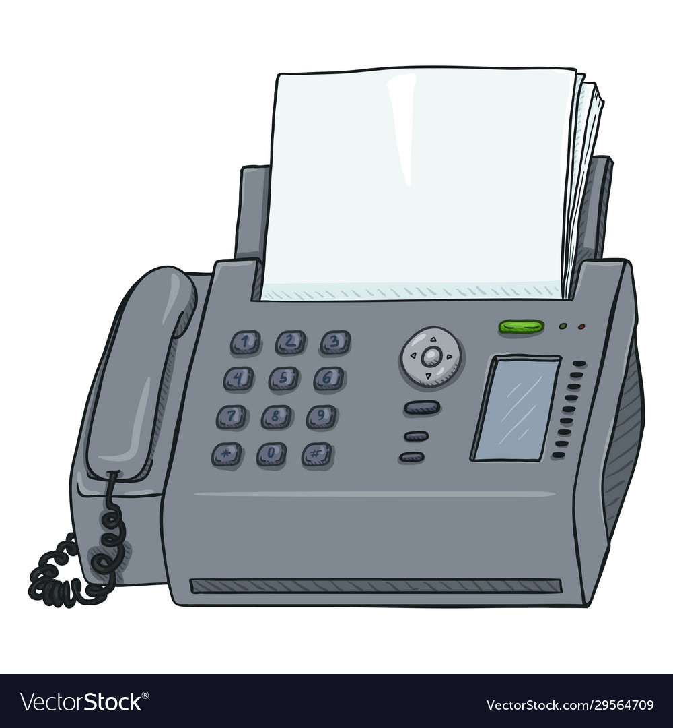
Fax Machines
Always have a fax sheet.
Strive for accuracy.
Fax after hours.
Keep machine well maintained.
Notes:
Fax machines have become necessary in many offices.
Just know when using a fax machine you need a cover page. A cover page doesnt need to be fancy but needs to include key information. The key information to be on them are your name, title, department, company, address, phone number, fax number, number of pages in the fax (including your cover page), and an introductory message. If information is confidential make sure to write confidential on the cover page.
When faxing your information also make sure everything is accurate. Double-check the number you are sending it to, to make sure it is the correct one, make sure the information is readable and the font isnt to small.
Try to fax after hours it can save you on long distance calls and can also prevent tying up someones machine.
Lastly make sure our machine is well maintained and that you have adequate paper supply for when people send you faxes.

Slide 20
Quick Quiz
  Page 85

Slide 21
End

