Slide 1
Customer Service
Chapter 5
Empowerment

Slide 2
Empowerment
To enable customer service providers to make a range of decisions to assist their customers
Empowerment allows CS providers to decide on their own whether or not customers’ requests should be granted
Such powers must be within limits

Slide 3
Empowerment…
Empowerment is a philosophy that must be reflected in the culture of a business
A business’s purpose and mission statements often show that they embrace an “empowered culture”
Notes:
In an empowered culture employees know the range of their power. They have been trained in the range of possible solutions to questions and they know that their superiors are willing to live with their decisions.

Slide 4

Empowerment…
Purpose statement: the reason for a company’s existence
Mission statement: the means by which the company will fulfill its purpose
Notes:
All businesses that deal with customers should have an official mission and purpose statement.

Slide 5
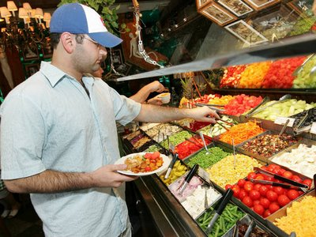
Coproduction
A situation where the customer participates at least in part in providing their own customer service
Notes:
Coproduction does not mean that the customers doll the work.

Slide 6
Coproduction…
Examples:
  Salad bars (make your own salad as you like it)
  Free beverage refills
  Completing medical background forms in a clinic or hospital
  Self-checkouts at the grocery store
  Online bill paying

Slide 7
Customer Service System
Any set of procedures that contributes to the completion of customer service
Unfortunately, CS systems are often not updated to reflect the changing times
Frontline CS providers are often the best people to make suggestions for change

Slide 8
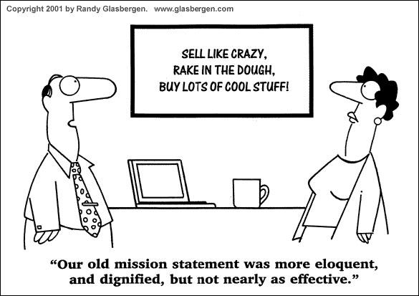
Quick Quiz
Page 68

Slide 9
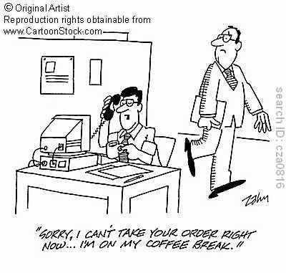
End

