Slide 1
Customer Service
Chapter 4
Strategy for Formulating a Plan for Success

Slide 2

Strategy
Excellent customer service doesn’t just happen. It is the result of a well-thought-out plan.
Strategy is a plan for positive action
Notes:
The most important step toward achieving excellent customer service is developing a strategy. This strategy can help a business to determine the proper level of customer service. Too much customer service may create a financial problem and to little could result in losing customers.
There are several variables to consider when developing a customer service strategy and we will look at them within the next few slides.

Slide 3
Planning
The establishment of specific customer service goals
For example:
  Answering customer calls within 7 seconds (or 3 rings)
  Approaching a customer within 15 seconds of entering the store
Notes:
This is the first step in developing a good customer service strategy. By establishing customer service goals, customer service providers determine what they would like to encounter.

Slide 4
Infrastructure
Made up of the networks of people, physical facilities and information that support customer service
  Hiring enough staff to cope with customer needs
  Having enough phone lines to handle all the calls to a 1-800 hotline
  Training staff in use of technology
  Keeping staff up to date on changes to company policies
Notes:
Customer service depends on the existence of an appropriate infrastructure.
Look at infrastructure as the highway that gets you were you need to go. Without it you might not realize what is possible. Remember that as sales grow, the companies ability to serve its customers needs should also grow.

Slide 5

Culture
The values, beliefs, and norms shared by a group of people
Two direct competitors may have entirely different cultures:
  Typical workday hours
  Industry lingo (jargon) used
  Peer accountability
  Levels of certification
  Extra company-sponsored activities
Notes:
A customer service environment should have a customer service-oriented culture.
Every business will have their own culture. If a businesses culture does not encourage excellent customer service, that excellent customer service will not exist.

Slide 6

High-Touch, Low-Touch Customers
High-Touch Customers
  Require a high level of customer interaction
Examples:
  Hotel check-in
  Purchase of real estate
  Lawyers and accountants
  Fine restaurants
  Banking services
Notes:
There are many different types of customers and customer service. Every customer will have different expectations.
One way to understand customers is to class them as hight-touch or low-touch.
High touch customers expect a high level of service. The believe that the cost of the service is included in the price. If they don't experience a high level of interaction they will most likely be dissatisfied.

Slide 7
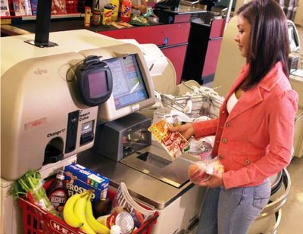
High-Touch, Low-Touch Customers
Low-Touch Customers
  Expect a low level of customer interaction
Examples:
  ATMs for routine banking
  Online bill payment
  Express check-in at the airport
  Pay-at-the-pump (gasoline)
  Self-checkout at grocery store
Notes:
When a choice is given many customers will choose a low touch experience. Low touch generally exists because of technology. It has a high usage and a low cost per use.

Slide 8
Consumption Behaviour
Refers to the customer’s usage and payment patterns
The more you know about your customers, the better able you are to provide excellent customer service
….
Notes:
valuating consumption behavior can be a relatively easy method of collecting information about a customer. Many companies have a computerized method of obtaining information about their customers behavior patterns.

Slide 9
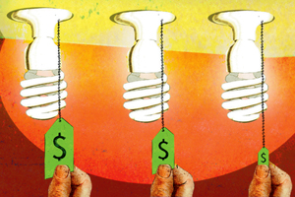
Consumption Behaviour…
What are customers buying?
Why did they buy it?
Why did they buy more today than last time?
How did they pay for it?
What else have they bought from us recently?
Notes:
Some important questions to ask when identifying consumption behavior are:

Slide 10
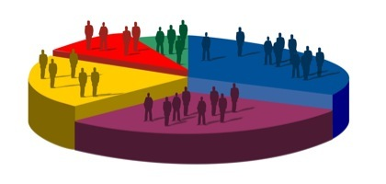
Market Segmentation
Dividing customers into groups with similar characteristics
Examples include:
  Customers who are prepared to do self-checkout at the grocery store
  Customers who shop during the day vs those who shop in the evenings or on weekends
  Customers with special needs
Notes:
Understanding your customers similarities is important when developing a customer service strategy.
It will help to divide customers into serviceable groups which makes it easier to determine the type of service we need to provide.

Slide 11
Development of a Strategy
When the variables—planning, infrastructure, culture, high-/low-touch customers, consumption behaviour, and market segmentation—have been evaluated, it is time to create a customer service strategy:
….

Slide 12
Development of a Strategy…
Segment the customers
Identify the largest and most profitable customer groups
Determine customer expectations
Develop a plan to achieve those expectations
Implement the plan
Set an evaluation timetable
Evaluate and make improvements
Notes:
The following 7 guidelines pra guide for creating the strategy:
Segment the customers: divide them into groups with similar characteristics.
Identify the largest and most profitable customer groups: Initially, it is better to serve the largest customer group, representing the majority of your business.
Determine customer expectations: find out what your customers want from their experience with you.
Develop a plan to achieve those expectations: create an innovative strategy that will allow you to serve your customers effectively.
Implement the plan: put your new strategy into practice, implementing all aspects of the strategy at the same time.
Set an evaluation timetable: before implementing your strategy, determine when and evaluation of its success will be conducted.
Evaluate and make improvements: evaluate the effectiveness of the new customer service and make appropriate improvements. Keep making changes to keep the new strategy as current as possible.

Slide 13

Quick Quiz
Page 58

Slide 14
End

