Slide 1
CUSTOMER SERVICE
Chapter 3
Problem Solving

Slide 2
Problem Solving
An active resolution to a challenging situation
  Problem-solving strategies one might use at home with family are typically not suitable for customer service
  CS providers must be good listeners
  Solutions must be timely

Slide 3

Creativity in Problem-Solving
Customers appreciate creativity
Creative problem-solving requires a business culture that allows new ideas to flow freely
  Many companies insist CS providers follow strict guidelines
  WestJet vs Air Canada

Slide 4

Confronting Conflict
Conflict: a hostile encounter that occurs as a result of opposing needs
Listen to other viewpoints
Don’t bring up old problems or assign blame
Use tact when responding to others
Turn your own feelings of anger into a source of energy that is productive
Focus on finding the best solution

Slide 5
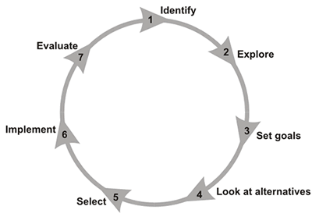
Problem-Solving Process
Identify the problem
Understand the problem’s unique characteristics
Define the requirements of a possible solution
Identify possible solutions
Select the best solution
Implement the solution
    Inform the customer, explain how it will affect him/her
Observe/evaluate the solution’s impact
Notes:
Numerous approaches may be taken when attempting to solve a problem. Here are some guidelines:
1 Identify the problem: Try to figure out what the problem is sometimes it can be hard
2. Understand the problems unique characteristics and the possible outcomes
3. Define the requirements of a possible solution considering the company policies currently in place.
4. Identify possible solutions.
5. Select the best solution
6. Implement the solution, informing the customer of the details and how the customer will be affected.
7. Observe and evaluate the solutions impact.

Slide 6
Problem-Solving Strategies
Brainstorming: a problem-solving strategy that involves groups of people
Diagramming: a problem-solving strategy that provides visual representations (pictures) of the problem and the facts related to it
Notes:
When approaching the challenge of determining a solution for a problem, individual strategies or a combination of them may be used. The to common strategies to solving problems are:
Brainstorming: Its a common method of looking for new ideas through group discussion
Diagramming: There are four types and we will look at them in the next few slides.

Slide 7

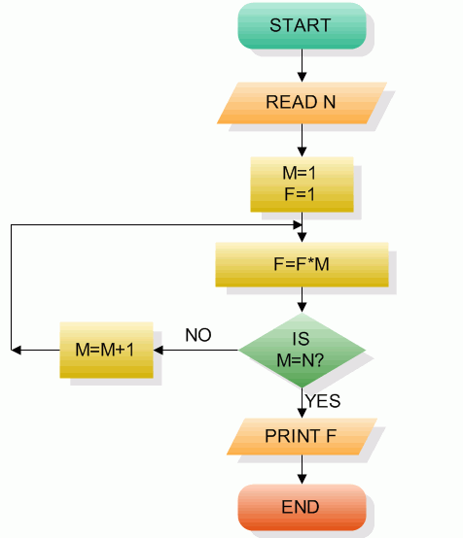
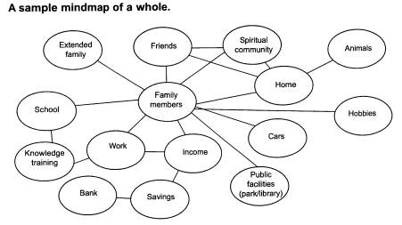
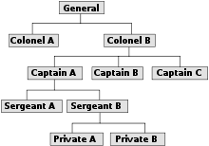
Problem-Solving Strategies…
Methods of Diagramming include:
Pro/Con Sheets
Flowcharts
Organizational Charts
Mind-mapping
p. 36-40
Notes:
Pro/Con Sheets: A problem-solving strategy in which a sheet of paper with a line down the centre is used to illustrate arguments for and against a possible solution
Flowcharts: A diagram that shows how information moves through a system
Organizational Charts: A commonly used method of showing the hierarchy of a company
Mind-Mapping: a creative approach to diagramming a problem on paper, showing possible solutions branching out from the original problem

Slide 8

Negotiation Skills
Negotiation: the evaluation of the possible solutions to a challenge and the selection of the solution that is mutually beneficial
Notes:
Negotiation must allow for give and take on both sides.

Slide 9

Negotiation Skills…
Improve negotiation skills by:
  Knowing your customer
  Asking questions, and listening to the spoken and unspoken messages
  Knowing the policies of your company
  Demonstrating a willingness to be flexible (if possible)
  Learning to handle your anger and the customer’s anger
  Considering what the customer may lose in the negotiation process
  Determining mutually beneficial solutions
Notes:
Knowing your customer: know what their needs are. Customers want to know that they are important to us and our business.
Ask questions and listen to the spoken and unspoken messages: The more information we collect the more efficiently we can solve their problems
Knowing the policies of your organization and in which areas of flexibility is allowed: It is hard to negotiate a resolution if you are unaware of what will be allowed.
Demonstrate the willingness to be flexible: The ability to react to situations as they occur is an important way of showing that you are flexible. You will need to be able to go with the flow and possibly change what you are doing any moment.
Learning to handle your anger and your customers anger appropriately: Anger can always be a possibility when it comes to negotiating. When anger arises it is best to diffuse the situation right away. To diffuse it you will want to try and anticipate the cause and confront it carefully. Also sometimes it is best to shift the responsibility for the customers anger back to the customer. This must be done with care, but it could have positive results.
Considering what the customer may lose in the negotiation process: Negotiation involves give and take. Try and understand what the customer will see as a compromise.
Determine mutually beneficial solutions to challenging problems and situations: When negotiating you want to seek solutions that are beneficial to botht he customer and the company. Just remember if the customer leaves angry no one wins as you lose customers and business. But if they leave happy you keep your business and can possibly gain more in the future.

Slide 10

Apologizing, Conveying Bad News
Apologies are a fact of life in business
Apologies are not a sign of weakness
…but…
CS providers should not apologize
without justification

Slide 11
Apologizing, Conveying Bad News…
When apologizing, consider these:
Acknowledge customer’s feelings
Express that you share the responsibility for the problem
Convey sincerity
Ask for the opportunity to correct the problem
Request the opportunity to continue doing business
Notes:
Acknowledge customers feelings: Do this by letting the customer know you recognize their feelings and emotions and show you care.
Express that you share the responsibility for the problem: Even if not fully part of the problem you are still part of the resolution.
Convey sincerity: When apologizing it is important to convey care and concern. Demonstrate that your sorry and care.
Ask for the opportunity to correct the problem: Just apologizing can have little impact. We need to correct the error or make changes in the future.
Request the opportunity to continue doing business: By asking the customer if we can still consider them an active customer it shows that you care and want to resolve the issues and are wanting to go forward in a positive way.

Slide 12

Barriers to Problem-Solving
Resistance to change
Habits
Individual insecurity
Past history
Fear of success or failure
Jumping to conclusions
Perceptions (inability to see it from the customer’s point of view)
Notes:
Resistance to change: People are reluctant to change but it can prevent you from taking chances and experiencing new things.
Habits: Limit what can be accomplished and may stand in the way of solving a problem. Can go undetected.
Individual insecurity: Can deter people from taking risks ar from pursuing behaviour that may require them to take a stand. May come from past experiences or lack of self confidence.
Past history: By looking at your past and only using what worked and what didn't work in situations can stop you from trying new methods of problem solving or decision making.
Fear of success or failure: this can be viewed as unreasonable, but it can greatly deter the confrontation of problems. The unknown can be frightening. Sometimes taking a chance is worth it. Just remember if you fail at something don’t stop get up and try again.
Jumping to conclusions: It is easy to jump to conclusions. When jumping to conclusions assumptions are made about what may or may not work. This can frequently lead to negative perspectives.
Perceptions (inability to see it from the customer’s point of view): Perceptions are the way we see things based off of experiences. We may be so blinded from our perspective that we can’t see it from another.

Slide 13

Follow-Up
Checking back to determine if a situation is operating according to the initial plan
Especially important after a solution has been implemented
Notes:
Just remember it is always important to follow up. If you are solving a problem and you had a solution but it was never implemented than the solution had little or no value.

Slide 14
Quick Quiz
Page 46

Slide 15
End

