Slide 1
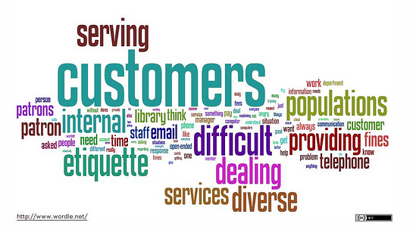
Customer Service
Chapter 2:
The Challenges of Customer Service

Slide 2
Barriers to Customer Service
By the company:
Restrictive management philosophy
Hard-to-understand warranties or owners’ manuals
Out-of-date procedures
Notes:
There are numerous obstacles that can stand in the way of excellent customer service. Some barriers are made by the company themselves and they are . See barriers above. These type of barriers in the most case are beyond the control of the customer and customer service provider and is a common part of the job.

Slide 3

Barriers to Customer Service
By the CS provider:
Laziness
Poor communication skills
Poor time management
Attitude, moodiness
Lack of training
Insufficient authority
Serving customers on autopilot
Inadequate staffing
Notes:
Some barriers however are controlled by the customer service provider. These barriers can be changed by putting in effort or by taking initative to make the change.

Slide 4
Perception
The way we see something based on our experience
  Developed over a period of time
  Reflect how we’ve been treated
  Reflect our values, our priorities, our prejudices
  Reflect our sensitivity to others
Notes:
Think of perception as is the glass half full or half empty?
Just remember whenever possible try to look at your customers as individual human beings.

Slide 5
Expectations
Our personal vision of the result that will come from our experience
  Expectations may be positive or negative
  Based in part on our perceptions
  Often based on past experiences
Notes:
Every customer will walk into a business with a set of expectations.
Sometimes we think what our customers expectations are are going to be more than they actually end up being.

Slide 6
Levels of Expectations
Primary expectations
  The customer’s most basic requirements of an interaction
  For example, at a restaurant:
    Satisfy hunger
    Let someone else do the cooking
    Pay a reasonable price

Slide 7
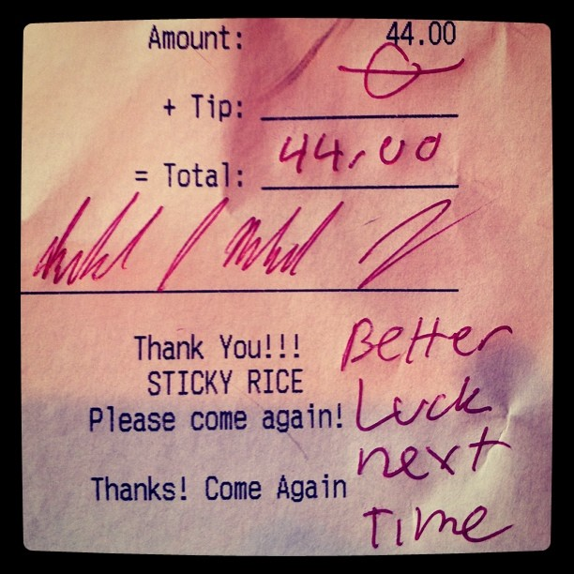
Levels of Expectations
Secondary expectations
  Expectations based on previous experience
  Each customer has his/her own unique set of expectations
  At a restaurant:
    Good service; being treated with courtesy

Slide 8
Scope of Influence
Our ability to influence others based on our perceptions or experiences
  Each person’s scope is different
    Based on size of circle of friends, acquaintances
  On average, our opinions influence between 7 and 15 people
Notes:
Scope of influence plays no favourites and is usually not objective. Therefore it is extremely important to do all we can to keep our customers and make them happy.
Studies have shown that it costs about 5 times as much to attract new customers as it does to keep our current customers.

Slide 9
Scope of Influence…
How effective is our scope of influence?
  “Word of mouth is the best form of advertising”
  Negative experiences are likely to be shared with superiors, those with more decision-making powers, income and influence
  Positive experiences are most likely to be shared with just the people closest to us
  Negative messages can easily be shared with the masses via Internet (e.g. YouTube, Facebook)

Slide 10
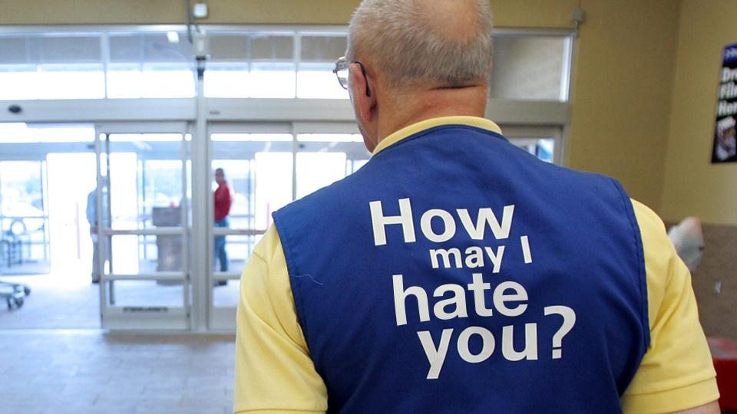
Reputation Management
The process of identifying how a company is perceived and establishing an action plan to correct, maintain, or enhance its reputation
Notes:
Nowadays you can go to many places to get the same item. Therefore you want to have a good reputation to attract customers.

Slide 11
Reputation Management…
A company with a good reputation:
  Is trustworthy
  Demonstrates excellence
  Is law abiding
  Follows through on promises
  Is ethically responsible
  Is a positive public citizen
  Communicates effectively
  Shows ongoing positive social responsibility
Notes:
By effectively managing the companies reputation the company can maintain an informed and realistic understanding of how customers and the community perceive it.

Slide 12
Exceeding Customer Expectations
Become familiar with your customers
Ask customers what their expectations are
Tell customers what they can expect
Live up to their expectations
Maintain consistency
Communicate with customers using the method they want to use (phone, email, face-to-face, etc)
Notes:
Become familiar with your customers: Get to know who they are and why they do business with you.
Ask customers what their expectations are: Find out what they see is the benefit of doing business with you. Is there anything they would like you to do that you aren’t currently.
Tell customers what they can expect: Convey your commitment to them
Live up to their expectations: Follow through with what your promises are
Maintain consistency: Don’t promise something you can’t deliver, but always make sure to deliver consistent service.
Communicate with customers using the method they want to use (phone, email, face-to-face, etc)

Slide 13

Credibility
The combination of knowledge, reputation and professionalism
Credibility encourages trust
Notes:
Our personal credibility can be one characteristic that determines success as people and as customer service providers.

Slide 14
Credibility…
Tips for cultivating credibility:
Practice consistency
Keep your word
Develop your expertise
Be a team player
Show your dedication to customers
Treat everyone with respect
Apologize if you are wrong
Remember that credibility is harder to regain than it is to lose
Notes:
Practice consistency: Approach similar situations with the same manor.
Keep your word: Follow through with commitments you make.
Develop your expertise: Become very knowledgeable about your products, the company and the industry.
Be a team player: Work successfully with others
Show your dedication to customers: Tell them what you will do for them and take every request seriously.
Treat everyone with respect: By showing others your respect them it creates an environment for them to respect you.
Apologize if you are wrong: Your honesty will impress others and they will respect you for who you are and not who you pretend to be.
Remember that credibility is harder to regain than it is to lose

Slide 15
Values
A combination of beliefs, perceptions, and ideas about the appropriate response to a situation
Both companies and individuals have a set of values
Your values dictate your behaviours and your philosophies

Slide 16

Ethics
A set of principles that govern the conduct of an individual or group
Is it legal?
Is it fair?
How do I feel about it?
How would public opinion see it?
What would others say about my actions?

Slide 17
Quick Quiz
Page 26

Slide 18
End

