Slide 1
Customer Service
Chapter 1
What is Customer Service?

Slide 2

What is customer service?
Anything we do for the customer that enhances the customer experience
  Décor, lighting, music, layout of store
  Smile, call customer by name
  Package carryout, timely assistance
  Courtesy, enthusiasm
  Up-to-date web site
  … see more on p. 3
Notes:
The person providing the customer service needs to ge to know their customers to be able to provide the with excellent customer service.
Examples of customer service are:
Having nice decor, good lighting, quiet msic and a good store layout.
Smiling and calling the customer by their name
Package up carry-out and provide timely assistance
Show the customer that you care by illustrating courtesy and enthusiasm
Make sure your website is up to date
Provide well explained instructions.

Slide 3

What is customer satisfaction?
The customer’s overall feeling of contentment with a customer interaction
  Did not feel like time/money/energy was wasted
  A problem was solved
  Additional stress was not added to customer’s day
Notes:
This is also the overall goal in customer service. Customer satisfaction recognizes the difference between customer expectations and customer perceptions. Satisfaction can develop quickly or overtime but customers will have concerns and our job is to reduce their concerns and stress.

Slide 4
Why is Excellent customer service so rare?
Employers perceive excellent customer service:
Costs money
Requires effort, or risk
Notes:
Companies are now placing a lot more importance on excellent customer service than ever before.
Customer service is rar because it requires two things: Spending money and taking action. It is known that customer service is important but not alot of people know how to provide great customer service. It is much more than having a great attitude or being a people person. You need to develop the skills and remember that you need to know the needs of the customer.
One of the best ways to become a better customer service provider is to become a better customer. If you practice being a customer yourself it will allow you to be more aware of what it takes to provide excellent customer service. By seeing what bothers you will allow you to see what most likely bothers your customers.
For discussion:
How do employers think customer service costs money? (training, giving rebates and incentives to customers, costly promotional merchandise or gifts)
How could customer service not cost a dime? (smiling employee, pleasant disposition, clean store, convenient location or hours)
How does customer service require effort? (Company feels they need to endorse the customer service model/plans and that requires their effort and commitment, monitoring of employees interactions with customers – ie. mystery shoppers, recording calls) other examples
How does customer service create risk for a business? Empowerment can create exposure to risk…example of Dennis and ice cream cones (HUGE!). Proper procedure would be to regulate the size – but how does that affect morale? What about empowering employees to the point where they can bind the company to promises? Ie. Faster internet, credits on bill, free merchandise etc.

Slide 5
5 Needs of Every Customer
Service
  Appropriate for the level (value) of purchase
Price
  No one wants to be ripped off
Quality
  Want the product to last for a reasonable period
Notes:
Every customer will have different wants but here are 5 basic ones that every customer will need:
Service: Small purchase might have a smaller service need where a big purchase might need more service.
Price: Cost is becoming more and more important. No one wants to be ripped off. We want to use our financial resources as efficiently as possible.
Quality: Customers are less likely to question price if they are doing business with a company that has a reputation for producing high quality products.

Slide 6

5 Needs of Every Customer…
Action
  Need action when a problem or question arises
Appreciation
  Need to know we appreciate their business
Notes:
Action: Examples are when business have customer support lines, flexible return policies, and customer carryout services.
Appreciation: There are many ways to show appreciation but one simple way is by saying thank you.

Slide 7
External / Internal Customers
External customers are
  The customers we do business with; people who are outside our organization
Internal customers are
  The people we work with throughout our organization (co-workers)
Notes:
External Customers: These type of customers have the power to enhance our reputation and to bring us new business.
Internal Customers: The manager, the mailroom attendant, and your co-workers are all examples of internal customers. If our internal customers don’t complete their work it can become very difficult to serve our external customers.
Our internal customers should be as important as our external customers. By showing them that we value them and that they are important we can create an excellent foundation on which we can begin to meet our external customers needs.

Slide 8
Customer Attributes
Characteristics that allow customers to be categorized according to
  Demographics
  Psychographics
  Firmographics
Notes:
Customer attributes allow customers to be categorized.

Slide 9

Customer Attributes…
Demographics
  Age, gender, marital status, education
  Stage in the family life cycle
  Home ownership, household size
  Occupation, income
  Ethnic background
  Religion
Notes:
Demographics – age, income level, marital status, education, ethnicity and religion
Straightforward and basic method of identifying customers.

Slide 10
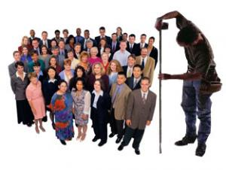
Customer Attributes…
Psychographics
  Lifestyles, modes of living
  Needs, motives, attitudes
  Reference groups
  Culture, social class
  Family influences
  Hobbies
Notes:
Psychographics- lifestyles, needs, motives, attitudes, culture, social class, hobbies
Can provide a more thorough picture of your customer.

Slide 11
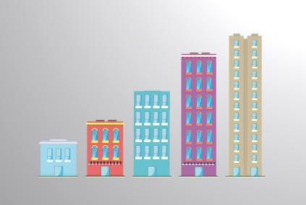
Customer Attributes…
Firmographics
  Characteristics about a company:
      How many employees
      Kind of business
      Retail, wholesale,
      service provider
      Hours of operation
Notes:
Firmographics – characteristics about a company (retail/wholesale, hours, # of employees, etc) This is essentially considering a place of business to have similar characteristics as a person, since many businesses are serving other businesses. The Learning Company may have a database of the companies who help us design our programs – that database would hold Firmographics about each.

Slide 12
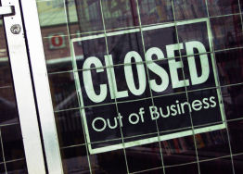
Cost of Losing a Customer
Lose current dollars
Lose future dollars
Lose jobs
Lose reputation
Lose future business
Notes:
It can take little to lose a customer and when we lose a customer there are issues we can face.
The first issue is the loss of current dollars. This can seem insignificant at the start but over time it can really add up. As we eventually lose future dollars.
The second issue is future loss of jobs. IF business goes elsewhere we might not be able to keep on our employees as they ar eno longer needed for the job. It could result in a great loss of work for some.
The third issue is loss of reputation. Word travels fast and could mean lose more customers or future customers due to our reputation being tarnished.
The fourth issue is the loss of our future customers. As stated before when our reputation is tarnished we lose customers. This is an intangible variable as it is very hard to asses long term effects of what could happen.
Earl’s example – contrast that with the A&W example of moving to hormone free beef.
Was it in the messaging? Earls pulled out of Canadian beef bc they couldn’t find a single humane supplier to supply all of their beef, which is why they pulled out. A&W didn’t say they ever pulled out of Canada, just that they’ve moved to all hormone free beef. Earls took 7 days to change back because of public outrage re: pulling out of Canada, and has instead said they’ll search for more than one supplier, which will allow them to include Canadian farms

Slide 13
Quiz Quiz
Page 9

Slide 14
End

