Slide 1
Compression syndromes of peripheral nerves

Slide 2
What we will cover
Thoracic outlet syndrome
Carpal tunnel
Piriformis syndrome

Slide 3
Understanding compression syndromes

Slide 4
Compression or entrapment injuries, also known as neuropraxia, cause a local conduction block in a peripheral nerve, but with no structural damage to the axon or to tissue distal to the lesion.
Can be the result of an external or internal forces which impair oxygenation and local neural conduction.
Blood vessels within the nerve, as well as those travelling along side the nerve, may be compressed along with the nerve.

Slide 5
Common types
Entrapment syndromes that affect arm and hand involve compression of the brachial plexus.
Carpal tunnel (most studied and accepted)
Thoracic outlet syndrome (most controversial)
Piriformis syndrome (often referred to as sciatica)
Anterior scalene syndrome
Costoclavicular syndrome

Slide 6
causes
External forces
Internal forces
  Hypertonic muscles
  Structural abnormalities
  Trauma and overuse
  Poor positioning of the limb
  Systemic conditions

Slide 7
Symptoms
Numbness, tingling, pain and weakness of the affected limb
  Due to a combination of ischemia of the nerve, which impairs the microcirculation within the nerve , as well as the local mechanical force of the compression.
  When an entrapment occurs, the nerve trunk responds to the trauma with an inflammatory response.
The subsequent increase in the vascular permeability and local edema contributes to impaired nerve transmission.
  The longer the disruption of microcirculation, the longer the recovery period.
  This is due in part to the development of intraneural edema during the recovery period.
  In cases where edema develops, the edema is accompanied by mechanical deformation of the nerve fibres and blood vessels.
The more severe the compression, the more extensive the tissue damage to the nerve trunk, with and increasingly poor prognosis. The severity of the lesion is a result of the magnitude and duration of the compression.
The extent of the damage is also influenced by;
  Structure of the nerve and its location and sixe within the endoneurium.
    Less endoneurium presents an increased risk of damage.
Recovery time varies after the compression is relieved
The key to treatment is relief of the compression of the nerve.

Slide 8
Thoracic outlet syndrome

Slide 9
In brief
It is a group of disorders that occur when blood vessels or nerves in the space between your collarbone and your first rib (thoracic outlet) are compressed. This can cause pain in your shoulders and neck and numbness in your fingers.

Slide 10
What is it
TOS is a condition that involves the compression of the brachial plexus and its accompanying artery between the anterior and middle scalenes or between the coracoid process and the pec minor muscle or between the clavicle and the first rib.
Somewhat controversial with respect to its etiology and diagnosis.
Nerve conduction testing is often negative for a nerve lesion
Can lead to an over diagnosis of CTS
Brachial plexus is composed of nerve roots C5 – C8 and T1
Travels with the subclavian artery between the intrascalene space.
After being joined with the subclavian vein the neurovascular bundle travels through the costoclavicular space and travels under the sub-pectoral space before continuing down the arm.
The condition begins insidiously and progresses slowly

Slide 11
Group read 826-829

Slide 12
Special testing
Adson’s test
Costoclavicular and Eden's test
Wright’s hyperabduction test
Upper limb tension test

Slide 13
treatment
Treat the entire shoulder girdle and neck and any postural contributors.
Decrease SNS firing
Address compensatory structures
Decrease compression on the neurovascular bundle.
Reduce fascial restrictions
Reduce pain, hypertonicity and trigger points.
Maintain ROM
Reduce edema, if present

Slide 14
Anterior and middle scalene treatment
Anterior scalene
  Treat the SCM first
  Origin and insertion work
  GTO release
  Pincer grasp
  Muscle stripping
  Fingertip kneading
Middle scalene
These muscles are treated using the origin and insertion technique along with progressively deeper muscle stripping and fingertip of thumb kneading to the cervical attachments and muscle bellies.
Interspersed with lighter circulatory strokes
Trigger points are treated using ischemic compression or repetitive muscle stripping followed by the appropriate stretch and heat

Slide 15
Pec minor treatment
Address pec major first. Treat any hypertonicity and trigger points found.

Slide 16
Piriformis syndrome

Slide 17
In brief
Piriformis syndrome is a condition in which the piriformis muscle, located in the buttock region, spasms and causes buttock pain. The piriformis muscle can also irritate the nearby sciatic nerve and cause pain, numbness and tingling along the back of the leg and into the foot (similar to sciatic pain).

Slide 18
What is it

Slide 19
Self care
Stretch tight, short muscles
Strengthen weak muscles
Educate the client
Refer the client
Encourage relaxation

Slide 20
Treatment frequency and expected outcome
1 hr treatment once a week for 4-6 weeks
Follow with a thorough reassessment
If pregnant, condition will often resolve postpartum.
If cause involves soft tissue, the prognosis is good, providing the client is compliant with the self-care program

Slide 21
Carpal tunnel

Slide 22
What is it?
Carpal tunnel syndrome (CTS) is a medical condition due to compression of the median nerve as it travels through the wrist at the carpal tunnel. The main symptoms are pain, numbness, and tingling, in the thumb, index finger, middle finger, and the thumb side of the ring fingers.
Most common entrapment syndrome in the arm.
Poultry processors, butchers, assembly line workers and keyboard opperators are among those who have increased rates of CTS.

Slide 23
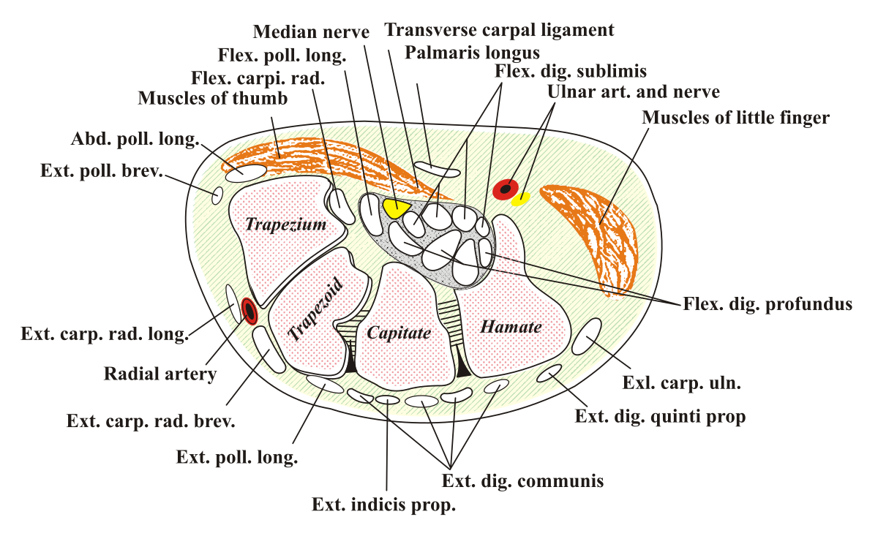

Slide 24
The causes
It is idiopathic in nature
Increased size of the contents through the tunnel
Decreased canal space
Acute in nature
  Secondary to trauma\infection
  Acute exacerbation of rheumatoid arthritis
  New activity requiring repetitive wrist action
  Hematoma

Slide 25
Contributing factors
Vitamin b6 deficiency
Familiar tendency

Slide 26
CTS is usually unilateral, usually affecting the dominant hand.
Systemic conditions must be considered first and treated by a Dr.

Slide 27
Other conditions
Pronator teres syndrome is a compression neuropathy of the median nerve at the elbow. It is rare compared to compression at the wrist (carpal tunnel syndrome) or isolated injury of the anterior interosseous branch of the median nerve (anterior interosseous syndrome).
Repetitive strain injuries (RSI) are a family of injuries affecting tendons, tendon sheaths, muscles, nerves and joints. They cause persistent or recurring pains most commonly in the neck, shoulders, forearms, hands, wrists, elbows and lower limbs.

Slide 28
Symptom picture
Group read pg 845-848

Slide 29
treatment
Reduce edema, fascial restrictions, hypertonicity, trigger points and stress.
General treatment
  Decrease SNS firing

Slide 30
Specific treatment
Group work

Slide 31
Self-care
Educate the client
Recommend hydrotherapy
Stretch shortened muscles
Strengthen weak muscles
Instruct in self-massage
Encourage relaxation
Refer the client

Slide 32
Tx frequency and expected outcome
45-60 min 2x/week for 2 weeks
Afterwards decreasing to 1x/week for 4 week, follow with a thorough reassessment.
The outcome is dependent on the cause of the CTS.

